Slide 1
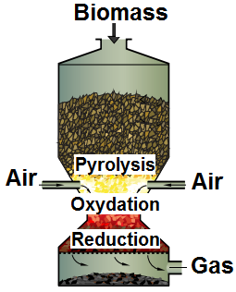
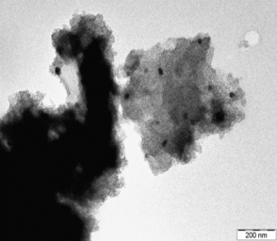
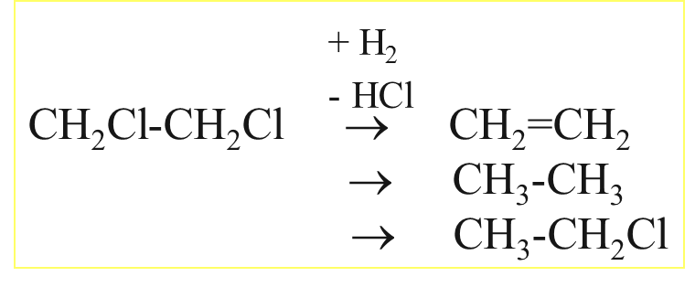
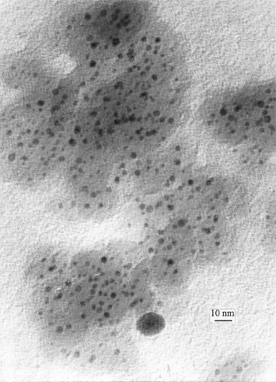
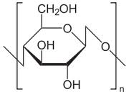
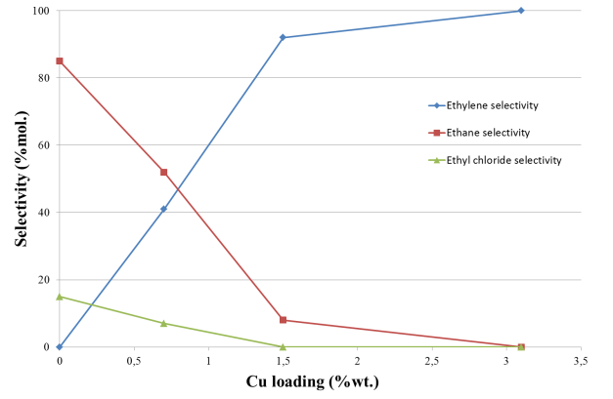
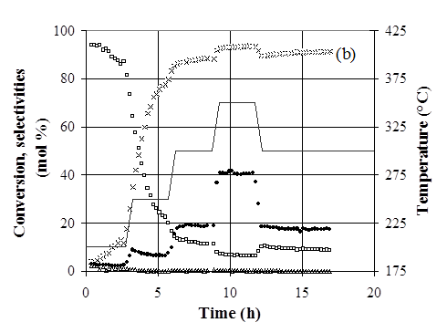
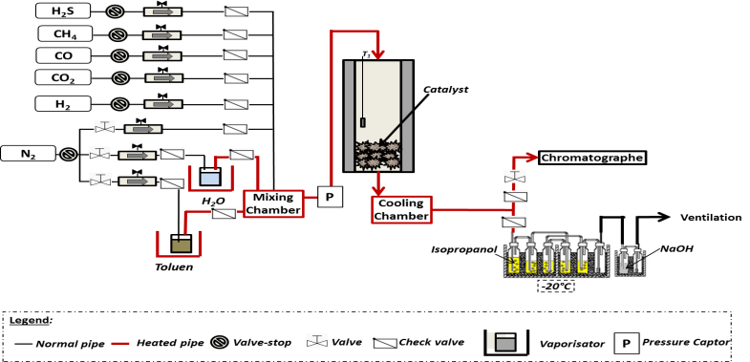
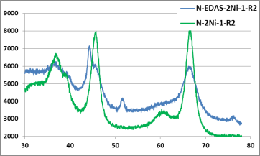

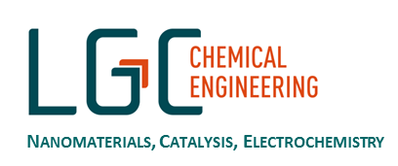
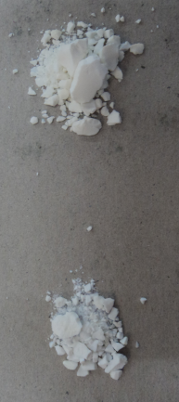
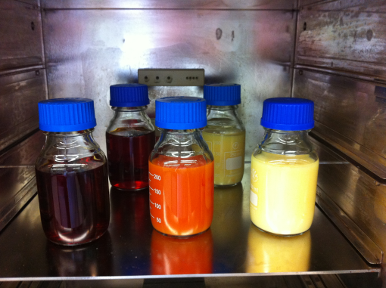
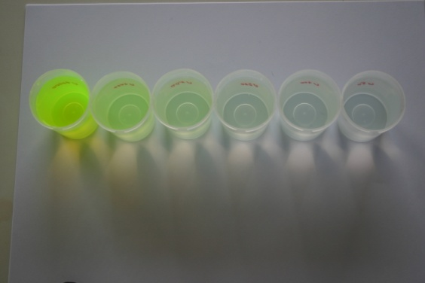
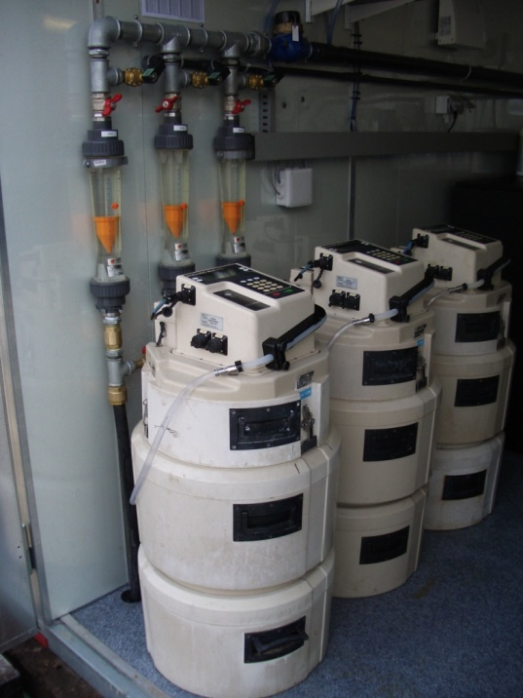
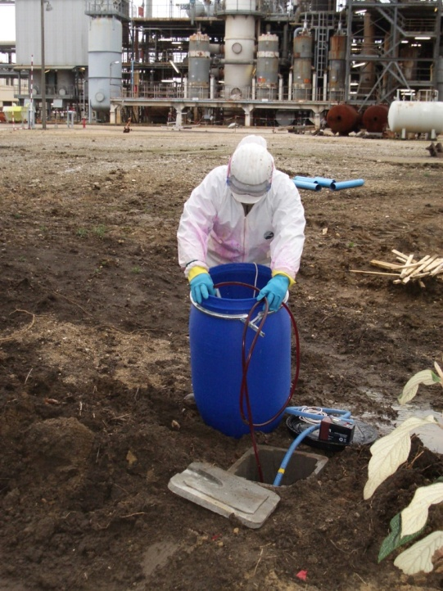

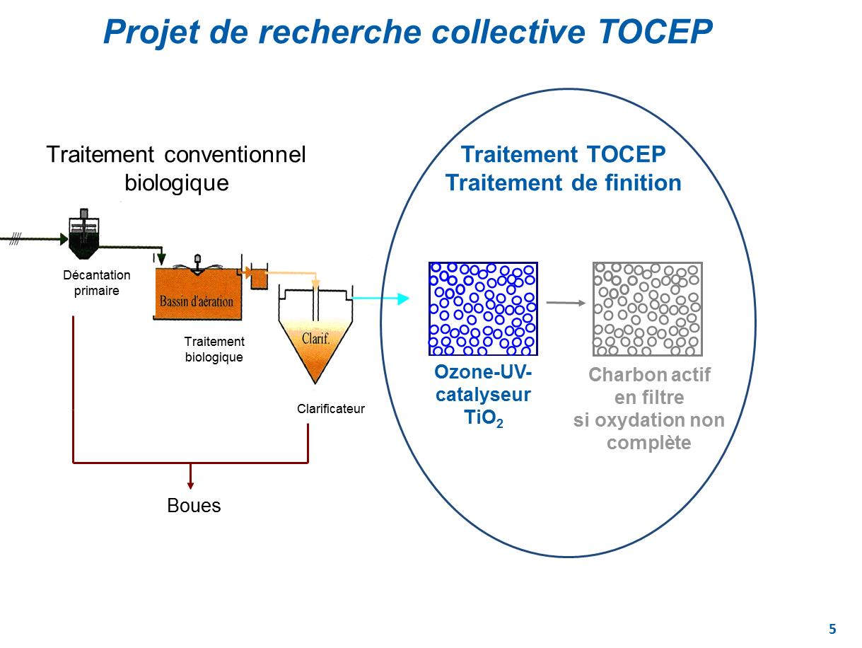

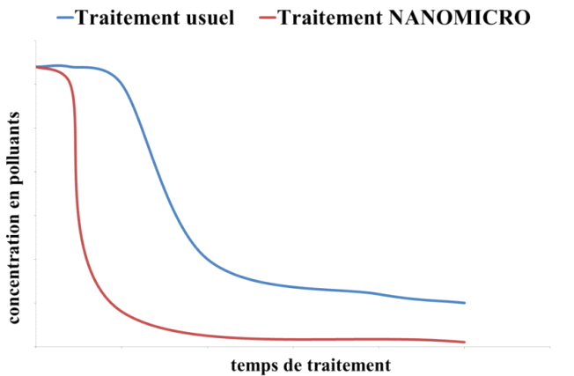
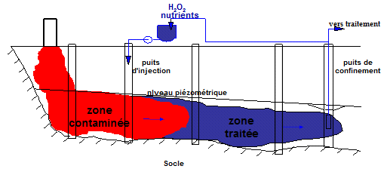
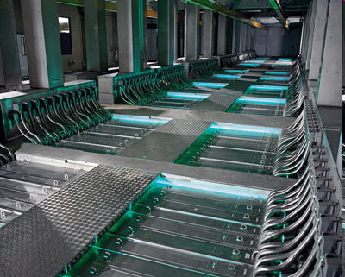
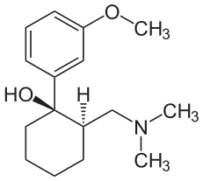
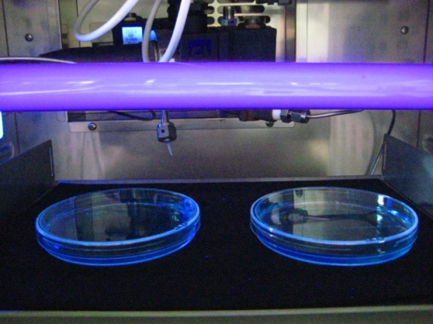
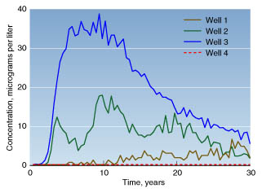
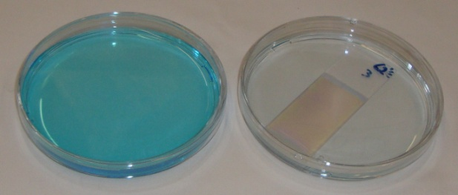
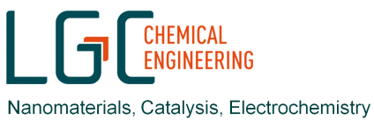

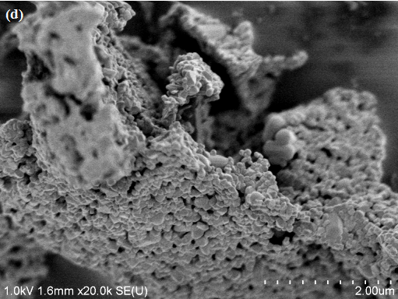
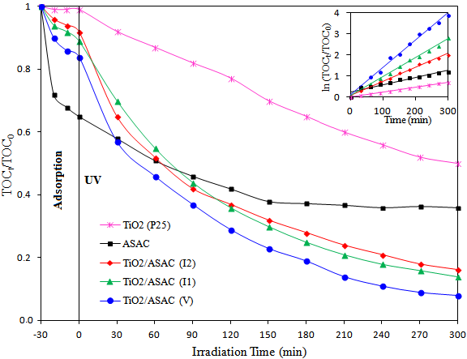
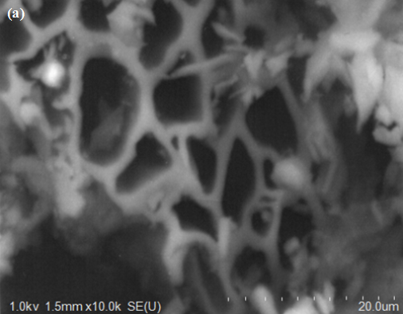
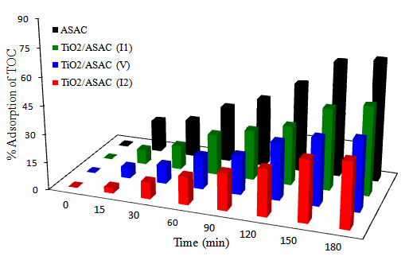
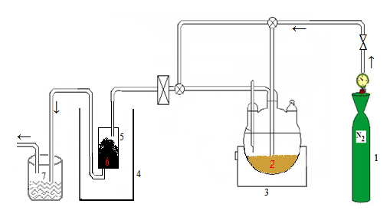
Department of Chemical Engineering – Nanomaterials, Catalysis & Electrochemistry
Biomass Gazification : Catalytic Purification of Bio-Syngas
Hydrodechlorination of chlorinated products
Metallic nanoparticles
TEM micrograph
Ni-Cu/SiO₂
Catalysts : Ni/Al₂O₃ doped with Mn, Mo, Fe,…
XRD spectra
Ni50-Cu50 sample. (●) ClCH₂-CH₂Cl conversion, (x) C₂H₄ selectivity, (□) C₂H₆ selectivity, (Δ) C₂H₅Cl selectivity, (—) Temperature.
Adsorption and photodegradation
of liquid pollutants
Sol-Gel Process
Adsorption and photodegradation
of liquid pollutants
RO
OR
OR’
CH
2
CH
2
X
OR
+
R’O
Si
(CH
2
)
3
HN
M
n+
NH
2
Scheme of experimental setup
OR
OR’
M = Ni, Pd, Pt, Fe,…
X = Si⁴⁺, Ti⁴⁺, Al³⁺,…
X
Activated carbon
+ H
2
O
O
O
CH
2
CH
2
-
ROH
Si
(CH
2
)
3
HN
M
n+
NH
2
-
R’OH
O
R
, R’
=
-
CH
3
,
-
C
2
H
5
, …
X
Photocatalytic TOC degradation tests over different samples
at 45 °C
Activated carbon + TiO₂
Bioremediation of hydrocarbons in soils
Catalytic oxidative treatments for polluted waters
with pharmaceutical products
Nanoparticles encapsulated in silica
Micro-organisms
32
Nanoparticules
Microorganismes
Products suitable for decontamination
Decrease the duration of treatment
Treatment of inaccessible sites
1,2 kg tramadol/month
University of Liège, Belgium
Department of Chemical Engineering – www.chimapp.ulg.ac.be
Nanomaterials, Catalysis & Electrochemistry – www.nce.ulg.ac.be
Contact: Stéphanie LAMBERT, * Stephanie.lambert@ulg.ac.be, ( +32 4 366 47 71

