Slide 1
Protein synthesis at the speed of codons
TASEP: a statistical physics model applied to molecular biology
Marc Joiret GIGA In Silico Medicine Liesbet Geris
PhD student GIGA Stem Cells Pierre Close
Thesis Comity: Pierre Dauby, Kristel Van Steen
March, 3rd, 2020

Slide 2
PhD student
Molecular biology & biochemistry
Bio-ir
Campus Gembloux, 1990
+
M.Sc. Physics
Statistical physics
Campus Liège, 2003
+
M.Sc. Biostatistics-Bioinformatics
Bioinformatics
UHasselt, 2017
=
Protein synthesis stochastic modeling with TASEP
Hired by Liesbet
Biomech, April 2018

Slide 3
Outline
Protein synthesis at the speed of codons
TASEP: a statistical physics model applied to molecular biology
PART 1: Molecular Biology of Protein Synthesis
PART 2: Open boundaries transport model on 1D-lattice
TASEP: Totally Asymmetric Simple Exclusion Process
In-house computational implementation of TASEP

Slide 4
PART 1: Molecular Biology of Protein Synthesis

Slide 5
transcription
translation
DNA
mRNA
protein
transcriptome
proteome
genes
transcripts
translatome
NGS technology
RNA-Seq
(2006) bulk or (2009) single cell
Ribo-Seq = ribosome profiling
(2009) Ingolia et al.

Slide 6
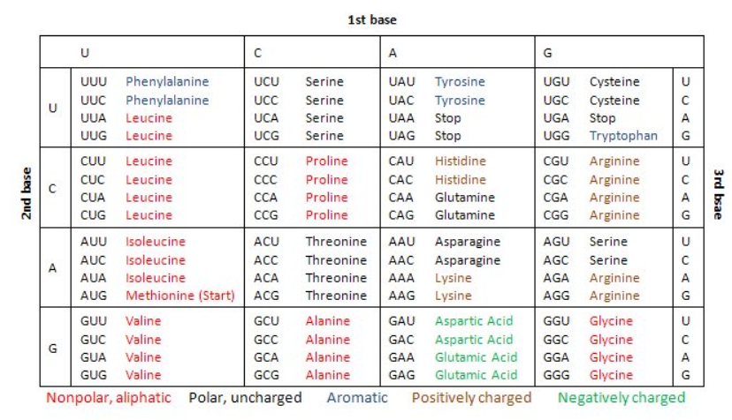
transcription
translation
DNA
mRNA
protein
4 nucleotides A,T, C, G
genes
transcripts
20 amino acids
64 codons

Slide 7
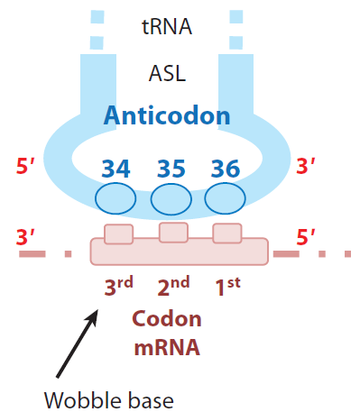
translation
51 tRNAs
mRNA
protein
transcripts
20 amino acids
64 codons

Slide 8
transcription
translation
51 tRNAs
DNA
mRNA
protein
4 nucleotides A,T, C, G
genes
transcripts
20 amino acids
64 codons

Slide 9
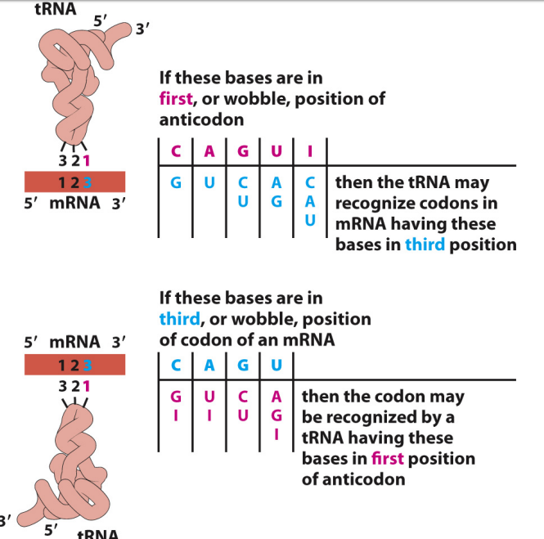
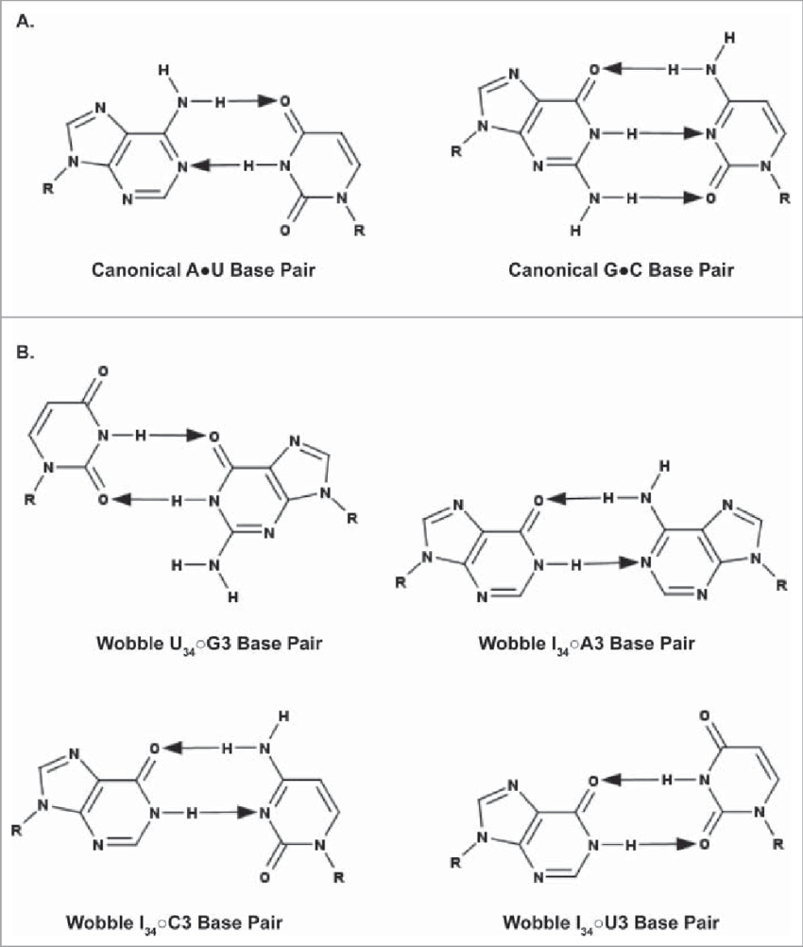
Wobble base rules

Slide 10
Codon Usage Biases
Codon usage biases: enrichment for certain synonymous codons in a given transcript, particularly in well expressed gene groups
Examples: Lysine (K), Glutamine(Q), Glutamate (E) have each 2 codons:
Lysine (K): AAA or AAG
Glutamine(Q): CAA or CAG
Glutamate (E): GAA or GAG
with last 2 nucleotides ending either AA or AG
For more than 76% of the genes in Homo sapiens: the codon usage is biased towards AG ending…
Notes:
Two major classes of metabolic reactions:
Catabolic pathways
• Break larger molecules into smaller products
• Exergonic (release energy)
Anabolic pathways
• Synthesize large molecules from the smaller
products of catabolism
• Endergonic (require more energy than they release)

Slide 11
Codon Usage Biases
Humans: the AA:AG ratio is <1 in more than 76% cds (ORF).
Mice: the AA:AG ratio is <1 in more than 67% of cds (ORF).
Notes:
Two major classes of metabolic reactions:
Catabolic pathways
• Break larger molecules into smaller products
• Exergonic (release energy)
Anabolic pathways
• Synthesize large molecules from the smaller
products of catabolism
• Endergonic (require more energy than they release)

Slide 12
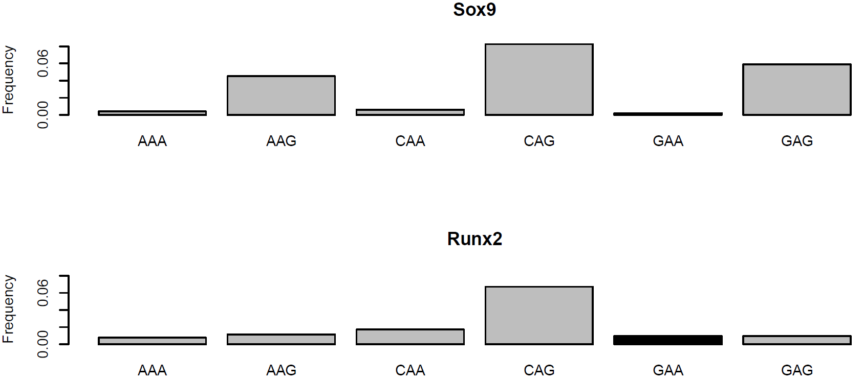
Codon Usage Biases
Notes:
Two major classes of metabolic reactions:
Catabolic pathways
• Break larger molecules into smaller products
• Exergonic (release energy)
Anabolic pathways
• Synthesize large molecules from the smaller
products of catabolism
• Endergonic (require more energy than they release)

Slide 13
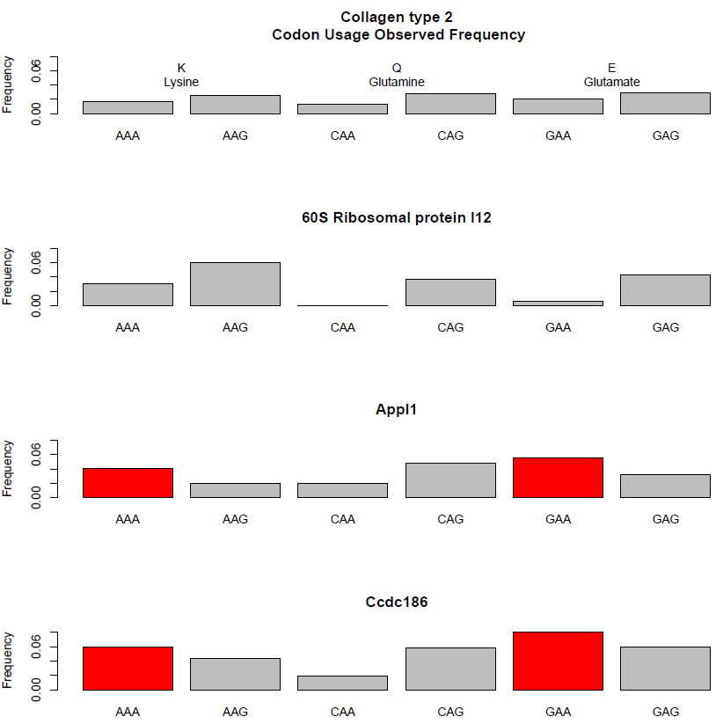
Codons : synonymous but not the same
Notes:
Two major classes of metabolic reactions:
Catabolic pathways
• Break larger molecules into smaller products
• Exergonic (release energy)
Anabolic pathways
• Synthesize large molecules from the smaller
products of catabolism
• Endergonic (require more energy than they release)

Slide 14
Are there functional implications of the bias in the synonymous codon usage ?

Slide 15
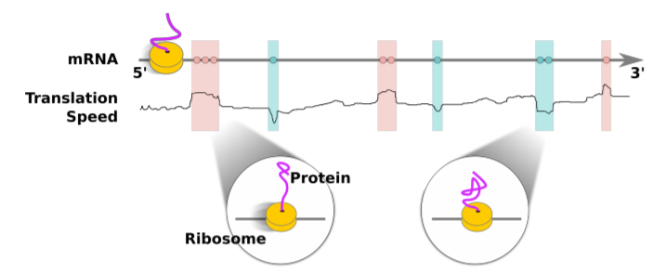
Fast codon
Second genetic code ?
Slow codon
The codon usage, fast or slow, acts as an additional source of structural information

Slide 16
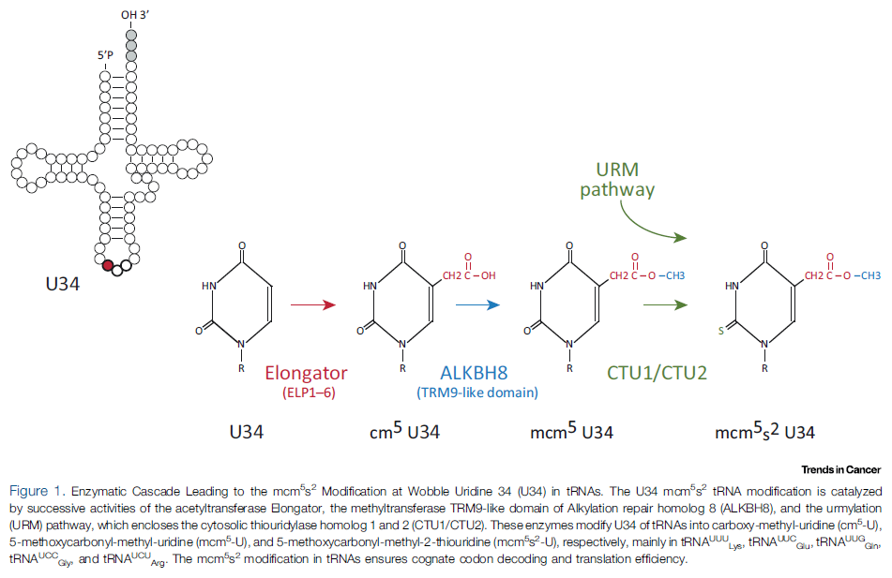
t-RNA modifications
t-RNA enzymatic modifications on wobble U34
Notes:
Two major classes of metabolic reactions:
Catabolic pathways
• Break larger molecules into smaller products
• Exergonic (release energy)
Anabolic pathways
• Synthesize large molecules from the smaller
products of catabolism
• Endergonic (require more energy than they release)

Slide 17
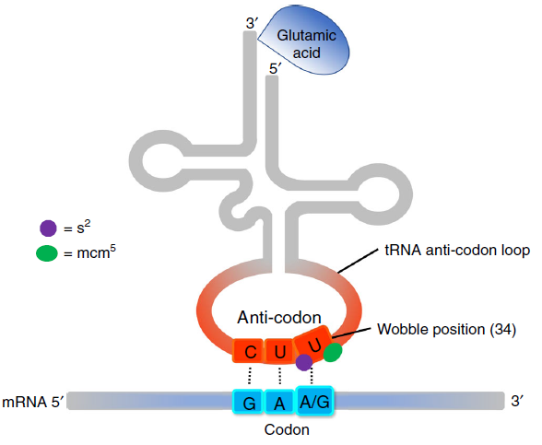
t-RNA modifications
t-RNA enzymatic modifications on wobble U34 selectively alters translation efficiency of transcripts whose codon usage patterns are specific to the t-RNA modification
Resistance to targeted therapy in melanoma
oncoproteome
Notes:
Two major classes of metabolic reactions:
Catabolic pathways
• Break larger molecules into smaller products
• Exergonic (release energy)
Anabolic pathways
• Synthesize large molecules from the smaller
products of catabolism
• Endergonic (require more energy than they release)

Slide 18
transcription
translation
DNA
mRNA
protein
51 tRNAs
transcriptome
proteome
genes
transcripts
translatome
NGS technology
RNA-Seq
(2006) bulk or (2009) single cell
Ribo-Seq = ribosome profiling
(2009) Ingolia et al.

Slide 19
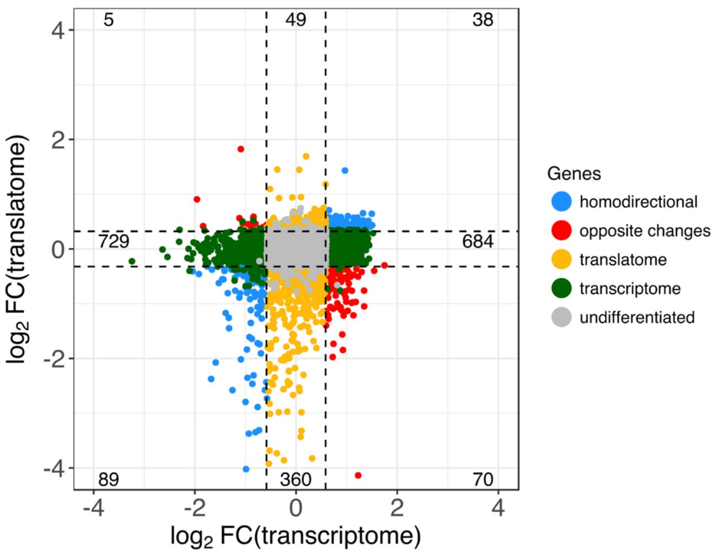
is RNA-Seq a good proxy for protein expression levels ?
Protein levels and mRNAs levels are poorly correlated
Translational control plays a keyrole in the dynamic range of protein levels

Slide 20
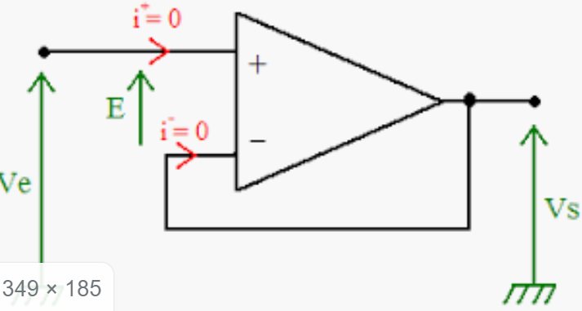
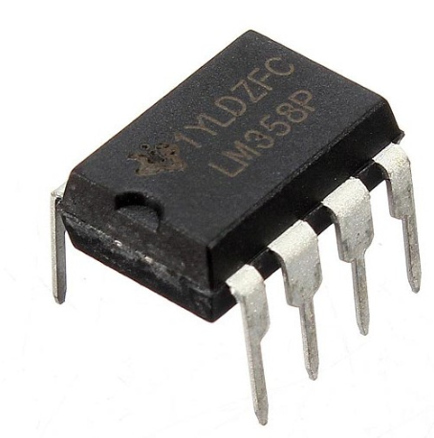
transcription
translation
DNA
mRNA
protein
transcriptome
2,000 proteins
proteome
genes
transcripts
30,000 proteins
single gene A
20 transcripts
translatome
0.1-1 billion proteins
single gene B
100 transcripts
23,000 genes
1-10 million transcripts
100 ribosomes
Is a cell made of AMPLI-OPs ?
What are the gains ?
300 ribosomes

Slide 21
transcription
translation
DNA
mRNA
protein
transcriptome
proteome
genes
transcripts
translatome
NGS technology
RNA-Seq
(2006) bulk or (2009) single cell
Ribo-Seq = ribosome profiling
(2009) Ingolia et al.

Slide 22
is RNA-Seq a good proxy for protein expression levels ?
Protein levels and mRNAs levels are poorly correlated
Translational control plays a keyrole in the dynamic range of protein levels

Slide 23
Ribo-Seq = ribosome profiling (2009) Ingolia et al. Science, 2009
Drugs inhibiting translation
Inhibiting INITIATION: harringtonine
Inhibiting ELONGATION:
lactimidomycin
cycloheximide

Slide 24
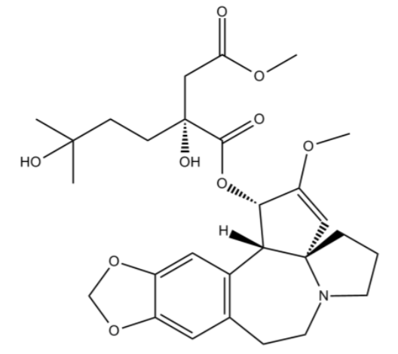
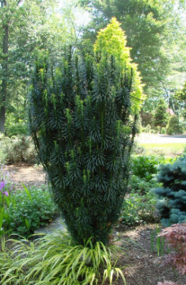
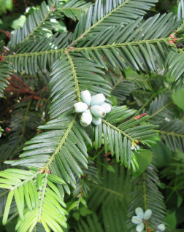
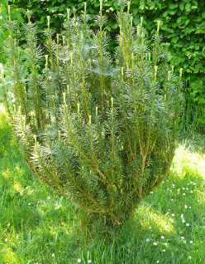
Drugs inhibiting translation
Initiation blockade: harringtonine
Harringtonine: natural alkaloid from Cephalotaxus harringtonia

Slide 25
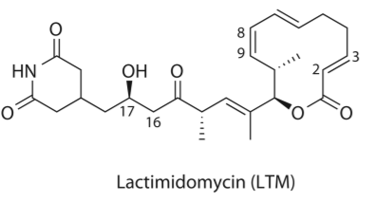
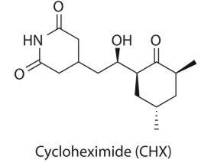
Drugs inhibiting translation
elongation blockade: lactimidomicin (LTM) and cycloheximide (CHX)
Glutaramide moiety
12-membered macrolide
LTM: Elongation translocation step blocked at START codon
CHX: Elongation translocation step blocked after first round of elongation next to the start codon, or for any translating ribosome. The E site on 60S unit can accommodate CHX and deacetylated-tRNA.

Slide 26
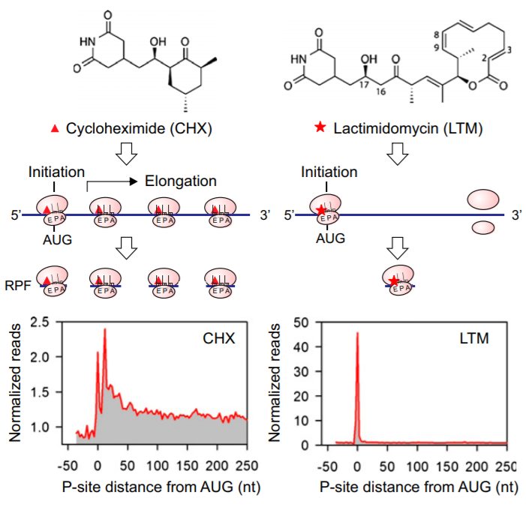
Drugs inhibiting translation

Slide 27
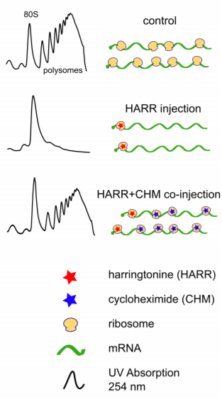
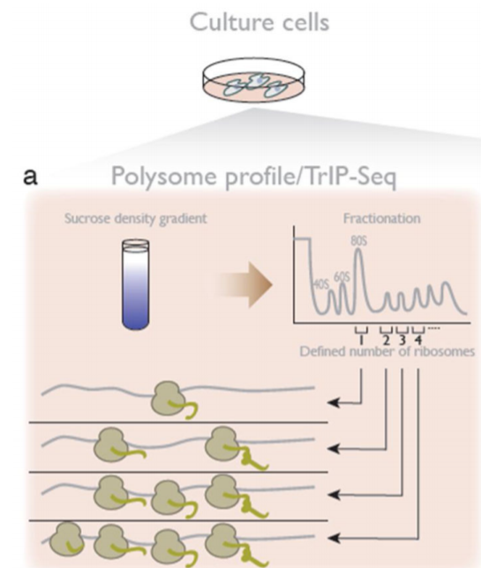
Drugs inhibiting translation
Analyzing translation by mRNA sequencing

Slide 28
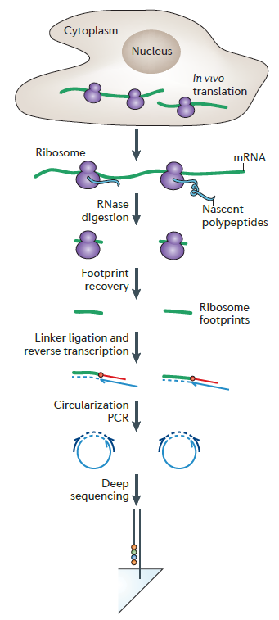
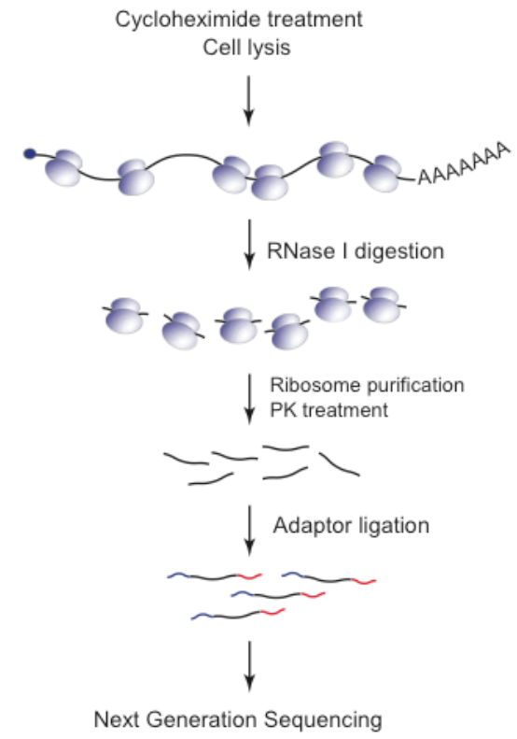
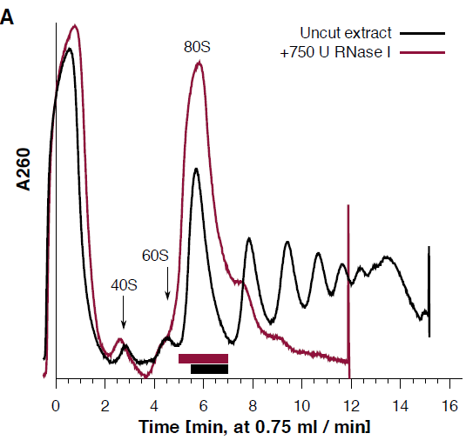
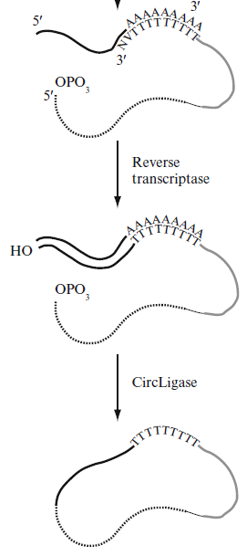
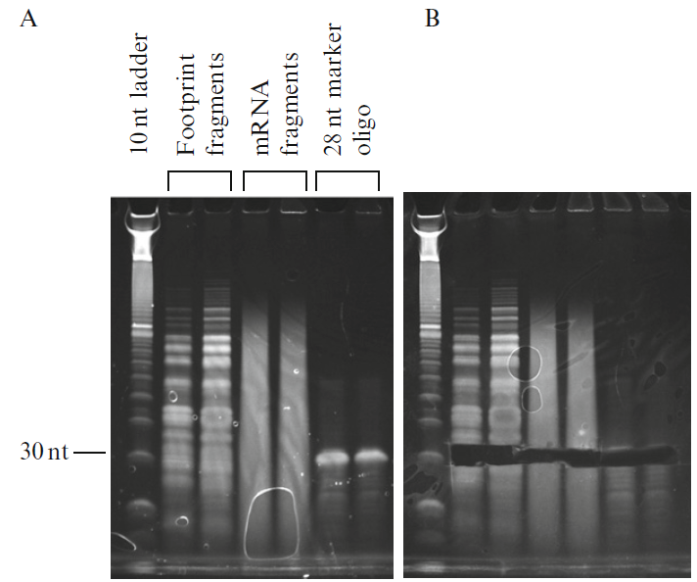
Ribo-Seq = ribosome profiling (2009) Ingolia et al. Science, 2009

Slide 29
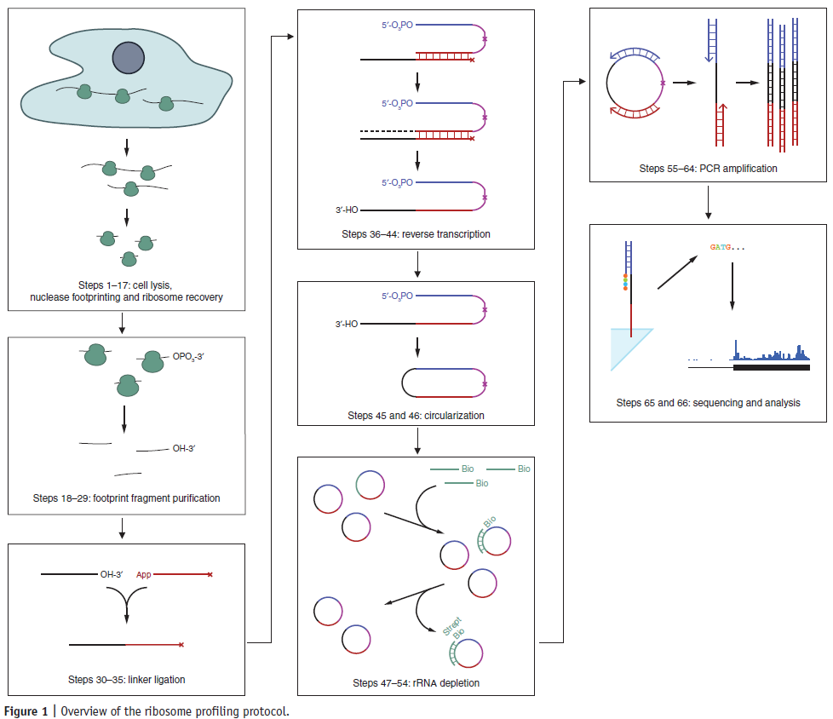

Slide 30
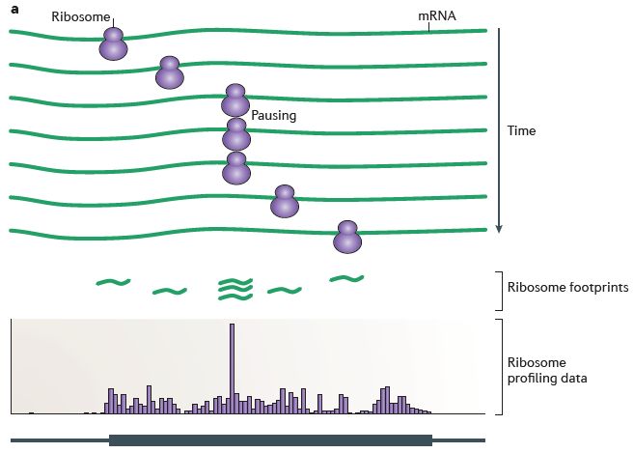
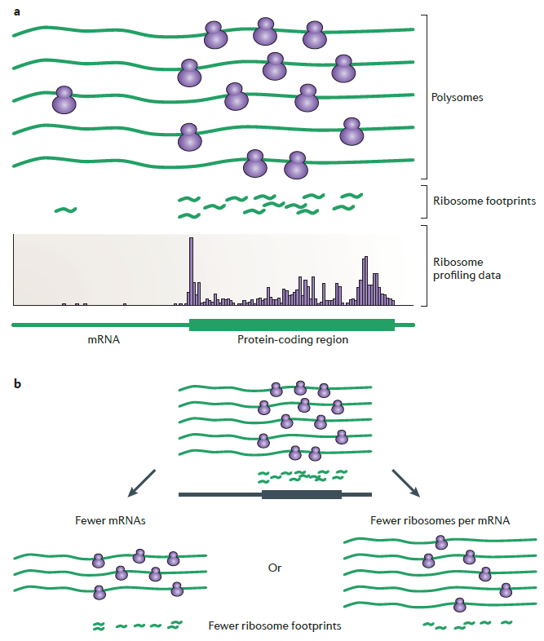
Ribo-Seq = ribosome profiling (2009) Ingolia et al. Science, 2009

Slide 32
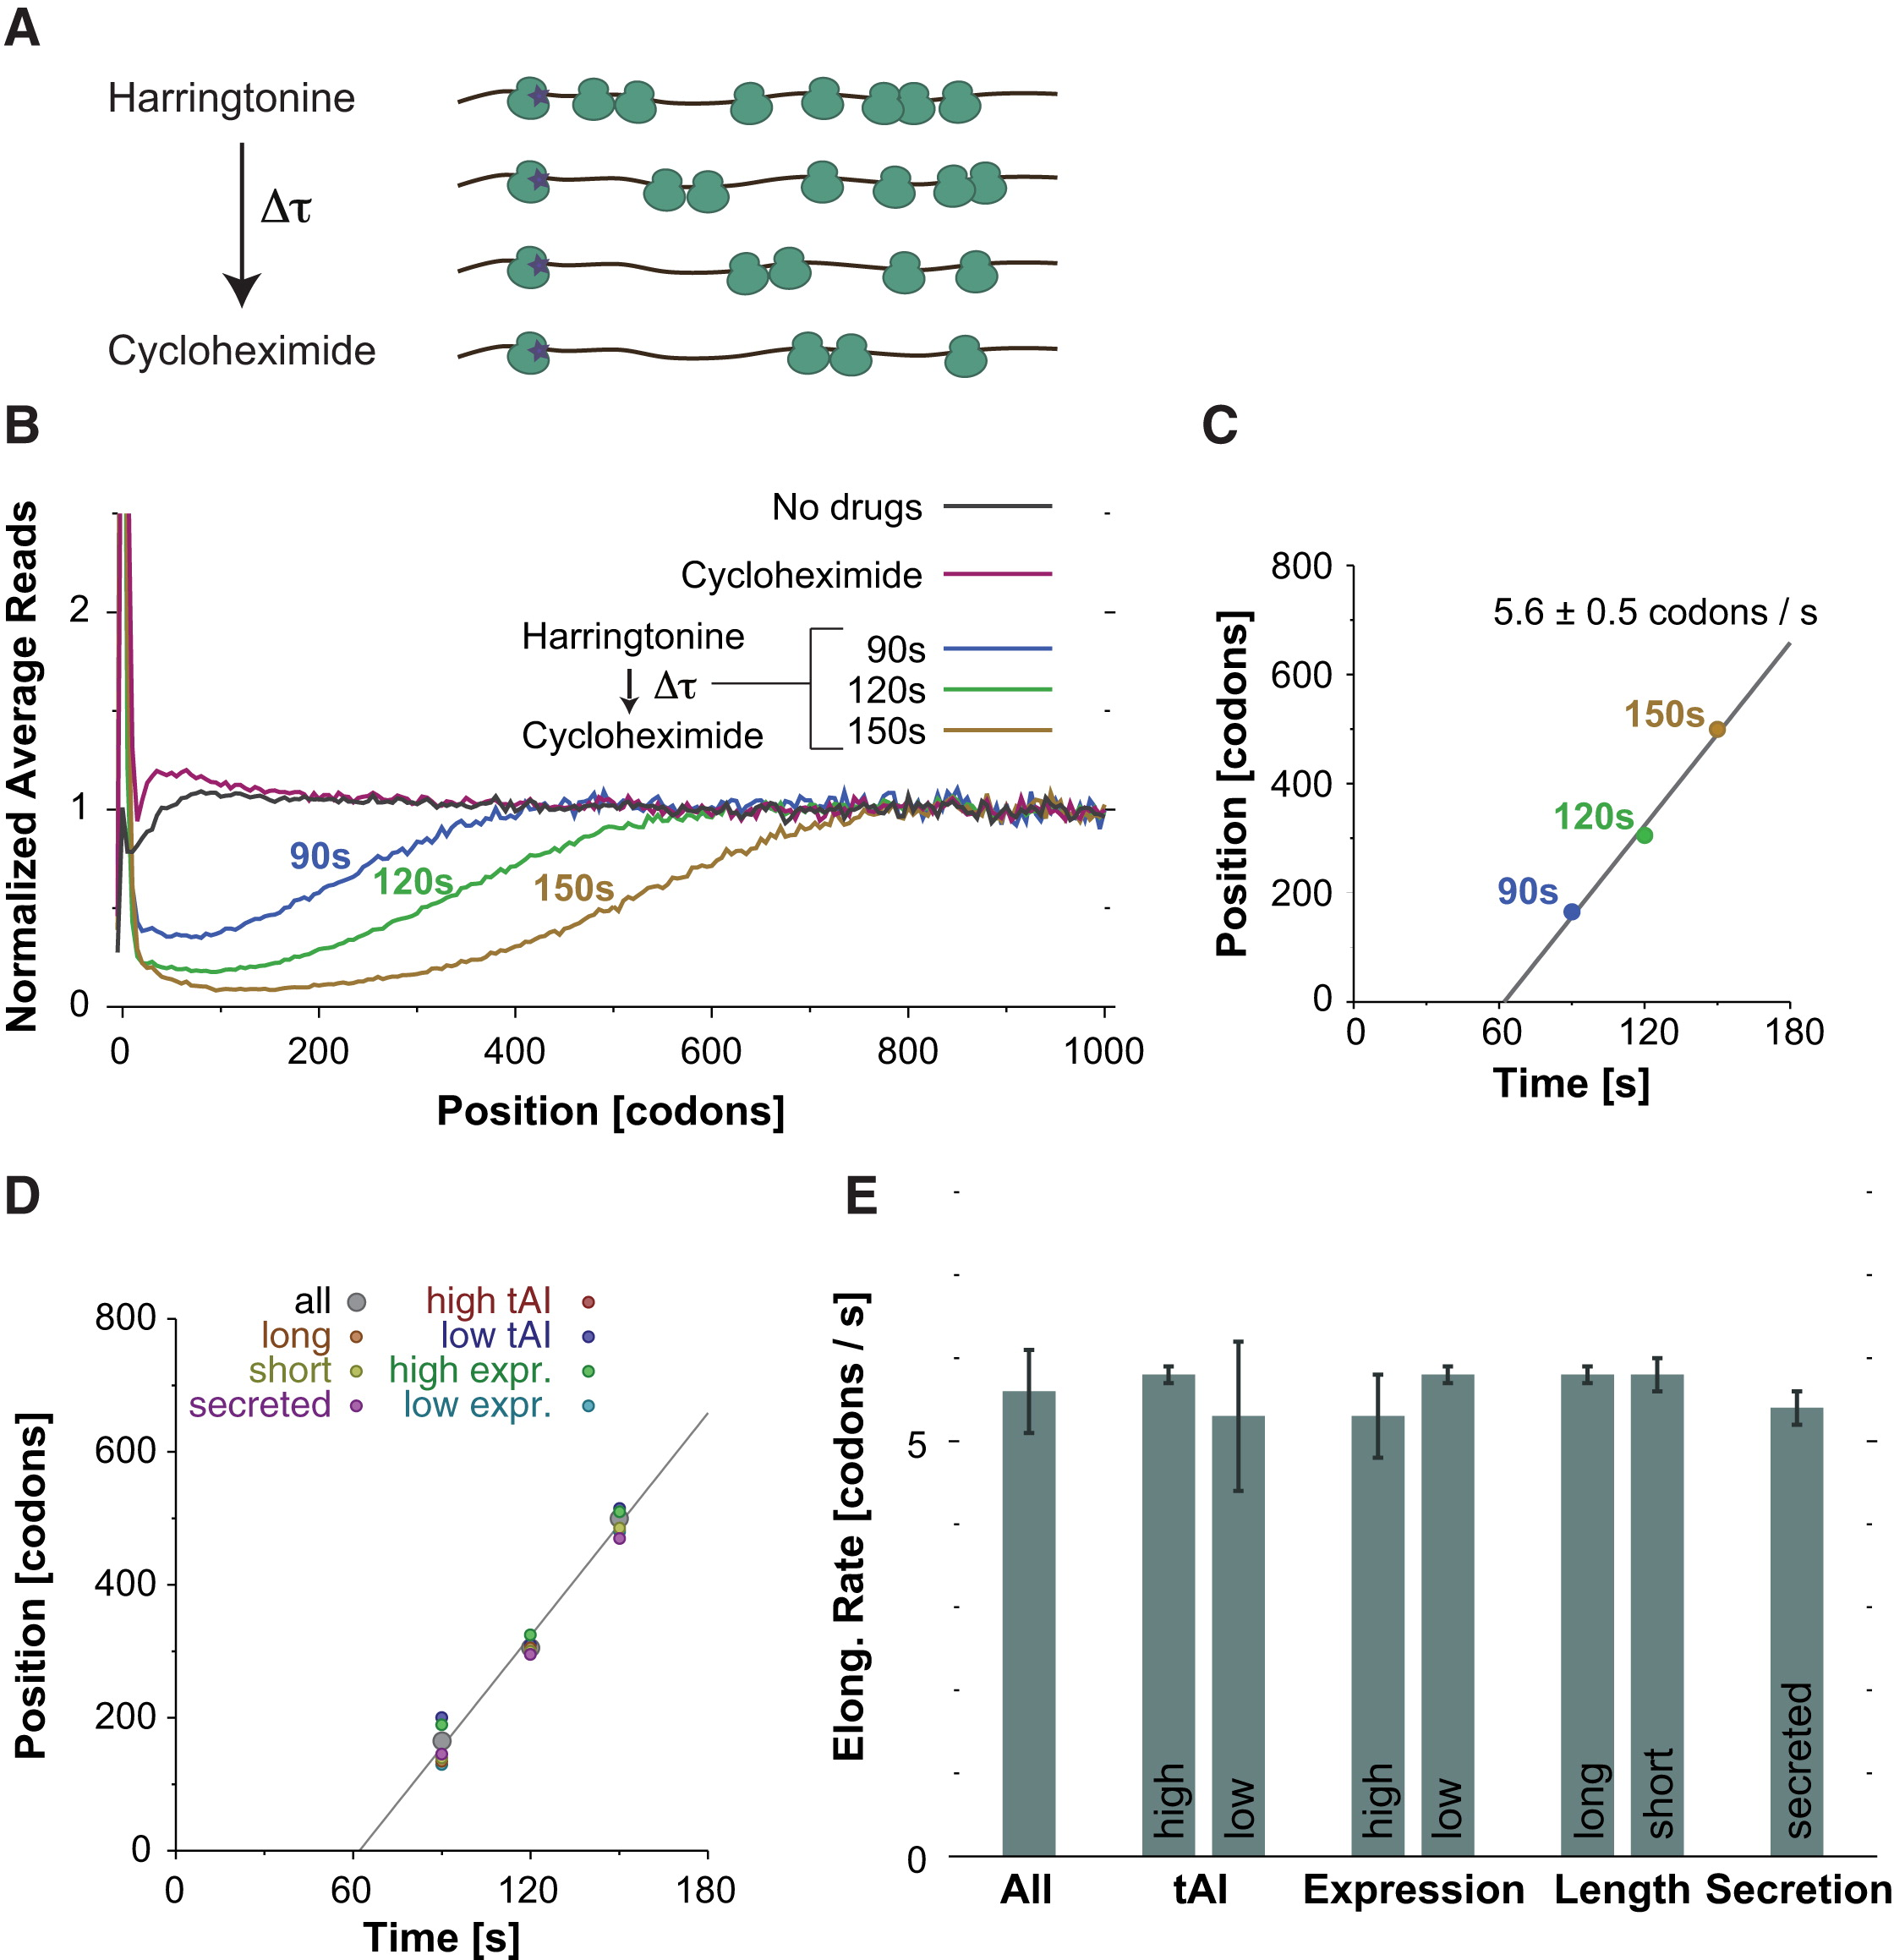
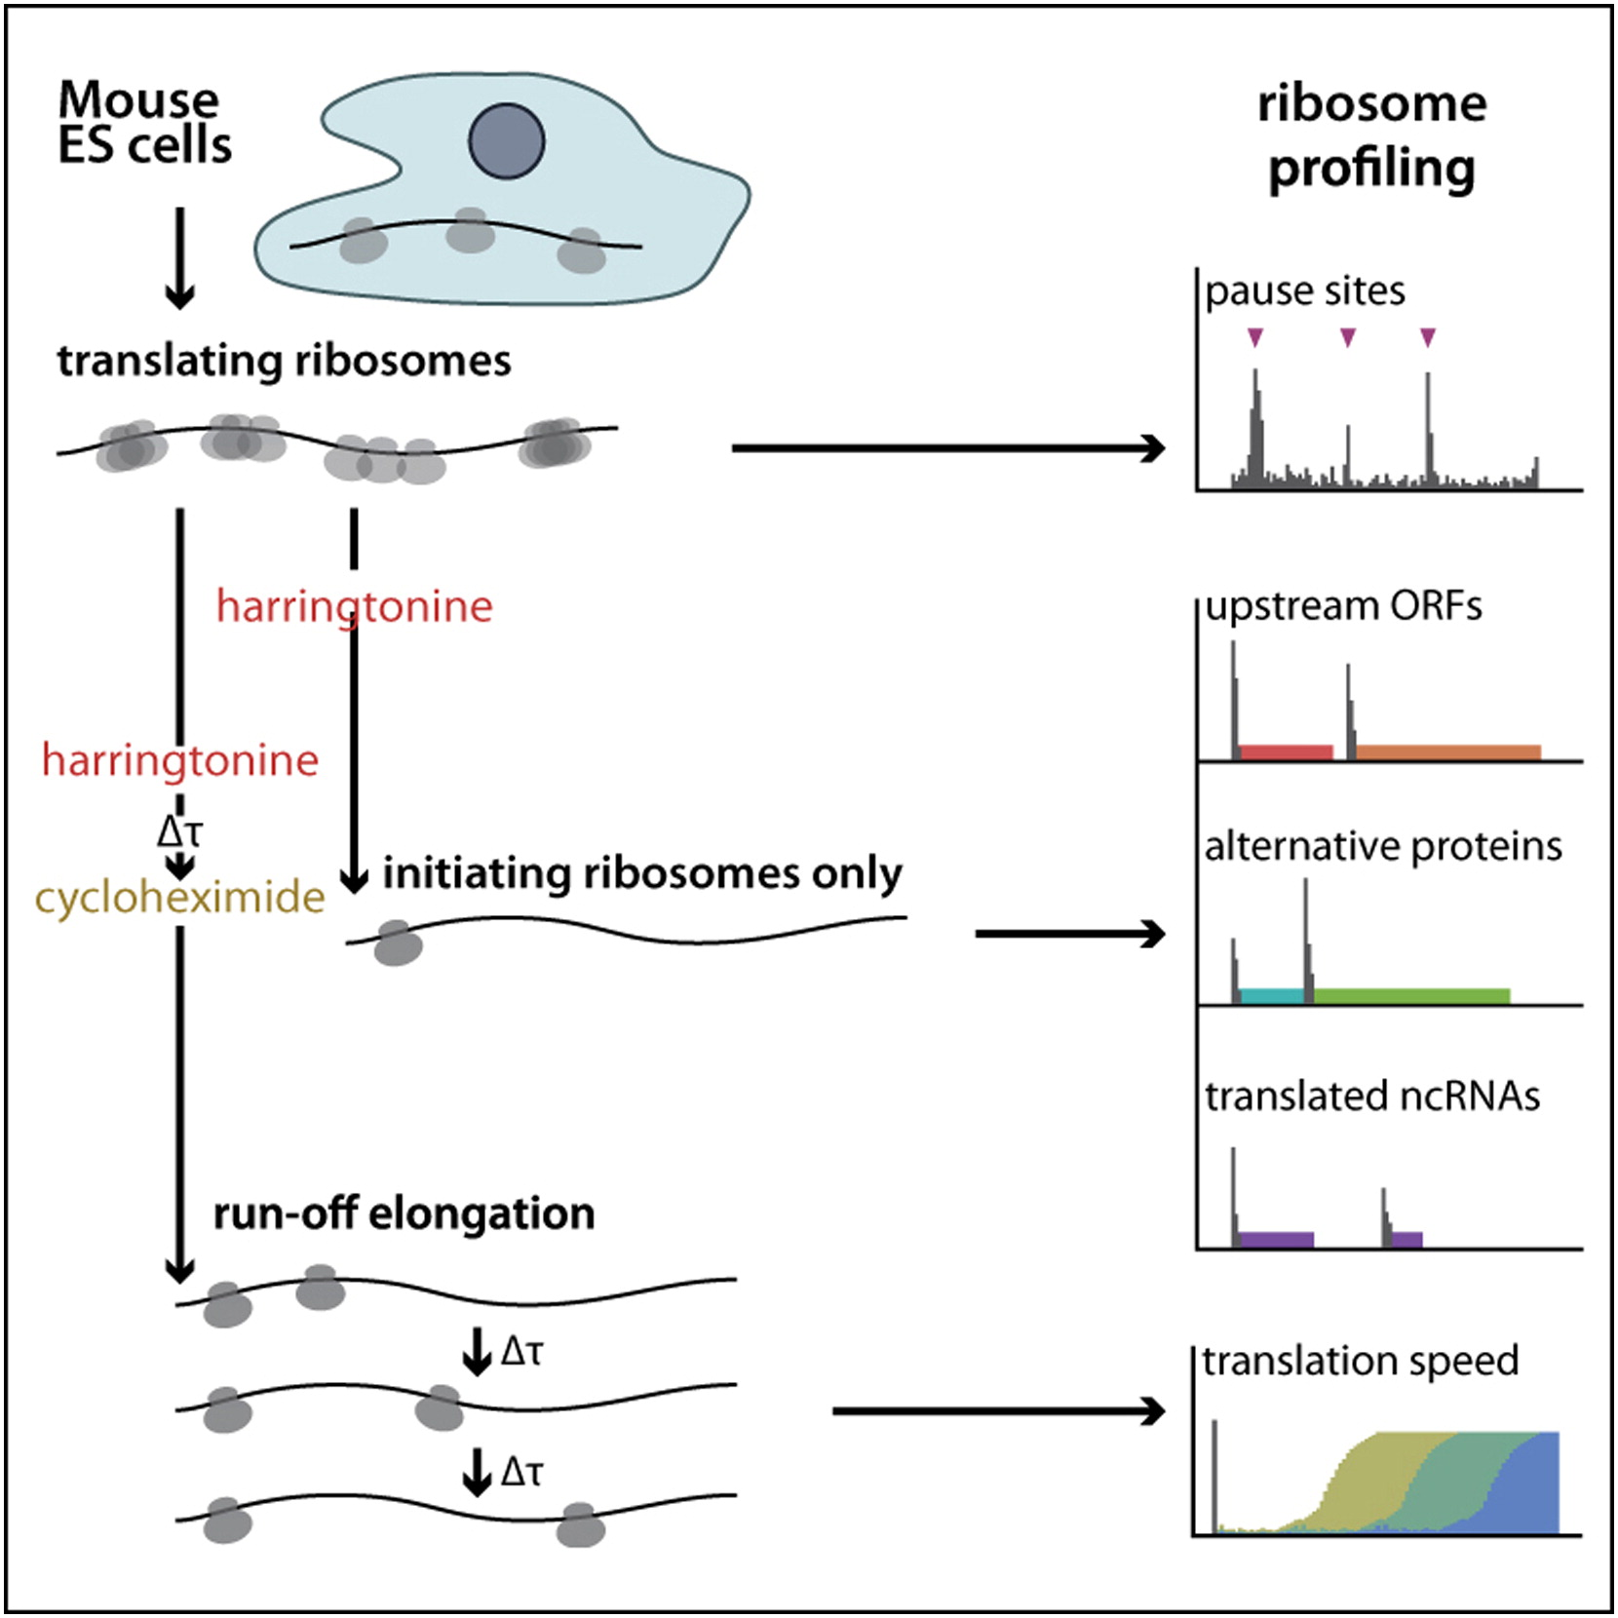
Ribosome profiling of mouse Embryonic Stem Cells Reveals the complexity of mammalian proteomes. Ingolia et al. Cell, 2011
Pulse-chase // run-off experiment
5.6 aa/s
Robust wrt tAI !!!

Slide 33
translation
mRNA
protein
64 codons
transcriptome
proteome
transcripts
20 amino acids
translatome
51 tRNAs
A second genetic code dictates the speed of translation ?
How codon usage could affect the speed of translation?

Slide 35
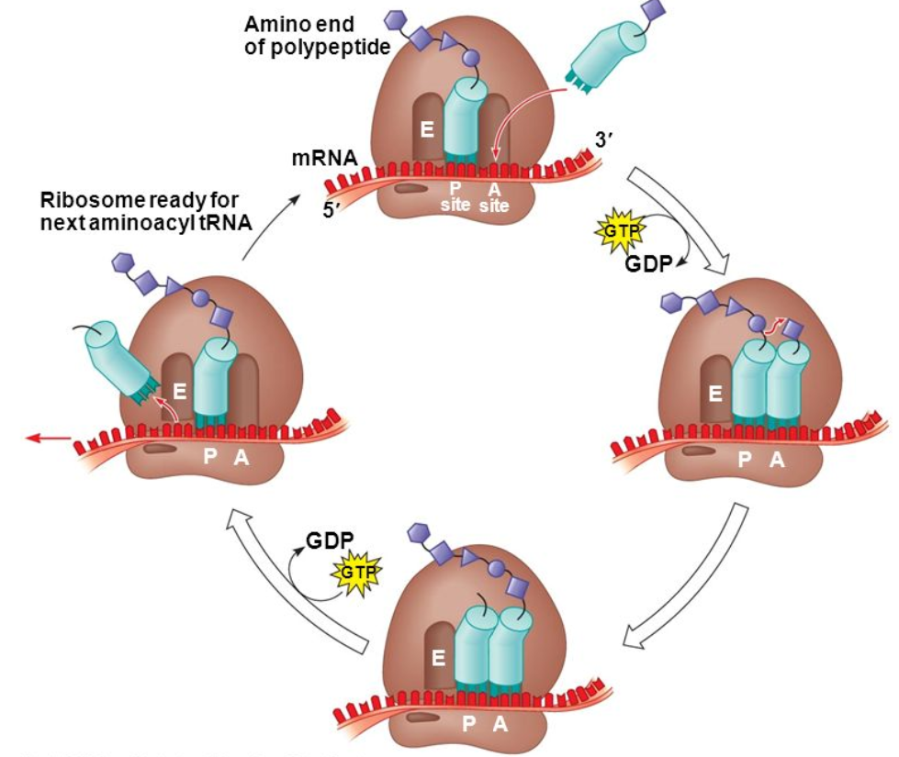

Slide 36
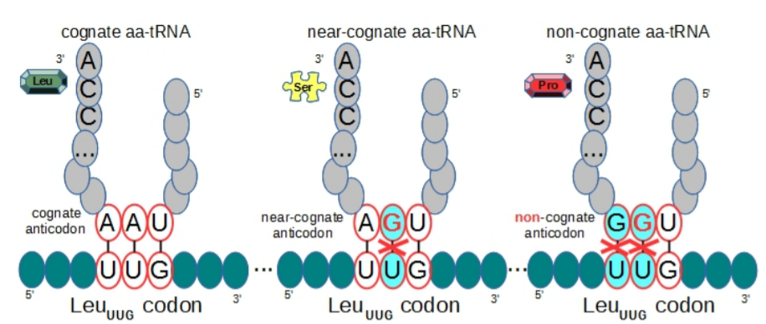
Cognate, near-cognate and non-cognate tRNAs
Near-cognate leading to translational error … or not…
Non-cognate always leading to translational error

Slide 37
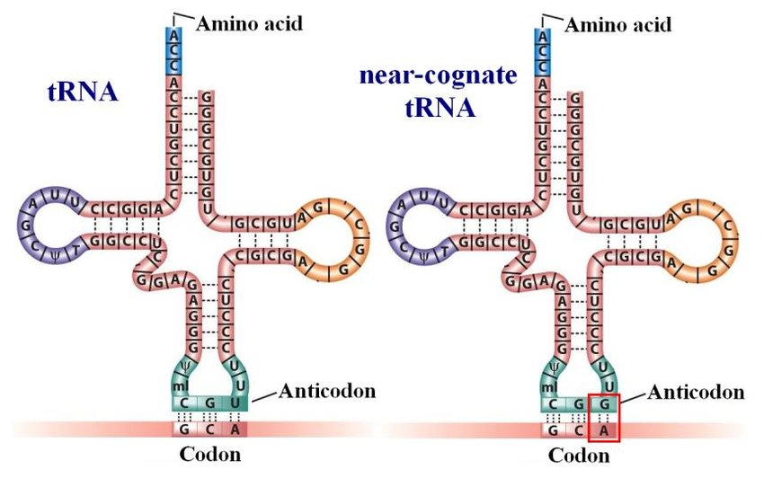
Cognate, near-cognate and non-cognate tRNAs
tRNA iso-acceptors for alanine
3’
alanine
3’
alanine
Near-cognate tRNAs
←→ delays in elongation time
&
increase error rate
5’
5’
aa-tRNAs that can participate in standard Watson-Crick interactions with the first two bases in a codon and can form either canonical or non-Watson-Crick pairs at the third or ‘‘wobble’’ position are designated cognate-tRNAs
… or any wobble
base 34 (e.g. I34)
At most one Watson-Crick base pairing mismatch of anti-codon (& not complying wobble rule for the 3rd base in codon)
Alanine(A): 4 anti-codons:
CGU, CGC, CGA, CGG
4 near-cognates anti-codons:
CGG, CUU, CCU, CAU
(A) (E) (G) (V)
mRNA
5’
3’
Alanine(A): 4 synonymous codons:
GCA, GCG, GCU, GCC
ORF Reading direction
Near-cognate not leading to error
Notes:
The core of my PhD thesis is about modeling. I want to extend an existing model, called TASEP (Totally Asymmetric Simple Exclusion Process), which is a physical statistical model (we call this a stochastic model). I would be happy to give you, in a near future, a full much more detailed presentation about it. For now, I just want to mention that one of the purpose of this computational model is to provide a quantitative estimation of the protein synthesis rate.
The speed of the ribosome is not uniform and depends on a least five direct main determinant factors:
A ribosome cannot move forward if another ribosome is stalled downstream (traffic jam)
A ribosome is slowed down if it has to deal with mRNA secondary structure
A ribosome is slowed down if it has to decode a codon for which the cognate or semi cognate tRNA is less abundant (codon usage dependency). Of course we want to include in this model the effect of tRNA enzymatic modifications !
A ribsome is slowed down if a proline residue has to be incorporated (proline has a cyclic ring that first needs to be broken up before making the peptide bond)
And finally and probably most importantly, the ribosome is slowed down when positively charged amino acid residues are incorporated and are trapped in the ribosome exit tunnel.

Slide 38
Cognate, near-cognate and non-cognate tRNAs
All near-cognate or non-cognate tRNAs will be rejected out of the ribosome in a double checked process: selection and kinetic proofreading by induced fit
The mechanism of selection and kinetic proofreading by induced fit
Each and every codons have a different number of near-cognate tRNAs
Sampling and Rejecting Near-cognate tRNAs takes more time (and is error prone)
←→ longer delays in elongation time for these codons with more near-cognate tRNAs
Translation error rate: 1/1,000 – 1/10,000

Slide 39
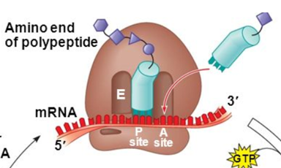
tRNAs pool
sample
Non-cognate tRNAs
reject
Cognate tRNAs
Sample
reject
sample
Near-cognate tRNAs

Slide 40
tRNAs pool
sample
Non-cognate tRNAs
reject
Cognate tRNAs
reject
multiple rounds
sample
Near-cognate tRNAs

Slide 41
tRNAs pool
sample
Non-cognate tRNAs
Cognate tRNAs
Sample & accept
The queuing time of a ribosome before translocation depends on the codon and on its number of near-cognate tRNAs
Inherently stochastic
Near-cognate tRNAs

Slide 42
Ribosome energy resources

Slide 43
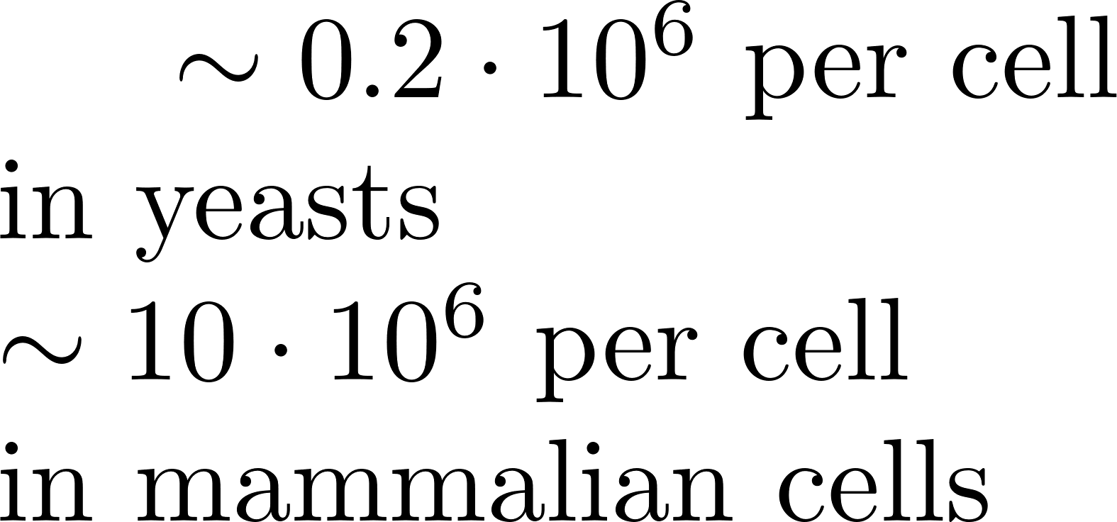
(eukaryote) Ribosomes
Nucleolus + RNAPol III
5S rRNA (120 nt)
28S rRNA, 5.8S rRNA
(4718 nt) (160 nt)
49 proteins (rpl)
60 S subunit
LSU (large subunit)
MW= 2.8 MDal
Nucleolus + RNAPol I
18S rRNA
(1894 nt)
mRNA
Length of protected mRNA: 30 nt
80 S complete
Ribosome
MW=4.2 MDal
40 S subunit
SSU (small subunit)
MW= 1.4 MDal
33 proteins (rps)
60% rRNA + 40% rp in weight
Notes:
The core of my PhD thesis is about modeling. I want to extend an existing model, called TASEP (Totally Asymmetric Simple Exclusion Process), which is a physical statistical model (we call this a stochastic model). I would be happy to give you, in a near future, a full much more detailed presentation about it. For now, I just want to mention that one of the purpose of this computational model is to provide a quantitative estimation of the protein synthesis rate.
The speed of the ribosome is not uniform and depends on a least five direct main determinant factors:
A ribosome cannot move forward if another ribosome is stalled downstream (traffic jam)
A ribosome is slowed down if it has to deal with mRNA secondary structure
A ribosome is slowed down if it has to decode a codon for which the cognate or semi cognate tRNA is less abundant (codon usage dependency). Of course we want to include in this model the effect of tRNA enzymatic modifications !
A ribsome is slowed down if a proline residue has to be incorporated (proline has a cyclic ring that first needs to be broken up before making the peptide bond)
And finally and probably most importantly, the ribosome is slowed down when positively charged amino acid residues are incorporated and are trapped in the ribosome exit tunnel.

Slide 44
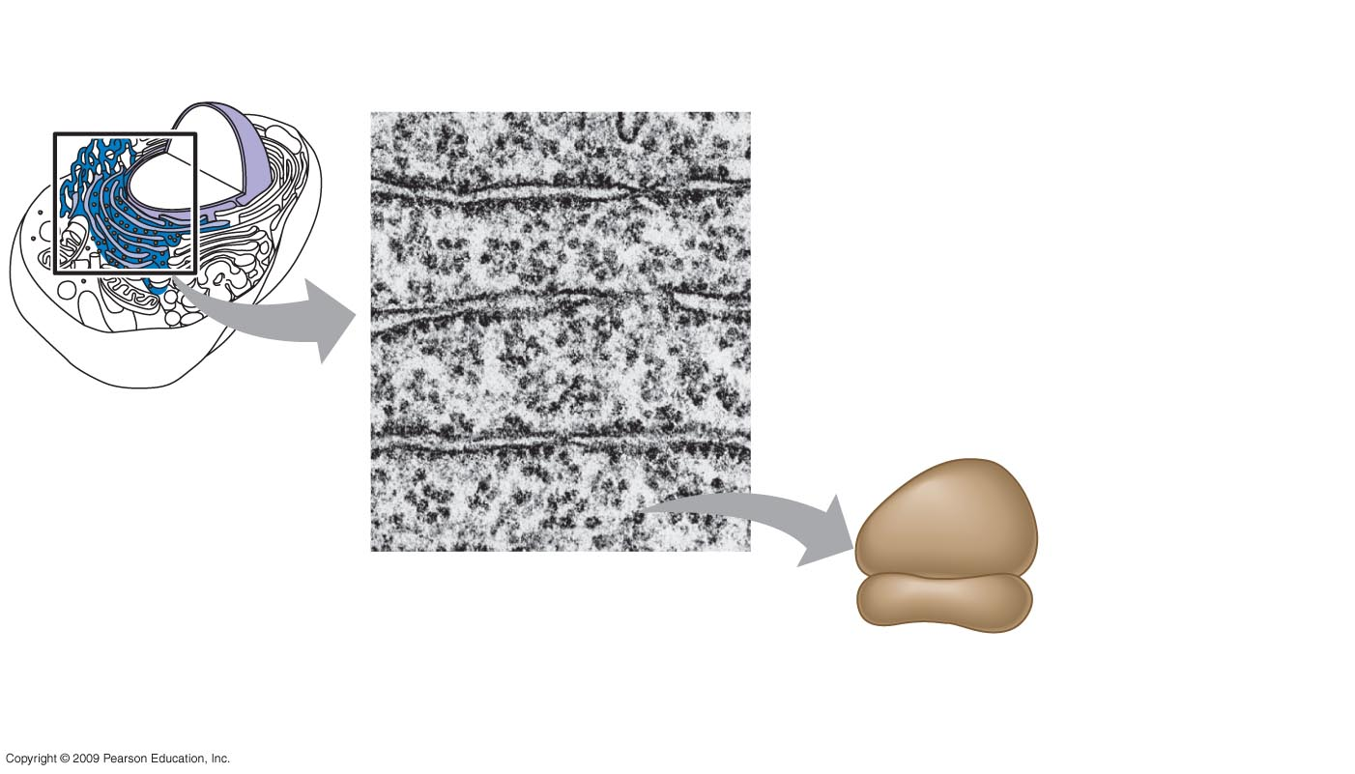
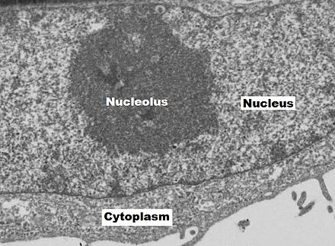
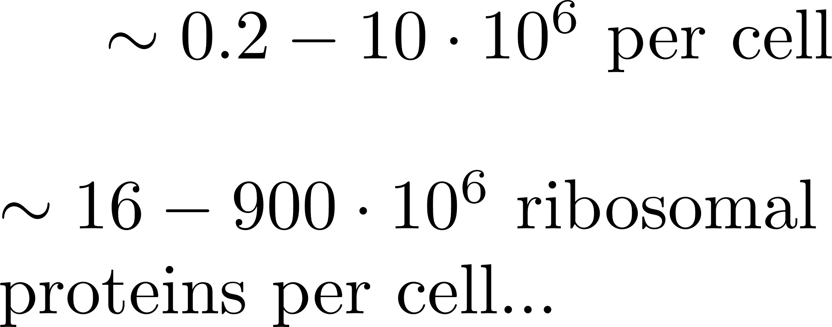
Ribosomes
Notes:
The core of my PhD thesis is about modeling. I want to extend an existing model, called TASEP (Totally Asymmetric Simple Exclusion Process), which is a physical statistical model (we call this a stochastic model). I would be happy to give you, in a near future, a full much more detailed presentation about it. For now, I just want to mention that one of the purpose of this computational model is to provide a quantitative estimation of the protein synthesis rate.
The speed of the ribosome is not uniform and depends on a least five direct main determinant factors:
A ribosome cannot move forward if another ribosome is stalled downstream (traffic jam)
A ribosome is slowed down if it has to deal with mRNA secondary structure
A ribosome is slowed down if it has to decode a codon for which the cognate or semi cognate tRNA is less abundant (codon usage dependency). Of course we want to include in this model the effect of tRNA enzymatic modifications !
A ribsome is slowed down if a proline residue has to be incorporated (proline has a cyclic ring that first needs to be broken up before making the peptide bond)
And finally and probably most importantly, the ribosome is slowed down when positively charged amino acid residues are incorporated and are trapped in the ribosome exit tunnel.

Slide 45
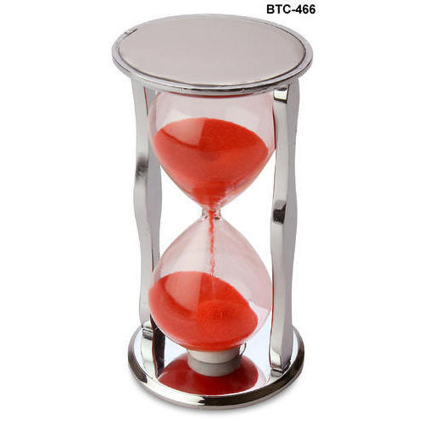
Queueing theory: Poisson, Exponential and Gamma Distribution
POISSON ?
Occurrence of a red car in the fixed time span = Poisson event
X = Random variable = Number (count) of red cars observed during the fixed time span ?
Poisson distribution:
(Discrete distribution)
Probability of no events occurring in the span up to time t :
Notes:
The core of my PhD thesis is about modeling. I want to extend an existing model, called TASEP (Totally Asymmetric Simple Exclusion Process), which is a physical statistical model (we call this a stochastic model). I would be happy to give you, in a near future, a full much more detailed presentation about it. For now, I just want to mention that one of the purpose of this computational model is to provide a quantitative estimation of the protein synthesis rate.
The speed of the ribosome is not uniform and depends on a least five direct main determinant factors:
A ribosome cannot move forward if another ribosome is stalled downstream (traffic jam)
A ribosome is slowed down if it has to deal with mRNA secondary structure
A ribosome is slowed down if it has to decode a codon for which the cognate or semi cognate tRNA is less abundant (codon usage dependency). Of course we want to include in this model the effect of tRNA enzymatic modifications !
A ribsome is slowed down if a proline residue has to be incorporated (proline has a cyclic ring that first needs to be broken up before making the peptide bond)
And finally and probably most importantly, the ribosome is slowed down when positively charged amino acid residues are incorporated and are trapped in the ribosome exit tunnel.

Slide 46
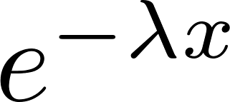
Queueing theory: Poisson, Exponential and Gamma Distribution
EXPONENTIAL ?
How long do I wait for the first occurrence of a Poisson event ?
The time to first event is now a continuous random variable
Probability that first event exceed is the same as the probability that no Poisson events will occur in , which was
As a result:
The CDF for X is
Exponential distribution (PDF):
Memoryless property
Notes:
The core of my PhD thesis is about modeling. I want to extend an existing model, called TASEP (Totally Asymmetric Simple Exclusion Process), which is a physical statistical model (we call this a stochastic model). I would be happy to give you, in a near future, a full much more detailed presentation about it. For now, I just want to mention that one of the purpose of this computational model is to provide a quantitative estimation of the protein synthesis rate.
The speed of the ribosome is not uniform and depends on a least five direct main determinant factors:
A ribosome cannot move forward if another ribosome is stalled downstream (traffic jam)
A ribosome is slowed down if it has to deal with mRNA secondary structure
A ribosome is slowed down if it has to decode a codon for which the cognate or semi cognate tRNA is less abundant (codon usage dependency). Of course we want to include in this model the effect of tRNA enzymatic modifications !
A ribsome is slowed down if a proline residue has to be incorporated (proline has a cyclic ring that first needs to be broken up before making the peptide bond)
And finally and probably most importantly, the ribosome is slowed down when positively charged amino acid residues are incorporated and are trapped in the ribosome exit tunnel.

Slide 47
Queueing theory: Poisson, Exponential and Gamma Distribution
GAMMA ?
How long do I wait for the 3rd or n^{th} occurrence of a Poisson event ?
The time is now a sum of 3 or n random variables that are iid ~
Gamma distribution = convolution product of exponential distributions
Memoryless property is partially lost, ageing or wear/tear stochastic mechanisms are well accommodated for by the Gamma distribution.
Notes:
The core of my PhD thesis is about modeling. I want to extend an existing model, called TASEP (Totally Asymmetric Simple Exclusion Process), which is a physical statistical model (we call this a stochastic model). I would be happy to give you, in a near future, a full much more detailed presentation about it. For now, I just want to mention that one of the purpose of this computational model is to provide a quantitative estimation of the protein synthesis rate.
The speed of the ribosome is not uniform and depends on a least five direct main determinant factors:
A ribosome cannot move forward if another ribosome is stalled downstream (traffic jam)
A ribosome is slowed down if it has to deal with mRNA secondary structure
A ribosome is slowed down if it has to decode a codon for which the cognate or semi cognate tRNA is less abundant (codon usage dependency). Of course we want to include in this model the effect of tRNA enzymatic modifications !
A ribsome is slowed down if a proline residue has to be incorporated (proline has a cyclic ring that first needs to be broken up before making the peptide bond)
And finally and probably most importantly, the ribosome is slowed down when positively charged amino acid residues are incorporated and are trapped in the ribosome exit tunnel.

Slide 48
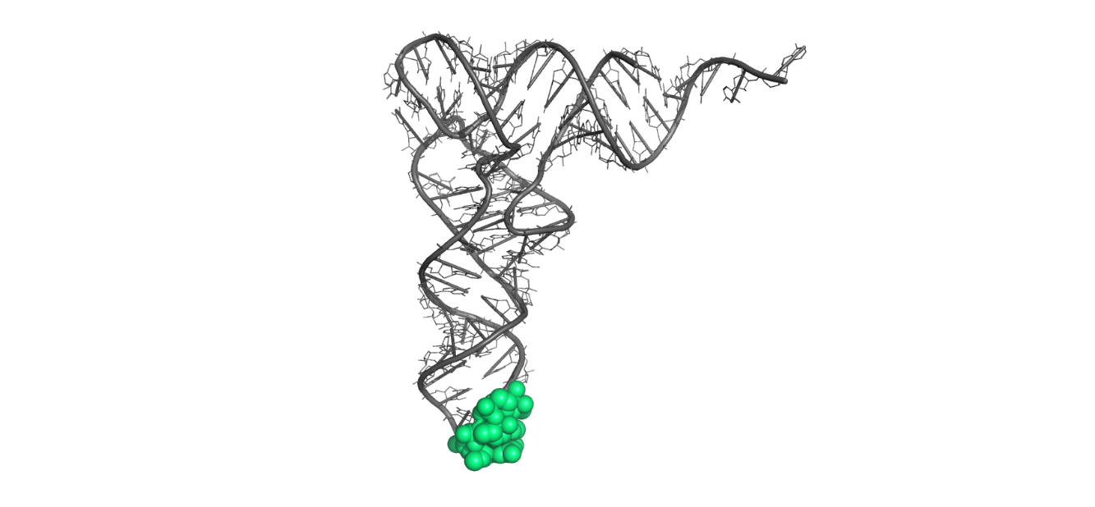
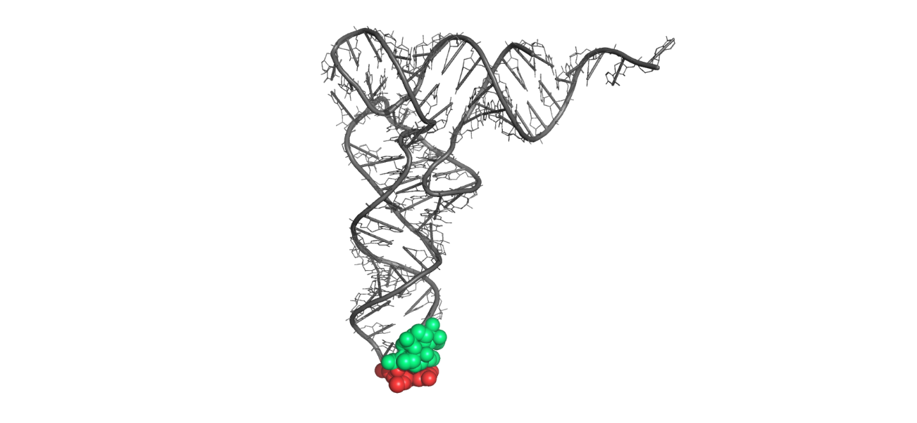
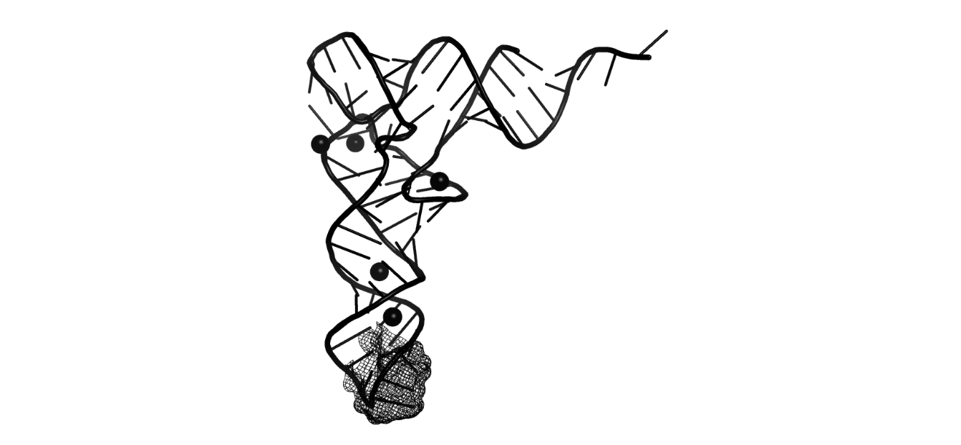
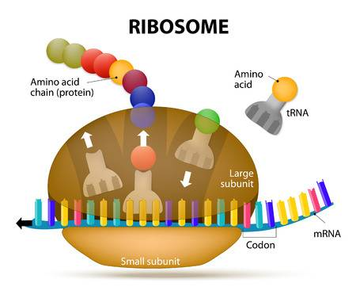
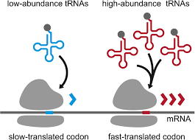
Queueing theory: Poisson, Exponential and Gamma Distribution
Replace the sitting man by a ribosome sitting on a codon…
Replace the colored cars by the 51 different charged tRNAs ?
What is the total decoding time on a given codon?
61 Gamma distributions for the 61 codons
Notes:
The core of my PhD thesis is about modeling. I want to extend an existing model, called TASEP (Totally Asymmetric Simple Exclusion Process), which is a physical statistical model (we call this a stochastic model). I would be happy to give you, in a near future, a full much more detailed presentation about it. For now, I just want to mention that one of the purpose of this computational model is to provide a quantitative estimation of the protein synthesis rate.
The speed of the ribosome is not uniform and depends on a least five direct main determinant factors:
A ribosome cannot move forward if another ribosome is stalled downstream (traffic jam)
A ribosome is slowed down if it has to deal with mRNA secondary structure
A ribosome is slowed down if it has to decode a codon for which the cognate or semi cognate tRNA is less abundant (codon usage dependency). Of course we want to include in this model the effect of tRNA enzymatic modifications !
A ribsome is slowed down if a proline residue has to be incorporated (proline has a cyclic ring that first needs to be broken up before making the peptide bond)
And finally and probably most importantly, the ribosome is slowed down when positively charged amino acid residues are incorporated and are trapped in the ribosome exit tunnel.

Slide 49
Come on... Are you kidding ?
Do ribosomes and tRNAs really play Gamma distributed dice?
Let’s check with real Ribo-Seq data...

Slide 50
Do ribosomes and tRNAs really play Gamma distributed dice ?
SRA / ENA are repositories of RNA-seq and Ribo-Seq data
SRA / ENA are goldmines for
bio-informaticians to dig in
Notes:
The core of my PhD thesis is about modeling. I want to extend an existing model, called TASEP (Totally Asymmetric Simple Exclusion Process), which is a physical statistical model (we call this a stochastic model). I would be happy to give you, in a near future, a full much more detailed presentation about it. For now, I just want to mention that one of the purpose of this computational model is to provide a quantitative estimation of the protein synthesis rate.
The speed of the ribosome is not uniform and depends on a least five direct main determinant factors:
A ribosome cannot move forward if another ribosome is stalled downstream (traffic jam)
A ribosome is slowed down if it has to deal with mRNA secondary structure
A ribosome is slowed down if it has to decode a codon for which the cognate or semi cognate tRNA is less abundant (codon usage dependency). Of course we want to include in this model the effect of tRNA enzymatic modifications !
A ribsome is slowed down if a proline residue has to be incorporated (proline has a cyclic ring that first needs to be broken up before making the peptide bond)
And finally and probably most importantly, the ribosome is slowed down when positively charged amino acid residues are incorporated and are trapped in the ribosome exit tunnel.

Slide 51
Do ribosomes and tRNAs really play Gamma distributed dice ?
Download any Ribo-Seq data from ENA
Ribo-Seq data with 160 millions reads on immortalized Human primary BJ fibroblasts
For any given codon, what is the distribution of the number of ribosomes footprints across all translatome?
Out of the 61 sense codons, let’s take AAG (K Lysine coding codon)
Notes:
The core of my PhD thesis is about modeling. I want to extend an existing model, called TASEP (Totally Asymmetric Simple Exclusion Process), which is a physical statistical model (we call this a stochastic model). I would be happy to give you, in a near future, a full much more detailed presentation about it. For now, I just want to mention that one of the purpose of this computational model is to provide a quantitative estimation of the protein synthesis rate.
The speed of the ribosome is not uniform and depends on a least five direct main determinant factors:
A ribosome cannot move forward if another ribosome is stalled downstream (traffic jam)
A ribosome is slowed down if it has to deal with mRNA secondary structure
A ribosome is slowed down if it has to decode a codon for which the cognate or semi cognate tRNA is less abundant (codon usage dependency). Of course we want to include in this model the effect of tRNA enzymatic modifications !
A ribsome is slowed down if a proline residue has to be incorporated (proline has a cyclic ring that first needs to be broken up before making the peptide bond)
And finally and probably most importantly, the ribosome is slowed down when positively charged amino acid residues are incorporated and are trapped in the ribosome exit tunnel.

Slide 52
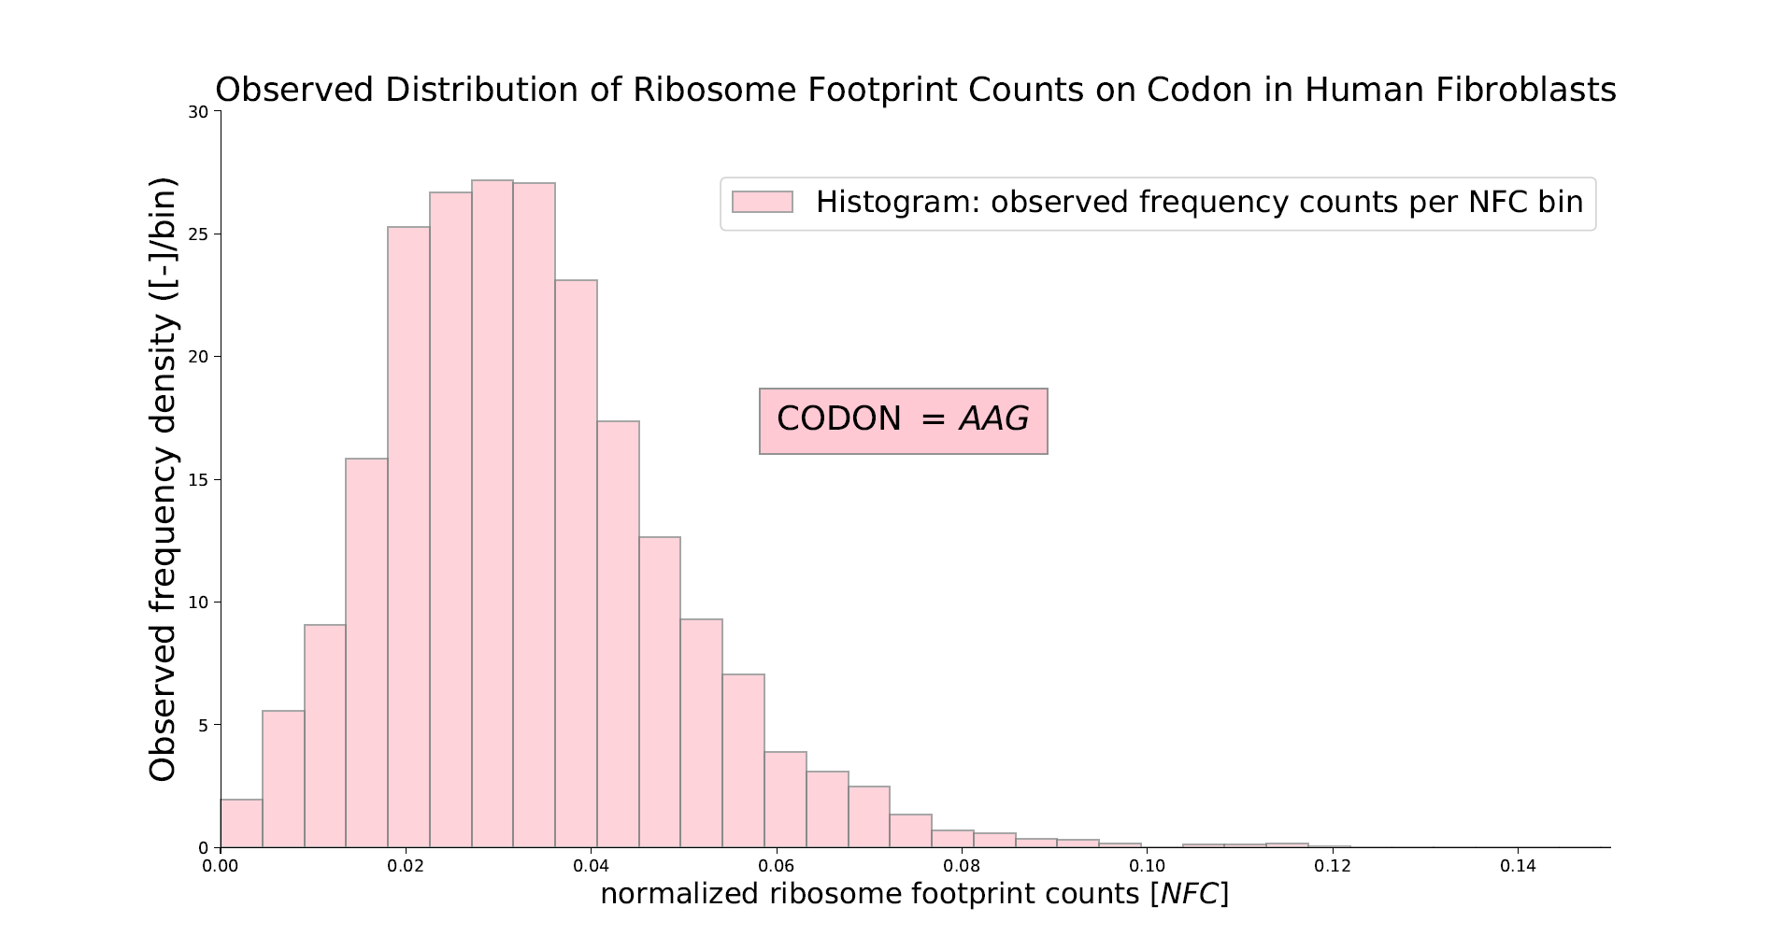

Slide 53
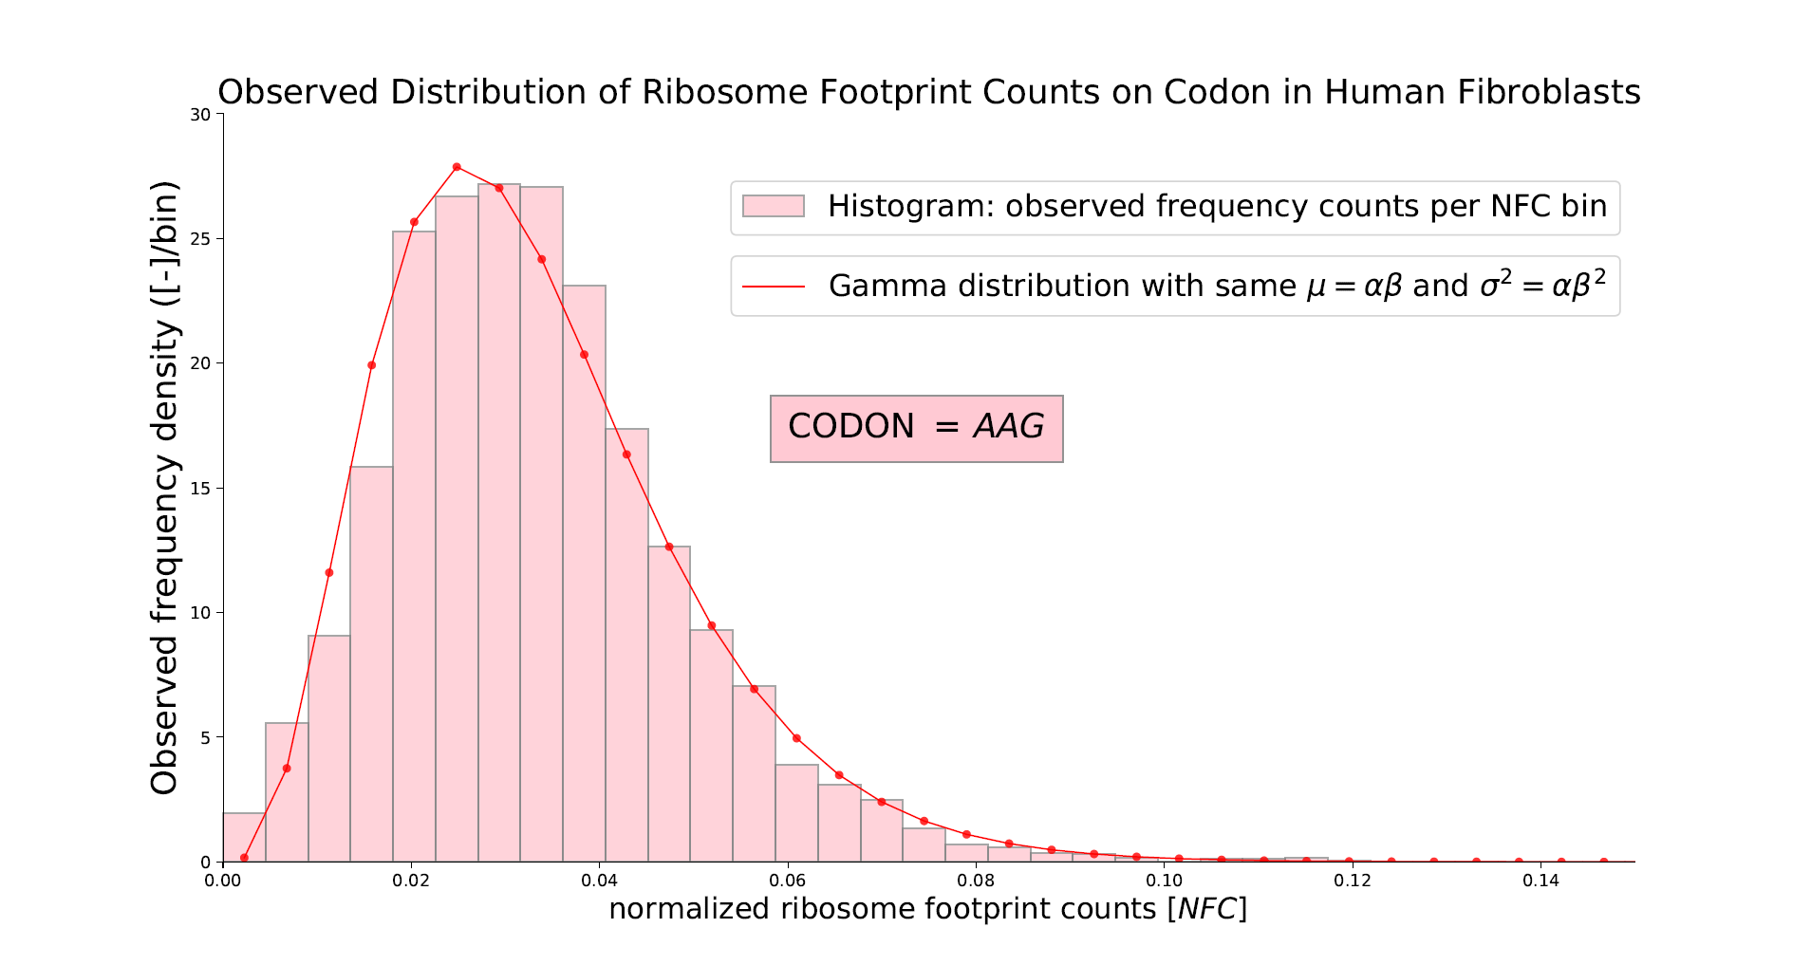

Slide 54
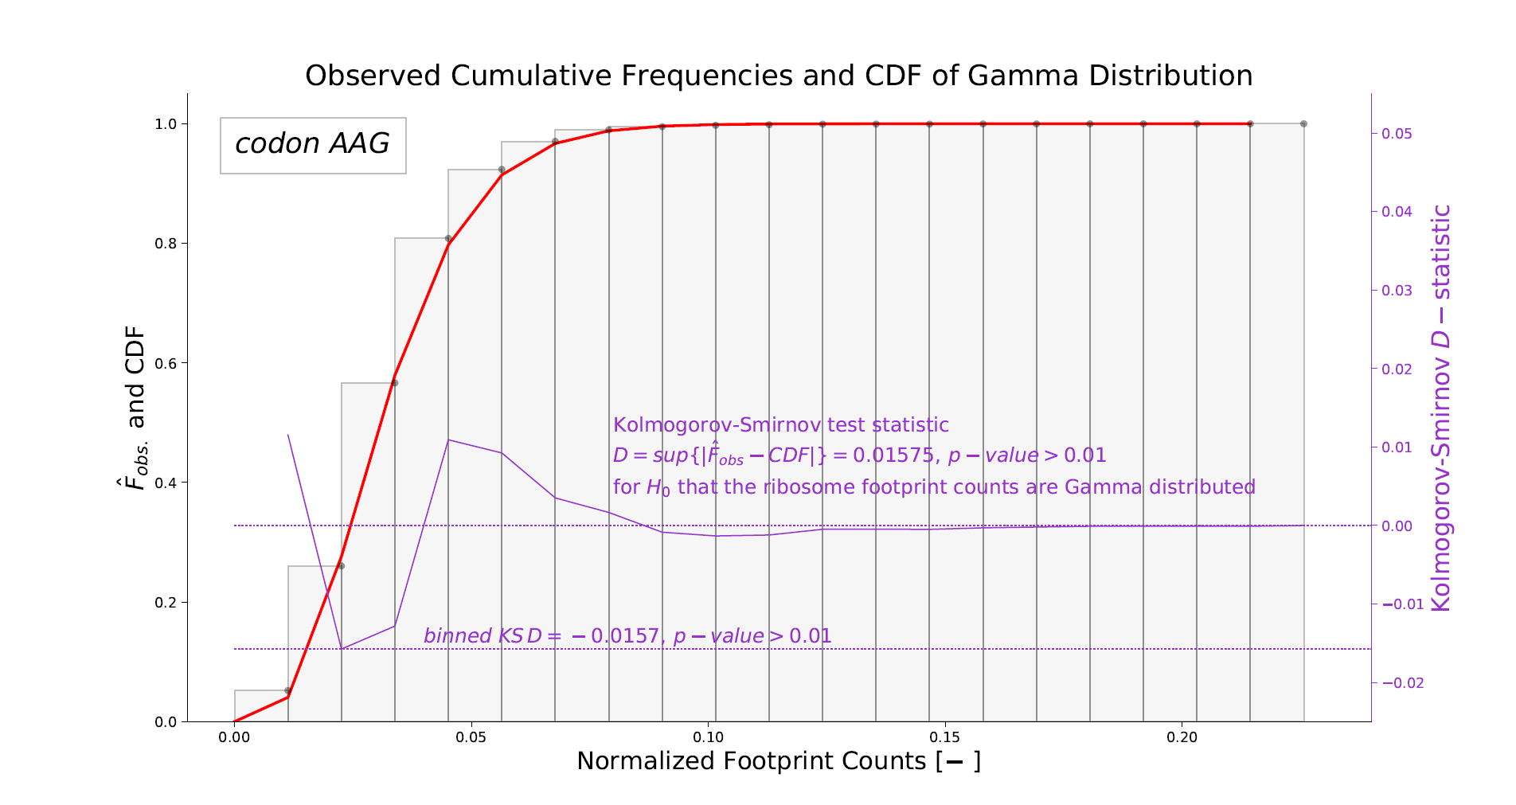

Slide 55
The decoding time of a ribosome on a codon can be reasonably modelled by a Gamma distribution
We will need to parametrize our model with 61 Gamma distributions for the 61 sense codons
Fit the parameters to Ribo-Seq data for a given species by mining from SRA or ENA repositories

Slide 56
PART 2 : TASEP: Totally Asymmetric Simple Exclusion Process
… and multiple TASEPs extension

Slide 57
Why a model of protein synthesis (elongation)?
Predict protein differential expression level beyond RNA-Seq
Shed light on ribosomes role in translational control
Provide insight in the interplay between tRNA relative abundance, codon usage and other factors (functions of second genetic code)
Help understand, interpret and predict Ribo-Seq results
Help understand what are the determinants of pausing and stalling
Help investigate association between pausing and proper protein folding or aggregation propensity
Provide new approaches to data-mine and bio-informatically track the impact of translational constraints on codon usage or codon ordering

Slide 58
Open boundaries transport model on 1D-lattice

Slide 59
Particle transport model on a 1D lattice

Slide 60
Particle transport model on a 1D lattice
Open boundaries

Slide 61
Particle transport model on a 1D lattice
Open boundaries

Slide 62
Particle transport model on a 1D lattice
Particles may move from left to right only. There is no way back
This is … totally asymmetric

Slide 63
Particle transport model on a 1D lattice

Slide 64
Particle transport model on a 1D lattice

Slide 65
Particle transport model on a 1D lattice
Hopping allowed from site i to i+1 if site i+1 is empty

Slide 66
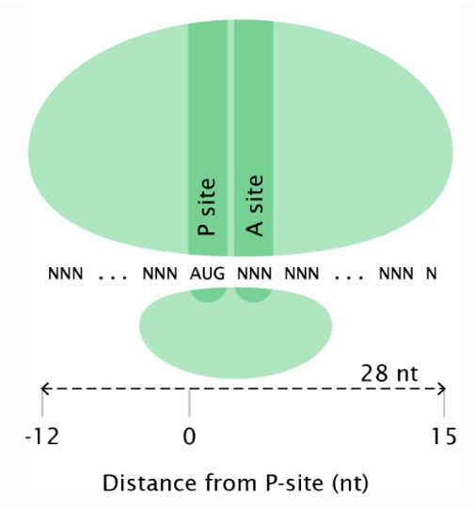
Particle transport model on a 1D lattice
No hopping from i to i+1 if site i+1 is not empty
This is called the simple exclusion
Real ribosomes have an extended footprint on the ‘lattice’

Slide 67
Particle transport model on a 1D lattice

Slide 68
Particle transport model on a 1D lattice

Slide 69
Particle transport model on a 1D lattice

Slide 70
Particle transport model on a 1D lattice

Slide 71
Particle transport model on a 1D lattice

Slide 72
Particle transport model on a 1D lattice

Slide 73
Particle transport model on a 1D lattice

Slide 74
Particle transport model on a 1D lattice

Slide 75
Particle transport model on a 1D lattice

Slide 76
Particle transport model on a 1D lattice

Slide 77
Particle transport model on a 1D lattice
1 particle has proceeded through all sites

Slide 78
Particle transport model on a 1D lattice
Homogeneous TASEP: solved exactly
Inhomogeneous TASEP: are different not fully understood
Inhomogeneous TASEP with binary disorder: only 2
Complete inhomogeneous TASEP: all are different

Slide 79
More than one TASEP … ?
Multiple complete inhomogeneous TASEP with infinite particle reservoir

Slide 80
More than one TASEP … But limited pool of particles?
Objects are lacking due to competition with concurrent TASEPs
Multiple complete inhomogeneous TASEPs with limited pool of particles

Slide 81
Start simple… but not trivial
Inhomogeneous TASEP with binary disorder: only 2
Determine the current (production rate)
Determine the density distribution and find critical entry rate (initiation rate) above which defects in the lattice do have an effect.
Plot a phase diagram
Introduce 2 ‘defects’ in the lattice where the hopping rate is smaller

Slide 82
Start simple… but not trivial
Inhomogeneous TASEP with binary disorder: only 2
Determine the current (production rate)
Introduce 2 ‘defects’ in the lattice where the hopping rate is smaller

Slide 83
Start simple… but not trivial
Inhomogeneous TASEP with binary disorder: only 2
Determine the density distribution
Introduce 2 ‘defects’ in the lattice where the hopping rate is smaller

Slide 84
Start simple… but not trivial
Inhomogeneous TASEP with binary disorder: only 2
Sketch a
phase diagram
Introduce 2 ‘defects’ in the lattice where the hopping rate is smaller

Slide 85
In-house computational implementation of extended TASEPs

Slide 86
The full TASEP model
Notes:
The core of my PhD thesis is about modeling. I want to extend an existing model, called TASEP (Totally Asymmetric Simple Exclusion Process), which is a physical statistical model (we call this a stochastic model). I would be happy to give you, in a near future, a full much more detailed presentation about it. For now, I just want to mention that one of the purpose of this computational model is to provide a quantitative estimation of the protein synthesis rate.
The speed of the ribosome is not uniform and depends on a least five direct main determinant factors:
A ribosome cannot move forward if another ribosome is stalled downstream (traffic jam)
A ribosome is slowed down if it has to deal with mRNA secondary structure
A ribosome is slowed down if it has to decode a codon for which the cognate or semi cognate tRNA is less abundant (codon usage dependency). Of course we want to include in this model the effect of tRNA enzymatic modifications !
A ribsome is slowed down if a proline residue has to be incorporated (proline has a cyclic ring that first needs to be broken up before making the peptide bond)
And finally and probably most importantly, the ribosome is slowed down when positively charged amino acid residues are incorporated and are trapped in the ribosome exit tunnel.

Slide 87
Future work … or bucket list
Finalize implementation to predict Ribo-Seq profiles, protein levels
Retrieve the 61 codons queueing time statistics from Ribo-Seq repositories
Redo this for Human, Mouse, Zebrafish, Yeasts
Explore U34 sensitive codons queuing time differences upon ELP3 gene knock-out
Data mine for reversed patterns in amino-acid charge distribution to probe the electrostatics effects in the ribosome exit tunnel
Incorporate for proline delays effects
Incorporate for N-grams delays effects
Incorporate for mRNA internal secondary structure effects
… and more

Slide 88
Thank you for your attention
Would be happy to answer any question

Slide 91
Jianli Lu, William R. Kobertz, Carol Deutsch.
Mapping the Electrostatic Potential within the Ribosomal Exit Tunnel
Journal of Molecular Biology (2007)

Slide 92
Note: original contribution, to be submitted ASAP

Slide 96
exit point
entry point
PTC
Ribosome exit tunnel length = 10 nm
40 aa residues
ZONE OF ELECTROSTATIC INFLUENCE

Slide 97
exit point
entry point
PTC
Ribosome exit tunnel length = 10 nm
40 aa residues
ZONE OF ELECTROSTATIC INFLUENCE

Slide 98
exit point
entry point
PTC
Ribosome exit tunnel length = 10 nm
40 aa residues
ZONE OF ELECTROSTATIC INFLUENCE

Slide 99
exit point
entry point
Ribosome exit tunnel length = 10 nm
40 aa residues
FREE ZONE
OUTSIDE RIBOSOME EXIT TUNNEL
PTC
ZONE OF ELECTROSTATIC INFLUENCE

Slide 100
exit point
entry point
(a)
(b)
(c)
Ribosome exit tunnel length = 10 nm
40 aa residues
(d)
FREE ZONE
OUTSIDE RIBOSOME EXIT TUNNEL
PTC
ZONE OF ELECTROSTATIC INFLUENCE

