Slide 1
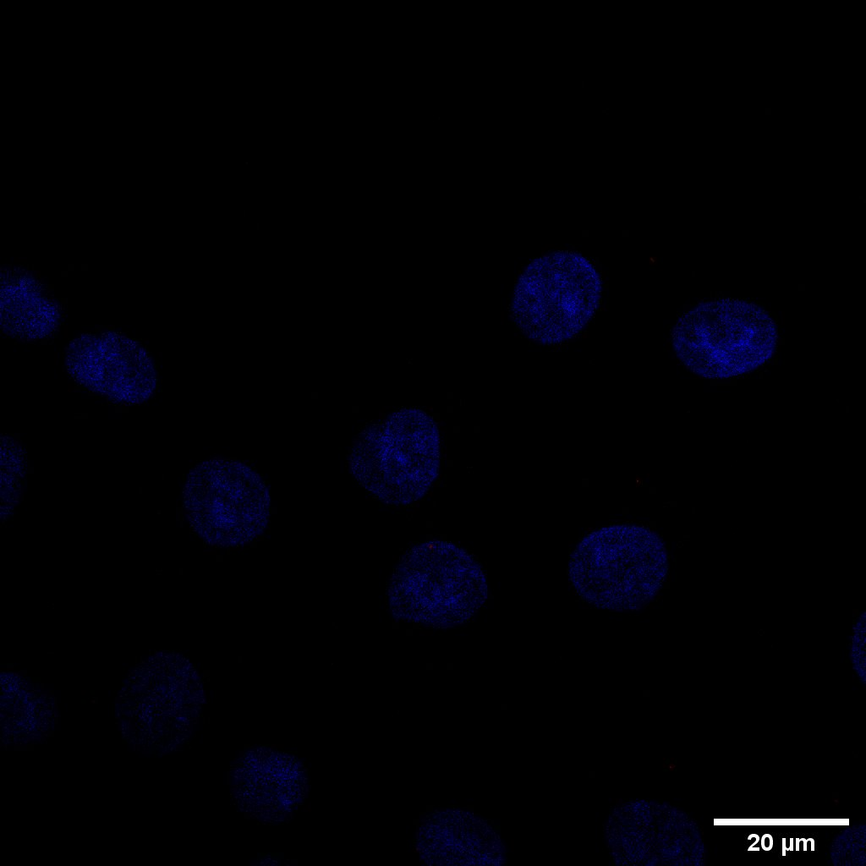
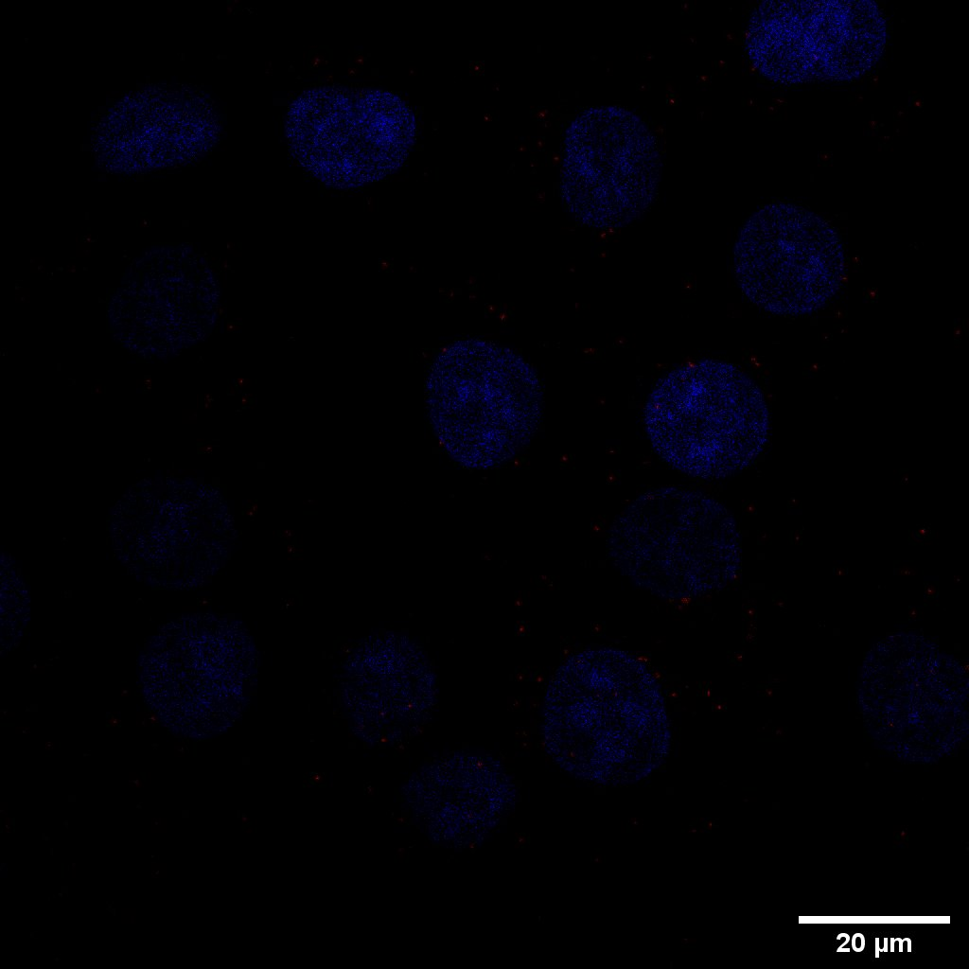
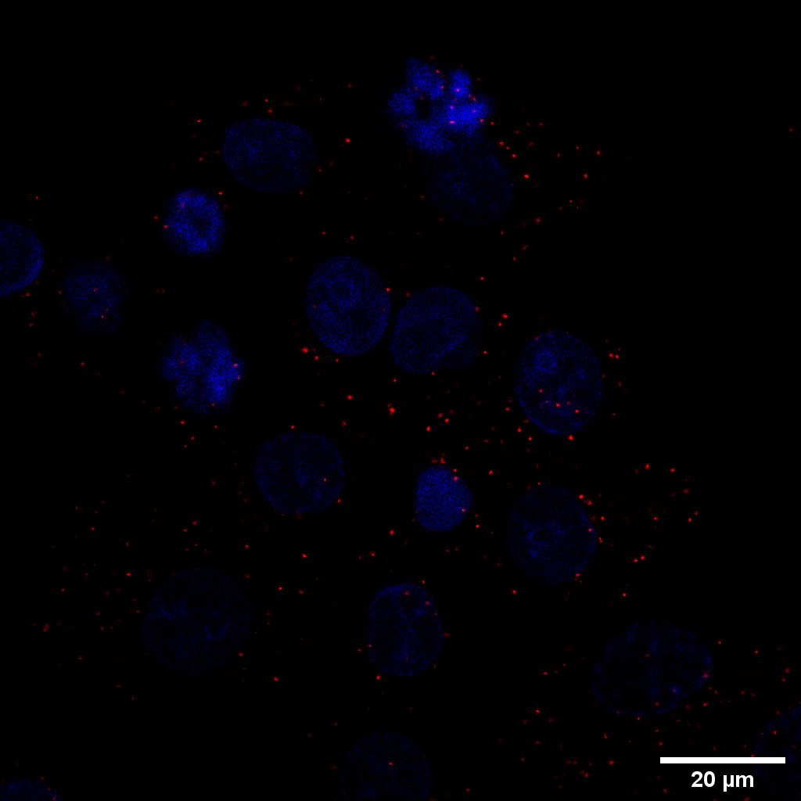
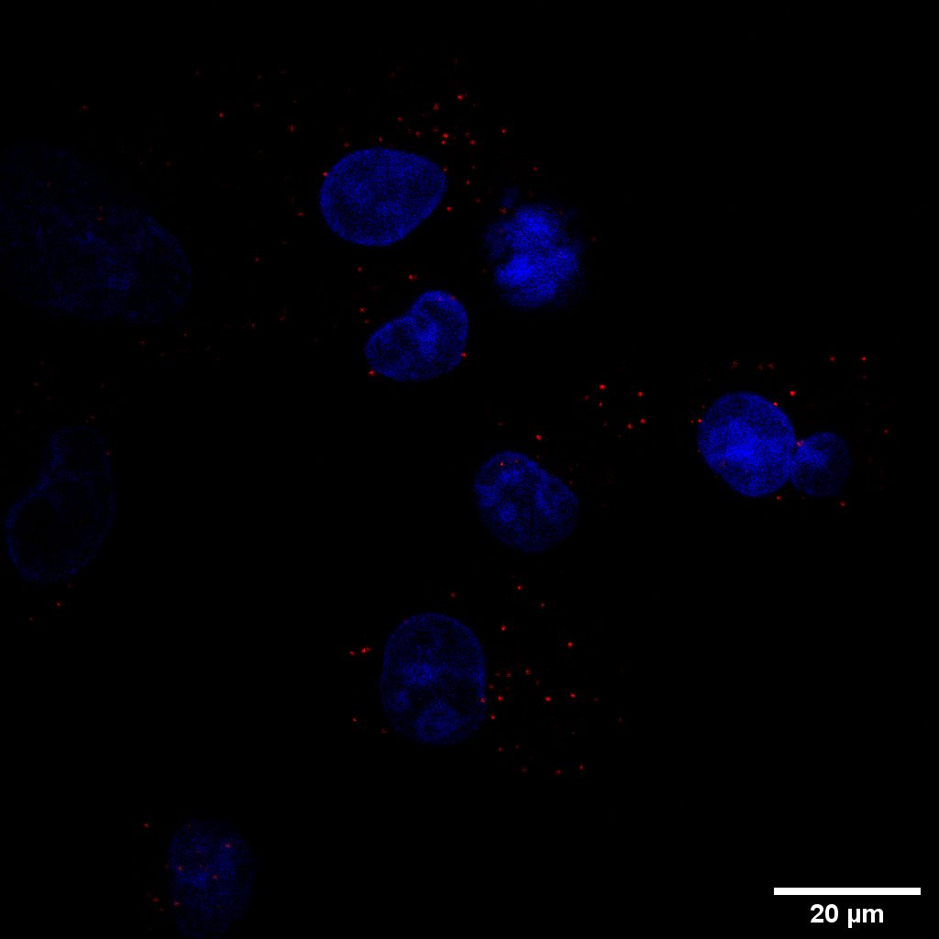
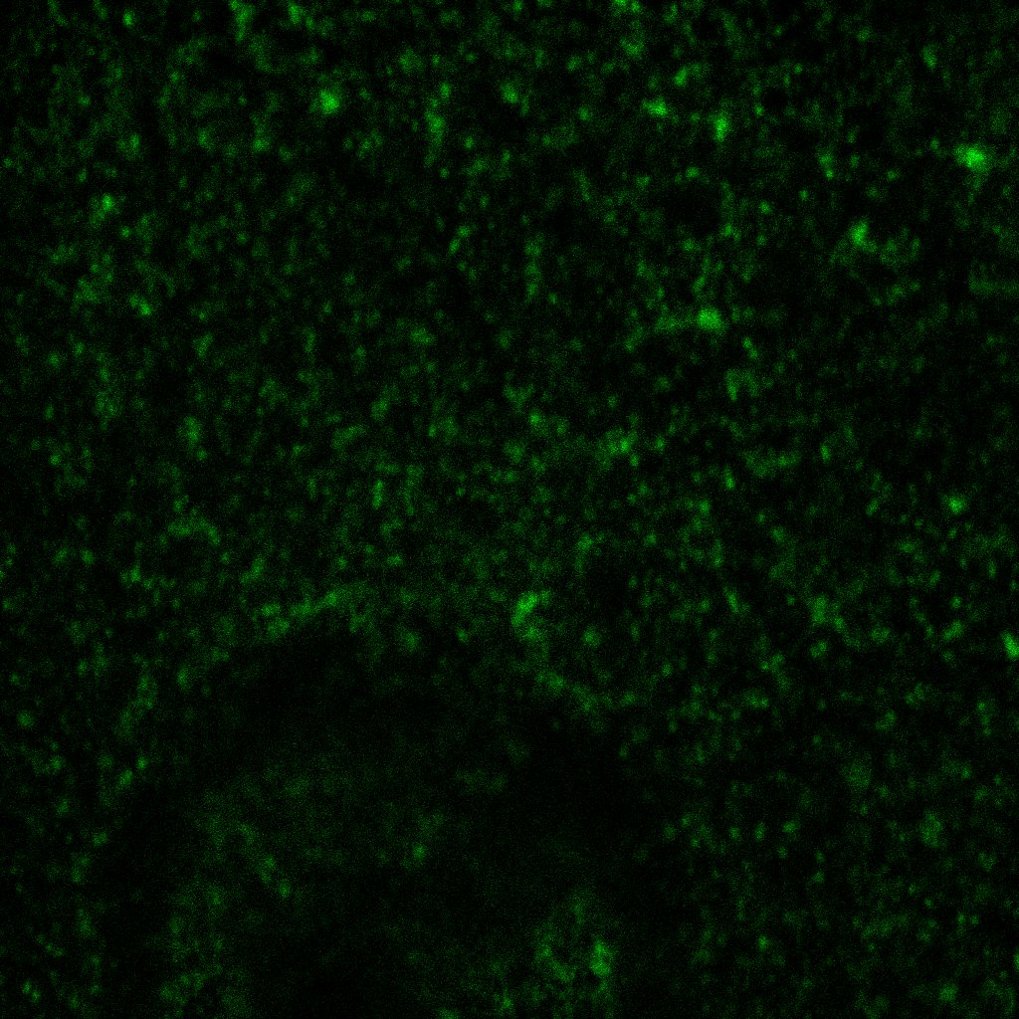
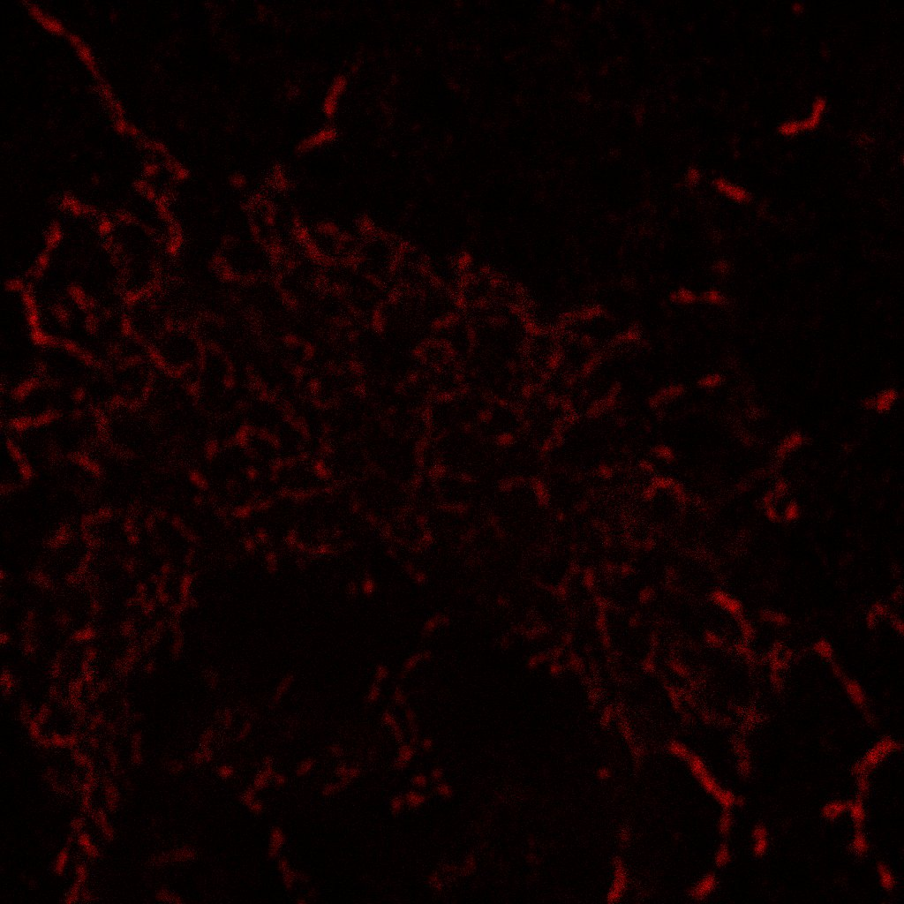
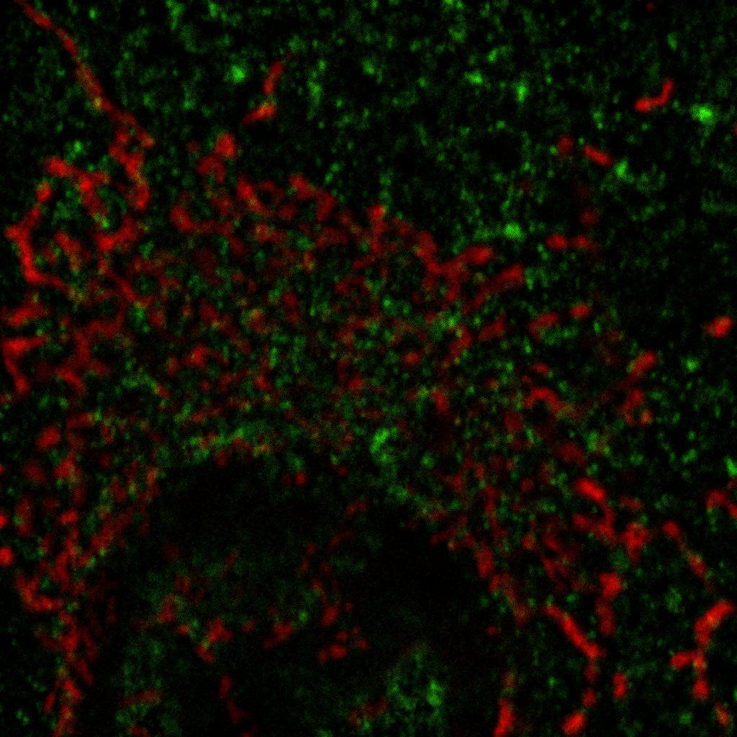
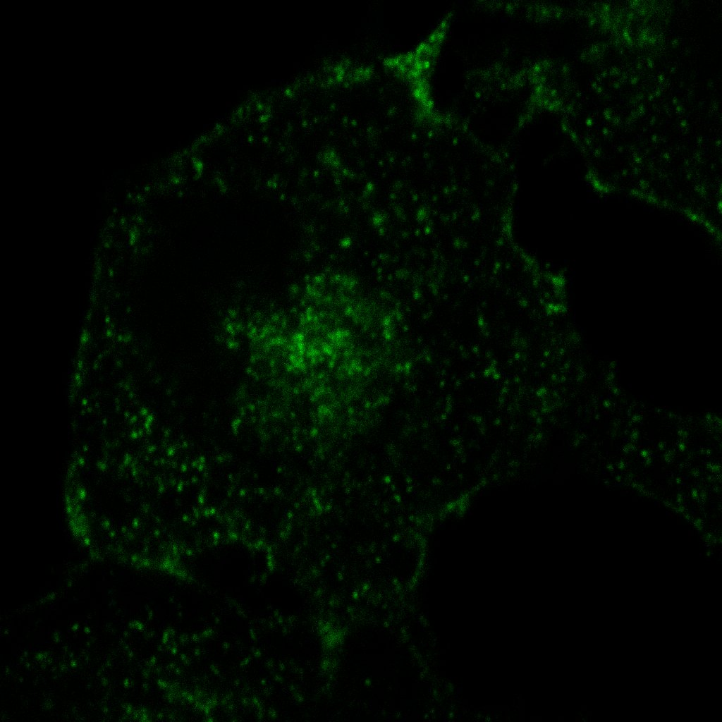
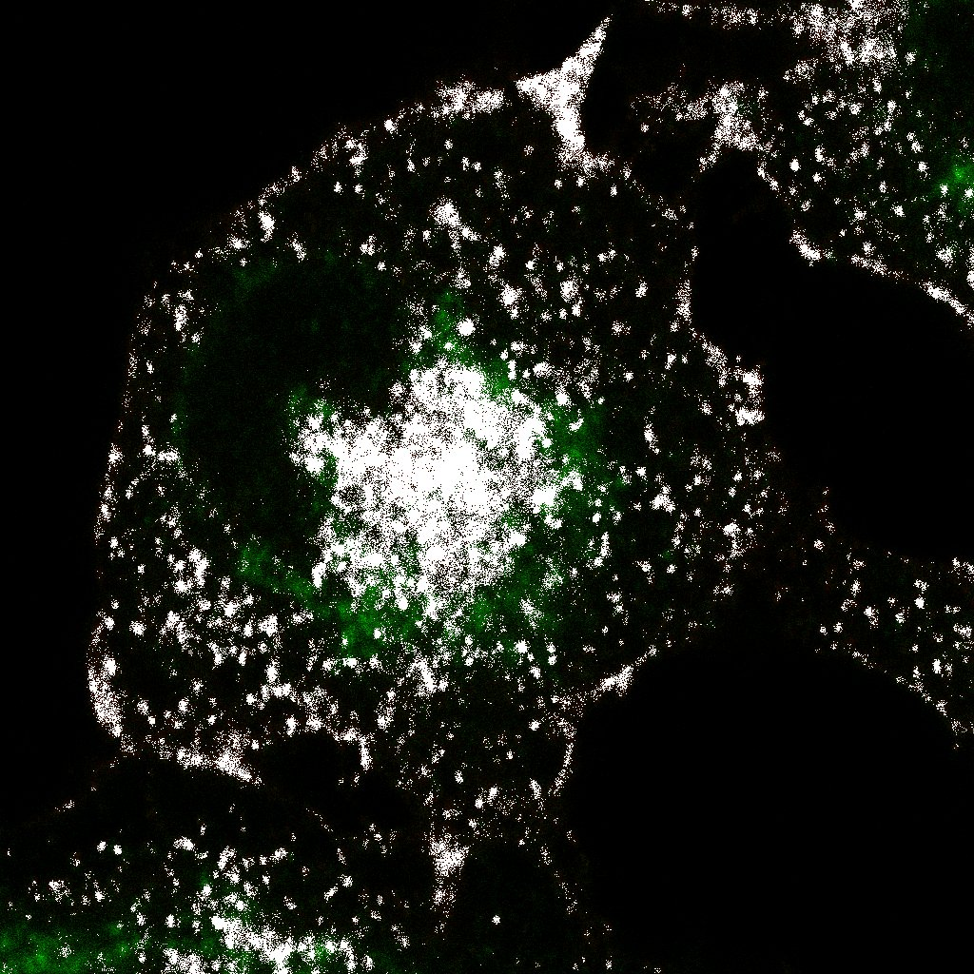
Role of myoferlin in mitochondrial dynamics and metabolic fitness
of pancreas cancer
S. Anania, G. Rademaker, T. Wissocq, A. Bellahcène, V. Castronovo, O. Peulen
Metastasis Research Laboratory, ULiege
Introduction
Pancreatic cancer is the 7th most common cause of cancer mortality in the world. It is predicted to become the second leading cause of cancer-related death in 2030. Myoferlin is a 230 kDa protein overexpressed in pancreatic cancer. Recently, our team showed a fragmentation of the mitochondrial network in PDAC cells when myoferlin was depleted using siRNA. Understanding the mechanism underlying this mitochondrial disruption would be of great interest as mitochondria are major actors in cancer development, progression and resistance
Results
A
C
Proximity ligation Assay
Irrelevant siRNA
Myoferlin siRNA
Sp1/Glut 1
Myof/Mito
(1)
(2)
Figure C: Proximity ligation assay (PLA) in PANC-1 cells. (1) Biological control. Sp1, a transcriptional factor, and Glut1, a glucose transporter, are known to be non-interacting proteins. (2) Myoferlin and mitochondria PLA. (3) MFN and myoferlin PLA performed in cells targeted with irrelevant siRNA (4) MFN and myoferlin PLA performed in cells transfected with siRNA targeting myoferlin.
Panc-1, mitochondrial TMRE staining
MFN/Myof GL3
MFN/Myof siRNA
(3)
(4)
B
Immunofluorescence
Myoferlin
Mitochondria
Colocalization
Myoferlin Sigma; MFN Abcam
(1)
Dilution: 1/75
D
Co-Immunoprecipitation
IgG
IgG
IgG
Extract
Myoferlin
MFN
Colocalization
Extract
Extract
Lysat
Lysat
(2)
(1)
(2)
Myoferlin
(3)
Myoferlin Sigma; MFN Abcam
MFN
Myoferlin Sigma;
MFN santa-Cruz
Myoferlin Sigma;
MFN Abcam
Figure B: Immunofluorescence in PANC-1 cells. (1) and (2) myoferlin-mitochondria and myoferlin-MFN colocalization map (3) Percentage of pixel colocalizing between myoferlin- mitochondria and myoferlin-MFN using Menders coefficients
Figure D : Immunoprecipitation of MFN in PANC-1 cells using (1) Santa-Cruz antibody and (2) Abcam antibody. Detection of co-immunoprecipitated myoferlin was then performed in both experiments. Lysat: total cell extract; IgG: IgG antibody used for immunoprecipitation; Extract: Protein extract from MFN immunoprecipitation.
Conclusion
Recently, our team showed a mitochondrial fragmentation using siRNA targeting Myoferlin. However, mechanisms underlying this process was still unknown. Our data strongly suggest that myoferlin interacts with MFN. Indeed, if myoferlin is a part of the mitochondrial fusion machinery, its silencing together with an unopposed fission would lead to mitochondrial fragmentation.
Sandy Anania
E-mail: Sandy,Anania@uliege,be

