Slide 1
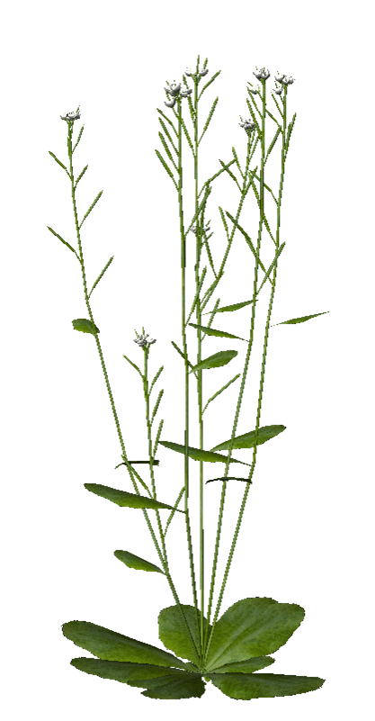
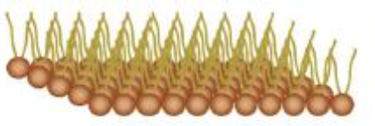
New insight into free phyto-oxylipins roles, a potential for biocontrol agents
Estelle DEBOEVER^{1,2}, Magali Deleu², Laurence Lins² and Marie-Laure Fauconnier ¹
¹ Laboratoire de Chimie Générale et Organique, Gembloux Agro-Bio Tech, Université de Liège, 2, Passage des Déportés, B-5030 Gembloux, Belgique
² Laboratoire de Biophysique Moléculaire aux Interfaces, Gembloux Agro-Bio Tech, Université de Liège, 2, Passage des Déportés, B-5030 Gembloux, Belgique
estelle.deboever@doct.uliege.be
Why free phyto-oxylipins ? In which context ?
PLANT OXYLIPINS
LITTERATURE
RESEARCH QUESTIONS
Fauconnier et al. 2008
In vitro antimicrobial effect = in planta effect ?
Is there any biological activity difference between HPOD/HPOT forms ?
What is the mechanism of action behind ?
Accumulation plant tissues
Exogenous application
In vitro In silico
Granér et al. 2003; Prost et al. 2005
Antimicrobial effect linked to membrane interactions ?
Are there any interactions between pathogen plasma membrane (PM) lipids and 13-HPO ?
Lipid specificity ?
HPOD behavior = HPOT ?
HPOD = antibacterial effect
HPOT = antifungal effect
Defence against Yarrowia lipolytica
Fatty acid hydroperoxides in plants microbes’ interactions: antimicrobial activity and effect on membrane models
1
Biocidal assays
Strong dose effect
Antibacterial properties
Tests on infected plants in progress
2
Biophysical approaches
= POPE:POPG:CL (60:21:11) → mimick the inner membrane of Pseudomonas sp. (Epand et al. 2007)
Lipid monolayer
Langmuir through
Strong affinity
Liposomes = lipid bilayer
Isothermal Titration Calorimetry
13-HPOD >> 13-HPOT
? Outstanding Questions ?
Do HPOs have the same antimicrobial effect in planta?
Are HPOs involved in innate immunity, thus elicitors?
Why are certain HPOs more efficient than others?
Why HPOs attack the pathogen and not the plant?
Laurdan Polarization
13-HPOD >> 13-HPOT

