Slide 1
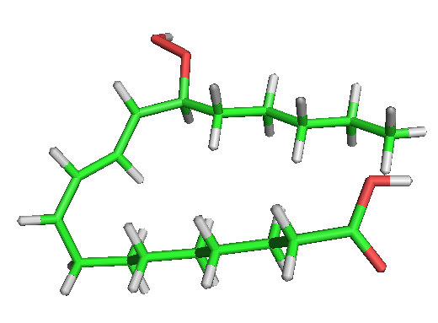
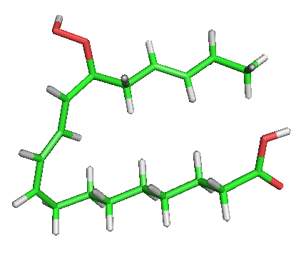
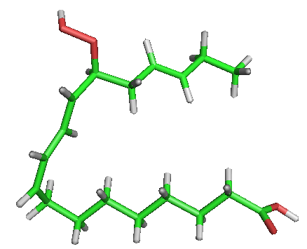
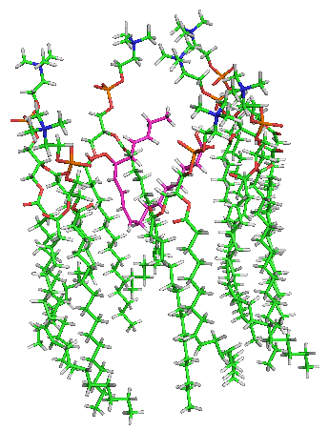
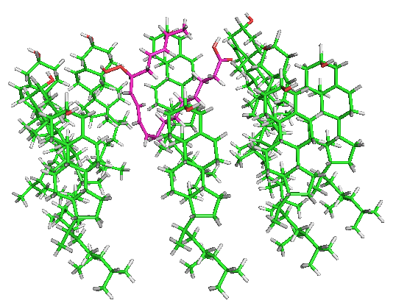
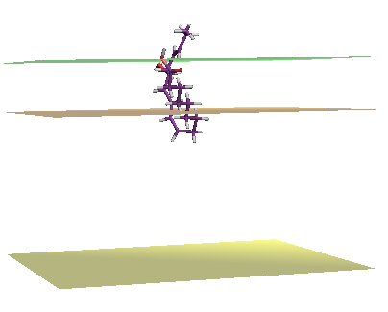
Use of complementary biophysical approaches to study the interactions of fatty acid hydroperoxides with biomimetic plant plasma membranes
E. Deboever, M.N. Nasir, L. Lins, M. Deleu & M-L. Fauconnier
Gembloux Agro-Bio Tech, University of Liège, Passage des déportés, 2, 5030 Gembloux/Belgium
Context and objectives
Biopesticides have emerged as a main alternative to conventional agriculture. Among them, elicitors have proved to be excellent candidates for biological control. They are metabolites produced by microorganisms, pathogenic or not, or plants which are able to trigger the natural resistance of plants. In this context, fatty acid hydroperoxides (FAH), belonging to the oxylipin family produced by plants via the lipoxygenase (LOX) pathway and known as playing a crucial role in the plant defence mechanisms, are promising candidates as exogenous eliciting agents. Some preliminary results have shown their capacity to trigger the production of reactive oxygen species by plant root cells, which is a first evidence of the FAH perception by plant cells in the context of its defensive state.
The molecular mechanism involved in the eliciting activity is far to be completely understood. A crucial step of the eliciting mechanism is the perception of the elicitor molecule by the plant cell. The dogma is that this recognition step involves a proteic receptor at the plasma membrane level. But some amphiphilic elicitors (like surfactin) have been shown to rather interact with the lipid fraction of the plasma membrane (Henry et al., 2011). As FAH have an amphiphilic structure, they are likely to interact with lipid compounds and rather use the second option to activate the defence mechanism of plant.
But up to now, nothing is known about the interaction properties of FAH with lipids mimicking the plant plasma membrane (PPM). This is the objective of our present study. Our strategy was to use complementary biophysical tools to characterize the interactions in terms of lipid specificity and in relationships with the structure of FAH. Two FAH, differing only by the number of unsaturation, were studied.
Determination of 3D structures of FAH
Most probable chemical structures of the FAH were determined using the STRUCTURE TREE procedure according to the molecule potential energy.
13-HPOD
13-HPOT_1
13-HPOT_2
Ability to insert within the membrane
The ability of the FAH structures to insert within the PPM was assessed using IMPALA simulations. IMPALA uses a membrane model where lipids are implicitly modelled by an empirical function and the membrane properties are modelled by energetic restraints. Results show that all 13-forms are able to insert within the membrane.
Affinity with membrane lipids
The ability of each FAH structure to form an assembly with several PPM constituents (phospholipids (PLPC), sterols (sitosterol) and sphingolipids (GluCer)) was calculated using the HYPERMATRIX procedure, which calculate and minimize the energies of interaction between all molecules of the complex until the lowest energy structure is reached. Interactions of FAH with sitosterol are not favourable. Instead, FAH have a high affinity for PLPC and GluCer.
13-HPOT_2
13-HPOT_2/PLPC
13-HPOT_2/sitosterol
Interactions with lipid monolayers
Glucosylceramide monolayer
PLPC/Glucosylceramide (80/20) monolayer
Functional groups involved in the interactions
The adsorption behaviour into lipid monolayers of different composition was measured using the Langmuir through technique.
Both molecules are suggested to be able to penetrate natural PPM (MIP > 30 mN/m). 13-HPOT shows globally a greater penetration than 13-HPOD (higher MIP and synergy factor).
Results showed that both hydrophilic and hydrophobic parts of PLPC interact with FAH. The presence of glucosylceramide may also modify these interactions, especially with the 13-HPOT.
Take Home Notes
Conclusion
Acyl-hydroperoxides, known as core molecules in the LOX pathway, are able to interact with certain functional groups of representative lipids of the PPM. 13–HPOT seems to have a greater affinity with the lipid systems studied, despite the subtle structural difference. These molecules may be good candidates as biopesticide, if their elicitor activity is further confirmed and related to their membrane activity.
Perspectives
Recent results have demonstrated the character of antimicrobial agents and elicitors of FAH. This being encouraging for their application as biopesticides
Acknowledgements
Estelle Deboever is supported by a grant from the Formation à la Recherche dans l’Industrie et l’Agriculture (FRIA). M. Deleu and L. Lins thank the F.R.S.-F.N.R.S. for their positions as Senior Research Associates. For further information, please contact : estelle.deboever@doct.ulg.ac.be

