Slide 1
Global AMS R&D Online Showcase

Slide 2
Introduction
Françoise Lessire – Isabelle Dufrasne
University of Liège
Researcher
Belgium

Slide 3
Robotic milking : some figures
General info and stats:
The first AMS were installed in 2000 in Wallonia
In Wallonia, 400 -500 farms are equipped with a AMS (2886 dairy farms in Wallonia = 17% farms equipped
One new milking installation on 2 is a AMS (2018)
Typical farm that has adopted robots?
farm system: dairy farms - 1 farmer, herd size: 65-75 cows => 120 cows 2-3 robots => association father/sons or brothers
10% of robotic farms keep on grazing
Two main brands: Lely and Delaval
The cow traffic is free or forced depending on the brand of the AMS
Production level : from medium (annual milk yield = 7000 kg) to high (>10 000 kg) depending on the production targets of the farmer

Slide 4
Adoption of AMS in Wallonia
Key drivers:
Typically farmer who wishes more free time (flexible working hours)
Difficulty to find manpower for milking (salary fees – competences –reliability)
Large herds
Key challenges:
Combining AMS and grazing
Adaptation of a second (third) AMS in the stable
AMS and large herds

Slide 5
Key AMS R&D projects
Autograssmilk project
AMS and grazing
Experimental site
Pilot farms

Slide 6
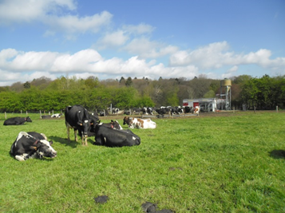
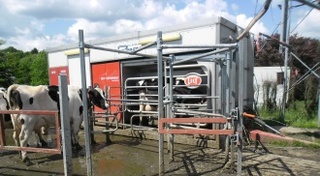
Key AMS R&D projects
Combining grazing and AMS
45-50 cows on average - Prim’Holstein
Annual milk yield: 6,900 kg/cow – 24 ha pastures
From mid april till end october, the feeding relies on 85% grazed grass

Slide 7
Development of a prototype of mobile AMS

Slide 8
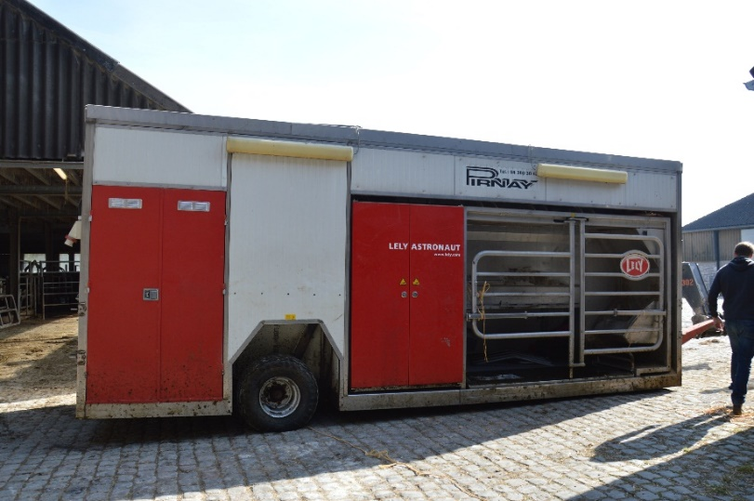
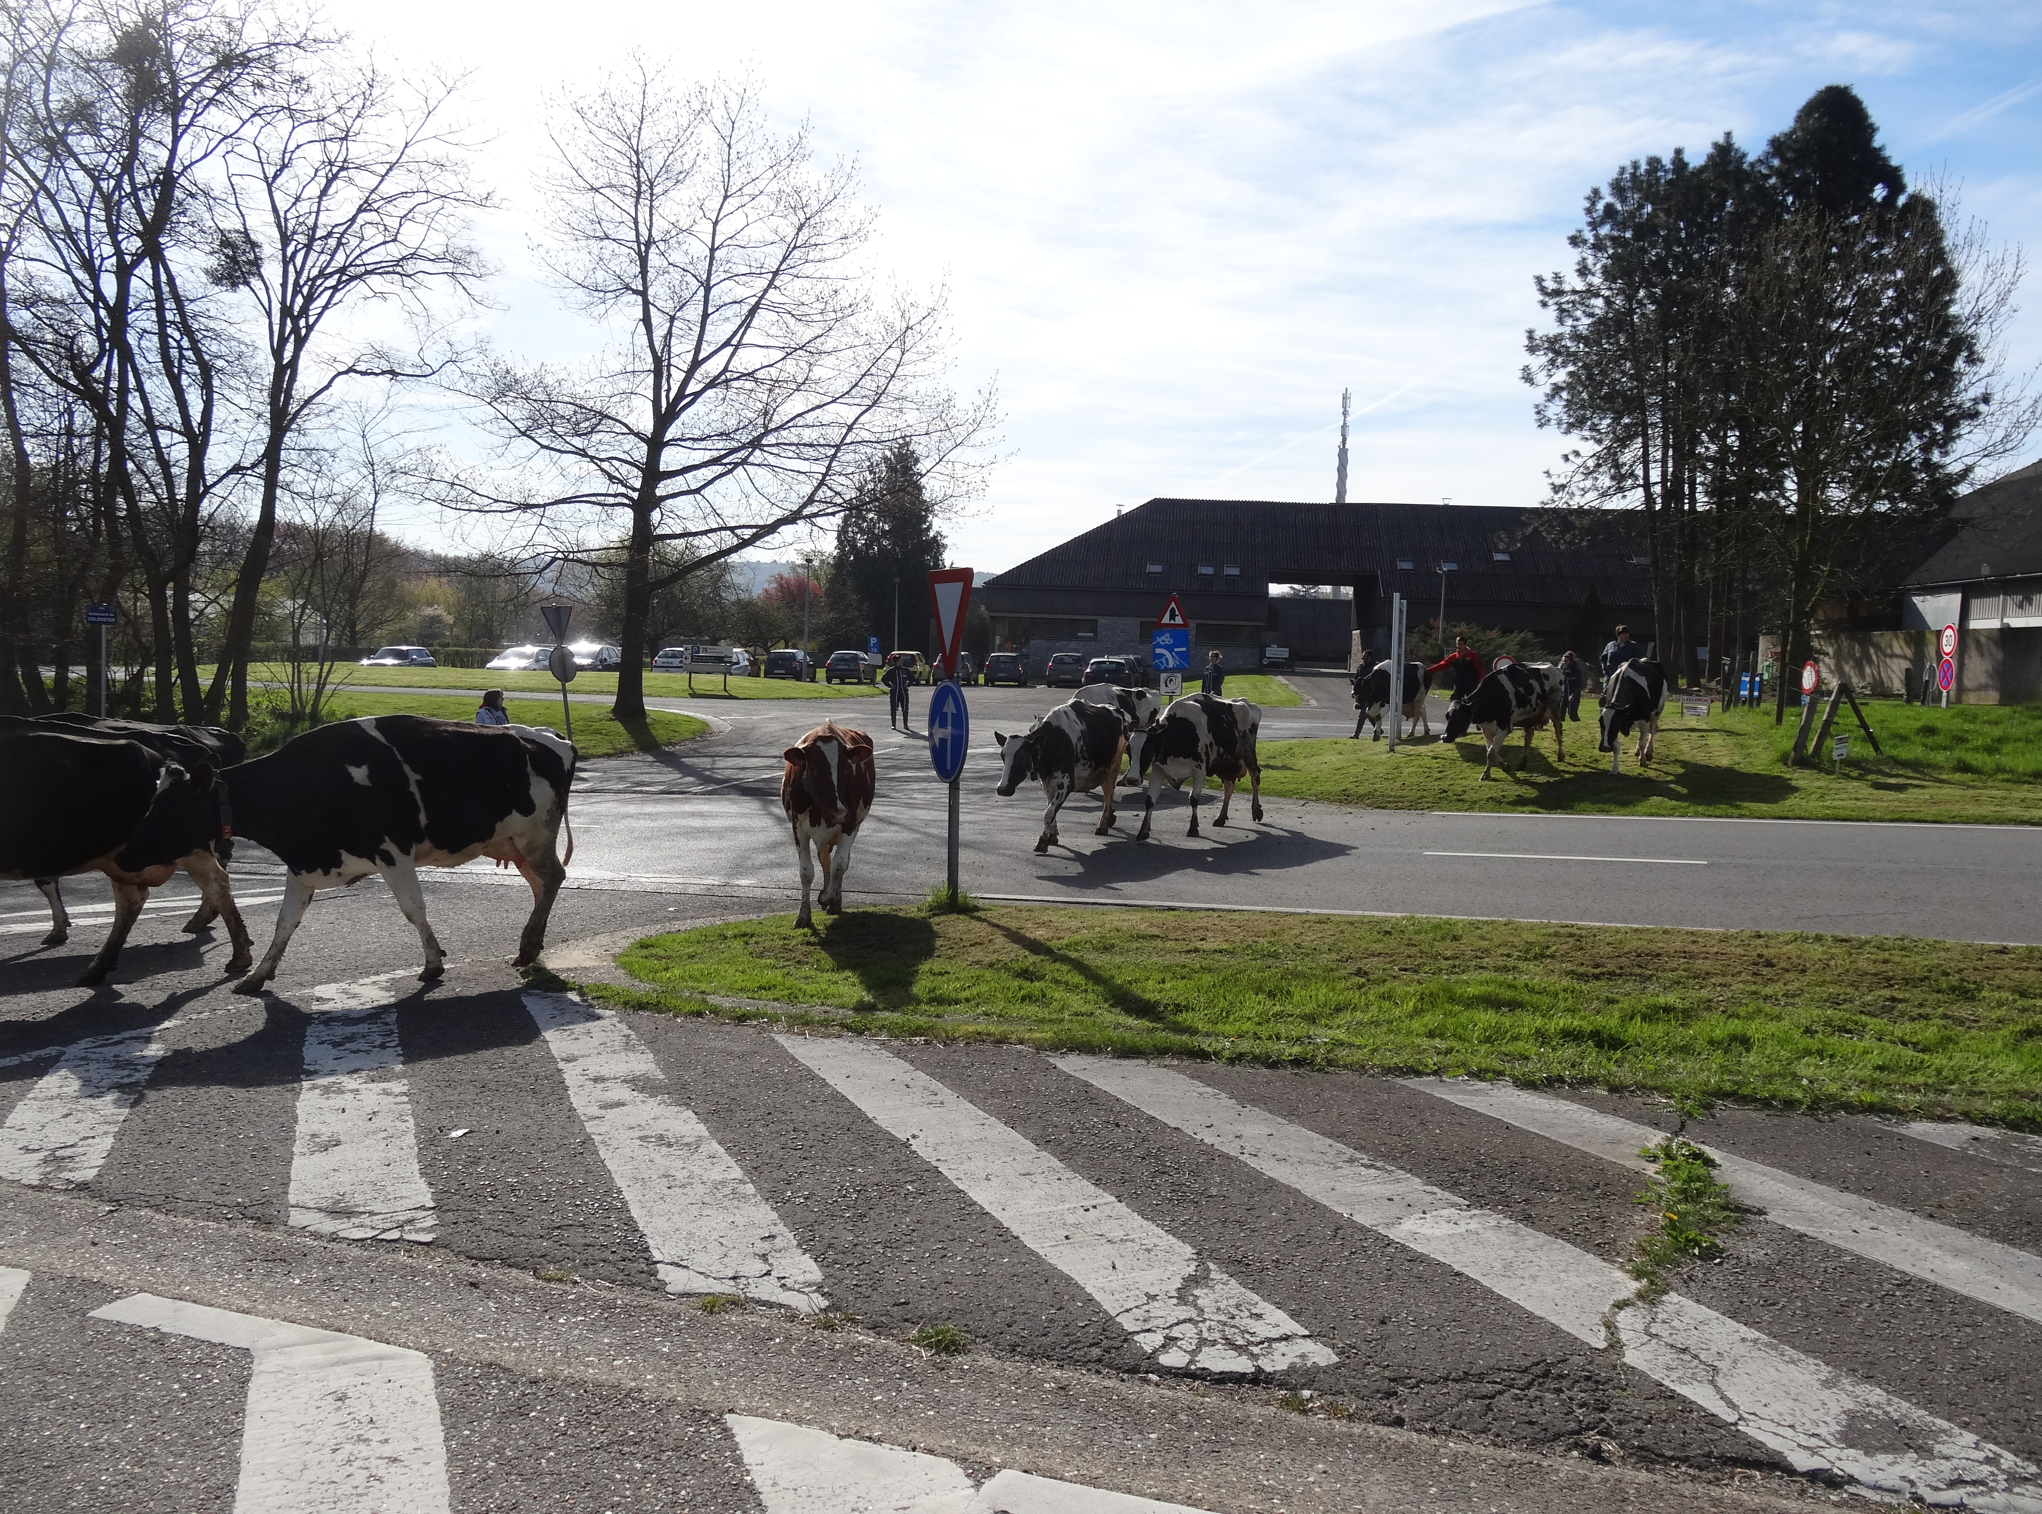
Moving the robot
 | Uliège
Distance barn– pastures | 100 m high traffic road
Time necessary for all the transfer | 15 h (4 people)
Transfer | Cows, robot, milk tank
Time without milking | 4 h

Slide 9
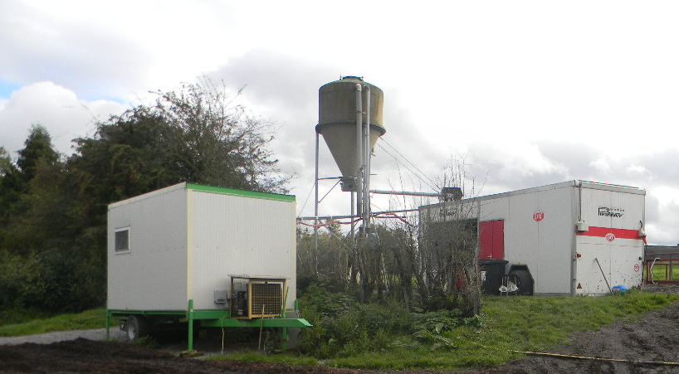
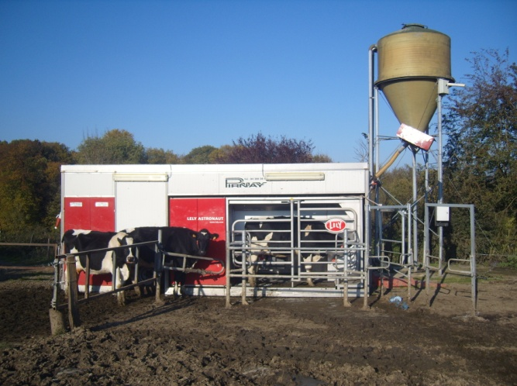
Mobile AMS: Layout of the milking area
Flexible tank
20 m³
80 m² slatted floor
Water trough 1000L

Slide 10
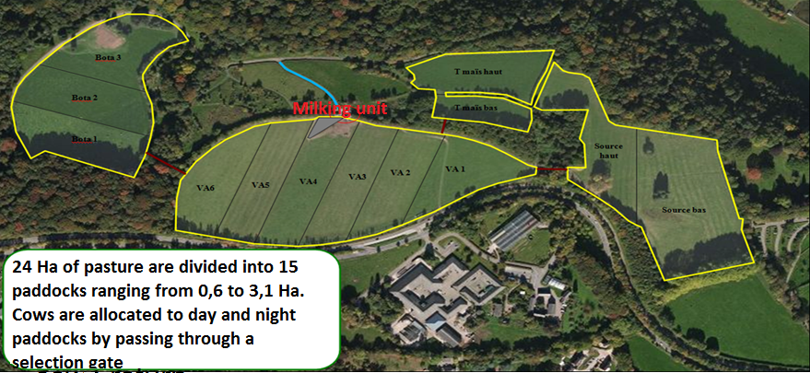
Grazing management
Strip grazing
Use of a rising
platemeter
In/out grass height

Slide 11
Low concentrates vs high concentrates Influence on traffic – milk yield
Herd divided in 2 groups
Follow-ups on 123 days
 | Low concentrate (LC) | High concentrate (HC)
Nbr cows | 15 | 14
Primiparous | 7 | 5
LN | 2.0 ± 1.3 | 2.4 ± 1.9
DIM* | 97 ± 63 | 94 ± 41
Concentrates (kg) | 2.1 | 4.1
* Days in milk at the beginning of the assay ; MY of the herd : 22.9 kg/cow/d 24/4/2013
Lessire, F., Froidmont, E., Shortall, J., Hornick, J. L., & Dufrasne, I. (2017). The effect of concentrate allocation on traffic and milk production of pasture-based cows milked by an automatic milking system. Animal, 1–9. https://doi.org/10.1017/S1751731117000659
Notes:
© SERVE Project, 2008
11

Slide 12
Low concentrates (LC) vs high concentrates (HC)
Results
 | LC | HC | Significance
Milk yield (kg/cow/d) | 21.33 ± 0.22 | 22.39 ± 0.22 | ***
Milking frequency (/cow/d) | 2.35 ± 0.02 | 2.37 ± 0.02 | ns
Returns = Milkings + failures + Refusals | 3.10 ± 0.07 | 3.60 ± 0.07 | ***
Increase in MY on average = 1,07 kg milk/cow/d
Milk response: 0,57 kg milk /kg concentrate : LOWER than in other studies
During May: inverse! High WSC

Slide 13
Low concentrates (LC) vs high concentrates (HC)
Results
 | LC | HC | Significance
At low grass availability
Milking frequency (/cow/d) | 2,42 ± 0,07 | 2,39 ± 0,07 | ns
Returns = Milkings + failures + Refusals | 3,38 ± 0,17 | 3,82 ± 0,17 | ***
Motivation : not only concentrate + grass availability

Slide 14
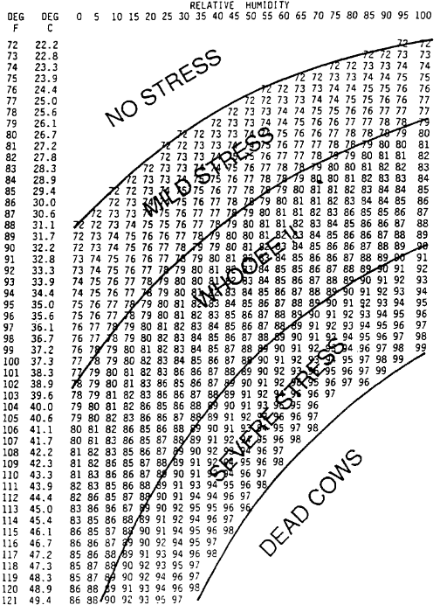
THI and mobile AMS
THI = thermal humidity index.
Determination
post hoc mild heat stress periods
Effect of heat stress
on traffic/ performance of cows
Lessire, F., Hornick, J. L., Minet, J., Dufrasne, I. (2015) Rumination time, milk yield, milking frequency of grazing dairy
cows milked by a mobile automatic system during mild heat stress [Rumination time,
milk yield, milking frequency of grazing dairy cows milked by a mobile automatic system during mild heat stress].
Advances in Animal Biosciences, 6(01):12-14.

Slide 15
Material and Methods
Measurements post hoc in July and August
HS: 4 consecutive days in July –7 days in August
THI ≥ 72 - mean T°C ≥ 23.1°C
Normal: 9 consecutive days in July and in August
THI < 68 – mean T°C =16.3°C
Herd = 45 dairy cows in July – 47 in August
Concentrates: 1.9 kg/cow/d N – 2 kg/cow/d HS
Grass intake: 14 kgDM/cow/d
THI = temperature umidity index.

Slide 16
Material and Methods
 | Temperature (°C) | THI | Distance (m) | Days in milk | Lactation number
Normal | 16.3 ± 0.9 | 60.8 ± 1.4 | 190.5 ± 79.1 | 183.5 ± 89.4 | 2.83 ± 1.78
Heat stress | 23.1 ± 2.3 | 70.5 ± 2.9 | 187.8 ± 40.6 | 182.9 ± 89.5 | 2.84 ± 1.77
P value | <0.0001 | <0.0001 | 0.82 | 0.66 | 0.42
THI = temperature humidity index.

Slide 17
Results
 | Milking frequency (/cow/d) | Milking visits (/cow/d) | Milk yield (/cow/d) | Rumination (minutes) | Milk F/P
Normal | 1.97 ± 0.04 | 2.69 ± 0.09 | 18.5 ± 0.3 | 418.9 ± 8.7 | 1.23 ± 0.01
Heat stress | 2.12 ± 0.04 | 2.99 ± 0.09 | 19.7 ± 0.4 | 339.2 ± 9.5 | 1.17 ± 0.01
P value | <0.01 | <0.05 | <0.01 | <0.001 | <0.10

Slide 18
Discussion
Higher MF – Higher visits to the AMS during HS
Higher MY during HS periods
More visits to AMS = > More opportunity to drink
Lower rumination time during HS with slight impact on F/P
Observations to be confirmed during longer periods
Ruminal function: to be investigated => One of the study lead in 2019

Slide 19
Large herds, AMS and grazing
size of herds
Automation of
agriculture
grazing
Why stop grazing?
47% of farmers report they stop grazing because of
difficulties in management (Survey Life Dairyclim 2016-2019)
Follow up 2 large herds
From 2013 to 2014: zootechnical performances?
From 2013 to 2015: economic performance

Slide 20
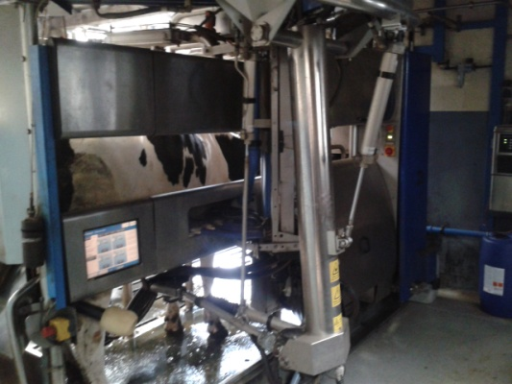
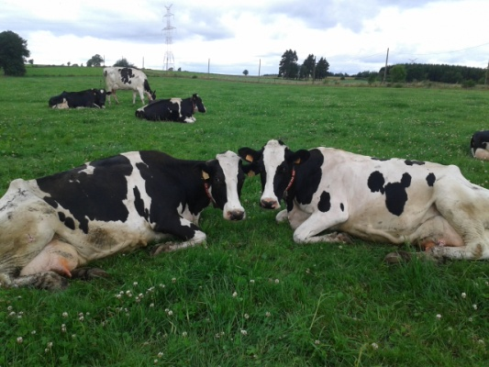
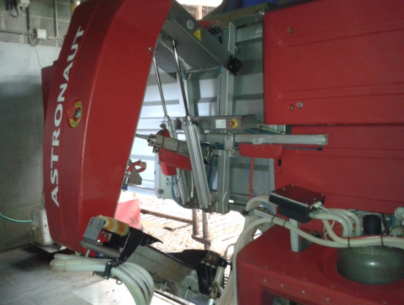
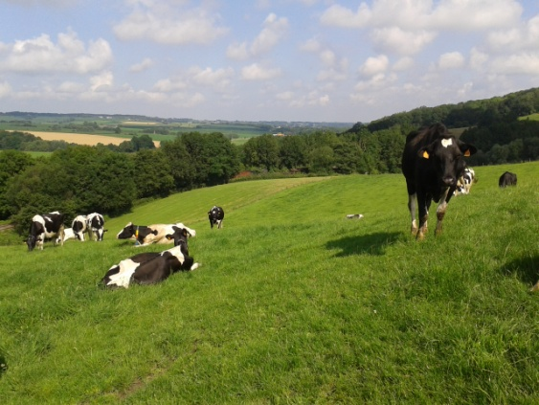
The experience of two Belgian dairy farms
Follow ups in 2013 -2015
Herd | 1 | 2
Working unit | 1 | 2.5
Nb cows | 110 | 155
Total annual MY (kg/farm) | 1 025 000 | 1 217 000
Pastures (ha) | 36 | 42
Nb paddocks | 9 (2-4 ha) | 22 (1.9 ha)
Distance max to AMS | 0.7 km | 1.5 km
Pasture management | rotational | rotational + strip
 | 2.5 days/paddock | Strip moved every day

Slide 21
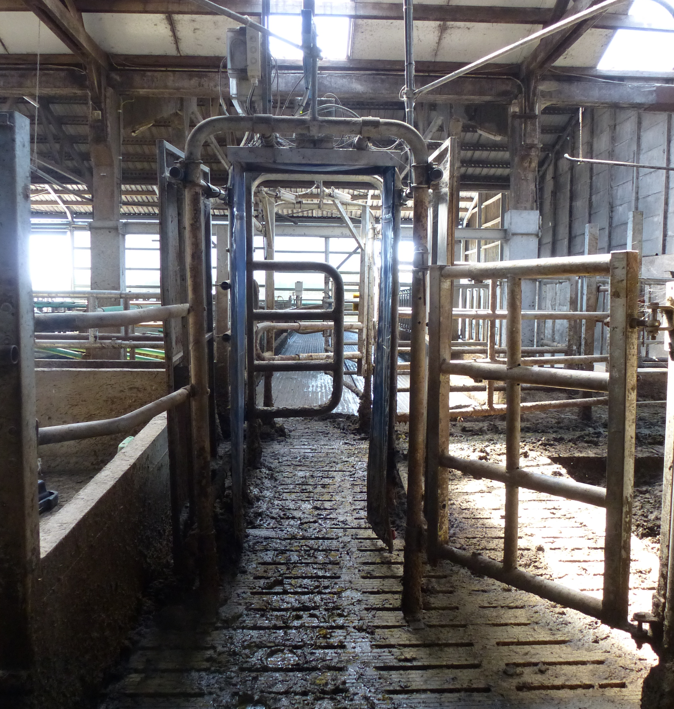
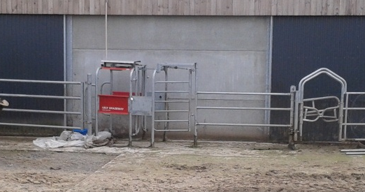
Material and Methods
During the grazing period:
Only milked cows are allowed to go to pastures (smart gates)
Cows stayed on pastures from 6 AM till 6 PM on average.
At 6 PM, the cows came back to receive a partial mixed ration (PMR)

Slide 22
Grazing management
Farm 1
Farm 2
Grazing period : 184 d in 2013 – 192 d in 2014
36 ha pastures
9 paddocks in rotationnal system
Grazing period : 216 d in 2013-2014
42 ha pastures - strip grazing

Slide 23
Results

Slide 24
Results

Slide 25
Results The experience of two Belgian dairy farms Follow-ups on 3 years
Calculation of the %
of grazed grass in cows’ ration
Herd 1 : 34% - over 3 years
Herd 2 : 33% - over 3 years

Slide 26
Results The experience of two Belgian dairy farms Follow-ups on 3 years Zootechnical performance
 | Herd 1 |  |  | Herd 2
 | Winter | Summer |  | Winter | Summer
MY (kg/cow/d | 30.0 ± 1.1 | 29.0 ± 1.6 | ns | 26.7 ± 1.1 | 26.9 ± 1.6 | *
F% | 4.07 ± 0.06 | 3.90 ± 0.13 | *** | 4.31 ± 0.09 | 4.08 ± 0.14 | ***
P% | 3.41 ± 0.11 | 3.33 ± 0.09 | *** | 3.51 ± 0.09 | 3.44 ± 0.10 | ***
Urea (mg/l) | 224 ± 44 | 219 ± 44 | ns | 218 ± 36 | 224 ± 39 | ns
Milking frequency (/cow/d) | 2.6 ± 0.1 | 2.4 ± 0.1 | *** | 2.6 ± 0.1 | 2.5 ± 0.1 | ***
Concentrates | 3.9 ± 0.5 | 3.5 ± 0.4 | *** | 3.0 ± 0.4 | 3.1 ± 0.4 | ns

Slide 27
Results The experience of two Belgian dairy farms Follow-ups on 3 years: effect on feeding costs
Comparison of feeding costs in winter vs summer

Slide 28
Discussion - conclusion
PMR quantities were continuously adapted following grass availablity
Incorporation of around 30% of grazed grass allowed to
Keep a high level of production
Decrease feeding costs
Keys of success:
Adaptation of PMR to grass supply

Slide 29
Key AMS R&D projects
Key things you thing need to be explored or would like to explore moving forward
In the context of climate change, we are more concerned about grazing management.
Effect of heat stress on a more extended period
Impact of MF on milk yield

Slide 30
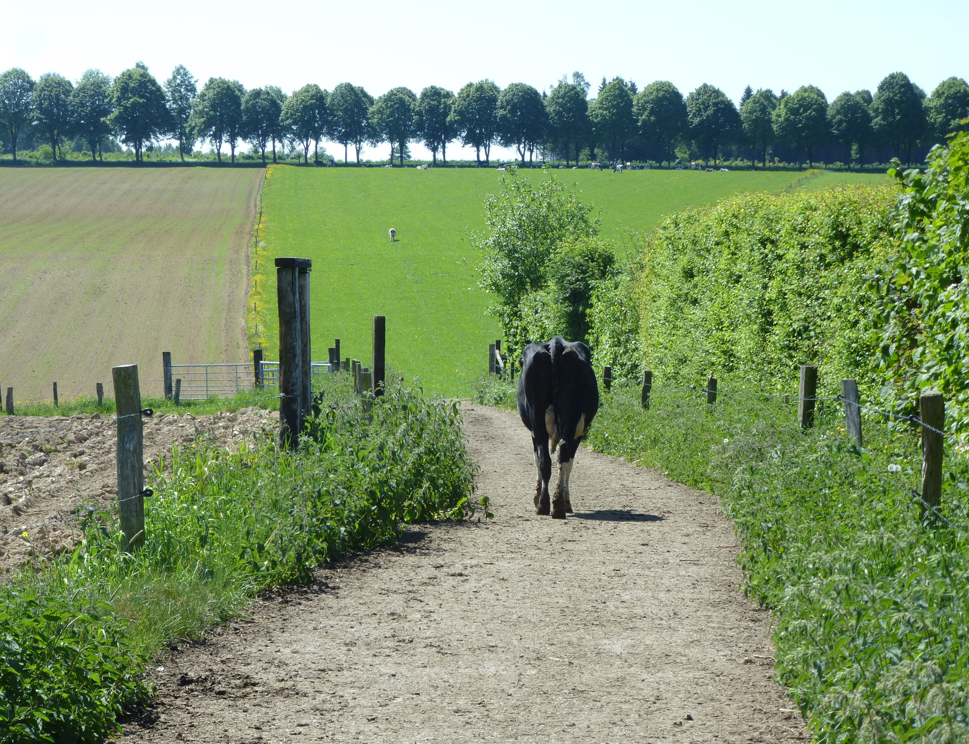
Thank you for your attention
Thank you for your attention

