Slide 1
Ionosphere Monitoring using Dual Frequency Smartphones
René Warnant*, Céline Remy*, Mathilde Debelle*, Gilles Wautelet⁺
*University of Liege-Geodesy and GNSS
⁺University of Liege - LPAP
4th Raw GNSS Measurement Workshop, GSA, 28 May 2020.

Slide 2
GNSS-Based Ionosphere Monitoring
The Geometry-free combination of GNSS dual frequency measurements makes it possible to monitor the ionospheric activity.
Absolute Total Electron Content (2-3 TECU)
Mitigation of the ionospheric error on absolute positioning
Ionosphere modelling
Rate of Total Electron Content (TEC) change (<=0,1 TECU/min)
Small-scale structures in TEC (Travelling Ionospheric Disturbances, scintillation monitoring)
Mitigation of ionospheric error on relative/differential positioning.
Tsunami early detection
Could Smartphone Raw GNSS Measurements give a useful contribution to this type of study ?

Slide 3
Smartphones versus Geodetic receivers
Smartphone disadvantages
Code and phase observable are less precise
Very strong multipath on code observables
Frequent cycle slips
Smartphone advantages
Availability of a large number of Smartphones (much denser information)
Cheap devices

Slide 4
Methodology
TEC from geodetic receivers as reference.
We identify the different steps of the data processing which could be affected by specific smartphone data characteristics.
Cycle slips
Many more cycle slips.
Not easy to detect with combined code/phase combinations (Widelane-narrowlane)
Geometry-free phase ambiguity computation (Absolute TEC)
Cycle slips ➔ additional ambiguities.
Comparison Smartphone Absolute TEC accuracy/precision wrt Geodetic Absolute TEC
Detection of small-scale structures
Can be detected out of the observation noise in Rate of TEC ?
For all the tests, elevation mask = 10°

Slide 5
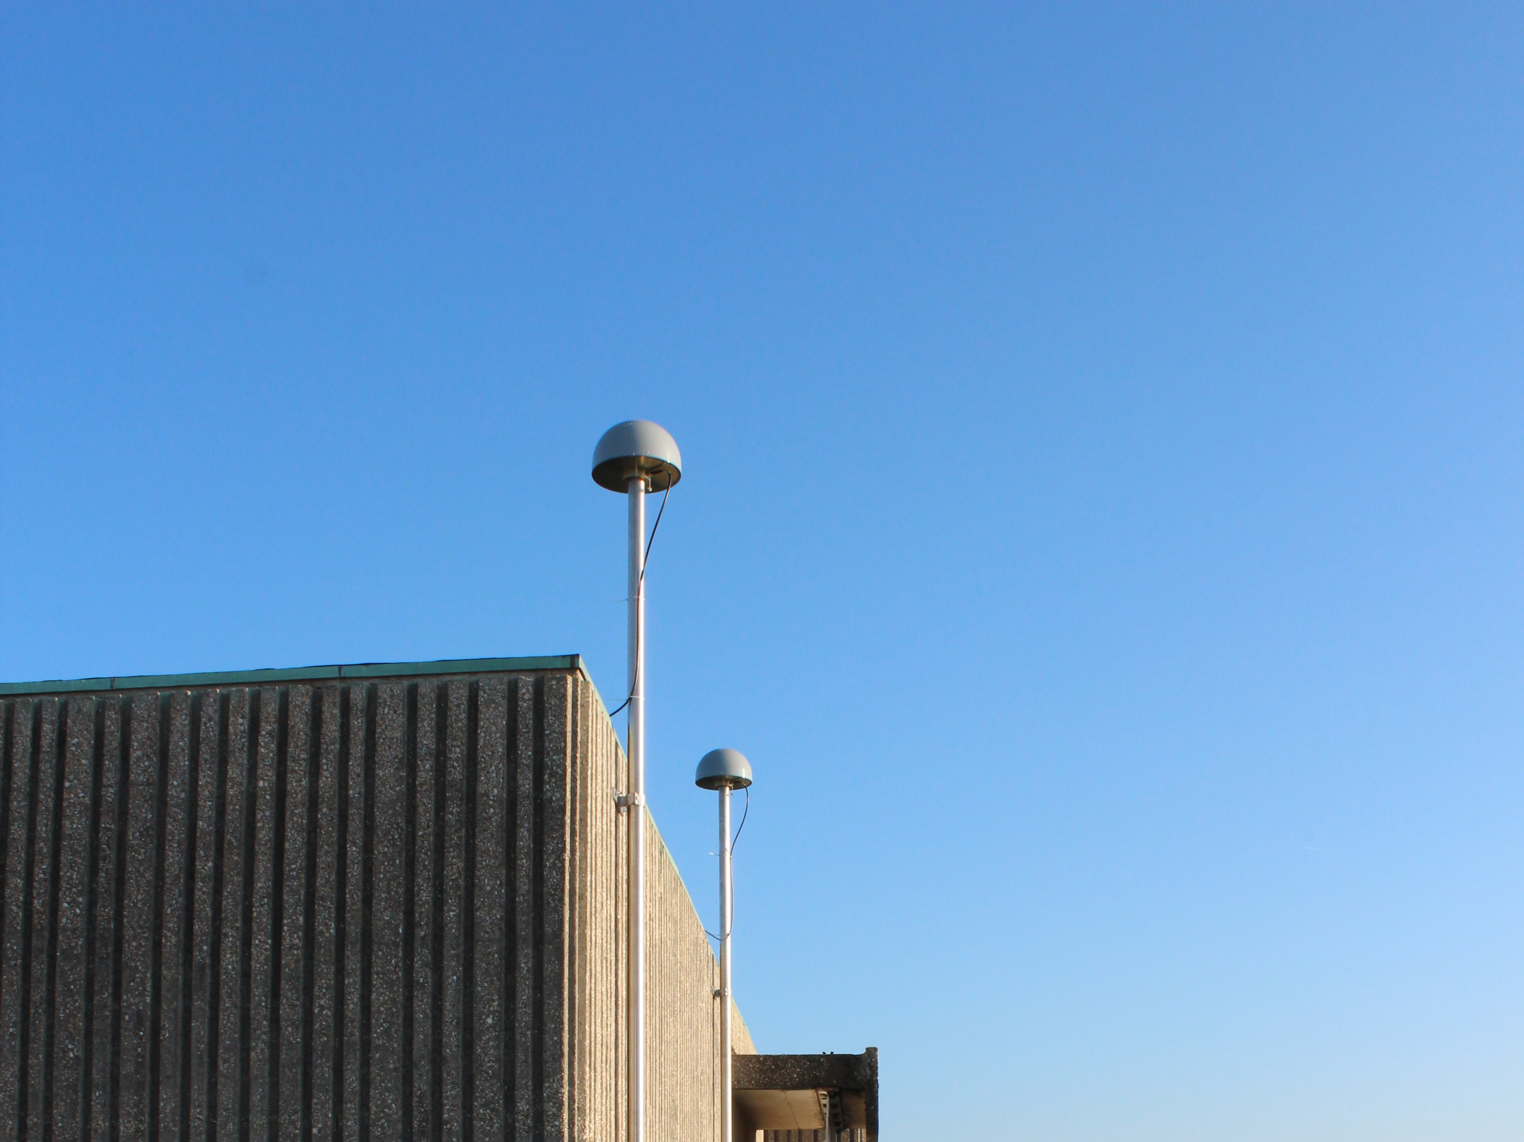
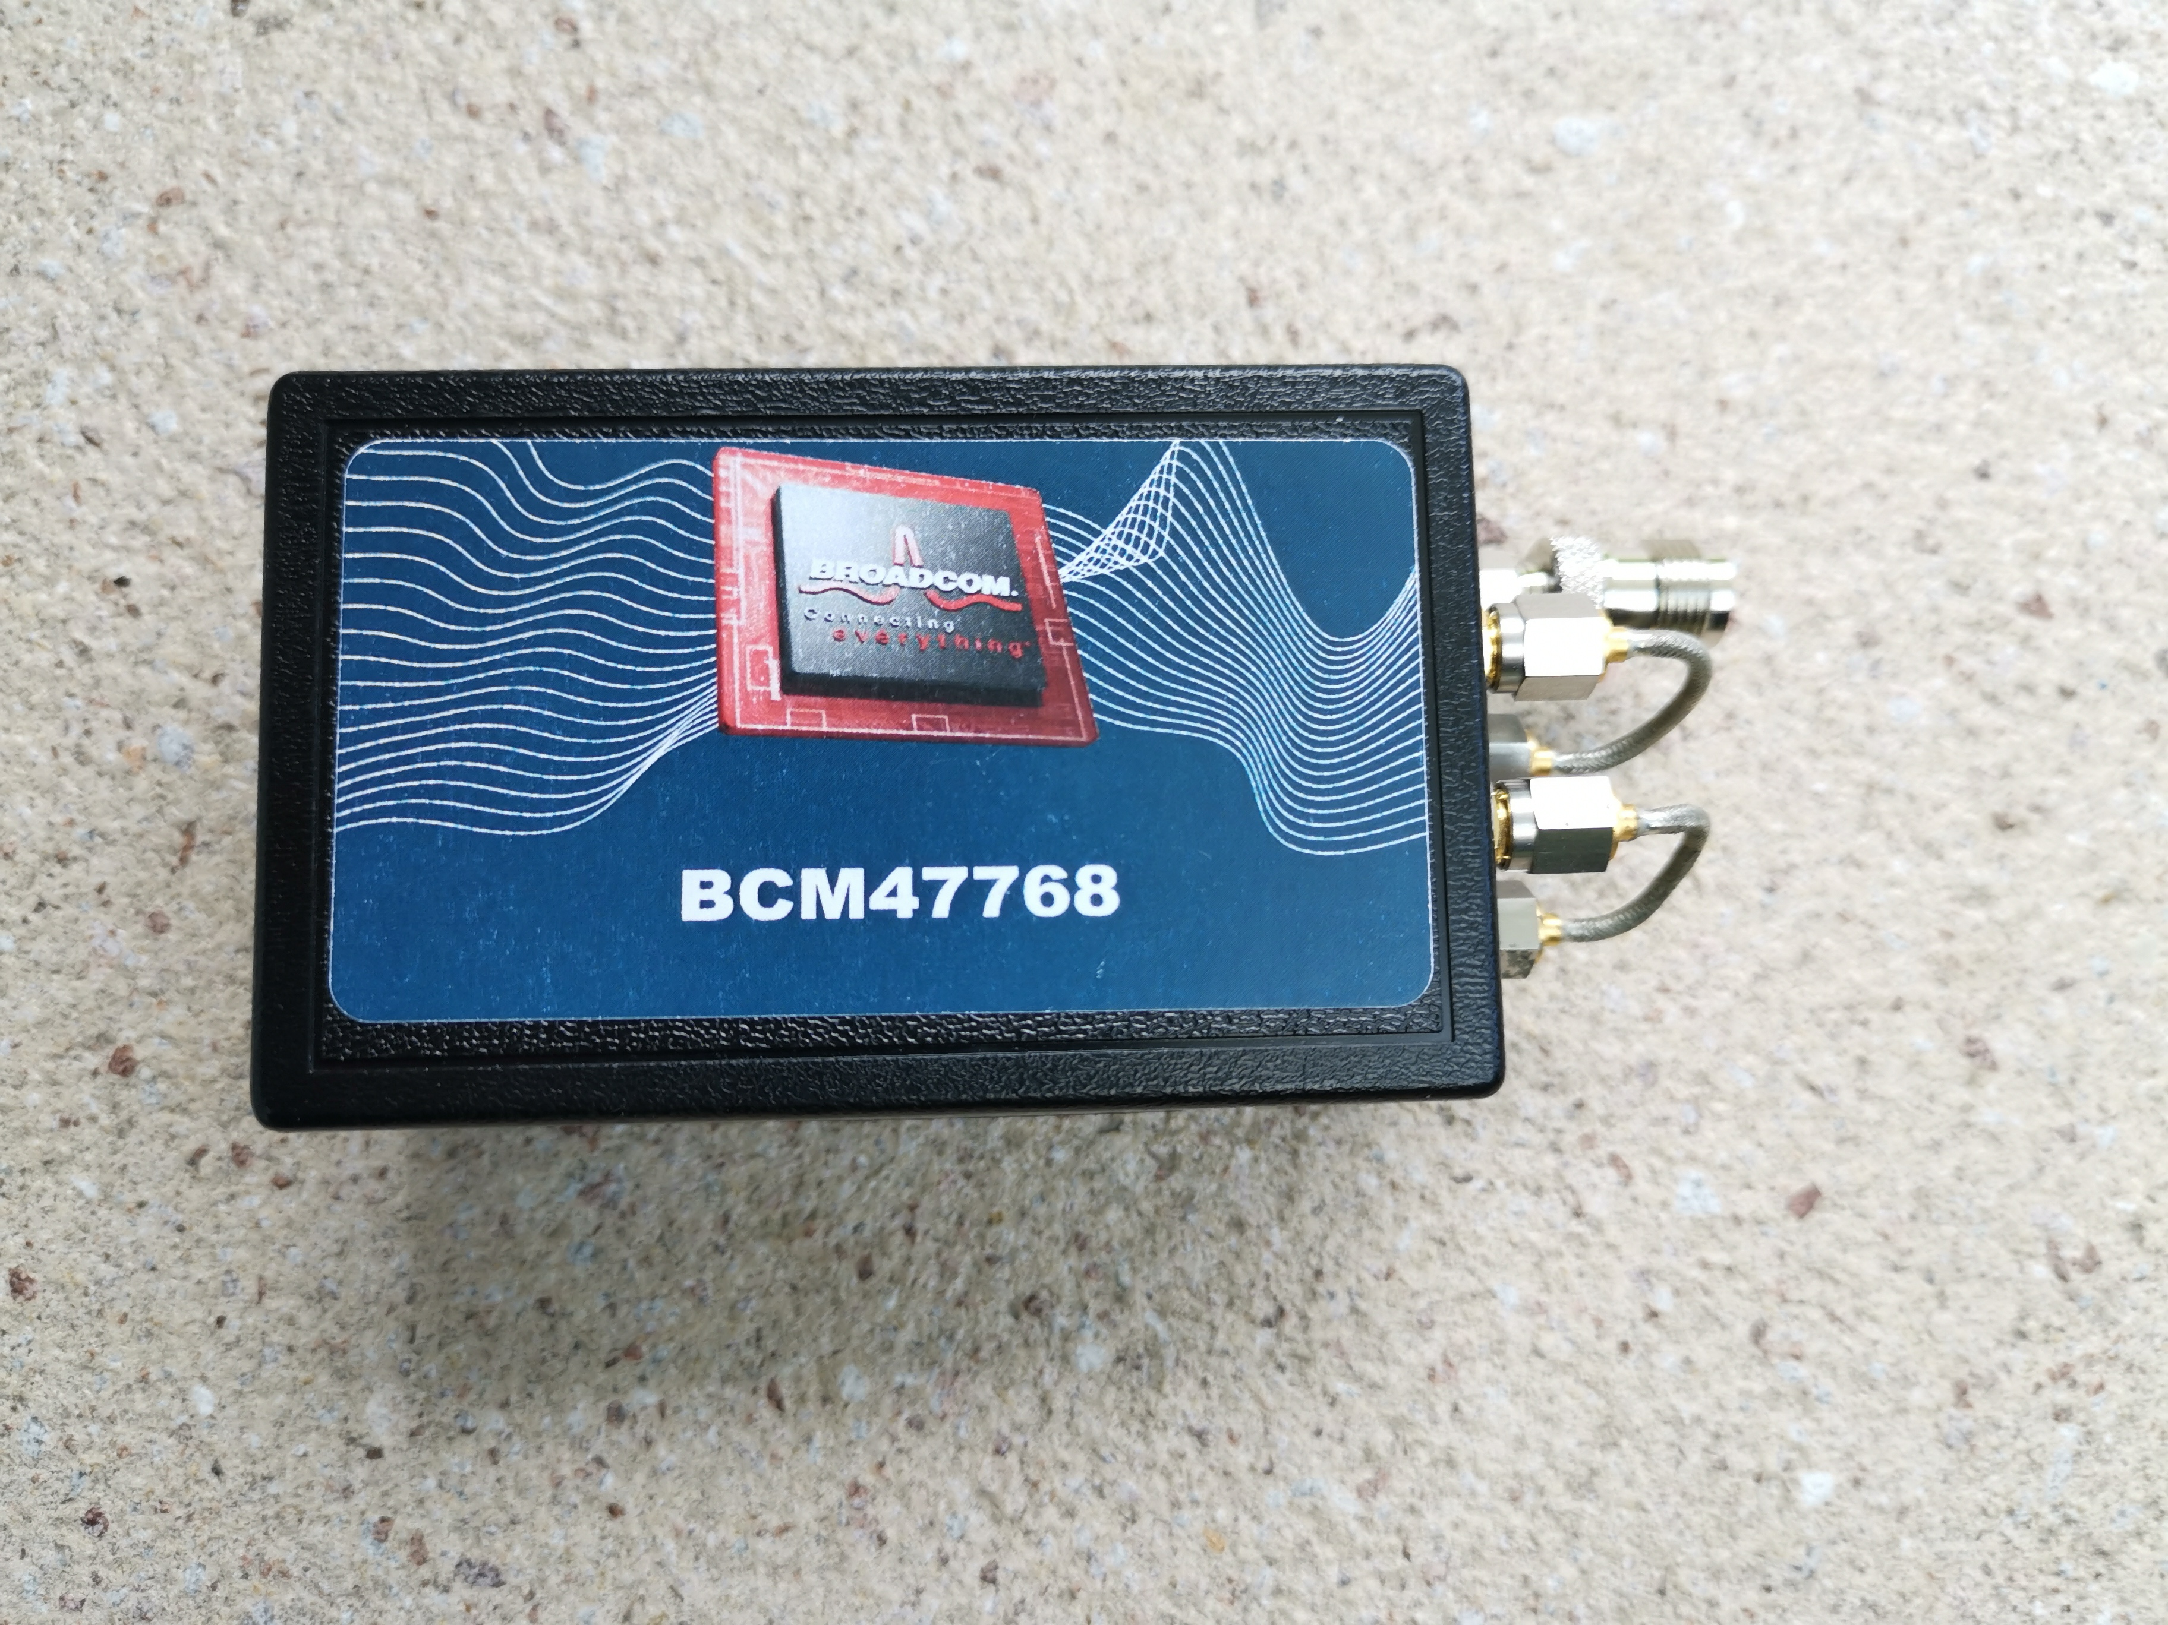
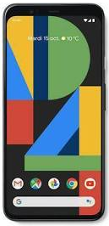
GNSS equipment
X400: Septentrio PolaRx4 (ULG0)
BCM: Broadcom BCM47765 Evk
Dual frequency GPS (L1/L5), Galileo (E1/E5a) and Beidou 3 (B1-2/B2a).
Directly connected to a geodetic antenna (ULG1).
PIX4: Google Pixel 4 XL
Qualcomm Snapdragon 855 chipset.
Dual frequency GPS (L1/L5), Galileo (E1/E5a).
Connected to a geodetic antenna through a shielded box (ULG1).
ULG0
ULG1

Slide 6
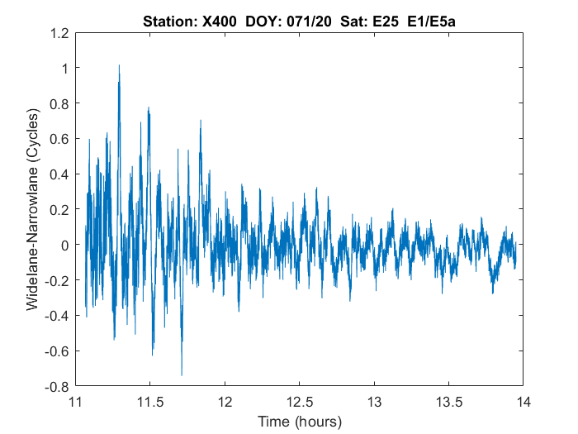
Cycle Slips : X400
Detection based on Widelane-Narrowlane combination (uses codes !)
X400 (Geodetic) :
CS >= 1-2 cycles can be easily detected but they are very rare (<1/day).

Slide 7
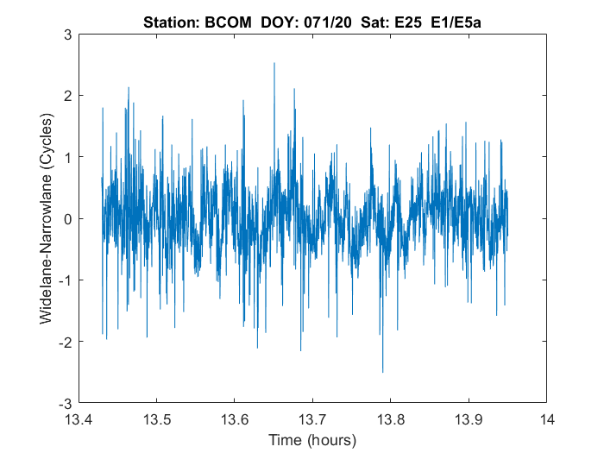
Cycle Slips : BCOM
BCOM :
CS >=1-5 cycles (GPS) or >=2-7 cycles (Galileo) can be detected
There many (large) cycle slips which can usually be detected by WLNL.

Slide 8
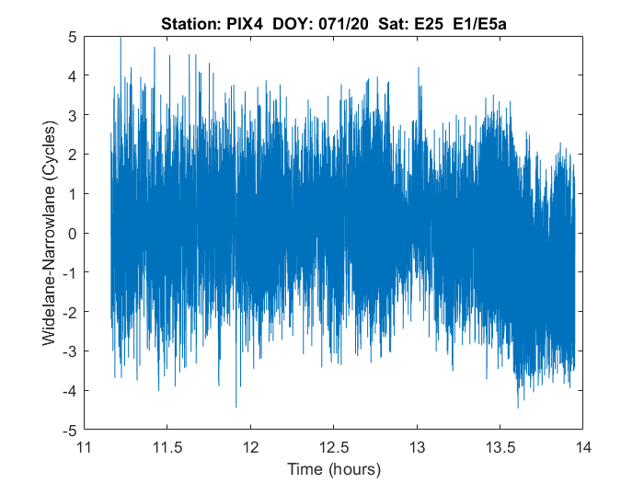
Cycle Slips : PIX4
PIX4
CS >=5-9 cycles (GPS) or >=3-9 cycles (Galileo) can be detected.
Not as many CS observed but they are small and difficult to detect using WLNL
Can be detected using the Geometry-free combination in a second step

Slide 9
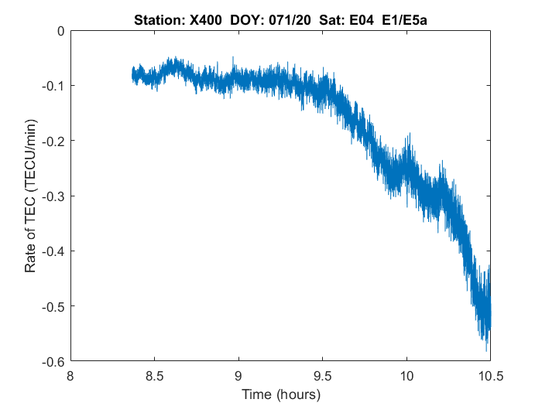
TEC rate of change : X400
Small-scale structures can be detected based on Rate of TEC Change.
TEC rate of change precision <= 0,1 TECU/min

Slide 10
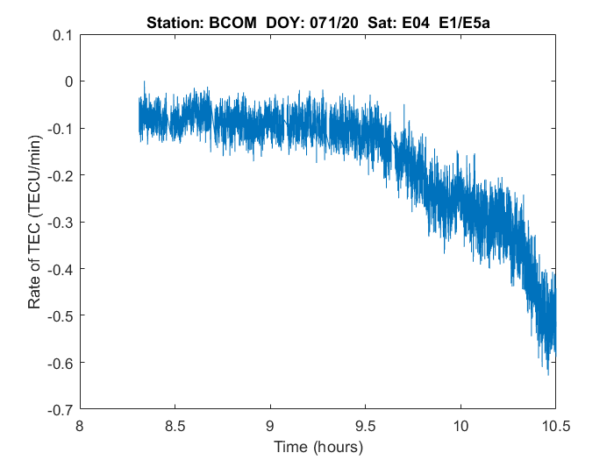
TEC rate of change: BCOM
TEC rate of change precision: 0,1-0,2 TECU/min

Slide 11
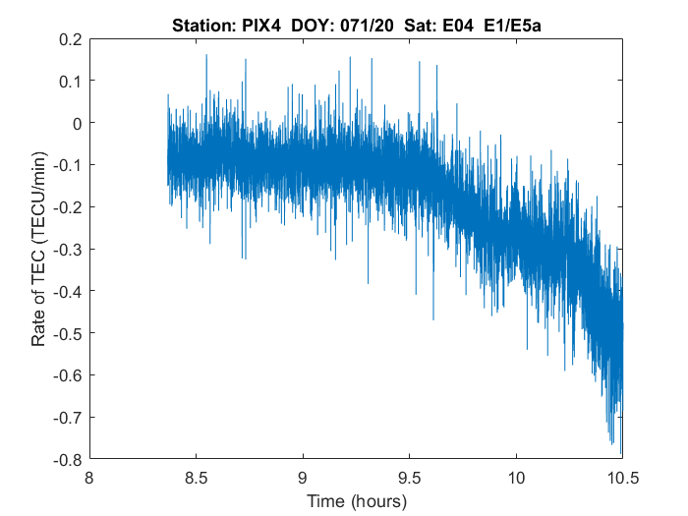
TEC rate of change: PIX4
TEC rate of change precision: 0,2-0,4 TECU/min

Slide 12
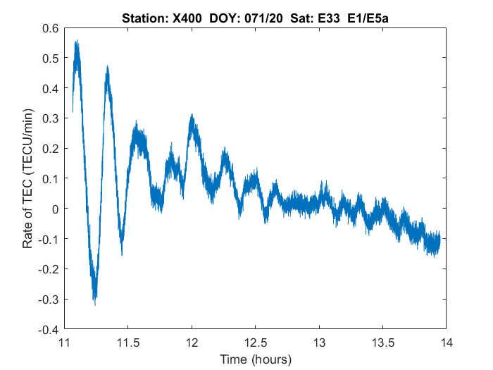
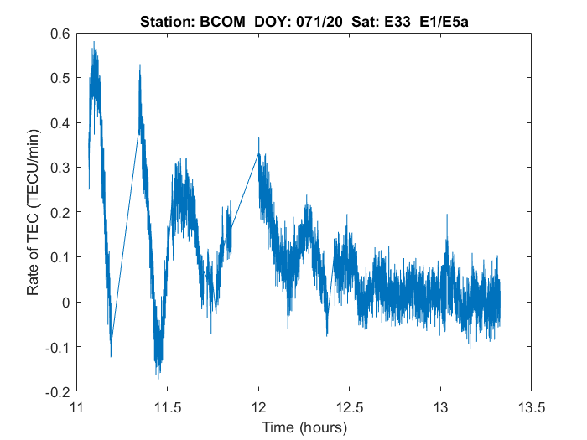
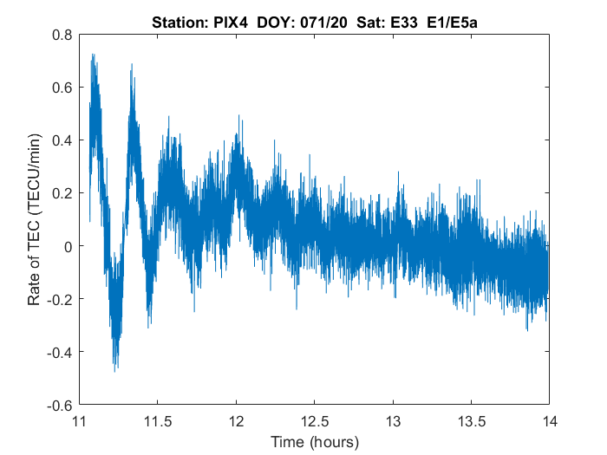

Slide 13
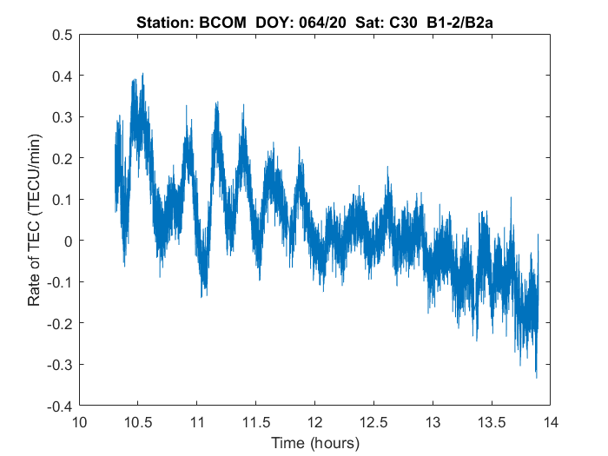
TEC Rate of Change (Beidou 3)

Slide 14
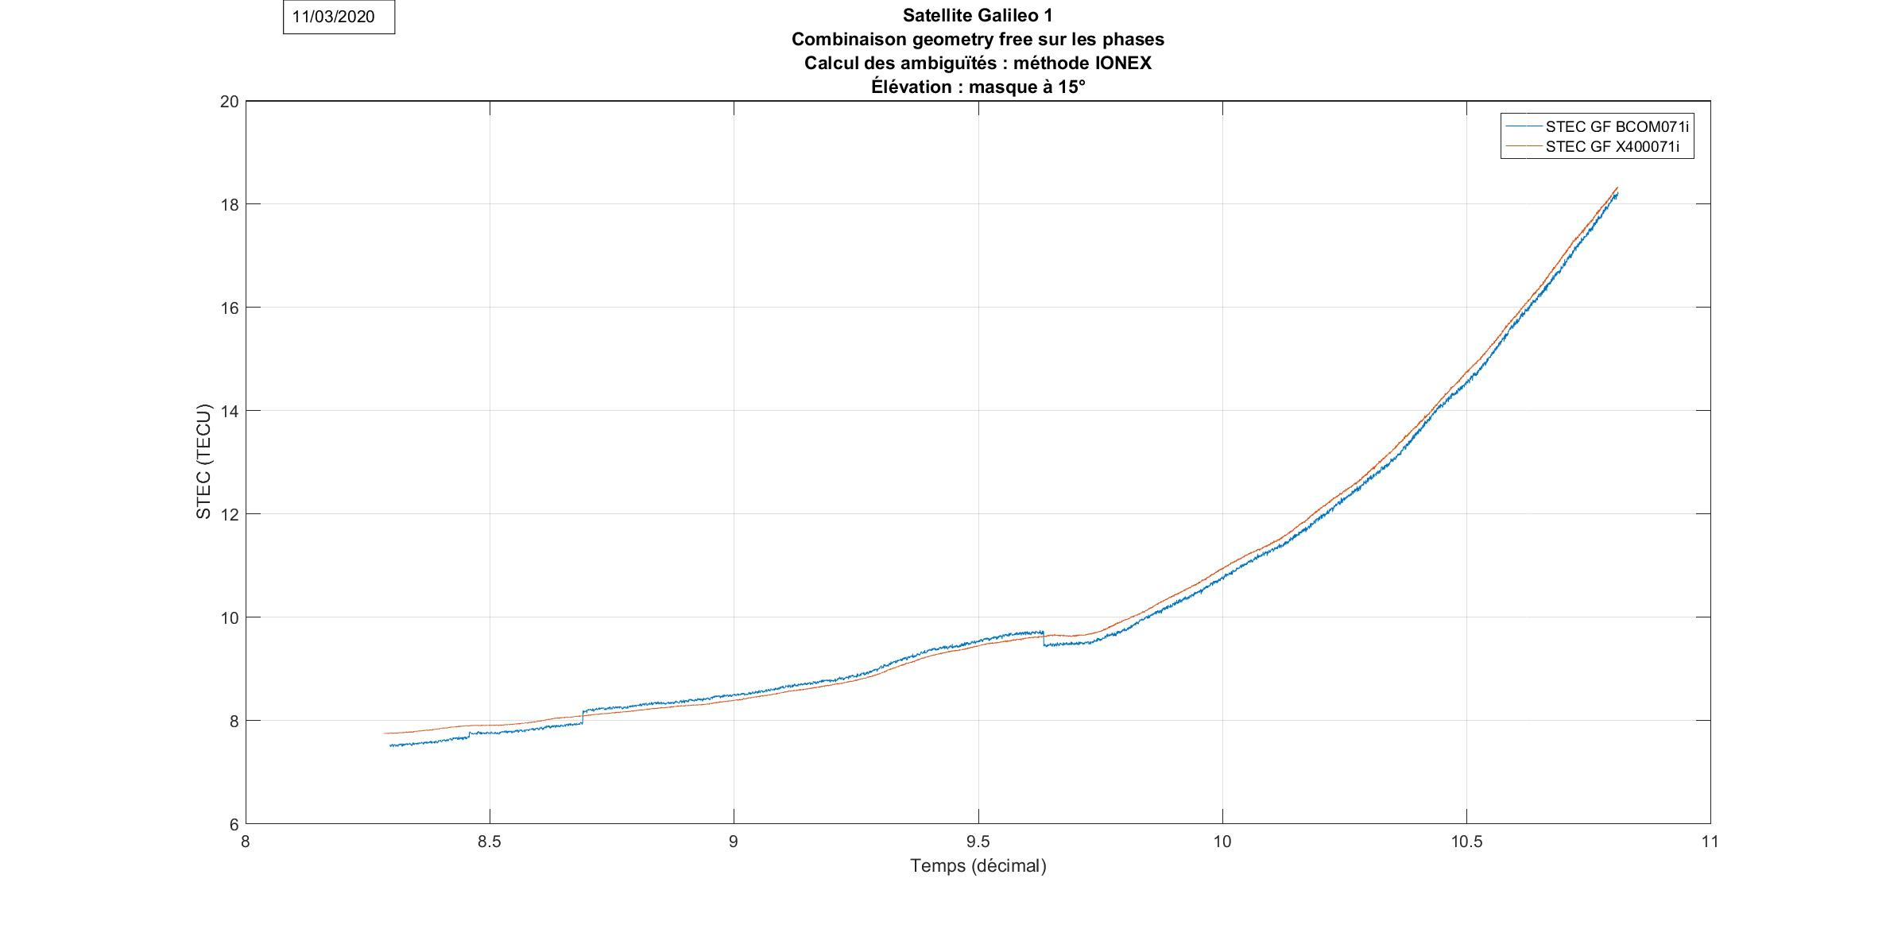
Absolute TEC: BCOM vs X400
Ambiguity computed using IONEX TEC maps from IGS
Difference X400-BCOM : 0,1 TECU - 2 TECU (due to CS).
Small jumps due to new ambiguity when cycle slips are detected
DOY 071/20 -Satellite E01
Time (Hours)

Slide 15
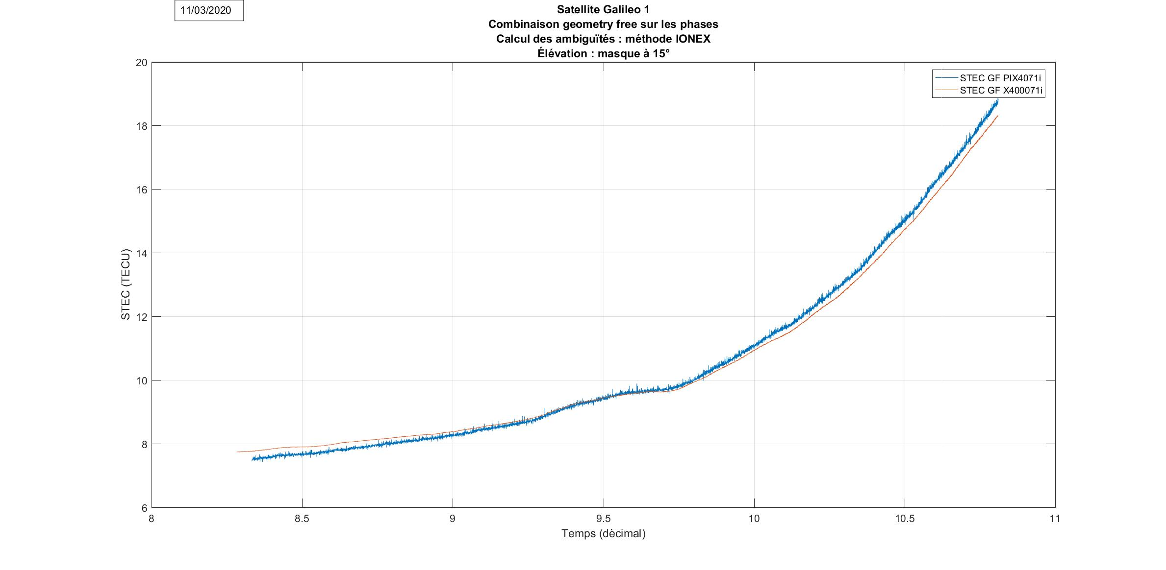
Absolute TEC: PIX4 vs X400
Difference X400-PIX4 : 0,1 TECU - 2 TECU
DOY 071/20 -Satellite E01
Time (Hours)

Slide 16
Conclusions
Smartphone dual frequency GNSS chips are valuable tools to monitor the ionospheric activity.
Absolute STEC reconstruction (IONEX):
Accuracy: 0,1 TEC to 2 TECU taking geodetic receivers as reference.
Precision: No significant difference wrt geodetic receivers.
Rate of TEC change makes it possible to detect small-scale structures in the ionosphere (Travelling Ionospheric Disturbances)
Results to be confirmed
When smartphone antenna is used
On more data, in particular, during more active ionospheric conditions.

