Slide 1
How to manage the ENG/EMG
The Covid-19
Changes
A dialogue between Belgium, Brasil, Italy and You

Slide 2
How and where
Covid -19 targets and mechanisms

Slide 3
Targets for Covid-19
Not long after the SARS-CoV-2 outbreak began, scientists discovered that the viral "spike" protein binds to a receptor on human cells known as angiotensin-converting enzyme 2 (ACE2). Another human protein, an enzyme called TMPRSS2, helps to activate the coronavirus spike protein, to allow for cell entry. The combined binding and activation allows the virus to get into host cell.
In the nasal passages, the researchers found that goblet secretory cells, which produce mucus, express RNAs for both of the proteins used by SARS-CoV-2 to infect cells.
In the lungs, the RNAs for these proteins have been mainly found in cells called type II pneumocytes. These cells line the alveoli (air sacs) of the lungs and are responsible for keeping them open.
In the intestine, the researchers found that cells called absorptive enterocytes, which are responsible for the absorption of some nutrients, express the RNAs for these two proteins more than any other intestinal cell type.
Date:April 22, 2020
Source:Massachusetts Institute of Technology

Slide 4
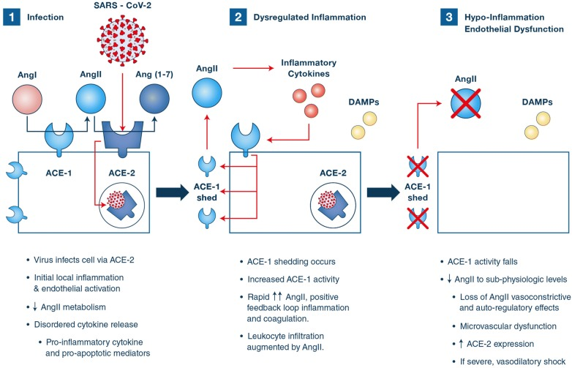
Mechanisms of Covid-19

Slide 5
Covid-19 neurological syndromes
Up to 35-40 % of patients reported neurological symptoms.
From mild and transitory to severe central stroke damage.
Nerves, roots, spinal cord may be affected by an inflammatory disease related to Covid-19 infection.
In some patients the neurological symptoms were the first signs of viral disease.

Slide 6
The new fear
Normal actvity was subjected to safety procedures for diseases transmitted by blood (HIV, Hepatitis B and C).
Now even simple interhuman contact may be harmful for ALL the people present in a medical structure: health workers, patients, staff.
Is the test useful or harmful? Necessary or not? Is better to do it or to postpone it?

Slide 7
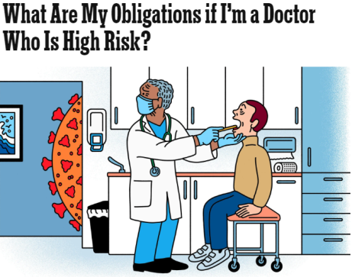
How do we feel ?
The different types of patient have been classified, based on the results of the swab test, into:
• Covid + (positive)
• Covid-uncertain (suspected positivity, awaiting swab outcome)
• Covid - (negative)
But……….. The reality is few swab tests, even less Ab blood tests
How we should consider an asymptomatic patient?????
As for HIV, HCV, HBV we must consider all patients and also ourselves potentially contagious
We are all afraid to bring the virus at home
Crosscontamination – potential medicolegal problem?
https://www.nytimes.com/2020/03/30/magazine/coronavirus-medical-ethics.html

Slide 8
COVID – 19 WORLD

Slide 9
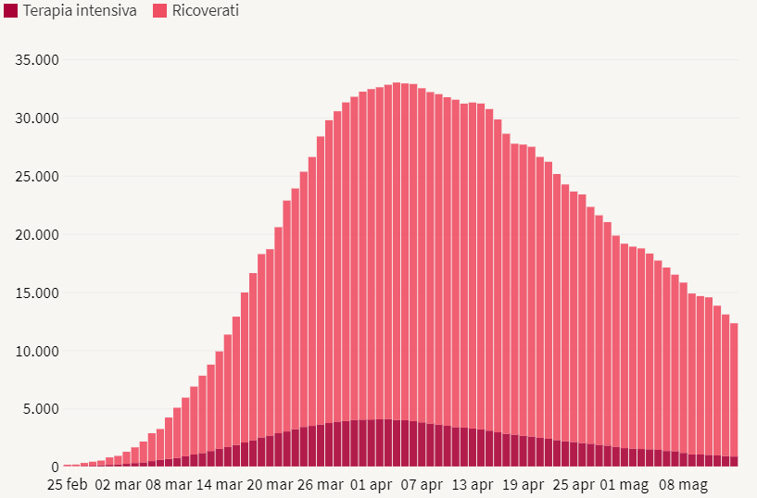
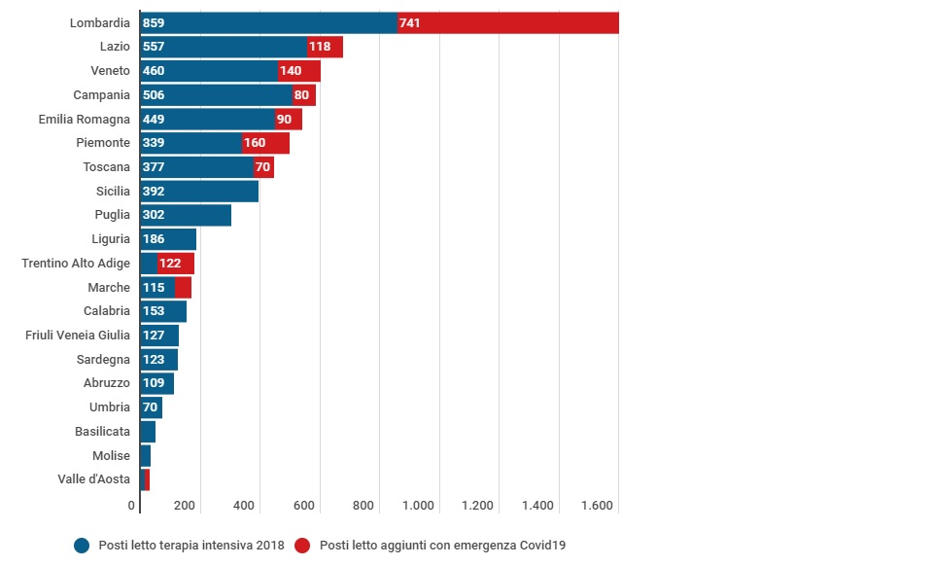
COVID impact we restart but the problem is still there
C 223.096
C 54,288
D 8903
D 31,368

Slide 10
PATIENTS X DEADS
C
MAY 14YH 2020

Slide 11
PATIENTS X DEADS
C
MAY 14YH 2020

Slide 12
PATIENTS X DEADS
C
MAY 14YH 2020

Slide 13
BRAZIL (better BraSil)
C

Slide 14
PATIENTS X DEADS
C
MAY 14YH 2020

Slide 15
Patient screening
Inpatients: to examine who is hospitalised in COVID-19 + and non COVID-19 use the protections according to the guidelines given by the institutions or hospitals.
Outpatients : phone pre-screening through secretarial staff at least 24 hours before or electronic form to be filled in.
On the day of exam a questionnaire is handed out to the patient and any accompanying person

Slide 16
TELEPHONE or TRIAGE STATE OF HEALTH DIAGRAM
Have you had COVID 19? YES ⬜ NO ⬜
If the answer is YES, is it cured (negative buffer?) YES ⬜ NO ⬜
Are you in quarantine? YES ⬜ NO ⬜
MAJOR SYMPTOMS at present or in the past 14 days
Fever> 37.5 ° YES ⬜ NO ⬜
Cough YES ⬜ NO ⬜
Breathing difficulties YES ⬜ NO ⬜
Ageusia, anosmia YES ⬜ NO ⬜
Conjunctivitis YES ⬜ NO ⬜
Diarrhea? YES ⬜ NO ⬜

Slide 17
Epidemiological screening
EXPOSURE TO VERIFIED CASES COVID 19 (positive swab test) YES ⬜ NO ⬜
EXPOSURE TO SUSPECTED CASES YES ⬜ NO ⬜
CONTACTS WITH FAMILIES OF SUSPECTED CASES YES ⬜ NO ⬜
COHABITANTS WITH FEVER OR INFLUENTIAL SYMPTOMS (no swab) YES ⬜ NO ⬜
CONTACTS WITH FEVER OR INFLUENTIAL SYMPTOMS (no swab) YES ⬜ NO ⬜
ATTENDANCE OF HEALTH ENVIRONMENTS WITH ASSESSED / SUSPECTED CASES YES ⬜ NO ⬜
WORK YES ⬜ NO ⬜ ⬜SMART WORKING ⬜A IN CONTACT WITH OTHER SUBJECTS
⬜WITH PROTECTION DEVICES
⬜ WITHOUT USING PROTECTION DEVICES
In which place ______________________________ (eg type: office, public exercise, transport other
HAVE YOU TRAVELLED IN THE LAST 14 DAYS? YES ⬜ NO ⬜

Slide 18
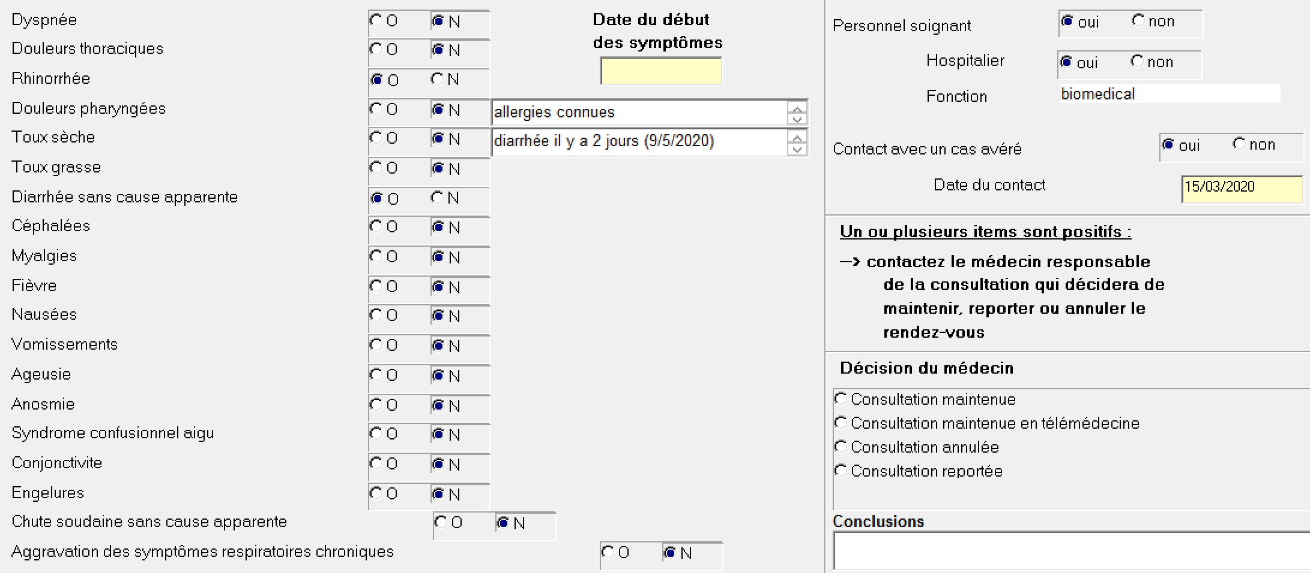
Covid-19 screening computerized card
F

Slide 19
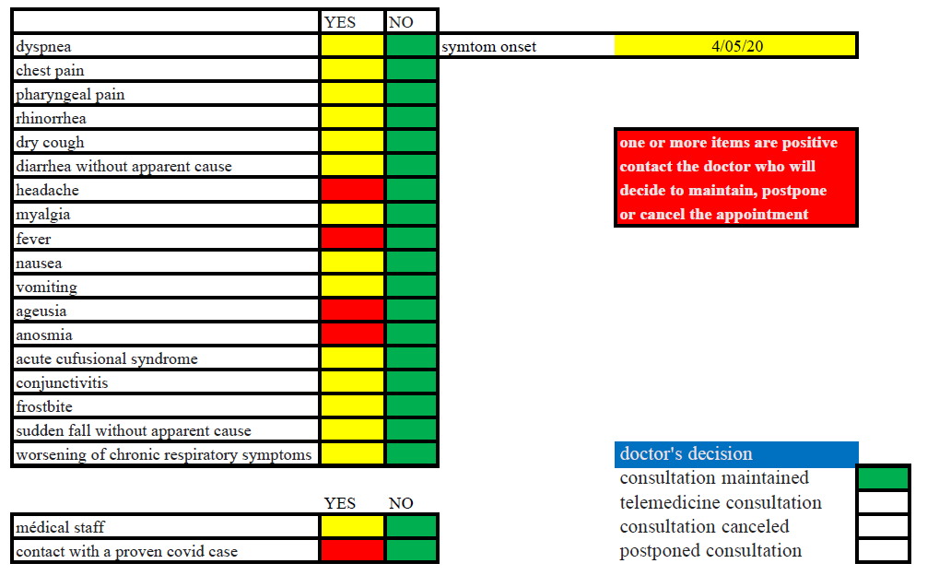
Covid-19 screening computerized card
F

Slide 20
Waiting room and medical rooom
Patients are allowed access if wearing a surgical mask and gloves (wear new gloves after hand disinfection only inside the medical office, shoe covers)
Taking patient and accompanying person body temperature
Triage questionnaire completed on the arrival
Plexiglass shield for the secretarial desk
Number of people: interpersonal distance must be kept
Separated entry and exit whenever possible
Only patients admitted
Accompanying person (with mask and gloves) only if minors or seriously handicapped patients
2 workers in the lab (MD + TNP)

Slide 21
PERSONAL protections

Slide 22
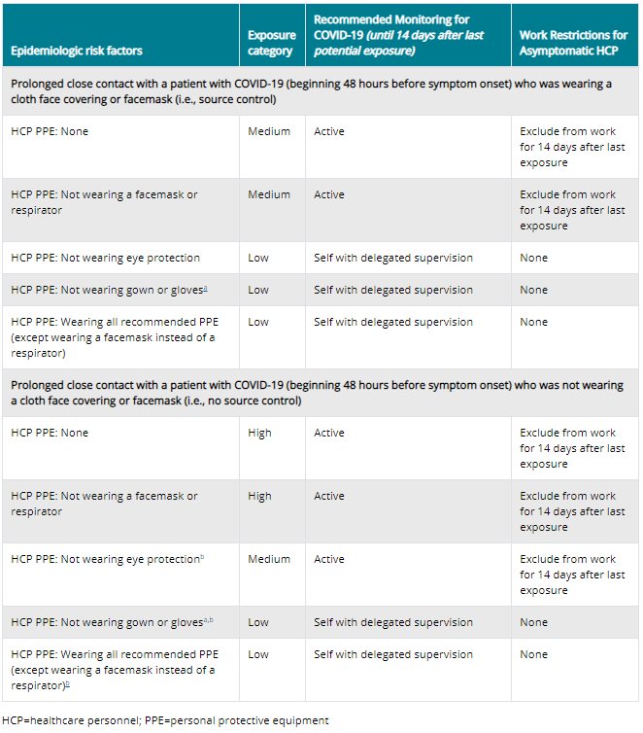
Exposure risk for healthcare personnel
ENG/EMG test requires close contact with the patient who must wear the mask

Slide 23
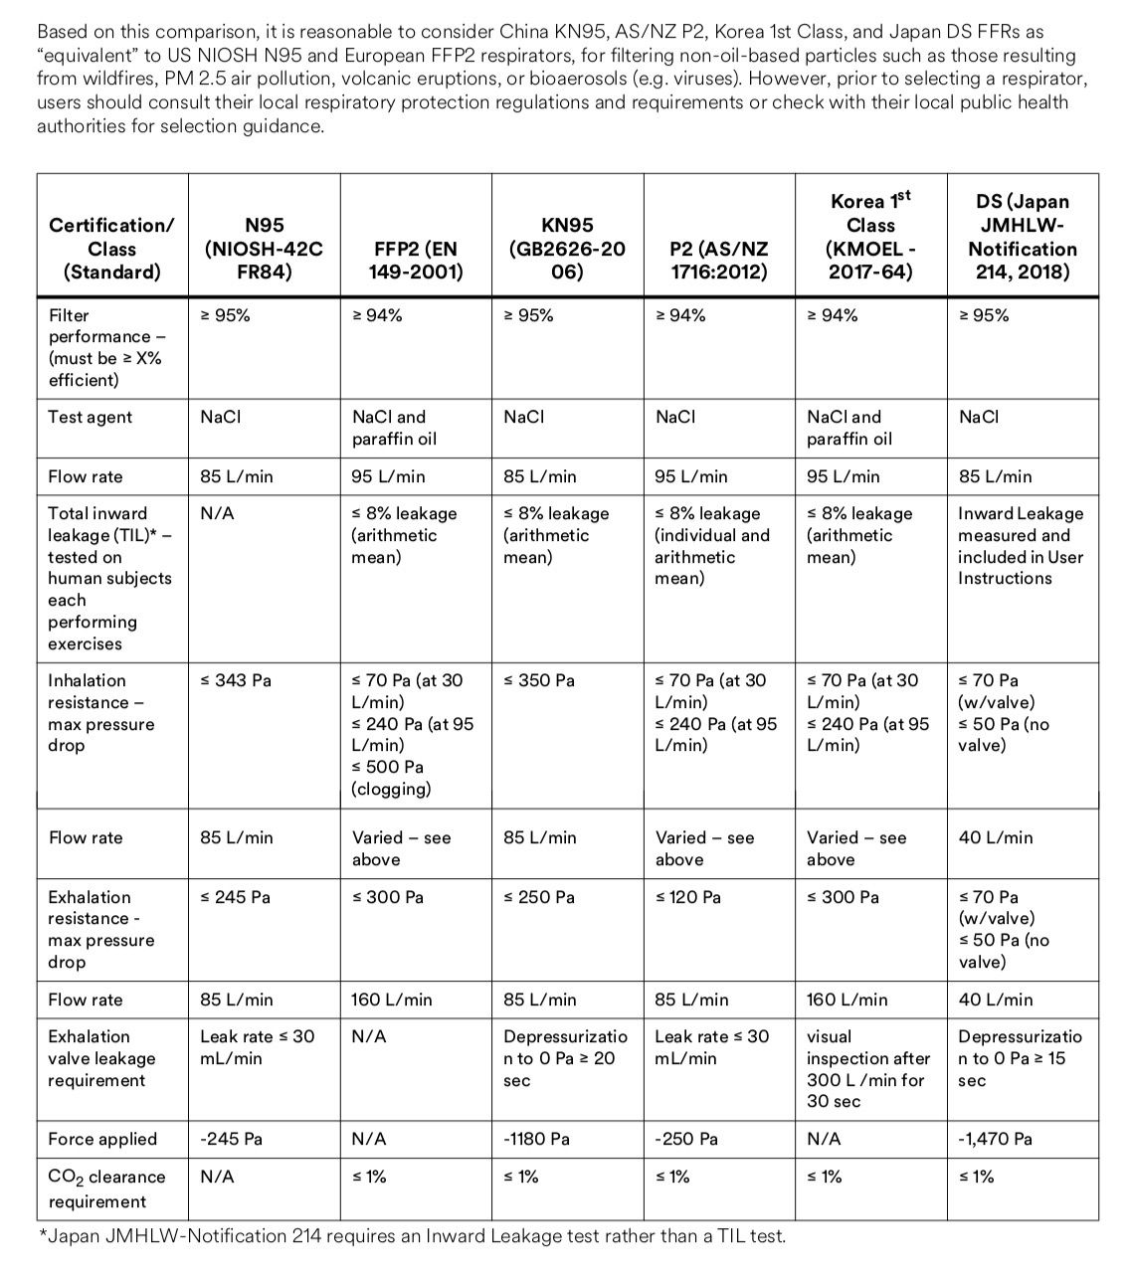
Wearing the correct mask

Slide 24
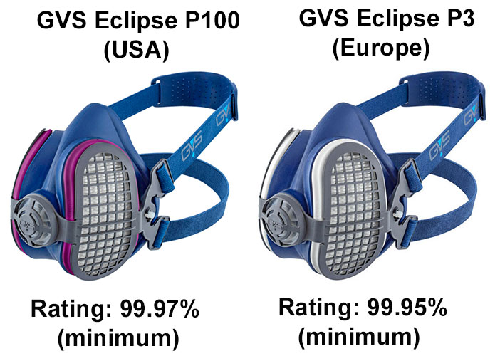
P100 and ffP3

Slide 25
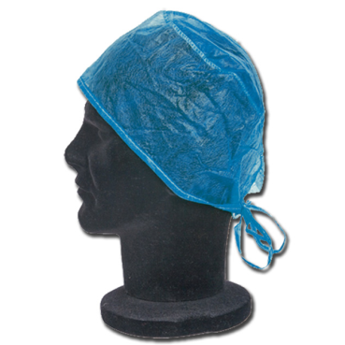
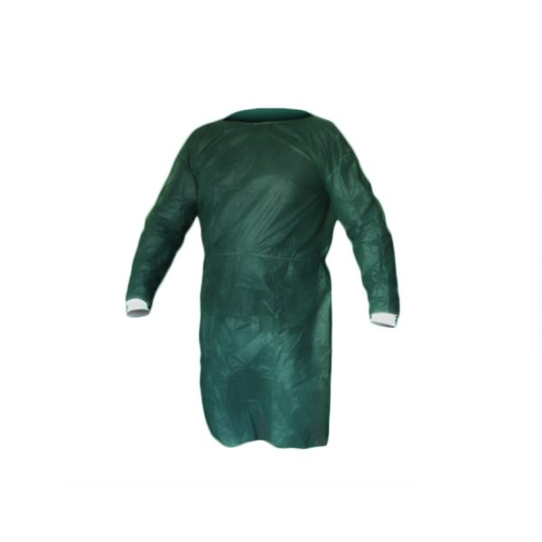
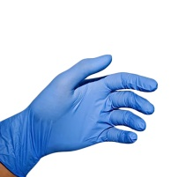
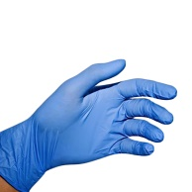
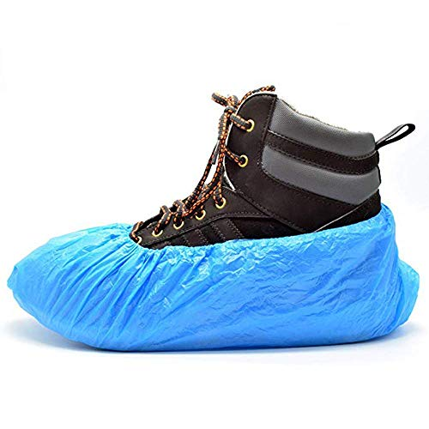
Personal protective equipment – Body protection
Wearing personal protective equipment may be useful for self-protection and to avoid cross-contamination between patients.
Double gloves (medium under, large over) are useful for dressing/undressing procedures
https://www.ecdc.europa.eu/sites/default/files/documents/COVID-19-guidance-wearing-and-removing-personal-protective-equipment-healthcare-settings-updated.pdf
disposable cap
disposable gown
gloves (double)
Avoid touching your face while doing the test or undressing
disposable shoe covers

Slide 26
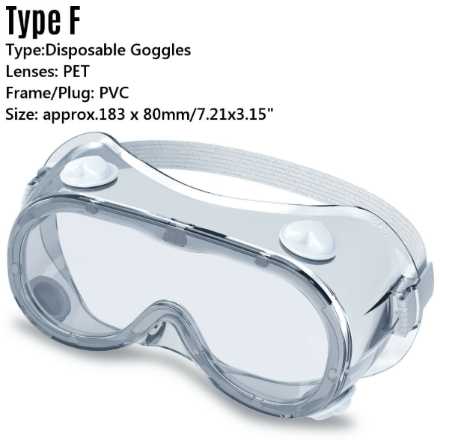
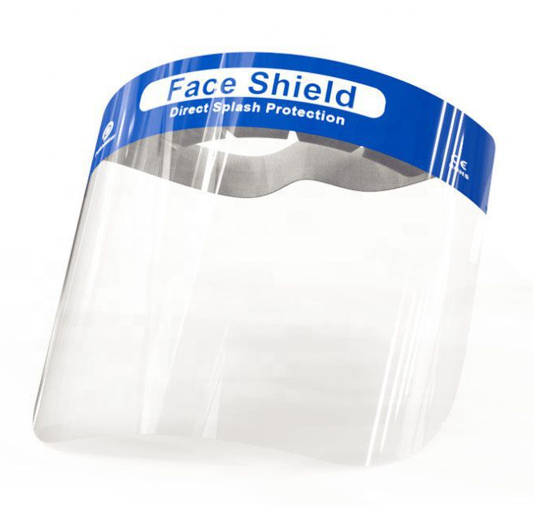
Face Protection
Goggles – convenient for ease of movement and providing space for glasses; easily mist up even if aerated
Face shield - must cover the whole face, providing less ease of movement; reduced fogging of the glasses

Slide 27
Appropriate use
Personal Protective Equipament
PPE

Slide 28
Body parts
Any differences in performing the tests?

Slide 29
Lower limbs
Distance from the face is maximal and the patients may wear face mask and gloves
Surgical mask and face protections are recommended for the examiner
Head cap, disposable gown and double gloves may be useful for the examiner

Slide 30
Upper limbs (not shoulders)
The distance to the face is reduced and patients may wear face mask but not gloves (careful cleaning/disinfection of hands)
Surgical mask and face protections are recommended
Head cap, disposable gown and double gloves may be useful for the examiner.

Slide 31
Shoulder, chest, back
Distance to the face is reduced and patients may wear face mask and gloves
Surgical mask or ffP2/KN95 and face protections are recommended
Head cap, disposable gown and double gloves may be recommended for the examiner

Slide 32
Cranial nerves
Performed on the face and the patients cannot wear face mask, gloves are worn.
FfP2/KN95 mask and face protections are necessary
Head cap, diposable gown and double gloves are recommended for the examiner.
The patient may have a cough reflex!

Slide 33
Perineal EMG
Probable contamination of the perineal area
Performed near the anatomic area, the patients must wear face mask and gloves.
Surgical mask or ffP2/KN95 and face protections are recommended
Head cap, gown and double gloves rcecommended the examiner

Slide 34
Botulinum toxin injections
Same recommendations for ENG and EMG tests
Depending on the part of the body that is injected

Slide 35
Safety behaviors
While wearing PPE: avoid touching already worn PPE
Remove gloves if torn or damaged
Change the second pair of gloves between one patient and another
Carry out hand hygiene before putting on new gloves
When removing PPE, be careful to avoid any contact between the dirty components and the area of the face or skin that is not intact
Decontaminate PPE as non-disposable goggles and face shields

Slide 36
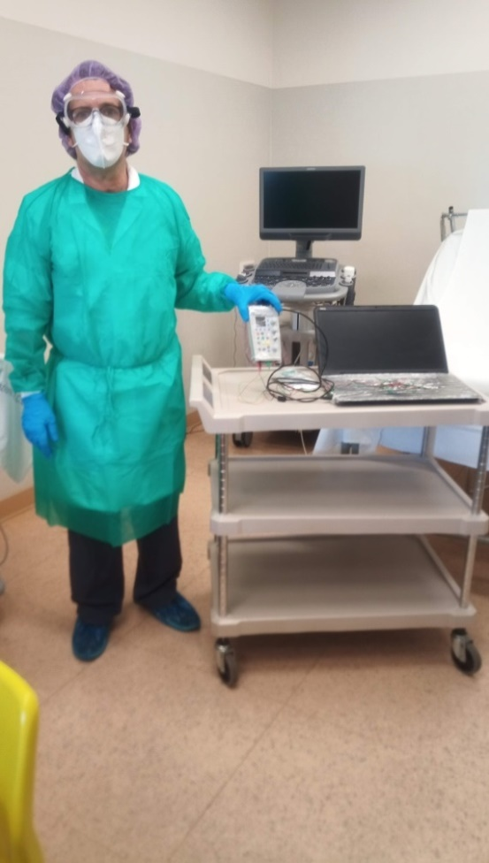
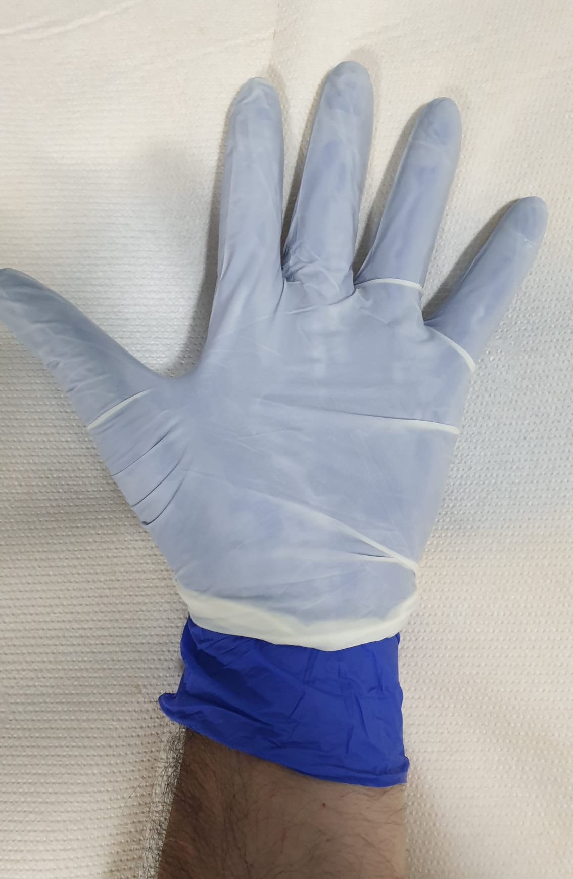
Tricks for neck and hands
Neck protection ??
Self-made neck protection
Use of double gloves – reduced exposure to disinfectants

Slide 37
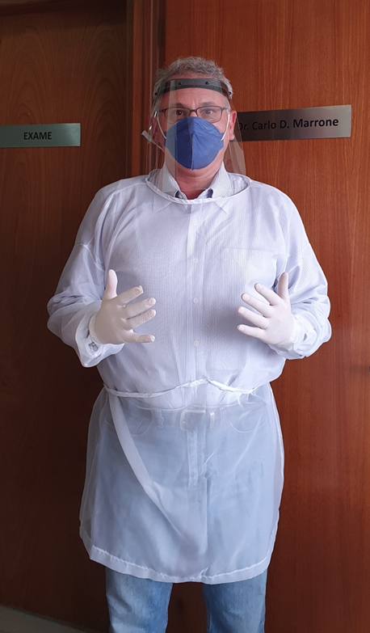
C

Slide 38
C

Slide 39
AAEM instructions

Slide 40
PPE Guidance for All Patient Interactions During COVID-19
Patient With Positive or PUI COVID
For healthcare worker
N95 Mask
Face Shield or protective goggles
Gown
Shoe covers
Gloves
Hair covering optional
If N95 can’t be worn PAPR (powered air-purifying respirators) suit
For the patient – not in a waiting room with other patients, examined in an isolation room if possible
Surgical mask if possible
Thoroughly clean all equipment, room, etc. after procedure and before seeing any other patient. Regarding EDX testing, see AANEM’s document Special Precautions While Performing EDX Testing for further information.

Slide 41
PPE Guidance for All Patient Interactions During COVID-19
All Other Patients
For healthcare worker
Surgical Mask
Face Shield or protective goggles (strongly recommended)
Gloves
For the patient – follow social distancing rules for waiting patients (i.e. having patients wait in car until ready for procedure. No additional people enter the building with the patient unless the patient needs assistance)
Surgical mask if possible

Slide 42
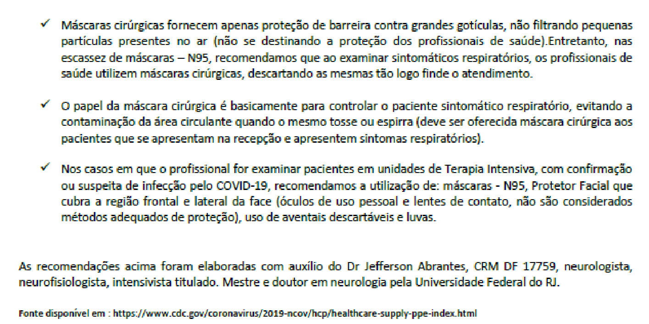
C
March 18th 2020

Slide 43
C

Slide 44
NF Staff
C

Slide 45
Personnel NF laboratory
C

Slide 46
Sterilization x Disinfection x Cleaning
C

Slide 47
Cleaning
C

Slide 48
Which tools are preferred?

Slide 49
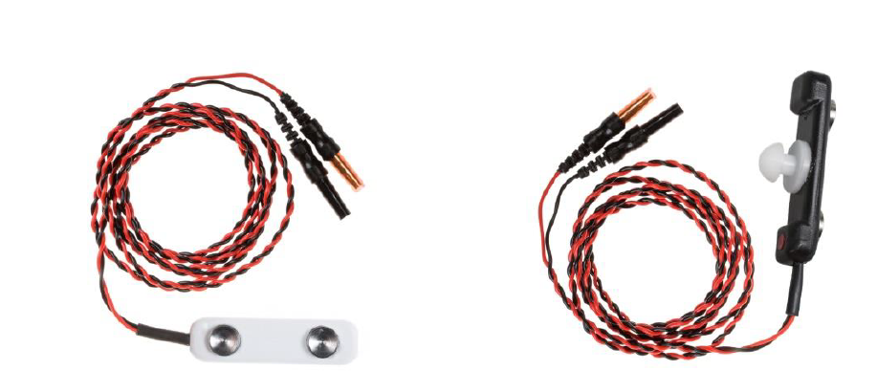
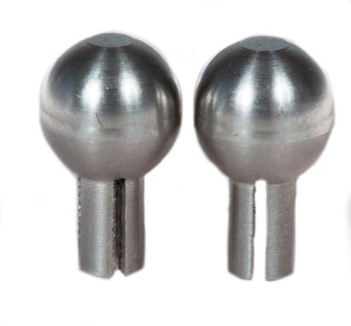
NCS – felters strong disinfection or use steel

Slide 50
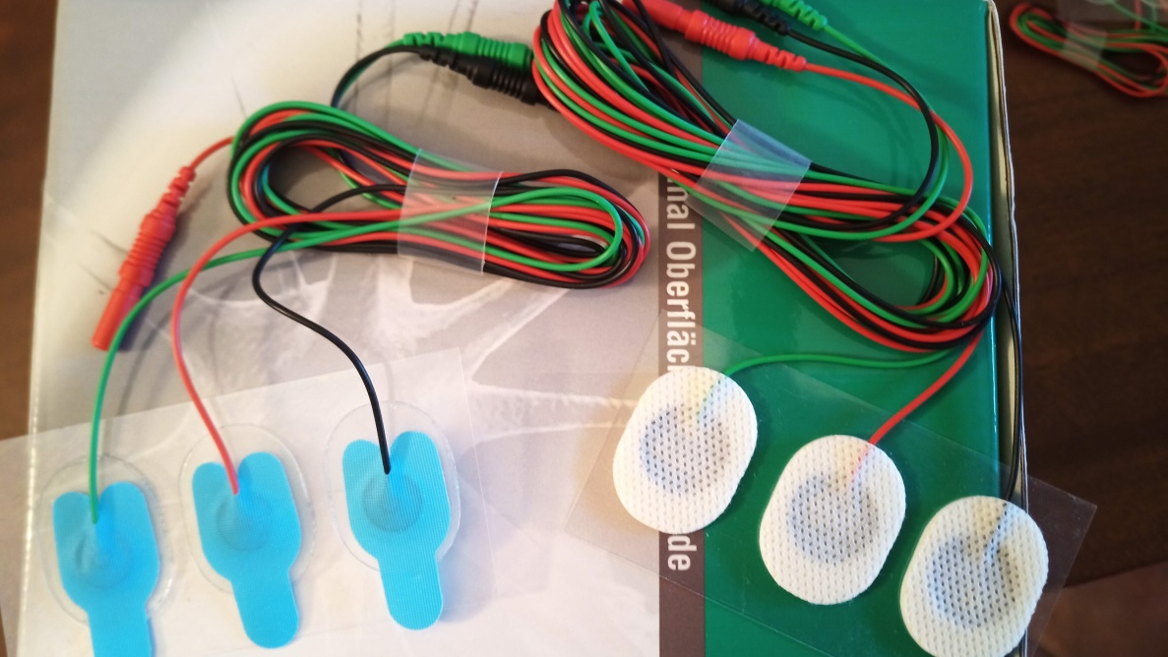
Single use disposable adhesive electrodes

Slide 51
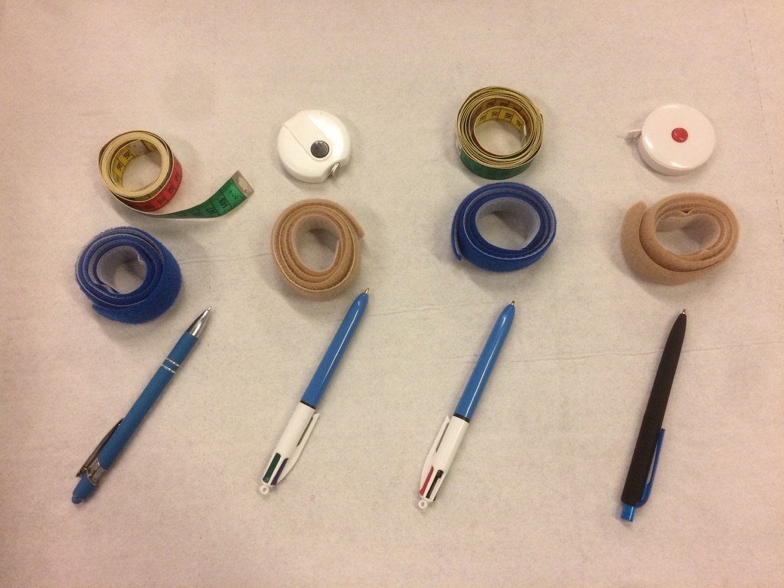
Measuring and marking instruments
F
One set for each patient may be useful to avoid losing time in disinfection

Slide 52
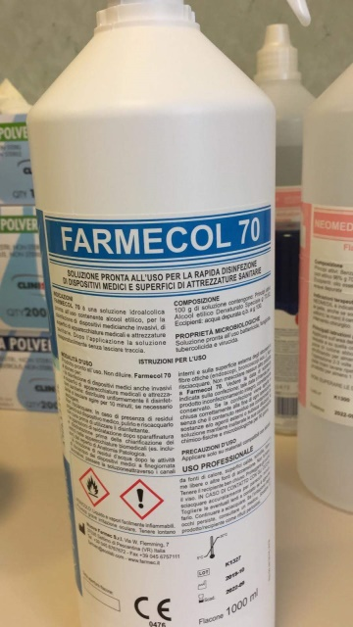
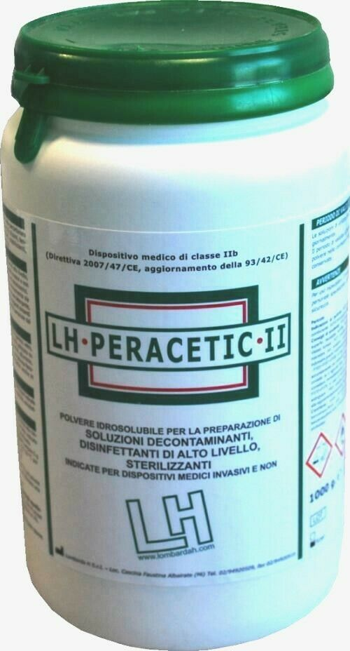
Maintenance and cleaning

Slide 53
C
https://www.epa.gov/pesticide-registration/list-n-disinfecants-use-against-sars-cov-2

Slide 54
Electromyography
The use of needle electrode is already considered a risky procedure
Cleaning and disinfection of the cable

Slide 55
ENMG test in Covid-19 room
A precaution, if possible, is to perform the EMG examination in a Covid-19 room and to power the equipment with an Uninterruptible Power Supply (UPS) to avoid that the power cable is necessary (usually touches the ground), and to wear high protection mask (ffP3 or N100) and full head/body protection if you works with a patient who creates aerosols (type NIV without helmet).
if available, use dedicated equipment that is left in the intensive department.
Careful cleaning and disinfection after use

Slide 56
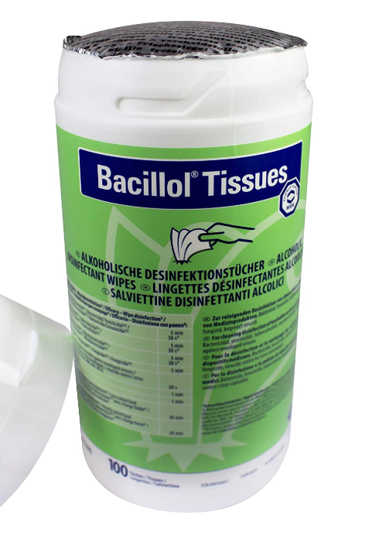
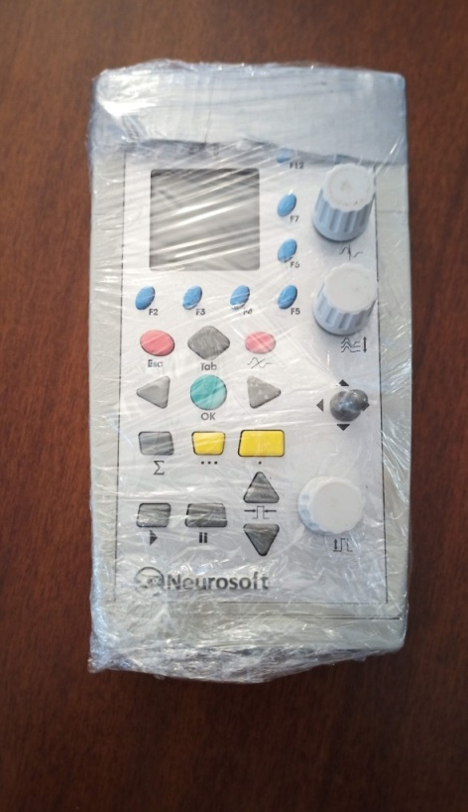
Instrument cleaning and protection
Specific alcohol-based wipes are available for disinfection.
A cling film (PVC) may be used to cover the amplifier, the keyboard, etc. in order to easily disinfect and not damage the machine and erase characters.
The argument is debated by some colleagues who prefer one way or another.

Slide 57
Electronic devices
C

Slide 58
C
??

Slide 59
C

Slide 60
Laundry and medical waste
C

Slide 61
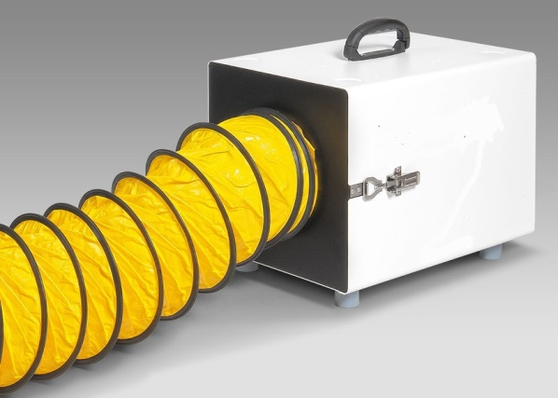
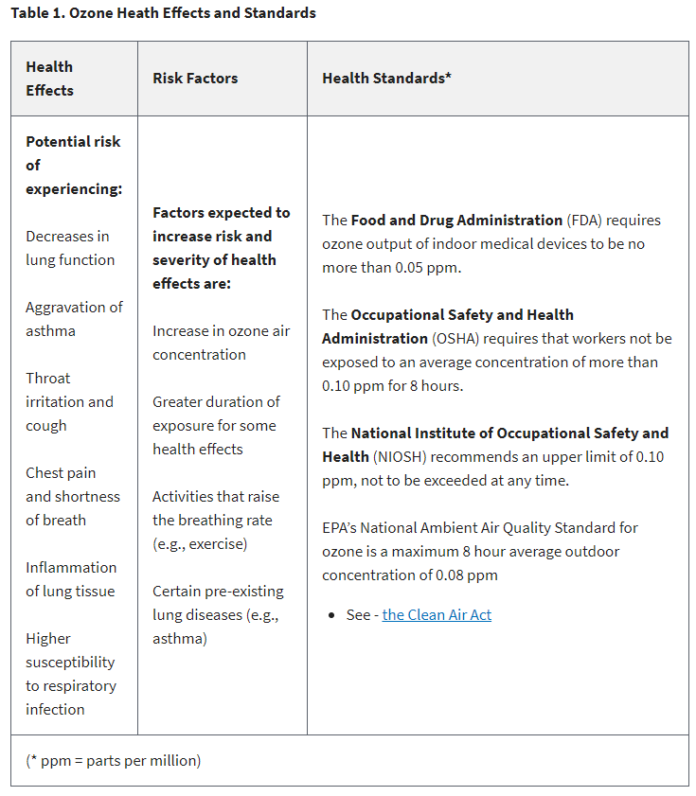
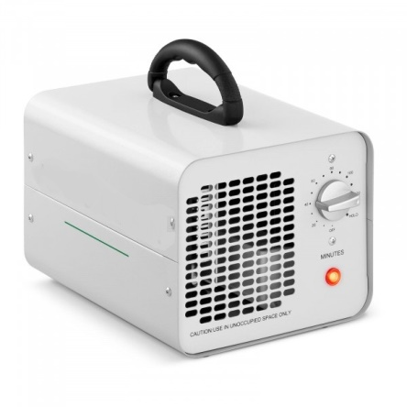
Air cleaning/disinfection
"There is no evidence that ozone performs a sterilizing function against the new coronavirus and consequently protects against contracting the infection." Italian Ministry of Health 8 May 2020
The best systems are those with multi-factorial filtering and sterilization and in particular those with the following composition:
HEPA filters of level H13-H14 capable of retaining with efficiency of 99.97% particles (therefore also viral) of size equal to 300nm, associated with activated carbon filters and UVC lamps without external dispersion with powers equal to or greater than 1200uw / cm2 and frequencies of 185nm - 254nm and 280nm possibly all associated using multiple emitters.

Slide 62
Questions
Rescheduling the exams if a patient is not in the right condition
Impact on the examination length – 15-30 minutes more
Impact on the daily number of patients
EMG/ENG sessions dedicated to a specific body district?
Ease while doing tests wearing PPE
Increase in special waste
Disinfection and recycling of PPE?
Costs will increase with the use of disposable electrodes and
PPE (+/- 15-20 euros each patient)
Long-term exposure to disinfectants: side effects?
Theory vs. reality: all we showed you is possible or necessary ?

Slide 63
In memoriam Prof. Arrigo Moglia 20/01/1947 – 15/04/2020 Italian health workers Covid-19 victims 162 doctors, 40 paramedics
Thank you for your attention
Special thanks to all the people who gave us precious advices and shared their experiences:
Italy: Enrico Alfonsi, Riccardo Benzi, Federico Biglioli, Raffaella Butera, Biagio Ciccone, Carlo Dallocchio, Enzo Decicco, Davide Faga, Camillo Foresti, Barbara Frigeni, Laura Obici, Maurizio Osio, Luigi Ruiz, Gianmario Santamaria, Massimo Schiappadori, Manuela Sonaglio, Nicola Zerbinati
South America: Guidance for clinical neurophysiology examination throughout the COVID-19 pandemic. Latin American chapter of the IFCN task force - COVID-19
Daniel San-Juan, Christian Ramos Jiménez, Cecilia Ximénez Camilli, Luis Adrián de la Cruz Reyes, Enya Gabriela Aguirre Galindo, Gustavo Eduardo Ramos Burbano, Maria Magdalena Penela, Monica Beatriz Perassolo, Armando Tello Valdéz, Jorge Gutierrez Godoy, Ana Lucila Moreira, Paulo Andre Teixeira Kimaid
A special thought goes to my former colleagues from the IRCCS C. Mondino Pavia

