Slide 1
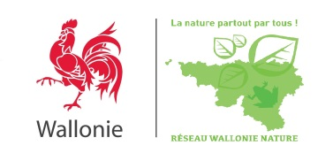
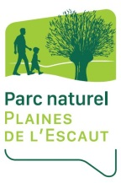
Mainstream Biodiversity
the way to go!
Biodiversity management in quarries – 'Life in Quarries':
[Integration of biodiversity in mining industry: habitat analogues]
Séleck M. - Maxime.seleck@uliege.be
Notes:
Life in Quarries as a case study

Slide 2
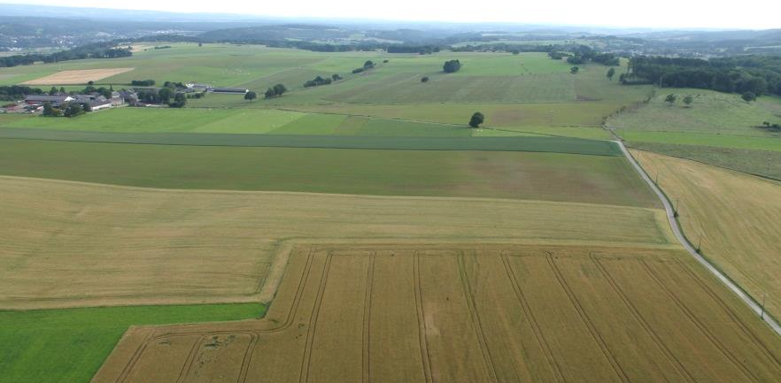
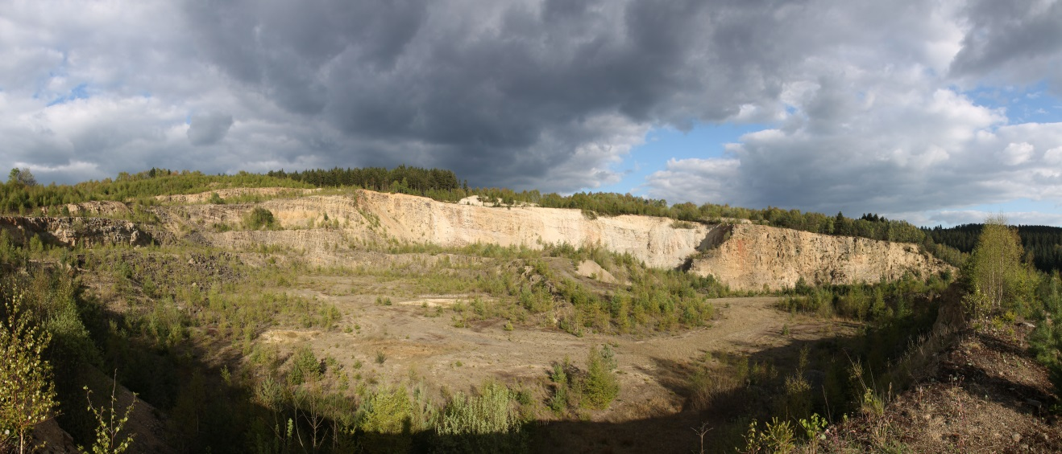
Quarries and Biodiversity
Notes:
In human dominated landscapes, quarrying activity, by creating heterogeneity, represents an opportunity to show how an economic sector can contribute to biodiversity

Slide 3
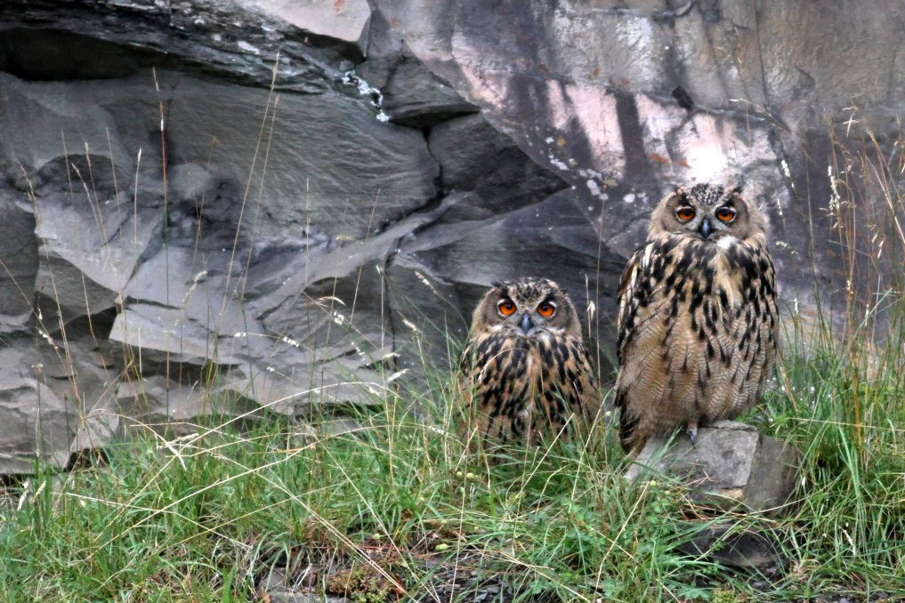
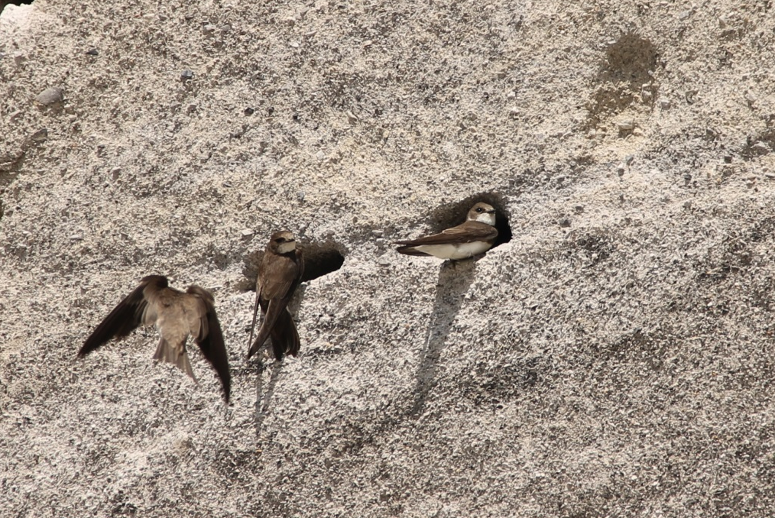
Quarries and Biodiversity
Notes:
Often, biodiversity in quarries is presented through the lens of its iconic, flagship species.

Slide 4
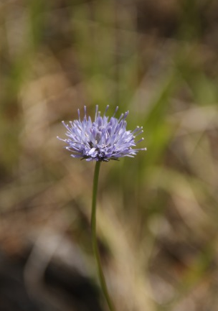
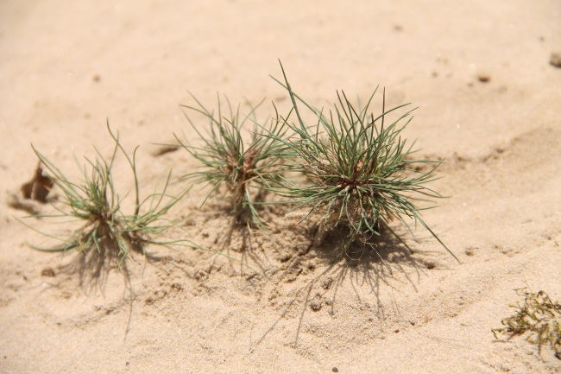
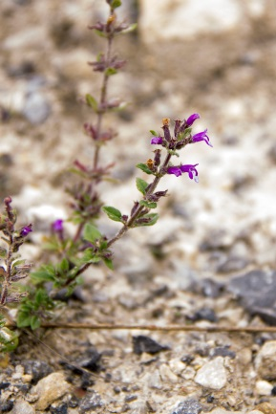
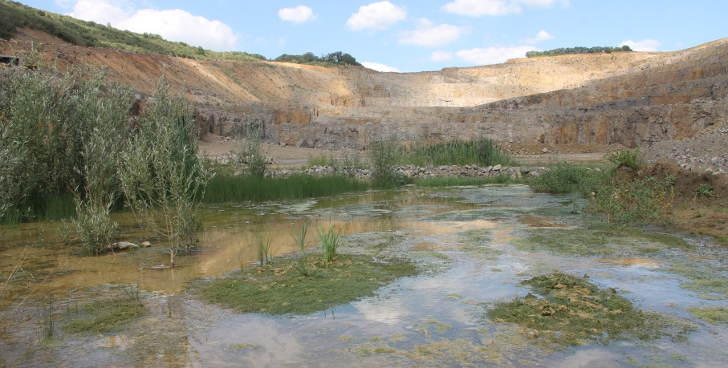
Quarries and Biodiversity
Notes:
But that often leads to overlook the whole potential they represent for a wide diversity of rare pioneer plants species, endangered amphibians or even habitats of EU interest

Slide 5
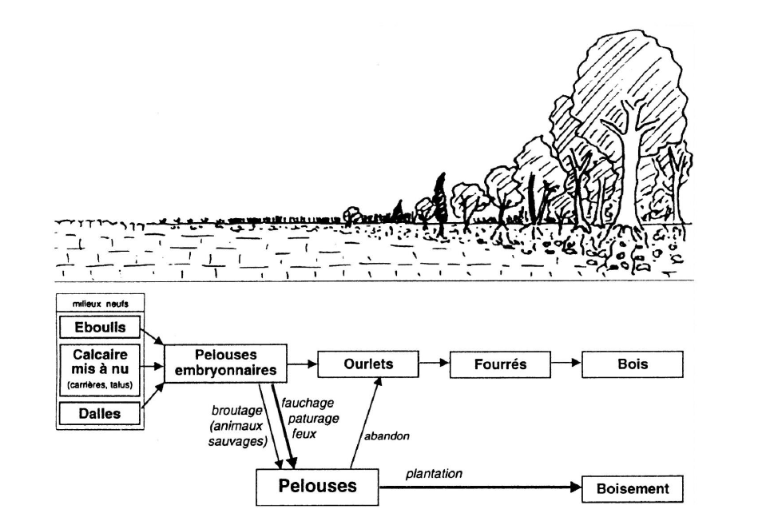
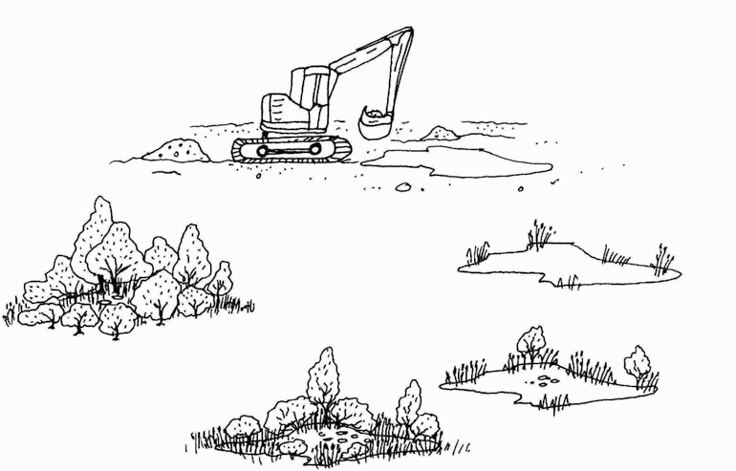
Habitat analogues
© Hunger, Schiel, Rademacher 2015
Notes:
On a daily basis, the extraction modulates its environment and creates an heterogeneity of habitats. Left out of impact for some time, these evolve in a process analogue to that of natural ecological successions.

Slide 6
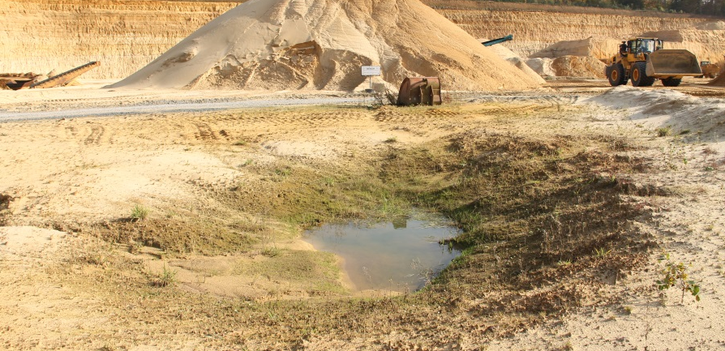
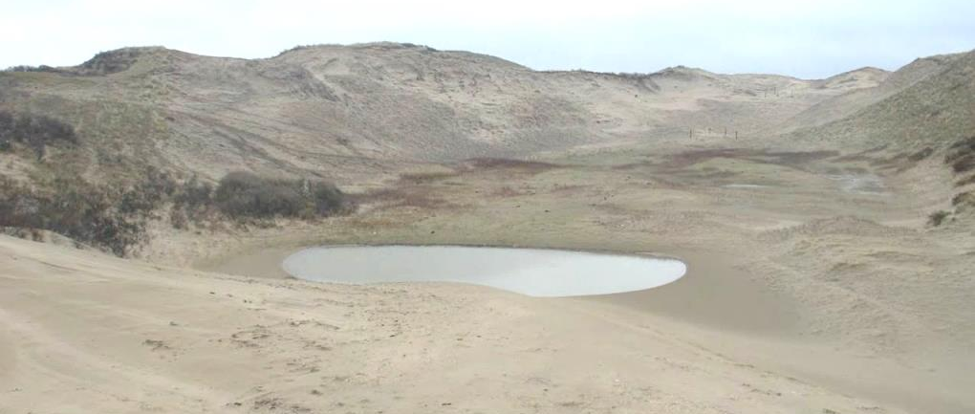
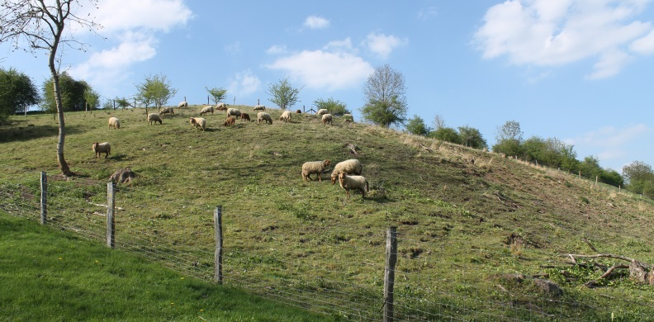
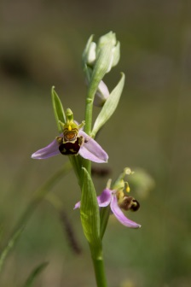
Habitat analogues
Extractive sites Natural ecosystems
© LIFE09 NAT/NL/000418 - Dutch Dune Revival
Notes:
These successions can lead to habitats that have become rare in the EU. Evolution from quarrying activity can for example lead, on the short term, to analogues of dune slacks and, in disused areas, to analogs of semi-natural grasslands.

Slide 7
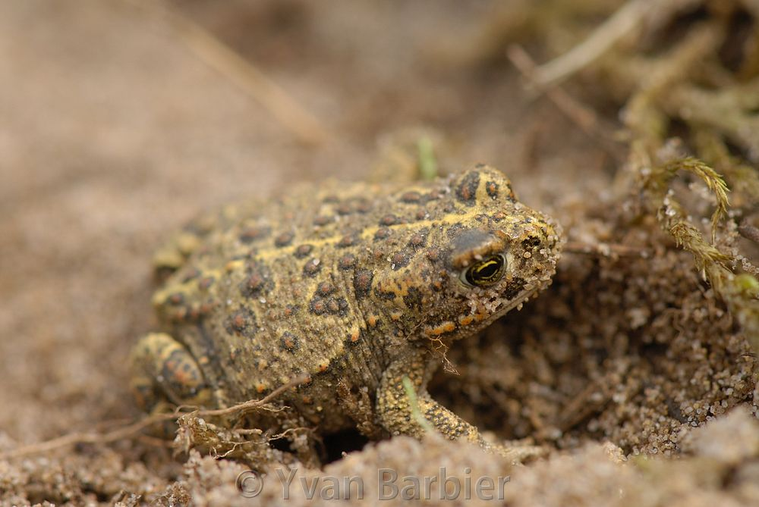
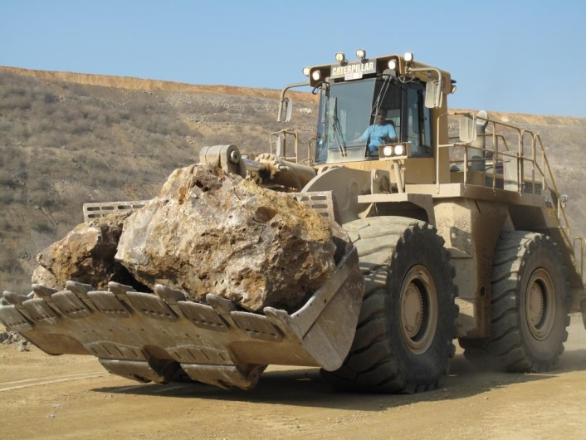
“Life in Quarries”
How to allow for co-existence ?
Notes:
For some years now, the EU extractive sector has been aware that its quarries can host protected and rare species. The question of how to manage them along with activity is at the center of the Life in Quarries project.

Slide 8
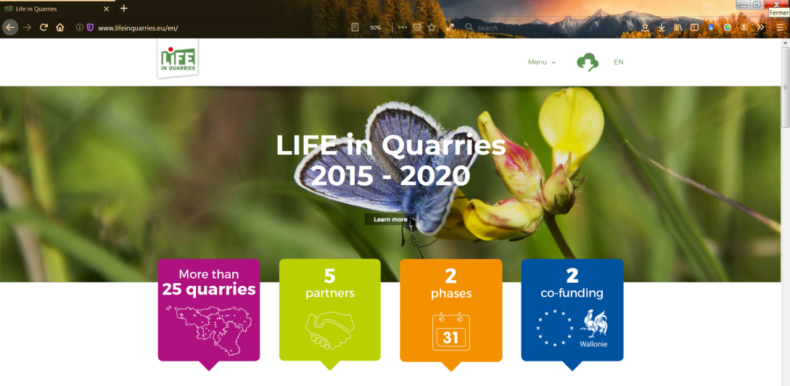
“Life in Quarries”
Innovative partnership for biodiversity, people and economy…
Notes:
The project is an innovative partnership in line with the EU Action Plan for nature, people and the economy. It associates an extractive federation, a university, NGOs and the public sector…

Slide 9
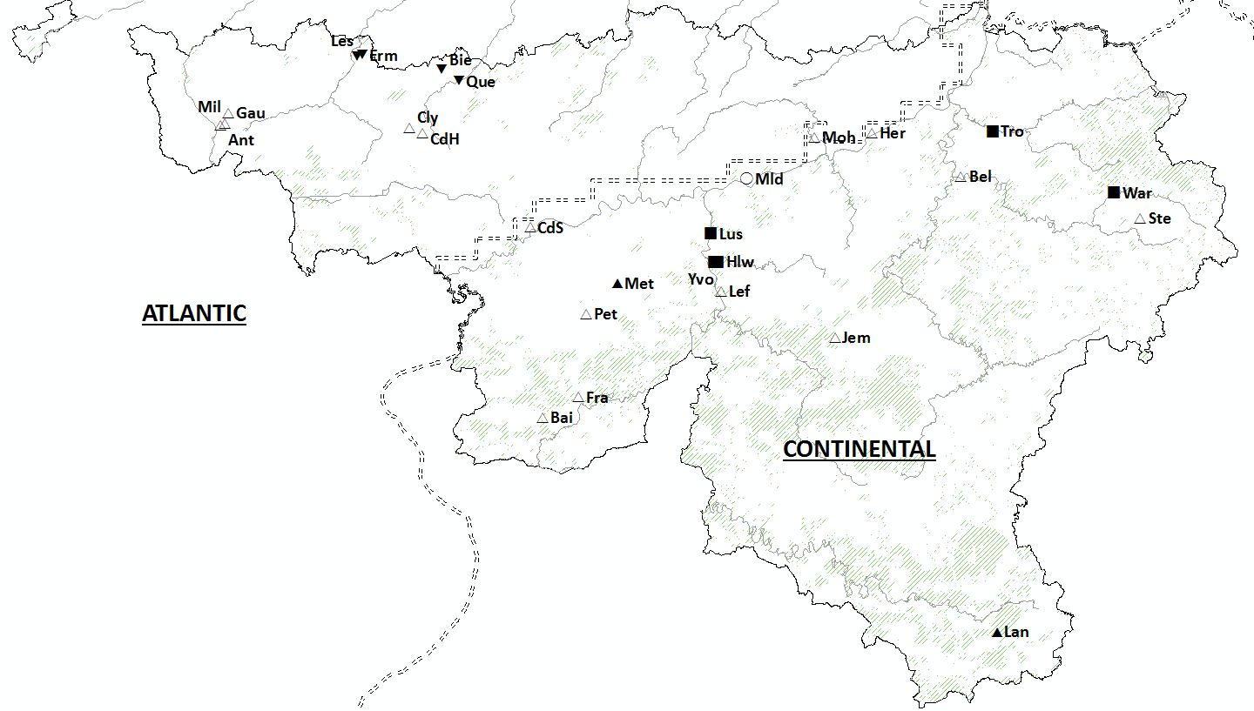
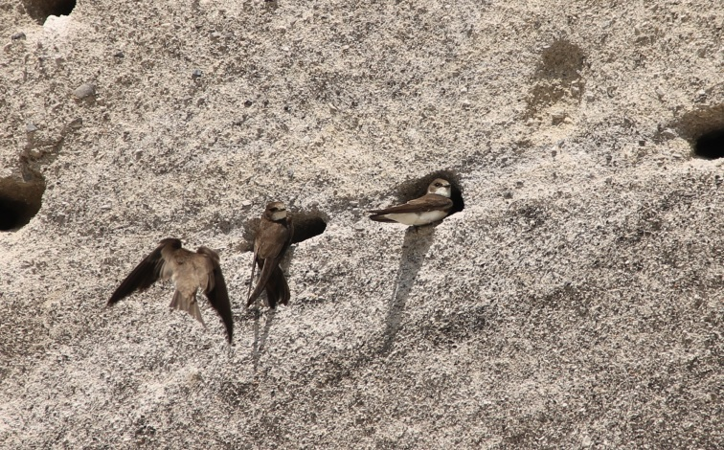
“Life in Quarries”
...in a network of extractive sites, in southern Belgium
Core populations
Stepping stones
Notes:
… to develop biodiversity in a network of quarries, thus contributing to a regional (Walloon) ecological network.

Slide 10
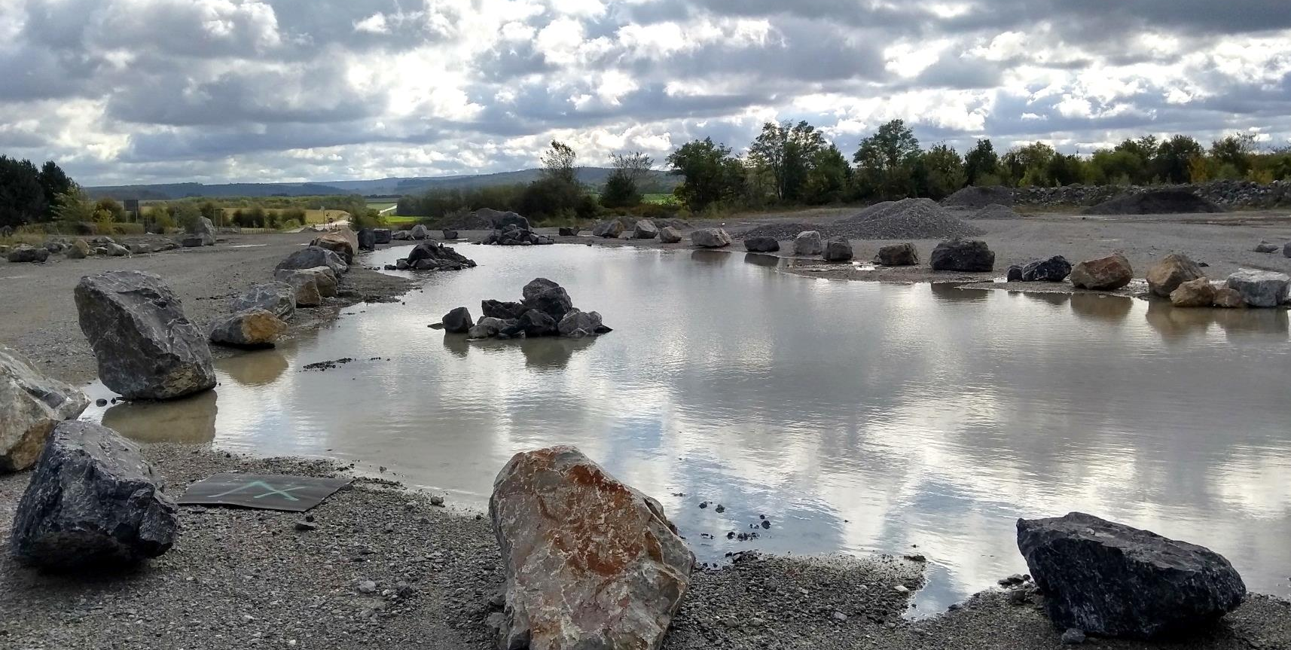
Integration of biodiversity by the industry : 3 axis
Notes:
In the project, we propose to develop and secure biodiversity in quarries by working on three axis :

Slide 11
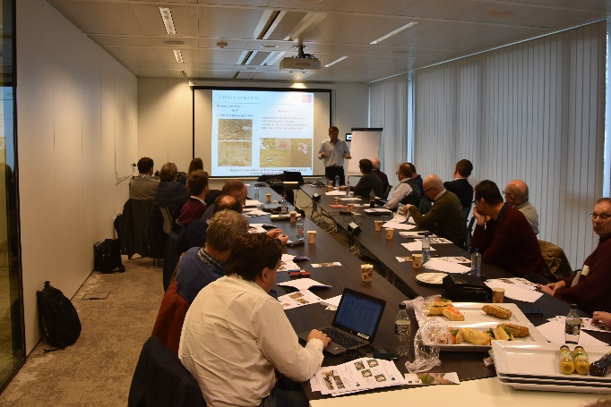
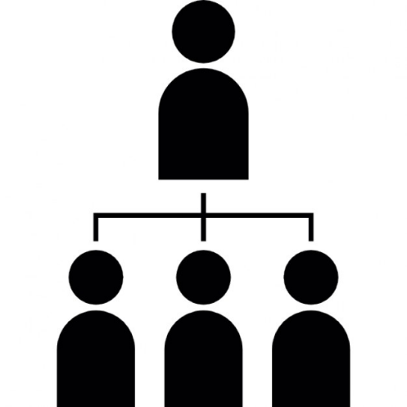
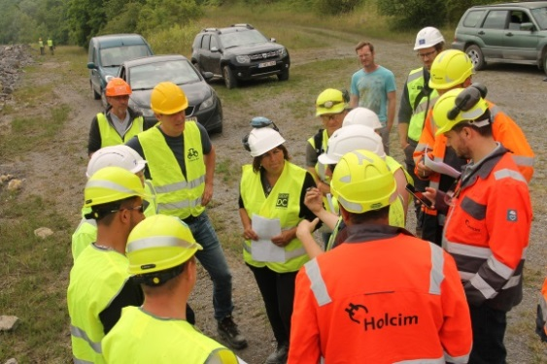
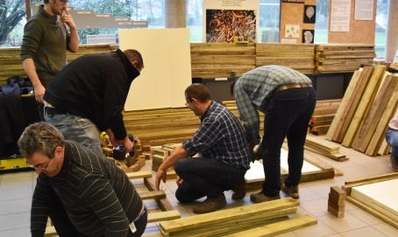
1. Transfer of Knowledge
Top Management: 17 CEOs
Biodiversity manager: ~ 40 pers.
Workers : > 200 pers.
Notes:
(1) The transfer of knowledge at different levels of the hierarchical chain aims at allowing quarry personnel to become aware of sites’ biodiversity and of ways to manage it.

Slide 12
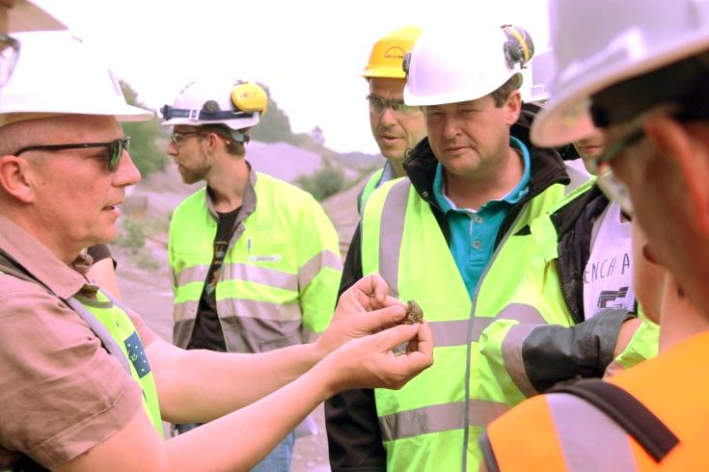
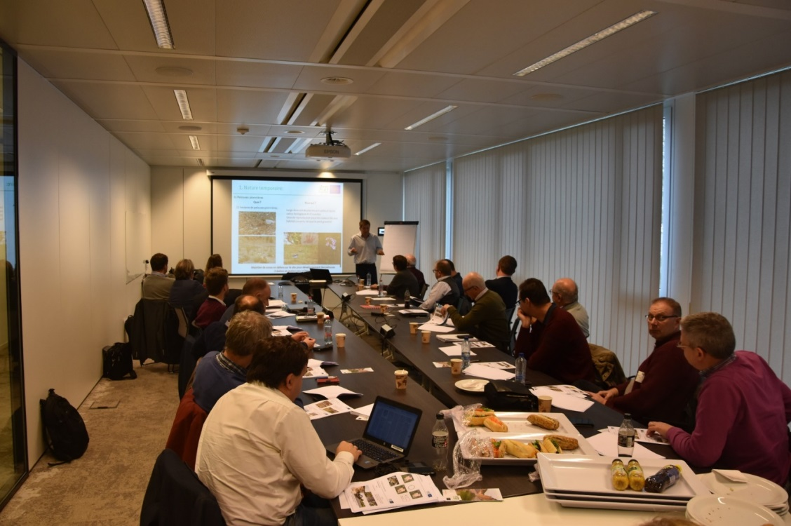
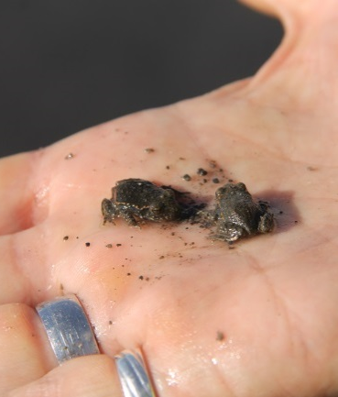
1. Transfer of Knowledge
Notes:
We adapt the resolution of the training to the level of attendees: from introduction to the relevance of integrating biodiversity in the business ecosystem for CEOs;
To direct contact with nature on sites for Quarry personnel and our ‘Miss & Mister biodiversity’

Slide 13
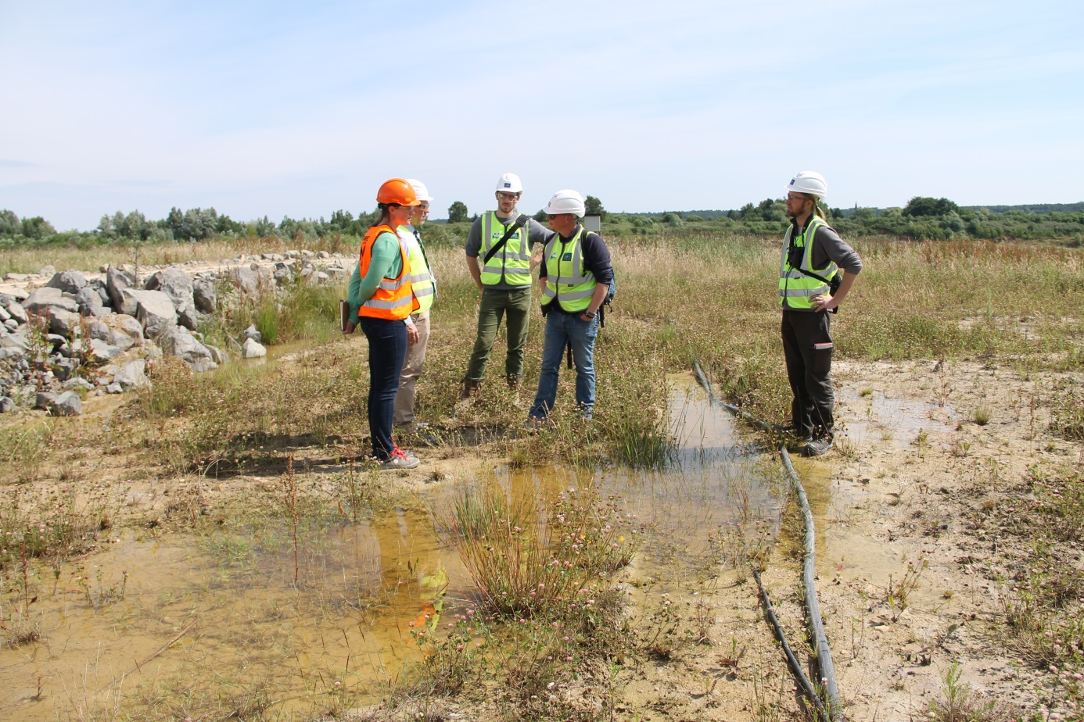
2. Quarries personnel as Biodiversity actors
Notes:
(2) On site, the trainings lead to the quarries personnel becoming actors of biodiversity along with specialists. From opportunities identified and explained, actions are proposed …

Slide 14
2. Quarries personnel as Biodiversity actors
Notes:
(2) … and implemented, by quarry personnel, to answer specific species’ needs.

Slide 15
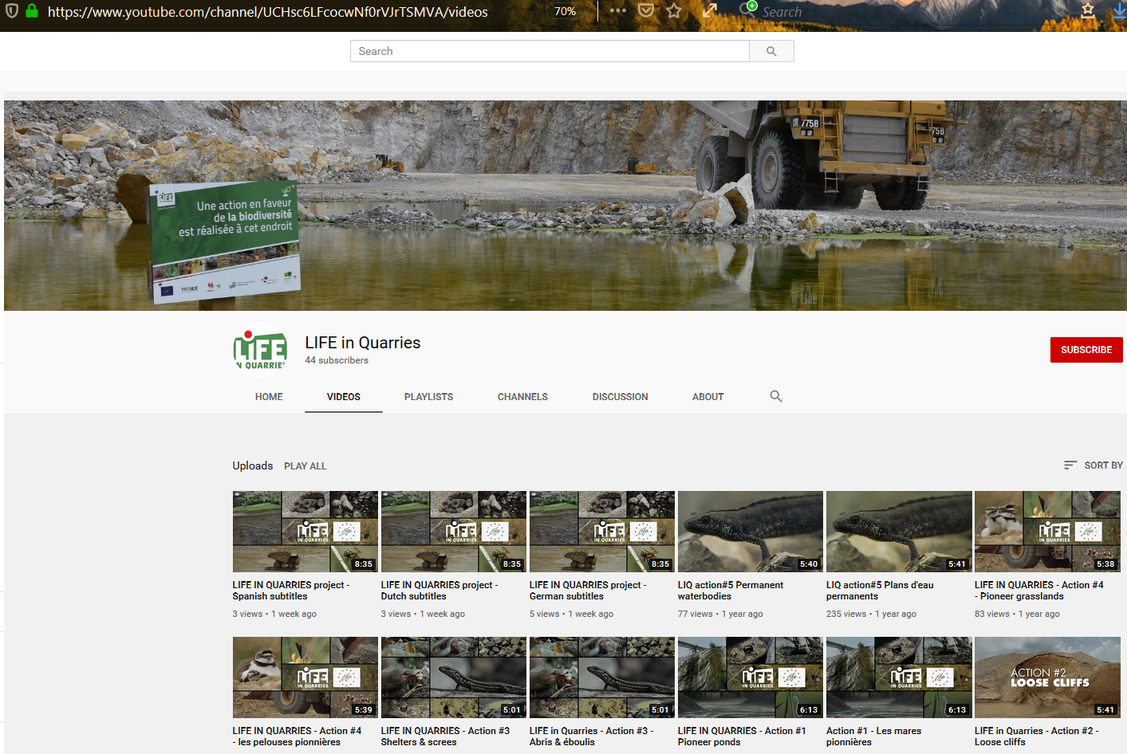
2. Quarries personnel as Biodiversity actors
Notes:
(2) To support implementation we developed video clips illustrating both the actions and targeted species.

Slide 16
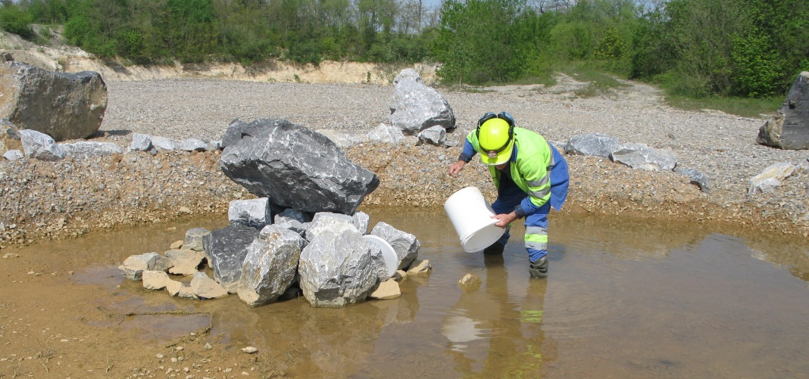
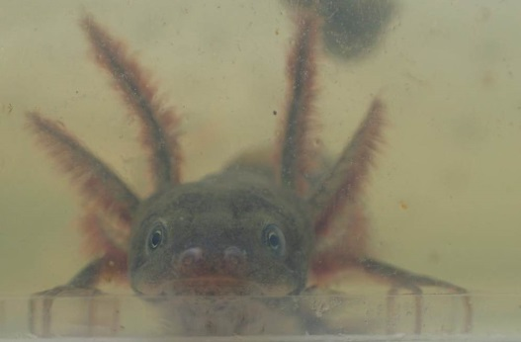
2. Quarries personnel as Biodiversity actors
Notes:
(2) The realizations leads to colonization of newly created biodiversity refuges and are a perfect set up for active introductions of beneficiary species. Quarries commit to manage these habitats and species on the long run through charters

Slide 17
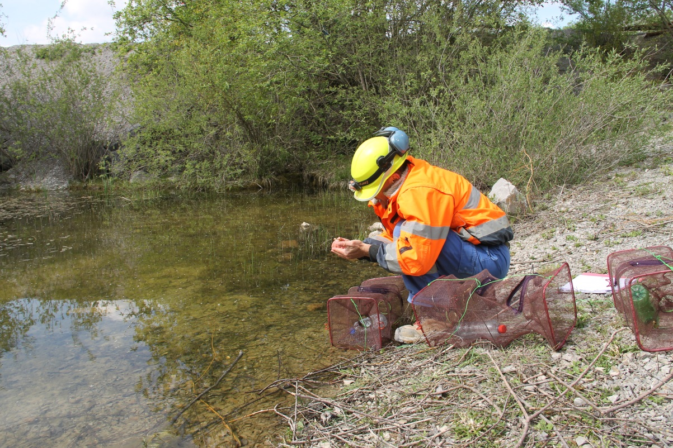
3. Monitor realizations
Notes:
(3) In highly dynamic sites, to allow for these charters to live on, we advocate for the integration, by site personnel, of a monitoring scheme and provide tools to do so.

Slide 18
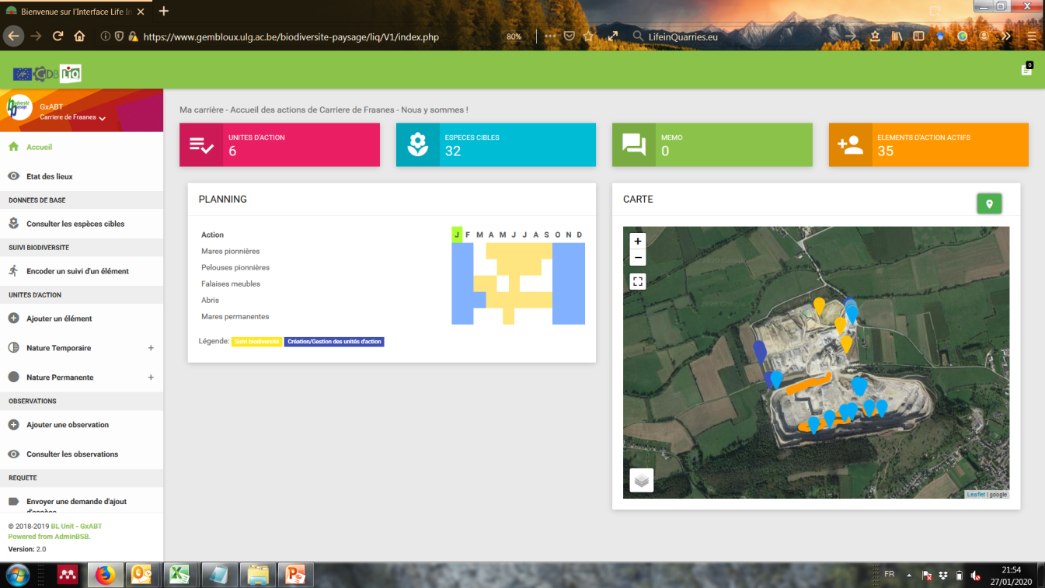
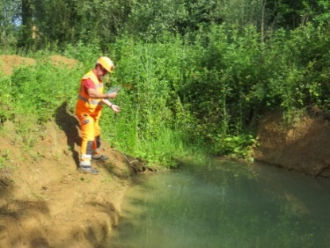
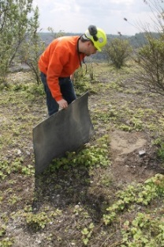
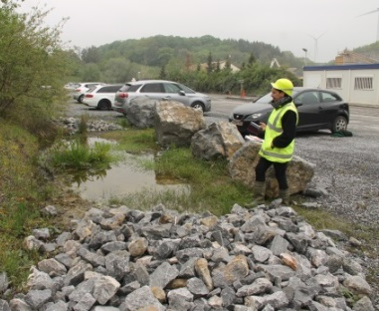
3. Monitor realizations
Notes:
(3) classical methodological tools such as leaflets have therefore been developed
but one of the originality of the Life In Quarries lies in the development of a simple web platform, allowing quarry personnel to monitor habitats created and their interest for biodiversity through simple indicators - such as butterflies colors.

Slide 19
We Invite you to see what is feasible in EU Quarries @
Quarries as opportunity for biodiversity and ecosystem services – A European approach
24 – 26 June 2020 – Liège, Belgium
www.lifeinquarries.eu
www.gembloux.ulg.ac.be/qa2020/
Notes:
We invite you to further learn on how it is possible to work on biodiversity in EU Quarries, after this short introduction I’ll thus finish by inviting you to attend the second edition of the Quarries Alive conference, held in Belgium in June, and specifically invite the EU to take advantage of the platform to share its strategy to promote biodiversity and ecosystem services in the industry!

