Slide 1
Nanoindentation for sub-miniaturized testing of irradiated steels: finite element modeling and experiments
Tymofii Khvan
SCK•CEN mentor: Dmitry Terentyev
University of Liège promoter: Ludovic Noels
Internal workshop on finite element modelling
04.02.2020

Slide 2
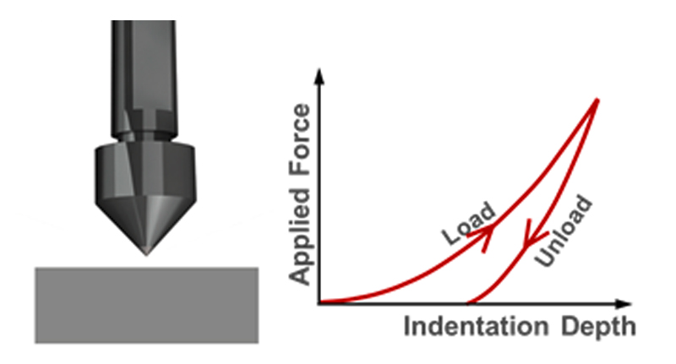
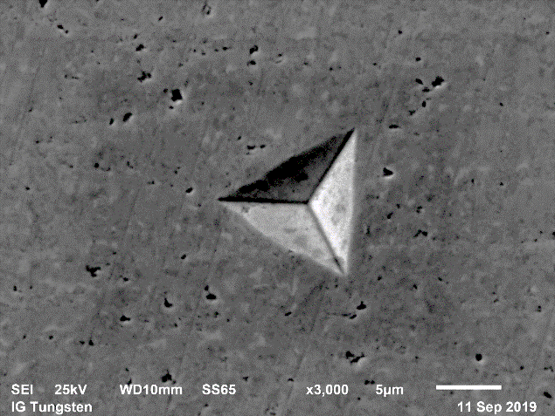
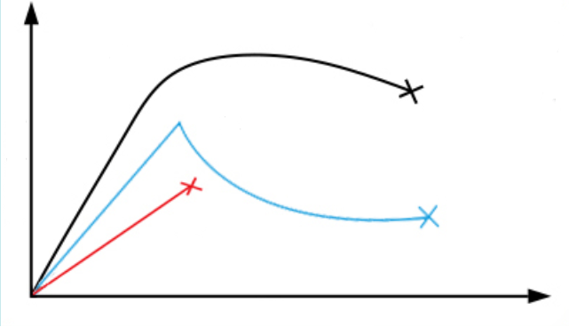
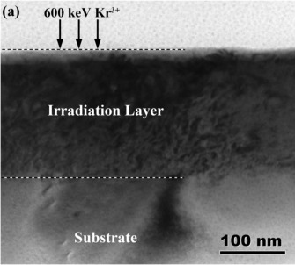
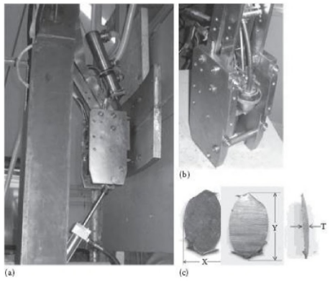
Nanoindentation test
Pyramid-like (not only) indenter probes a material by immersion
Affects a small volume of material (miniaturization concept)
Has a lot of applications:
Testing of thin ion-irradiated sub-surface layer
Testing of in-service structures where small piece of material can be safely cut out
Characterization of mechanical properties when tensile testing is not achievable: strain softening, embrittlement (irradiation effects)
Normal test curve
2020 Anton Paar GmbH
Stress
Strain softening
Brittle material
Strain
Q.R. Xie. Journal of Solid State Chemistry 231 (2015) 159-162
Scooped boat-shaped coupon from reactor core shroud, BARC, India.

Slide 3
Finite element modelling of nanoindentation
NI test data
Constitutive laws from tensile test/reverse FEM
NI FEM model
Prediction
Irradiated stress-strain curve
Irradiation effect
Notes:
We target to elaborate the FEM nanoindentation model as a user-oriented tool, which does not require or requires a minimum of coding or validation from the end user.

Slide 4
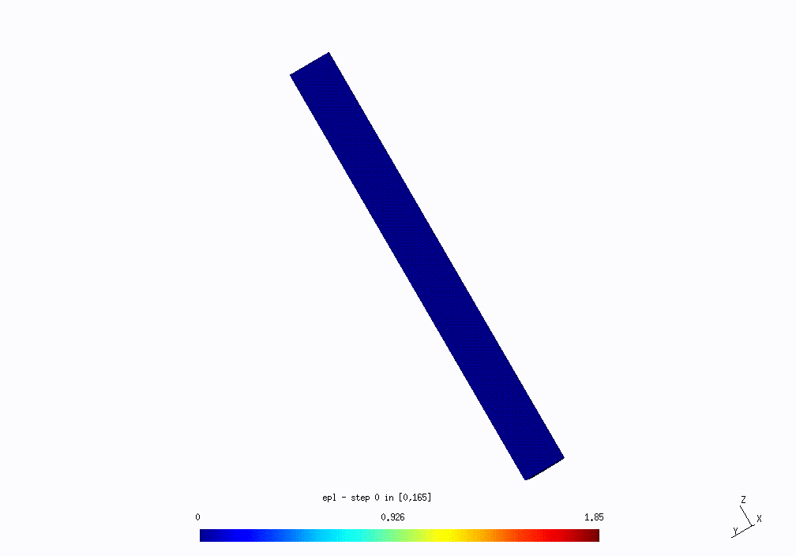
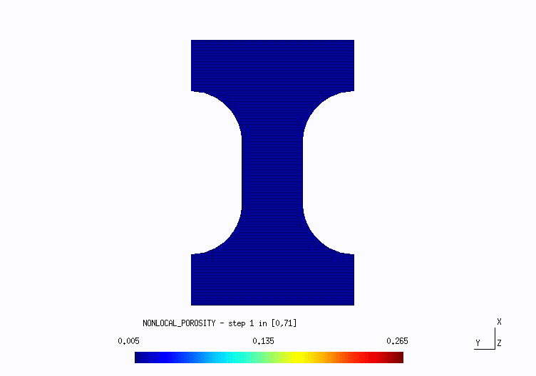
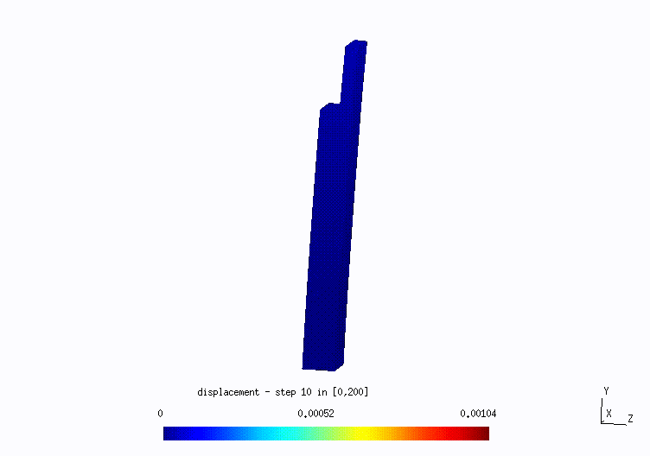
CM3Libraries for Gmsh
Features:
Solver is based on dis-/continuous Galerkin method
Allows to apply different theoretical models to different domains
Allows to apply an interdomain
Includes different theoretical models
Connected to Gmsh mesh generator
Allows user improvements (highly useful in case of numerical instabilities)
Non-commercial and free to use
J2 flow theory of plasticity
Cohesive crack model
Non-local Gurson failure model
Composite laminates failure

Slide 5
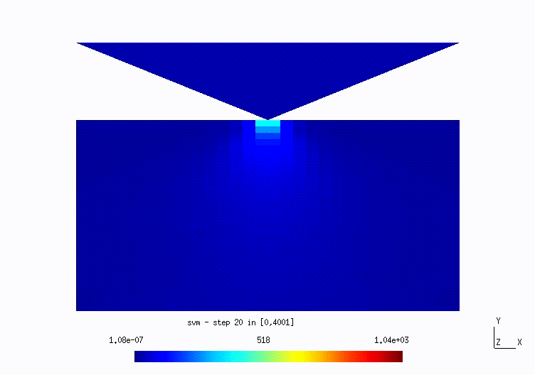
Indentation of single crystal
1 mm

Slide 6
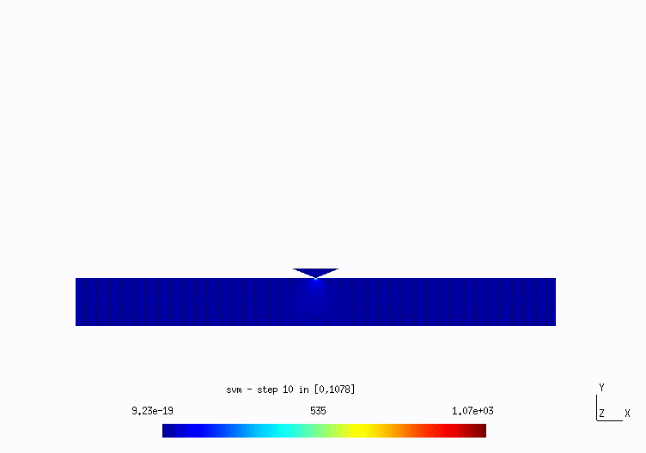
Indentation of polycrystal
1 mm

Slide 7
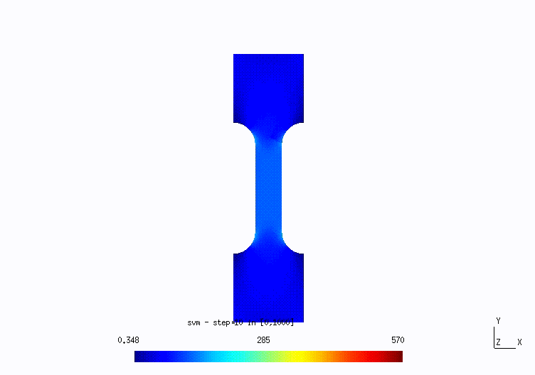
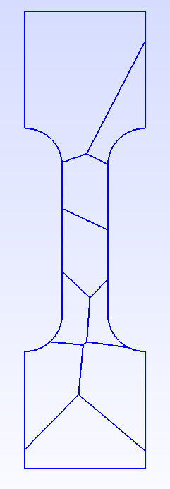
Tensile test of dogbone polycrystal (ε = 2%, T = 400 C)
16 mm

Slide 8
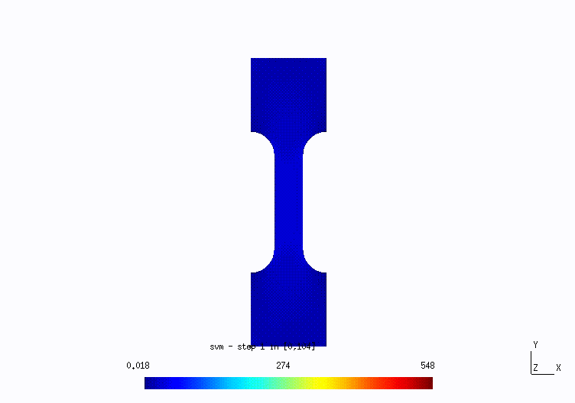
Tensile test of dogbone polycrystal with intergranular fracture (T = 0 C)
16 mm

Slide 9
Thank you for your attention!

Slide 10
