Slide 1



PhD progress presentation
Nanoindentation for sub-miniaturized testing of irradiated materials: FEM analysis and experiments

Slide 2
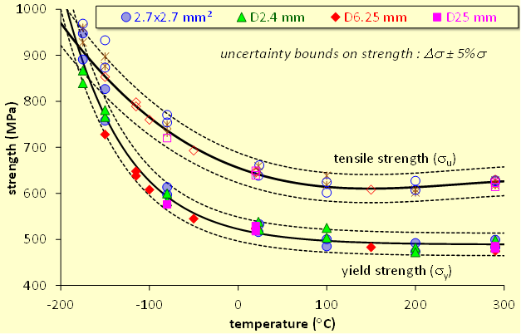
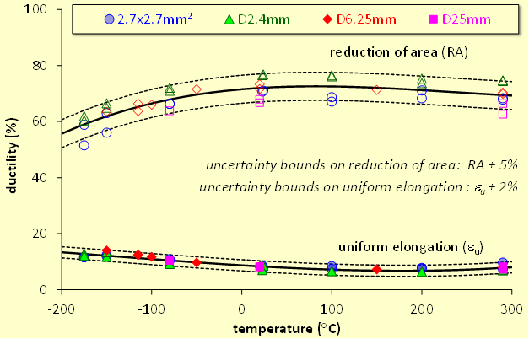
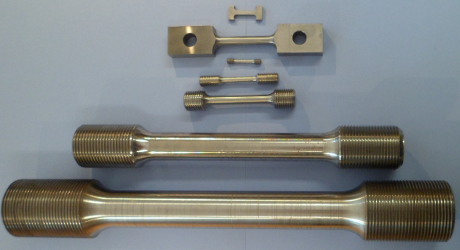
Purpose of the research
Miniaturization concept in nuclear materials research:
Less activity on contact
Saves human resources
Decreases time and costs
Solution for limited availability of irradiation space
Well scalability of mechanical properties with the decrease of dimensions
Nanoindentation:
Almost unlimited reusability of specimens
Non-destructive
Requires microscale volume for testing
Well informative technique
UTS and yield stress values of temperature for different size specimens
Reduction of area and uniform elongation values of temperature for different size specimens
D25mm
D6.25mm
ID font color corresponds to the one from the graphs above
2.7x2.7 mm²
D2.4 mm
Notes:
I will start from the reminder of the main purpose of my project. This is the miniaturization concept in nuclear materials research. It is an important approach which has the following features: ! smaller specimens have less activity on contact, ! it saves the human resources by lowering the irradiation dose to personnel involved in post-irradiation testing, ! decreases irradiation time and costs. ! It is also a great solution for limited availability of irradiation space and ! has a good scalability with the decrease of specimen dimensions what you can see on the graphs on the right. Plastic and strength properties match very well for the specimens of different sizes from the picture above. Regarding nanoindentation, ! we can say that it provides almost unlimited reusability of specimens, ! it is non-destructive test and ! requires microscale volume for testing. On top of these, ! it is well informative technique in materials sciences.

Slide 3
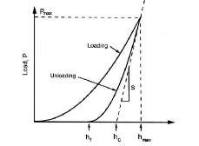
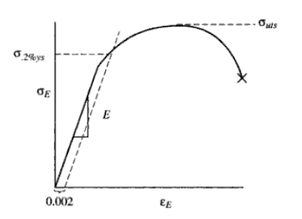
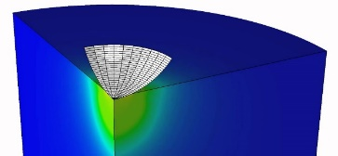

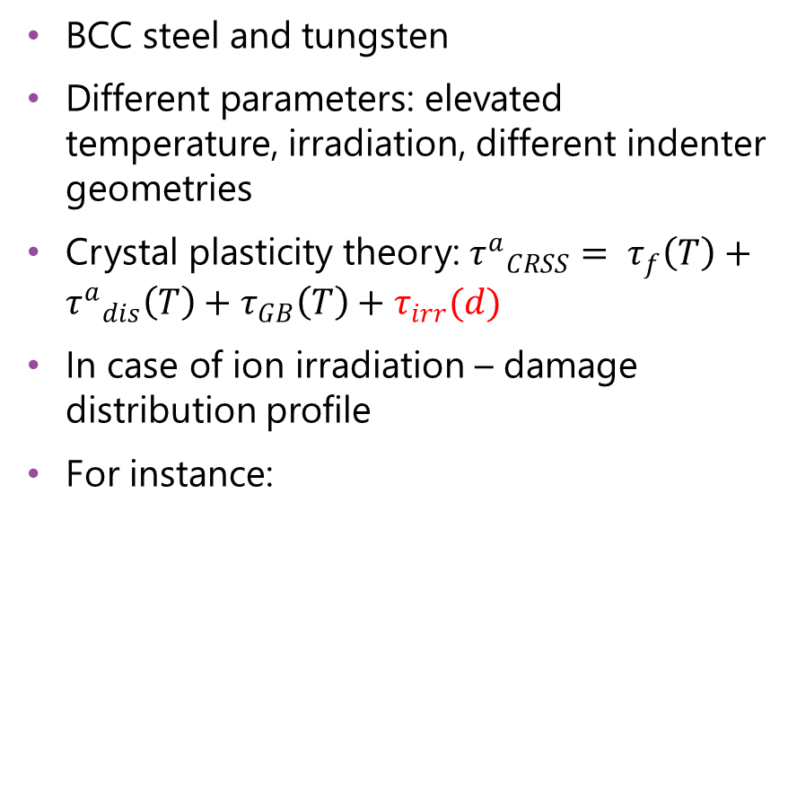
Goals of the research
Main goals:
Development and validation of nanoindentation FEM model for reactor materials and the use of it to derive the elastoplastic-deformation laws of irradiated materials
Demonstration of predictive capability of the model by simulating conventional tests
Support in assessment of mechanical tests applied to harvest the design data such as fracture toughness or plastic deformation capacity before and after irradiation
BCC steel and tungsten
Different parameters: elevated temperature, irradiation, different indenter geometries
Crystal plasticity theory: ${τ^{a}}_{CRSS}= τ_{f}\left(T\right)+{τ^{a}}_{dis}\left(T\right)+τ_{GB}\left(T\right)+τ_{irr}(d)$
In case of ion irradiation – damage distribution profile
For instance:
NI test data
Constitutive laws from tensile test/reverse FEM
NI FEM model
Irradiated stress-strain curve
Irradiation effect
Notes:
Now about the goals. ! The first goal or how we also call it – baseline goal, is to develop and validate the nanoindentation FEM model for fusion and fission materials and then the use of it to derive the elastoplastic-deformation laws of these materials in irradiated state. ! The primary materials of interests are BCC steel and tungsten, ! the model should include different parameters …. ! Crystal plasticity theory is chosen as a basis, one of the main reasons for this – is the expected possibility to add an additional parameter tau irr which can be a term or a function on top of crystal plasticity critical resolved shear stress formulation for simulating the irradiation hardening. ! In case of ion irradiation it is important to describe the effect of irradiated hardening distributed in non-uniform damage profile. ! As an example of the NI model application is to input nanoindentation test data, true stress-strain curve from tensile test or even from reverse FEM and receive an irradiated constitutive law.
The second goal or medium-ambitious goal, is to demonstrate the predictive capability of the model by simulating tensile or 3-point bending tests and the third one or ultimate goal is to assess or to support an assessment of important mechanical tests applied to harvest the design data such as fracture toughness or plastic deformation capacity before and mainly after irradiation.

Slide 4


Applicability of the FEM NI model
σ
Gurson damage model
with softening
Elastic law
J2 plasticity
2
(2)/3
2
- Irradiated material with softening
σ_{y}
- Reference material
σ_{y}
- ${τ^{a}}_{CRSS}$
σ_{y}
σ_{y}
- ${τ^{a}}_{CRSS}{+ τ}_{irr}(d)$
2
2
(2)/3
F
0
Elastic law
J2 plasticity
Gurson damage
model
ε
Demonstration of predictive capability.
Assessment in plastic deformation capacity estimation and fracture toughness test
3
0
d
Notes:
Speaking about the second and the third goals, let’s consider exemplary deformation curves. After the derivation of a deformation law by crystal plasticity NI FEM, the obtained data can be used to simulate tensile and 3-point bending tests by using combinations of other theories like J2 plasticity in combination with damage model (Gurson, Chaboche) but the last one is not compulsory. One can demonstrate that the same J2 model, whose parameterization was assisted by NI results, can describe tensile and three point bending tests applied at least on the initial stage of plastic deformation (before the void damage begin to operate) to the chosen material.
For the third goal a combination of J2 FEM and damage model will be used to estimate the fracture toughness or plastic deformation capacity. In the very end, the set of the tools mentioned above have to demonstrate that all of the prescribed steps could be (or not) performed and confirmed with experiments for a chosen material (say iron or Eurofer97 steel, or tungsten).

Slide 5
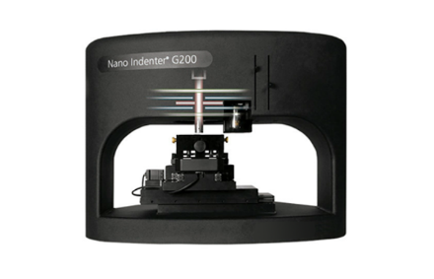
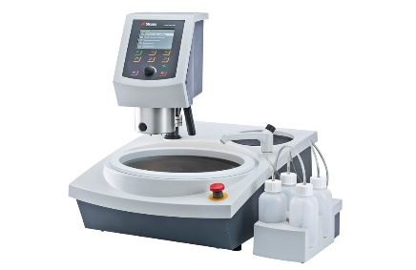
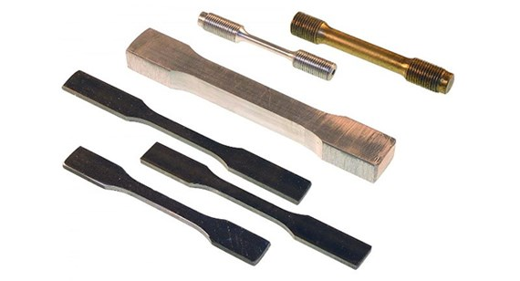
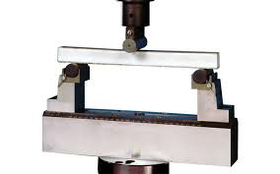
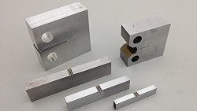
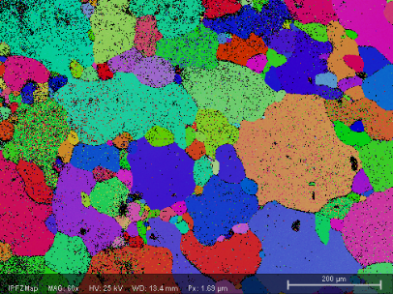
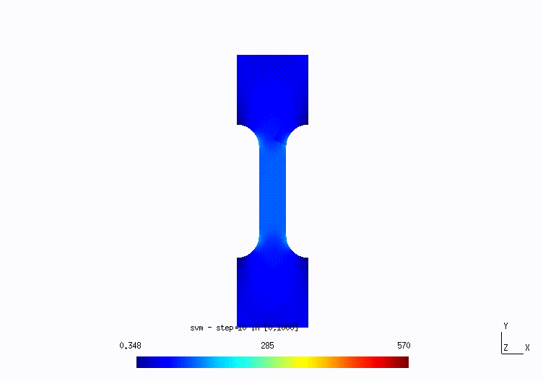
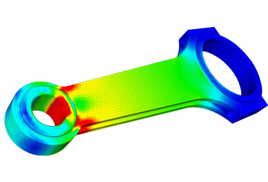
Skills required to achieve the goals of the research
Nanoindentation:
Testing setup
Specimen preparation
Other testing benches:
Tensile tests
3-point bending tests
Fracture toughness tests
Microstructure investigations:
Scanning electron microscopy
Electron backscatter diffraction analysis
Finite element modelling:
The use of gmsh and cm3Libraries
General understanding of FEM principles
✓ Obtained
✓ Obtained
To be obtained
✓ Obtained
✓ Obtained
✓ Obtained
✓ Obtained
Partly obtained
Partly obtained
Notes:
The onward discussed skills are important for successful implementation of the goals. From the nanoindentation point of view ! I had to study the operation process for testing machine and ! specimen preparation process. Both skills are obtained. Other important testing benches are ! tensile testing machine, ! 3-point bending testing machine and ! fracture toughness testing machine. Tensile and 3 point bending are studied, fracture toughness is not yet. But should not be a problem because they all are very similar to each other.
! For microstructure investigations SEM and ! EBSD were important. Both I can do myself, the pictures on the slide were taken by me.
And from the modelling point of view I presumed two main points – ! the use of the code of Ludovic and ! general understanding of the FEM principles. I would call my progress as “Partly obtained” for both, because one is a strong tool with a lot of different features and another is a huge scientific field. Some of the things are clear to me, some I just know how to use, some I am still studying and some are yet far from my understanding.

Slide 6
Methodology
Nanoindentation tests performed
Experiments:
For the first goal (FEM NI model development):
Nanoindentation tests
Corresponding tensile tests for validation
For the second goal (demonstration of predictive capability):
Tensile tests are expected to be enough from the previous part, but can be performed more if needed
3-point bending tests under different conditions
For the third goal (support in harvesting the design data):
Fracture toughness tests under different conditions
Type of material/Type of condition | Pure Fe | Deformed Fe | FeCrC | F/M steel | Tungsten (reference/deformed)
Room temperature | Done | Done | To be done | Done, more to be done | Done
Elevated temperature | To be done | To be done | To be done | To be done | To be done
Irradiated | Done | To be done | To be done | Done, more to be done | Done
Tensile tests performed
Type of material/Type of condition | Pure Fe | FeCrC | F/M steel | Tungsten
Room temperature | Done by my group, but needs a review | To be done | Done by my group | Done by my group
Elevated temperature | Done by my group | To be done | Done by my group | Done by my group
Irradiated | To be done | To be done | Done by my group | Done by my group
Notes:
Now I want to speak about methodology. The list of experiments needed for the model implementation is the following: ! for this first goal – nanoindentation tests, the list of performed tests you can see on the right. As it was decided, an implementation of the steel will be performed in several steps of raising complexity, from pure iron product to F/M steel. Green cells are performed tests, red are need to be performed, yellow – still an open question if it is needed and the blue ones are performed with some remark. ! For further validation, the corresponding tensile tests should be also performed and some of them are already done.
! For the second goal the tensile tests… and also ! 3point bending tests under different conditions. ! For the third goal only the fracture toughness tests are expected.

Slide 7
Methodology
Modelling:
For the first goal (FEM NI model development):
Step-by-step complication of the material constitution (pure Fe → BCC steel) in crystal plasticity
An implementation of the τ_{irr} term to simulate the irradiation contribution
Description of non-uniform ion-irradiated layer
Minor improvements if needed (indenter tip imperfection, pile-ups/sink-ins consideration)
Validation with tests
The steps for two other goals are depended on the way and success of the implementation of the first one, but the general idea is to combine the set of theories (J2 plasticity, hardening, damage models, etc.) to be able to simulate conventional mechanical tests of irradiated materials
Nanohardness-displacement curve of reference and ion-irradiated tungsten and roughly estimated non-uniform damage profile
Constitutive laws + τ_{irr}(d₁)
Constitutive laws + τ_{irr}(d₂)
Constitutive laws + τ_{irr}(d₃)
Constitutive laws + τ_{irr}(d_{n})
Notes:
From the modelling point of view, the following steps are needed for ! the first goal completion: step by step complication of the material constitution in crystal plasticity, ! an implementation of tau irr term to simulate the irradiation contribution, which is still a totally open question. ! Depending on this implementation, further description of non-uniform ion-irradiated layer is needed. One of the ideas is to divide the specimen geometry model into thin layers (domains) whereas each is having the same reference material constitution and different tau irr depended on depth. But still it is a topic for discussion.
! If needed, some minor impovements can be considered and performed. ! Validation with test.
The steps bla bla…

Slide 8
Objectives completed this year (May 2019 – May 2020)
Modelling part of the project
Connection of crystal plasticity model (ALAMEL, provided by Prof. Laurent Dellanay, UCLouvain) with cm3Libraries for gmsh (finite element solver developed by Prof. Ludovic Noels, ULiege) and its validation by ABAQUS
Fit of the constitutive parameters of ALAMEL material to switch from tungsten (previously used) to pure iron from the project
Studies of the use of cm3Libraries for gmsh by creating different geometries and draft simulations could be useful for future work
Experimental part of the project
Nanoindentation tests of pure iron with respect to different crystal orientations ([101], [111])
Nanoindentation tests of tungsten products under different conditions: reference, deformed, irradiated
Nanoindentation tests of F/M steel
Notes:
Now I want to talk about my progress and the main objectives done for the past year.

Slide 9
ALAMEL
Examples of validation:
Uniaxial tension:
Features:
Crystal plasticity based user-defined material for a finite element solver
Strong tool which makes calculations with respect to grains interactions
Constitutes the plastic material properties by a set of constants which describe dislocation dynamics parameters (Burgers vector, kink pair formation enthalpy, saturated/initial dislocation density, etc.)
Elastic properties are constituted by elastic coefficients
Connected to FEM solver via UMAT interface but can be also used in standalone mode
Pure shear:
Notes:
I will start from ALAMEL. What is ALAMEL? It is…
This are the ones I use to get the constitutive law for the materials of interests.
Standalone mode is the calculation mode without any geometry, where theoretical crystal of around 1000 grains is considered to behave under prescribed deformation tensor.
On the right you can see the validation with ALAMEL-ABAQUS combination, which has already been used to successfully perform another PhD project. As you can see it perfectly coincides.

Slide 10
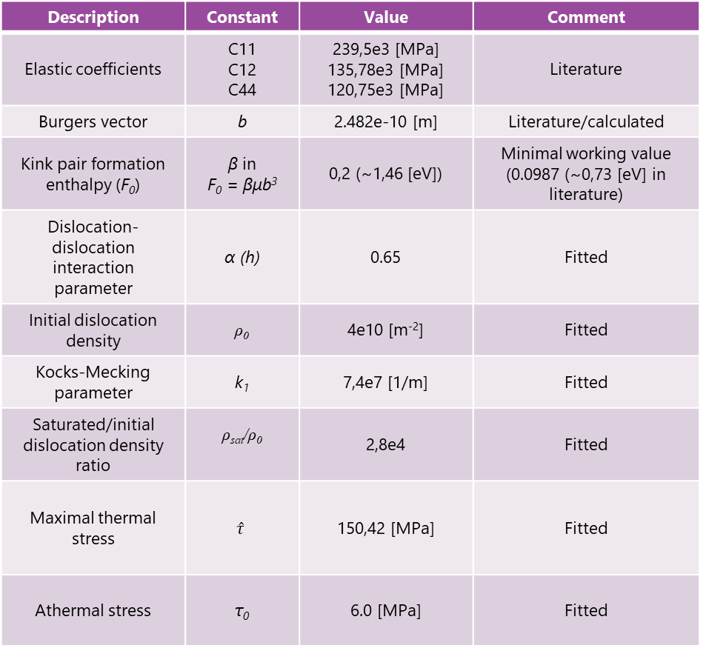
Material constants fitting
Description | Constant | Value | Comment
Elastic coefficients | C11 C12 C44 | 239,5e3 [MPa] 135,78e3 [MPa] 120,75e3 [MPa] | Literature
Burgers vector | b | 2.482e-10 [m] | Literature/calculated
Kink pair formation enthalpy (F₀) | β in F₀ = βμb³ | 0,2 (~1,46 [eV]) | Minimal working value (0.0987 (~0,73 [eV] in literature)
Dislocation-dislocation interaction parameter | α (h) | 0.65 | Fitted
Initial dislocation density | ρ₀ | 4e10 [m⁻²] | Fitted
Kocks-Mecking parameter | k₁ | 7,4e7 [1/m] | Fitted
Saturated/initial dislocation density ratio | ρ_{sat}/ρ₀ | 2,8e4 | Fitted
Maximal thermal stress | $$\hat{τ}$$ | 150,42 [MPa] | Fitted
Athermal stress | τ₀ | 6.0 [MPa] | Fitted
Notes:
To fit the pure iron product in alamel, parameters in the table were used. Nothing is really special there, just a value for kink pair formation enthalpy is two times higher than in literature, but the minimal possible value for the correct work of ALAMEL was chosen, below it the model simply crashes. On the right you can see the match of experimental true stress-strain curve and the ones given by ALAMEL with this set of parameters.

Slide 11
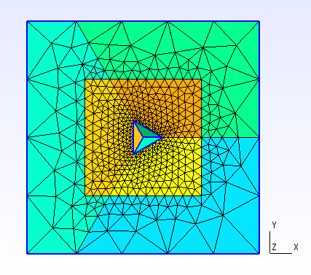
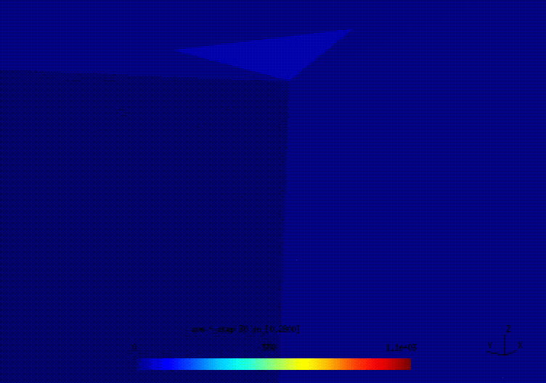
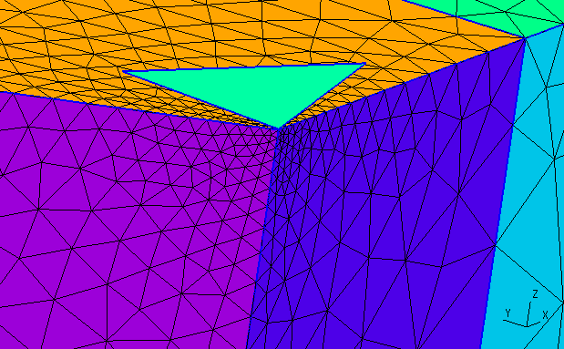
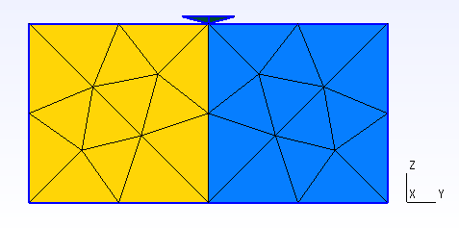
FEM of nanoindentation: geometry and meshing
Model parameters:
Specimen dimensions: 60x60x30 μm
Single crystal
Indenter immersion: 1,5 μm in 140 s
XYZ constrained on the bottom
Temperature: 273 K
<111>, <100> and <101> orientations
Notes:
After fitting the constitutive laws, so that could be potentially used to simulate the indentation of iron. Parallelepiped single grain specimen with dimensions of 60 60 30 um and the Berkovich three sided pyramid in the center of XY plane were built for FEM analysis. Boundary conditions were: ! displacement of the pyramid on 1.5 um down along Z and fixed along XY and the bottom ! XY plane (shown as red) fixed along XYZ. The force was archived also from the bottom XY plane. ! Temperature was 273 K and ! in total three simulations were performed to see the dependence of the grain orientation. ! Mesh was refined around the potential contact. ! You can see the animation of the immersion process from the inside, so that only one side of the pyramid and the corresponding piece of the specimen are shown.

Slide 12
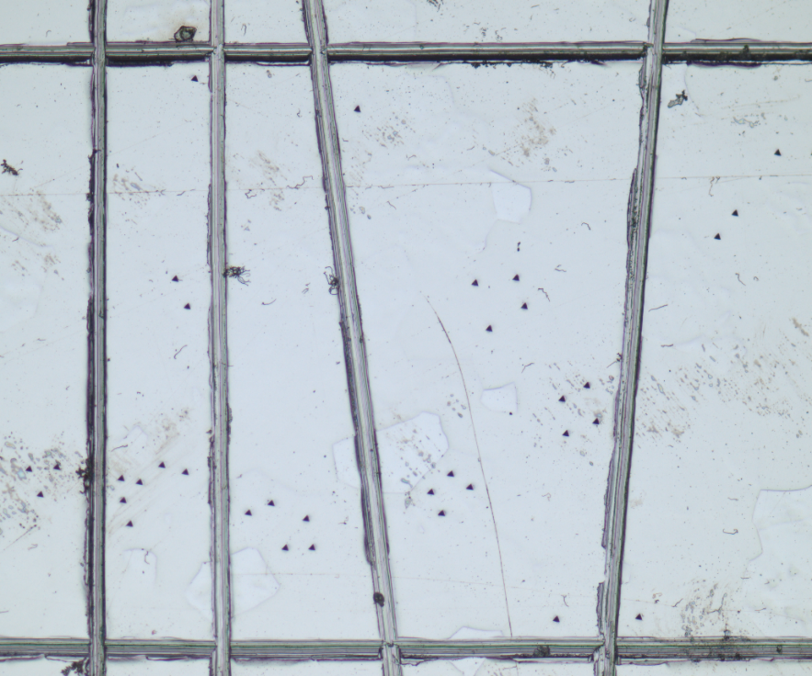
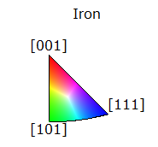
Nanoindentation of iron
EBSD map of pure iron marked with scratch lines and orientation legend
Photo of the same area made by optical microscope
The scratches (black lines on the EBSD map) were manually made with a sharp tool for better orientation on the surface area
Differently oriented grains of the same iron specimen were indented to compare hardness and load-displacement curves
Notes:
To compare the simulation output with an experimental data the pure iron product was indented with respect to grain orientations. For this, some scratches were made with a sharp tool for better orientation on the specimen surface and then EBSD map was acquired.

Slide 13
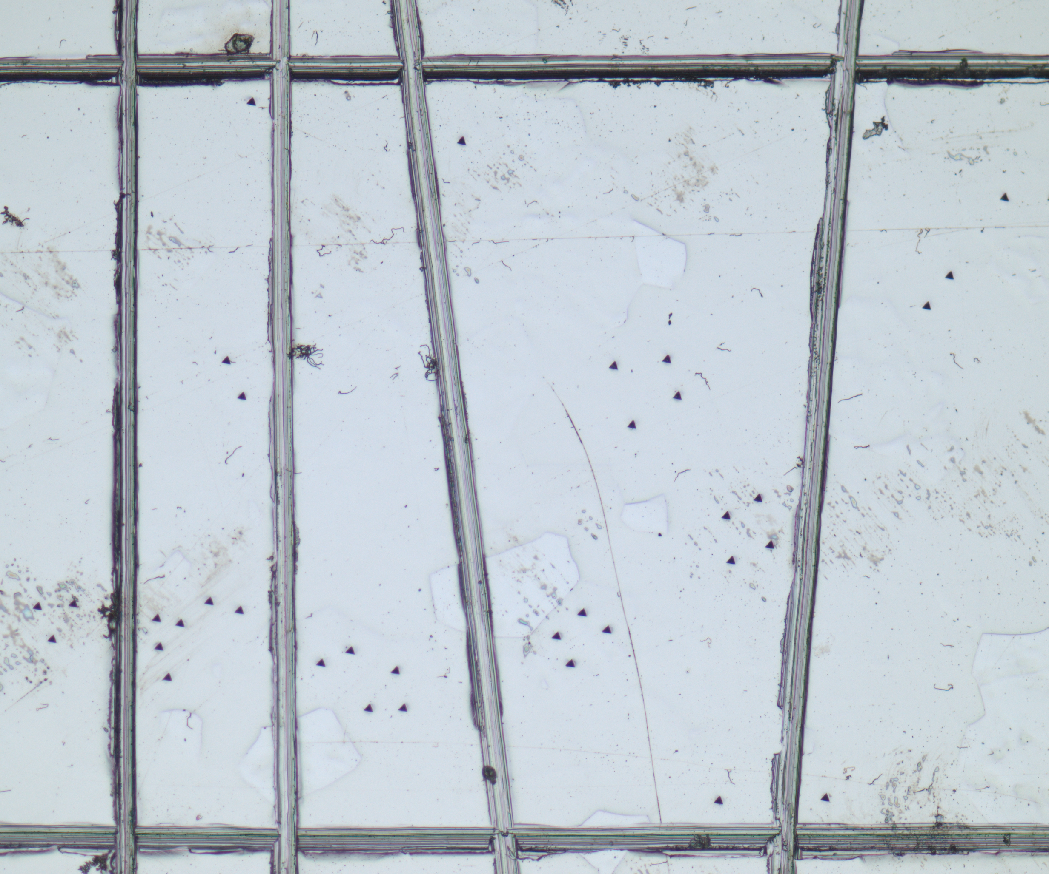
Nanoindentation of iron
In summary:
20 indents for [101]
18 indents for [111]
Overlapping (not 100% precise) of EBSD map and microscope picture
Notes:
By overlapping the optical microscope photo of indents and EBSD map, we can see the grains were indented. The averaged load displacement curves are then compared and as it can be seen on the graph on the right they coincide very well, so we can assume that the material response on the indenter immersion is not depended on the grain orientation at least for 101 and 111 directions. 001 can be also done for confirm the conclusion, but I don’t see any argument against it.

Slide 14
FEM and experimental results comparison
Displacement-force curves for [111] oriented crystal
Displacement-force curves for [101] oriented crystal
Displacement-force FEM curves for [100], [101]
and [111] oriented crystals
The same comparison for IGP tungsten.
Such divergence is probably due to sub-grains 0.6 – 4 μm size which were not included in modelling
Main conclusions:
The set of constants for user-defined material of ALAMEL simulating pure iron product can be used for establishment of FEM model of nanoindentation process at the room temperature
The load-displacement response is not depended on the crystal orientation for this iron product
Notes:
In comparison of FEM and experimental results we can see a good match. First two graphs compare the experimental and FEM force displacement curves in corresponding grain orientation. The third one on the very right compares only FEM curves for all three orientations. The same comparison was also made for iter grade tungsten previously used in ALAMEL, but the difference is quite high. I can assume, that it happens due to sub-grains 0.6 – 4 um size which were not included in the geometry of the model.

Slide 15
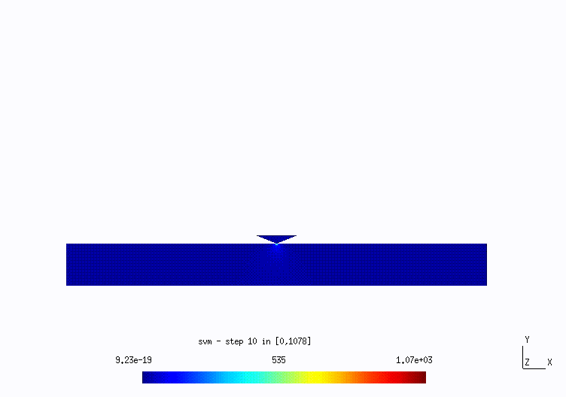
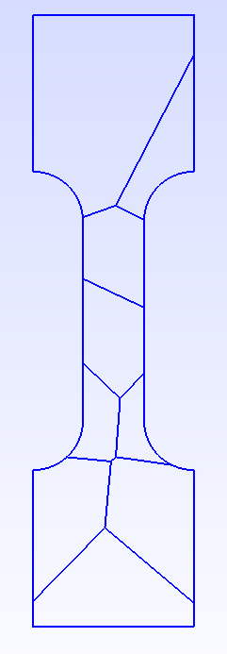
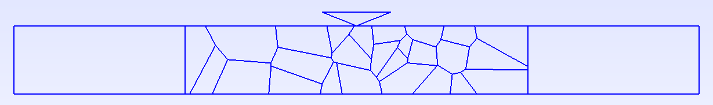
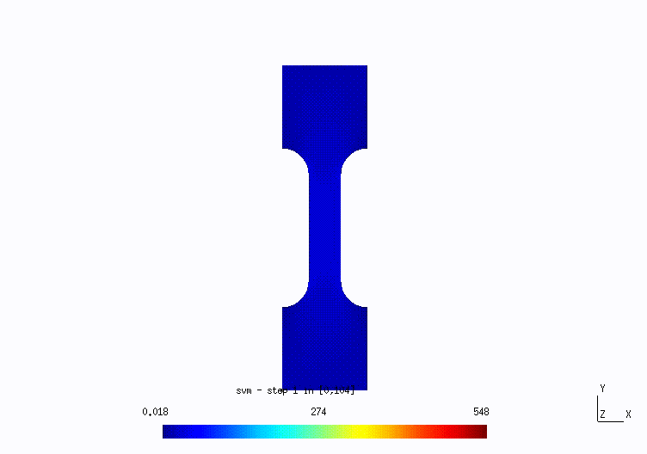
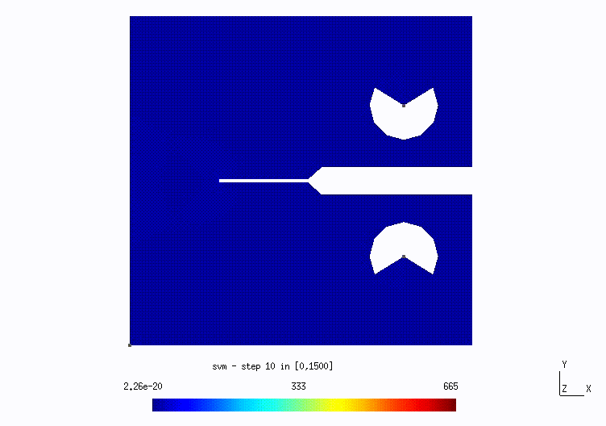
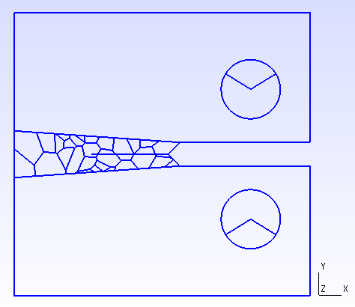
Other geometries and simulations
16 mm
1 mm
2D Vickers tip indentation of polycrystal
2D Tensile test (ε = 2%, T = 400 C)
16 mm
~10 mm
~10 mm
2D Intergranular fracture during tensile test
2D E399 CTS single crystal
2D E399 CTS with Voronoi pattern
Notes:
Some other draft simulations and geometries I was working on

Slide 16
Nanoindentation results
Reference and irradiated iron
Deformed reference and irradiated iron
Deformed reference and irradiated iron
Reference and irradiated ultrafine-grained tungsten
Reference and irradiated tungsten with elongated grains
Deformed reference and irradiated tungsten with elongated grains
Notes:
Nanoindentation load displacement curves for different reference and irradiated iron and tungsten products from the test table mentioned in methodology slide

Slide 17
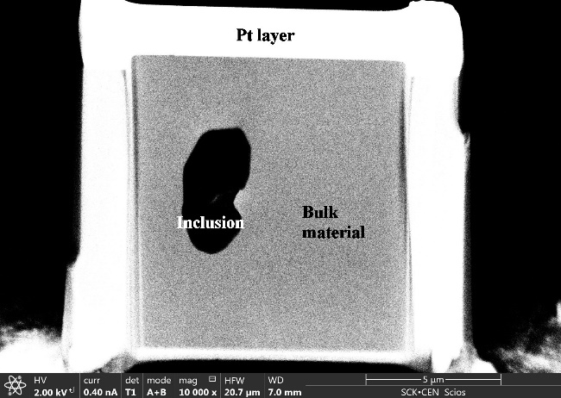
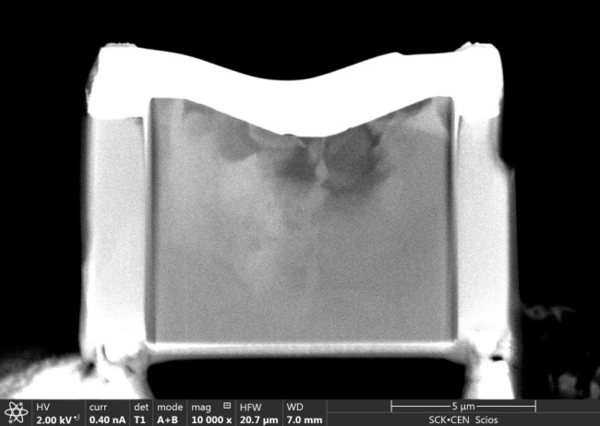
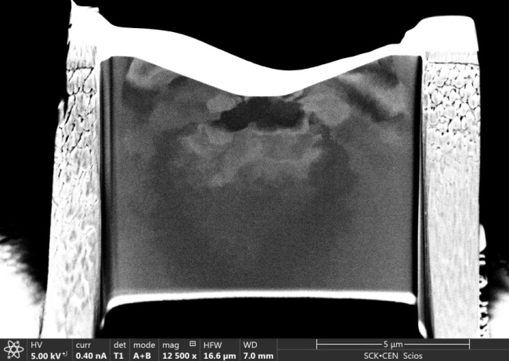
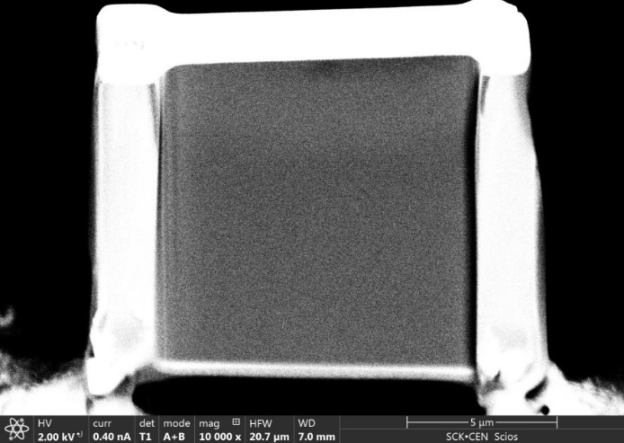
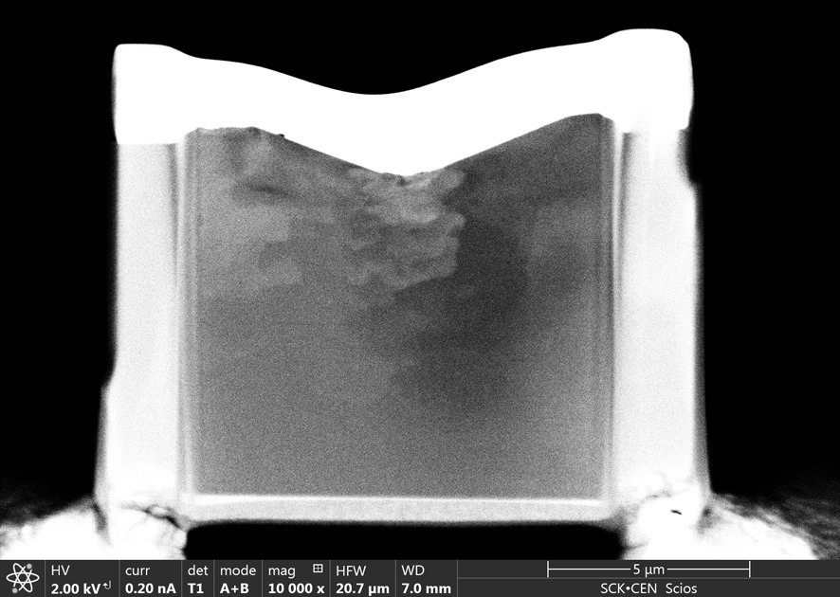
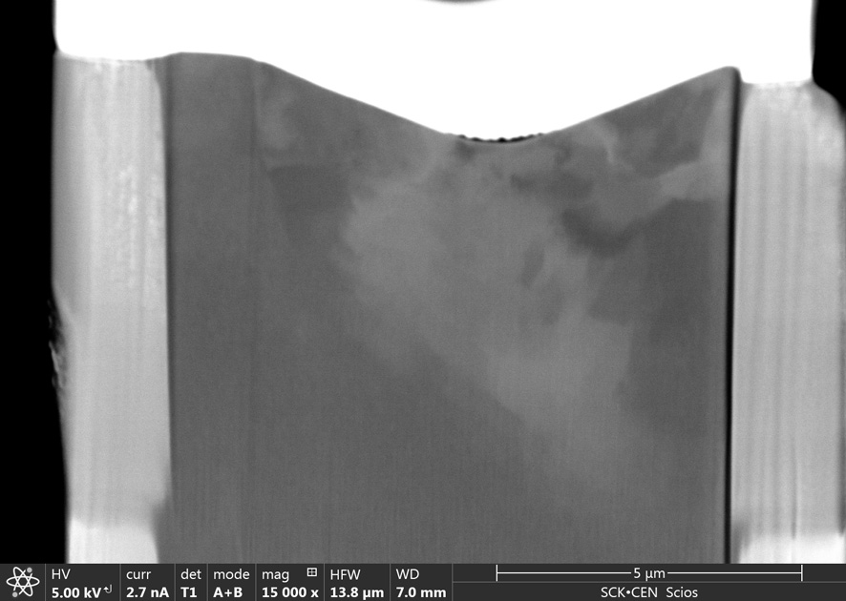
Investigations below and next to the indent
Area far from the reference iron indent
Area below the reference iron indent
Irradiation parameters:
300 ºC
Fe²⁺ at 5 MeV
1 dpa
Area far from the ion-irradiated iron indent
Area below the ion-irradiated iron indent
Notes:
Another interesting work using focused ion beam was performed in our lab. The indent adjacent area in irradiated and reference iron specimen was burnt using FIB and investigated with SEM and TEM. On the pictogram you can see the schematic indent made with normal lines and the removed area with dashed rectangles. ! Firstly, the area far away from the indent were investigated, to make suggestions about affection of this zone by indentation. As you can see both reference on the top and irradiated on the bottom specimens do not show any distortions, despite of the random inclusion, so one can say that only the area below the indent was affected as it can be seen here. ! From these SEM photos it is hard to say that the damage propagates differently in both reference and irradiated specimen so let’s take a look on the TEM results

Slide 18
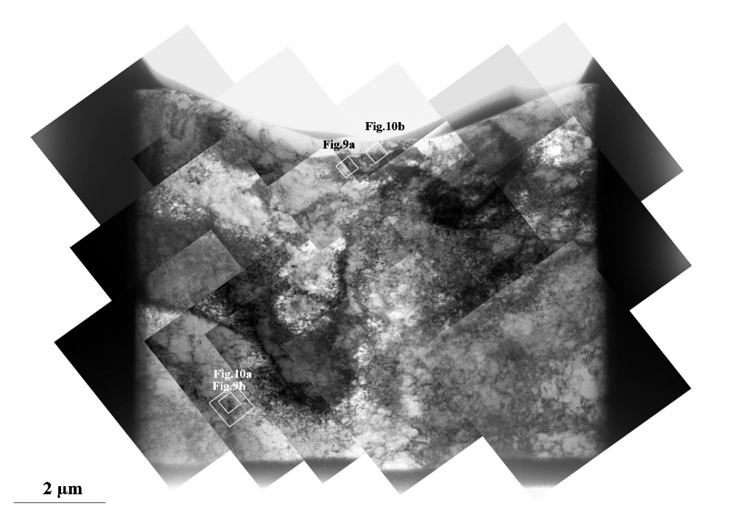
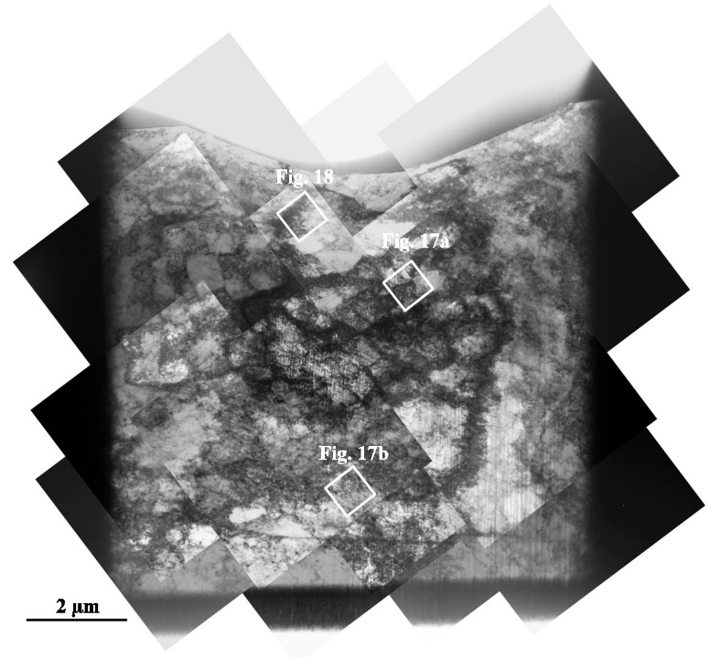
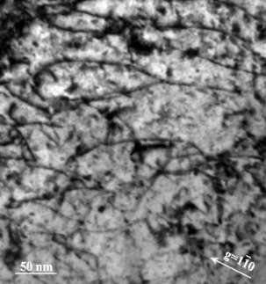
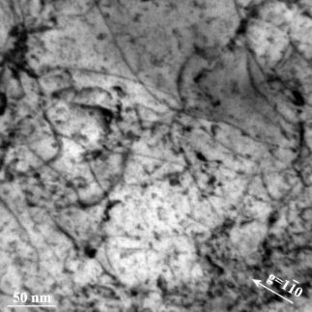
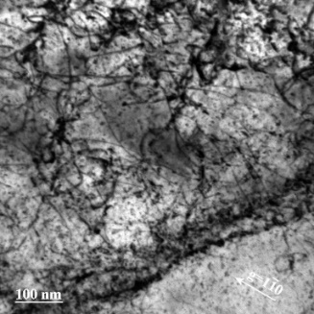
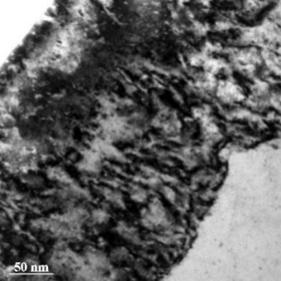
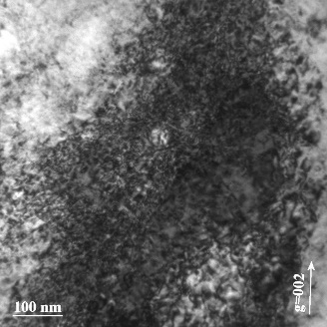
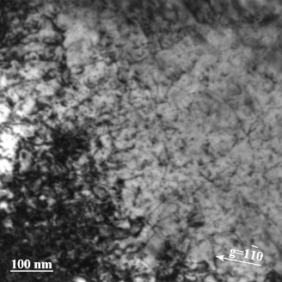
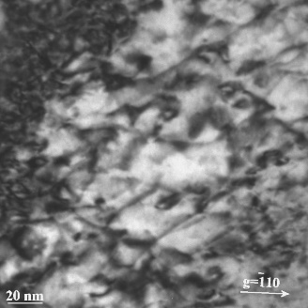
Investigations below the indent
TEM images of the area below the reference iron indent
TEM images of the area below the ion-irradiated iron indent
Fig. 9a
Fig. 9b
Fig. 10a
Fig. 10b
Fig. 17a
Fig. 17b
Fig. 18
Dislocation density:
near tip – 1.37 ∙ 10¹⁵/m²
below tip – 0.85 ∙ 10¹⁵/m²
Slip band (a) and low angle grain boundary (b)
Dislocation density
undistinguishing high deformation area
distinguishing zone - 1.1 ∙ 10¹⁵/m²
Defects associated with ion irradiation damage (dislocation loops)
Notes:
On this slide you can see the TEM photos of reference on the left and irradiated on the right areas under indents. The first important thing to be observed, ! it is the difference in dislocation density close to the tip. In reference specimen, (9a) the individual lines are clearly seen and the density can be calculated which is 1,37 by ten to the fifteenth reversed squared meteres. In the irradiated specimen, some areas had so high deformation area, so the individual lines could not be observed. It means more plastic deformation in the irradiated specimen. ! Second observation, is dislocation density far from the tip. As it was calculated, for the reference specimen it equals to 0.85 by ten to the fifteenth reversed squared meteres and by ten to the fifteenth reversed squared meteres for the irradiated one. This means that in the irradiated specimen, the plastic deformation zone does not propagate further then in the reference one. ! The third thing to be noted – circular defects in the irradiated specimen, which are most likely ion-induced dislocation loops. They act as obstacles for dislocation movement and keep the deformation in a certain zone.
! The last thing to be noted is a formation of slip bands which can transform into low angle grain boundaries at high dislocation density values.

Slide 19
Investigations below the indent
Main conclusions:
The plastic zone propagates close to the indent both in reference and irradiated iron with the radius of approximately factor 7 to penetration depth
Harder irradiated material needs more force to create an indent with the same size as in the reference one. However, the plastic deformation does not extend deeper in this case, which happens due to blocking of dislocations movement by ion induced defects
Therefore, the amount of plastic deformation in the irradiated specimen is higher, but also limited by a certain zone, which leads to the areas contained such high amount of dislocation, that the individual lines are not visible
At sufficiently high dislocation density, previously formed dislocation slip band can transform into low angle grain boundaries
Notes:
So, let’s conclude:

Slide 20
Knowledge dissemination
During this year:
Nanoindentation round robin work of several labs determining the indentation size effect
An experimental work on several chromium products
Nanoindentation work on several tungsten products in reference, deformed and irradiated states
Published paper in Nanomaterials
Poster presentation at PFMC-17, Eindhoven, the Netherlands.
Submitted paper to the Journal of Nuclear Materials
Submitted paper to the Journal of Nuclear Materials

Slide 21
4 year plan
 | Year 1 |  |  |  | Year 2 |  |  |  | Year 3 |  |  |  | Year 4
Experimental part: 1. Ref. experiments
2. Validation
Modeling part: 3. Room temperature
4. Elevated temperature
5. Irradiation effect
6. Validation
Knowledge dissemination: 7. Literature review
8. Writing thesis
9. Publications
I am here
Notes:
To finish the presentation, I want to discuss my future 4 year and closest plans. This is the table I use to show my PhD 4 year plan which I use since I was a candidate for this position. I have added these blue cells to expand it a bit because of the increase of my understanding. I want to note that at the moment everything is going according to the plan, and the experiments and validation should be going step-by-step to satisfy the appearing new needs.

Slide 22
Next year plan
 | Year 2
 | May | June | July | Aug. | Sept. | Oct. | Nov. | Dec.
Experiments
Modelling of reference Fe at elevated temperature
Modelling of deformed Fe at RT and elevated temperature
Geometry and constitutive laws for FeCrC or steel, NI at RT
Irradiation effect implementation
Notes:
For the plans until the end of the year. In the end of May or in the beginning of June we have already agreed a small experimental campaign to perform some elevated temperature nanoindentation tests of reference steel and iron up to 400-500C. Then this data can be used to validate the output of FEM at the elevated temperature. Meanwhile, I will be working on the deformed Fe constitution. To start, I will keep the set of constants as in reference Fe, but the initial value of dislocations density I will set higher, and the saturated value I will calculate to keep the same ratio in the end. Let’s see what it will give
In the end of summer I am planning to start to work on the geometry and constitutive laws for FeCrC or steel. As I understand, laths, blocks, packets should be implemented in geometry, it is still a topic for discussion. Also the implementation of irradiation effect should be started soon, as I see it should be the most complicated thing.

Slide 23
Thank you very much for your attention!

