Slide 1

Nanoindentation for sub-miniaturized testing of irradiated materials: FEM and experiments
Khvan Tymofii
SCK•CEN Mentor: Dmitry Terentyev
SCK•CEN Co-mentor: Giovanni Bonny
University of Liège Promoter: Ludovic Noels
Notes:
Good afternoon everyone, my name is Tymofii Khvan and I will present you my PhD project which goes under the guidance of Dmitry Terentyev at Belgian Nuclear Research Center SCK CEN and Ludovic Noels at University of Liege, Belgium.

Slide 2

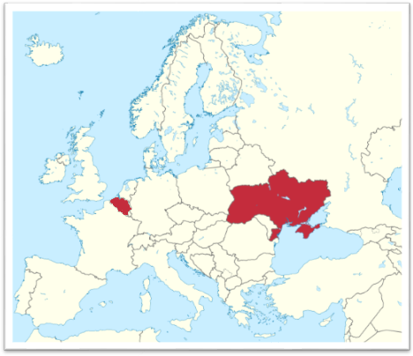


Me
Kharkiv
Belgian Nuclear Research Centre SCK•CEN
Mol
V.N. Karazin Kharkiv National University
Notes:
I want to start from a small introduction of the places where I am originally from and where I work. If we go to the north of Belgium, there will be a place called Mol where our Belgian Nuclear Research Center SCK-CEN is based. But I came from a big eastern European country called Ukraine and if we take a look on the east of it, there will be a city called Kharkiv, where I graduated from…

Slide 3
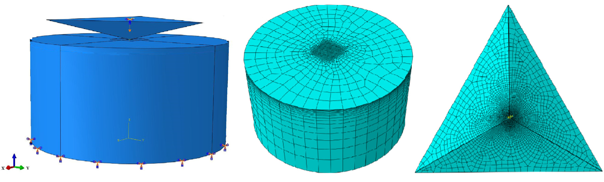
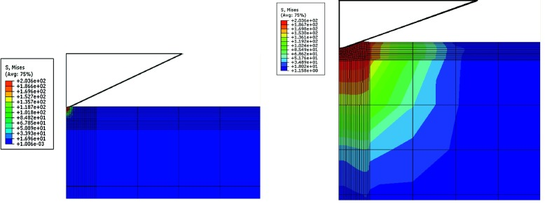
Nanoindentation and finite element modeling
X. Xiao, D. Terentyev. Materials Science & Engineering A 743 (2019), 106-113
A. Karimzadeh. Computational Material Science, 81 (2014), 595-600
Notes:
So, the main task of my project is to develop and validate a finite element model for the process of nanoindentation of irradiated ferritic-martensitic steels. At the moment we are only focusing on Berkovich three-sided pyramid indenter tip but it is possible that spherical tip will be also considered for modeling. Nanoindentation with the combination of finite element analysis becomes a great tool which allows us to simulate stress-strain fields under the indenter tip and therefore analyze a behavior of a material and make conclusions about its mechanical properties.

Slide 4
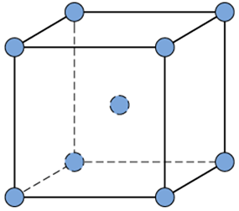
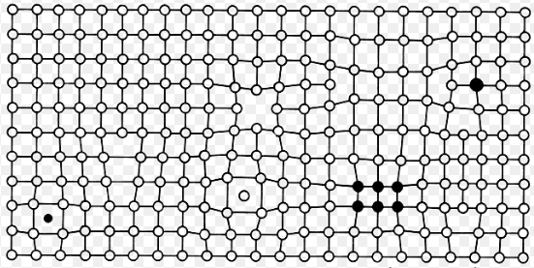
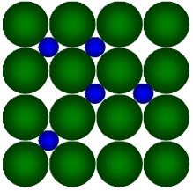
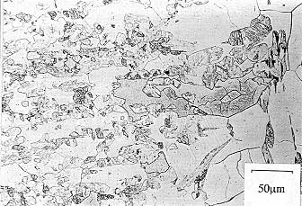
Modeling steps for microstructure
Pure BCC Fe
Plastically deformed BCC Fe
FeCrC solid solution
Ferritic-martensitic steel
Notes:
To build such model we will go from the simplest material microstructure and conditions with increasing their complexity at each step. We should start the model creation from Iron with the highest possible purity and lack of defects. Then the model will be expanded for an Iron after some plastic deformation, to describe interaction of defects inside it. Next step will be a solid solution of FeCrC and in the very end the structure of ferritic-martensitic steel will be described.

Slide 5


Modeling steps for conditions
Nanoindentation at room temperature
Nanoindentation at elevated temperature
Nanoindentation with effect of irradiation included
Validation experiments are being performed in Université catholique de Louvain, Louvain-la-Neuve, Belgium
Validation experiments will be performed in Research Centre Řež, Prague, Czech Republic
Notes:
Beside the microstructure, increase of complexity for nanoindentation conditions will also take place. We will start the development of our model from room temperature, then move to elevated temperature and in the very end an effect of irradiation will be included. The room temperature tests for both validation and model input can be performed on Keysight nanoindenter G200 at UCL in Louvain-la-Neuve in Belgium and for complicated conditions it is assumed to be done in REZ research center in Prague, Czech Republic

Slide 6

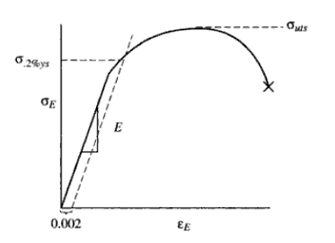
General application
NI test data
Constitutive laws from tensile test/reverse FEM
NI FEM model
Prediction
Irradiated
stress-strain curve
Irradiation effect
Notes:
The one of the most interesting applications for such approach is shown on the slide. We expect that it can be possible to take the nanoindentation finite element model, put the data from nanoindentation of some material, add constitutive laws taken from tensile test or even obtained with reversed FEM approach, describe the irradiation impact and predict the irradiated stress-strain curve.

Slide 7
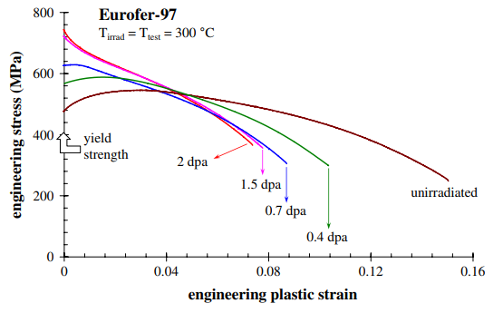
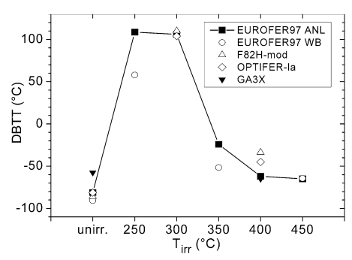
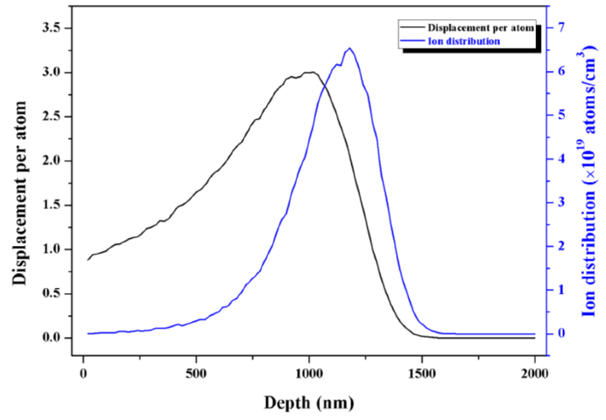
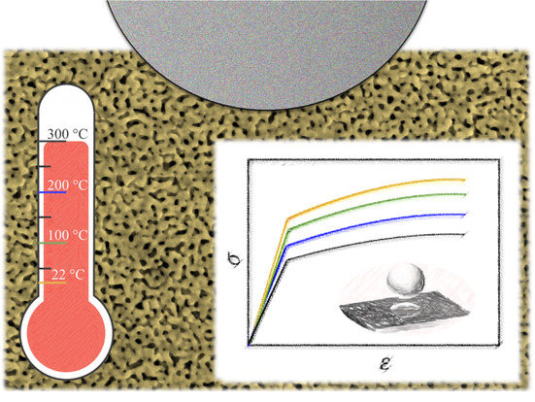
Other useful applications of nanoindentation
Strain softening after a dose of 1.5 dpa
Material can become brittle at room temperature after irradiation
R. Chaouadi. Journal of Nuclear Materials 372 (2008) 379-390
E. Gaganidze. Journal of Nuclear Materials 355 (2006) 83-88
Damage peak
Xue Bai. Metals 7, (2017), 25
A. Leitner. Nanomaterials 2018, 8(6), 366
Notes:
There are some more interesting ways to use it as well. In case of strain softening phenomenon or when material behaves brittle and we can not obtain constitutive laws from conventional tensile test, nanoindentation with combination of finite element model can be useful to predict them. Also, with nanoindentation we can measure a thin ion-irradiation layer, what can be useful in case we know the correlation between ion and neutron damage or to measure an impact of high irradiation dose caused by high energy ions. We expect that it is also possible to simulate complicated elevated temperature test.

Slide 8
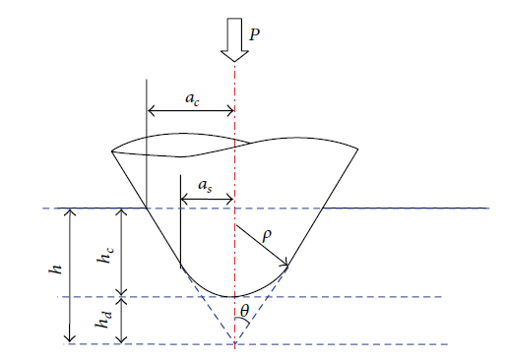
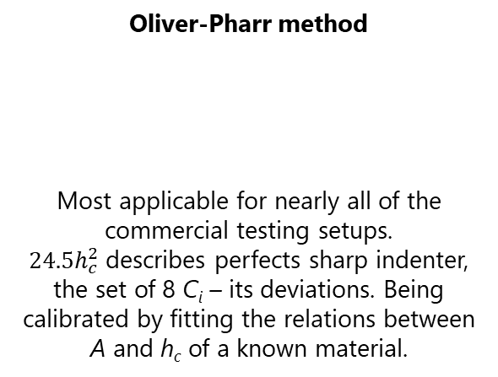
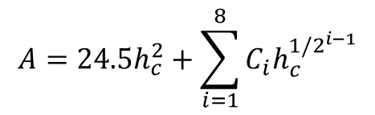
Imperfection of indenter implementation
Oliver-Pharr method
Most applicable for nearly all of the commercial testing setups. $24.5h_{c}^{2}$describes perfects sharp indenter, the set of 8 C_{i} – its deviations. Being calibrated by fitting the relations between A and h_{c} of a known material.
$$A=24.5h_{c}^{2}+\sum_{i=1}^{8}{C_{i}h_{c}^{{1/2}^{i−1}}}$$
A. Karimzadeh, Computational Materials Science 81 (2014) 595-600
Notes:
Some of future problems to be solved we can already see. First one is the imperfection of indenter, because it is obvious that diamond tip can not be perfectly sharp on the end, so we have to describe the uncertainty it creates. The most applicable method is Oliver-Pharr method shown on the slide, wher 24.5 multiplied by square of contact depth describes perfect sharp indenter and 8 other elements – its deviations. It can be calibrated with fitting by indenting already known material.

Slide 9
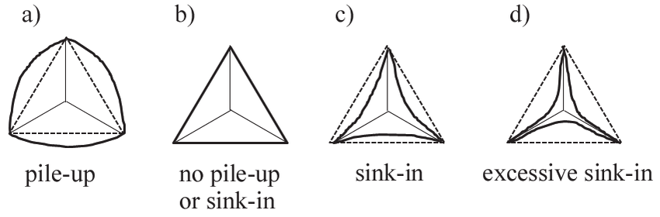
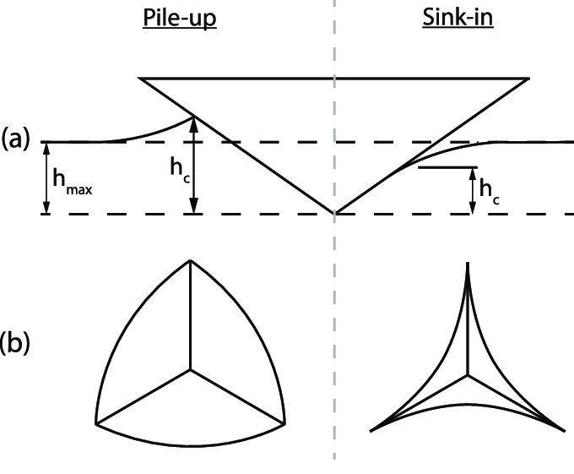
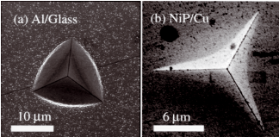
Pile-ups and sink-ins consideration
M. Hardiman, Polymer testing 52 (2016) 157-166
M. Hardiman. Polymer Testing 52 (2016)
D. Mercier. Matériaux & Techniques 99 (2011),169-178
Notes:
The second one is the effect of pile-up and sink-ins. Depending on material properties, indenter immersion can cause the flow of some material volume outside or inside the indent. Both phenomena distort the final indent and creates complexity in contact area determination and therefore derivation of mechanical properties.

Slide 10
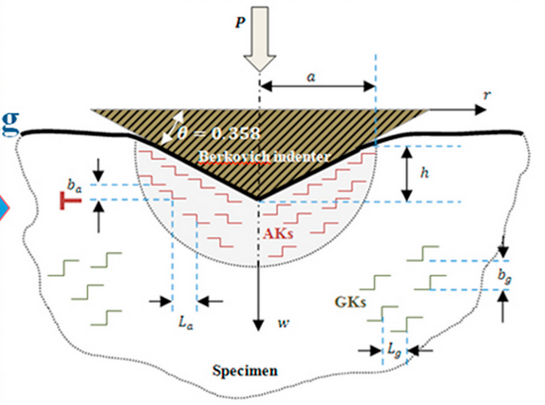
Size effect implementation
Indentation size effect
George Z. Voyiadjis, Polymer 55 (16) 5 2014, 4182-4198
Notes:
On of the phenomenon needed to be taken into account is indentation size effect. It is the high leap of indentation hardness right after indenter immersion and its decrease to some saturated Hardness with the further immersion. It is described by the concepts of geometrically necessary and statistically stored dislocations and also by strain gradient. We don’t have a need of physical implementation of it, but some mathematical way will be applied.

Slide 11
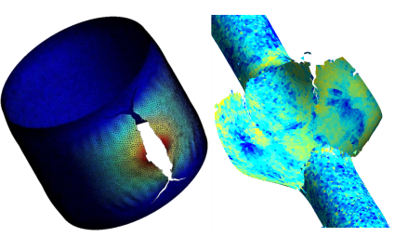
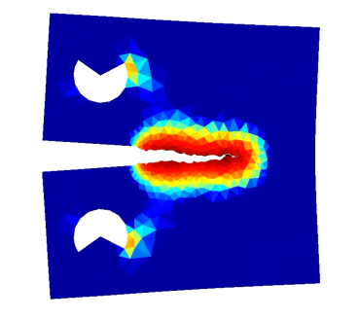
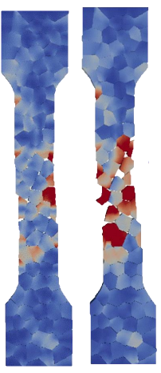
FEM code of Prof. Ludovic Noels
Features:
Solver is based on discontinuous Galerkin method
Simulation geometry is described using Gmsh 3D mesh generator
Open source, therefore allows user improvements
Free to use
Application examples:
Compact tension
specimen
Blast loaded cylinder
Detonated pipe
Tensile test
Notes:
To build the model, FE self-made code of professor Ludovic Noels will be used. Its features are shown on the screen… It has already proven itself as a powerful analytical tool which allow to simulate different problems. Some of them are shown on the slide.

Slide 12
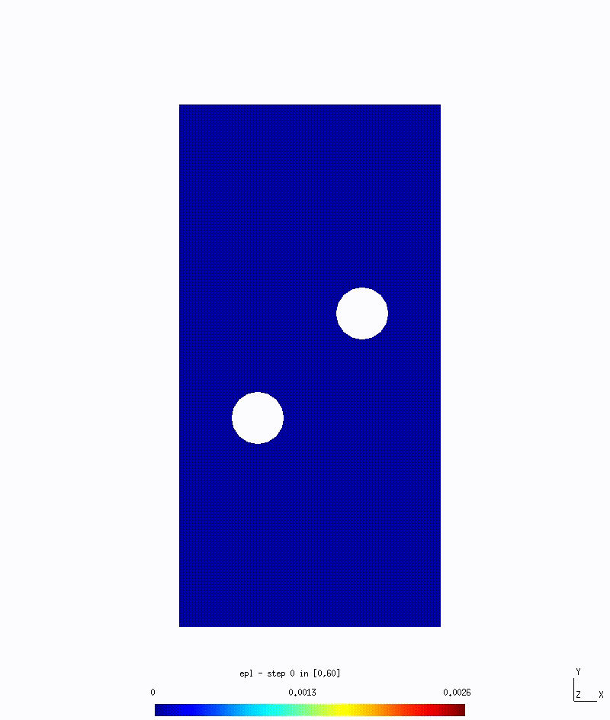
Small animated example

Slide 13
Short summary of performed work
Experimental
FEM
Nanoindentation machine and testing process were studied as well as other important experimental setups (3-point bending test bench, tensile deformation machine, Vickers hardness tester)
A set of nanoindentation tests were made for ion irradiated and non-irradiated, deformed and non-deformed steels and pure iron as a future reference data for model input and validation
Just started…
Some of the nanoindentation hardness curves were mathematically described by using A. Karrer’s* approach for irradiated nanoindentation hardness ΔH_{irr} extrusion
*A. Kareer, P. Hosemann. Journal of Nuclear Materials 498 (2018), 274-281

Slide 14
Nanoindentation results
Notes:
Here you can see some tests were performed for iron products

Slide 15
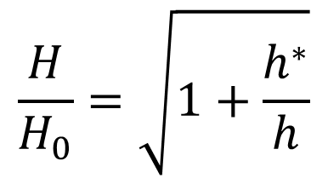
Irradiated hardness extrusion
J362 steel
9%Cr steel
$$\frac{H}{H_{0}}=\sqrt{1+\frac{h^{∗}}{h}}$$
Specimen ID | Dose, DPA | h*, µm | H₀, GPa
J362 | ~1 | 0,05 | 2,58
9%Cr | ~1 | 0,1 | 1,94
D. Nix, H. Gao, J. Mech. Phys. Solids, Vol. 47, No. 3, 411-425, 1998
Notes:
On this slide the work of hardness curves modeling is presented for the purpose of irradiated hardness extrusion. The value of this work for my project can be the possible use of the model to describe indentation size effect which was mentioned before. The description of size effect is made using Nix and Gao approach where we use saturated Hardness H0 and characteristic length h* which both can be found on the hardness curves or fitted.

Slide 16
Short summary of close future work (0.5 – 1 year)
Experimental
FEM
A set of tests has to be done on differently oriented grains of pure iron sample, to see the dependence between grain orientation and an output
To get used into the FEM code we are going to use and understand how it works inside
Gradual filling of the experimental data list for unirradiated irons at room temperature for the first step model input
To decide which elastoplasticity model we are going to use to perform numerical simulations and how we should implement it in the code
To start the first numerical simulations to see and estimate which problems we can face in a future

Slide 17
Thank you for your attention!

Slide 18
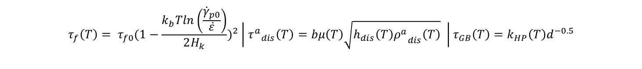
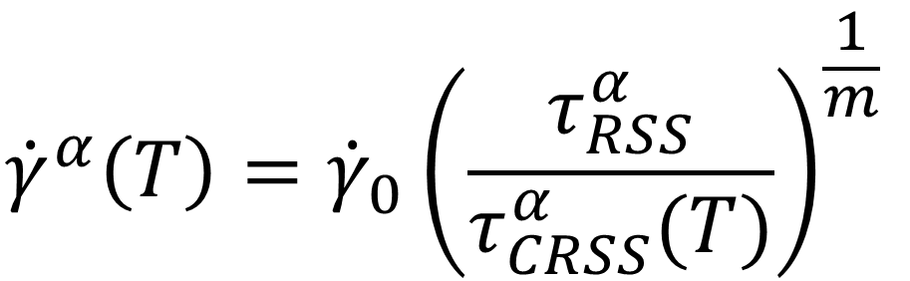
Single grain crystal plasticity model
$${\dot{γ}}^{α}\left(T\right)={\dot{γ}}_{0}{\left(\frac{τ_{RSS}^{α}}{τ_{CRSS}^{α}(T)}\right)}^{\frac{1}{m}}$$
$${τ^{a}}_{CRSS}= τ_{f}\left(T\right)+{τ^{a}}_{dis}\left(T\right)+τ_{GB}(T)$$
Lattice friction effect
Dislocation-dislocation interaction
Dislocation-grain boundary interaction (Hall-Petch effect)
$$τ_{f}\left(T\right)= τ_{f0}{(1−\frac{k_{b}Tln\left(\frac{{\dot{γ}}_{p0}}{\dot{ε}}\right)}{2H_{k}})}^{2} \left| {τ^{a}}_{dis}\left(T\right)=bμ\left(T\right)\sqrt{h_{dis}\left(T\right){ρ^{a}}_{dis}\left(T\right)} \right|τ_{GB}\left(T\right)=k_{HP}\left(T\right)d^{−0.5}$$

Slide 19
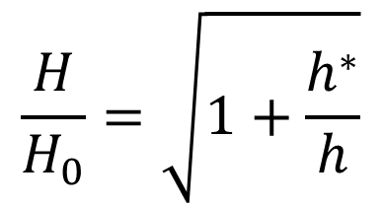
Nix and Gao model
$$\frac{H}{H_{0}}=\sqrt{1+\frac{h^{∗}}{h}}$$

Slide 20
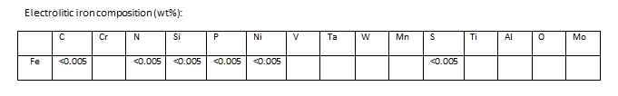
Purity of Fe

Slide 21
Copyright © 2018 - SCK•CEN
PLEASE NOTE!
This presentation contains data, information and formats for dedicated use only and may not be communicated, copied, reproduced, distributed or cited without the explicit written permission of SCK•CEN.
If this explicit written permission has been obtained, please reference the author, followed by ‘by courtesy of SCK•CEN’.
Any infringement to this rule is illegal and entitles to claim damages from the infringer, without prejudice to any other right in case of granting a patent or registration in the field of intellectual property.
SCK•CEN
Studiecentrum voor Kernenergie
Centre d'Etude de l'Energie Nucléaire
Belgian Nuclear Research Centre
Stichting van Openbaar Nut
Fondation d'Utilité Publique
Foundation of Public Utility
Registered Office: Avenue Herrmann-Debrouxlaan 40 – BE-1160 BRUSSELS
Operational Office: Boeretang 200 – BE-2400 MOL

