Slide 1
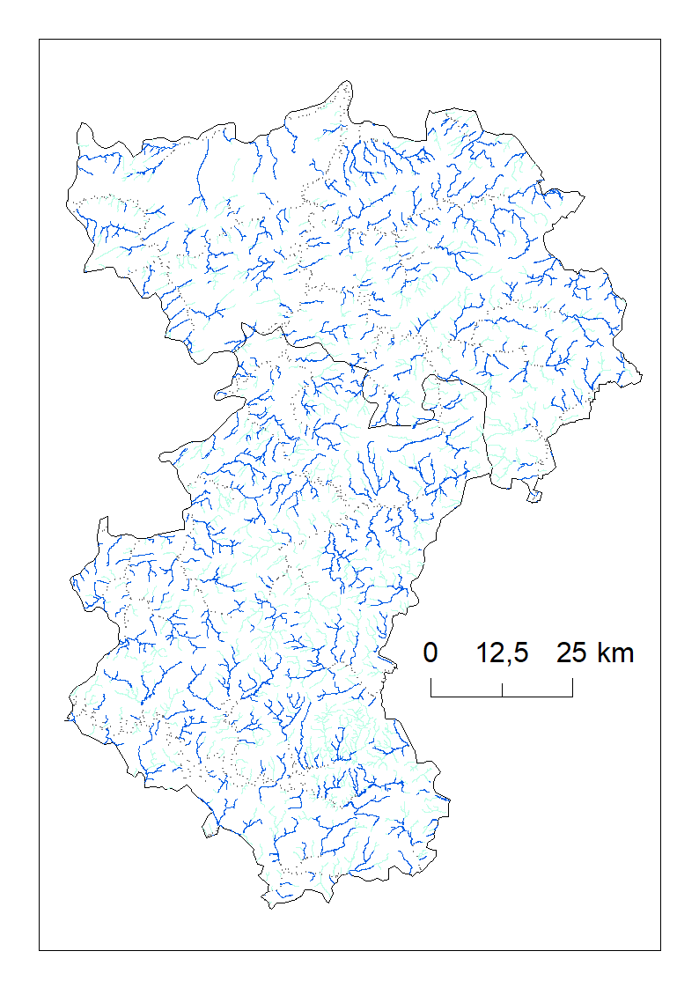
Supporting river management with UAV’s in the Provinces of Liège and Luxembourg
Researchers : Leo Huylenbroeck, Adrien Michez, Philippe Lejeune
Institution : Terra Research Center, Gembloux Agro-Bio Tech, ULiège
Phone number : + 32 (0)81 62.26.89
E-mail : leo.huylenbroeck@uliege.be
Funding : Province de Luxembourg & Province de Liège
Description
The technical services of the Province of Luxembourg and Liege manage 2800 km of rivers. The management of these rivers involves numerous field visits: regular monitoring of the river network, studies prior to carrying out work, etc. In order to increase the extent, quality and frequency of visits, the Provinces have equipped themselves with UAV’s.
Our partnership aims to support the development of an expertise in the use of UAVs for the management of watercourses within the Provinces. This involves setting up acquisition and image processing routines adapted to the context of watercourse management.
More concretely, our project encompasses issues related to flight planning (rapid, yet accurate mapping of long river corridors), respect of privacy (overflight of private gardens), extraction of synthetic information about river banks or riverine vegetation, flood mapping.
The Provinces of Liège & Luxembourg are responsible for 2.800 km of watercourses
Remote sensing tools are increasingly used in river science and management. The added value of UAV’s lies notably in their flexibility. They can be deployed rapidly and for a low marginal cost by river managers.

