Slide 1
Supporting river management with UAV’s in the Provinces of Liège and Luxembourg
Presentation given during the ID2Move Belgian Academic Seminar “Autonomous Systems”
07/06/2019 – Nivelles
Contact : Leo.Huylenbroeck@uliege.be
Notes:
Leo Huylenbroeck, faculty of Gembloux
I’m going to present a partnership that we have engaged with the Provinces of Liege and Luxembourg, that aims to support river managers in their missions with UAV’s.

Slide 2
Plan of the presentation
Background : river management
Objectives and content of the project
Notes:
First I’m going to talk to you about the missions of river managers in order to explain why UAV’s can have an added value for the fulfilling of these missions.
Then I’ll talk about the objectives of the project and our work approach. We are still at the start of this project so I will mostly present our methodology, I won’t be able to show you many achievements yet.

Slide 3
Background : river management

Slide 4
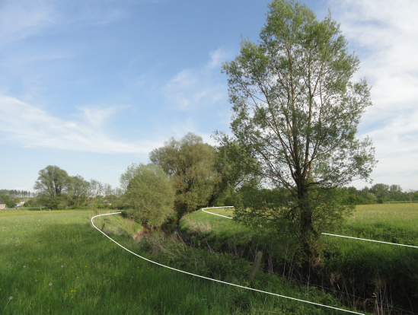
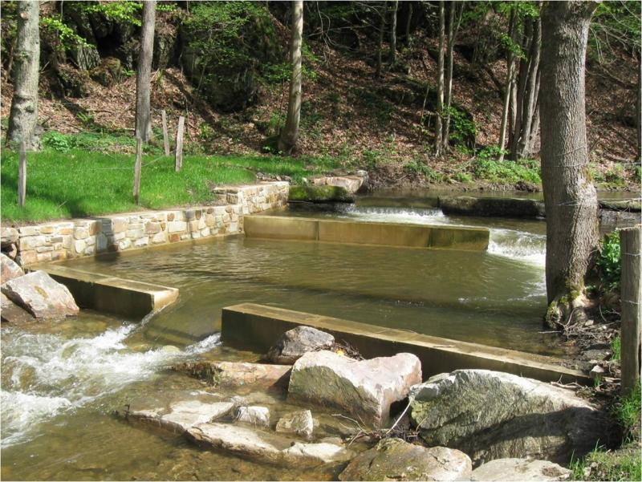
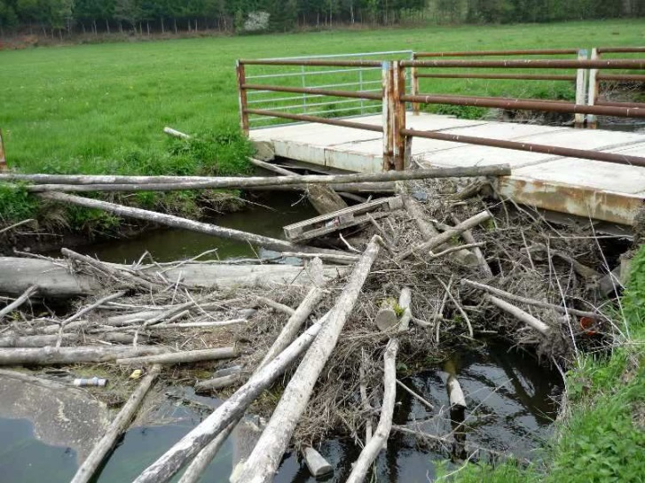
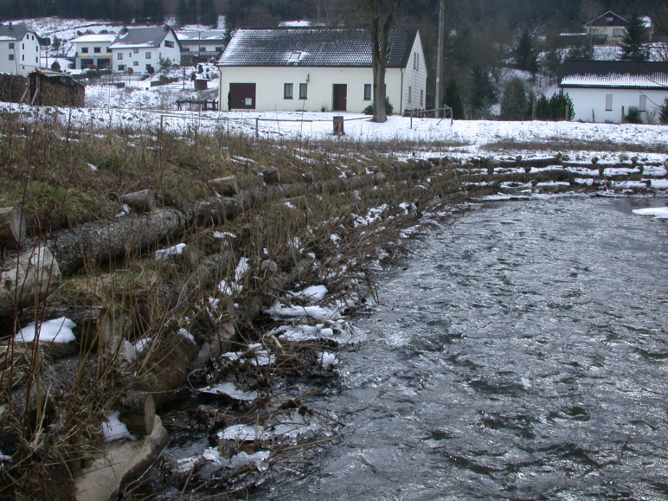
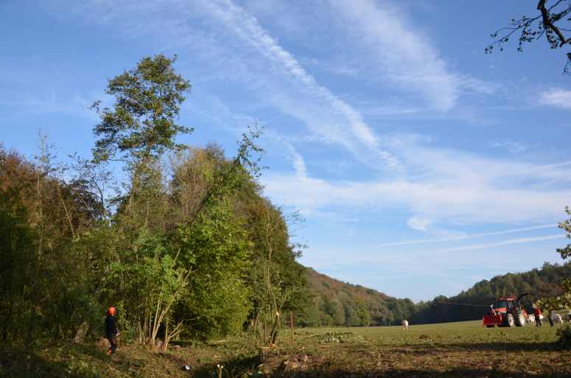
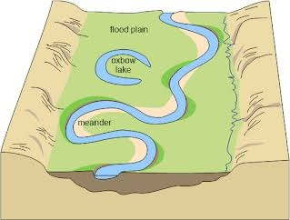
River management
Background : river management
Minor bed of rivers = public management
Main missions of river managers :
Protect people and goods
Promote naturalness
Shoreline
Shoreline
Private management
Minor bed : public management
Notes:
In Wallonia, and in many other countries in the world, the minor bed of rivers is under the responsability of the public, it is managed by administrations. In other words, administrations are responsible for the river and its banks. Beyond banks, we are most of the time on private land.
In this minor bed, river managers have several missions. The two most important missions are:
Protect people and goods from the damage that may be caused by the river, so they must fight against inundations by removing jams that may impair the free flowing of water, they must prevent treefalls that could cause damage to consturctions along streams, they must fight against the detrimental effects of erosion, sometimes by consolidating banks…
And the second mission, that is more recent: they must promote naturalness. It may include for example removing barriers to the circulation of fish, creating new meanders, or deliberately not doing any work on the river when there is no danger.

Slide 5
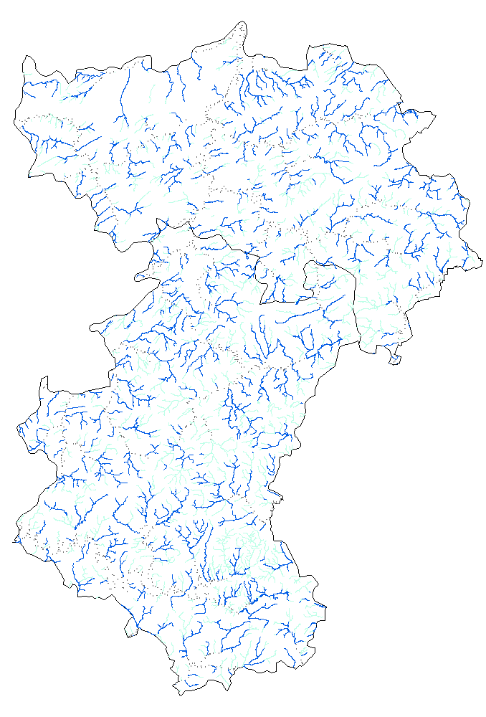
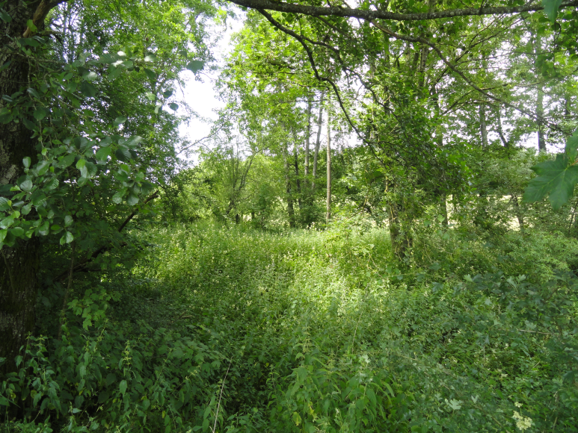
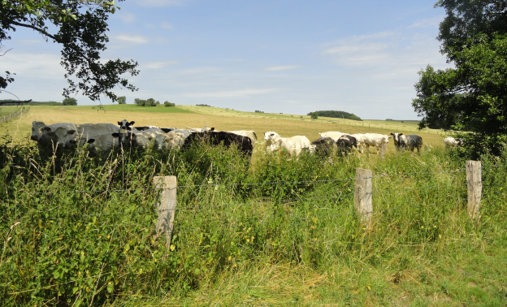
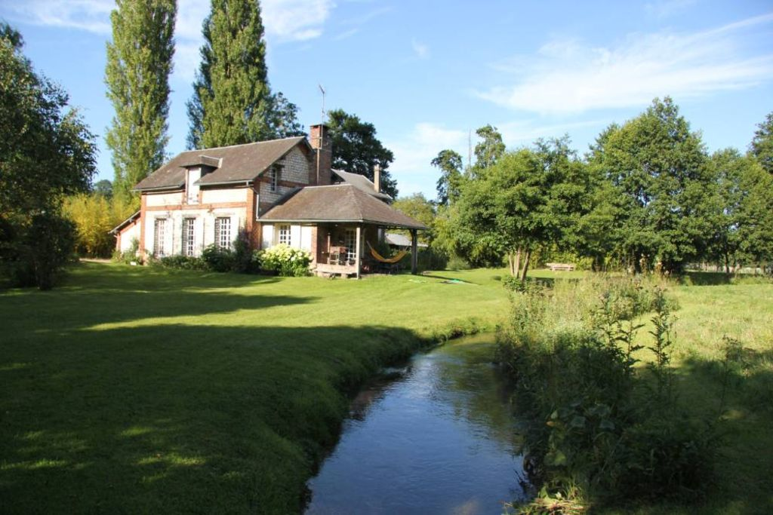
River management
Background : river management
Provinces of Luxembourg et de Liège manage 2800 km of watercourses
River network to be regularly surveyed (min. every 6 years)
Studies to make before prior/after works on watercourses
→ Numerous field visits and measures, in areas that are difficult of access
Notes:
The Provinces of Liège and Luxembourg, which are the funders of this project, must fulfill these missions on 2800 km of watercourses, maily small streams. To fulfill these missions,
They have to survey the river network regularly to anticipate problems (for exemple erosion, log jams, ouvrages défecteux). And when there is work to do on the river, they make studies prior to work, to evaluate what can be done, and after works to evaluate the success of management operations. In these context they regularly need topographic or géometric information.
These visits are performed by field campaigns. These visits must be realized in places that are often difficult to access, because there is cattle, dense vegetation, or because river flow in backyards…

Slide 6
UAV’s for river management
Background : river management
Remote sensing can be used to increase the extent, quality and frequency of visits
Data already available in Wallonia (LiDAR, orthophotos)
Resolution not sufficient for operational purposes
Need for flexibility in the timing of acquisition
Provinces have acquired UAV’s and pilots were trained
Aim of the partnership : co-construct an expertise in the use of UAV in river managemenent
Notes:
That’s why Provinces consider using remote sensing to increase the extent, the frequency and the quality of visits.
In Wallonia we already have a lot of remote sensing data (in particular we have LiDAR surveys and orthophotos), but none of them have a resolution that is fine enough for operational purposes. Moreover, it’s important for river managers to be have a good flexibility for the acquisition, to be able to undertake specific acquisitions at a particular time, for exemple following a catastrophic event or in preparation of doing work on the river.
For these reasons and for others – because UAV’s are not only used in the context of river management at the Provinces – Provinces have acquired their own UAV’s and pilots were trained.
The aim of our partnership is to co-construct an expertise in the use of UAV’s for river management.

Slide 7
methodology

Slide 8
Global framework
Methodology
3 main aspects :
Design of image acquisition routines that are appropriate for different scenarios (co-construction)
Design of processing routines that provide information that is relevant for river management
Training of personnel
Notes:
Te project is structured in among 3 mai aspects :
First, we design image acquisition routines that are suitable for different scenarios. What is the optimal flight plan, how to georeference images in an efficient way, etc.
Second, we want to design processing routines beyond the production of orthophotos and DSM, in order to extract new information that is relevant for river management, for example the extraction of bank profiles, the mapping of floods, etc.
Finally, we will train the personnel of Provinces to use GIS, GNSS, and the tools that have been developed in the framework of this project. Wa want them to be autonomous at the end of the project.

Slide 9
Design of image acquisition routines
Methodology
Learning by practice (co-construction)
≠ scenarios for ≠ contexts
Legal constraints
Flight rules
Respect of max. height and restricted zones
VLOS
Derogations ?
Overflight of private backyards/houses
Personal data → GDPR
Acquisition permitted without consentment if public interest with legal basis → OK
Inhabitants must be informed with a letter
Inhabitants can ask for access to personal data
Notes:
So the first step is to design image acquisition routines that are suitable for different scenarios. We work on real cases with river managers, in order to confront to the local context of sites to be overflight and operational needs of managers. we need different acquisition schemes depending of the objective that is pursued.
Overall there are legal constraints that must be respected while overflying rivers :
First, we respect the royal arrete, that notably restricts the maximum fly height and that requires us to keep the UAV in sight. It is very limiting for river applications because we need to survey rivers over tens of kilometers. Until now we did not ask for derogations, we do not exclude it later in the project.
Then, we must often overflight private houses of gardens, and we must respect privacy of people that are overflown.
Photos of backyards are personal data, because they can reveal information about the people’s private life, and these photos can easily be linked to the identity of people. So we fall under the scope of the GPDR.
According to these rules we must have a consentment to acquire data over backyards, but there are exceptions. In our case, it is tolerated to acquire data because we do it in the public interst (managing rivers is of public interest) and river managers are legally required to perform regular surveys along the rivers they are responsible for.
Even in this case, we must send an information letter to inhabitants prior to overflight, and inhabitants have the right notably to access data that concern them.

Slide 10
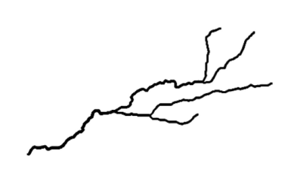
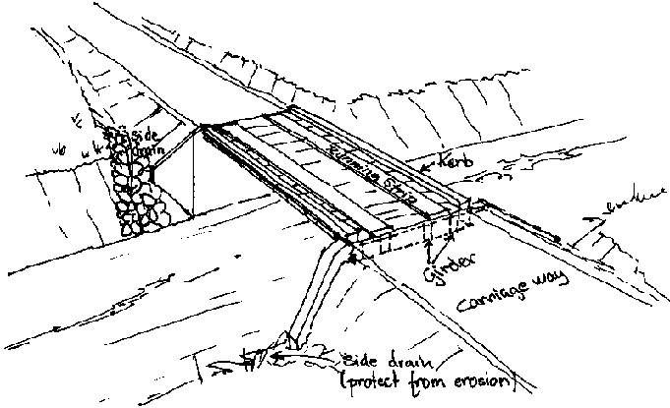
Design of image acquisition routines
Methodology
Technical constraints
UAV specifications (autonomy, weight, payload,…)
Site constraints (presence of vegetation, topography, take off/landing sites, access…)
Aim of the acquisition?
Survey length >< Accuracy
Required geometric accuracy, number of shootings
Monitoring of the river network
Study prior to work, inspection of built structure
Length 10 m 100 m 1 km 10 km
Notes:
Beside legal constraint, we have to compose wih technical constraints that are linked to the UAV (its autonomy, its portability) or site constraints, in particular the presence of vegetation that hides the river and sometimes the confined topography that makes flight operations difficult.
Beyond these general aspects, we need different acquisition schemes depending of the objective that is pursued.
First, there’s a often an inverse relationship between the length of river to be surveyed and the accuracy of models that have to be constructed. At a small scale, river mangers need precise, topographic information in order to carry out studies prior to carrying out work. On the contrary, at a larger scale, geometric accuracy is not as important, as managers only use images to detect potential problems such as dead trees, pollutions, erosion, log jams. The only constraint is that the images can be orthorectified.
So flight plans must be adapted, for more local, precise surveys we will have a low fly height, numerous shootings, and models will be carefully georeferenced, while for larger surveys, tens of kilometers long, we can only fly a few lines and reference models in an expeditive way.
We are running tests to determine the optimal flight plans for different scenarions: how many flight lines, addition of oblique or low altitude images.

Slide 11
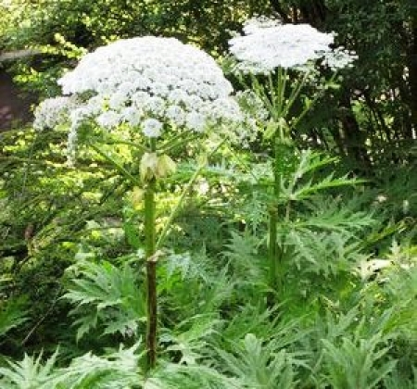
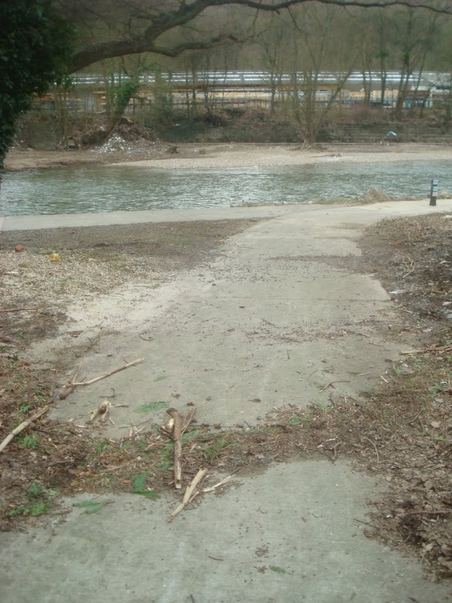
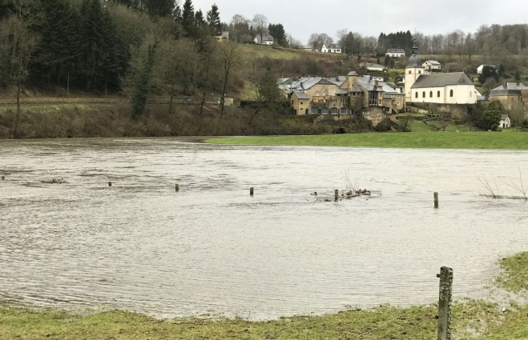
Design of image acquisition routines
Methodology
Aim of the acquisition?
Support to the eradication of invasive species
→ adequation of timing with plant phenology and with eradication operations
Inundation maps
→ reactivity and respect of legislation
Notes:
Another case that requires specific considerations for the acqisition scheme, river managers often have to eradicate invasive plants, so plants that are not part of native ecosystems and whose uncontrolled growth causes damage to the streams. UAV’s can be used to detect these plants or to evaluate the success of eradication. There are two constraints: first to be able to detect these plants you need to overfly them during a particular time of phenology, during flowering for example. Then you need to be well synchronized with eradication operations,
UAV’s can also be used as an alternative to helicopters in order to map floods. It can be difficult to fly during the flood itself because of the weather and the short duration of floods on small streams, but more reasonably it is possible to map flood marks after the flood. Again, we must overcome organisational challenges; you need to be reactive to be able to see these flood marks.

Slide 12
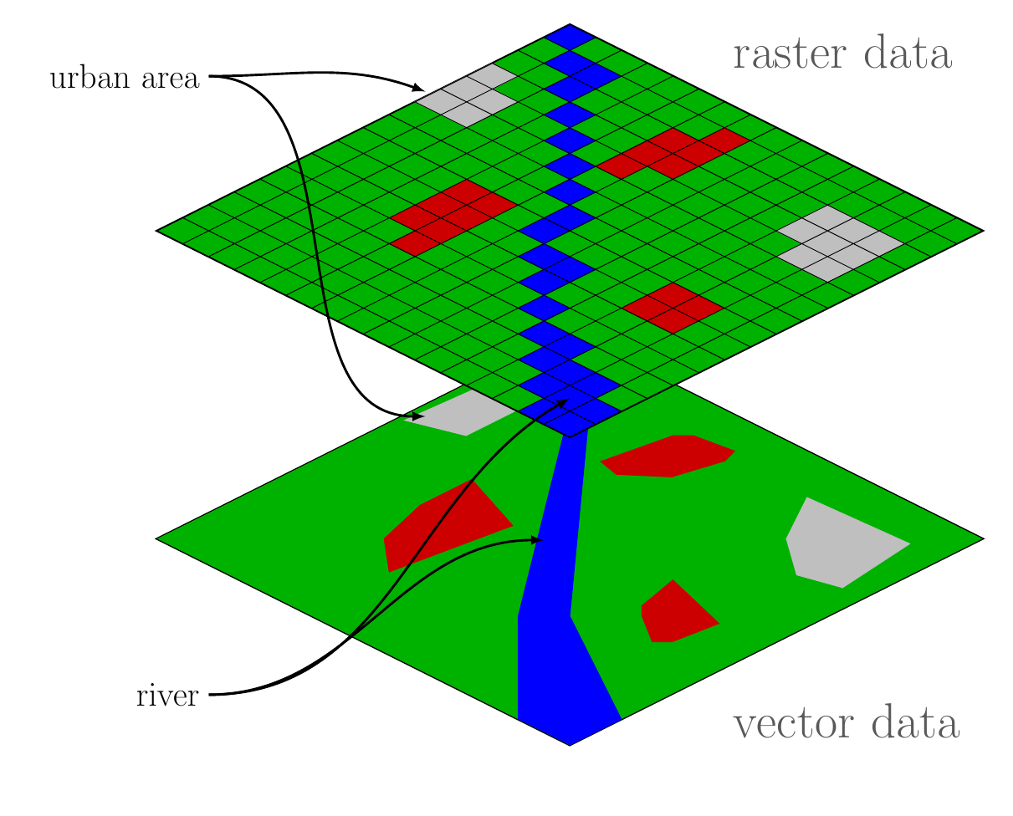
Design of processing routines
Methodology
Numerous tools available
Adaptation of existing tools for river applications + knowledge transfer to personnel
Selected applications:
Semi-Automated vectorization/classification
Description of river banks
Mapping of flood extent
Notes:
Then the next step is to design processing routines to obtain information that is relevant for river managers, information that can be easily be used by them.
I’m not going into much details here : There are numerous tools that are available for image processing and we will rely on the existing, but we will adapt these tools to the context of river management, then integrate it into training courses for pilots.

Slide 13
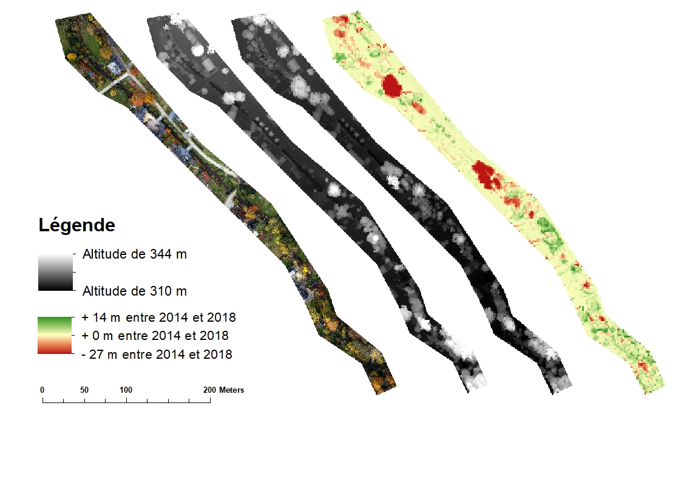
Design of processing routines
Methodology
Selected applications:
Automated vectorization/classification
Description of river banks
Mapping of flood extent
Multi-temporal comparisons
Characterisation of vegetation
Treefalls
Vegetation growth
Orthophoto 2018 (UAV)
DSM 2018 (UAV)
DSM 2014 (LiDAR)
Différence DSM 2018 –2014

Slide 14
Training of personnel
Methodology
River managers
Management issue
Specifications
Cartographic layers
UAV pilots
Appropriate acquisition
Image processing
Fundamentals in GIS + workshops on UAV applications
Extensive training in GIS +
Image processing
Notes:
Then the third and last aspect of this projet is dedicated to training of the personnel. We want to create a dynamic in which river managers can express the need for information, knowing what’s possible with UAV’s, and then UAV pilots make most of the technical work: they acquire the images and they process them, to deliver cartographic layers that can be manipulated easily by river managers. At the end of the project Provinces should be autonomous, they should be able to perform their own acquisition to answer operational issues.
As I said, the objective is to have river managers that know what is possible to do with UAV’s, we want them to be able to decide for themselves the cases in which the use of UAV’s is relevant or not, they can mobilize UAV as a tool, because as every tool, it’s not designed to do everything. They must also be able to manipulate cartographic data. So we will train them to use GIS, and we also plan to organise workshop to discuss the use of UAV’s in real cases: what data can be extracted, what are the technical and legal constraints.
Then, UAV pilots generally have more technical profiles, they are more familiar with new technologies, we will give them more extensive training in GIS, and we will also train them for the processing of images in the context of rivers.

Slide 15
Summary and Project format
Methodology
Project format :
4 years from february 2018 to february 2022
Funders : Provinces of Luxembourg & Liège (half/half)
3 main delivrables: co-construction of acquisition schemes, design of standard processing procedures & training of personnel

Slide 16
Thank you for your attention !
Presentation given during the ID2Move Belgian Academic Seminar “Autonomous Systems”
07/06/2019 – Nivelles
Contact : Leo.Huylenbroeck@uliege.be

