Slide 1
RURAL MIGRANT LABOR IN INDUSTRIAL ZONES
A case study in the industrial zones of
Bac Ninh province
Ph.D student: Ngo Trung Thanh
Supervisor: Prof. Philippe LEBAILLY
Co-supervisor: Dr. Nguyen Thi Dien
Academic year: 2015-2016

Slide 2
Outline
Introduction
Objectives
Methodology
Findings
Conclusion

Slide 3
Introduction
Pattern of development and migration debate has never ended (Haas 2007)
Migration has became a key issue of development (Skeldon 2003)
Thousand industrial zones have been found in developing countries (Milberg and Amengual 2008)
Low wages (Kusago and Tzannatos 1998). and unstable employment (Rondinelli 1987)
Labour-repressive environment and low union density (McCallum 2011)

Slide 4
Introduction (cont)
Vietnam context:
No of IZs: 01 in 1991; 149 in 2007; and 289 in 2013
No of employment: 01 mill in 2006; 1.6 mill in 2011; and 2.1 mill in 2013
Ratio of migrant labor: Phu Tho and Thai Binh: 80%; Vinh Phuc: 70% and Bac Ninh 65%

Slide 5
Objectives
Why do rural labors migrate to industrial zones?
To identify who are the migrant labours in industrial zones
To analyse the social economic factors of migrant’s household in sending areas
To analyse employment environment in the Industrial zones

Slide 6
Analytical Framework
Pull
Migration
Household strategy
Induvidual
Push

Slide 7
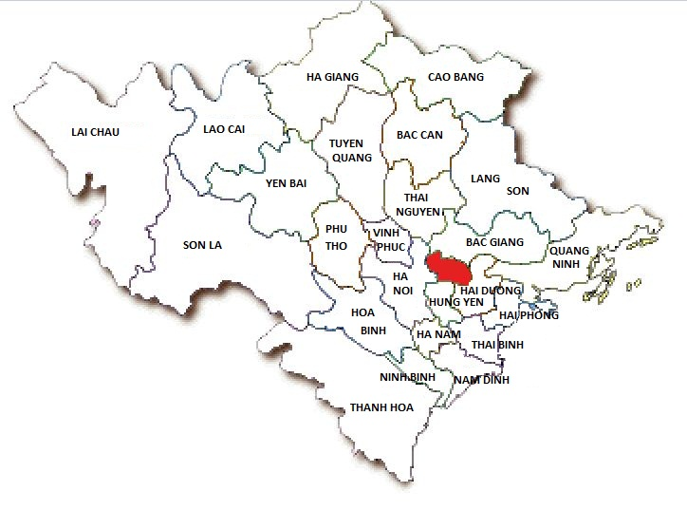
Study site
Provinces | Ha noi | Bac Ninh | Hai Duong | Vinh Phuc
IZs | 14 | 15 | 11 | 20
Area (ha) | 3.499,9 | 6.393,6 | 2.570,5 | 7.259,2
Total labour |  | 129.4 | 63 | 37
Migration rate |  | 65% | 35% | 70%
Year | Total | Domestic | Migrant | Migration rate (%)
2008 | 33,111 | 20,231 | 19,476 | 58.8
2009 | 41,323 | 21,900 | 19,423 | 47.0
2010 | 56,874 | 25,678 | 31,196 | 54.9
2011 | 87,053 | 35,655 | 51,398 | 59.0
2012 | 117,455 | 44,673 | 72,782 | 61.9
2013 | 129,423 | 45,197 | 84,226 | 65.0

Slide 8
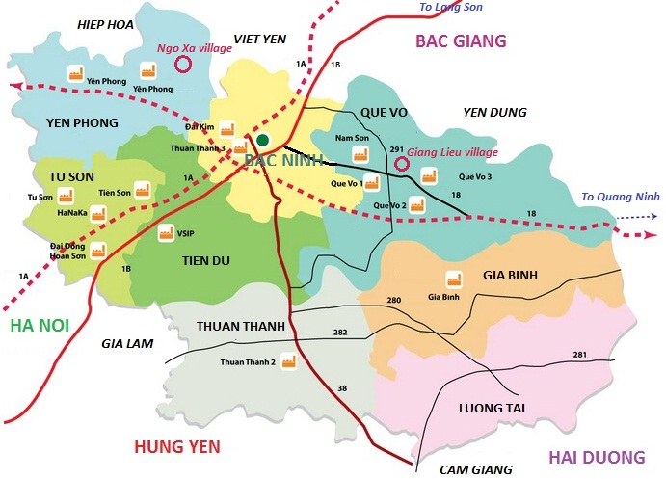
Study site
Yen Phong: 1200 ha
2005
Que Vo: > 600 ha
2001

Slide 9
Room for rent and migrant worker in Bac Ninh
 | No of Household | No of room for rent | No of migrant worker
Phuong Lieu commune, Que Vo
Phuong Cau village | 150 | 1720 | 2000
Do Nha village | 300 | 1947 | 3600
Giang Lieu village | 470 | 2935 | 5600
Ha Lieu village | 7 | 53 | 88
Long Chau commune, Yen Phong
Ngo Xa village | 345 | 5230 | 7368
Man Xa village | 215 | 4595 | 5125
Chi Long village | 400 | 2500 | 3492
Dai Chu village | 7 | 43 | 96

Slide 10
Methodology
Sample selection
List of HHS with room for rent
Ten hhs in Ngo Xa, Yen Phong
98 migrants in Ngo Xa, Yen Phong
92 migrants in Giang Lieu, Que Vo
Ten hhs in Giang Lieu, Que Vo

Slide 11
Findings
 | Total
N | 190
Mean | 22.9
Median | 23
Mode | 20
Minimum | 17
Maximum | 39
Age of migrant labor in industrial zones of Bac Ninh

Slide 12
Findings
N = 190
Gender and Education level of migrant workers in industrial zones of Bac Ninh

Slide 13
Findings
City | 1
District town | 12
Rural area | 177
Total | 190

Slide 14
Findings
N = 190
Household status and main livelihood of workers before migration

Slide 15
Findings
Livelihood activities | No of HH | Min | Max | Mean
No of labor in cultivation before migration | 177 | 1 | 5 | 2.45
No of labor in cultivation after migration | 177 | 0 | 5 | 2.12
No of labor in husbandry before migration | 125 | 1 | 5 | 2.28
No of labor in husbandry after migration | 125 | 0 | 5 | 1.93
No of labor in nonfarm before migration | 99 | 1 | 4 | 1.58
No of labor in nonfarm after migration | 99 | 0 | 4 | 1.57
Labor arrangement of migrant’s household before and after migration

Slide 16
Findings
Livelihood activities | Decrease |  | Unchange |  | Increase |  | N
 | No | % | No | % | No | %
Cultivation | 19 | 10.0 | 171 | 90.0 | - | - | 190
Husbandry | 12 | 6.3 | 171 | 90.0 | 7 | 3.68 | 190
Nonfarm | 1 | 0.5 | 178 | 93.7 | 11 | 5.79 | 190
The main livelihood activities of migrant’s household before and after migration

Slide 17
Findings
 | Frequency | Percent
No inudustrial zone/factory | 102 | 53.7%
Industrial zone, but not looking for job | 72 | 37.9%
Industrial zone, looking for job, but not work | 16 | 8.4%
Total | 190 | 100%
Nonfarm opportunity in sending area

Slide 18
Findings
N = 88
Why migrant workers do not seek and work in nonfarm sector in sending areas?

Slide 19
Findings
N = 190
N = 155
Do they look for a job outside industrial zones in sending areas ? And Why?

Slide 20
Findings
Role of remittance
Current marriage status | No remittance | Importance | Not Importance | Total
Got Marriage - Husband/wife in home town | 0 | 19 | 5 | 24
Got Marriage - Husband/wife in the IZ | 9 | 27 | 9 | 45
Got Marriage - Husband/wife outside the IZ | 1 | 7 | 3 | 11
Single | 8 | 57 | 43 | 108
Divorced | 0 | 0 | 2 | 2
Total | 18 | 110 | 62 | 190
Chi-Square Tests with sig = 0.012

Slide 21
Findings
Easy requirement for employment in Industrial zones
Secondary school diploma
Identity card
Health certification: 200 VND on market (8 euro)
Age: 18 - 30
Gender priority: Female

Slide 22
Findings
 | Frequency | Percent
Up to 12 months | 119 | 63
From 13-24 months | 55 | 29.1
From 25-36 months | 14 | 7.4
More than 36 months | 1 | 0.5
Total | 189 | 100
How long have they worked in the Industrial zones?? The strategy of hiding labor?

Slide 23
Findings
Better working condition compare to agriculture works:
Working inside with air conditioner
Light work
Clean
Higher wage by cash

Slide 24
Findings
Social network – what they do not have for employment in sending areas
Relatives
Classmate

Slide 25
Findings
Trade off for future
Working hours: 14
8h AM – 8h PM
8h PM - 8h AM
Entertainment:
Phone
Sleep (6-8h/day)
Health care: poor

Slide 26
Findings
Stay or move?
Plan for employment in IZ | Frequency | Percent
Permanent | 31 | 16.3
Temporary | 149 | 78.4
Stop whatever | 10 | 5.3
Total | 190 | 100
Notes:
Why PRA will be used?

Slide 27
Conclusion
Push:
Labor surplus and seasonal convertibility of agriculture products
Lack of capital
Poor social relations related to employment
Pull:
High demand of labor
Employment strategy of enterprise
Working environment

Slide 28
Thank you for attention

