Slide 1
Hybrid fractionation process for Faba bean protein extraction: Effect of combining dry and wet extraction steps on anti-nutritional factors content
Lionel Dumoulin
Co-promoters: Pr. Richel and Pr. Blecker
National Symposium for Applied Biological Sciences 2020 - 31st January

Slide 2
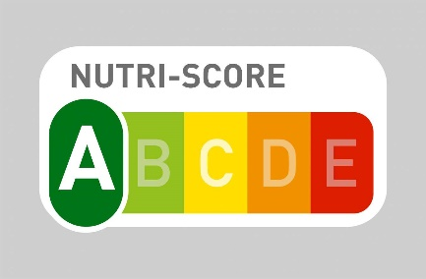
Notes:
Extraction protéines => pourquoi?

Slide 3
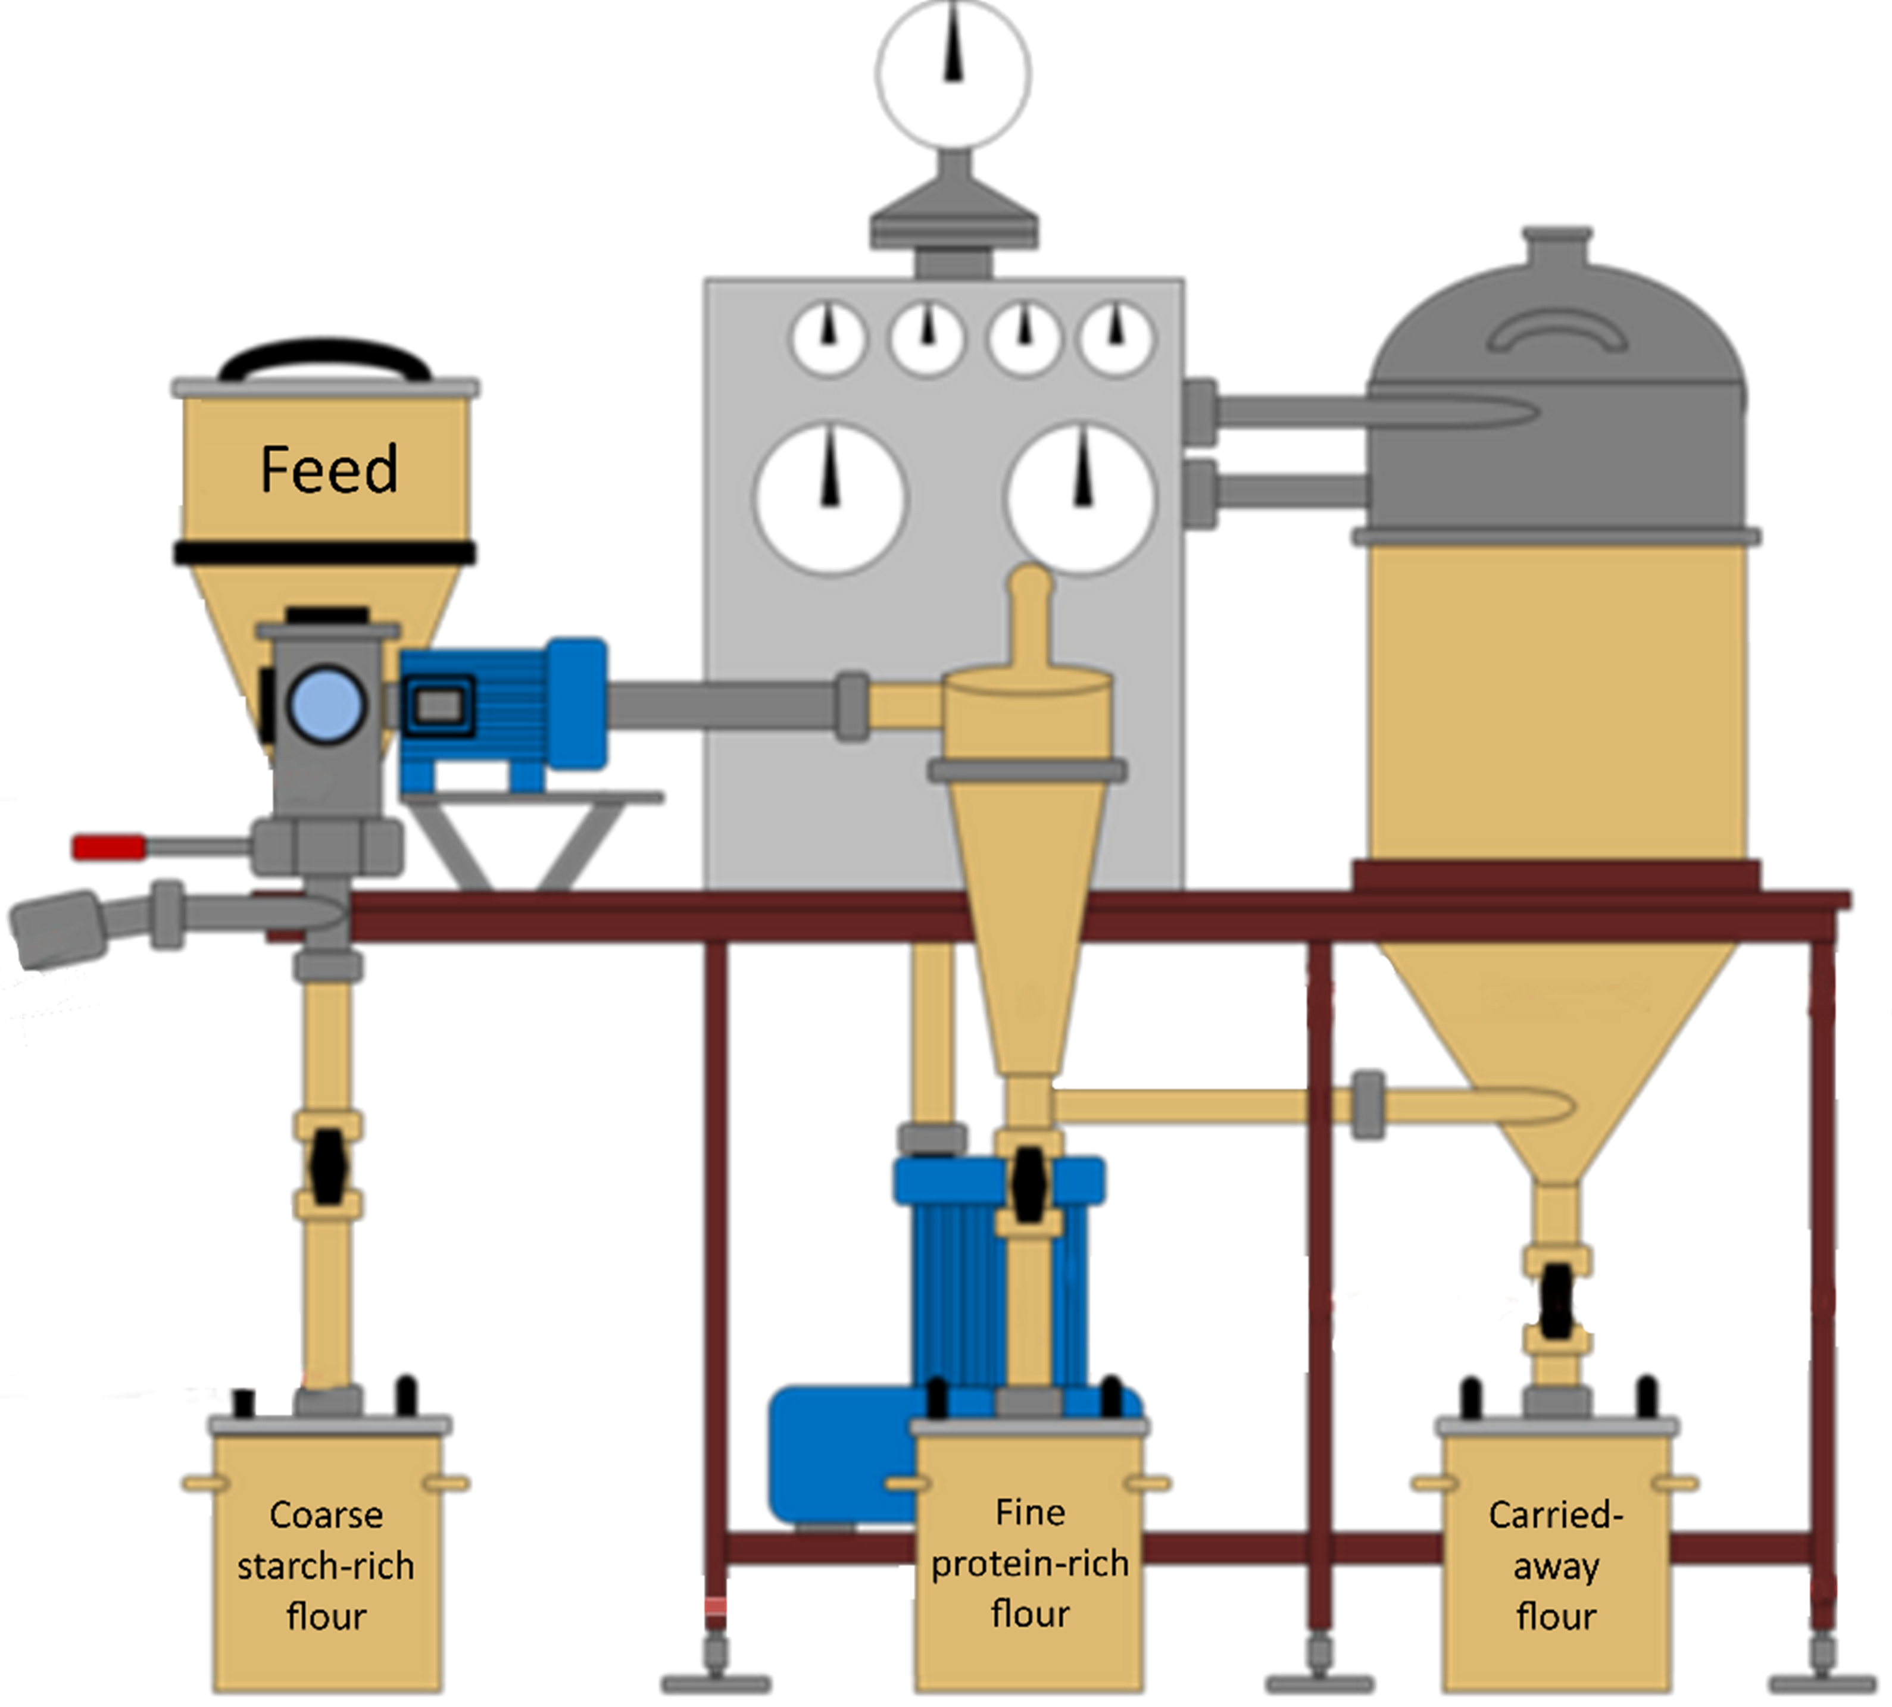
Extraction
Wet
Dry
High purity
Well-known process
No water/solvent used
Keep natural properties
High water and energy consumption
Lower protein content
Need of fine grinding
Notes:
Protéines => qu’est-ce qu’il faut étudier?

Slide 4
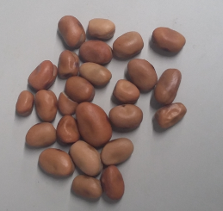
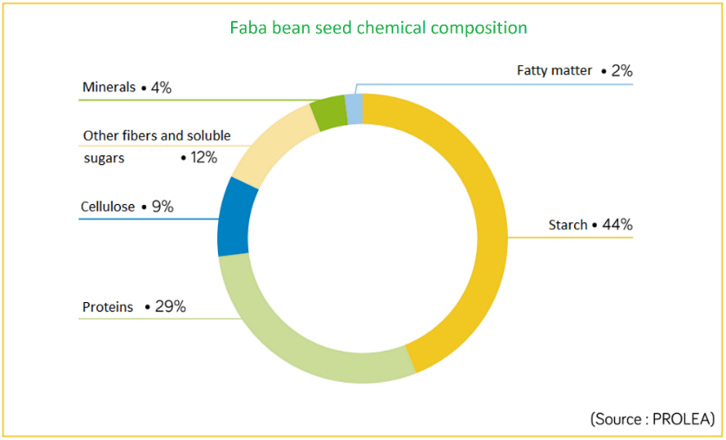
Dehulling + Micronisation
Wet extracted proteins
Protein-free starch
*from a research paper submitted to LWT – Food science and technology
Notes:
Titre image composition!

Slide 5
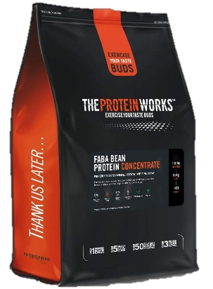
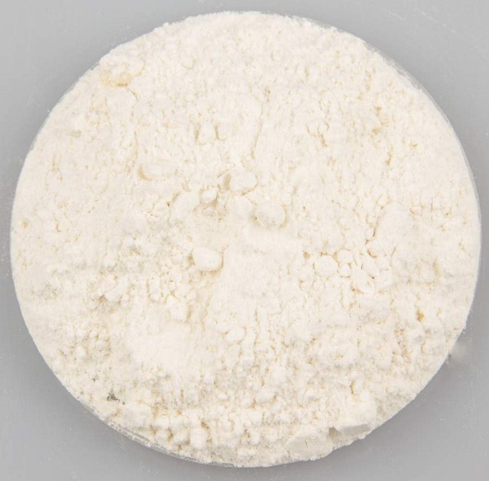
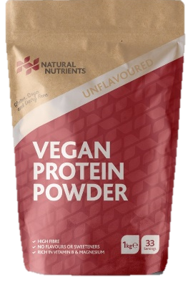
66 % proteins
89 % of the seed proteins are recovered
30% proteins
~ 1,5 times more!
90 % proteins

Slide 6
Most of the proteins recovered
Lower water and energy consumption
2 fractions for ≠ purposes
Mastery of the total process to improve
What about the proteins properties?
Notes:
Consommation d’eau divisé par 5 à 10x, suivant l’echelle!, diminution énergétique théorique

Slide 7
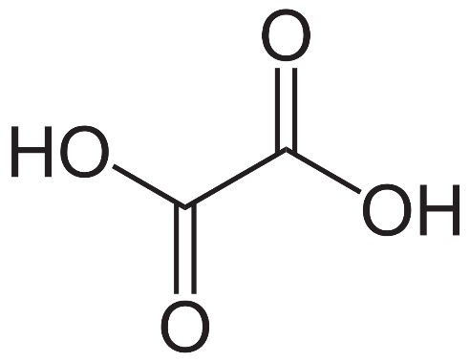
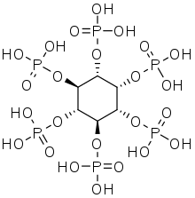
Anti-nutritional factors
Chelating agent
Inhibitor
-ases
Lectins
…
Toxic compounds
Allergenic comp
(con)vicin
…

Slide 8
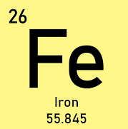
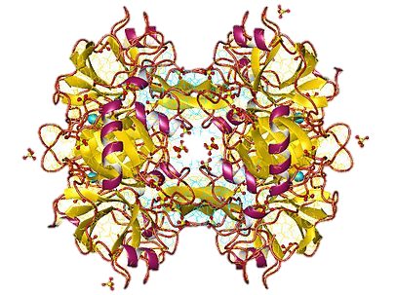
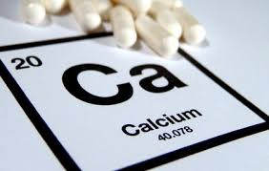

Slide 9
B
B
b
A
b
a
Notes:
Mettre nom? => trouver le graphe original

Slide 10
Parameters
$$\frac{phytate}{mineral}$$
Digestibility
Toxicity

Slide 11
E-mail : lionel.dumoulin@uliege.be

