Slide 1
Posidonia oceanica, a top producer of dimethylsulfoniopropionate and dimethylsulfoxide
Richir J., Champenois W., Engels G., Abadie A., Gobert S., Lepoint G., Silva J., Santos R.
& Borges A.V.
2019-10-10,
Cascais,
Portugal
DMSP
DMSO
DMS

Slide 2
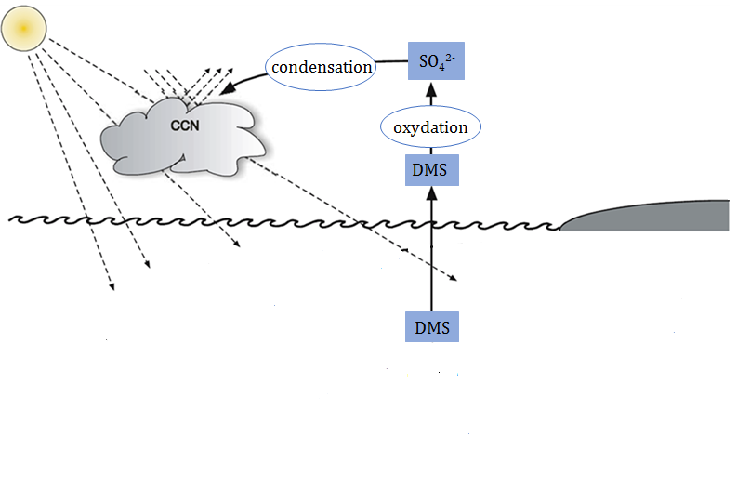
DMSP and related sulfonium compounds
DMSP
-
DMSO
Stefels et al. (2007), Biogeochemistry
Notes:
CCN: cloud condensation nuclei
SO42-: sulfate ion

Slide 3
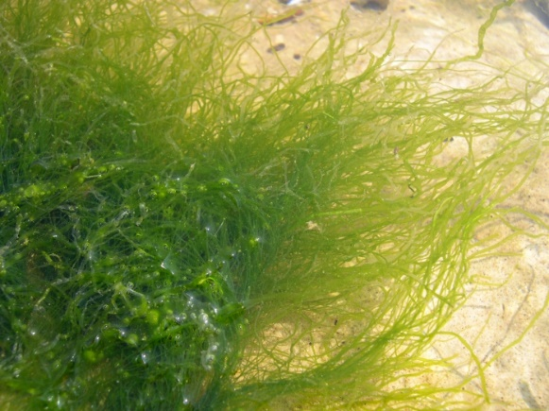
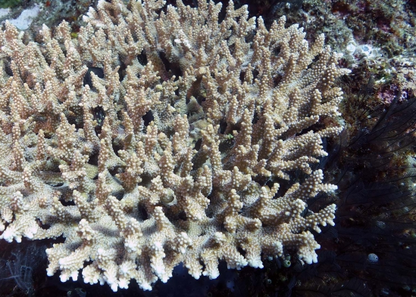
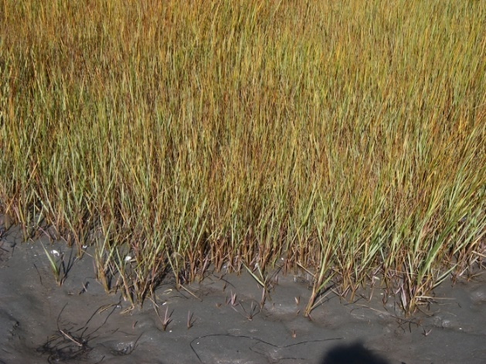
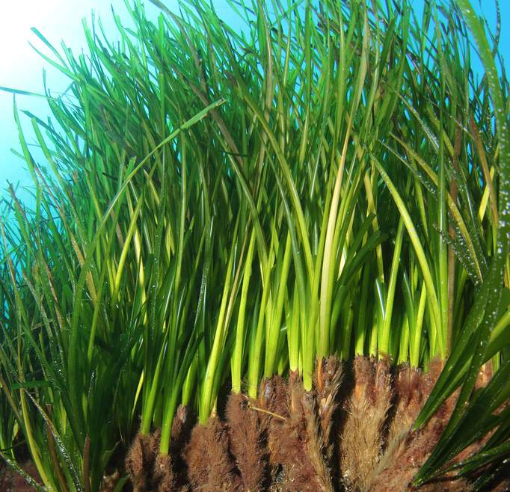
DMSP in marine primary producers
Macroalgae
(e.g., Ulva intestinalis ;
Van Alstyne (2008),
J Mar Biol Assoc UK)
Coral (e.g., Acropora millepora ; Raina et al. (2013), Nature)
FUNCTIONS
● osmolyte
● cryprotectant
● antioxydant
● overflow metabolite (C, N, S, excess energy)
● predator deterrent
● antibiotic
● antifouling
● …
Phytoplancton
(e.g., Phaeocystis globosa ; Speeckaert et al. (2018),
Sci Total Environ)
Seagrass
(e.g., Posidonia oceanica ;
Borges & Champenois (2015),
Aquat Bot)
Salt marsh plant
(e.g., Spartina alterniflora ;
Husband & Kiene (2007), Wetlands)

Slide 4
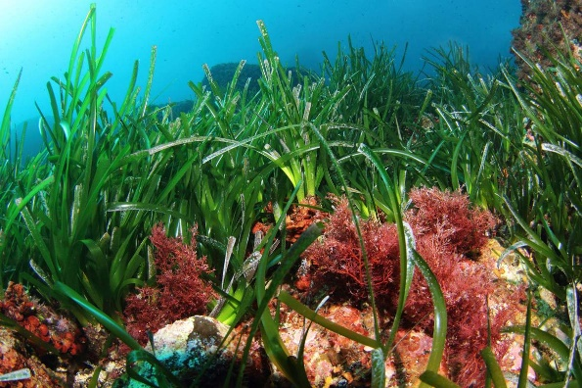
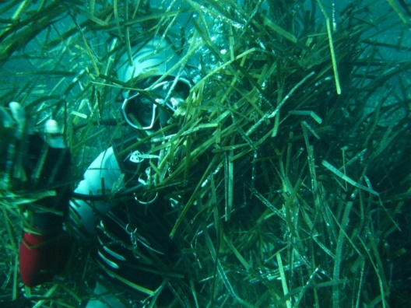
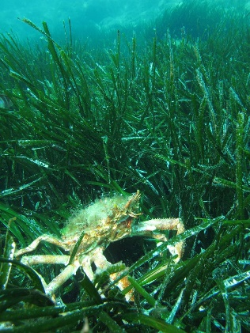
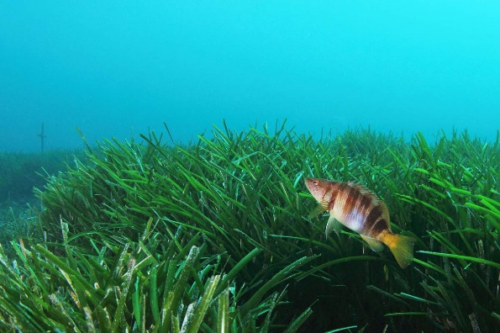
Posidonia oceanica
Husband and Kiene (2007), Wetland ; Husband et al. (2012), Environ Exp Bot ; McFarlin and Alber (2013), Mar Ecol-Prog Ser ; Simó and Vila-Costa (2006), Mar Chem

Slide 5
Posidonia oceanica

Slide 6
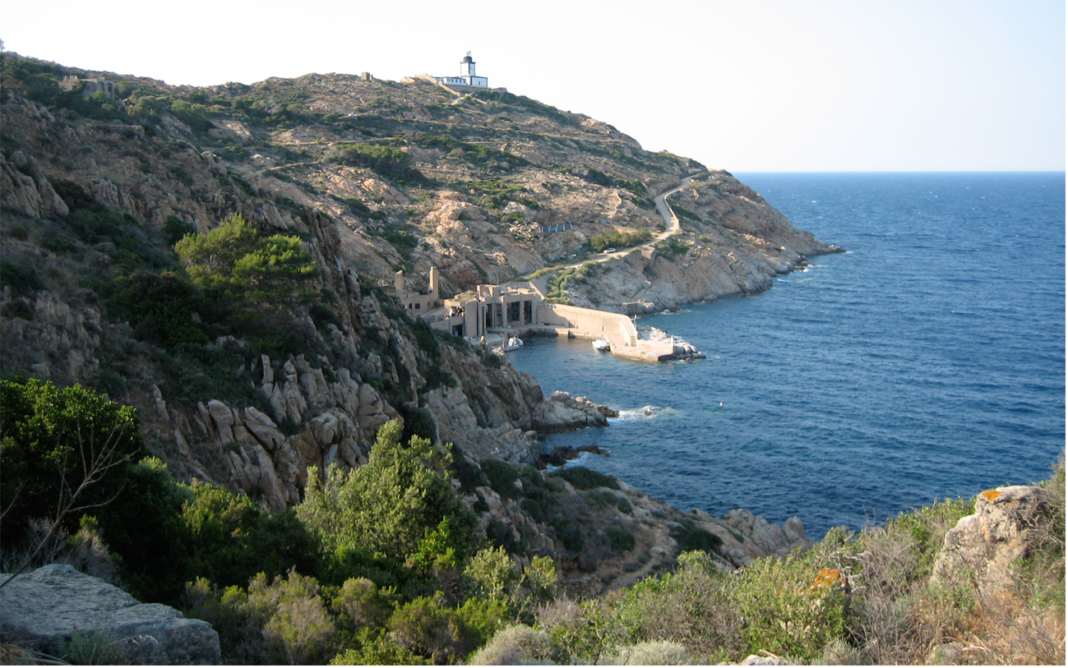
Thanks for your attention

