Slide 1
Rhizoremediation of an aged-contaminated soil with two Fabaceae: impact on PAHs bioaccessibility.
NSABS 2020
Marie DAVIN
Université de Liège – Gembloux Agro-Bio Tech
Soil-Water-Plant Exchanges – Laboratory of Chemistry of Natural Molecules
Co-Promotors: Gilles COLINET, Marie-Laure FAUCONNIER

Slide 2
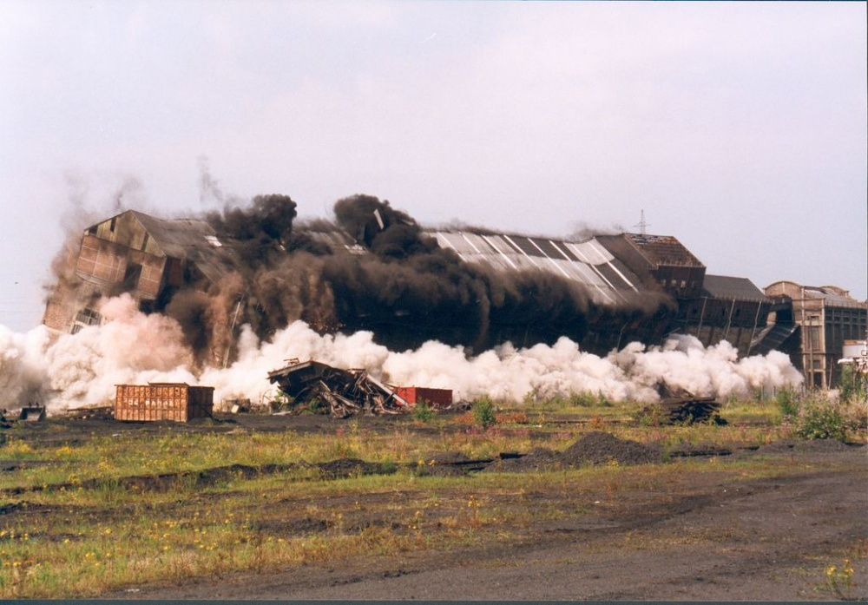
Brownfields need remediation
Source: SPAQuE
Notes:
Wallonia: still up to 17k potentially contaminated sites, many are being evaluated, need to implement economic and risk-based management strategies

Slide 3
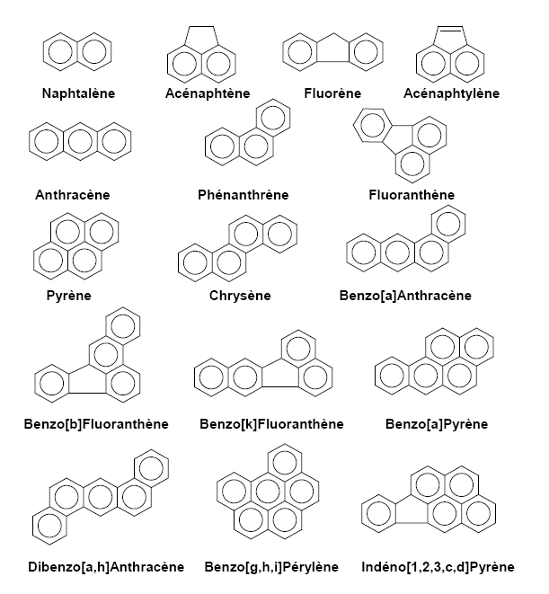
Polycyclic Aromatic Hydrocarbons
Persistent Organic Pollutants
Hydrophobic
Low H₂O solubility
Low volatility
(Potential) carcinogens/mutagens
16 apolar from US-EPA
Notes:
6000 sites en Wallonie

Slide 4
Polycyclic Aromatic Hydrocarbons
3 groups based on MW:
∑2-3 rings
∑4 rings
∑4-6 rings
∑all
Notes:
6000 sites en Wallonie

Slide 5
State of the art
Phytoremediation (plants)
Bioremediation (microorganisms)
Rhizoremediation
Limited by bioaccessibility
Fabaceae ?
Hypothesis
Could Medicago sativa L. or Trifolium pratense L. enhance PAHs bioaccessibility, and thus bioremediation, as part of the rhizospheric effect?
Notes:
availability of a chemical to “cross an organism’s cellular membrane from the environment, if the organism has access to the chemical”

Slide 6
Rhizoremediation experiment
Pots: Aged-contaminated soil + culture
Culture: Medicago sativa L. (alfalfa)
Trifolium pratense L. (red clover)
Control (unplanted)
Time: 3-6-12 months (April 2018 to April 2019)
Repetitions: 5
Conditions: Uncontrolled (outdoors)
+ tap-water (many drought episodes)
Analyses: Residual PAHs content →exhaustive CH₂Cl₂ extraction
Bioaccessible PAHs content →mild Tenax® extraction
MS
TP
C
Notes:
Comment on aged-soil
Comment on exhaustive extraction (known) and mild extraction

Slide 7
Rhizoremediation experiment:
Plants
C
MS
TP
Several TP plants died throughout the experiment.
MS plants developed better than TP plants on the contaminated soil.

Slide 8
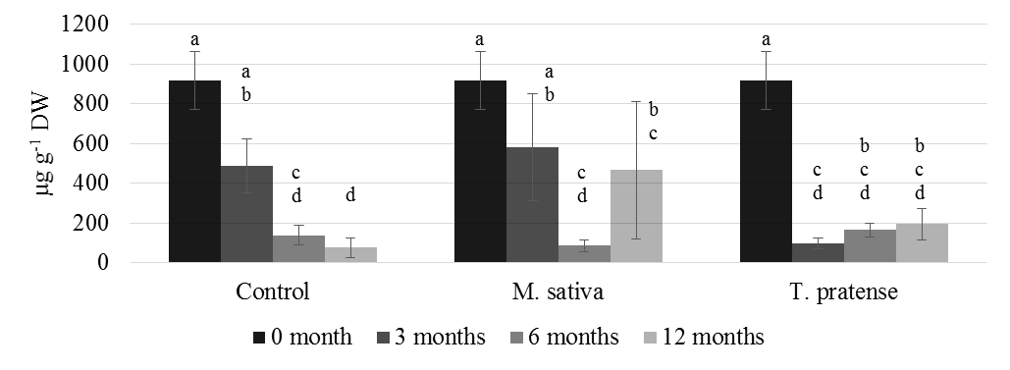
Rhizoremediation experiment: residual contents
∑all
T*t
Similar patterns for each PAHs group within each treatment
Notes:
The presented data focusses on the different groups of PAHs (∑2-3 rings, ∑4 rings, ∑4-6 rings and ∑all) as they summarize and emphasize the observations made on individual PAHs data. Statistical analyses on residual contents were performed after log10 transformation. Analysis of variance showed significant interactions between time (three, six or twelve months) and treatment (C, MS, or TP) on both residual and bioaccessible contents.

Slide 9
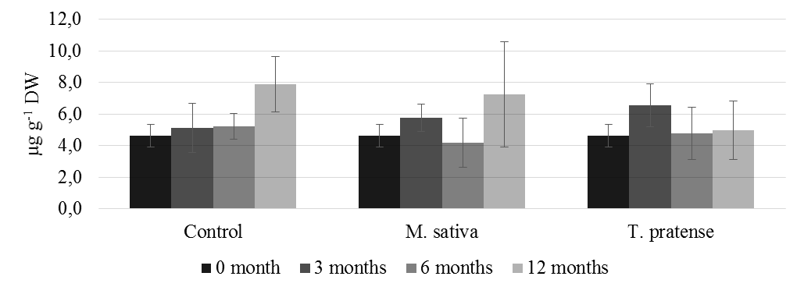
Rhizoremediation experiment: bioaccessible contents
∑2-3 rings
T*t
Similar patterns for each treatment within each PAHs group
∑4 rings
∑4-6 rings
∑all

Slide 10
Conclusions and perspectives
On this study:
Long term: residual PAHs contents ↓ more when plants absent (C) / small (TP)
repeat and measure PAHs in plants and in leaching water?
MS to slow PAHs migration?
PAHs bioaccessible contents slightly influenced by plants presence
→ plants for risk management?
On studies to come:
Contrasted results in the literature (on PAHs residual contents)
more studies needed on realistic aged-contaminated and contrasted soils
Bioaccessible contents very low compared to residual contents
systematic measure of bioaccessibility in remediation experiments needed to add a risk-analysis point-of-view

Slide 11
Thank you for your attention
mdavin@uliege.be

Slide 12
Assessing bioaccessibility?
Tenax ® beads as an infinite sink to mimic maximal potential biodegradation

Slide 13
Assessing bioaccessibility?
Tenax ® beads as an infinite sink to mimic maximal potential biodegradation

