Slide 1
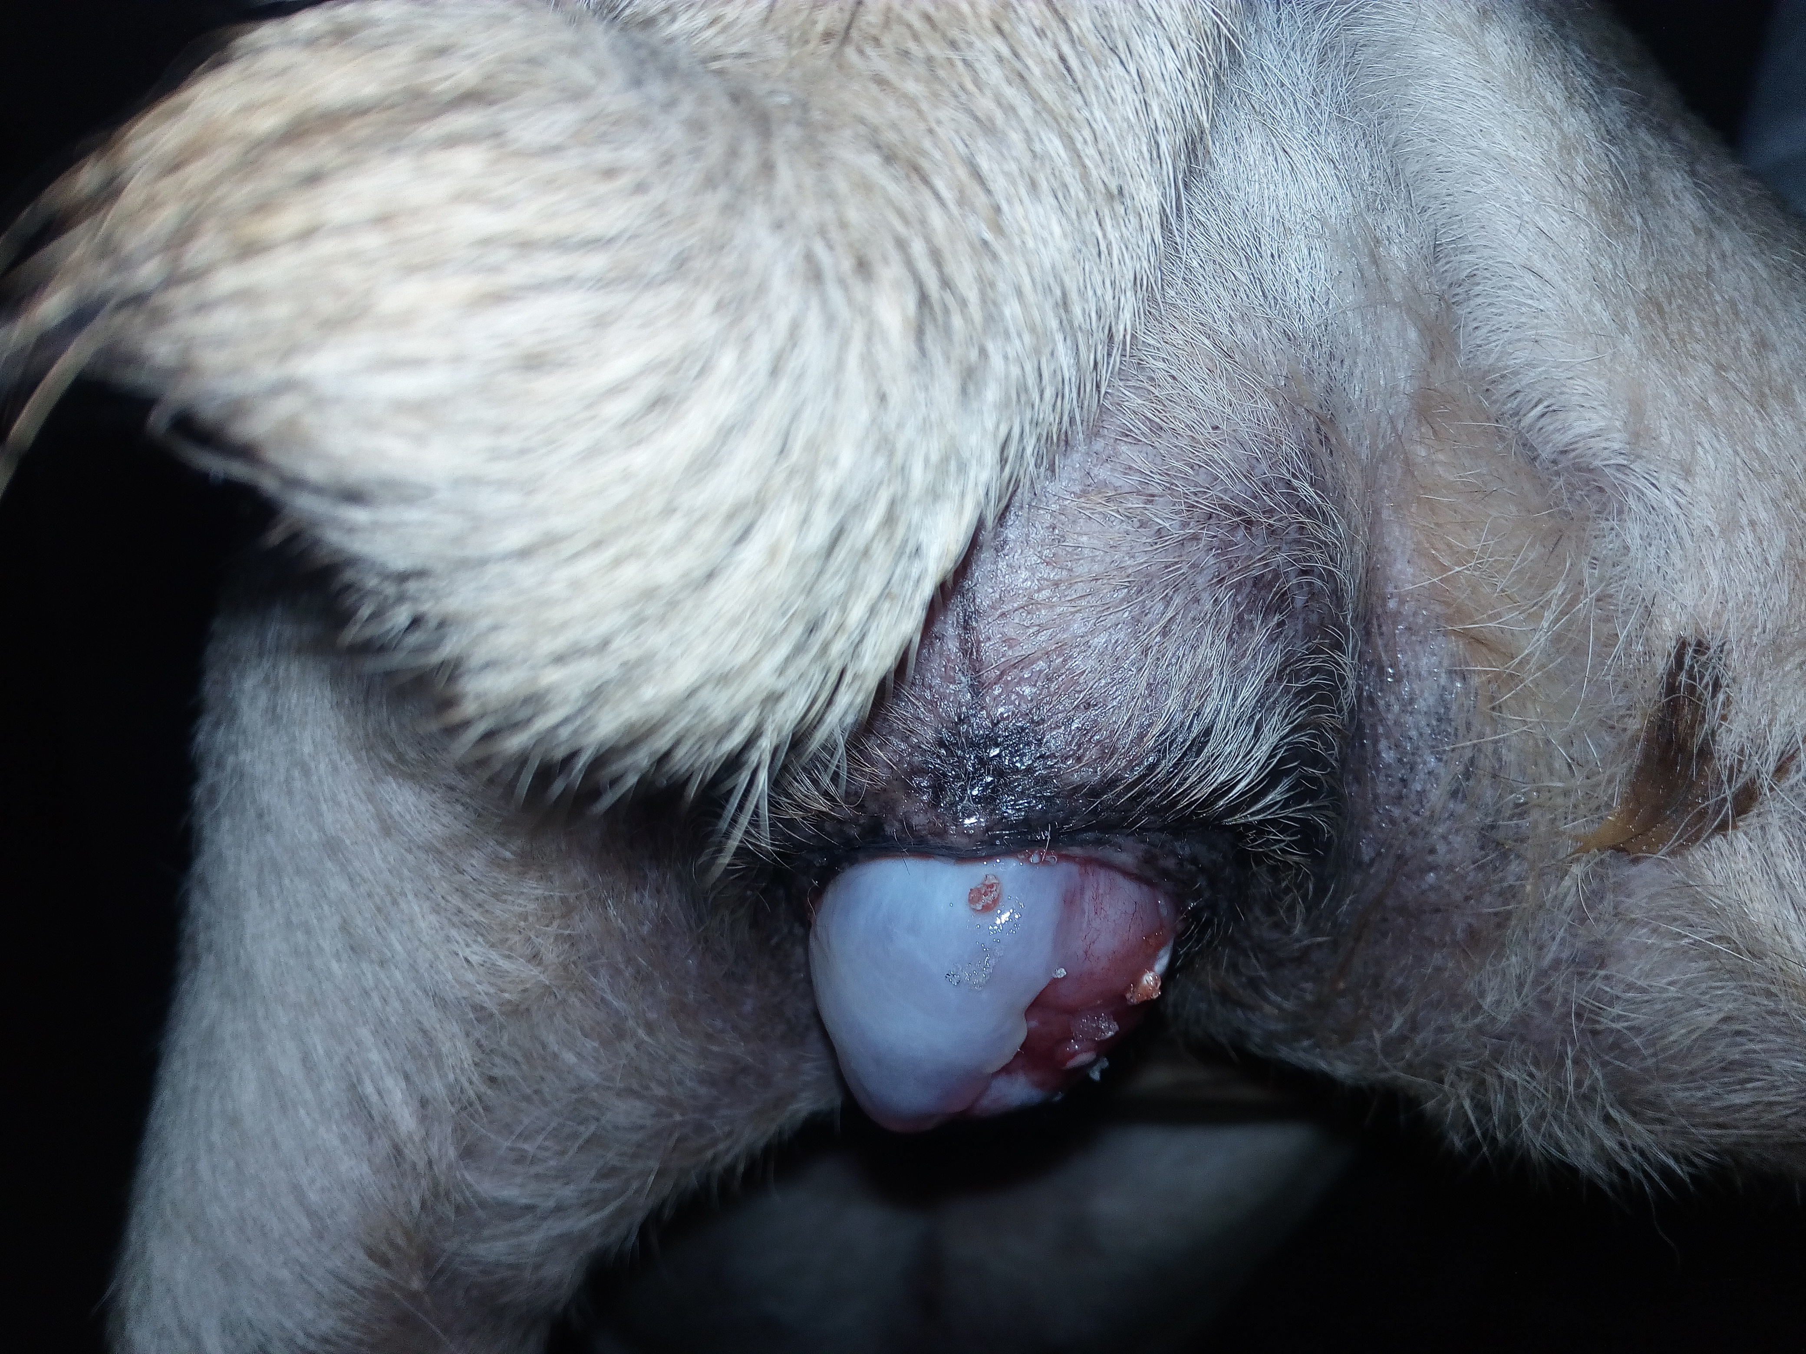
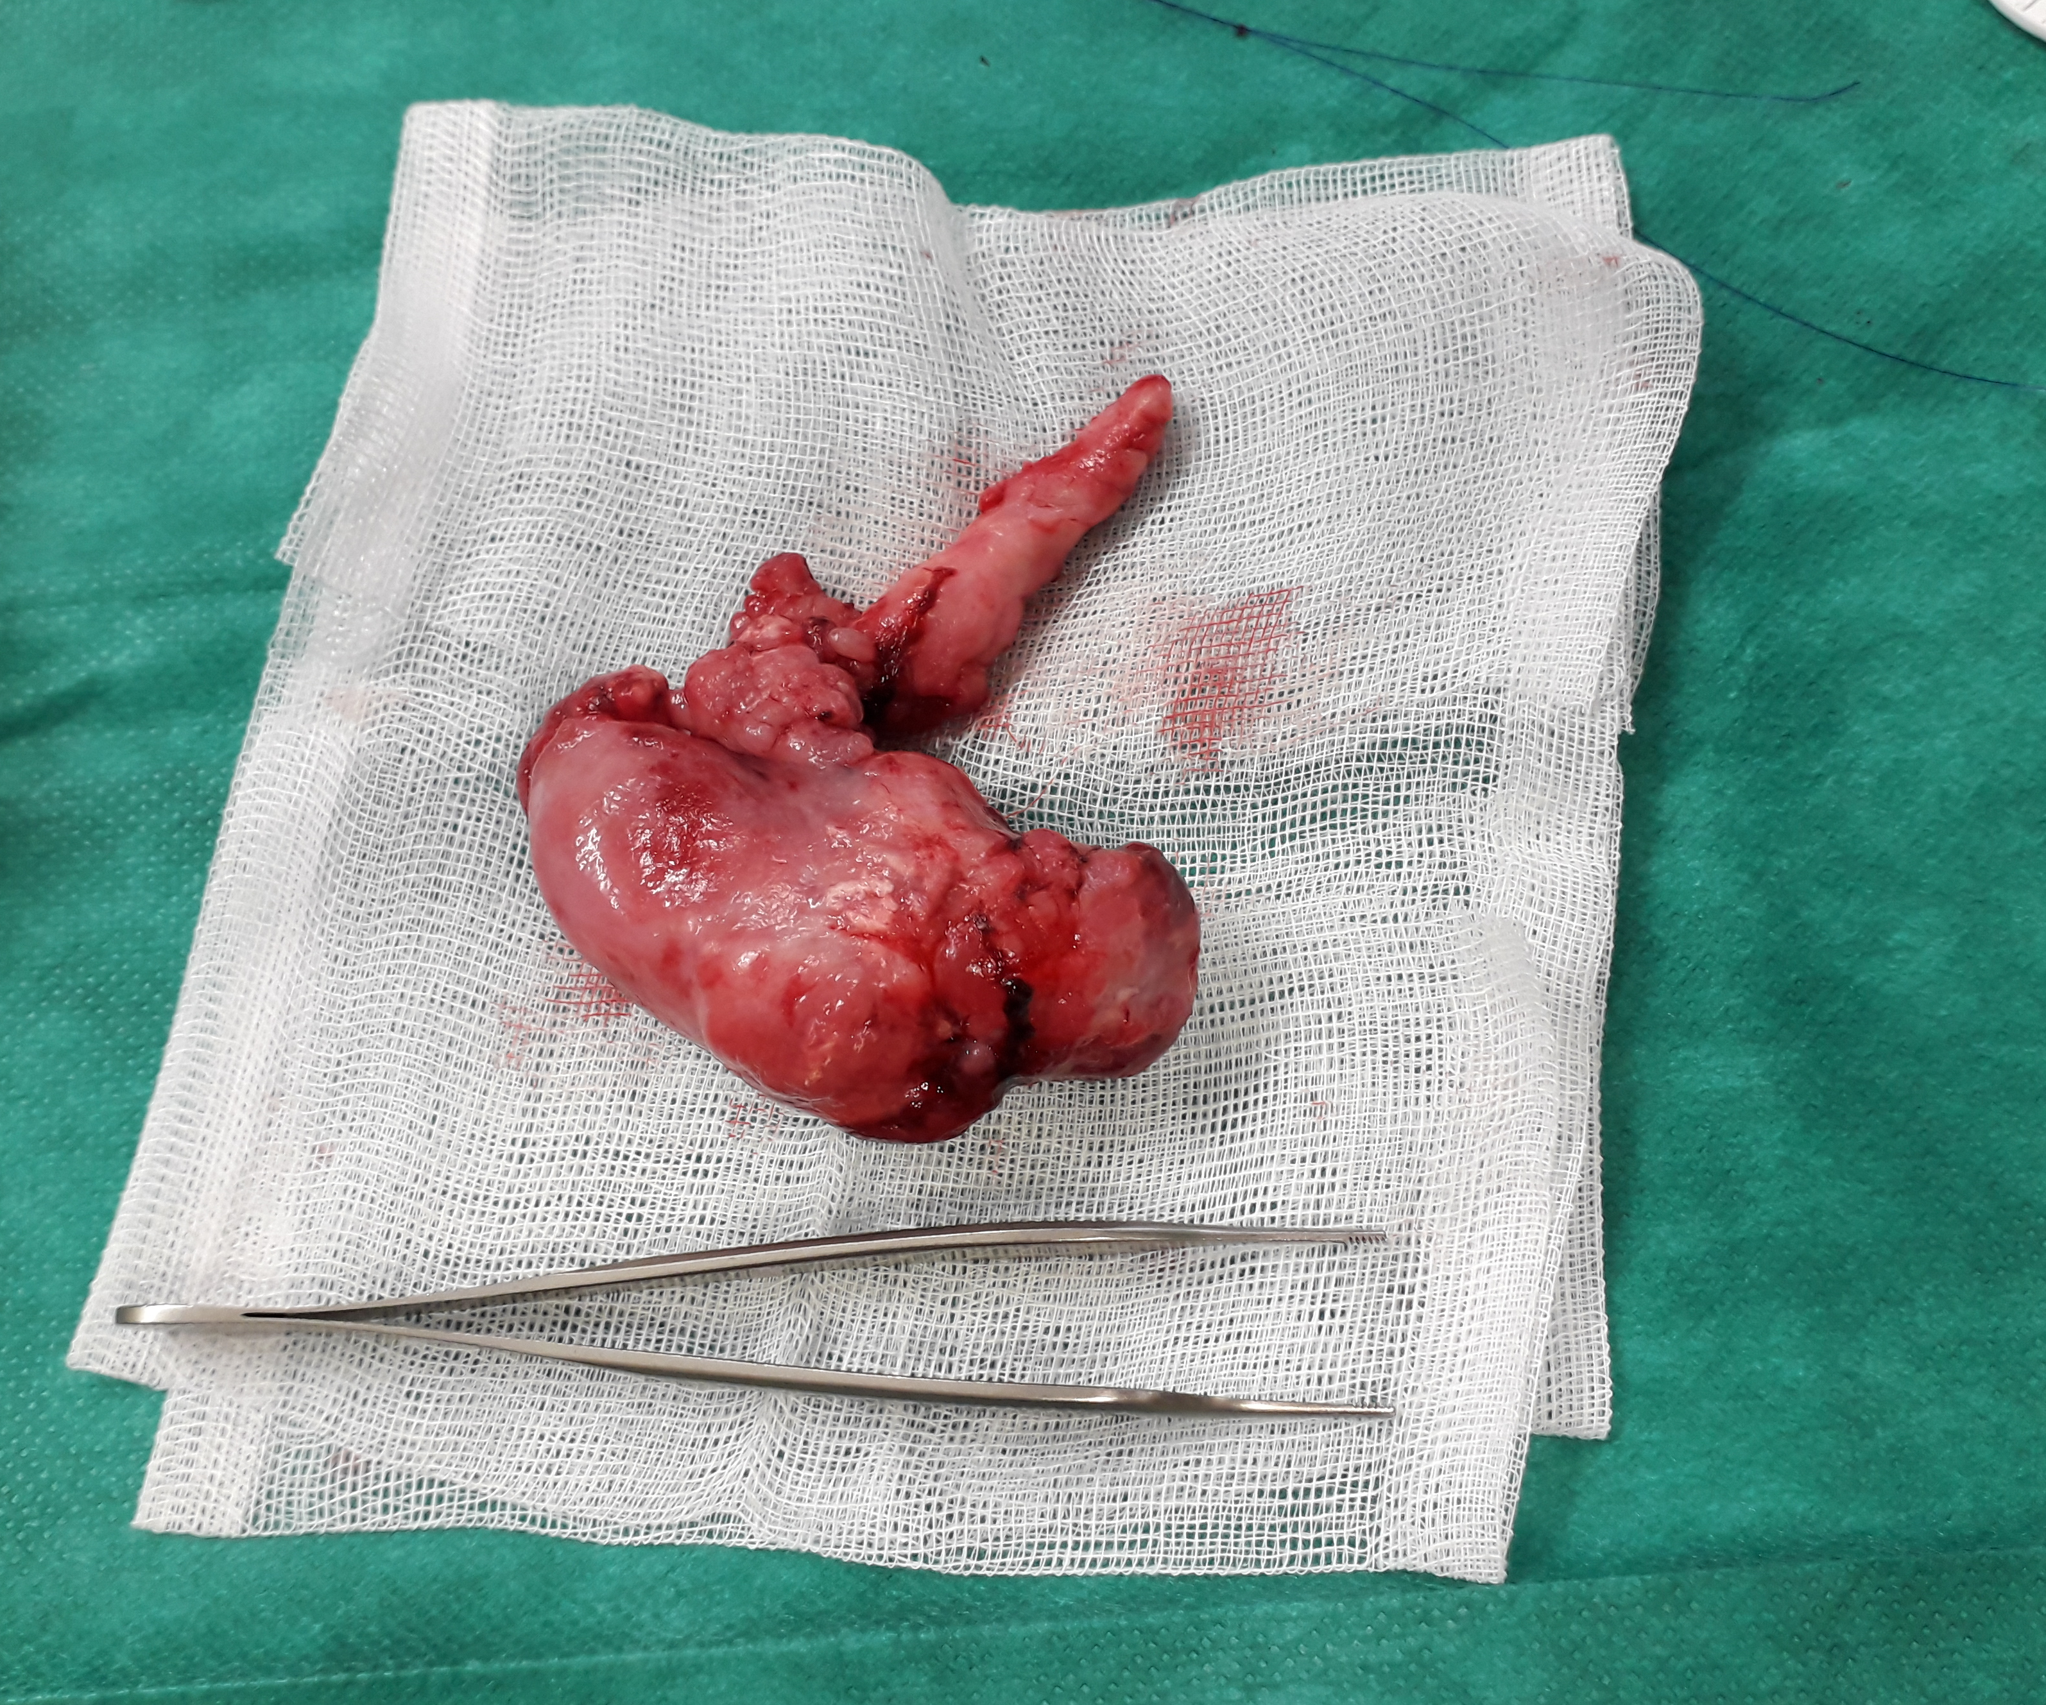
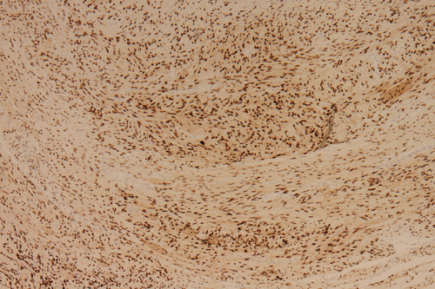
A vaginal fibroleiomyoma in a ten-year-old spayed pug dog
F. Brutinel¹, S. Egyptien¹, M. Hamon¹, M. Heimann², S. Noël¹ and S. Deleuze¹
¹University of Liège, ²Veterinary pathology laboratory, Anapet E-mail: flore.brutinel@uliege.be
Purpose: Description of a case of benign vaginal tumour in a spayed bitch. Investigation for potential causes of estrogen impregnation and research of estrogen receptors on the resected mass by immunohistochemistry.
Case
Ten-year-old pug, spayed two years before
Referred for a bleeding vaginal mass protruding intermittently from the vulva (Figure 1), tenesmus, dysuria progressing to anuria
No report of signs of heat after ovariectomy or exogenous estrogen administration
Antimüllerian hormone and progesterone assayed a few days before: 0.01 and 0.1ng/ml respectively
Complementary exams
Vaginal cytology: no sign of estrogen impregnation
Endoscopic vaginal examination: single, painful mass with areas of calcification and necrosis, measuring 5x5 cm, involving the dorsal wall of the caudal vagina
Abdominal ultrasonography: No ovarian tissue identified - Liquid dilatation of the vagina, hemorrhagic vulvar discharge occurred after the procedure - No evidence of abdominal metastasis
→ No evidence of residual ovarian tissue
Figure 1: Perineal swelling and vaginal mass protruding from the vulva.
Treatment and outcome
Emergency surgical excision due to complete urethral obstruction
Resection through an episiotomy and a partial thickness incision around the pedicle - Vaginal mesh and urinary catheter left in situ during 48h (important diffuse bleeding)
Good outcome
Histological diagnosis and research of estrogen receptors by immunohistochemistry
Fibroleiomyoma with some atypical areas with anysocaryosis
Estrogen receptors αER 1D5 found by immunohistochemistry in the tumor, including atypical areas, healthy vaginal epithelium and smooth muscles (Figure 3)
Figure 2: Vaginal mass after excision.
Discussion
Vaginal and vulval tumors :
2.4-3% of all canine tumors, 73% of them are benign - Vaginal leiomyomas are usually found in intact bitches
Influence of ovarian hormone strongly suspected: ovariohysterectomy recommended at the time of excision of the vaginal mass
E2 receptors present in surface epithelium, stroma and smooth muscle cells of the healthy vaginal tissueª
Half of the benign vaginal tumors have estrogen receptors and 84% progesterone receptors^{b}
In this reported case:
no evidence of residual ovarian tissue
the vaginal mass is strongly suspected to have been already present at the time of ovariectomy
less likely, the mass may have appeared and grown after sterilization in absence of estrogen stimulation, even if estrogen receptors were present as it is suspected that they may persist without estrogen stimulation.
Figure 3: Immunohistochemistry for estrogen receptors. The tumor cells show nuclear immunolabelling with anti-ER antibody. X100.
Conclusion
We report a rare case of a benign vaginal tumor in a spayed bitch without evidence of ovarian remnant syndrome. This tumor still has ER. Vaginal examination before late neutering should be recommended to detect any vaginal mass.
References:
ª Vermeirsch H., et al, Immunolocalization of sex steroid hormone receptors in canine vaginal and vulvar tissue and their relation to sex steroid hormone concentrations. Reprod Fertil Dev. 2002;14(3-4):251-8.
^{b} Millán Y., et al, Steroid receptors in canine and human female genital tract tumours with smooth muscle differentiation, J Com Pathol. 2007 Feb-Apr;136(2-3):197-201.

