Slide 1
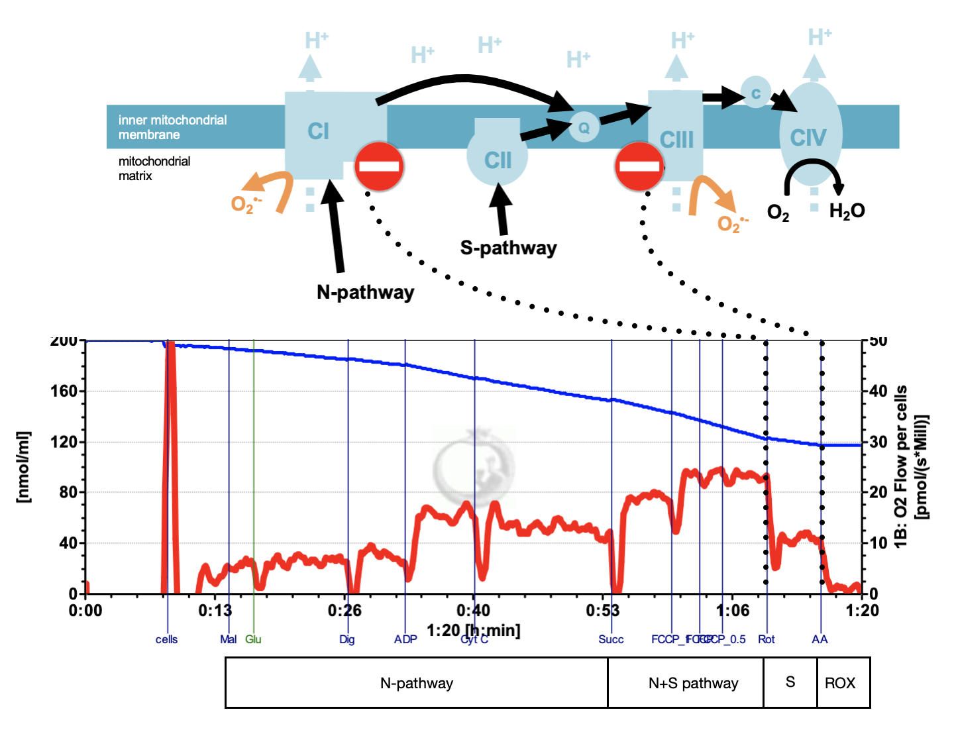
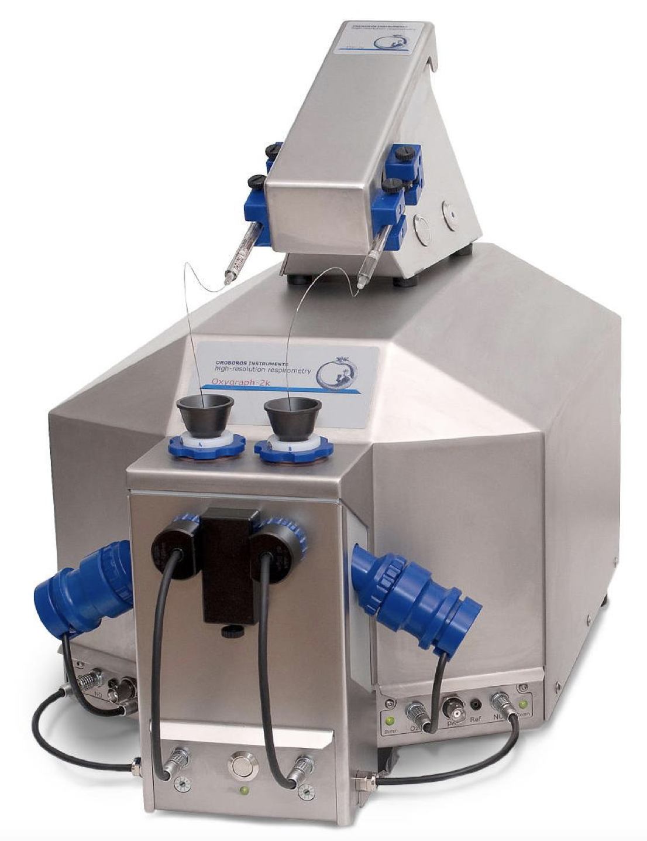
Mitochondrial dysfunction in horses
Mitochondrial dysfunction has been extensively described in the literature in the last century. Numerous conditions cause various phenotypes due to mitochondrial alterations like Alzheimer’s and Parkinson’s disease, obesity, diabetes and skeletal muscle disorders¹. Despite this, the literature is scarce about the contribution of mitochondrial dysfunction as a cause of horse myopathy^{2,3}.
Methods
High-resolution respirometry and specific substrate-uncoupler-inhibitor titration (SUIT) protocols were used to measure mitochondrial oxygen fluxes.
Two SUIT protocols (Fig. 1) were applied on PBMC isolated from whole blood of healthy horses with no diagnosed metabolic syndrome.
Results
The PBMC yield varies between 1.5 and 1.9 x 10⁶ cells/ml of whole blood (n=38).
Figure 1: Standardized SUIT protocol
Peripheral blood mononuclear cells isolated from equine blood were added to the Oxygraph-2k chamber (Oroboros Instruments, Austria) and permeabilized with digitonine (DigX). Oxygen concentration ([µM]; blue line) and oxygen consumption per million of cells ([pmol O₂.s⁻¹.mil⁻¹ ]; red line) were recorded over time in the closed chambers. Different energetic substrates, uncouplers and inhibitors were subsequently added to evaluate the N-pathway, oxidative phosphorylation and electron transfer capacities.
Our first respirometric results show a high variability depending on the timeframe between blood draw and isolation as well as between the end of isolation and the moment of cell analysis.
A standardization of the procedure is vital for reproducibility between laboratories and comparison between healthy and ill horses. The next steps are to compare the oxygraphic measures between equine PBMC and muscle biopsies, as well as the comparison of mitochondrial function between healthy and horses in extreme metabolic conditions (e.g atypical myopathy). Furthermore, quantification of reactive oxygen production via chemiluminescence (DCFH-DA recording via a microplate reader) is currently under examination.
Discussion and Perspectives
An adequate isolation procedure was established. Further, we can record stable and reproducible oxygen fluxes in respirometry when the timeframe between the different steps is strictly respected.
Figure 2: PBMCs post isolation and washing.

