Slide 1
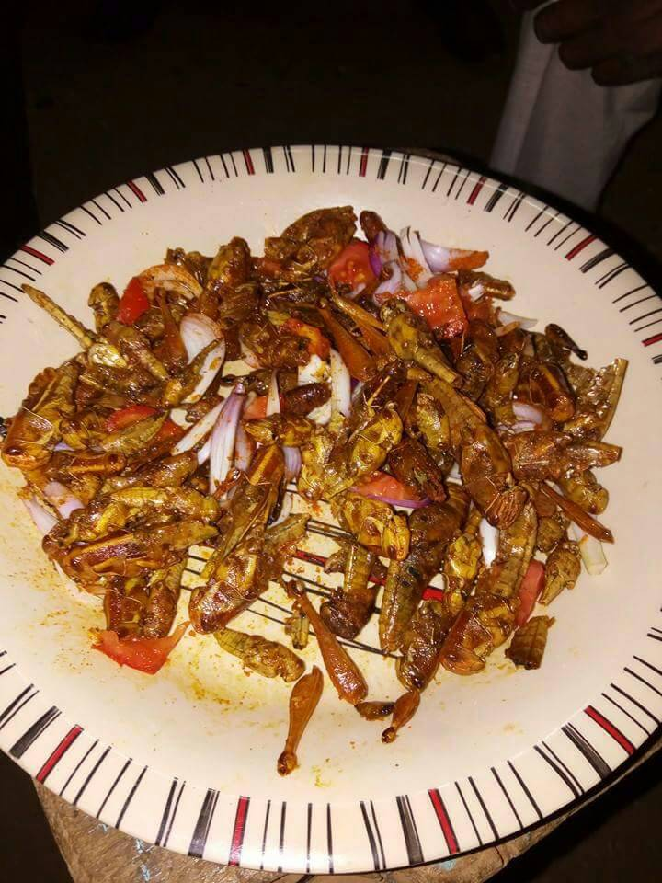
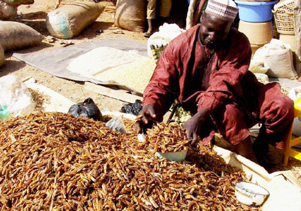
Sensitization profile of cricket food-allergic or cricket tolerant patients
in an entomophagous population in Niamey, Niger
R.M.M.J. Gadisseur ¹, S. Laouali ² , J. Courtois ³, X. Van Der Brempt ⁴, J.P. Jacquier ⁵, E. Cavalier ¹, S. Tollenaere ³, D.A. Maizoumbou ² , T. Hamidou ⁶
Material & Methods:
We described 15 patients who came to the Lamordé Hospital in Niamey to explore their allergies. Each patient underwent a clinical anamnesis of allergy and Skin Prick Tests (SPT) to cricket, shrimp, cockroach, HDM in the Department of Dermatology-Allergology.
Then, we measured the specific IgE (sIgE) on each patient serum at the University Hospital of Liège. First, we used a traditional method (ImmunoCAP© 250, Thermofisher, Uppsala, Sweden) to determine the sIgE against allergen extracts (shrimp, cockroach) and against molecules (Der p10-TP, Pen a1-TP). Afterwards, we measured the sIgE against components with a microarray technique (ImmunoCAP© ISAC, ThermoFisher, Uppsala, Sweden). The ImmunoCAP ISAC proposes sIgE to different allergens from Cockroach (Bla g1, Bla g2-Aspartic Protease, Bla g5- Glutathion S-transferase, Bla g7-TP), Shrimp (Pen m1-TP, Pen m2-AK, Pen m4-Sarcoplasmic Ca-binding protein (SCaBP)) and HDM (Der p1/Der f1, Der p2/Der f2, Der p10-TP).
1 : Department of Clinical Chemistry, CHU de Liège - Liège(Belgique),
2 : Department of Dermatology, Hôpital de Lamordé - Niamey (Niger)
3 : CRIG - Centre de Recherches des Instituts Groupés de HELMo - Liège(Belgique),
4 : Department of Pneumology-Allergology, Clinique St Luc - Bouge (Belgique),
5 : Department of Pneumology, Centre Hospitalier Métropole Savoie - Chambéry (France),
6 : Department of Dermatology-Allergology, Hôpital de Lamordé - Niamey (Niger),
1537
Introduction:
Results:
In Niger, edible insects are mainly used for human consumption. There are poor publications on the allergenicity of edible insects in Africa, but food allergies can be severe. Moreover, cross-reactions between shrimp and edible insects have been described. Tropomyosin (TP) and Arginin Kinase (AK) have been described as arthropod panallergens. These molecules are responsible for cross-reactivity between insects and other arthropods.
Patients were entomophagous (n=14), some of them were allergic to cricket (n=11 including 4 patients presenting angioedema), to shrimp (n=8), to cockroach (n=5), to HDM (n=4), some were co-allergic to shrimp/HDM (n=2), co-allergic to shrimp/HDM/cockroach (n=1).
The 15 patients had positive SPT to cricket, even the 3 cricket-tolerant patients (P12-P13-P14).
All the 11 cricket-allergic patients were sensitized to shrimp and to cockroach.
Five patients were sensitized to TP: Der p 10 (n=4), Bla g 5 (n=1), Pen m 1 (n=5).
SIgE against AK were detected in 7 patients (2 patients were mono-sensitized =P6-P8). The higher sIgE rates were found with AK sensitization.
We found no sensitization to TP, AK, Sarcoplasmic Calcium-Binding Protein in the 3 cricket-tolerant patients (P12-P13-P14).
The allergen involved in angioedema after cricket ingestion remained undefined in 1 patient (P1).
The non-entomophagic patient, presenting rhinitis only, had positive sIgE for Pen m2 AK and a positive SPT for shrimp (P15).
Although other known arthropod allergens (GADPH, myosin light chain, fructose-biphosphate aldolase, actin, tubulin) have been identified.
In-vitro diagnostic tools are able to provide the sensitization profile of patients presenting food allergies. Component-Resolved-Diagnosis using molecular allergens are very useful to determine the eliciting allergens and to understand cross-reactivities.
The aim of the study was to highlight for the first time the sensitization profile of patients from an entomophagous population in Niger (mainly cricket consumers) who displayed symptoms of allergy (sometimes severe – angioedema) to one or more of the following allergens: cricket, shrimp, cockroach, House Dust Mites (HDM).
 |  |  |  |  | Allergy History |  |  |  | SPT (mm) |  |  |  |  |  | ImmunoCAP - sIgE |  |  |  | ImmunoCAP ISAC microarray - sIgE
P | Age | Sex | Atopy | Entomophagy | Symptoms after cricket meal | shrimp | HDM | cockroach | Pos Ctrl | Neg Ctrl | shrimp | HDM | cockroach | cricket | Der p 10 TP | Pen a 1 TP | shrimp | cockroach | CCD MUXF3 | Bla g 1 | Bla g 2 | Bla g 5 | Bla g 7 TP | Der f 1 | Der f 2 | Der p 1 | Der p 10 TP | Der p 2 | Pen m 1 TP | Pen m 2 AK | Pen m 4
1 | 31 | M | As-Rh-C | Cricket season | OAS - U - AO - GI - V | Yes | Yes | ? | 5 | 2 | 4 | 8 | NT | 7 | neg | neg | 0,98 | 1,02 | neg | neg | neg | neg | neg | 10,54 | 25,11 | 21,06 | neg | 33,34 | neg | neg | neg
2 | 26 | F | As-Rh | Cricket season | OAS - Dys - HypoT -V - AO | Yes | No | No | 5 | 0 | 5 | NT | NT | 5 | 6,75 | 4,24 | 6,71 | NT | neg | neg | neg | neg | 7,1 | 3,4 | 6,9 | 6,6 | 6,8 | 7,2 | 7,1 | neg | neg
3 | 26 | F | As-Rh-AD-C | Occasional | OAS - U - AO - Rh - C - GI | Yes | No | Yes | 5 | 0 | 4 | 0 | 4 | 6 | 0,22 | 0,23 | 6,26 | NT | neg | neg | neg | neg | 0,64 | neg | neg | neg | 0,6 | neg | 0,56 | 14,84 | neg
4 | 36 | M | As-Rh | Occasional | OAS - U - AO | Yes | No | ? | 6 | 0 | 0 | 0 | NT | 5 | neg | neg | neg | 0,12 | neg | neg | neg | neg | neg | neg | neg | neg | neg | neg | neg | neg | neg
5 | 44 | M | Rh | Occasional | U - OAS - GI - V | Yes | No | No | 5 | 0 | NT | 0 | 0 | 6 | neg | neg | 6,8 | 9,57 | neg | neg | neg | neg | neg | neg | neg | neg | neg | neg | neg | neg | neg
6 | 55 | F | As-Rh-C | Cricket season | OAS - U - OE | No | No | ? | 5,5 | 0 | 0 | 4 | 4 | 4 | 0,18 | 0,14 | 6,36 | 14,6 | 1,22 | neg | neg | neg | D | neg | neg | neg | neg | neg | neg | 13,19 | neg
7 | 39 | M | As-Rh-AD-C | 2 x/year | U -GI - V | Yes | ? | Yes | 5 | 0 | 10 | 0 | 6 | 8 | neg | 0,11 | 56,7 | 25,6 | neg | neg | neg | neg | neg | neg | neg | neg | neg | neg | 1,6 | 30 | 1,2
8 | 8 | F | As-Rh-C | Cricket season | OAS - U | ? | ? | Yes | 4 | 0 | 0 | 0 | 4 | 4 | neg | neg | 9,83 | 0,72 | neg | neg | neg | neg | neg | neg | neg | neg | neg | neg | neg | 26,78 | neg
9 | 20 | M | Rh-AD-C | 2 x/year | U | ? | Yes | ? | 6 | 0 | 5 | 6 | 5 | 4 | neg | neg | 3,17 | 28 | neg | neg | neg | neg | neg | 3,35 | 0,53 | 0,82 | neg | 0,53 | neg | 3,22 | neg
10 | 14 | F | Rh-C | 1 x | GI | No | No | Yes | 5 | 0 | 4 | 0 | 5 | 6 | neg | neg | 0,48 | 21,7 | neg | 4,07 | neg | neg | neg | neg | neg | neg | neg | neg | neg | neg | neg
11 | 31 | M | As-Rh | Stop | OAS | Yes | No | No | 5 | 0 | 5 | 5 | 6 | 8 | 0,12 | 0,12 | 12,6 | 4,77 | 0,46 | neg | neg | 1,88 | neg | neg | neg | neg | neg | neg | neg | 42,86 | neg
12 | 17 | F | As-Rh-AD-C | Occasion | No symptoms | Yes | Yes | Yes | 6 | 0 | 6 | 4 | 6 | 5 | neg | neg | 0,33 | 25,1 | neg | neg | neg | neg | neg | neg | neg | neg | neg | neg | neg | neg | neg
13 | 44 | M | Rh | Cricket season | No symptoms | No | Yes | No | 6 | 0 | 4,5 | 5 | 0 | 4 | neg | neg | neg | neg | neg | neg | neg | neg | neg | 9,14 | neg | 12,32 | neg | neg | neg | neg | neg
14 | 27 | F | Rh-C | Occasional | No symptoms | No | No | No | 5 | 0 | 5 | 5 | NT | 5 | neg | neg | 2,59 | 40,8 | 0,63 | 3,53 | neg | neg | neg | neg | neg | neg | neg | neg | neg | neg | neg
15 | 30 | M | Rh | NEVER | / | No | No | No | 5 | 0 | 4 | 8 | 0 | 7 | neg | neg | neg | neg | neg | neg | neg | neg | neg | 17 | 4,9 | 41 | neg | 14 | neg | 10 | neg
Conclusions:
We showed for the first time, the sIgE profile of cricket food-allergic or tolerant patients coming from a region in Africa where entomophagy is very common. Some of them underwent life-threatening reactions (angioedema).
Co-sensitization to shrimp and to cockroach is very often associated with food allergy to cricket in Niger. Specific IgE to Tropomyosin and Arginin kinase were frequently positive in our population describing allergy to cricket.
Cricket tolerant patients seems to have no sensitization to TP and AK.
In 3 cricket-allergic patients presenting a positive SPT to cricket, the eliciting allergen could not be determined.
Some allergenic components are missing on the market to define the sensitization profile of this entomophagous population. Western Blot and Tandem Mass Spectrometry may be useful to highlight cricket allergens and to define a complete sIgE sensitization profile.
Table 1: Description of the 15 patients; age, sex (M/F), allergy symptoms (U= Urticaria, OAS=Oral Allergy Syndrome, AO=Angioedema, GI= Gastrointestinal trouble, V= Vomiting, Dys= Dyspnoea, HypoT=Hypotension, C= Conjunctivitis, Rh=Rhinitis).
SPT(mm), sIgE with ImmunoCAP (KUA/L) and with ImmunoCAP ISAC microarray. ImmunoCAP neg <0,10KUA/L. ImmunoCAP ISAC neg <0,30 ISU.
Bibliography : Hamidou T, Maizoumbou DA, Laouali S and Jacquier JP. Allergie et sensibilisation aux criquets Ornithacris turbida cavroisi dans la communauté urbaine de Niamey : à propos de 27 cas. Revue française d’allergologie 2017;57:225–228.
Notes:
Though traditionally confined to some Asian, African and South American countries, consumption of edible insects, known as entomophagy, is gradually spreading to the USA and European countries. Although it remains rather limited, essentially for psychological reasons, in some European countries entomophagy is developing with the emergence of companies dedicated to the mass production of edible insects, together with the opening of restaurants specialized in menus featuring such insects. In spite of the nutritional interest and apparent safety of eating edible insects, it is advisable that we be aware of the allergic risk, which this may represent for people allergic to shellfish, mollusks or house dust mites. Various panallergens such as tropomyosin and arginine kinase, which are common to insects, crustaceans, mollusks, dust mites and nematodes, can be responsible for the cross-reactivity between these organisms of different origins. In addition to these panallergens, other allergens more specifically associated with insects could likewise trigger allergic reactions. However, these allergens are still not well known and remain to be identified and characterized. In the meantime and because of the existence of cross-reactive allergens in insects, it seems wise to advise individuals known to be allergic to shellfish or mollusks to avoid eating edible insects.

