Slide 1
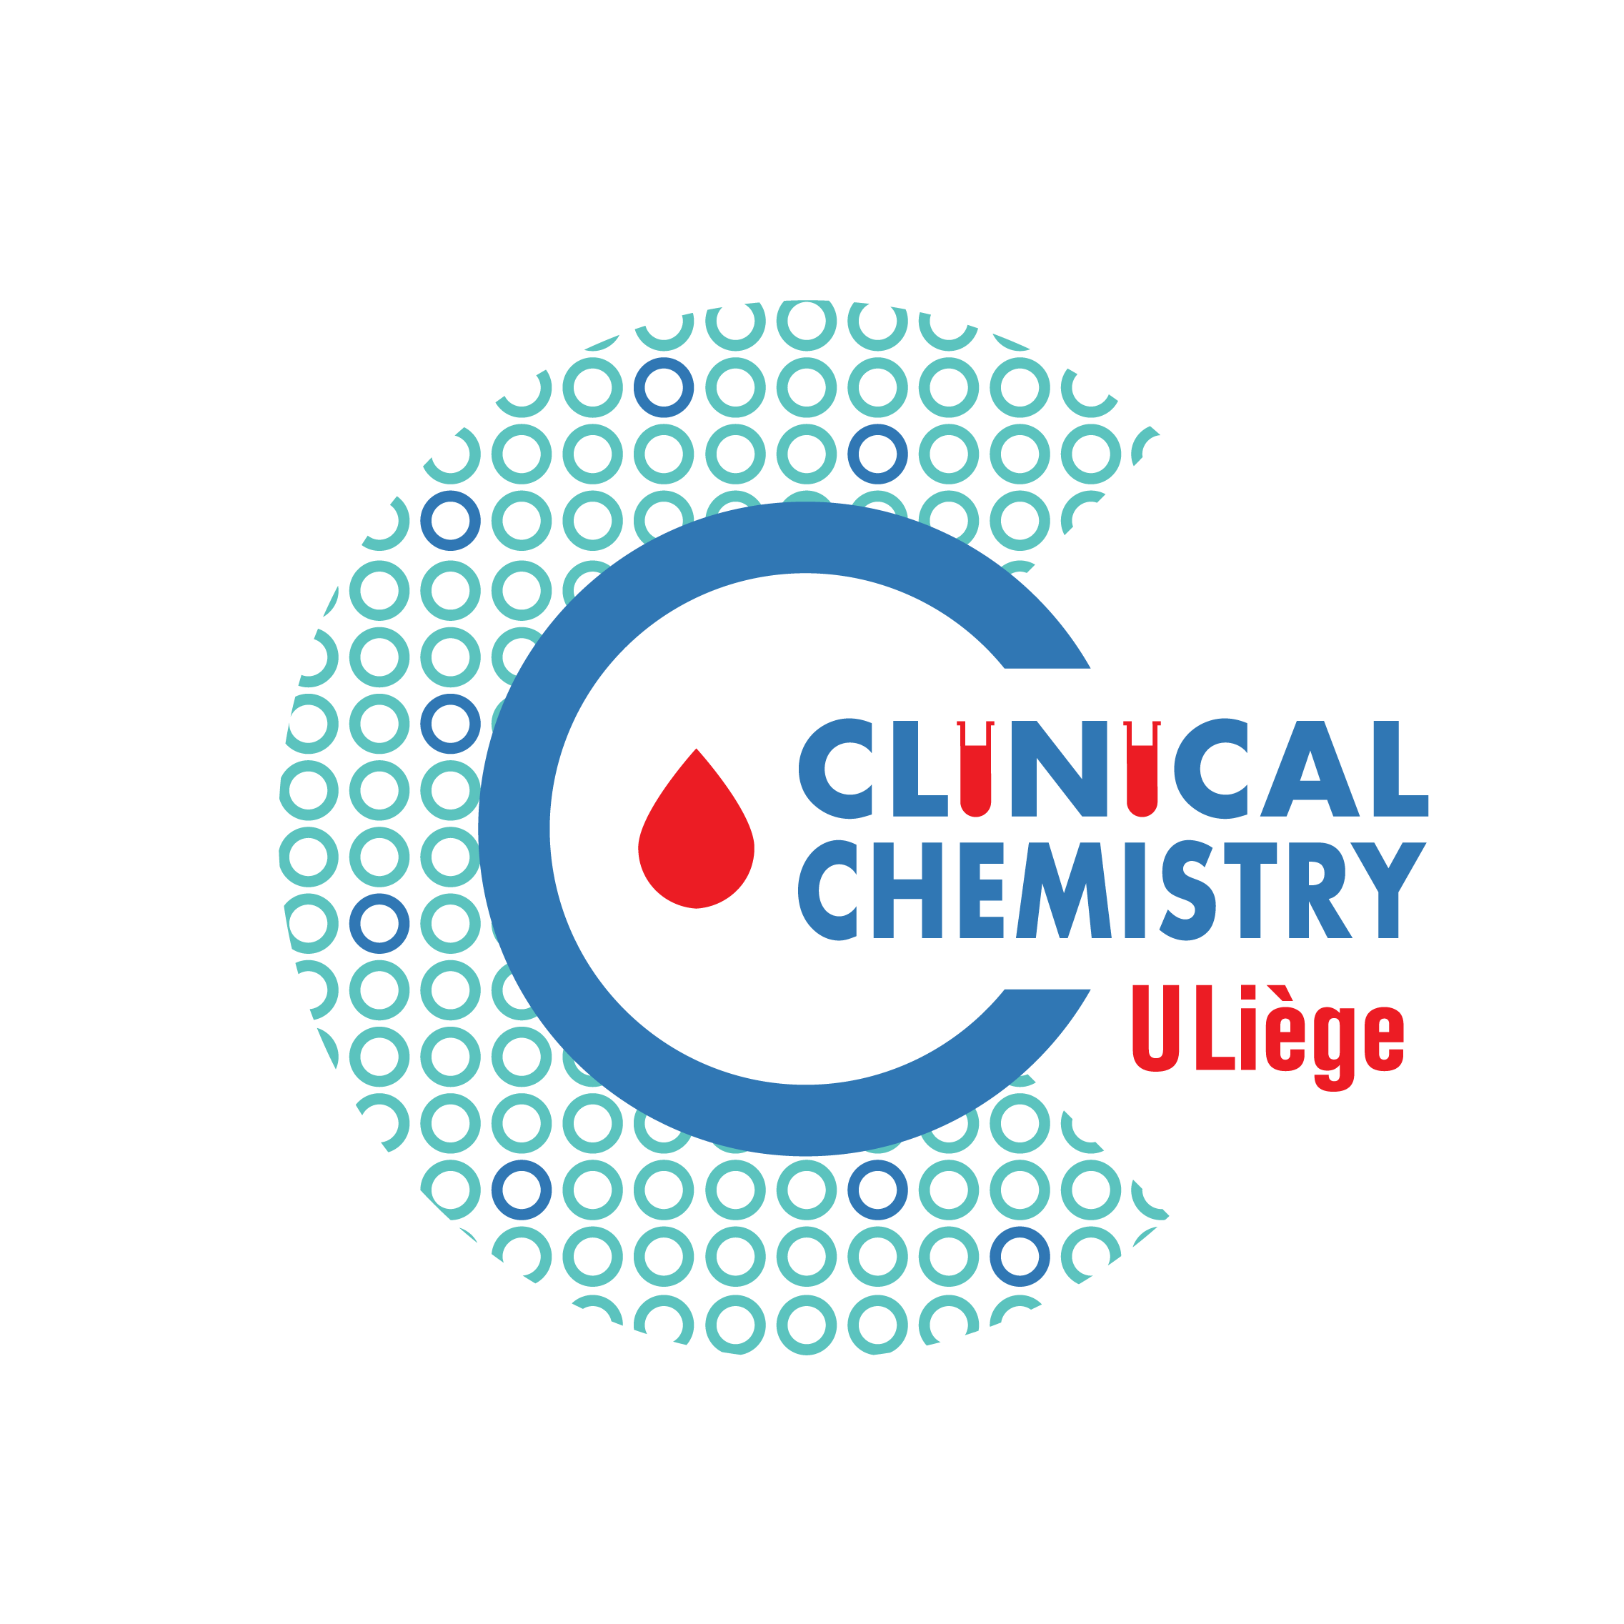


Good Clinical Practice
for in-vitro diagnosis of food allergy
Romy GADISSEUR
Department of Clinical Chemistry
University of Liège, CHU Sart-Tilman
Liège, Belgium
Email: romy.gadisseur@chuliege.be
Notes:
THIS IS MY Lab clinician point of view after looking at the litterature.

Slide 2
Food Allergy
An adverse immune response to the proteins in food.
As the result of a humoral response (IgE), a cellular response (T cells), or both.
Meta-analysis, IgE-mediated food allergies in Europe
The over-all lifetime prevalence of self-reported food allergy =17,3%
Point prevalence for self-reported FA (5.9%), positive SPT to at least one food(2.7%), positive specific IgE (10.1%), and challenge-verified FA (0.9%) was lower.
The highest prevalence in north western Europe and in children, compared to adults.
Low prevalence of self-reported and confirmed FA was found in Southern Europe, while sensitization was similar.
Specific age groups and Foods
Young children: cow’s milk, hen’s eggs, peanuts, tree nuts, sesame seeds, kiwi allergy
Among adults: shellfish, fish, peanuts and tree nuts
Notes:
FA = an adverse immune response to the proteins in food.
A food allergy is typically defined as an adverse immune response to the proteins in a food. This may occur as the result of a humoral response, a cellular response (ie, T cells), or both.
The over-all lifetime prevalence of self-reported food allergy was17.3%
Point prevalence for self-reported FA (5.9%), positive SPT to at least one food(2.7%), positive specific IgE (10.1%), and challenge-verifiedFA (0.9%) was lower. The highest prevalence was seen innorthwestern Europe and in children compared to adults.
Low prevalence of self-reported and confirmed FA was found in Southern Europe, while sensitization was similar toother regions.
Certain foods are more common allergens among specific age groups. Accounting for the majority of immediate food allergies in young children
are cow’s milk, hen’s eggs, peanuts, tree nuts, and ses- ame seeds, with kiwi allergy becoming more prevalent in this group.3 Among adults, shellfish, fish, peanuts, and tree nuts are the most common causes of food allergies.4

Slide 3
International recommendations discourage anti-food IgG assays
European Academy of Allergology and Clinical Immunology,
American Academy of Asthma, Allergy and Immunology (AAAAI)
Anti-food IgG assays are useless tests for the diagnosis of food allergy or intolerance.
Not to perform unproven diagnostic tests.
Should no longer be routinely prescribed.
Their use should be reserved for research purposes, in the current state of medical knowledge.
Notes:
First of all, some words about IGG testings. I will be brief on this topic… but if I have to make this talk about Good medical practices in vitro diag of allergy I must to put one slide over IgG…
From my point of view of lab clinician, i must say that we have to follow the recommandations …
IgG antibody testing for delayed food sensitivity remains controversial.

Slide 4
Anti-food IgG assays
CE labeled but…they are unreliable
No specific information on the food tested
which components react with IgG?
Native foods and culinary preparations (couscous, polenta ...) does not guarantee reproducibility of the extraction stage => complex biological products.
=> We should know which molecular component of the food is recognized. The meaning of the result differs according to the recognized component.
Clinical Chemists should not propose the test …
No reimbursement
Notes:
Those IgG assays are CE-labeled (it means that the companies provided some evidences that the test performance is validated)…
But…
Clinical significance of anti-food IgG detection
Some authors have observed in selected groups of patients, the presence of IgG more frequently against foods (wheat, milk, eggs, legumes ...) compared to healthy controls. The removal of these foods in some cases significantly improved the symptoms during the study period. These still fragmentary studies, limited in their duration, include several methodological biases that make their results questionable.

Slide 5
Good allergy specialists make good laboratory clinicians and vice-versa
No training in allergy and clinical immunology for healthcare young students/practitioners => may not be familiar with the proper application and interpretation of available test results.
Clinical history => serum antibodies and allergy skin testing can be of considerable assistance in identifying (or excluding) the particular allergens that may be causing the patient’s symptoms.
Numerous tests available to assess for food reactions.
2 main categories of tests : in-vivo/in-vitro tests !
skin prick testing
measurements of allergen-specific IgE from blood.
Notes:
Many healthcare practitioners have not received formal training in allergy and immunology and, as a result, may not be familiar with the proper application and interpretation of available test results.
In the context of the clinical history, both serum antibodies and allergy skin testing can be of considerable assistance in identifying (or excluding) the particular allergens that may be causing the patient’s symptoms.
Numerous tests are available on the market and are being used by conventional and alternative practitioners to assess for food reactions.
There are 2 main categories of tests available: allergy skin tests (skin prick testing) and measurements of allergen-spe- cific antibodies from blood.

Slide 6
sIgE : method comparison
Mainly 2 methods used: Immulite (Siemens), ImmunoCAP (Thermofisher).
New arrivals, seen at EAACI : Hycor system – ISYS Immunodiagnostic
ImmunoCAP = most extensively studied.
sIgE calibration curve of the total IgE assay WHO standard
Results not comparable
Immulite was reported to overestimated sIgE when compared with ImmunoCAP (example : cow’s milk). QCE
ImmunoCAP measures total IgE and sIgE equally, whereas IMMULITE higher sIgE signals when compared to the summed level of total IgE
ISYS less CCD in allergen extracts than ImmunoCAP
Be aware of the assay the laboratory is using.
Clinicians cannot compare test results among these different methods in assessing changes in patients’ IgE reactivity to a given food.
Wang J. et al, J Allergy Clin Immunol. 2008
Notes:
In laboratories, you can find different methods for IgE measurements.
, sIgE assays employ the calibration curve of the total IgE assay generated with the WHO standard for IgE
Different allergy laboratory methods may not yield comparable results.
ImmunoCAP measured total IgE and sIgE equally, whereas IMMULITE displayed higher sIgE signals when compared to the summed level of total IgE for all four chimeric antibodies. Results obtained with the two assay systems are not interchangeable by means of mathematical conversion
This is done under the assoption of a comparable binding strength between the allergen and the sIgE and between the primary anti-IgE antibodies used for the reference curvend total IgE

Slide 7
Diagnostic work-up Food Allergy
Starts with the history, followed by sensitization tests (skin, IgE and basophil tests) and optional challenge tests.
Conventional allergy diagnostic tools – Allergen extracts
Hyper-eosinophilia: only a guiding element
total IgE: Poor interest, not good indicator of atopy
Except <3 years and atopic eczema
Neither necessary nor sufficient for diagnosis
High in 20% of NON-allergic subjects.
Normal in 20% of allergic subjects.
Other pathologies with elevation of total IgE (Parasitosis, immunodeficiency, smoking, respiratory viruses, inflammatory diseases).
Modulation of the interpretation of specific IgE.

Slide 8
Low Total IgE, what can we expect ?
Only a little as 1% IgE on the surface of the cell needs to be allergen specific for an effective allergen dependent cell activation.
Using the historical cut-off 0,35 KU/L we would disregard potentially relevant sensitization in particular in patients with low total IgE (<35KU/L, 1% rule).
sIgE measurements in the range of 0,1-0,35 KU/L are technically reliable and of diagnostic use.
In particular in patients with a clear history of allergy and low total IgE (<35 KU/L) the diagnostic range of 0,1-0,35 KUA/L must be considered relevant.

Slide 9
sIgE cut-off
Using cut-off = 0.35 kU/L, sIgE testing has high Se but poor Sp to diagnose FA.
Diagnostic cut-off values can vary widely in studies.
95% PPV cut-off to diagnose PA =15 kU/L in USA and UK, but =24.1 kU/L, 34 kU/L, 57 kU/L in studies performed in Netherlands, Australia, France.
Different patient population (prevalence of FA, comorbidities) and/or from the research study where the cut-offs were determined (inclusion criteria…).
These factors need to be taken into account when comparing studies and when extrapolating cut-offs into daily clinical practice.
Validated diagnostic cut-offs : reliable when applied to a similar population to the population in which they were generated.
PPVs = function of Se and Sp of the test and the prevalence of the disease => only valid for patients + same pretest probability of disease.
Notes:
Diagnostic cutoff values can vary widely in different studies.
For instance, the 95% PPV cutoff to diagnose PA was 15 kU/L in US¹⁴ and UK⁷ studies, but was 24.1 kU/L, 34 kU/L, and 57 kU/L in studies performed in the Netherlands,¹⁷ Australia,¹⁸ and France,¹⁹ respectively.
These differences can result from the patient population (prevalence of FA, comorbidities) and/or from the research study where the cutoffs were determined (inclusion criteria…).
These factors need to be taken into account when comparing studies and when extrapolating cutoffs from published studies into daily clinical practice.
Validated diagnostic cutoffs are reliable when applied to a similar population to the population in which they were generated.
PPVs are a function of the sensitivity and specificity of the test and the prevalence of the disease; therefore, they are only valid for patients who have the same pretest probability of disease as the population in which the PPV was established. For instance, in our clinic population in London, the cutoff of 15 kU/L for peanut sIgE had 95% PPV in 2 different studies performed approximately 10 years apart.^{7, 16} The consistency of these findings indicates that the identified cutoff can be reliably applied to our patient population in the clinic.
Using the cutoff of 0.35 kU/L, sIgE testing has high sensitivity but poor specificity to diagnose FA.
peanut allergy: sIgE to peanut Se= 75%-100% and Sp= 17%-63%.
Adopting 95% positive predictive value (PPV) cutoffs, the specificity of IgE testing increases.
Sampson et al (2001) : PA, cutoff 15 kU/L, Sp=96.8% and Se =28.4% in a UK study.7 This indicates that the 95% PPV cutoffs can be useful to confirm the diagnosis of FA, especially if there is a recent history of an immediate-type allergic reaction.
On the contrary, the cutoff of 0.35 kU/L can be useful to exclude the diagnosis of FA as it has a high negative predictive value (NPV).
Levels of sIgE between positive and negative cutoffs without a clear clinical history do not allow us to confirm or exclude the diagnosis, falling in the so-called immunological gray area
Positive and negative cutoffs can be helpful in guiding the clinical diagnosis of FA; however, they are not absolute and need to be interpreted in light of the clinical history, as patients can still be allergic or tolerant below and above 95% NPV and 95% PPV, respectively.16 PPV and NPV decision levels have been identified for sIgE to other foods (Table I).

Slide 10
Clinical Reasoning to Diagnose Food Allergy
Conventional IgE testing : natural extracts useful for some time.
Component allergen tests :
More precise profiling of the allergen-sIgE repertoire.
Higher diagnostic precision.
Better management of the patient.
The list of allergenic molecules available for testing is not complete.
Molecular allergens for IgE testing provide additional information, particularly in polysensitized patients and with allergens of low abundance, low stability or associated risks.
IgE reactivity to members of the same allergen family reflect the degree of protein homology and IgE cross-reactivity.
If it is high, the relevance needs to be sorted out clinically.
“always think molecular - use molecules, when needed”.
Positive sensitizations to allergen extracts or molecules are only clinically relevant in case of corresponding symptoms
6 IgE/day reimbursed
+8€15 each

Slide 11
Main Protein Families
PR-10 Protein, Bet v 1 homologue
Unstable to heat, cooked fruits generally tolerated
Local symptoms = Oral Allergy Syndrome
Allergy to fruits and vegetables in the North of Europe
nsLTP (non specific Lipid Transfer Protein)
Stable to heat and digestion, allergies to coocked food.
Frequently associated to systemic reactions, severe réaction in addition of OAS
LTP causes food allergy to fruits without any pollen allergy context
Often, associated with allergic reactions to fruits and vegetables in the South of Europe
Profilin
Rarely associated with clinical symptoms bur severe reactions in a minority of patients.
Present in a wide variety of pollens (trees, weeds, grasses) and food allergen
Homology of structure between Profilins of the different fruits and vegetables.
Storage Proteins
In seeds.
Heatstable, reactions to coocked foods possible

Slide 12
Main Protein Families
Tropomyosin
Actin-Binding protein in muscles
Major allergen in vertebrates, minor allergen in house dust mites.
Cross-reactions marker between shellfish, HDM and cockroach
CCD, MUXF3 (cross-reacting carbohydrate determinants)
Sensitization marker to carbohydrate determinants
Present in a majority of plants and hymenoptera venoms.
Rarely associated with clinical symptoms.
Parvalbumin
Major allergen in fish.
Marker of cross reaction between fish/amphibian
Extremely stable to heat and to digestion.
=> Reaction even to coocked food.
95% responsible for allergy to fish
Serum albumin
Present in all body fluids and solids (egg, milk, chicken, beef)
Cross reactions between different species !
Actin-Binding protein in muscles
Notes:
A ajouter : Fabienne peux-tu me rappeler lesquels sont des composants à CCD ? Phl p 4 …. Et ???

Slide 13
Clinical Reasoning to Diagnose Food Allergy
sIgE testing to components :
for single allergens
for multiple allergens in micro/macro-arrays: ImmunoCAP ISAC, ALEX, Faber...
MULTIPLEX - large sensitization profile :
Useful in identifying patterns of sensitization in complex polysensitized patients => Cross-reaction versus real co-sensitization
Latex with unclear clinical relevance that are sensitized to a pan-allergen
Identifying the culprit allergen in patients with recurrent anaphylaxis.
Helps confirm or rule out an IgE-mediated allergy
Useful in pediatric (low blood volume)
Multiplex assays may reveal sensitization to molecules with potentially no clinical relevance.
2 strategies « from clinics to molecules » or « from molecules to clinic »
Notes:
sIgE testing to components is available for single allergens and for multiple allergens in microarrays.
Multiplex assays may introduce concerns where they reveal sensitization to molecules with potentially no clinical relevance as they are all tested independent of the patient's history. However, multiplex assays can be useful in identifying patterns of sensitization in complex polysensitized patients (eg, patients sensitized to pollen, plant foods, and latex with unclear clinical relevance that are sensitized to a panallergen) and in identifying the culprit allergen in patients with recurrent anaphylaxis.^{22, 23}

Slide 14
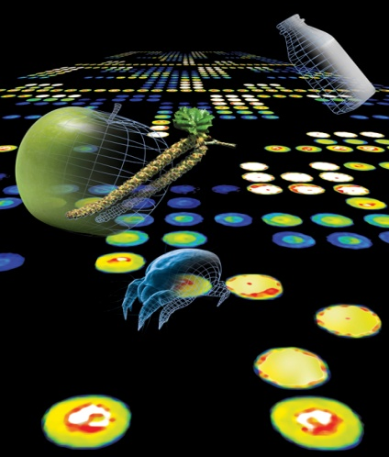

Slide 15
Multiplex, in primary screening:
If SPT unreliable (inflamed skin or atopic dermatitis), elderly patients (reduced number of mast cells in the skin)
When SPT are not feasible due to taking anti-histamines.
In small children when skin area is limited and number of SPT high
Patients with anaphylactic events or suspicion of polysensitization.
In complex cases, the total number of patient visits to obtain an allergy diagnosis can be reduced with the complete ISAC microchip diagnosis.
Specific immunotherapy can be defined more quickly => improves overall patient management

Slide 16

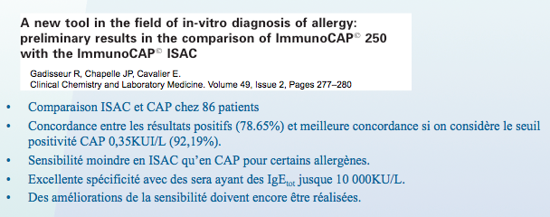
@
Figure 1

Slide 17
Too much information is not good information
The more results, the more difficult the interpretation becomes ...
For proper use of the microarray, consider the results based on the patient's clinic.
Which allergen is relevant-unexpected => in the hands of specialists
A negative result is as important as a positive result!
Exclude the allergic origin of an event
No reimbursement

Slide 18
@
Basophil Activation Tests (BAT) in FA
Functional assay = in-vitro provocation test
Uses live basophils in whole blood : detect ability of IgE to mediate activation after stimulation with allergen.
beyond the detection of IgE binding to allergen to test IgE function, depends on IgE epitope specificity, affinity, and clonality.
The basophils of allergic patients : dose-dependent expression of activation markers (CD63 - CD203c)
sensitized-tolerant patients do not express or much lower expression
In a PA study, basophils of peanut allergic patients showed higher BA to peanut compared with peanut-sensitized-tolerant even in the subgroup where allergic and tolerant children had comparable levels of peanut sIgE. (Santos et al, J Allergy Clin Immunol 2014)
The difference in up-regulation of BA markers in response to allergen between allergic and non-allergic patients forms the basis of the use of the BAT to diagnose FA.
Notes:
The basophil activation test (BAT) is a functional assay that uses live basophils in whole blood to detect the ability of IgE to mediate activation of basophils after stimulation with allergen.
It goes beyond the detection of IgE binding to allergen to test IgE function, which depends not only on the allergen-sIgE levels but also on IgE epitope specificity, affinity, and clonality.⁶⁶
The basophils of allergic patients typically show a dose-dependent expression of activation markers, such as CD63 or CD203c, whereas the basophils of sensitized-tolerant patients do not express or have a much lower expression of activation markers after stimulation with allergen. In a PA study, basophils of peanut allergic patients showed higher basophil activation to peanut compared with peanut-sensitized-tolerant even in the subgroup where allergic and tolerant children had comparable levels of peanut sIgE.¹⁶ The difference in upregulation of basophil activation markers in response to allergen between allergic and nonallergic patients forms the basis of the use of the BAT to diagnose FA.
The main added value of the BAT in the diagnosis of FA compared with tests routinely used in clinical practice, such as SPT and sIgE to allergen extracts, is its enhanced specificity with often conserved sensitivity. For instance, the BAT to peanut showed 98% sensitivity and 96% specificity to diagnose PA, with the specificity reaching 100% in a subsequent validation. The specificity of the BAT ranged between 77% and 100% in other studies (Table IV).^{11, 67, 68, 69, 70, 71, 72, 73} The BAT with single allergen components can potentially improve its diagnostic accuracy, but further research studies are needed.^{72, 74, 75} The BAT has been shown to be potentially useful in identifying the culprit allergen in cases of pollen-food allergy syndrome (PFAS),^{71, 76, 77} allergy to red meat,⁷⁸ or food-dependent exercise-induced anaphylaxis.⁷⁹ As for other diagnostic tests, cutoffs determined for the BAT can vary with the patient population, the design of the study, and the methodology adopted for the BAT procedure and data analyses.²⁰

Slide 19
Basophil Activation Tests (BAT) in FA
Main added value in the diagnosis of FA compared with tests routinely used in clinical practice, such as SPT and sIgE to allergen extracts
its high specificity with often conserved sensitivity.
BAT to peanut : 98% Se and 96% Sp (Sp 77% and 100%)
BAT with single allergen components to improve diagnostic accuracy : further studies needed.
BAT potentially useful in identifying the culprit allergen in cases of pollen-food allergy syndrome (PFAS), allergy to red meat or food-dependent exercise-induced anaphylaxis.
BUT ! Cut-offs for BAT vary with patient population, design of study, and methodology (BAT procedure and data analyses)
Notes:
The main added value of the BAT in the diagnosis of FA compared with tests routinely used in clinical practice, such as SPT and sIgE to allergen extracts, is its enhanced specificity with often conserved sensitivity. For instance, the BAT to peanut showed 98% sensitivity and 96% specificity to diagnose PA, with the specificity reaching 100% in a subsequent validation. The specificity of the BAT ranged between 77% and 100% in other studies (Table IV).^{11, 67, 68, 69, 70, 71, 72, 73}
The BAT with single allergen components can potentially improve its diagnostic accuracy, but further research studies are needed.^{72, 74, 75} The BAT has been shown to be potentially useful in identifying the culprit allergen in cases of pollen-food allergy syndrome (PFAS),^{71, 76, 77} allergy to red meat,⁷⁸ or food-dependent exercise-induced anaphylaxis.⁷⁹ As for other diagnostic tests, cutoffs determined for the BAT can vary with the patient population, the design of the study, and the methodology adopted for the BAT procedure and data analyses.²⁰

Slide 20
Basophil Activation Tests (BAT) in FA
Fresh blood !
Flow cytometry => appropriate equipment, trained lab technicians...
In selected cases when routine tests do not allow diagnosis.
Santos et al : BAT good performance in a subgroup of patients with equivocal test results for SPT, peanut sIgE, and Ara h 2 sIgE with 92% accuracy compared with its 97% accuracy in the study population overall.
Second step in diagnostic workup,
BAT performed in patients who would have otherwise been referred for an OFC after standard allergy testing.
A positive BAT confirmed the diagnosis of FA and dispensed with an OFC, whereas patients with a negative BAT or non-responder basophils needed to be referred for the OFC.
This stepwise approach ensured a 67% reduction in the need for the OFC.
In addition to patients with a negative BAT or non-responder basophils, patients with BAT results that are discordant with the clinical history require an OFC to confirm or refute the diagnosis of FA.
Notes:
METTRE LES PUBLI

Slide 21

Conclusion
The clinical history should guide what food allergens are selected for testing (From clinic to molecules).
The practical value of allergy skin or blood tests rests in their ability to give accurate and consistent results when used as a confirmatory tool.
From molecules to clinic ?
We are not ready, no reimbursement of multiplex...
All in-vitro tests should be interpreted in the context of the patient’s clinical presentation, age, relevant allergen exposures and the performance characteristics (Se, Sp) of the allergy tests.
Use cut-offs only if you have the same population
Conventional allergy tests yield information on sensitization that is not always equivalent to clinical allergy.
Notes:
Tests used to diagnose IgE-mediated food allergy reflect different aspects of the underlying mechanism of this immune-mediated disorder:
the skin prick test measures the response of skin mast cells to allergen,
the basophil activation test measures the response of circulating basophils to allergen,
IgE tests measure the concentration of circulating IgE, either total IgE or sIgE to allergen extracts or to individual allergen components.
Total IgE and allergen-specific IgG4 can be used to calculate ratios with allergen sIgE.

Slide 22
Thank you
Email: romy.gadisseur@chuliege.be

