Slide 1
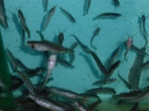
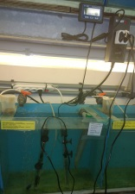
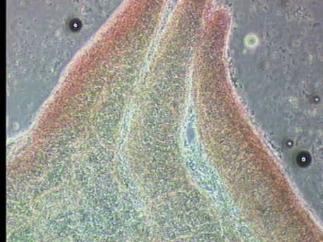
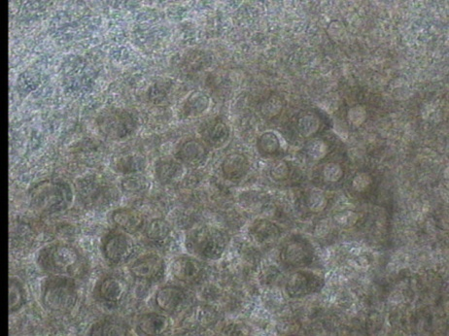
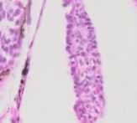
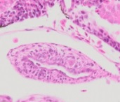
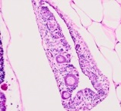
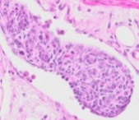
Effect of high temperature on sex determination and sex differentiation process in African catfish Clarias gariepinus
AFFISH-RC
Santi S.^{1,2}, Mélard C.¹, Toguyeni A.², Antoine N.³ and Rougeot C.¹
¹University of Liège, Aquaculture Research and Education Center (CEFRA), Chemin de la Justice, 10, B-4500 Tihange, Belgium.
²Natural Resources and Environmental Sciences Research and Studies Laboratory, Polytechnic University of Bobo-Dioulasso, Burkina Faso
³Veterinary Medicine Faculty, University of Liège, Belgium
Introduction
In African catfish as in most teleost fish, temperature act on sex differentiation process, with masculinizing effect of high temperature [1,4]. Masculinizing effect of high temperature was related to repression of aromatase gene by DNA methylation of this gene promoter [2,3]. Temperature effect occur, in several species, before gonadal histological differentiation and thus suggest brain implication in sex differentiation process. Thus the aim of this study was to determine high thermosensitivity period in African catfish and with histologically observations confirm brain implication in Temperature sex-determinism in this species.
Materials and methods
Determination of thermosensitive period (Fig.1)
19 full-sib families were obtained by artificial reproduction.
500 larvae / 50L aquarium in duplicate.
Masculinizing temperature: 36°C applied during 3 days.
Fig1:heat shock application during larval and juveniles period.
Sex ratio analysis: aceto-carmine squash method on 100 fish (70 days old, 52±10g).
Histological development of gonads
Sampling dates: 10, 15, 20, 25, 35, 45, 55 and 70 days post-hatching (dhp).
10 fish randomly sampled and sacrificed.
Observation by henatoxylin-eosin coloration
Results
Effect of high temperature
Highest thermosensitive period (inversion rate: 93%) range from D6 to D8 post-hatching (Fig.2)
Applied from D6 to D8, high temperature (36°C) induce singnificant skewed sex-ratio toward male phenotype (25 to 100% masculinisation rate) in all progenies of 19 full-sib families,
Fig.2: Effect of high temperature treatment (36°C) from hatching – D0 – until 29 dph during 3 days on masculinization rate (%).
Histological development of gonads
Undifferentiated gonads at 10 dph (Pict.1 A), only somatic cells (SCs) and primordial germ cells (PGCs) and are present in gonad structure.
First signs of ovarian differentiation at 25 dph (Pict.1 B).
Sex histological complete differentiation at 45 dhp (Pict.1 C, D).
Microscopic identification of testis (left) and ovary (right) of 52g African catfish (magnification 40x).
OC
♀
♀
♂
PO
Sp
A
B
C
D
Pict.1: Histology of C. gariepinus gonad at different stages of development.
OC: Ovarian cavity; PO: Primary oocyte; Sp: Spermatocyte
Discussions and Conclusions
The maximum thermosensitive period were ranged from D6 to D8 post-hatching and fluctuate highly according the family. Our results clearly showed that in African catfish, thermosensitivity period occur long before histologically complete differentiation of gonad at 45 dph. Thus, high temperature do not act directly on differentiate gonad to induce masculinization. This suggest implication of brain, PGCs and epigenetic regulation of genes implicated in sex differentiation process, on Temperature sex-determinism process in African catfish.
References
1. Guerrero-Estèvez S, Moreno-Mendoza N (2010) Sexual determination and differentiation in teleost fish. Reviews in Fish Biology and Fisheries, 20, 101-121.
2. Navarro-Martín L, Viñas J, Ribas L, Díaz N, Gutiérrez A, Di Croce L, Piferrer F (2011) DNA methylation of the gonadal aromatase (cyp19a) promoter is involved in temperature-dependent sex ratio shifts in the European sea bass. PLoS Genetics, 7.
3. Piferrer F, Ribas L, Díaz N (2012) Genomic Approaches to Study Genetic and Environmental Influences on Fish Sex Determination and Differentiation. Marine Biotechnology, 14, 591-604.
4. Rougeot, C., Krim, A., Mandiki, S.N.M., Kestemont, P. and Mélard, C. (2007). Sex steroid dynamics during embryogenesis and sexual differentiation in Eurasian perch, Perca fluviatilis. Theriogenology 67. 1046-1052.
Acknowledgments: Study supported by ARES-CCD: “Académie de Recherche et d’Enseignement supérieur – Comission de la Coopération au Développement”
8th International conference on hormones, brain and behavior, Liege (Belgium) June 24-27, 2014 s.santi@doct.ulg.ac.be – www.cefra.ulg.ac.be – www.affish.ulg.ac.be

