Slide 1
A quality by design approach for liposomes production by innovative method using supercritical fluids:
which parameters use to obtain good physicochemical characteristics?
Noémie Penoy
PhD Student
npenoy@uliege.be
2nd Scientific CIRM Day
Notes:
Hello everyone, thank you for giving me the opportunity to present my project. This presentation will be focus on the development of an innovative method using supercritical fluids for liposomes production using the quality by design strategy to find parameters allowing a production of liposomes of specific physicochemical characteristics.

Slide 2
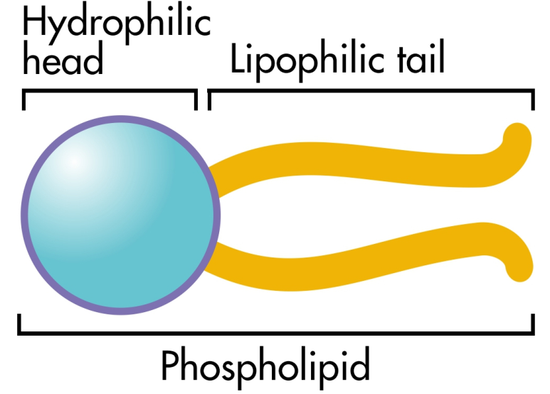
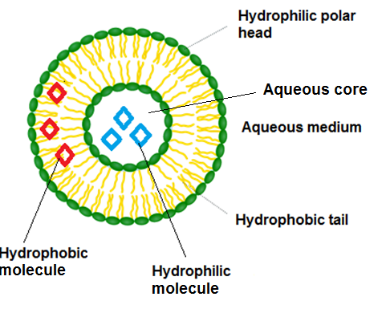
The project
Spherical nanoparticles composed of phospholipids
Encapsulation of hydrophilic/hydrophobic molecules
LIPOSOME
Prolongation of the drug effect
Targeting specific tissues
Increased efficiency
Decreased toxicity
Protection of the active molecule
Notes:
Liposomes are spherical nanoparticles consisting of one or more lipid bilayers composed predominantly of phospholipids surrounding an aqueous compartment. These nanovectors allowing the encapsulation of both hydrophilic and hydrophobic molecules with several advantages such as prolongation of the drug effect, targeting pathological tissues with a decrease of side effects and an improvement of the therapeutic index. Finally, they also can protect these active molecules from external agents.

Slide 3
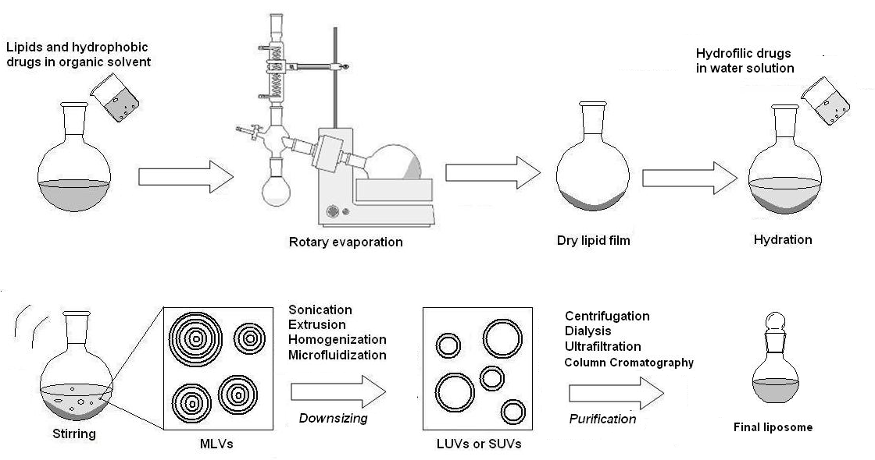
The project
Classical laboratory methods to prepare liposomes
Thin film hydration
Detergent removal
Solvent injection
Reverse phase evaporation
Emulsion method
TFH : method used in our laboratory
W. Bigazzi, N. Penoy et al. , Supercritical fluid methods: An alternative to conventional methods to prepare liposomes, Chem. Eng. J., October 2019
Notes:
Different methods exist to prepare liposomes at laboratory scale. Thin film hydration, detergent removal, solvent injection, reverse phase evaporation and emulsion method are recognized as the conventional liposome preparation methods.

Slide 4
The project
Classical laboratory methods to prepare liposomes
Lots of drawbacks
Use of organic solvents
Small quantities produced
Several steps fo form liposomes
No GMP conditions
W. Bigazzi, N. Penoy et al. , Supercritical fluid methods: An alternative to conventional methods to prepare liposomes, Chem. Eng. J., October 2019
Notes:
The main drawbacks of these methods are the use of large amounts of organic solvents, the small quantities produced and the need of lots of steps to obtain liposomes with the desired features. These drawbacks hinder the manufacturing at the industrial scale for clinical studies in Good Manufacturing Practices (GMP) conditions.

Slide 5
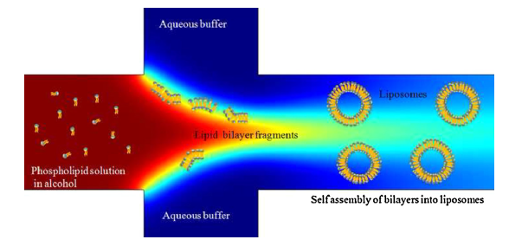
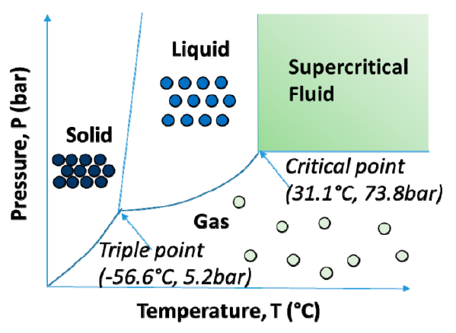
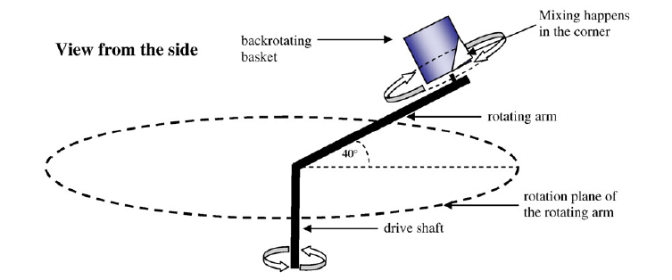
The project
Innovative methods to prepare liposomes
Microfluidic method
Supercritical fluid technology
Homogenization method
Notes:
Many more innovative methods have emerged such as microfluidic methods, homogenization methods and methods using supercritical fluids. Among these different methods, the use of supercritical fluids is considered as a good alternative.

Slide 6
Supercritical fluid technology
Supercritical carbon dioxide
Advantages :
Solvating properties
Miscibility with organic solvents
High density
Viscosity and diffusivity similar to gases
Promotes mass transfer
Particles design/Drug formulation
W. Bigazzi, N. Penoy et al. , Supercritical fluid methods: An alternative to conventional methods to prepare liposomes, Chem. Eng. J., October 2019
Notes:
Supercritical state is defined as a state in which a compound is when the pressure and temperature are above its critical point. Carbon dioxide (CO₂) is the most used supercritical fluid since it is inexpensive, has low critical pressure (Pc = 73.8 bar) and temperature (Tc = 31.1 °C) and is recognized as safe in pharmaceutical manufacturing. In supercritical conditions, carbon dioxide has good solvating properties, miscibility with organic solvents, a liquid-like density but a viscosity and a diffusivity close to gases encouraging a good mass transfer. All these advantages promotes the use of supercritical fluids for the particles design.

Slide 7
Supercritical fluid technology
Particles design/Drug formulation
Supercritical carbon dioxide used as :
Solvent
Cosolvent
Antisolvent
Dispersing agent
W. Bigazzi, N. Penoy et al. , Supercritical fluid methods: An alternative to conventional methods to prepare liposomes, Chem. Eng. J., October 2019
Notes:
In this application, the supercritical carbon dioxide can be used in different ways regarding the lipid material. As solvent, cosolvent, antisolvent or Dispersing agent. This latest is the best way given that we can completely avoid the use of organic solvent.

Slide 8
Supercritical fluid technology
Supercritical CO₂ as a dispersing agent
sc CO₂
Reactor
Lipids in aqueous buffer
W. Bigazzi, N. Penoy et al. , Supercritical fluid methods: An alternative to conventional methods to prepare liposomes, Chem. Eng. J., October 2019
Notes:
Here is the principle of using supercritical carbon dioxide as a dispersing agent. Firstly we put an aqueous dispersion of phospholipids in a reactor and we pressurize the system with supercritical carbon dioxide.

Slide 9

Supercritical fluid technology
Supercritical CO₂ as a dispersing agent
Reactor
Reactor
sc CO₂
Lipids organize in bilayers
Legend
Lipids in aqueous buffer in supercritical conditions
Lipids in aqueous buffer in supercritical conditions
Phospholipid
Supercritical CO₂
Aqueous buffer
W. Bigazzi, N. Penoy et al. , Supercritical fluid methods: An alternative to conventional methods to prepare liposomes, Chem. Eng. J., October 2019
Notes:
We apply agitation to the system for a certain period of time. Supercritical carbon dioxide is saturated in the hydrophobic chains of the lipids so that the lipids are dispersed properly and organize in bilayers.

Slide 10
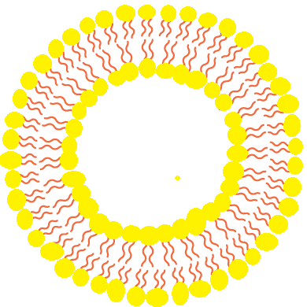
Supercritical fluid technology
Supercritical CO₂ as a dispersing agent
Reactor
Reactor
sc CO₂
Legend
Lipids in aqueous buffer in supercritical conditions
Phospholipid
Liposomes suspension
Supercritical CO₂
Aqueous buffer
W. Bigazzi, N. Penoy et al. , Supercritical fluid methods: An alternative to conventional methods to prepare liposomes, Chem. Eng. J., October 2019
Notes:
After a certain time, we depressurize the system so that the carbon dioxide reverts to its gaseous state and the lipids organize themselves into liposomes.

Slide 11
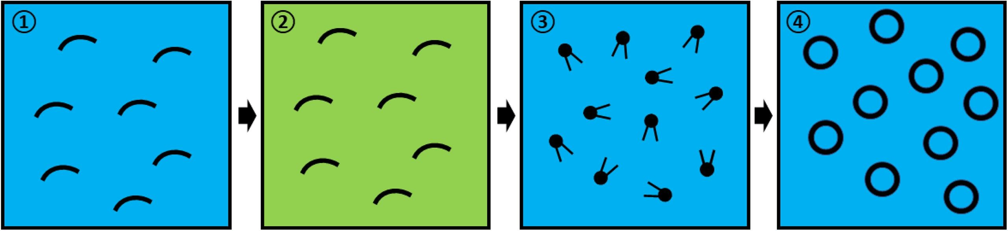
Supercritical fluid technology
Supercritical CO₂ as a dispersing agent
Without any use of organic solvent
In one step
Large scale production
W. Bigazzi, N. Penoy et al. , Supercritical fluid methods: An alternative to conventional methods to prepare liposomes, Chem. Eng. J., October 2019
Notes:
The main interest of this technique is the total absence of organic solvent and the possibility of a one step preparation adaptable on a large scale production.

Slide 12
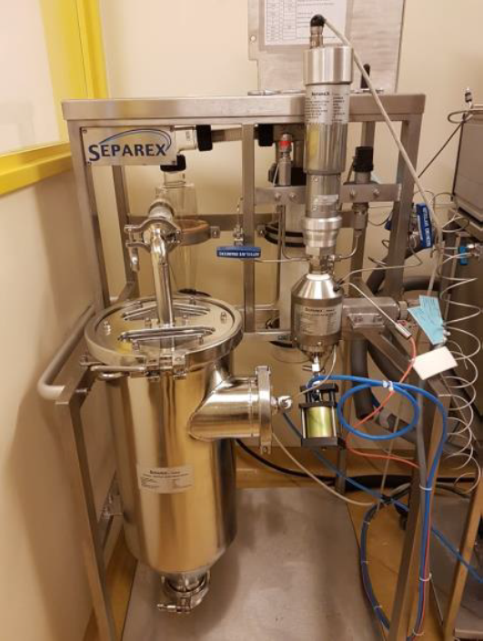
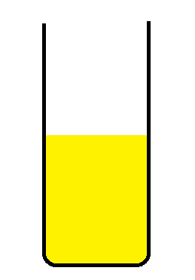
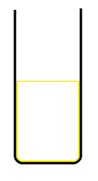
Supercritical fluid technology
In practice ➔ lots of parameters are involved in the process
Phospholipids dispersion
Liposomal suspension
Notes:
In practice it's a bit more complicated. The equipment used at the laboratory is complex and involves many parameters which can influence the quality of the liposomes. For this reason we decided to use the quality by design strategy.

Slide 13
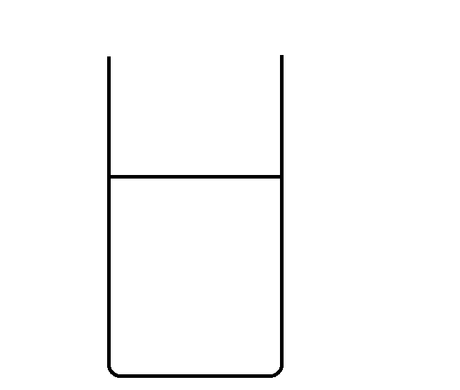
Risk analysis
Critical Quality Attributes
(CQAs)
Process parameters
Pressure (bars)
Temperature (°C)
Agitation rate (rpm)
Contact time (h)
Formulation parameters
Phospholipids concentration (mM)
Suspension volume (mL)
For drug delivery applications :
Size < 200 nm
Dispersity as low as possible
Notes:
The first step of this strategy was the selection of the potential risk factors wich might influence the quality of the liposomes. Six parameters were selected : four process parameters : the pressure, the temperature, the agitation rate and the contact time with the supercritical carbon dioxide, and two formulation parameters : the lipids concentration and the volume of the suspension. The second step was the selection of the critical quality attributes for the liposomes. We target a size of 200 nm with a low dispersity.

Slide 14
Objective
Find the optimal conditions for liposome production using supercritical CO₂ by a QbD approach
Find conditions allowing the production of liposomes of desired features (± 200 nm)
Transfer these conditions to more complex liposomes formulations
Notes:
The objective of this work is to find the optimal conditions for liposome production using supercritical CO₂ by a QbD approach. For that, we will find conditions with specific parameters allowing the production of liposomes of a size around 200 nm with a small dispersity. The final objective of this study will be to see if these conditions are transferrable to other formulations of liposomes already developed in our laboratory.

Slide 15
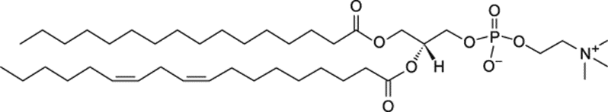
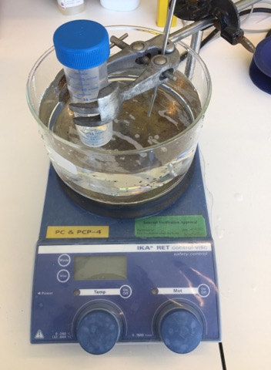
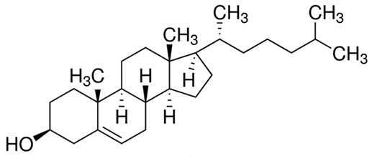
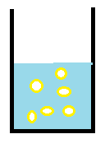
Methodology
Formulation
2. Sample preparation
3. Supercritical CO₂ process
65°C
1200 rpm
15 min
Lipids in aqueous buffer in supercritical conditons
Soy phosphatidylcholine (SPC) (70%) (m/m)
Legend
Phospholipid
Supercritical CO₂
Aqueous buffer
Cholesterol (CHOL) (30%) (m/m)
Liposomes suspension
Notes:
Regarding the methodology, for the experimental design, we used a simple formulation composed of soy phosphatidylcholine as main phospholipid and cholesterol in a percentage of 70-30%. The sample preparation consisted to prepare a phospholipid dispersion in aqueous buffer at 65°C, 1200 rpm and for 15 minutes. The different parameters of the process were adjusted and finally at the end of the process the sample was recovered at the bottom to be analyzed by dynamic light scattering in terms of particles size and dispersity.

Slide 16
Design of experiments
Exp | Lipids concentration (mM ) | Volume (mL) | Contact time (h) | Agitation rate (rpm) | Temperature (°C) | Pressure (bars) | Block
1 | 51,0328 | 10 | 0,5 | 400 | 57,5 | 250 | 1
2 | 27,532 | 20 | 1 | 550 | 57,5 | 185 | 1
3 | 50,5127 | 30 | 2 | 700 | 35 | 250 | 1
4 | 5,05833 | 10 | 2 | 400 | 80 | 120 | 1
5 | 5,007053 | 30 | 2 | 400 | 35 | 120 | 1
6 | 50,0675 | 30 | 0,5 | 400 | 80 | 250 | 1
7 | 50,03196 | 10 | 0,5 | 400 | 80 | 120 | 1
8 | 27,5644 | 20 | 1 | 550 | 57,5 | 185 | 1
9 | 5,08813 | 30 | 0,5 | 700 | 57,5 | 120 | 1
10 | 5,02385 | 30 | 2 | 400 | 80 | 250 | 1
11 | 5,0671 | 30 | 0,5 | 400 | 35 | 250 | 1
12 | 5,02021 | 10 | 0,5 | 700 | 35 | 250 | 1
13 | 50,8555 | 10 | 0,5 | 700 | 35 | 120 | 1
14 | 50,3337 | 10 | 2 | 700 | 57,5 | 250 | 1
15 | 5,3016 | 10 | 2 | 700 | 80 | 250 | 1
16 | 50,08459 | 10 | 2 | 400 | 35 | 185 | 1
17 | 4,9426 | 10 | 0,5 | 700 | 80 | 185 | 1
18 | 49,9899 | 30 | 0,5 | 700 | 80 | 185 | 1
19 | 50 | 30 | 2 | 700 | 80 | 120 | 1
20 | 27,52 | 20 | 1,25 | 550 | 57,5 | 185 | 1
Exp | Lipids concentration (mM ) | Volume (mL) | Contact time (h) | Agitation rate (rpm) | Temperature (°C) | Pressure (bars) | Block
1 | 30,0008648 | 15 | 0,5 | 600 | 80 | 200 | 2
2 | 29,9407 | 15 | 0,5 | 600 | 50 | 120 | 2
3 | 5,05938 | 15 | 0,5 | 400 | 59 | 120 | 2
4 | 5,03745 | 30 | 0,5 | 600 | 80 | 120 | 2
5 | 4,9897 | 30 | 0,5 | 400 | 80 | 160 | 2
6 | 29,9572 | 30 | 0,5 | 400 | 60,35 | 120 | 2
7 | 5,01582 | 15 | 0,5 | 400 | 50 | 200 | 2
8 | 5,08151 | 30 | 0,5 | 600 | 62,6 | 176,4 | 2
9 | 4,9383 | 30 | 0,5 | 400 | 57,95 | 181,2 | 2
10 | 30,08587 | 15 | 0,5 | 600 | 80 | 200 | 2
11 | 30,0433 | 30 | 0,5 | 400 | 56,6 | 175,6 | 2
12 | 17,5542 | 22,5 | 0,5 | 500 | 65 | 160 | 2
13 | 17,6341 | 22,5 | 0,5 | 500 | 65 | 160 | 2
14 | 17,5967 | 22,5 | 0,5 | 500 | 65 | 160 | 2
Liposome size (nm) and dispersity analysis by Dynamic Light Scattering (n=3)
Desired answers: Size ± 200 nm
Notes:
This experimental design was constructed on the basis of the risk analysis and the six parameters have been varied in a certain range.

Slide 17
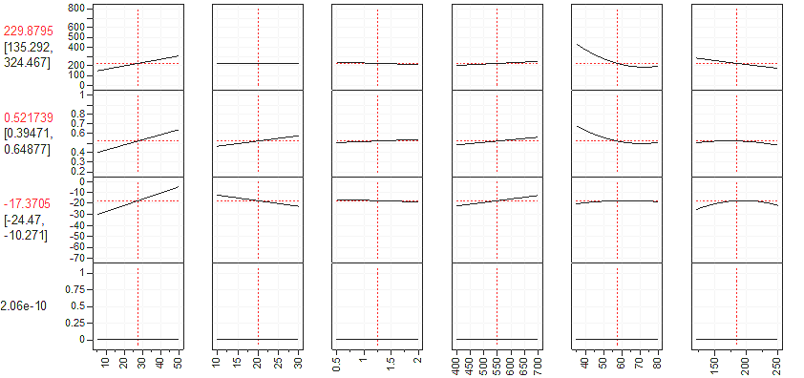
Design of experiments
Size (nm)
Non influential parameters :
  Contact time : 30 minutes
  Agitation rate : 500 rpm
Influential parameters :
  Lipids concentration (mM)
  Suspension volume (mL)
  Temperature (°C)
  Pressure (bars)
PdI
Zeta
Potential (mV)
Desirability
Lipid
Concentration (mM)
Suspension
Volume (mL)
Contact
Time (h)
Agitation
Rate (rpm)
Temperature
(°C)
Pressure
(bars)
27.5 mM
20 mL
1.25 h
550 rpm
57.5 °C
185 bars
Notes:
The first analysis of the results have highlighted the parameters having an influence on the characteristics of the liposomes produced. Indeed, higher the lipid concentration is, higher are the size and the dispersity. The volume of suspension has a low impact on the dispersity. The contact time has no influence. The stirring speed influences a little, if it increases, the size and especially the dispersity also increases. For the influence of the temperature, we note that we must work above 50 ° C and finally, the pressure has a weak influence on the size and must not be too low. Since the contact time and the stirring speed had no influence, we fixed them on 30 minutes and 500 rpm.

Slide 18
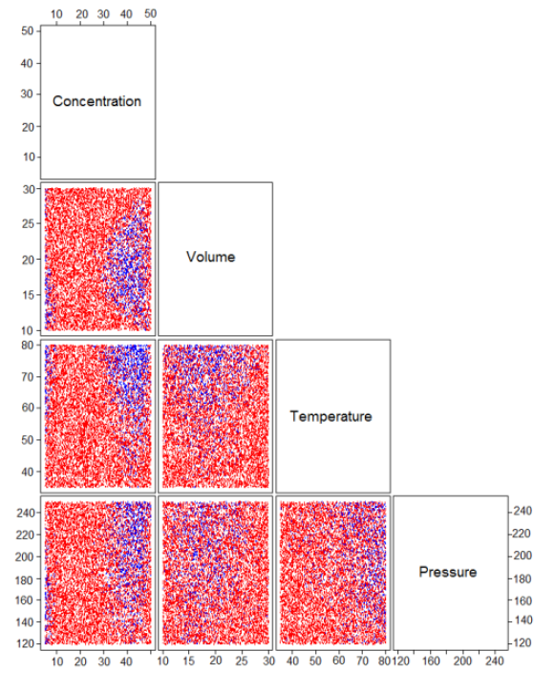
Design of experiments
: High defect rate
: Low defect rate
Notes:
The final analysis of the results provided the design space. We can see red areas where we obtained a high defect rate in terms of size and dispersity and blue areas with a low defect rate where the size values and dispersity fit with our expectations. Regarding the blue areas, we can observe two blues areas, one in high concentration values and the other in low concentration values.

Slide 19
Design of experiments
Condition 1 | Condition 2
Concentration : 45 mM Volume : 14 mL Temperature : 80 °C Pressure : 240 bars Expecting values : 51-213 nm | Concentration : 5 mM Volume : 10 mL Temperature : 80 °C Pressure : 156 bars Expecting values : 67-221 nm
SCALE-UP
Notes:
So the design space have highlighted two working conditions where the expecting values fitted with our expectations in terms of liposomes size. The condition 1 with a high lipids concentration of 45 mM and the condition 2 with a low lipids concentration of 5 mM. These two conditions allow the production of liposomes of a size between 51 and 221 nm.
To see if these conditions are reproducible, we have validated them with the simple formulation. Both conditions have been validated, however the condition 1 is the condition that interests us the most for a scale-up given the high lipid concentration

Slide 20
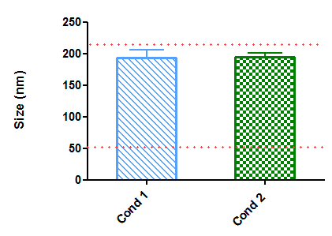
Reproducibility
Formulation SPC/CHOL 70/30 % (m/m) :
n = 3
Condition 1 | Condition 2
45 mM | 5 mM
14 mL | 10 mL
80°C | 80°C
240 bars | 156 bars
Notes:
For the validation of the conditions with the simple formulation composed of soy phosphatidylcholine and cholesterol, we can observe that the results in terms of size fit with the expectations values giving by the experimental design with a good reproducibility.

Slide 21
Are these conditions transferrable to other liposomes formulations ?
Notes:
But are these conditions transferrable to other liposomes formulations ?

Slide 22

Applicable to other formulations ?
Formulation SPC/CHOL/DSPE PEG 2000 65/30/5 % (m/m)
n = 3
Condition 1 | Condition 2
45 mM | 5 mM
14 mL | 10 mL
80°C | 80°C
240 bars | 156 bars
Notes:
As the simple formulation composed of soy phosphatidylcholine and cholesterol is not applicable for therapeutic use, we have add pegylated lipid to make stealth liposomes. Regarding the results, we can see that the size of our liposomes still fit with the expectations but the conditions 2 give a higher size with a higher dispersity.

Slide 23
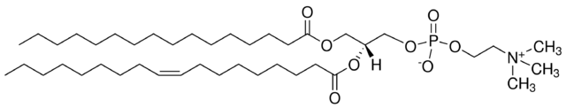
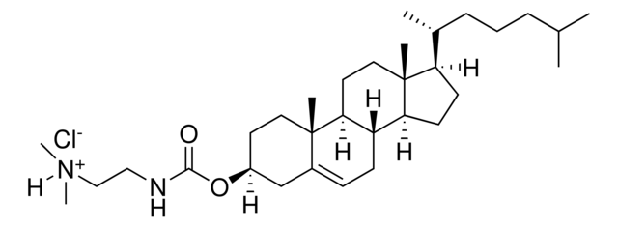
Applicable to other formulations ?
Formulation EPC/DC-CHOL/CHOL/DSPE PEG 2000 50,05/29,4/0,6/19,95 % (m/m)
n = 3
Condition 1 | Condition 2
45 mM | 5 mM
14 mL | 10 mL
80°C | 80°C
240 bars | 156 bars
Notes:
An other formulation developped in our lab is composed of a natural phospholipid ; Egg phosphatidylcholine, as main phospholipid. We can see that the values of size fit again with the expectations, even if we are a little bit up the limit giving by the experimental design for the condition 1. We also can observe a reverse trend with a smaller size obtained with the condition 2.

Slide 24
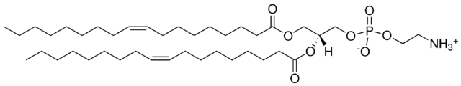
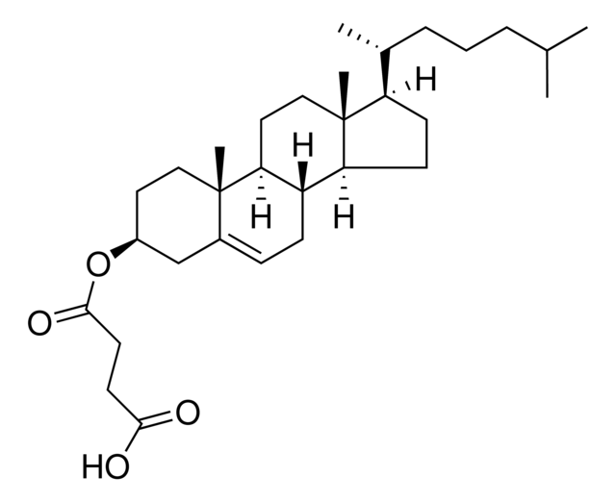

Applicable to other formulations ?
Formulation DOPE/CHEMS/CHOL/DSPE PEG 750 43/21/30/6 % (m/m)
n = 3
Condition 1 | Condition 2
45 mM | 5 mM
14 mL | 10 mL
80°C | 80°C
240 bars | 156 bars
Notes:
This formulation is used in our laboratory for the peptide delivery. Regarding the results, the expectations in terms of size were just obtained with the condition 2 even if the size obtained with the condition 1 is still acceptable depending on the application. The particularity of this formulation compared to the other is a high proportion of membranes stabilizers, cholesterol and cholesterol hemisuccinate. Maybe these membranes stabilizers at a high concentration, interfere with the liposomes formation.

Slide 25
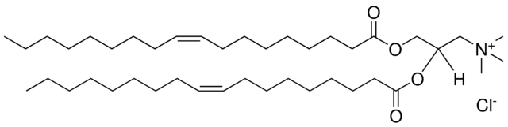
Applicable to other formulations ?
Formulation DOTAP/CHOL/DOPE 44,45/33,33/22,22 % (m/m)
n = 3
Condition 1 | Condition 2
45 mM | 5 mM
14 mL | 10 mL
80°C | 80°C
240 bars | 156 bars
Notes:
The last formulation, more complex, is developed in our lab for the gene delivery. The results don’t fit with the expectations and we also observe a smaller size and dispersity with the condition 2. The condition 1 give a really high size compared to other formulations with a high dispersity. The difference with the other formulations is the presence of a positively charged lipid in a high proportion. Maybe the charges at a high concentration interfere with the formation of liposomes by repulsive forces.

Slide 26
Take home message
  The influential parameters of the process are :
    the lipids concentration
    the suspension volume
    the temperature
    the pressure
  2 working conditions
  Transferrable to simple formulation
  Optimization
  Condition 1 promising for the scaling-up
Condition 1 | Condition 2
45 mM | 5 mM
14 mL | 10 mL
80°C | 80°C
240 bars | 156 bars
± 200 nm
Notes:
To conclude, what it's important to remember is that we found the influential parameters of the process which allowed us to control them. We highlighted two working conditions which allow to produce liposomes of simple formulation with a reproducible size around 200 nm. This process suits for the production of liposomes of simple formulations. We could observe that for complex formulation, it’s more difficult to obtain good characteristics and maybe an optimization will be necessary to obtain a size closer to 200 nm. Even if some results come out of the values given by the experimental plan (213 and 221 nm), depending on the applications, these values can be acceptable and the condition 1 is promising fir our scaling-up project.

Slide 27
Perspectives
Suppress the sample preparation (dispersion step) → One step process
Understand the effect of supercritical conditions on liposome formation
  Integrity of the phospholipids by NMR
  Modification of the glass transition temperature using DSC
  Solubility of the phospholipids in the supercritical carbon dioxide
Notes:
For the perspectives, we will try to suppress the sample preparation to habe a full one step process and to understand the effect of supercritical conditions on liposome formation.

Slide 28

Brigitte Evrard
Géraldine Piel
Anna Lechanteur
Natacha Rocks
Hope Sounouvou
Coralie Bellefroid
Olivier Jennotte
Nathan Koch
Noémie Penoy
Isaïe Niamba
Luc Delma
Ange Ilangala
Chloé Parulski
Manon Berger
Laurence Collard
Françoise Léonard
Vanessa Strauven
Thank you for your attention !
Notes:
Thank you everyone for you attention.

