Slide 1



Allergies croisées crustacés et insectes comestibles
Romy GADISSEUR
Department of Clinical Chemistry
University of Liège, CHU Sart-Tilman
Liège, Belgium
Email: romy.gadisseur@chuliege.be

Slide 2
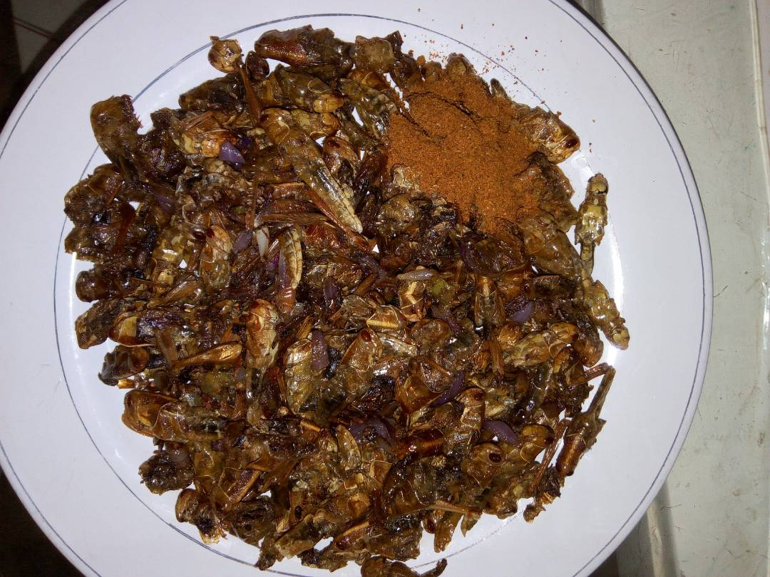

Novel Foods – Is it risky ?
Global demographic implosion => look for sustainable protein sources to ensure the nutrition of peoples.
Food Allergy Organization (FAO) considers that the consumption of edible insects (entomophagy) could be an alternative to this crisis. Indeed, they represent nutritional, economical and ecological benefits. FAO promotes large-scale insect production and consumption.
No toxicity risk has been declared so far with best-sellers (crickets,
Allergenic risk ? consumers exposition
  => food allergy is a major public health problem in the world.
  Study allergenic potential of novel protein sources
    taxonomy relationship with known allergenic sources in order to identify possible groups at risk.
Notes:
FAO considers that the consumption of edible insects (entomophagy) could be interesting from a nutritional, economical and ecological point of view
Looking at the litterature, therre is no toxicity risk to declare
But there is one major risk to consider : the allergy risk of a novel protein source ! => INDEED food allergy is a major public health problem in the world.
Global demographic implosion threatens food security and forces us to look for sustainable protein sources to ensure the nutrition of peoples. Faced with this challenge, the Food Allergy Organization (FAO) considers that the consumption of edible insects (entomophagy) could be an alternative to this crisis (4). Indeed, they represent nutritional, economical and ecological benefits. FAO promotes large-scale insect production and consumption (4).
Considering that no toxicity risk has been declared (6), allergenic risk to which its consumers would be exposed should be studied, while food allergy is a major public health problem in the world. Indeed, when studying the allergenic potential of novel protein sources it is important to study its taxonomy relationship with known allergenic sources in order to identify possible groups at risk.

Slide 3
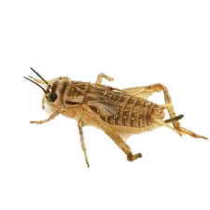
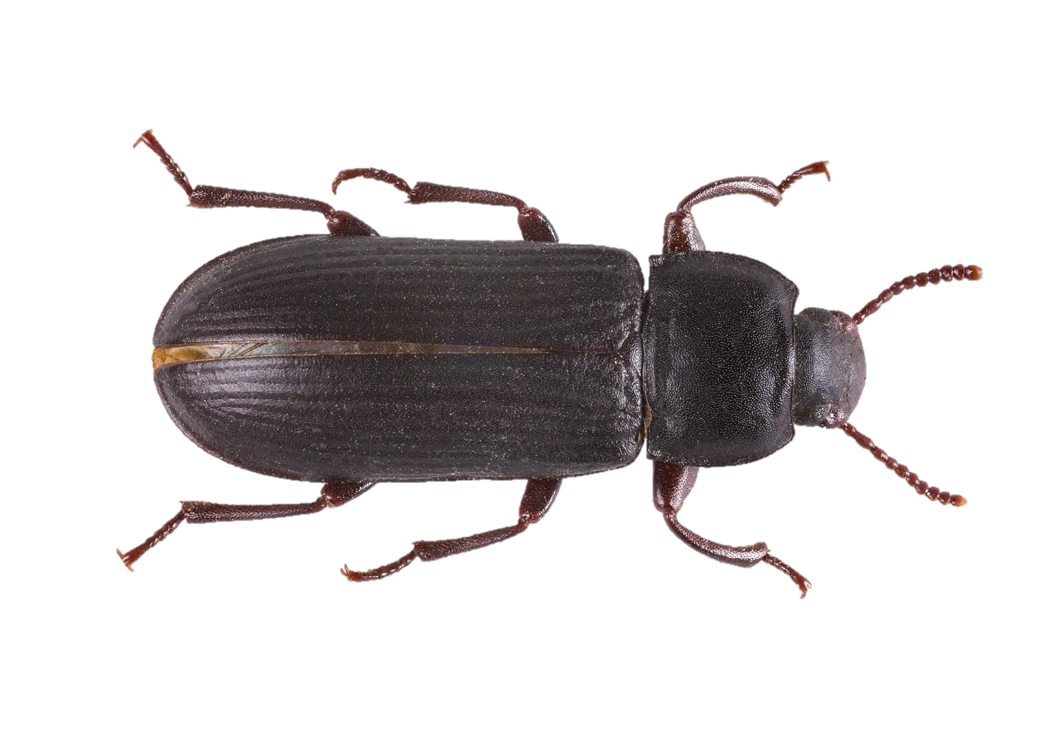
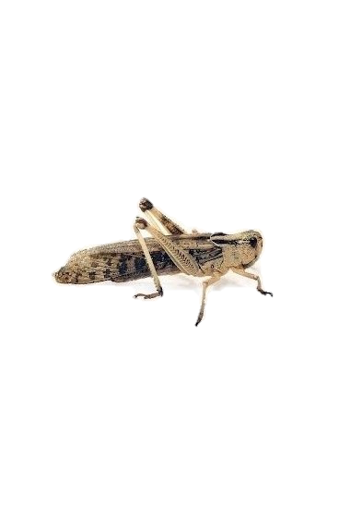
Novel Foods – Belgian legislation
Non-ruminant livestock and pets : can be fed live insects.
Dead insects and dead insect products must first be processed.
  The rendered fats can be used in animal feed for all animal species.
  Protein flours, processed whole insects called «processed animal proteins» (PAT).
  These PATs can be used in pet foods and in aquaculture feeds
Human food
  Acheta domesticus
  Tenebrio molitor
  Locusta migratoria
Aquaculture feeds :
  Hermetia illucens (mouche soldat)
  Acheta domesticus
  Tenebrio molitor§
  Musca domestica (mouche domestique)
  Acheta domesticus (grillon domestique)
  Alphitobius diaperinus (petit ténébrion mat)
  Gryllodes sigillatus (grillon domestique tropical)
  Gryllus assimilis (grillon des steppes)

Slide 4
Allergy risk – Who is concerned ?
  Prevalence of food allergy in Europe up to 5.7% depending on age.
Allergenic potential of novel protein sources ?
  Study its taxonomy relationship with known allergenic sources => groups at risk ?
  Allergenic risk : due to a possible cross-reactivity with other arthropods, especially crustaceans.
  Edible insects : Allergenic risk for subjects allergic to crustaceans, house dust mites (HDM) or mollusks.
  The overall lifetime prevalence of self-reported shellfish allergy is 1,3% and shellfish is among the ten most prevalent food allergic sources.
Notes:
The Prevalence of food allergy in Europe is up to 5.7% depending on age.
When you evaluate a new protein source that could be associated with allergy, you need to study the taxonomy relationship with known allergenic sources to distinguish the patient group at risk
Considering the taxonomy, there is something clear : there could be a cross-reactivity with other arthropods, especially crustaceans.
The overall lifetime prevalence of self-reported shellfish allergy is 1,3% and shellfish is among the ten most prevalent foods allergic sources.
Indeed, when studying the allergenic potential of novel protein sources it is important to study its taxonomy relationship with known allergenic sources in order to identify possible groups at risk. In regard to insects consumption, the allergenic risk might principally arise due to a possible cross-reactivity with other arthropods, especially crustaceans. So, the allergenic risk that edible insects may represent for subjects allergic to crustaceans, house dust mites (HDM) or mollusks must be assessed (vanderbrempt). Prevalence of food allergy ranges in Europe up to 5.7% depending on age. The overall lifetime prevalence of self-reported shellfish allergy is 1,3% and shellfish is among the ten most prevalent foods allergic sources (3).

Slide 5
Food allergy – How it works…
Adverse health effects
Immunological mechanisms are involved that can be induced in sensitized subjects following dietary exposure to a relevant allergen in food.
Food allergy develops in two phases :
  First phase : susceptible subjects are immunologically primed to specific food proteins resulting in allergic sensitization. Such sensitization may be acquired following dietary exposure to food proteins, or following other routes of exposure (like inhalation or skin contact). SILENT PHASE !
  Second phase : if sensitized subjects encounter sufficient levels of the inducing allergen in the diet then an allergic reaction may be elicited. SYMPTOMS !
    Symptoms vary from mild, local and transient effects to systemic anaphylaxis.
    Allergy results from the elicitation of a specific immune response.
    The elaboration of sIgE antibodies is the most common immunological mechanism implicated in the acquisition of sensitization to food proteins (Perry TT et al. Clinical manifestations of food allergy. Pediatr Ann 2013)
Reproducible, even at low doses of allergens, immediate (<2 hours)
Notes:
Adverse health effects in which immunological mechanisms are involved that can be induced in sensitized subjects following dietary exposure to a relevant allergen in food.
(24). Food allergy develops in two phases. During the first phase susceptible subjects are immunologically primed to specific food proteins resulting in allergic sensitization. Such sensitization may be acquired following dietary exposure to food proteins, or following other routes of exposure (like inhalation or skin contact). If sensitized subjects subsequently encounter sufficient levels of the inducing allergen in the diet then an allergic reaction may be elicited. The symptoms of such reactions vary from mild, local and transient effects to systemic anaphylaxis (24). Allergy results from the elicitation of a specific immune response. The elaboration of sIgE antibodies is the most common immunological mechanism implicated in the acquisition of sensitization to food proteins (24).

Slide 6
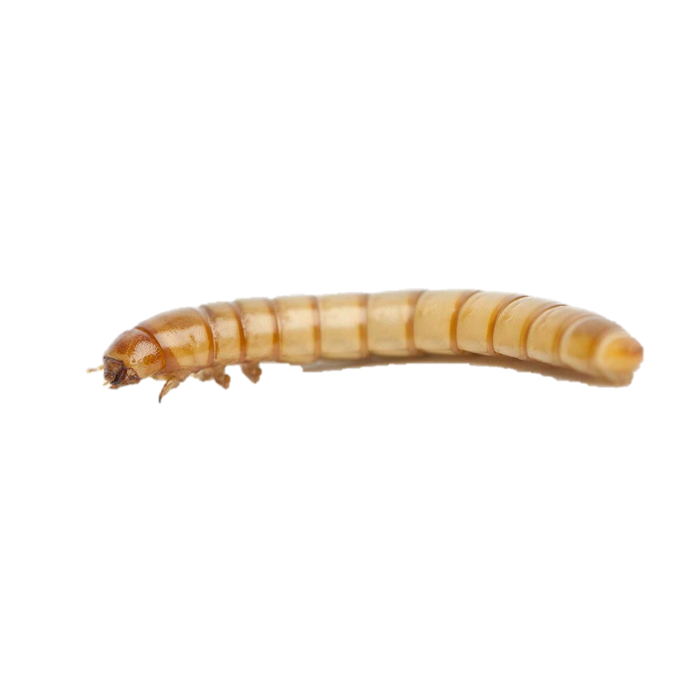
What kind of allergens –What is known…
Prevalence of insect food allergy in European countries is not known so far…
Various panallergens common to insects, crustaceans, mites and mollusks, may be responsible for cross reactions between these organisms of different origins.
Some allergens, more specific to insects, could also trigger allergic reactions = poorly known
  It was already showed that the majority of shrimp food allergic patients also had mealworm food allergy.
  Primary mealworm allergy can develop in professional and hobby insect breeders.
  Some cases of insect allergy with respiratory or cutaneous clinical symptoms were described into laboratory technicians assigned to the maintenance of insect farms.
Notes:
The Prevalence of insect food allergy in European countries is not known so far
But we know Various panallergens such as tropomyosin (TP) or arginine kinase (AK), common to insects, crustaceans, mites and mollusks, that may be responsible for cross reactions between these organisms of different origins.

Slide 7
Molecular allergy… main allergens
Tropomyosin
Arginin kinase
Alpha-amylase
Myosin light chain
Sarcoplasmic Calcium Binding Protein
GADPH,
Fructose-biphosphate aldolase,
Actin,
Tubulin…
Low homology to vertebrate tropomyosin
Sequence homology identified in Crustacea (shrimp,45 crab,4 lobster), mollusks (oyster, scallop, squid), parasites (anisakis), dust mite and insects : cockroach, grasshopper
Very stable to digestion, heatstable
Cross-reactions to multiple crustaceans = fairly common.
Potential risk of severe reactions.
Panallergens
Shellfish allergens:
Tropomyosin
Arginine kinase
Myosin light chain
Sarcoplasmic calcium-binding protein
Notes:
Thanks to molecular biology many allergens could be described

Slide 8




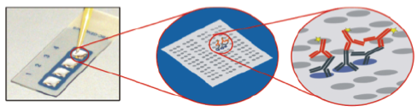
Singleplex - Multiplex
ImmunoCAP
ImmunoCAP ISAC
MULTIPLEX
Notes:
Classical” IgE assay format: Basis of most current singleplex and multiplex assays
The noncompetitive, heterogeneous (separation of free and bound), immunometric (labeled antibody) assay that employs allergen immobilized on a solid phase “allergosorbent” to bind specific antibodies of all isotypes from serum is the design that has endured in both singleplex and multiplex assays that are used in clinical laboratories (Fig. 1). Following a buffer wash to separate free and bound human antibody, radionuclide-, enzyme- or fluorescence-labeled anti- human IgE is added to detect IgE antibodies that have bound to immobilized allergen. The magnitude of the response (counts per minute-radioactivity, optical density, chemiluminescence, or fluorescence) after the final buffer wash is proportional to the quantity of allergen-specific IgE antibody in the original test serum

Slide 9
Singleplex versus Multiplex
Multiplex :
Cockroach (Bla g 1, Bla g 2- Aspartic Protease, Bla g 5- Glutathion S-transferase, Bla g 7/TP),
Shrimp (Pen m 1/TP, Pen m 2/AK, Pen m 4- Sarcoplasmic calcium-binding protein)
HDM (Der p 1/Der f 1, Der p 2/Der f 2, Der p 10/TP).
Singleplex :
Schrimp (Pen a 1/TP)
HDM (Der p 1/Der f 1, Der p 2/Der f 2, Der p 10/TP)
Notes:
Classical” IgE assay format: Basis of most current singleplex and multiplex assays
The noncompetitive, heterogeneous (separation of free and bound), immunometric (labeled antibody) assay that employs allergen immobilized on a solid phase “allergosorbent” to bind specific antibodies of all isotypes from serum is the design that has endured in both singleplex and multiplex assays that are used in clinical laboratories (Fig. 1). Following a buffer wash to separate free and bound human antibody, radionuclide-, enzyme- or fluorescence-labeled anti- human IgE is added to detect IgE antibodies that have bound to immobilized allergen. The magnitude of the response (counts per minute-radioactivity, optical density, chemiluminescence, or fluorescence) after the final buffer wash is proportional to the quantity of allergen-specific IgE antibody in the original test serum

Slide 10
Shrimp allergic patient … their DBPCFC profiles
4 primary mealworm allergic subjects showing sensitization (IgE binding /BAT) to mealworm
    None of the patients had knowingly consumed mealworm or other insects
    2 subjects had a positive DBPCFC to mealworm and the other two had inhalant allergy to mealworm.
15 shrimp allergic patients
  13 out of 15 shrimp allergic patients had a food allergy to mealworm as indicated by a positive DBPCFC.
IgE binding on dot blot to extracts of different insects, was found for all patients.
Notes:
The 15 shrimp allergic patients, of whom 13 had a food allergy to mealworm, had a median age of 38 years (range 19–69) and 47% was male. Sensitization to shrimp was shown by a pos- itive ImmunoCAP (> 0.35 kU/L) with a median of 5.5 kU/L (range 0.37–53.3 kU/L). The majority had inhalant allergies to HDM (11/15) and pollen (11/15). Eight had atopic dermatitis and nine patients had one or more other food allergies. None of the patients had knowingly consumed mealworm or other insects [3]. Four primary mealworm allergic subjects regu- larly exposed to some of the tested insects were also studied.
IgE binding on dot blot to extracts of different insects, was found for all patients. This IgE binding was comparable to that of mealworm extract, except for two patients. These pa- tients showed only IgE binding to proteins of a few insects, as shown in Table 1. Basophil reactivity to all insect species was highly similar, see Table 2. The BAT results corroborated the dot blot findings, and showed to be somewhat more sensitive than CAP.
Cross-reactive proteins were identified using im- munoblot. Different protein profiles were recognized by the shrimp allergic patients. The majority (9/15) recognized a band at approximately 40 kDa. Identification of this band in mealworm previously showed that it contained both tropomyosin and arginine kinase. Patient 12 showed also IgE binding to a 50 kDa proteins and patients 4, 8, and 10 mainly recognized bands with a molecular weight > 100 kDa, including a band at 200 kDa. Patients 9 and 11, who had no food allergy to mealworm, recognized proteins with differ- ent molecular weights compared to the other 13 patients. Figure 1 shows two representative immunoblot’s of patients 2, 4, 9, and 12.
Shrimp allergic patients with food allergy to mealworm showed IgE reactivity (blot and BAT) to all insect extracts. The main IgE binding proteins were tropomyosin and/or arginine kinase (9/13).
Binding to other proteins with a MW of #50 kDa and MW > 100 KDa was also seen.
Primary mealworm allergic subjects showed sensitization to some tested insect extracts. No clear similarities between insect sensitization patterns on the immunoblot were seen for the primary mealworm allergic subjects.
Furthermore, basophil reactivity to the insect extracts tested was different for these subjects.
That IgE from shrimp allergic patients binds to proteins from different insects is not surprising because crustaceans and insects both belong to the same phylum (Arthropoda).
Within the clade Pancrustacea, shrimp belong to the subphylum crustacea and insects belong to the subphylum Hexapoda [15]. As a result of this phylogenetic relation, homology between proteins of shrimp and different insects can be expected and has been previously documented.

Slide 11
Shrimp allergic patient … their DBPCF profiles
Primary mealworm allergic subjects showed sensitization to some tested insect extracts.
  No clear similarities between insect sensitization patterns on the immunoblot were seen for the primary mealworm allergic subjects.
  Furthermore, basophil reactivity to the insect extracts tested was different for these subjects.
Shrimp allergic patients with food allergy to mealworm showed IgE reactivity (blot and BAT) to all insect extracts.
  The main IgE binding proteins were tropomyosin and/or arginine kinase (9/13).
  Binding to other proteins with a MW of 50 kDa (alpha-amylase?) and MW > 100 KDa (Myosin?) was also seen.
IgE from shrimp allergic patients binds to proteins from different insects
  Not surprising => crustaceans and insects both belong to the same phylum (Arthropoda).
  Within the clade Pancrustacea, shrimp belong to the subphylum crustacea and insects belong to the subphylum Hexapoda.
As a result of this phylogenetic relation, homology between proteins of shrimp and different insects can be expected and has been previously documented.

Slide 12
  28 y.o. woman :
  Perennual itching, stuffy nose and sneezing for 2 years. Dyspnea, cough and wheezing, for 1 year.
    Symptoms related to exposure to several types of crickets bred on a farm where she had been working for the last 3 years
      Gryllus campestris, Gryllus bimaculatus, and Acheta domestica.
    Asymptomatic during long holidays but not on weekends (because her work included weekends).
    Treated with antihistamines, inhaled long-acting bronchodilators, and steroids, but symptoms did not change.
  Sensitization was produced by environmental exposure in the workplace.
  sIgE levels to other arthropods such as D pteronyssinus, shrimp, or grasshoppers was lower than to crickets and EAST inhibition assay results were negative.
  We can confirm that the patient was primarily sensitized to crickets and rule out that the patient’s symptoms were due to sensitization to other arthropods.
Notes:
28y.o. woman :
perennial itching; stuffy nose and sneezing for 2 years; dyspnea, cough and wheezing, for 1 year.
She related the symptoms to exposure to several types of crickets bred on a farm where she had been working for the last 3 years: Gryllus campestris, Gryllus bimaculatus, and Acheta domestica. She was asymptomatic during long holidays but not on weekends (because her work included weekends). She denied exposure to pets. She had been treated with antihistamines, inhaled long-acting bronchodilators, and steroids, but her symptoms did not change.

Slide 13

Professionnal allergy
Lab technicians in insect rearing:
  respiratory symptoms : caugh, rhinitis, dyspnea, asthma…
  Cutaneous symptoms : urticaria, pruritis…
  Aeroallergens and contact allergens
Farmers, bakers : insects contaminating the flour
Sailors : cockroach allergy
?
Titanic giganteus
Titanus giganteus

Slide 14
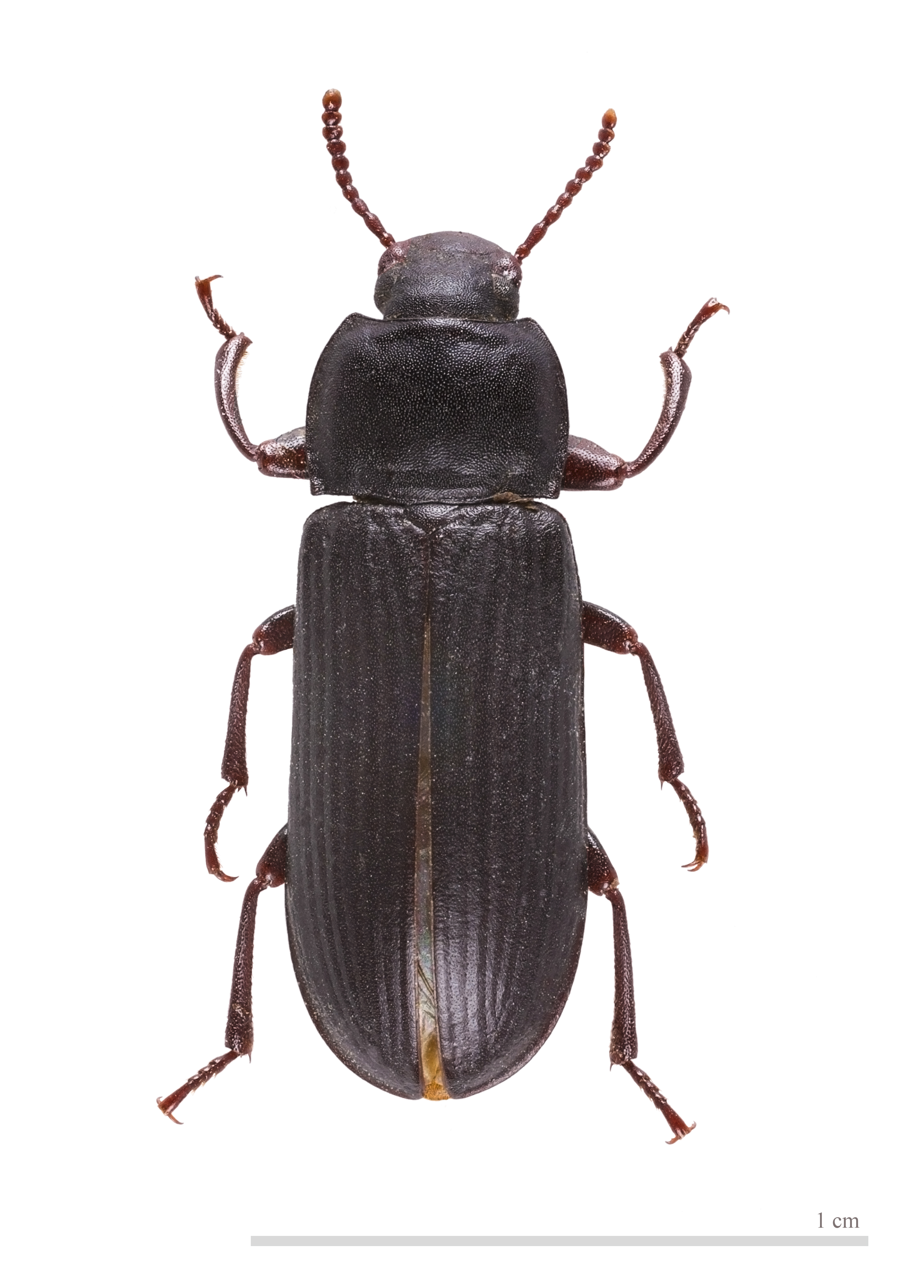
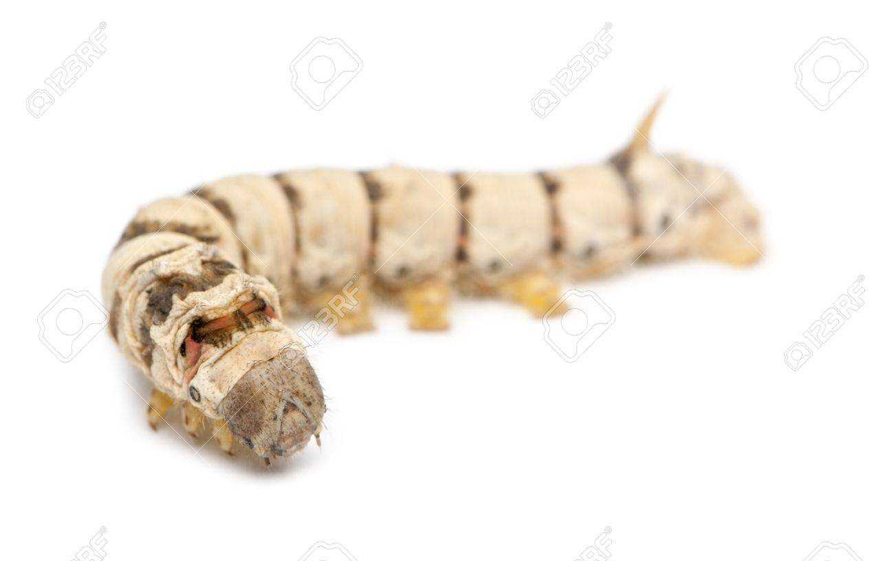
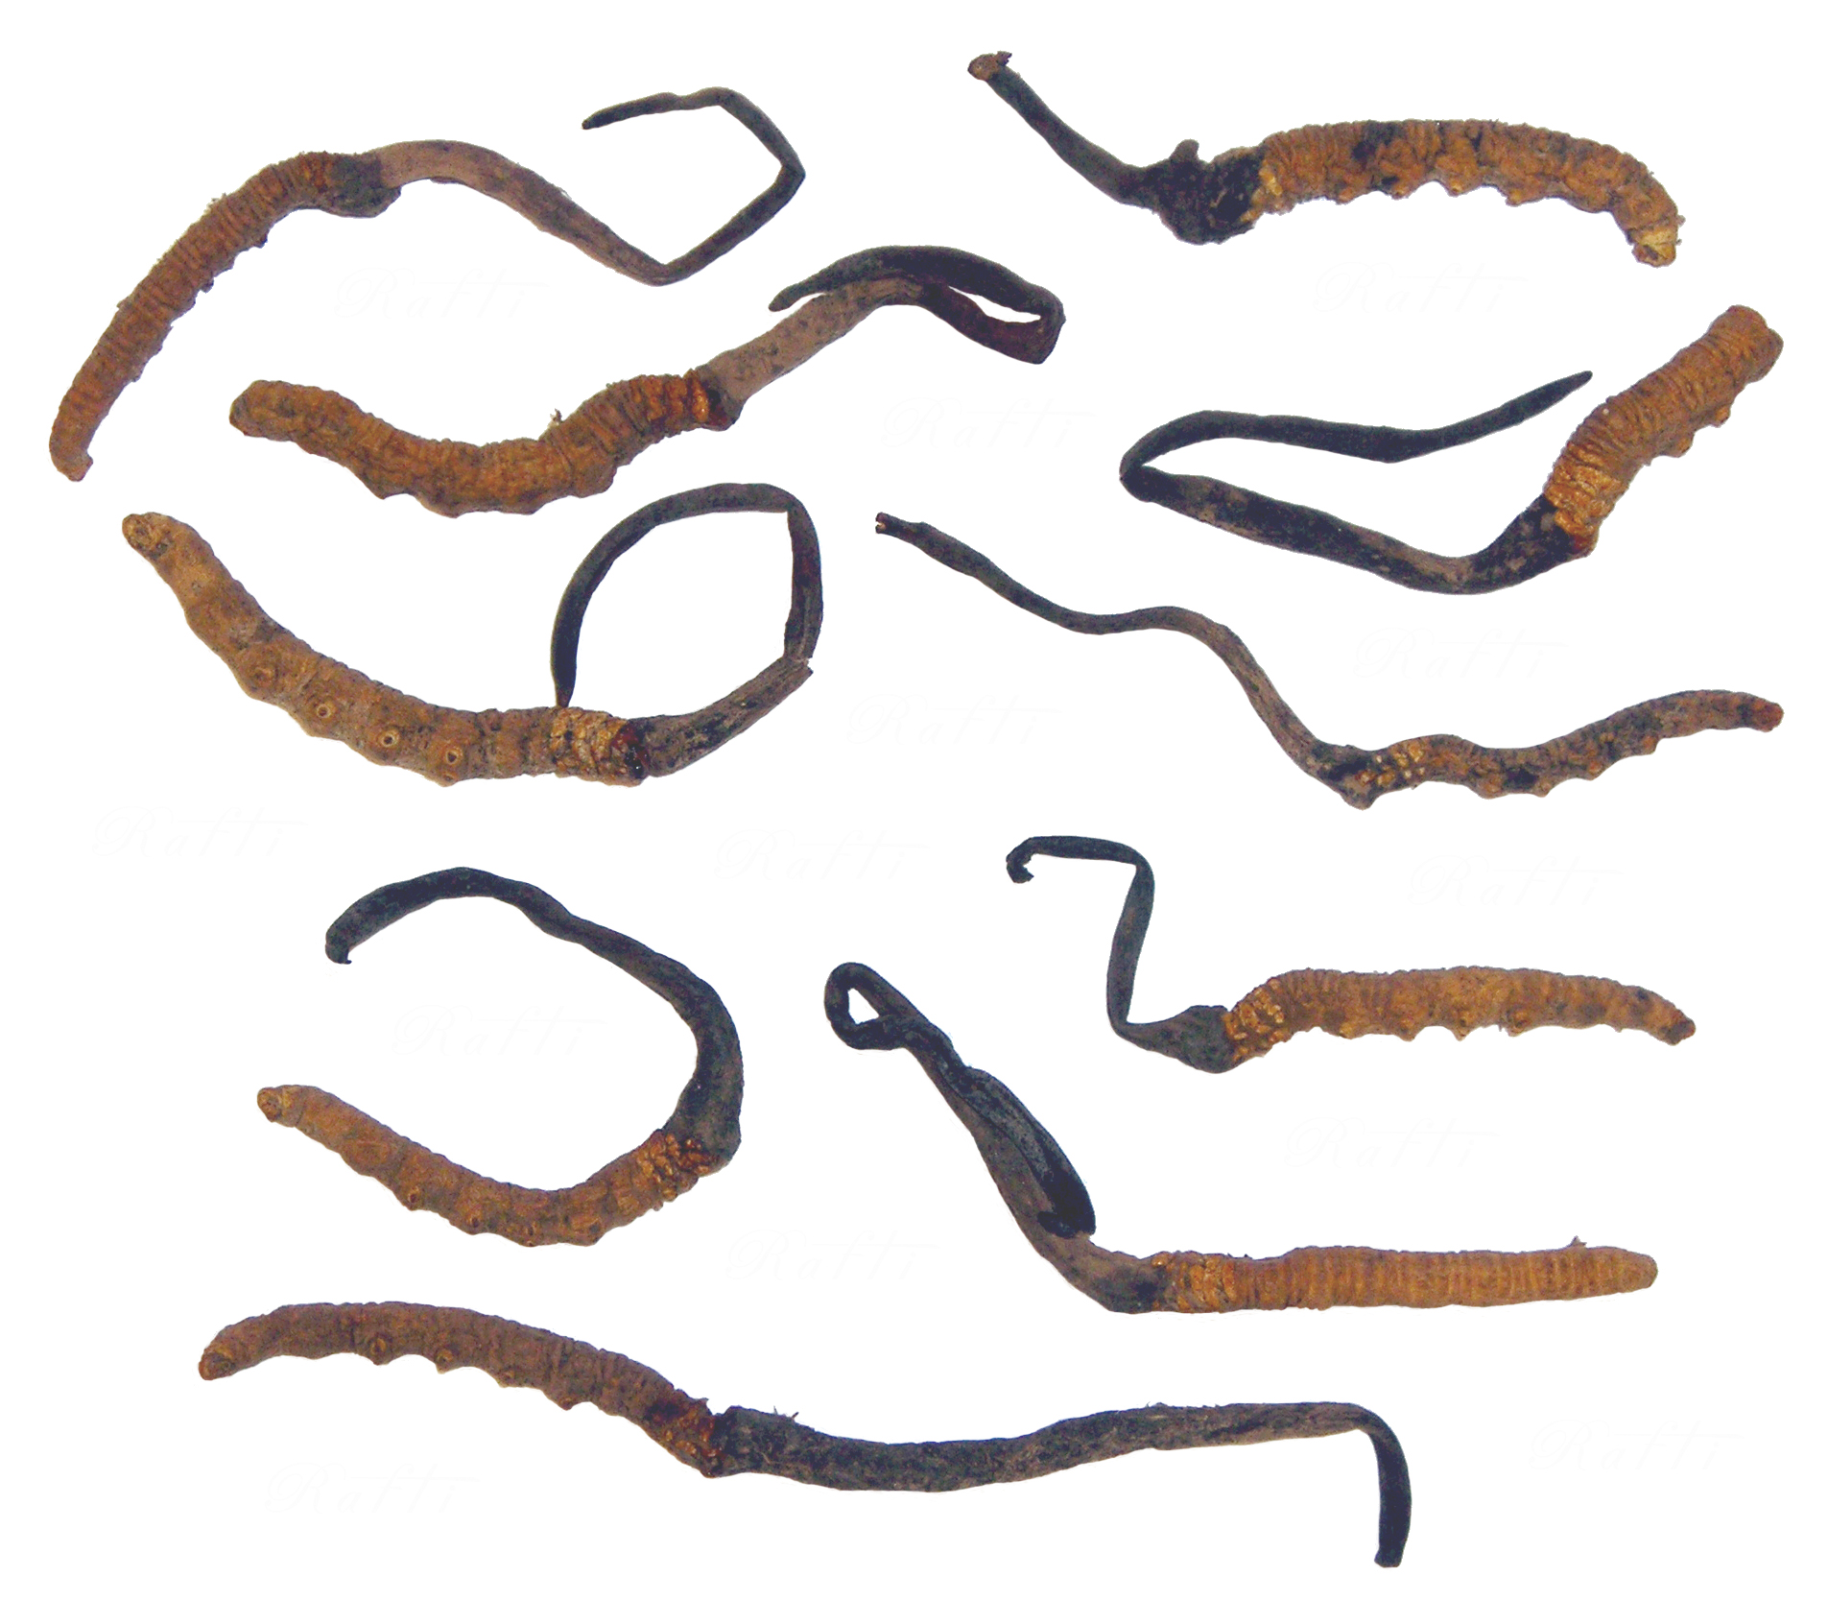
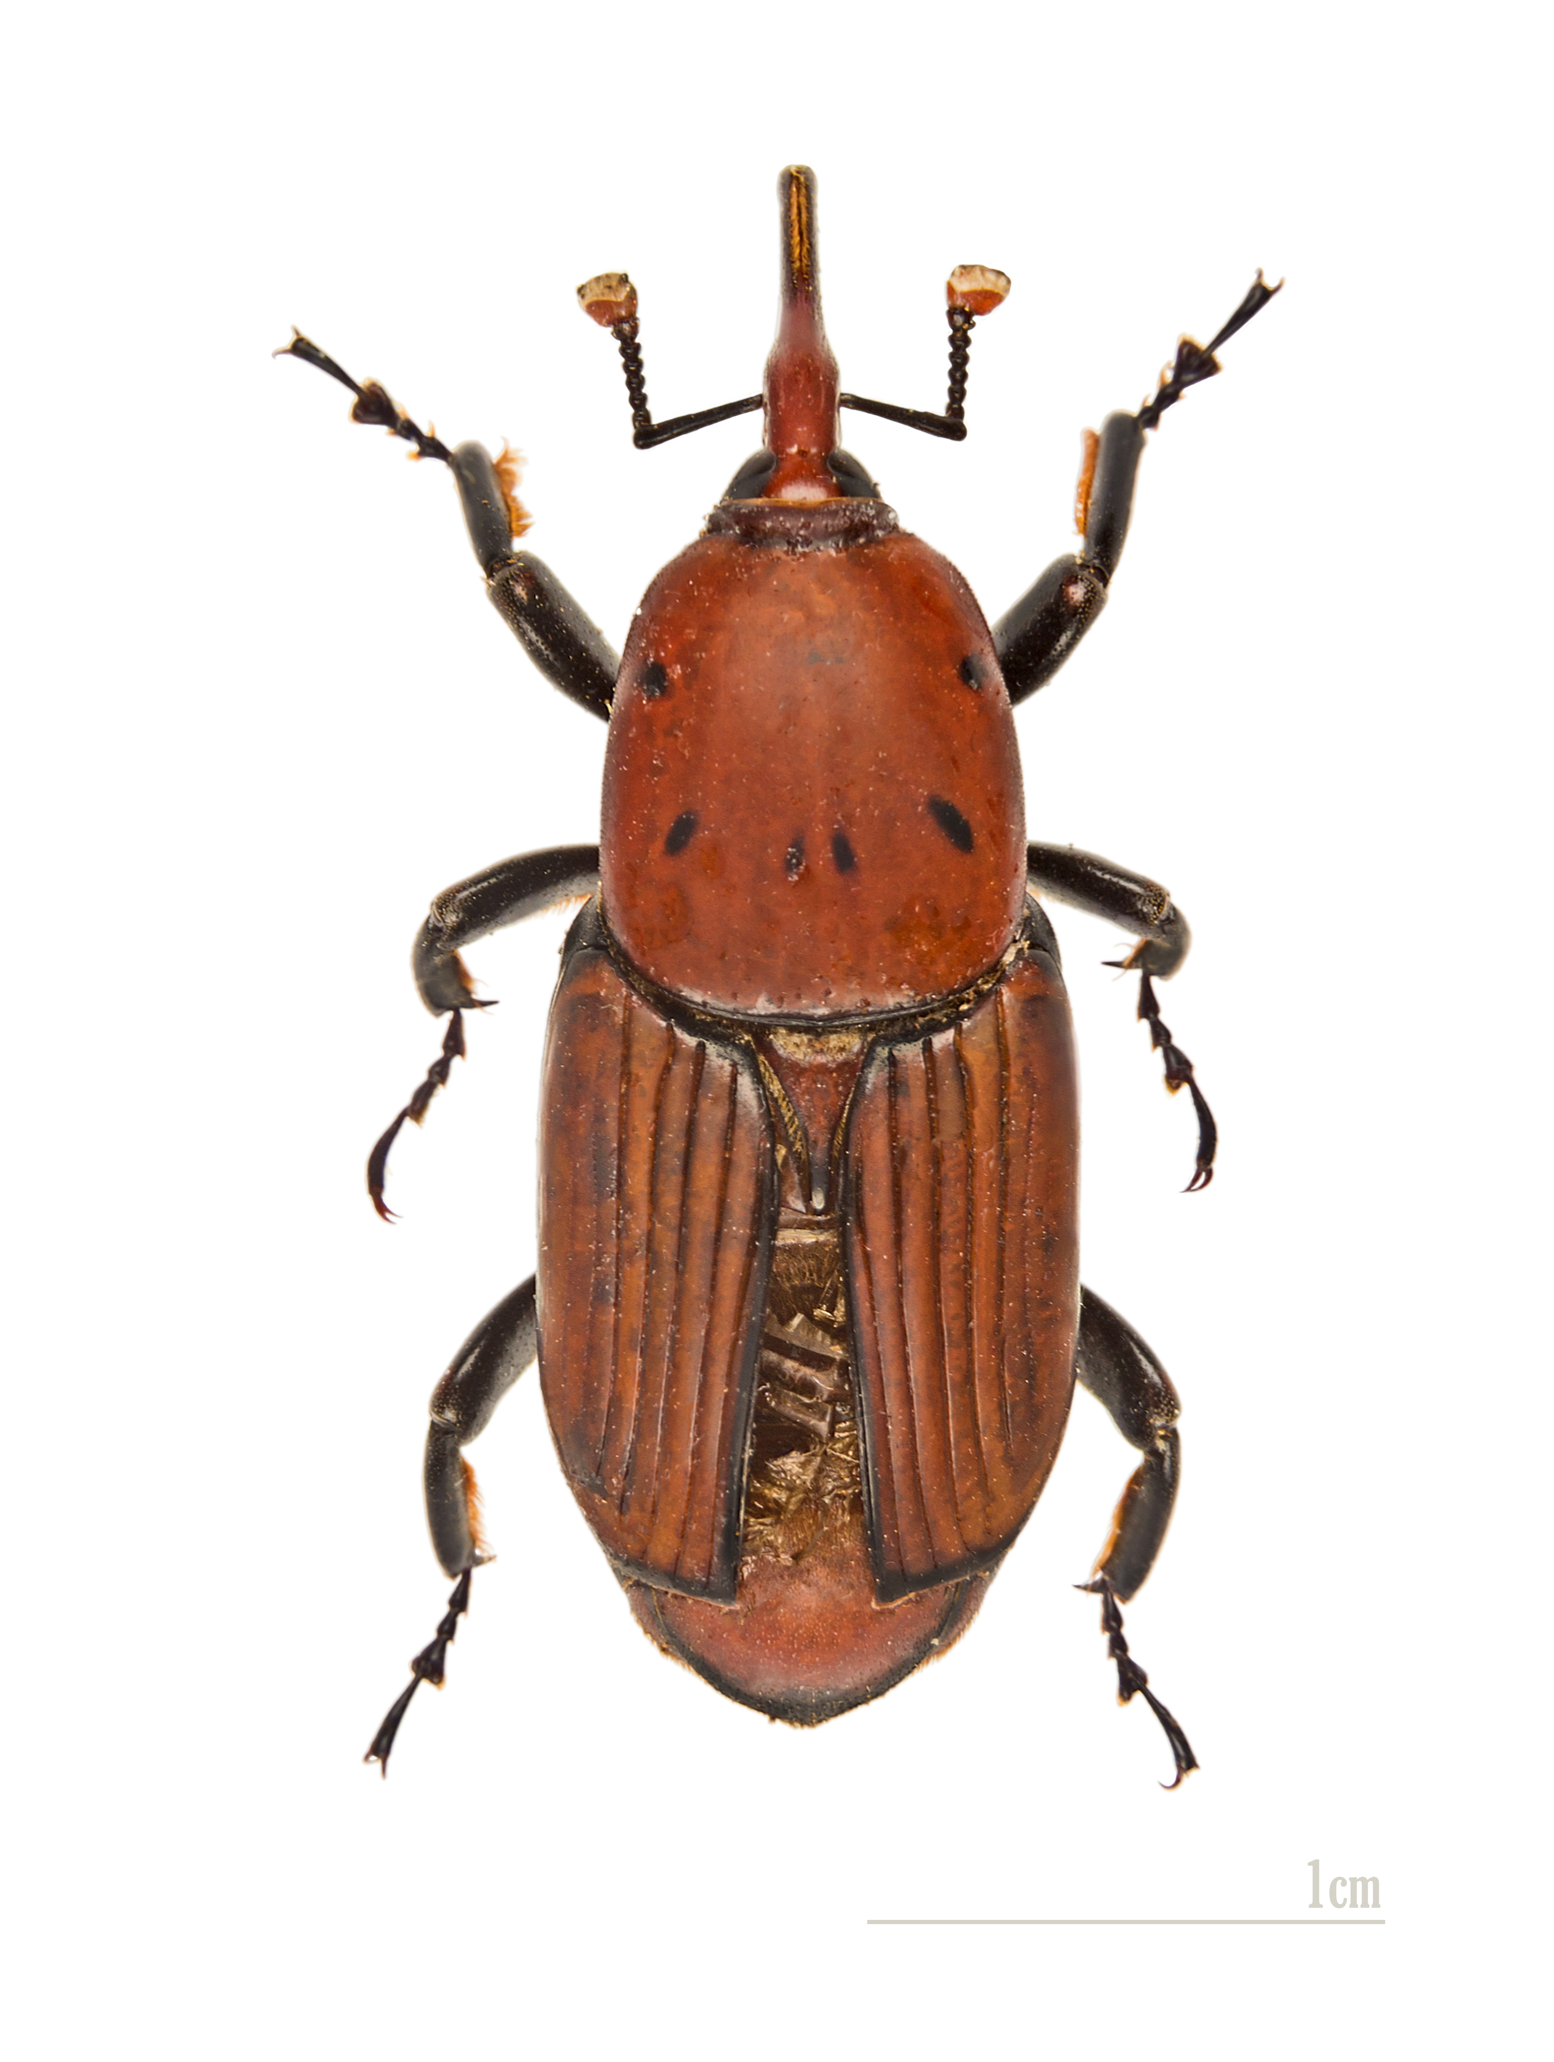
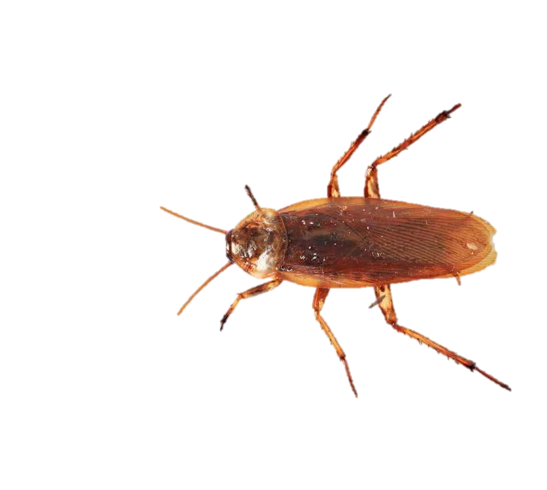
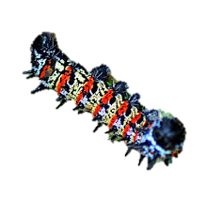
Severity of reactions related to insect consumption
Several cases of anaphylaxis have been described in the literature…
One case of food allergy after eating mealworm (Tenebrio molitor) - Freye et al. (1996)
French tourist after eating silkworm pupae (Bombyx mori) Ji et al. (2008)
  13 other cases of anaphylaxis in CHINA have been described
Ji et al. : 27 cases of anaphylaxis caused by consumption of grasshoppers and 27 cases caused by consumption of locusts in China between 1980 and 2007
Cross-reactions between the mushroom-caterpilar (Ophiocordyceps sinensis) and silkworm pupae (Bombyx mori) - Choi et al. (2010)
Severe food allergy reaction after eating 20 roasted palm worm (larva of Rhynchophorus ferrugineus) in Malaisia in 2012
« Le Monde » Journal reported in 2012 that a 32 y.o. men died after eating cockroaches and worms
Anaphylaxis linked to food that were contaminated by insects or by storage dust mites.
  « pancake syndrome »
Kung et al. described in a case report an atopic adolescent who had ingested mopane caterpillar (Imbrasia belina) and developed anaphylaxis.
Notes:
Plusieurs cas de réaction anaphylactique à l’ingestion d’insectes comestibles ont été rapportés dans la littérature :
􏱡 un cas d’anaphylaxie alimentaire au ver de farine (Tenebrio molitor) a été décrit par Freye et al. (1996) [20] ;
􏱡 un cas de choc anaphylactique chez un touriste français dû à la consommation de pupes de ver à soie (Bombyx mori) (Fig. 1A) a été publié par Ji et al. (2008) [21]. Ces auteurs mentionnent différentes publications (en Chinois), qui font référence à 13 cas de réactions anaphylactiques suite à l’ingestion de pupes de ver à soie frites dans l’huile [5–8]. Ils estiment qu’en Chine, chaque année, plus d’un millier de réactions anaphylactiques sont enregistrées après consomma- tion de ces pupes rôties. Ces chiffres laissent présager que les réactions anaphylactiques aux insectes comestibles sont plus fréquentes que ne l’indiquent les très rares publications, de surcroît en Chinois, consacrées à ce sujet ;
􏱡 plusieurs cas de réaction croisée entre le champignon chenille utilisé en médecine traditionnelle chinoise (Ophiocordyceps sinensis) (Fig. 1C) et les pupes de ver à soie (Bombyx mori) ont même été rapportés par Choi et al. (2010) [22]. L’allergène responsable n’a pas été identifié ;
􏱡 un cas d’allergie alimentaire sévère (hospitalisation) au ver de palmier (larve de Rhynchophorus ferrugineus) (Fig. 1B) a été signalé en Malaisie en 2012 [23], chez un touriste chinois ayant consommé une vingtaine de larves rôties ;
􏱡 le journal Le Monde a récemment (10 octobre 2012) rapporté le cas suivant : « Edward Archbold, 32 ans, a avalé plusieurs douzaines de cafards et de vers lors d’un concours, organisé vendredi par une boutique de reptiles, et dont le premier prix était un python. Mais la compétition terminée, il a été pris de vomissements avant d’être transporté à l’hôpital, où il est mort quelques minutes plus tard. Une autopsie doit encore déterminer les causes exactes de son décès. Le shérif de la

Slide 15
Insect allergy in China
46 y.o. chinese man consumed 20 sago worms - First time he had eaten the sw.
  = Washed and fried in a wok without the addition of cooking oil for home consumption.
No prior history of allergy, asthma or viral illness.
He developed generalized itchiness on his face, arms and body, and also difficulty in breathing a few hours after the ingestion of the worms
This patient obviously had bravely eaten the sago worms for the first time and developed symptoms and signs consistent with anaphylaxis.
Notes:
A 46 year old Chinese man consumed about 20 sago worms three days prior to the index hospitalization episode. He claimed that it was the first time he had eaten the sago worms. The worms were washed with water and fried in a wok without the addition of cooking oil for home consumption. He was an active smoker and there was no other significant cardiovascular risk factor. There was no prior history of allergy, asthma or viral illness.
He developed generalized itchiness on his face, arms and body, and also difficulty in breathing a few hours after the ingestion of the worms. After 3 days of consuming the sago worms, his clinical status gradually worsened until he needed admission to a district hospital,

Slide 16
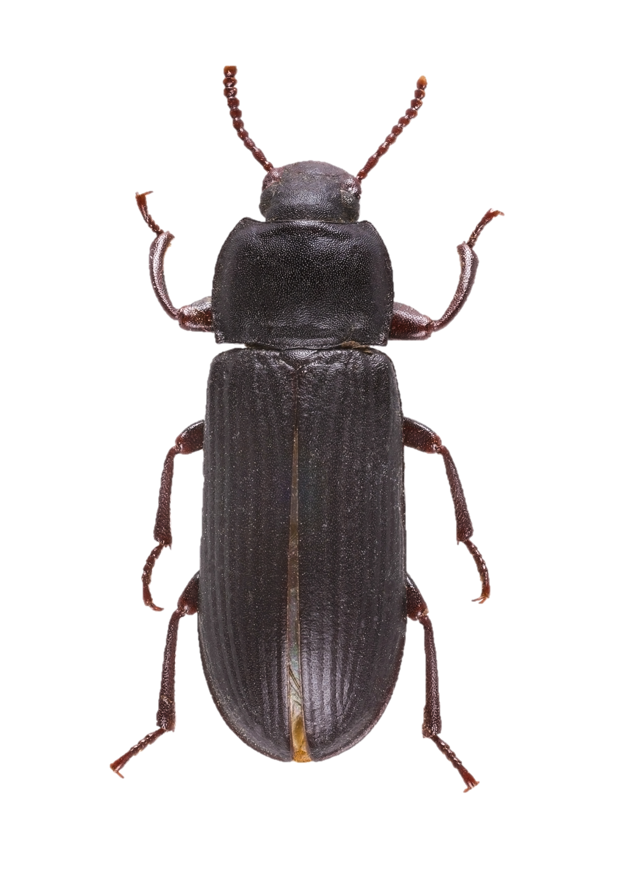
Severity of reactions related to insect consumption
French case of severe food anaphylaxis induced by Tenebrio molitor (mealworm)
Male patient : allergy to house dust mites (HDM). No sensitization to crustaceans.
Immunoblot, sIgE binding to allergens :
  T. molitor pupal cuticle protein G1A,
  larval cuticle proteins A1A and A2B,
  hexamerin,
  tropomyosine
  α-amylase (HDM),
  Tubulin (a potential pan-allergen).
Attention to the risk for HDM allergic patient eating T. molitor larvae
Beaumont P et al, Rev Fran All.2019.

Slide 17
What about the situation in Africa…
Among various communities in Africa, edible insects are harvested seasonally from the wild at different morphological stages and mainly used for food.
  Nsevolo et al described that entomophagy is strongly integrated into the food practices as nearly 80% of the population consumes insects
  It was estimated that the average household in Kinshasa eats approximately 300 g of caterpillars per week.
  95% of forest people in the Central Africa Republic were reported to depend on insects to meet their protein needs
A wide range of insect species are collected in the wild and eaten, or used to feed animals.
Van Huis et al reported that some 246 insect species are eaten either as delicacies or as components of the daily diets.
Edible insects = in those population, a major food allergen?

Slide 18
Insect allergy frequent in some populations : Niger
Method : Retrospective study, 155 patients presenting allergy.
  Amongst them 27 patients presenting sensitization with/without allergy to cricket Ornithacris turbida cavroisi.
Results :
  19 were sensitized (70,37 %)
  8 had allergy to crickets (29,62 %).
    OAS was frequent (6 out of 8),
    urticaria (4 patients),
    Vomit (1 patient),
    Face oedema (1 patient)
    dyspnea (1 patient).
    One presenting grade 3 anaphylaxis.
Discussion : risk of allergy linked to entomophagy.
  5% of the population presenting allergies ?

Slide 19
Review
Confirm the allergic risk for crustacean-allergic subjects to consumption of insects while the clinical significance for the cross-reactivity between HDM and edible insects needs to be established.
There are also signs that subjects who are constantly exposed to insects (like insect-rearing workers) may develop food allergy, which may be a cause of concern with the prospect of increasing insect-rearing units for mass production of insects for food and feed.
Although tropomyosin and AK seem to be the major cross-reacting allergens, their clinical significance needs to be assessed and their role should be further established through inhibition studies.

Slide 20
Take-home messages
  As a result of this phylogenetic relation, homology between proteins of shrimp and different insects can be expected and has been recently documented.
  We expect that shrimp allergic patients could likely have a clinical reaction when eating other insects.
    > 1% population, allergy to shrimp
NOT ONLY Shrimp allergic patients !!
  Severe reactions, anaphylaxis… in HDM allergic patient !
Pneumallergens, professional allergy !
Crude/rosten/flour/cooked… : We should study allergenicity of allergens after different process…
  What about epitopes ?
Inform the clients on the label of food products
Keep it in mind !
insects

Slide 21

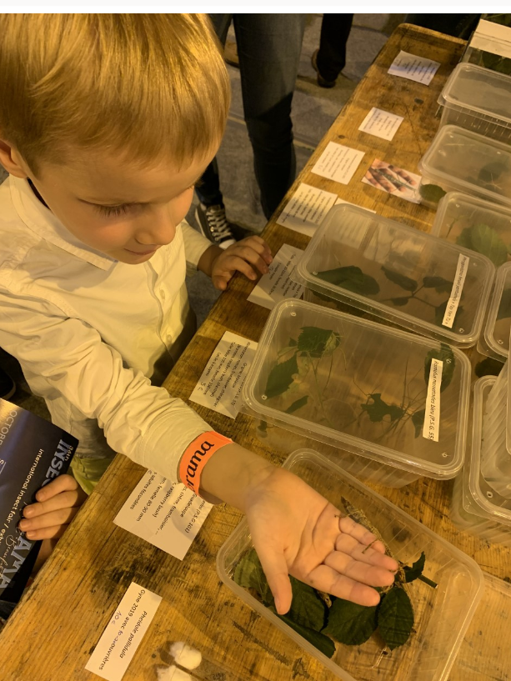

CHELORRHINA ROMYAE
Time for questions…

