Slide 1
Effects of production and curing conditions on performances of stabilized compressed earth blocks: Kaolinite vs quartz-rich materials
Philbert Nshimiyimana *; H. Moussa; A. Messan; L. Courard
Liège, Belgium & Ouagadougou, Burkina Faso
AMRS2019 Dec 10-13, Arusha, Tanzania

Slide 2
Compressed earth blocks for modern building construction
Notes:
1/3 of global population live in earth based housing
Healthy and comfortable in-door environnement

Slide 3
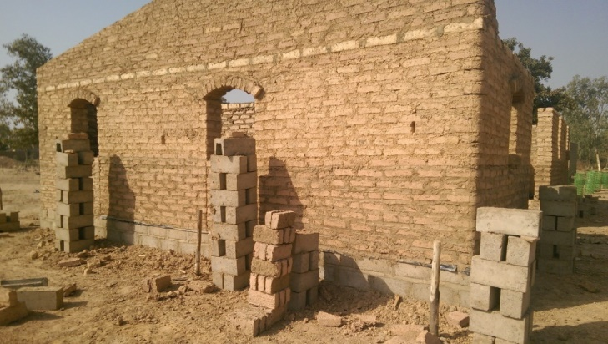
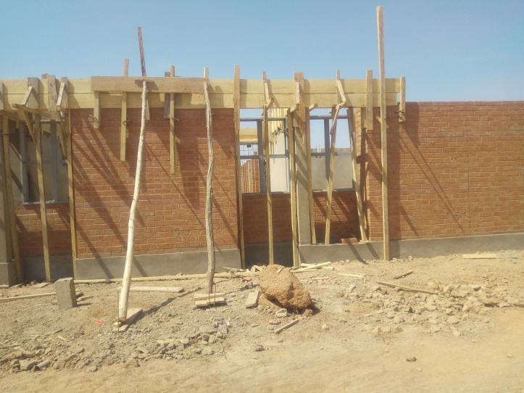
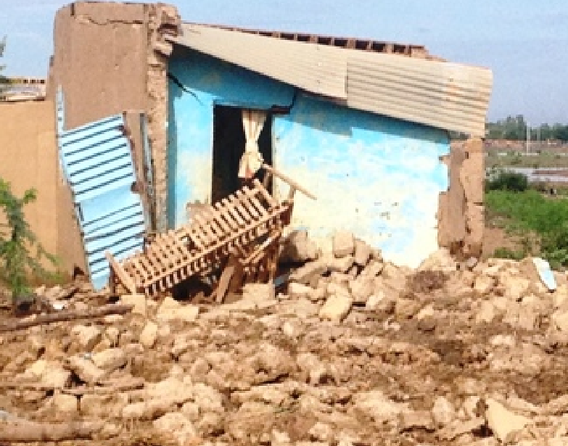
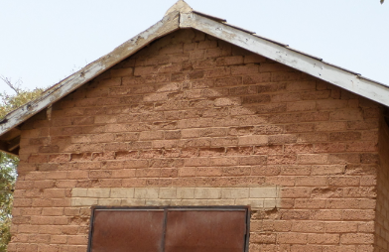
Compressed earth blocks (CEBs) for modern construction
Traditional adobe bricks
(Compressive strength of 1 MPa)
Compressed earth blocks
(Compressive strength of 2 MPa)
Zoungrana, 2017; Hema, 2016, Millogo et al. 2014Houben and Guillaud, 2006; Bogas et al. 2018; XP P13-901, 2001;
Notes:
1/3 of global population live in earth based housing
Healthy and comfortable in-door environnement

Slide 4
Stabilization using chemical binders improves the performances of CEBs in dry and wet conditions
Hydration reaction of cement for binding earthen particles;
Pozzolanic reaction of lime with the earthen materials;
Geopolymerization of (thermally activated or not) aluminosilicates (clay) using alkaline solution activators;
By-product materials/ binders …
Nshimiyimana et al. 2019, 2018; Ojo et al. 2019; Bogas et al. 2018; Sore et al. 2018, Al-Mukhtar et al. 2010; Houben & Guillaud, 2006

Slide 5
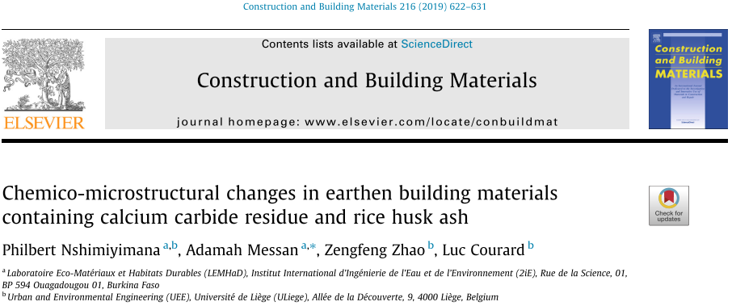
By-product materials: Calcium carbide residue (CCR) improves the performances of CEBs

Slide 6
CCR improves the performances of CEBs: Need to understand the effects of production & curing conditions
Production conditions:
Kaolinite-rich earth material + CCR + OMC
Quartz-rich earth material + CCR + OMC
Curing time: 0, 28, 45, 90 days;
Curing temperature: 20±2°C, 30±5°C (ambiante temp. lab.), 40±2°C.

Slide 7
EXPERIMENTAL APPROACH

Slide 8
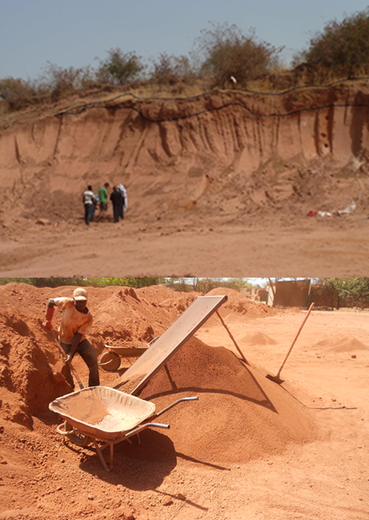
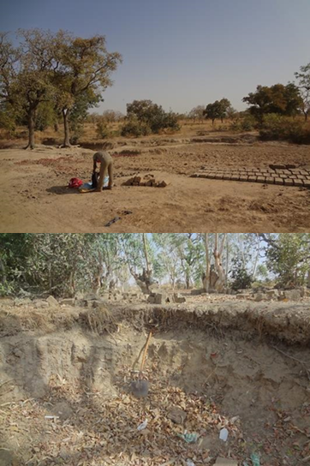
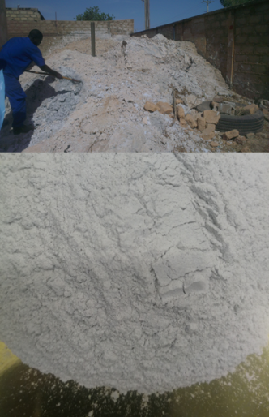
Raw materials were processed and characterized
Earthen materials : < 5 mm
CCR : <125 µm
Mineral (%) | Kaolinite (75) | Quartz (60) | Portlandite (50)
Fine: <80 µm (%) | 67 | 83 | 85
PI (LL) | 15 (50) | 20 (35) | -
OMC (%) [Kg/m³] | 17.4 [1760] | 15.6 [1850] | -
Specific density | 2.75 | 2.66 | 2.49

Slide 9
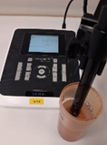
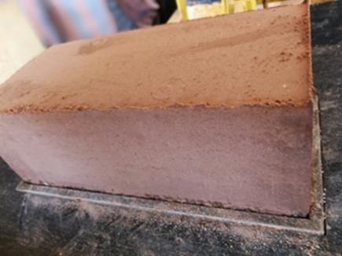
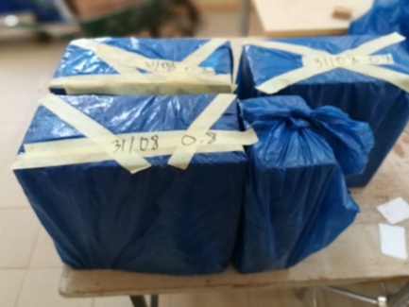
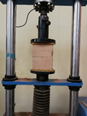
CCR (0, 10, 20 wt %) was added to the earthen materials for production of mix solutions & stabilized CEBs
Measuring the electrical conductivity (EC) of mix solutions:
Produced with earth+CCR+100 mL H2O;
cured for 1-45 days at 20 vs 40 °C.
295x140x95 mm
Testing the compressive strength of stabilized CEBs:
produced using OMC vs OMC+2%;
Cured for 0, 28, 45, and 90 days;
Cured at 20, 30 (ambient temp.), and 40 °C.
CDE, 2000

Slide 10
RESULTS & IMPLICATIONS

Slide 11
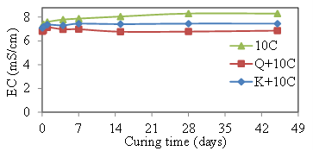
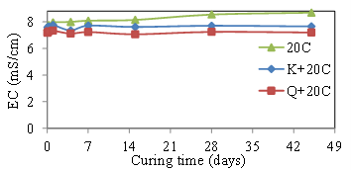
Pozzolanic reaction is limited in the mix solution of earth+CCR cured at 20°C

Slide 12
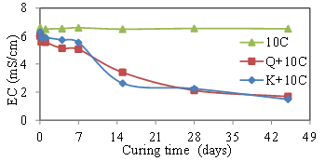
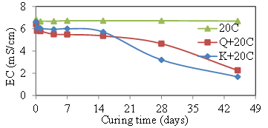
Pozzolanic reaction reached the maturity after 28-45 days in the mix solution of earth+CCR cured at 40°C
Consumption of free [Ca²⁺] during the pozzolanic reaction

Slide 13
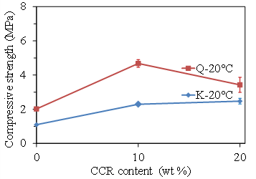
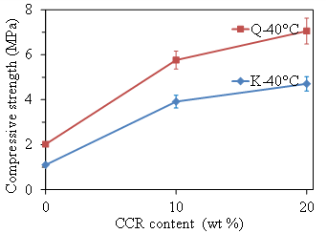
Increasing the curing temperature increases the compressive strength of stabilized CEBs cured for 45 days
Curing Temperature 20°C
Curing Temperature: 40°C

Slide 14
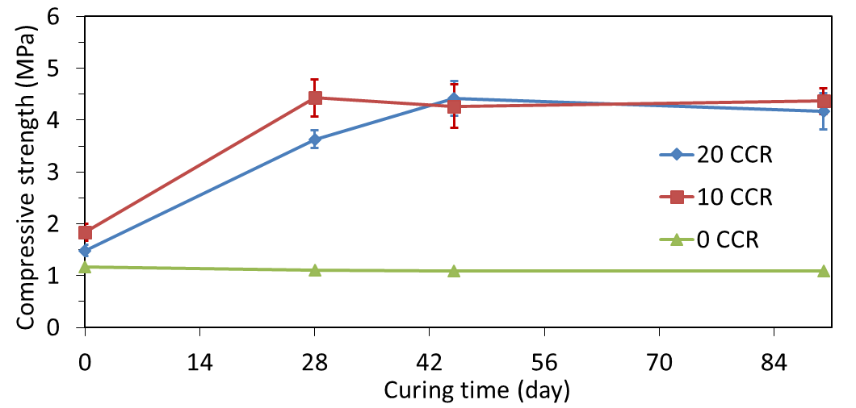
Compressive strength increases with the curing time & reaches the max. after 45 days at ambient temp. (30±5°C)
28
45
90 days
Compressive strength >4 MPa: Stabilized CEBs are useful for construction of 2 storey building: ARS 675:1996 (CDI 1998).

Slide 15
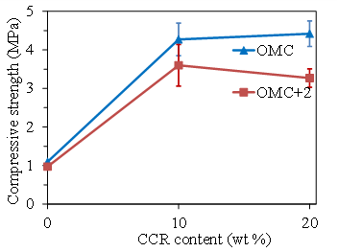
Increasing moulding moisture decreases the compressive strength of stabilized CEBs

Slide 16
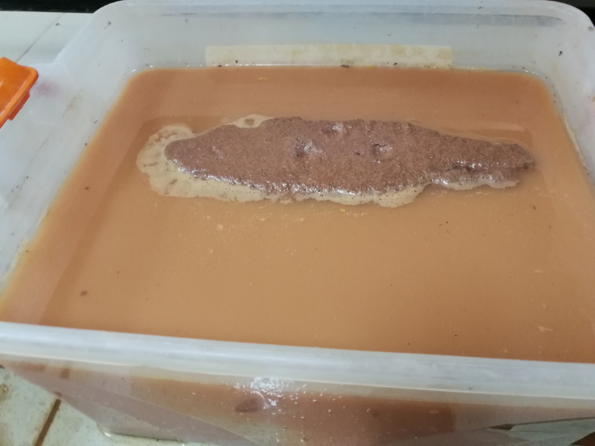
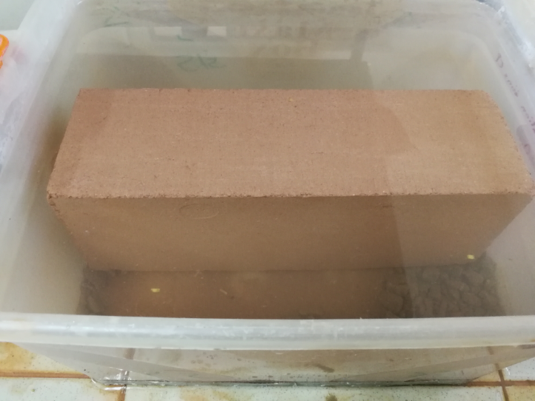
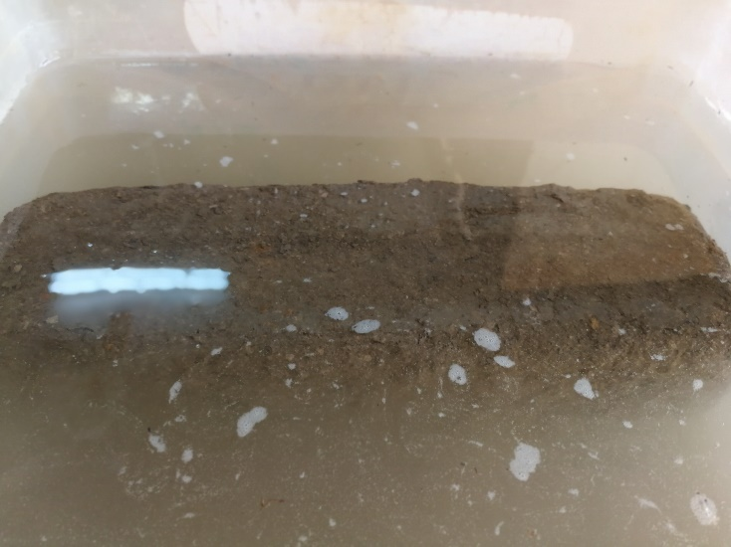
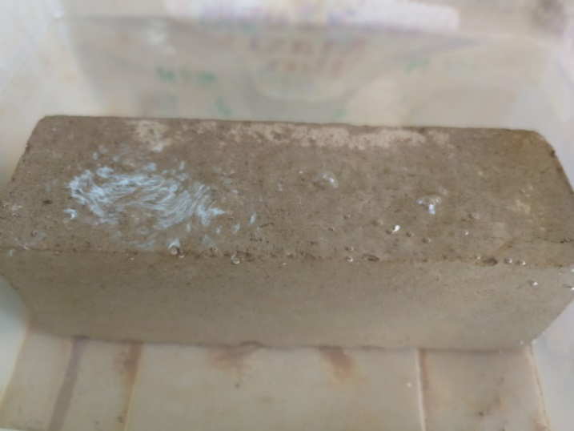
Stabilized CEBs are additionally resistant to degradation in water
Unstabilized CEBs (0 % CCR)
Stabilized CEBs (10 % CCR)
K-rich
Q-rich

Slide 17
CONCLUDING REMARKS

Slide 18
Conclusions and perspectives
Reaction reaches the maturation after 28-45 days depending on the content of CCR at 40 °C; and only limited at 20 °C;
Compressive strength of stabilize CEBs decreases with the moulding moisture, beyond the OMC;
Compressive strength of CEBs cured at 40°C increases:
3.3 times (1-4.7 MPa for 0-20% CCR) for kaolinite-rich;
2.5 times (2-7.1 MPa for 0-20% CCR) for quartz-rich;
Stabilized CEBs are useful for construction of 2 storey building: need to further study their resistance to erodability.
Notes:
Stabilization of CEBs with CCR improves the physico-mechanical performances through pozzolanic reaction.

Slide 19
MERCI POUR VOTRE ATTENTION
UNIKIN
PRD 2016-2021: Improving the quality of earth-based Habitat in Burkina Faso
pnshimiyimana@doct.uliege.be
philbert.nshimiyimana@2ie-edu.org
RG: philbert nshimiyimana

