Slide 1


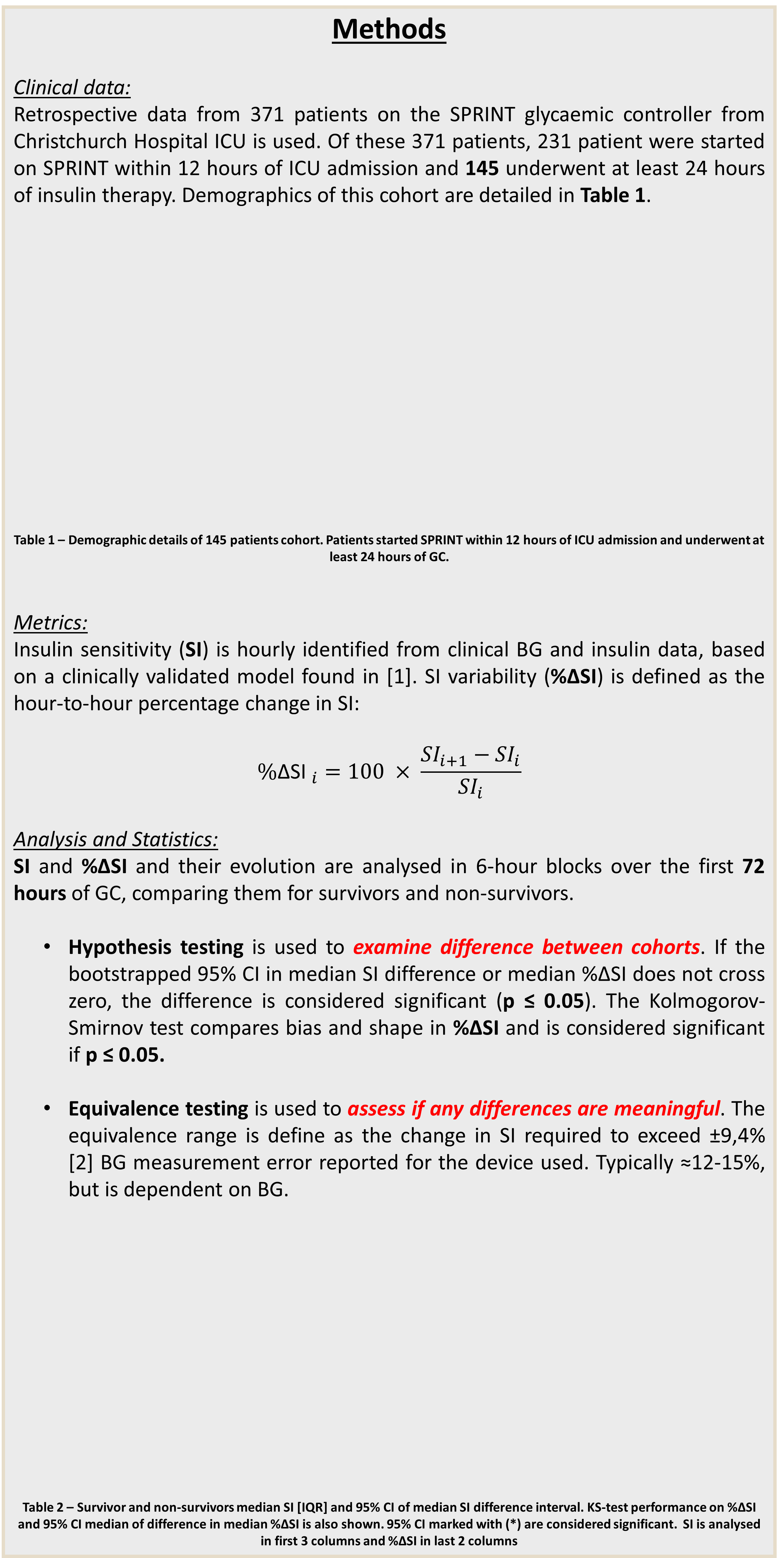
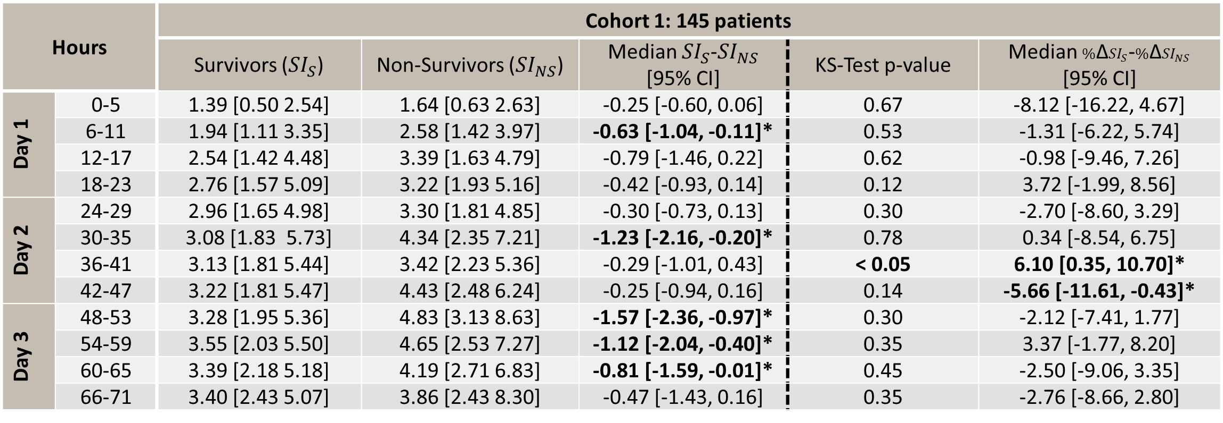
Glycaemic Variability and Mortality in Glycaemic Control – Protocol or Patient?
Geoff Shaw¹, Vincent Uyttendaele², Jennifer Dickson², Kent Stewart², Thomas Desaive³, J Geoffrey Chase²
¹Department of Intensive Care, Christchurch Hospital, New Zealand
²Centre of Bioengineering, University of Canterbury, New Zealand
³GIGA science group, University of Liège, Belgium
Introduction
Glycaemic control (GC) to improve outcomes in critical care has proven difficult, yielding significant glycaemic variability and hypoglycaemia. The strong association of glycaemia, glycaemic variability and mortality are due either to patient-condition (non-survivors are harder to control) or difference in control (non-survivors and survivors are equally difficult to control). This study uses a clinically validated and patient-specific insulin sensitivity (SI) level to compare metabolic variability (difficulty to control) in survivors and non-survivors with equivalent glycaemic control.
Specifically, are non-survivors more variable and thus harder to control?
Methods
Clinical data:
Retrospective data from 371 patients on the SPRINT glycaemic controller from Christchurch Hospital ICU is used. Of these 371 patients, 231 patient were started on SPRINT within 12 hours of ICU admission and 145 underwent at least 24 hours of insulin therapy. Demographics of this cohort are detailed in Table 1.
Table 1 – Demographic details of 145 patients cohort. Patients started SPRINT within 12 hours of ICU admission and underwent at least 24 hours of GC.
Metrics:
Insulin sensitivity (SI) is hourly identified from clinical BG and insulin data, based on a clinically validated model found in [1]. SI variability (%ΔSI) is defined as the hour-to-hour percentage change in SI:
$${\%\text{Δ}\text{SI} }_{i}=100 × \frac{{SI}_{i+1}−{SI}_{i}}{{SI}_{i}}$$
Analysis and Statistics:
SI and %ΔSI and their evolution are analysed in 6-hour blocks over the first 72 hours of GC, comparing them for survivors and non-survivors.
Hypothesis testing is used to examine difference between cohorts. If the bootstrapped 95% CI in median SI difference or median %ΔSI does not cross zero, the difference is considered significant (p ≤ 0.05). The Kolmogorov-Smirnov test compares bias and shape in %ΔSI and is considered significant if p ≤ 0.05.
Equivalence testing is used to assess if any differences are meaningful. The equivalence range is define as the change in SI required to exceed ±9,4% [2] BG measurement error reported for the device used. Typically ≈12-15%, but is dependent on BG.
Table 2 – Survivor and non-survivors median SI [IQR] and 95% CI of median SI difference interval. KS-test performance on %ΔSI and 95% CI median of difference in median %ΔSI is also shown. 95% CI marked with (*) are considered significant. SI is analysed in first 3 columns and %ΔSI in last 2 columns
Results
Table 2 shows median SI [IQR] for survivors and non-survivors over first 72 hrs.
Figure 1 shows the SI and %ΔSI cdfs using 6 hrs blocks and Figure 2 shows the equivalence test for SI (left) and %ΔSI (right). Key results include:
SI Results %ΔSI Results
Figure 1 – SI level and %ΔSI cdfs for survivors (blue) and non-survivors (red). Solid lines represent the first 6 hour block and dashed line the second.
Figure 2 – Equivalence testing on SI (left) and %ΔSI (right). The solid lines give equivalence range for 9.4% BG error and the dotted lines a smaller 7% error reported for the device used [2, 3].
SI level is not equivalent and is often not statistically different between survivors and non-survivors.
SI level is higher in non-survivors than survivors, and this result is often statistically significant as glycaemic control progresses.
 | Cohort 1 | Survivors | Non-Survivors | P
N | 145 | 119 (82%) | 26 (18%) | /
Age (Yr) | 67 [57 75] | 66 [57 74] | 73 [59 78] | 0.15
Gender (M/F) | 91/54 | 75/44 | 16/10 | 1.0
APACHE II Score | 20 [17 26.25] | 19 [16 25] | 22 [19 31] | <0.01
ICU Length of Stay (hrs) | 113 [65 212] | 127 [65 256] | 108 [65 154] | 0.49
Diabetic type I/ type II (total) | 9 / 24 (33) | 8 / 21 (29) | 1 / 3 (4) | 1.0
Median BG [IQR] mmol/L | 5.7 [4.9 6.7] | 5.8 [5.0 6.8] | 5.5 [4.8 6.4] | 0.03
% BG in 4.4-8 mmol/L [IQR] | 79.3 | 79.1 | 80.0 | 0.71
Number patients BG < 2.2 | 0 | 0 | 0 | /
Median Insulin [IQR] U/hr | 3 [2 4] | 3 [2 4] | 3 [1 3] | <0.01
Median feed [IQR] g/hr | 3.25 [1.92 4.87] | 3.25 [1.92 4.87] | 3.25 [1.92 4.87] | 0.70
SI variability is equivalent between survivors and non-survivors, and not statistically different for all but two 6-hour blocks.
Conclusion
Patient-specific SI and %ΔSI metrics are used to assess controllability between survivors and non-survivors. While SI level tends to determine the total amount of insulin to be titrated, it is variability that determines the risks of insulin therapy and overall controllability (hyper- and hypo- glycaemia).
Overall, similar to higher SI for non-survivors and equivalent variability suggest survivors and non-survivors are equally controllable given an effective glycaemic control protocol.
This outcome suggests that glycaemic level and variability, and thus the association between glycaemia and outcome, is essentially determined by the quality of glycaemic control, and not the underlying patient variability.
Hours |  | Cohort 1: 145 patients
 |  | Survivors (${SI}_{S}$) | Non-Survivors (${SI}_{NS}$) | Median ${SI}_{S}$-${SI}_{NS}$ [95% CI] | KS-Test p-value | Median ${\%\text{Δ}SI}_{S}$-${\%\text{Δ}SI}_{NS}$ [95% CI]
Day 1 | 0-5 | 1.39 [0.50 2.54] | 1.64 [0.63 2.63] | -0.25 [-0.60, 0.06] | 0.67 | -8.12 [-16.22, 4.67]
 | 6-11 | 1.94 [1.11 3.35] | 2.58 [1.42 3.97] | -0.63 [-1.04, -0.11]* | 0.53 | -1.31 [-6.22, 5.74]
 | 12-17 | 2.54 [1.42 4.48] | 3.39 [1.63 4.79] | -0.79 [-1.46, 0.22] | 0.62 | -0.98 [-9.46, 7.26]
 | 18-23 | 2.76 [1.57 5.09] | 3.22 [1.93 5.16] | -0.42 [-0.93, 0.14] | 0.12 | 3.72 [-1.99, 8.56]
Day 2 | 24-29 | 2.96 [1.65 4.98] | 3.30 [1.81 4.85] | -0.30 [-0.73, 0.13] | 0.30 | -2.70 [-8.60, 3.29]
 | 30-35 | 3.08 [1.83 5.73] | 4.34 [2.35 7.21] | -1.23 [-2.16, -0.20]* | 0.78 | 0.34 [-8.54, 6.75]
 | 36-41 | 3.13 [1.81 5.44] | 3.42 [2.23 5.36] | -0.29 [-1.01, 0.43] | < 0.05 | 6.10 [0.35, 10.70]*
 | 42-47 | 3.22 [1.81 5.47] | 4.43 [2.48 6.24] | -0.25 [-0.94, 0.16] | 0.14 | -5.66 [-11.61, -0.43]*
Day 3 | 48-53 | 3.28 [1.95 5.36] | 4.83 [3.13 8.63] | -1.57 [-2.36, -0.97]* | 0.30 | -2.12 [-7.41, 1.77]
 | 54-59 | 3.55 [2.03 5.50] | 4.65 [2.53 7.27] | -1.12 [-2.04, -0.40]* | 0.35 | 3.37 [-1.77, 8.20]
 | 60-65 | 3.39 [2.18 5.18] | 4.19 [2.71 6.83] | -0.81 [-1.59, -0.01]* | 0.45 | -2.50 [-9.06, 3.35]
 | 66-71 | 3.40 [2.43 5.07] | 3.86 [2.43 8.30] | -0.47 [-1.43, 0.16] | 0.35 | -2.76 [-8.66, 2.80]
[1] Lin, J., et al., A physiological Intensive Control Insulin-Nutrition-Glucose (ICING) model validated in critically ill patients. Comput Methods Programs Biomed, 2011. 102(2): p. 192-205.
[2] Freckmann, G., et al., System accuracy evaluation of 27 blood glucose monitoring systems according to DIN EN ISO 15197. Diabetes Technol Ther, 2010. 12(3): p. 221-31.
[3] SKUP, Glucocard X-Meter : Meter and test strips designed for glucose self-measurement manufactered by Arkray, Inc. 2006, University of Bergen: Norway.

