Slide 1


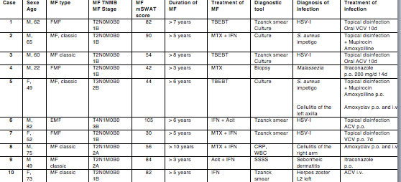
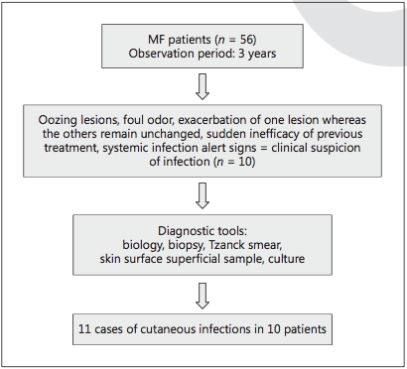
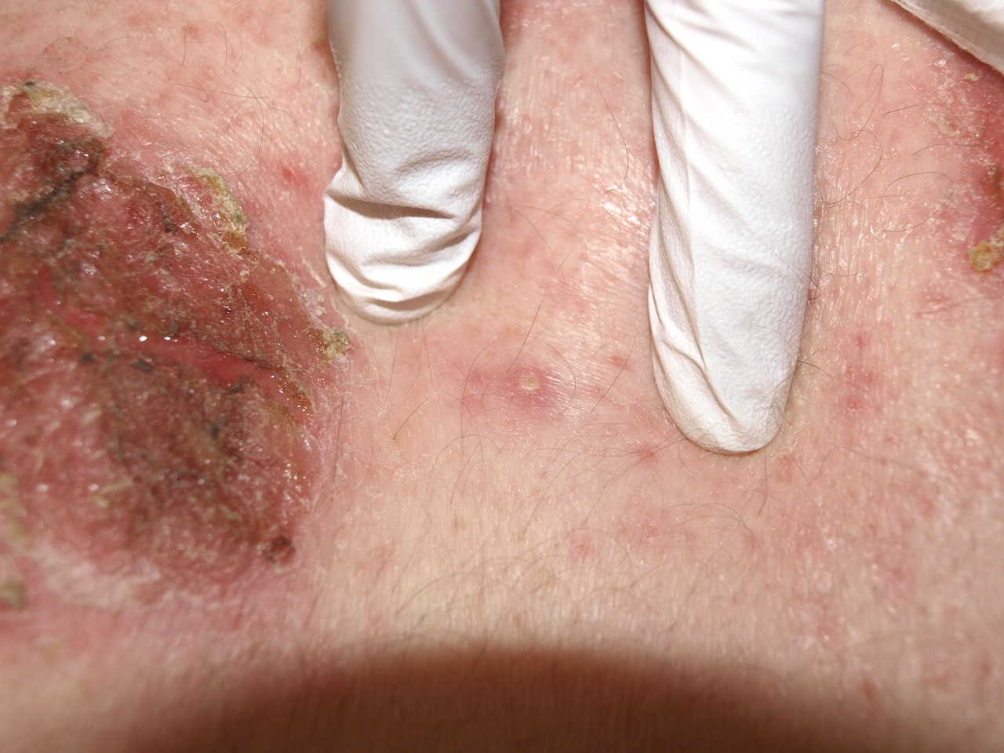
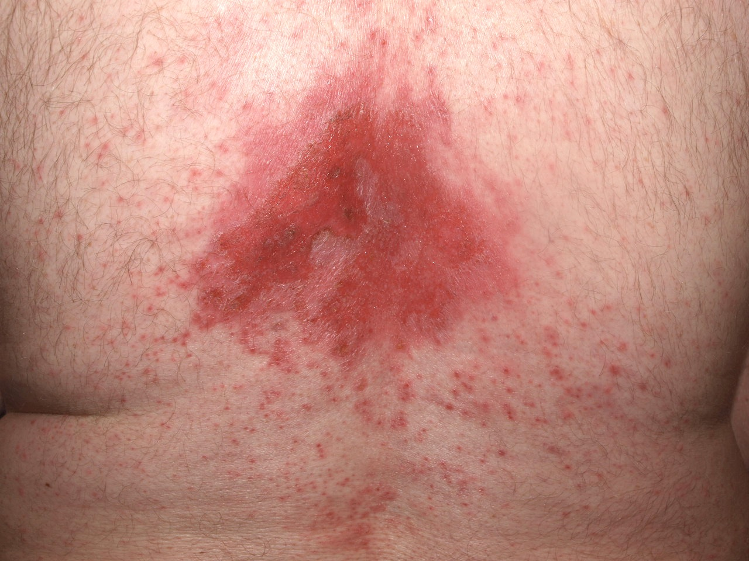
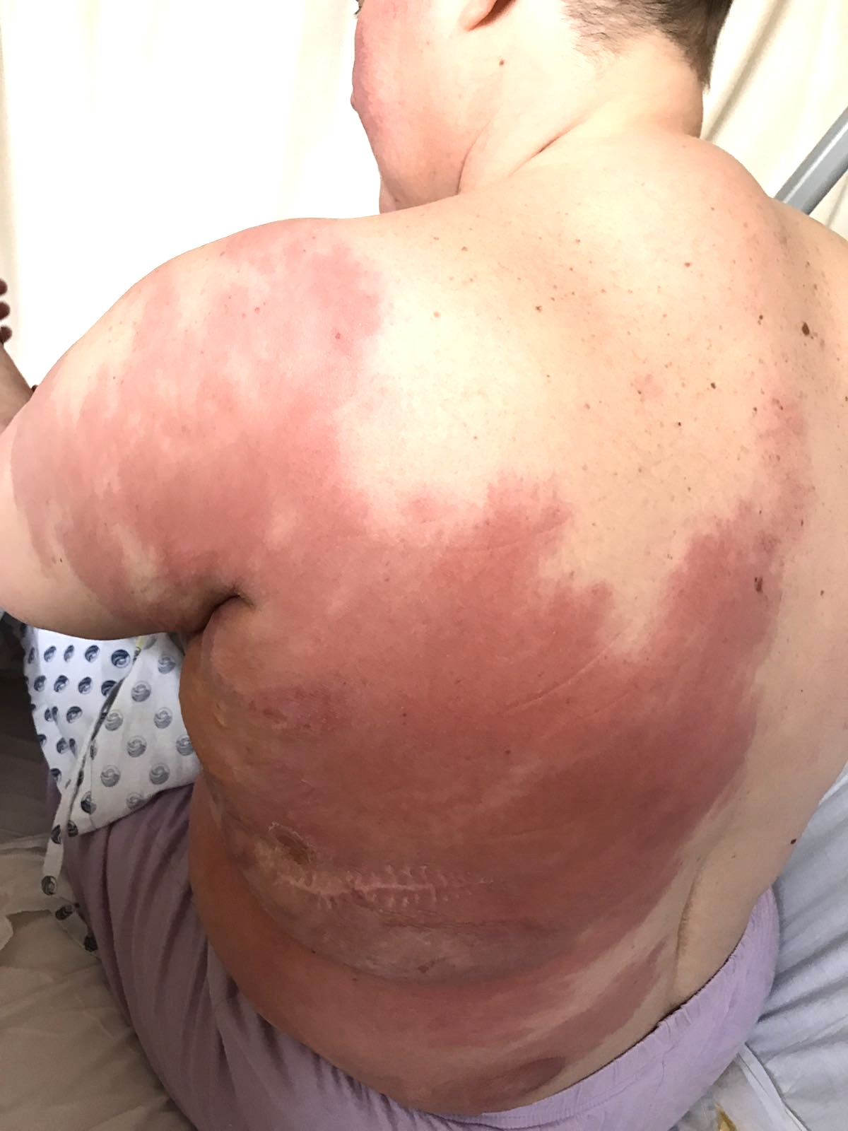
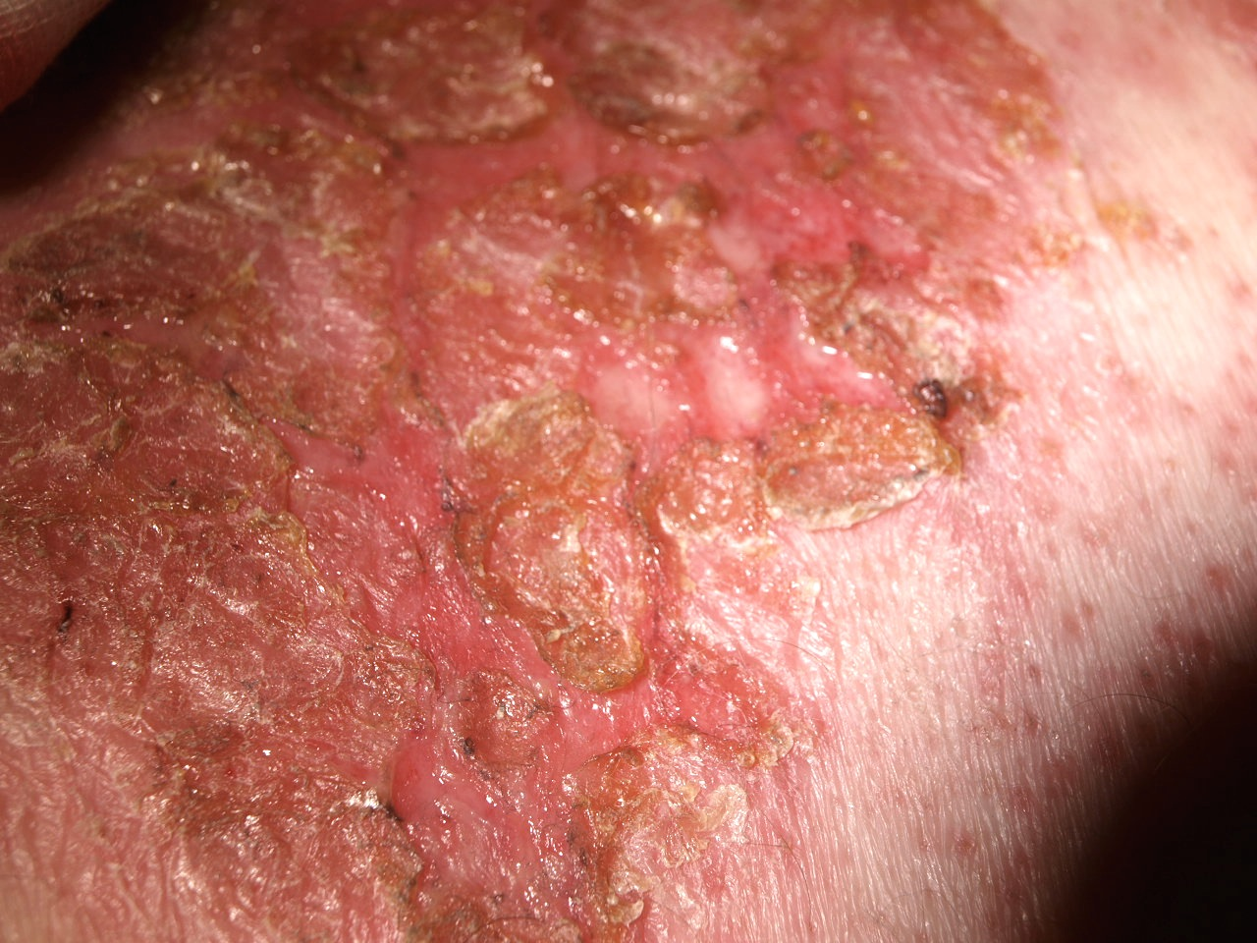

Risk factors for skin infections in Mycosis Fungoides E. Lebas¹ MD, J.E. Arrese² MD, PhD, A.F. Nikkels¹ MD, PhD Departments of ¹Dermatology and ²Dermatopathology, Liège University Hospital CHU, 4000 Liège, Belgium
Skin Cancer Center
Introduction and objectives Mycosis fungoides (MF) is the most frequent type of primary cutaneous natural killer cell and T-cell lymphoma. One of the major complications of MF is infection, in particular cutaneous infections. Our purpose was to assess the number of skin infections, their clinical characteristics, the diagnostic methods and the therapeutic management to identify risk factors for skin infection in MF patients.
Material and methods
Results Four herpes simplex virus type-I (HSV-I), 2 staphylococcal (S. Aureus) impetiginizations and 2 Malassezia infections were detected in single isolated plaque/patch stage MF as well as 1 varicella zoster virus infection (herpes zoster) and 2 cases of cellulitis in 10 patients. Infections were either limited to single or clustered MF lesions (HSV, S. Aureus and Malassezia), or were independent of MF lesions (herpes zoster and cellulitis). All patients presented long-standing and widespread MF. None of the infected MF lesions resembled the usual HSV-1, Malassezia and impetigo skin infections.
Malassezia
HSV-1
S. Aureus impetigo
Cellulitis
Discussion Different skin infections may be observed among patients suffering form MF. This case series illustrates the atypical clinical presentations in MF patients of common cutaneous infections, in particular for HSV-1 and Malassezia. Cellulitis and HZ were not different from the common manifestations but can be severer and prolonged in MF patients. There are numerous risk factors for cutaneous infections in MF patients. Extracutaneous involvement with lymphoma was the most important risk factor for recurrent bacterial skin infection and for disseminated HSV infection. Systemic medication such as methotrexate and interferon represent additional risk factor, as well as topical corticosteroids, UVB or PUVA. The more widespread the MF lesions are, the higher the probability is to acquire pathogens. The disruption of the normal skin barrier is an additional risk factor. This disruption can be linked to the type of MF, or to pruritus and consequent scratching, or have an iatrogenic origin (carmustine, radiotherapy or total body electron beam therapy). It has been described that several actors of the immune system are activated in advanced MF together with a shift from a Th1 to a Th2 cytokine profile. Later-stage MF skin lesions are associated with an overexpression of different innate immunity components, probably as a compensatory mechanism for the deficient downstream adaptive CD8-cytotoxic-mediated immunity. Unfortunately, these alterations are probably no enough to stop or to delay cutaneous infection susceptibility.
Conclusion The clinical presentations of common skin infections complicating MF lesions are atypical, associated with a diagnostic delay and require longer treatments than usual. Patients with advanced MF should be particularly monitored for skin infections, especially by HSV and S. aureus. Unexplained exacerbation or the sudden appearance of oozing or ulcerations in MF lesions should initiate a search for viral, bacterial or fungal agents.

