Slide 1
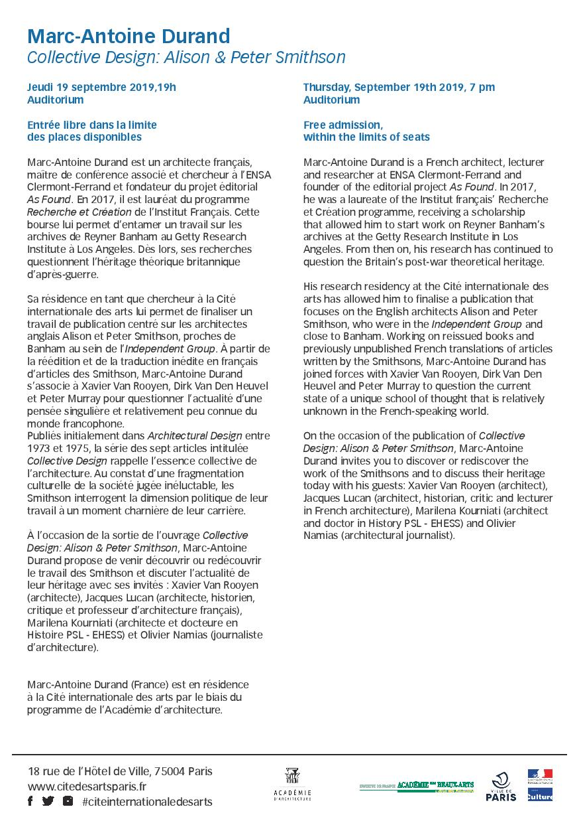

Slide 2
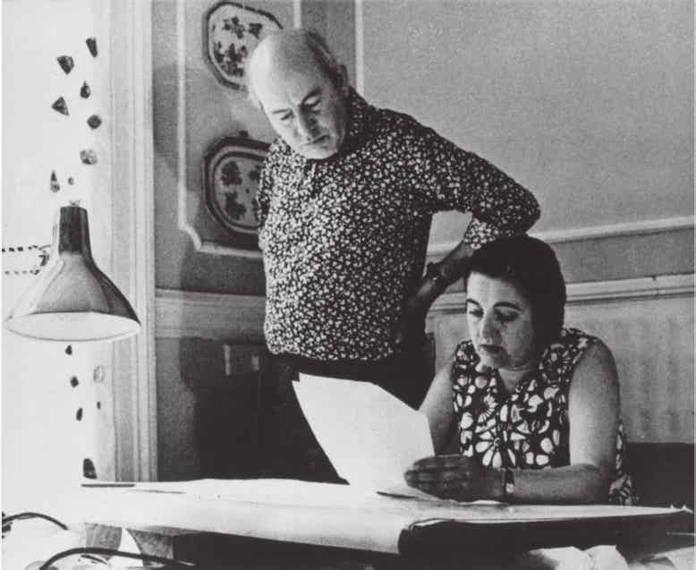
Xavier Van Rooyen Architecte, chercheur ULiège
Repositionnement des Smithson dans l’histoire
Alison and Peter Smithson at Cato Lodge in their drawing room

Slide 3
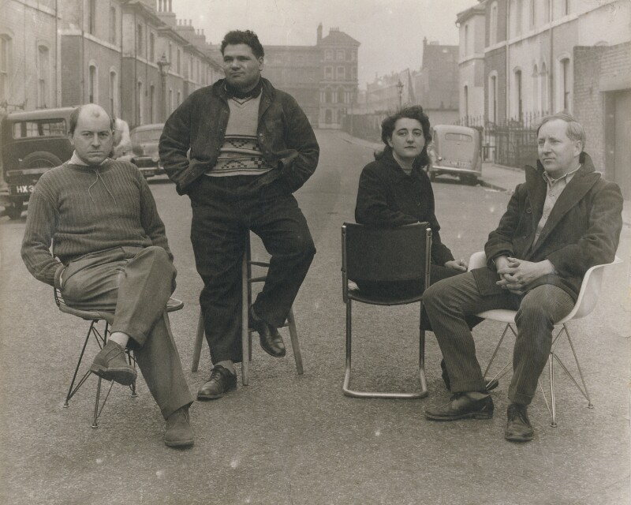
Activité au sein des groupes artistiques
Independent Group
Four artists included in the exhibition 'This is Tomorrow‘, photo prise par Nigel Graeme Henderson

Slide 4
Présence au sein des CIAM
Urban Re-identication Grid, 1953 or CIAM 9 at Aix-en-Provence, with photos by Nigel Henderson

Slide 5
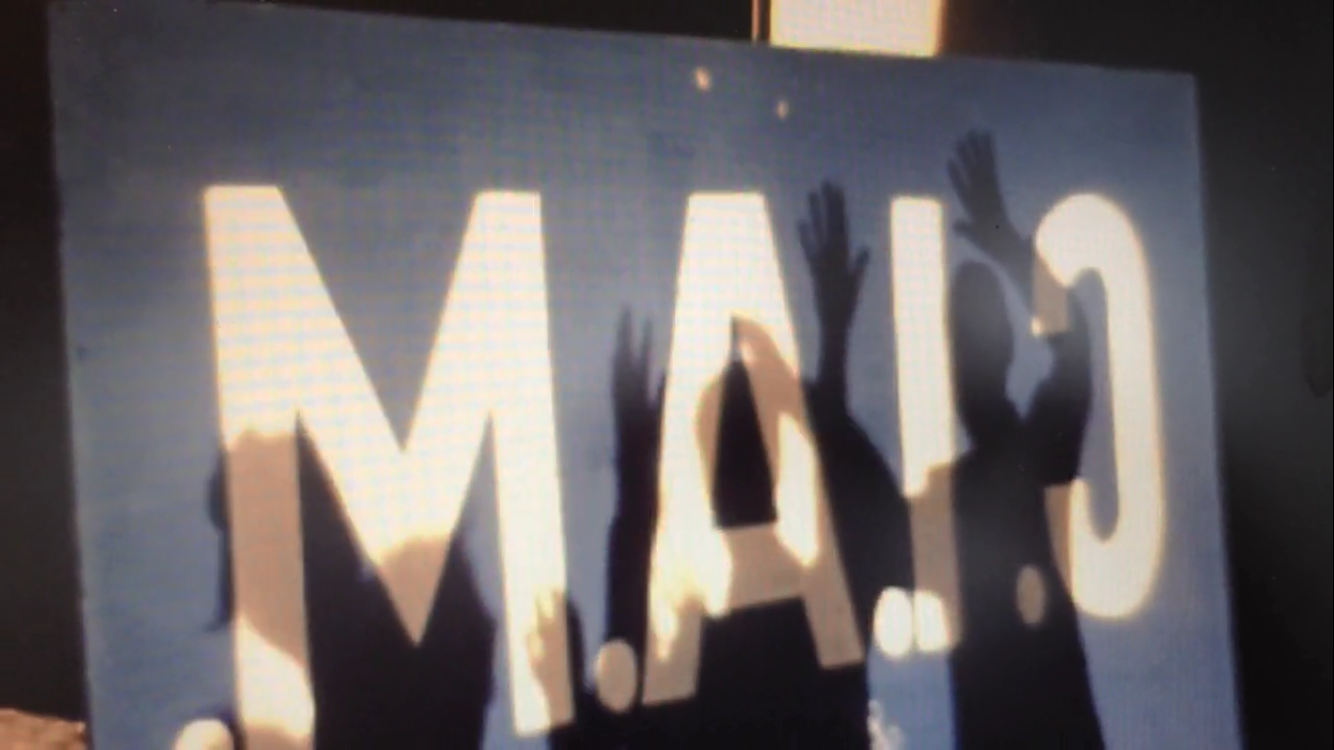
Mort des CIAM. Avènement du Team Ten
Vidéo tounrée lors du Congrès d’Otterlo en 1959 annonçant la mort des CIAM

Slide 6
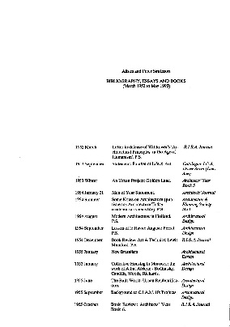
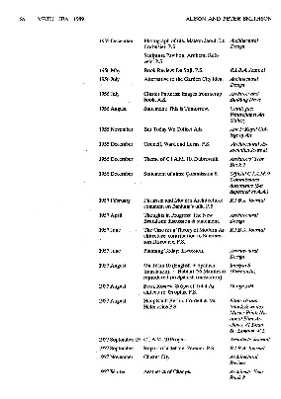
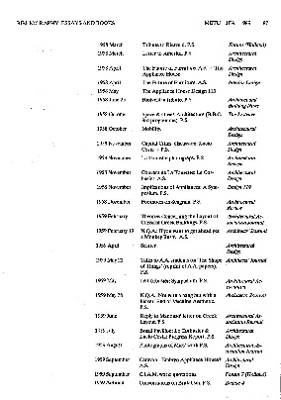
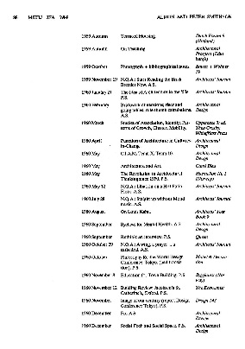
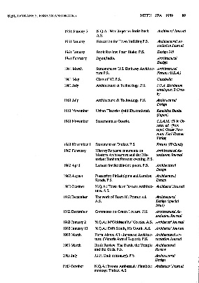
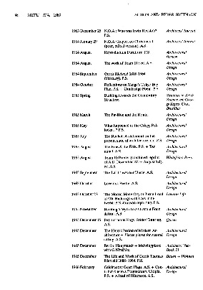
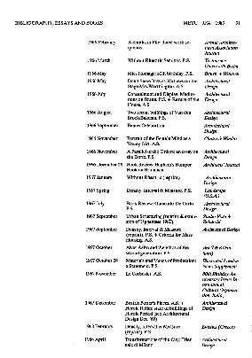
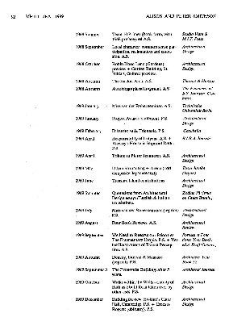
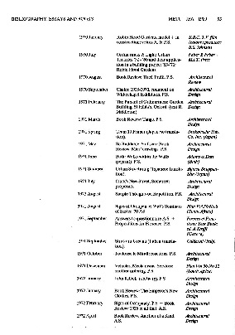
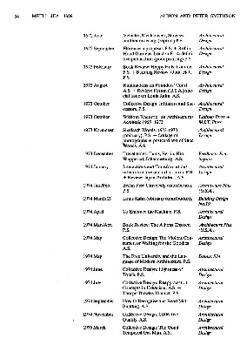
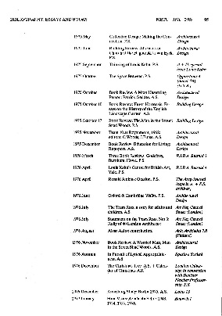
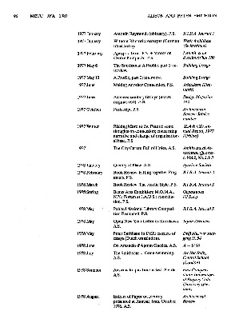
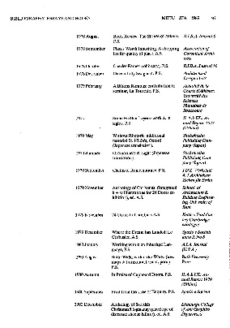
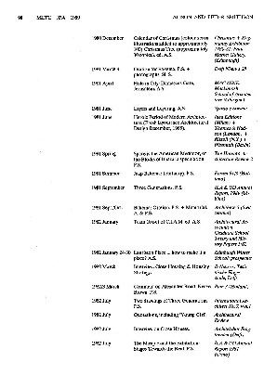
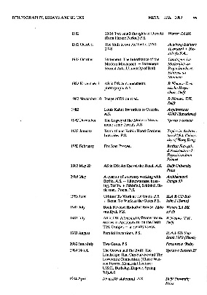
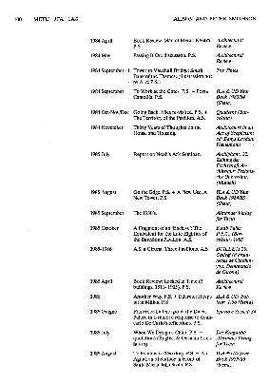
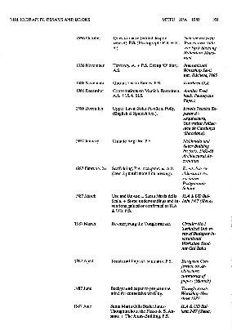
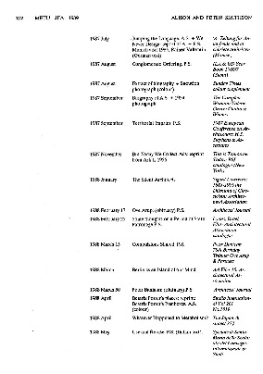
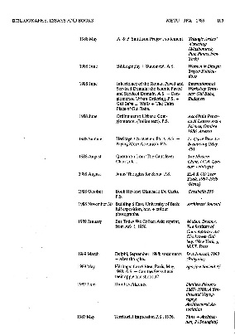
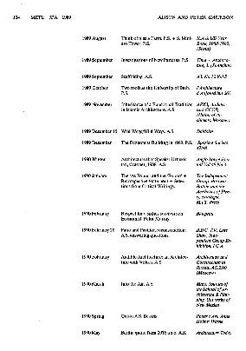
Ecrits
Liste d’écrits de 1952-1990

Slide 7
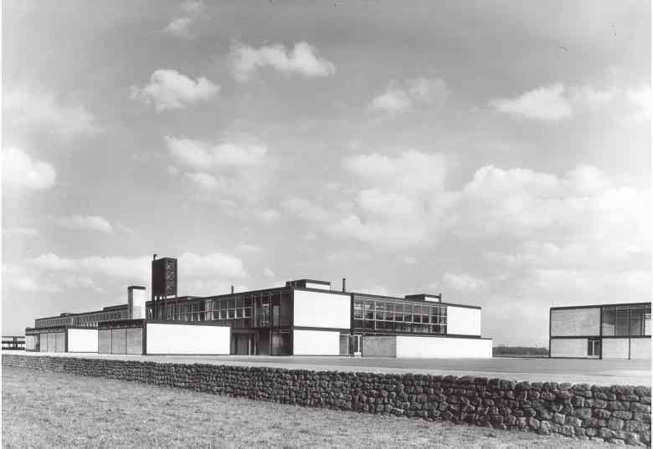
New Brutalism
" What is new about the new brutalism among movements is that it finds its closest affinities not in past architectural styles, but in peasant dwelling forms. It has nothing to do with craft, We see architecture as the direct result of a way of life”. Architectural Design, January 1955, printed again in Banham, The New Brutalism, 46. The resurgence of brutalism is highlighted in an article written by Bianchi M. et Van Rooyen X., Housing the multitude: struggling with impermanence and singularities.
Architectural Design, January 1955, printed again in Banham, The New Brutalism, 46.
Hunstanton Secondary Modern School, 1949-1954, iew rom the street with annexes and ha-ha in rontphoto: John Maltby

Slide 8
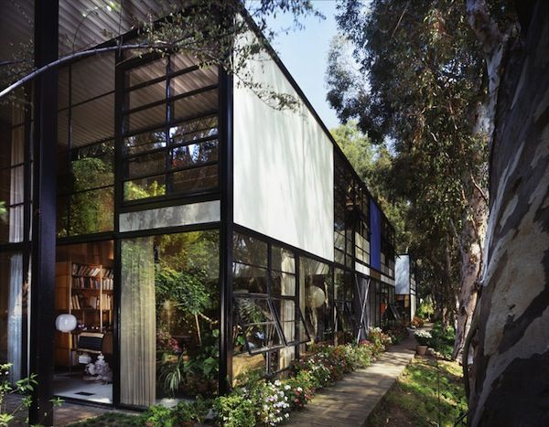
Aesthetic of change
Santa Monica House, Charles and Ray Eames, California (USA), 1949

Slide 9
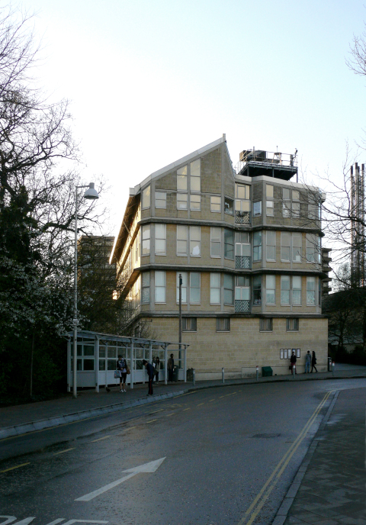
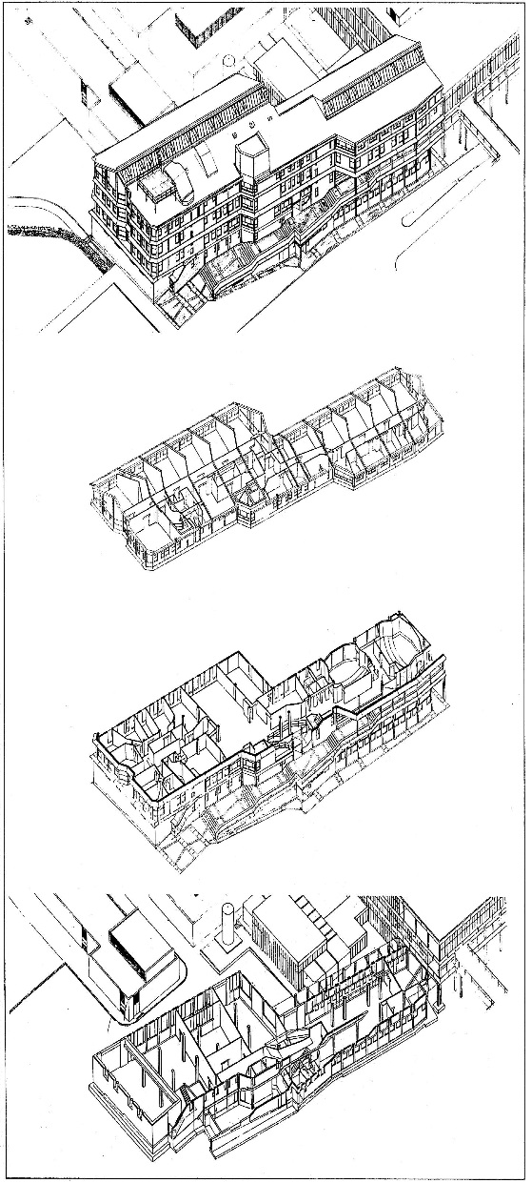
Conglomerate Ordering
“A building built in the conglomerate order: has a spatial presence, more impressive than that of the simple object; something that is in no way reducible to a geometric scheme, which cannot be communicated in a two-dimensional image.
It has the ability to absorb spontaneous additions, technical changes, without these things disturbing the sense of order; on the contrary, they intensify it. It can be adapted to a use other than that described in the "agreement of use" of the built complex of which it was a part.”
Peter Smithson, “Canons de l’ordre conglomérat”, in L’architecture d’aujourd’hui, octobre 1989, 140 “
Smithsons’ buildings for University of Bath II, 1988

Slide 10
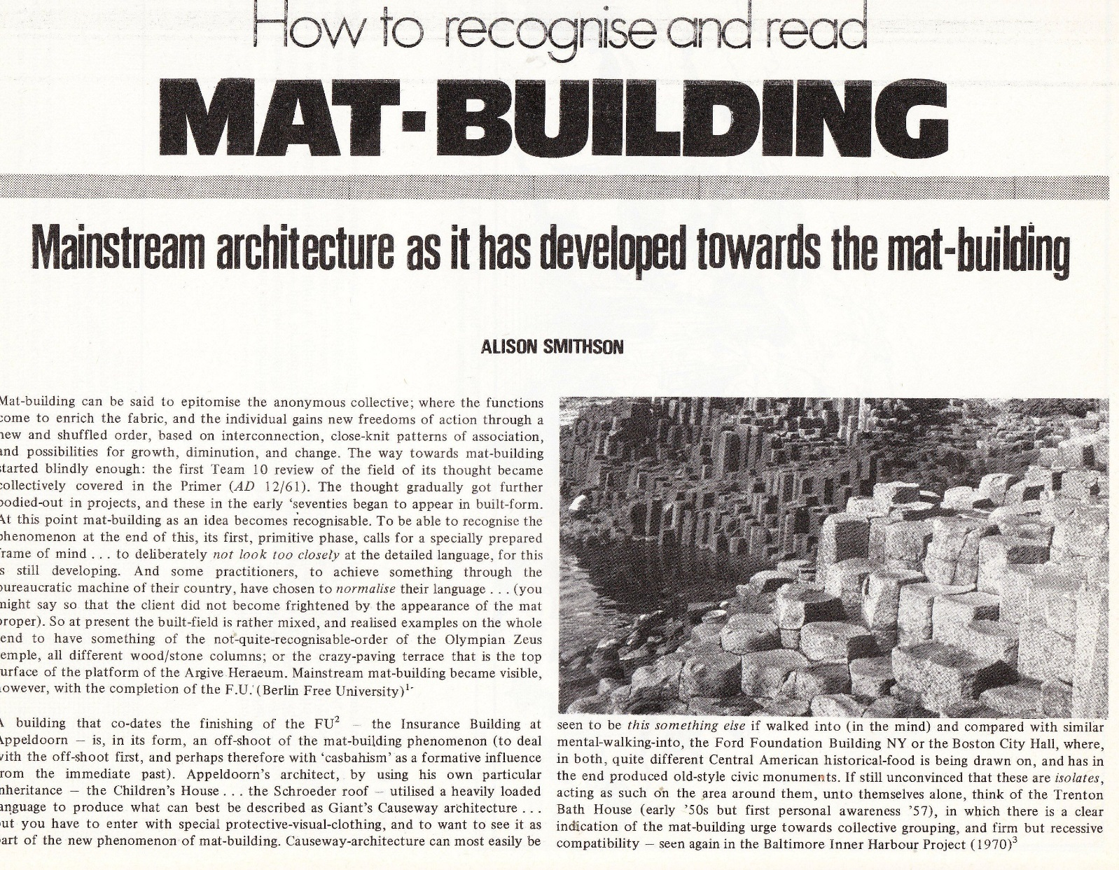
Mat Building
" Mat-building can be said to epitomize the anonymous collective ; where the functions come to enrich the fabric, and the individual gain new freedom of action through a new and shuffled order, based on interconnection, close-knit patterns of association, and possibilities for growth, diminution and change”
Alison Smithson, « How to recognise and read Mat-Building. Mainstream architecture as it has developed towars the mat-building”, Architectural Design, no.9, 574
Première page de l’article paru dans Architectural Design, no.9, 574

