Slide 1


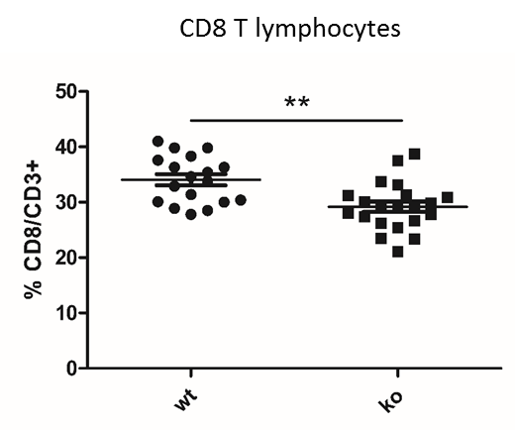
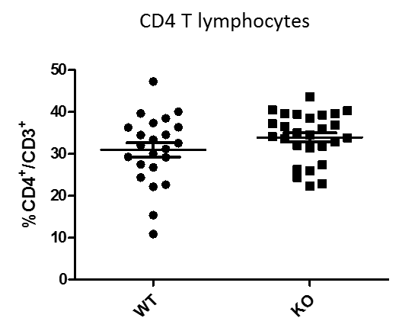
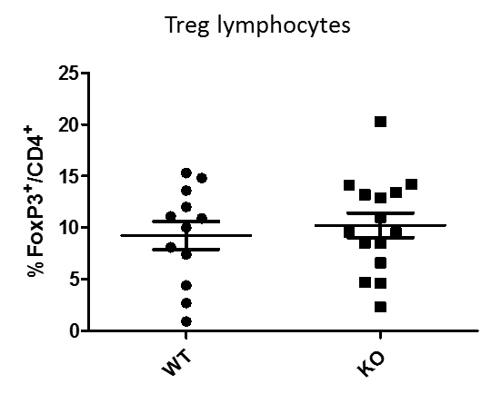
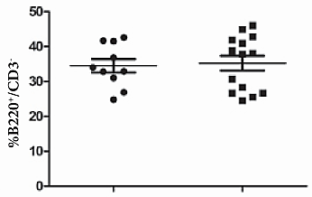
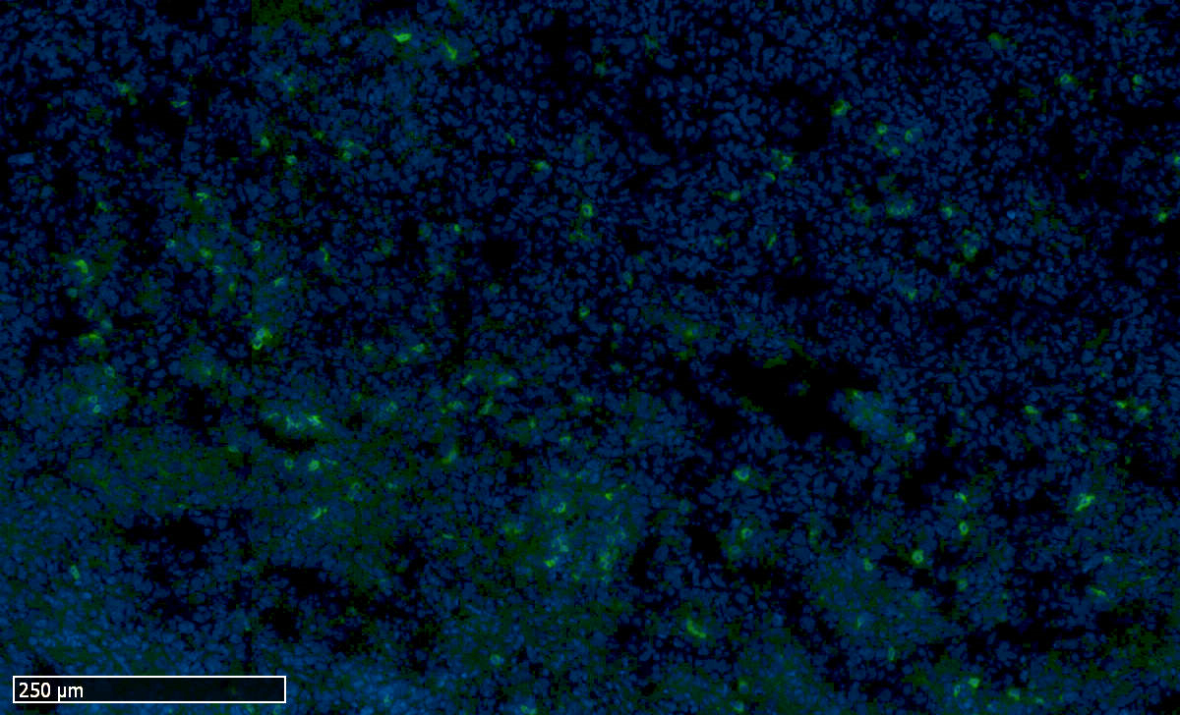
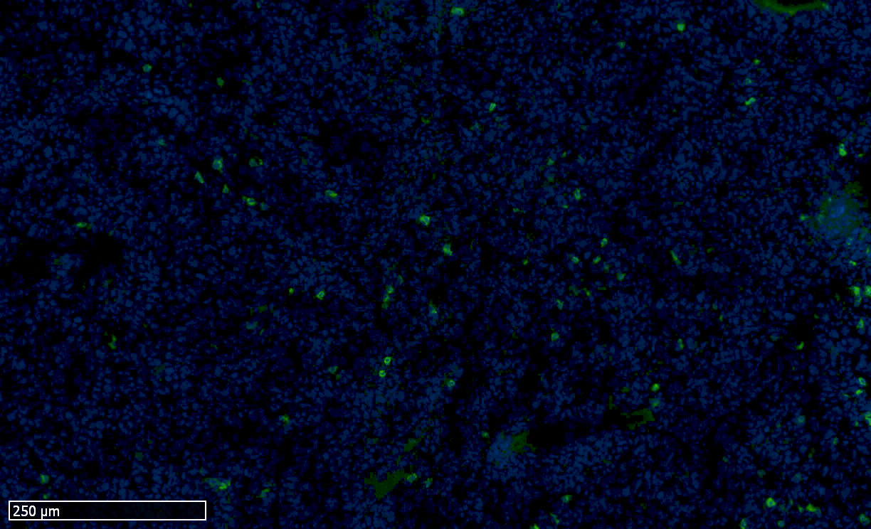
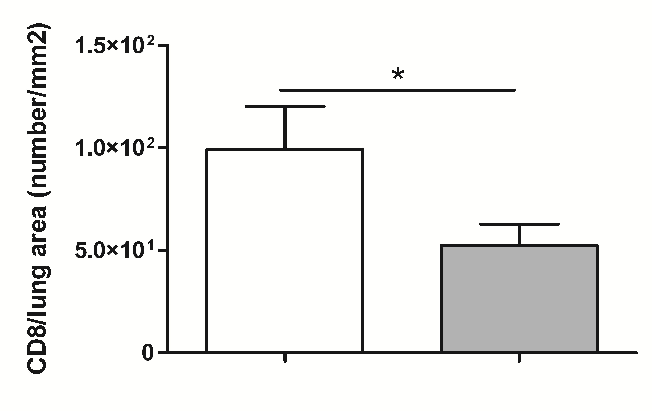
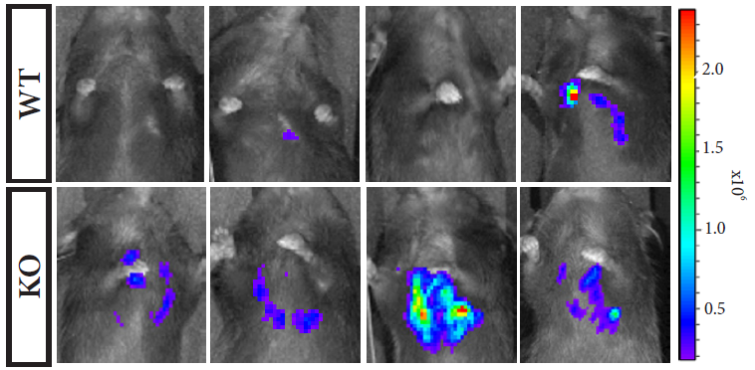
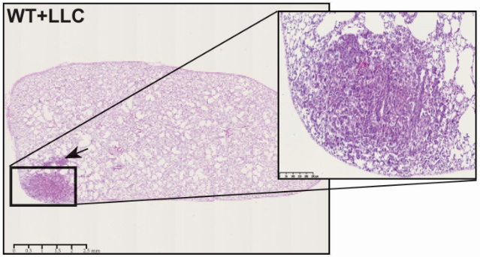
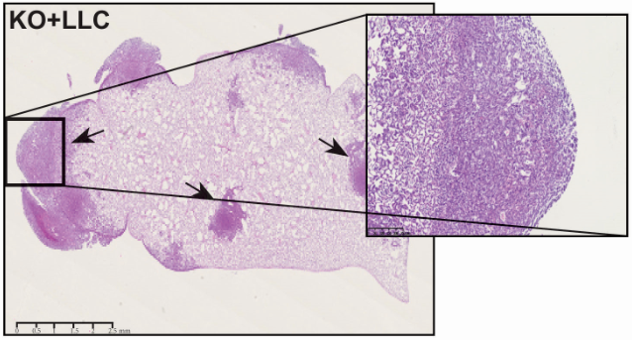
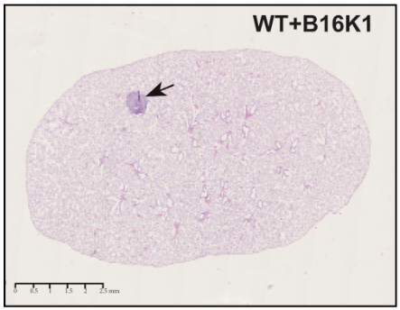
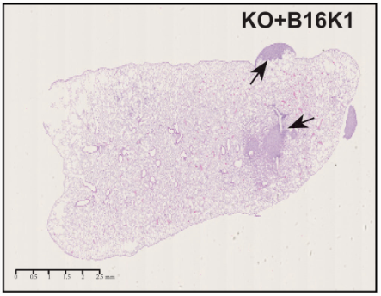
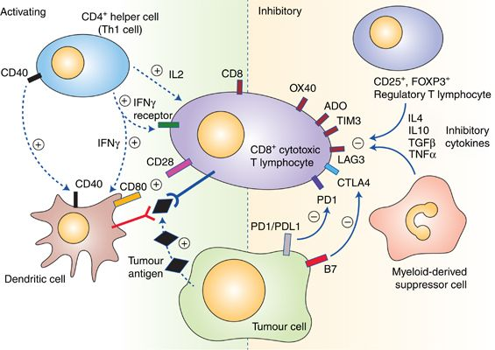
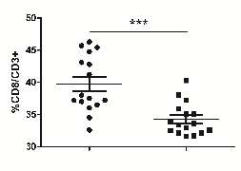
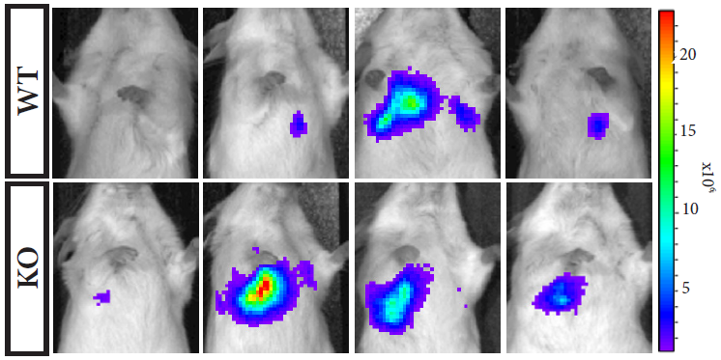
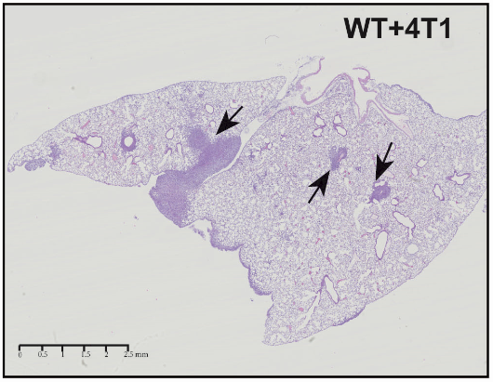
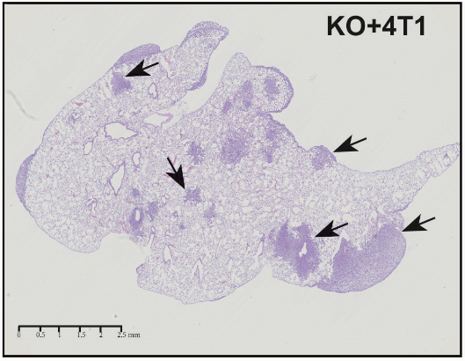
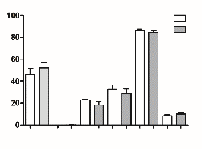
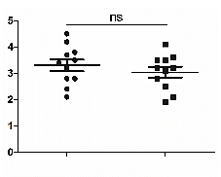





Microenvironment-derived ADAM28 impacts the onset of lung cancer
Hubeau C¹, Gerard C¹, Carnet O¹ , Moser M² , Fässler R², Noel A¹, Rocks N¹ , Cataldo D¹
¹GIGA-Research, GIGA-Cancer, Laboratory of Tumor and Development Biology, University of Liège, Belgium
²Max Planck Institute of Biochemistry, Department of Molecular Medicine, Martinsried, Germany
Background
ADAM28 deficiency reduces CD8⁺ T cell mobilization to lungs in tumor-bearing mice
Functional features of ADAM28-deficient CD8⁺ T cells are not impaired
,
A
B
C
ADAM28 is a multifunctional membrane-bound proteinase which is overexpressed in non-small cell lung carcinoma (NSCLC). In this cancer, ADAM28 expression by cancer cells is correlated with cell proliferation and metastatic dissemination suggesting the implication of ADAM28 in lung cancer development. Moreover, studies have shown that knockdown of ADAM28 decreased the formation of lung metastasis in different mouse models. Therefore, this protease may be a new potential target in the treatment of lung cancer. However, functions of ADAM28 in the tumor microenvironment are currently unknown.
With this project, we aim to determine effects of host-derived ADAM28 on lung tumor development.
LLC IV model
A
B
C
D
WT = 6
KO = 8
WT = 6
KO = 8
WT = 6
KO = 8
WT = 18
KO = 21
WT = 23
KO = 27
WT = 12
KO = 15
WT = 10
KO = 14
WT
KO
WT
KO
D
E
Methods
E
WT
CD8
DAPI
KO
CD8
DAPI
F
To characterize physiological and pathological effects of microenvironment-derived ADAM28 on lung metastasis formation, ADAM28^{-/-} mice were generated into two mouse strains (C57BL/6 and BALB/c). Lung metastatic dissemination was assessed in both ADAM28 knock-out (KO) and wild-type (WT) mice after intravenous injection of Lewis Lung Carcinoma cells, B16K1 melanoma cells or 4T1 breast carcinoma cells. As ADAM28 promotes leukocyte transendothelial migration, lymphocyte subtypes implicated in tumor cytotoxicity or in regulation of immune response were studied by flow cytometry to explain the tumoral phenotype.
WT = 6
KO = 6
WT = 4
KO = 4
250 µm
250 µm
WT
KO
WT = 11
KO = 15
Figure 4 : A-C. Evaluation of GrzB (A), CXCR3 (B) and IFN-γ (C) expression on CD8⁺ T cells by flow cytometry in total lung extracts of WT and ADAM28 KO mice after intravenous LLC cell injection (Day 21) (**p < 0.01). D. Proliferation assay was performed on WT and ADAM28 KO CD8⁺ T cells stimulated by conditioned medium (CM) from tumor cells (LLC, 4T1, B16K1) or by CM from CD8⁺ T cells. E. Migration assay was performed on CD8⁺ T cells isolated from WT and ADAM28 KO mice. Chemoattractants used in the lower chamber of the Boyden Chamber were either CXCL10, CM from tumor cells (LLC, 4T1, B16K1) or CM from CD8⁺ T cells previously isolated from WT or ADAM28-deficient mice. All results were normalized to the migration of WT CD8⁺ T cells (without CXCL10 stimulation) considered as baseline migration and expressed as fold increase from baseline.
Results
G
B16K1 IV model
H
4T1 IV model
ADAM28 depletion in the microenvironment promotes dissemination of tumor cells to lungs
Conclusion & perspectives
A
B
LLC IV model
C
WT = 10
KO = 11
WT = 11
KO = 11
Our results demonstrate for the first time a protective role of microenvironment-derived ADAM28 whereas tumor cell-derived ADAM28 promotes tumor development and metastatic dissemination. Moreover, we showed that ADAM28 deficiency decreases the infiltration of CD8⁺ T cells within lungs of tumor-bearing mice which affects the cytotoxic immune response. In addition, we observed that ADAM28 deficiency reduced the splenic CD8⁺ T cell population in tumor-free mice but does not impaired T cell maturation suggesting that ADAM28 is not essential for the process. Therefore, we hypothesize that ADAM28 exerts its protective effect through an indirect mechanism involving the immune response. To determine the link between microenvironment-derived ADAM28 and cytotoxic T cell response, we will investigate other immune cells which could either activate or inhibit CD8⁺ T lymphocytes.
Tumor Density
WT
KO
Figure 2. : A-D. CD8⁺ (A), CD4⁺ (B), Treg (C) and B (D) lymphocyte populations in lung tissues of tumor-bearing WT and ADAM28 KO mice 21 days following LLC cell injection (**p <0.01). E. Representative photographs of stained CD8⁺ T cells infiltrated within lungs bearing equally-sized tumors from WT and ADAM28 KO mice. F. Quantification of CD8 staining reported to total lung area of WT and ADAM28 KO mice (*p <0.05). G. Percentages of CD8⁺ T cells were evaluated by flow cytometry in lungs from WT and ADAM28 KO mice 35 days after B16K1 cell injection (**p < 0.01). H. Evaluation of CD8⁺ T cell percentages within lungs from WT and ADAM28 KO mice 14 days following 4T1 cell injection (***p < 0.001). .
WT
KO
WT = 25
KO = 20
ADAM28 deficiency affects CD8⁺ T cell mobilization to splenic tissues in tumor-free mice
but does not impair T cell maturation
D
B16K1 IV model
Tumor Density
E
C57BL/6
BALB/c
A
B
WT
KO
WT = 20
KO = 19
F
G
4T1 IV model
H
WT
KO
WT = 16
KO = 16
WT = 6
KO = 5
Tumor Density
C57BL/6
Barnes et Amir, 2017 (British Journal of Cancer)
C
WT
D
In the tumor microenvironment, various immune cells can influence CD8⁺ T cell-mediated immune response resulting in activation or inhibition of cytotoxic lymphocytes.
WT = 11
KO = 11
KO
Funding
For more details
WT
KO
% cells
%CD8⁺/CD4⁻ B220⁻
Gerard et al. 2018 « Microenvironment-derived ADAM28 prevents cancer dissemination »
Oncotarget, 2018, Vol. 9, (No. 98), pp: 37185-37199
DN1
DN2
DN3
DN4
DP
CD4⁺
WT = 5
KO = 5
WT
KO
WT = 11
KO = 11
Figure 1. A. Biophotonic monitoring (photon mode) of lungs in WT and ADAM28 KO mice at day 21 following intravenous injection of luciferase-transfected LLC cells. B. Tumor density quantification in lungs from WT and ADAM28 KO mice at day 21 after LLC cell injection (*p< 0.05). C. Representative images of hematoxylin and eosin-stained lungs from WT and ADAM28 KO mice bearing LLC tumors (black arrows). D. Tumour area quantification in lungs from WT and ADAM28 KO at day 28 following intravenous injection of B16K1 cells (**p< 0.01). E. Hematoxylin and eosin-stained lung sections from WT and ADAM28 KO mice bearing B16K1 tumors (black arrows). F. Biophotonic imaging (photon mode) of luciferase activity related to 4T1 tumor cells in lungs of WT and ADAM28 KO mice at day 14 following intravenous injection of 4T1 cells. G. Quantification of tumor density in lungs from WT and ADAM28 KO mice at day 14 after 4T1 cell injection H. Representative images of hematoxylin and eosin-stained lungs from WT and ADAM28 KO mice bearing 4T1 tumors (black arrows).
Figure 3. A. CD8⁺ T cell population was assessed by flow cytometry in the spleen of tumor-free C57BL/6 WT and ADAM28 KO mice (***p < 0.001). B. Evaluation of CD8⁺ T cell percentages in the spleen of tumor-free BALB/c WT and ADAM28 KO mice (**p <0.01). C. Percentages of thymocyte subsets were determined by flow cytometry at different stages of T cell maturation (DN1, DN2, DN3, DN4, DP and CD4⁺ T cells) in the thymus of tumor-free WT and ADAM28 KO mice. D. Single-positive CD8⁺ T cell population (CD8⁺/CD4⁻ B220⁻) was evaluated by flow cytometry in the thymus of tumor-free WT and ADAM28 KO mice (p>0.05).
Contact: celine.hubeau@uliege.be

