Slide 1
MOOCs
Spreading knowledge, creating communities, branding universities?
Björn-Olav Dozo, University of Liège
Notes:
I would like to introduce you to MOOCs. Those who know the concept will not learn a lot, but I hope that they find some questions that I am going to ask interesting. What is a MOOC ? A MOOC is a massive online open cursus : a lot of people follow a cursus online, with internet. In this talk, I would like to present you what are MOOCs, how they can help to build communities about a specific topic, and why it could be useful to the reputation of a university.

Slide 2
Spreading knowledge
Notes:
So the first thing to assume is that the foundation of a MOOC is to spread knowledge. This knowledge is built by teachers, but also by the community who follows the MOOC and who participates to the debates in the forum.

Slide 3
What is a MOOC ?
a course of study made available over the Internet without charge to a very large number of people
"anyone who decides to take a MOOC simply logs on to the website and signs up"
Notes:
A MOOC is adressed to everybody. All you need is an internet connexion and modern computer. So it is an incredible way to learn things, without moving from your house. As a course, it is structured by teachers in different lessons, like in a classroom. It lasts often several weeks, so you can follow the course at your own rythm.

Slide 4
Subscribe to a MOOC…
Notes:
To subscribe to a MOOC, the best way is to find a provider. MOOCs are available on different platforms; you just have to log in and choose which course you want to follow in the catalogue. Some courses are always open, other are available only for some weeks, to encourage interactions between participants.

Slide 5
… in different languages
Notes:
The main language is english, but there are a lot of platforms in different languages, as Fun MOOC (France Université Numérique, which means France Digital University) which is in French. At the University of Liège, FUN is the platform that we choose to publicize our MOOCs.

Slide 6
Platforms
Notes:
Here is a brief selection of different international platforms. edX is probably the most recognized platform, because it was the first one to communicate massively about MOOCs. It is also a platform which gives access to a software to build our own platform, a content management system called Open edX, which is used by FUN MOOC.

Slide 7
Example : edX
Notes:
Just to show the importance of this kind of platform : edX is twenty millions of learners from every country in the world, two thousands and six hundreds courses, seventy-two millions of enrollments in courses since the start of the platform.

Slide 8
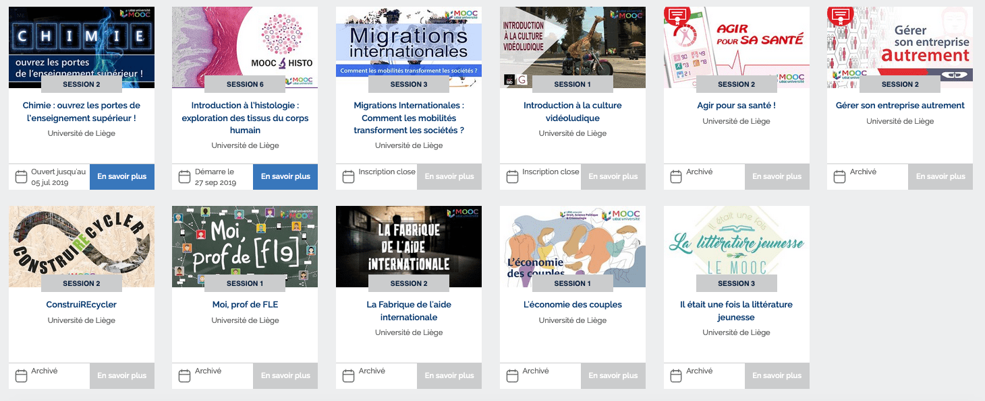
Example : ULiège
Notes:
Here is the development of MOOCs at the university of Liège : we have produced 20 MOOCs since 2017, for a total by now of one hundred and twenty thousands (120000) students enrolled. Eleven MOOCs are already available, nine are coming. Some have more than one session (children literature and histology for example).

Slide 9
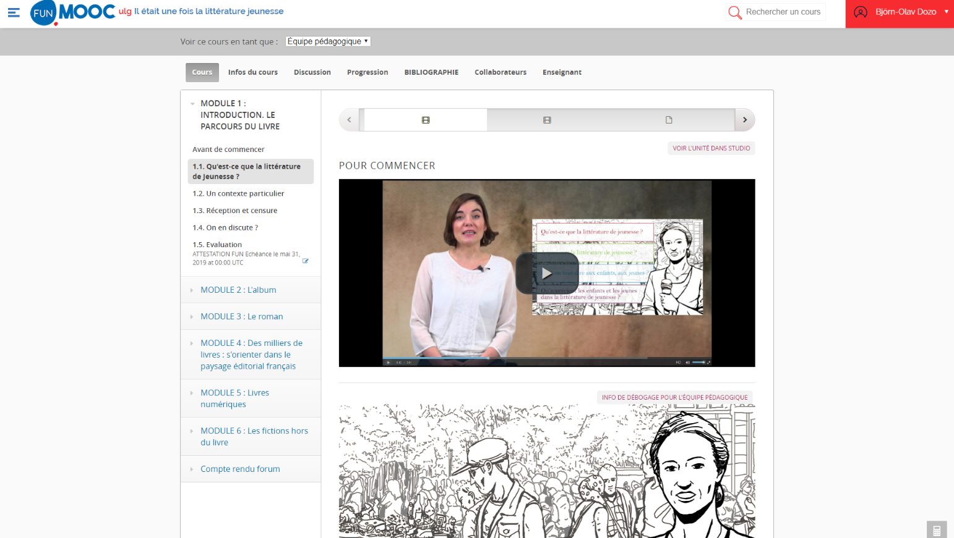
How does it work ?
Videos
Texts
Quiz modules
Forums
Peer graded tests
Notes:
MOOCs are composed of different things: videos, texts, quizzes, forums, peer-reviewed tests, and of course a lot of interactions. Interactions between teachers and students, but also between students themselves, thanks to the forums. In some of our MOOCs, we add a broadcast radio show, with questions from the students in live, to interact in live between teachers and students.

Slide 10
Building communities
Notes:
So the main point for me about MOOCs, maybe even more than spreading knowledge, is the possibility to build communities. One of the key of success for a MOOC could be the capacity to federate a large group of people, even after the end of the session. The goal is to root the interest for the subject of the MOOC, to prepare other actions for the future, like summer schools in face-to-face.

Slide 11
Communities around the MOOC
Forums
Peer graded tests
Social networks, in particular Facebook
Notes:
There are three main ways to create communities and interactions between students as peers : forums, peer graded tests and social networks. Each of them develop a particular way to engage students into the MOOC.

Slide 12
Forums
Notes:
Forums are structured by topics, and the teachers’ team can manage the different topics to group and organize the discussions. You can connect topics to video, and so on. The great thing about forums is that you can give feedback to the students. It is a key point to develop your community : without feedback, the community will not participate and the number of active students for the quiz and exercices will decrease. The communication is in both ways : it is also the place where students can give you feedbacks about the MOOC.

Slide 13
Peer graded tests
Rémy Bachelet, « Does peer grading work? How to implement and improve it? ». European MOOCs Stakeholders Summit 2015, May 2015, Research Track, https://goo.gl/3QCXDG
Notes:
The peer graded tests are linked to the massification of the teaching. When the tearchers ask the students to produce a text, like a composition or a redaction, it is impossible to correct and grade every text. For example, in the first session of the MOOC about children literature, there were thirteen thousands students… Even if 10% participate until the composition test, it was impossible to grade everybody. So we choose to use peer evaluation. It is an automatic system that gives the works to grade to the students, so it is very light for the teacher. And it is valuable : with three or four peer grades, it is as good as if the teacher grades it himself.

Slide 14
Facebook
Notes:
Facebook (and other social networks) are great tools to federate communities. It is very useful for the communication part of the MOOC : you can send news of the MOOC directly in the Facebook feed of the students. Facebook is part of their lifes, so they are more implicated with Facebook than if they have to go on a specific platform to hear about the MOOC. With Facebook, they don’t look for news, they don’t search for them, they receive them directly. It is a very complementary tool for MOOC managers.

Slide 15
Branding universities
Notes:
In the last part of this speech, I would like to talk about the return of MOOCs for the universities. Because the returns for the students are obvious, and for the teachers, it is a very meaningful experiment. But it is not only that : for universities, there are a lot of stakes in terms of brand and image.

Slide 16
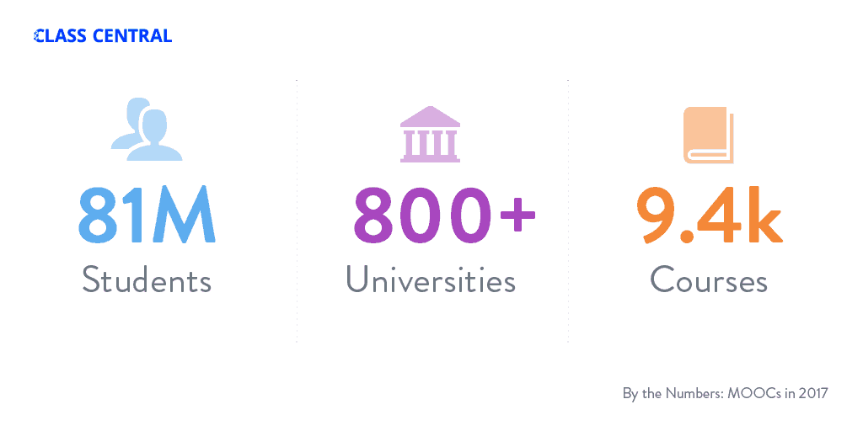
MOOCs by numbers
2016
2017
2018
Source : ClassCentral
Notes:
Just to show some numbers : the students who follow MOOCs are now more than one hundred millions, there are about nine hundreds universities that produce MOOCs, for about eleven thousands courses. It is a very big and competitive market.

Slide 17
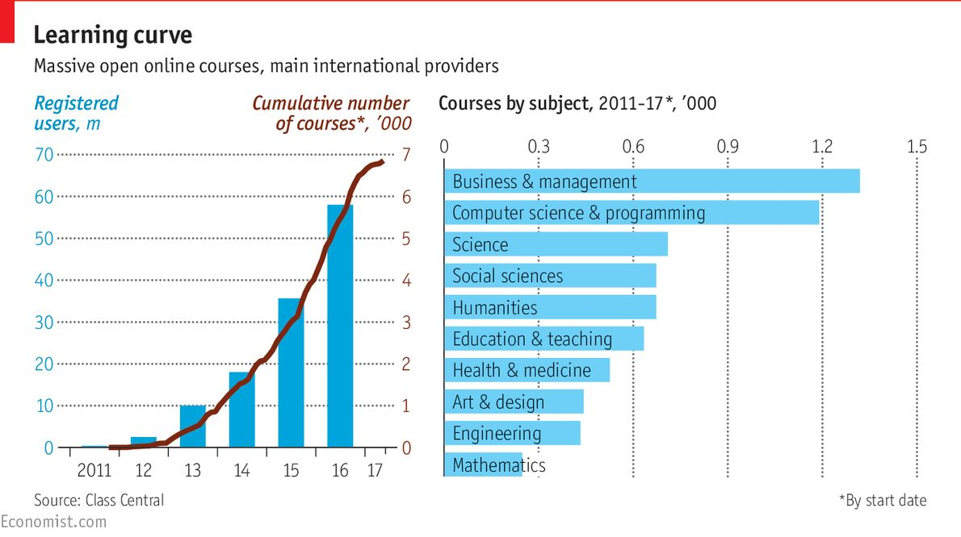
Numbers of courses
Notes:
The growth of the number of courses is impressive, and more and more universities are developping MOOCs, with a preference in the subjects for MOOCs in business and management and in computer sciences. So there is a competition between MOOCs about general subjects : it already exists a lot of MOOCs which are introduction to a field. So the future is much more specialized MOOCs.

Slide 18
Micro-masters
Notes:
A recent trend is the launch of micro-masters : a micro-master is a group of MOOCs which are coordinated together to give a complete formation about a topic. You can get credits with them, but you often have to pay to follow them. There are a lot of questions with micro-masters : how to articulate them with courses in face-to-face? How to evaluate them ? And so on.

Slide 19
Potential MOOC Market
https://www.marketsandmarkets.com/Market-Reports/massive-open-online-course-market-237288995.html
Notes:
What motivates the development of these solutions is the potential market of the MOOCs. For some universities, it is a way to extend their field of influence and to grab market shares far from their geographical situation.
APAC : Asie-Pacifique
MEA : Middle-East and Africa

Slide 20
Who benefits of MOOCs branding?
“Hollands and Tirthali (2014) in their survey on institutional expectations for MOOCs, found that building and maintaining brand was the second most important reason for institutions launching MOOCs (the most important was extending reach, which can also be seen as partly a branding exercise).
Institutional branding through the use of MOOCs has been helped by elite Ivy League universities such as Stanford, MIT and Harvard leading the charge, and by Coursera limiting access to its platform to only ‘top tier’ universities.
[…] by and large, most MOOCs succeed in the sense of bringing an institution’s reputation in terms of knowledge and expertise to many more people than it would in any other form of teaching.”
Tony Bates, “Strengths and weaknesses of MOOCs: Part 3, branding and cost”, 15 November 2014,
https://www.tonybates.ca/2014/11/15/strengths-and-weaknesses-of-moocs-part-3-branding-and-cost/
Notes:
Tony Bates explains what motivates institutions. I quote : “Hollands and Tirthali (2014) in their survey on institutional expectations for MOOCs, found that building and maintaining brand was the second most important reason for institutions launching MOOCs (the most important was extending reach, which can also be seen as partly a branding exercise).
Institutional branding through the use of MOOCs has been helped by elite Ivy League universities such as Stanford, MIT and Harvard leading the charge, and by Coursera limiting access to its platform to only ‘top tier’ universities.
[…] by and large, most MOOCs succeed in the sense of bringing an institution’s reputation in terms of knowledge and expertise to many more people than it would in any other form of teaching.”

Slide 21
Future of MOOC ? Digital Learning
“Already, the term “MOOC” seems a bit quaint. Most MOOCs are no longer massive or open. None of what we call MOOC platforms refer to themselves in those terms. Only the regional platforms (e.g. ThaiMOOC, FUN MOOC) do that. Is it time to move on from MOOCs in favor of the next thing?” (Laurie Pickard, « 4 Takeaways from EMOOCs 2019 », https://www.classcentral.com/report/4-takeaways-from-emoocs-2019/)
At ULiège : blended learning, for students in classrooms and behind their computers
Notes:
But for some commentators, MOOCs have already mutated in something else. They are a transitionnal moment for universities to go digital in their teachings. And it is partly true : some MOOCs are not massive (the topic is too specific) and some are not open (you have to pay to follow them). At the university of Liège, we develop blended learning, with students in classrooms and behind their computers. I think that it is in fact a normal evolution…

