Slide 1
Recovery of Phosphorus from Sewage Sludge and Subsequent Purification Using Reactive Extraction
Shariff Z.A., Fraikin L., Léonard A., Pfennig A. za.shariff@uliege.be Products, Environment, and Processes (PEPs) Department of Chemical Engineering Université de Liège https://www.chemeng.uliege.be

Slide 2
agenda
introduction
PULSE process concept
process development
SLE modelling
cascaded option tree
experimental results
summary

Slide 3
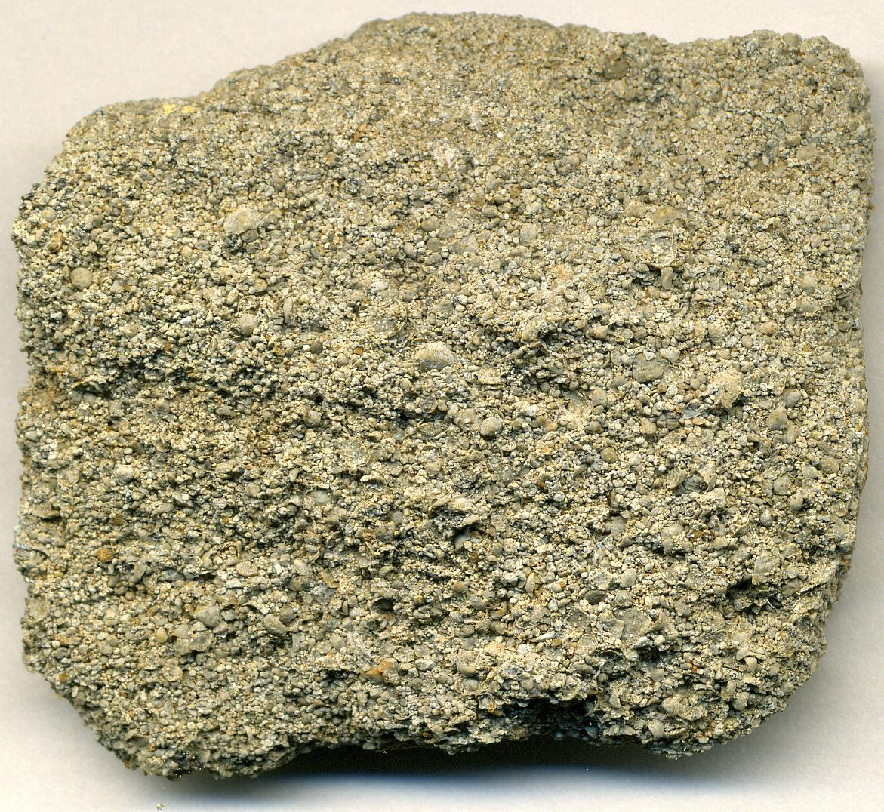
introduction
essential element for all forms of life
finite resource
EU imports more than 90% of P
sewage has potential to cover more than 20% of P demand in North-West Europe
rock phosphate

Slide 4
PULSE (Phosphorus University of Liege Sludge Extraction) process
acid
dewatered
sludge
drying
leaching
separation
organic
solvent
base/Ca
solid
waste
waste water
reactive extraction
precipitation
P + impurities
CaP/
re-extraction
metals
re-extraction agent/NH₃

Slide 5
modelling: SLE & speciation

Slide 6
modelling tool: non-linear data fitting

Slide 7
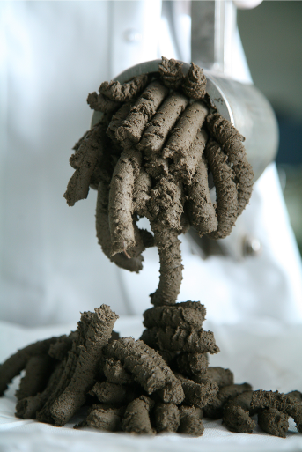
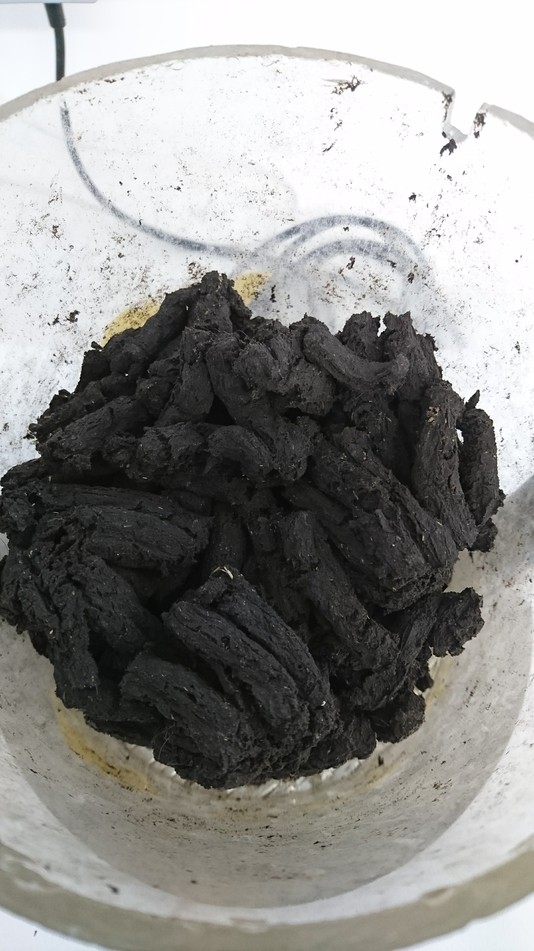
cascaded option tree: drying
extraction compatibility
filtrability
P leaching
operation cost
transport/handling/storage
dewatered sludge
P-recovery from sludge
- | dewatered sludge | 0 | 0 | 0 | -
+ | convective air drying | + | 0 | 0 | 0 | 0
 | slow drying (no air) | + |  | 0 | 0 | 0
dried sludge
drying conditions
- | not feasible
+ | good
0 | acceptable
 | not evaluated
Bednarz, A. et al. 2014

Slide 8
P leaching with different acids and pH

Slide 9
sludge leach liquor

Slide 10
reactive extraction with HCl conc. 1mol/L

Slide 11
reactive extraction of Fe with A336 + TBP
Alamine 336:
$$Fe{Cl}_{4}^{−}\text{+ }\overline{R_{3}NH^{+}{Cl}^{−}}\text{= }\overline{Fe{Cl}_{4}R_{3}NH}\text{+} {Cl}^{−}$$
TBP:
$$Fe{Cl}_{4}^{−}\text{+ }\overline{TBP}\text{= }\overline{Fe{Cl}_{4}TBP}$$

Slide 12
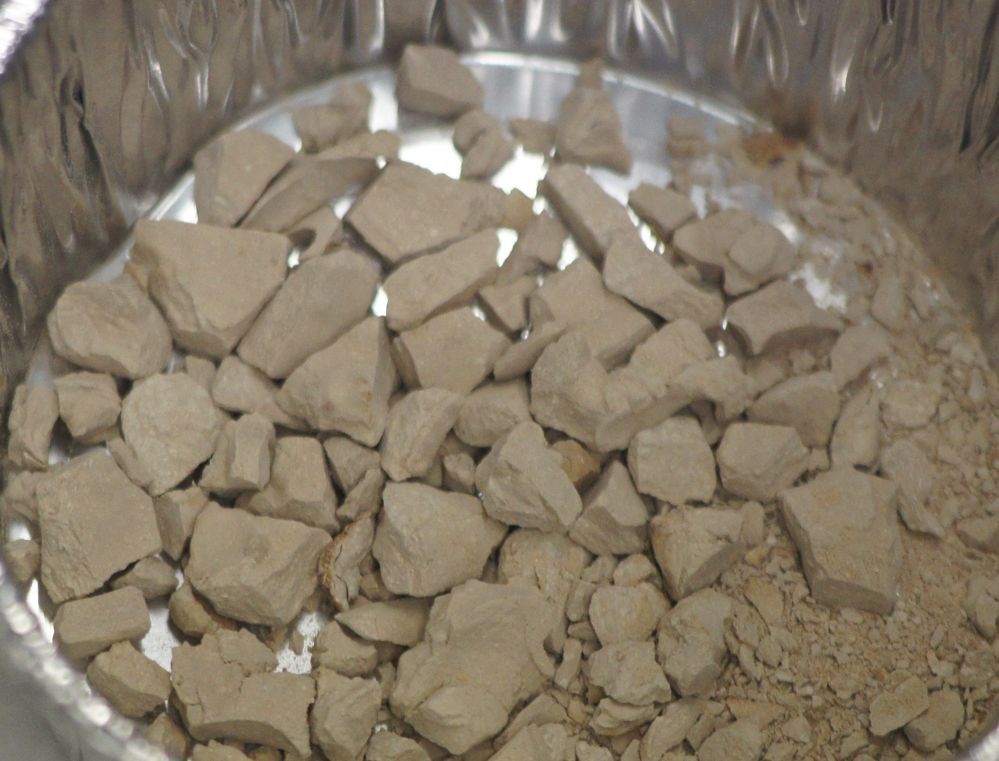
PULSE product
Component | Concentration
P₂O₅ | 29.2%
CaO | 21.7 %
Total C | 6 %
Al₂O₃ | 2.61 %
MgO | 1.84 %
Fe | 0.325 %
Mn | 10800ppm
Cr | 1530 ppm
Cu | 294 ppm
Ni | 51.6 ppm
Pb | 38,8 ppm
Zn | 8.97 ppm
Cd | 0.735ppm
Hg | 0.054 ppm
leaching of dried sludge
filtration
metal removal by reactive extraction
CaP precipitation with NaOH
(pH = 6 - 7)

Slide 13
summary
no significant difference between P leaching from wet or dry sludge
P leaching depends only on pH and not on the type of acid
extraction of metals at low pH only achieved with Alamine 336
metals concentration in product is within the limits set by the EU fertilizer regulations except in case of Cr

Slide 14
Acknowledegements
financing
Interreg North-West Europe
SPW-Wallonia
analytics
Bogdan A. , Michels A., Meers E., Durand B. - Faculty of Bioscience Engineering, Ghent University, Belgium
Kroonen D. & Baukens I. – Prayon S.A., Belgium

Slide 15
Recovery of Phosphorus from Sewage Sludge and Subsequent Purification Using Reactive Extraction
Shariff Z.A., Fraikin L., Léonard A., Pfennig A. za.shariff@uliege.be Products, Environment, and Processes (PEPs) Department of Chemical Engineering Université de Liège https://www.chemeng.uliege.be

Slide 16
References
http://www.nweurope.eu/projects/project-search/phos4you-phosphorus-recovery-from-waste-water-for-your-life/
Doetsch, P., Pinnekamp, Johannes, Montag, D., Rath, W., Grömping, M., 2010. Rückgewinnung von Pflanzennährstoffen, insbesondere Phosphor aus der Asche von Klärschlamm (Abschlussbericht PASCH). Institut für Siedlungswasserwirtschaft der RWTH Aachen, Aachen.
Bednarz, A., Rüngeler, B., Pfennig, A., 2014. Use of Cascaded Option Trees in Chemical-Engineering Process Development. Chem. Ing. Tech. 86, 611-620.

