Slide 1
Liège Game Lab x Ritsumeikan Center for Game Studies – Kyoto – 8/6/2018
Notes:
Joke about the team spirit
A few words about our group of research

Slide 2
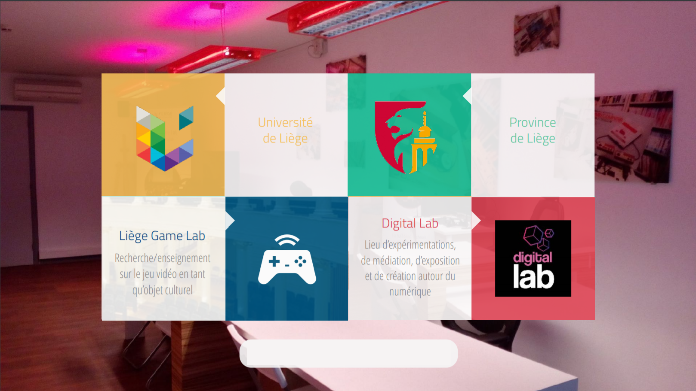
Research, teaching
Video games as cultural objects
Experimentations, mediation, expositions, creation
Twitter : @LiegeGamelab
Notes:
Two institutions
Province = administrative institution, one of the parts of Belgium
They give us a place and money to make research and cultural mediation

Slide 3
History of the lab
Master thesis of Fanny, Pierre-Yves and Julie on video games
Beginning of the PhD thesis of Bruno, Fanny, Pierre-Yves, Julie and Boris
Creation of the course « History and analysis of video games practices »
Publication of 2 collective works about book and video games relations
« Liège Game Lab » name (like Utrecht Game Lab) / website
Digital Lab foundation / MOOC / expertise out of the university

Slide 4
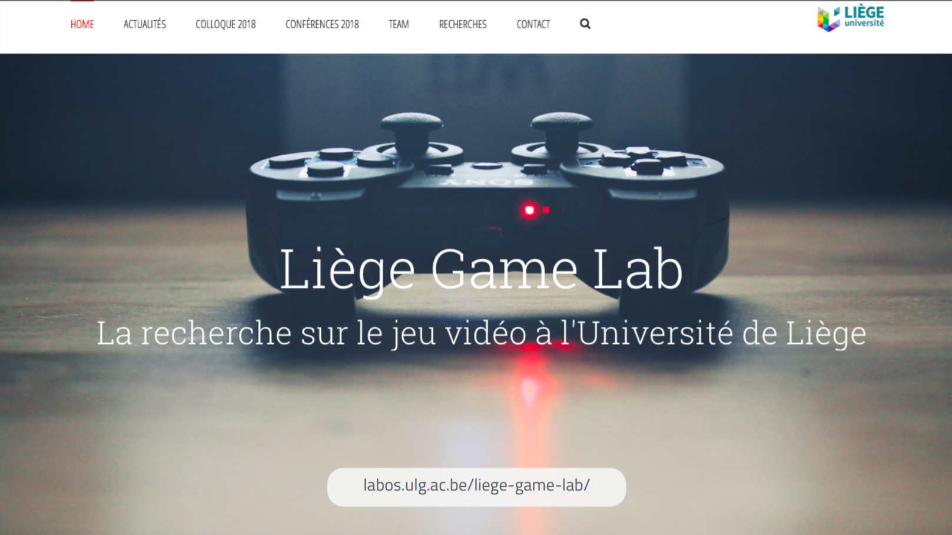
Notes:
Our website, where you can find our news, some presentations of our work and some videos to show the offices

Slide 5
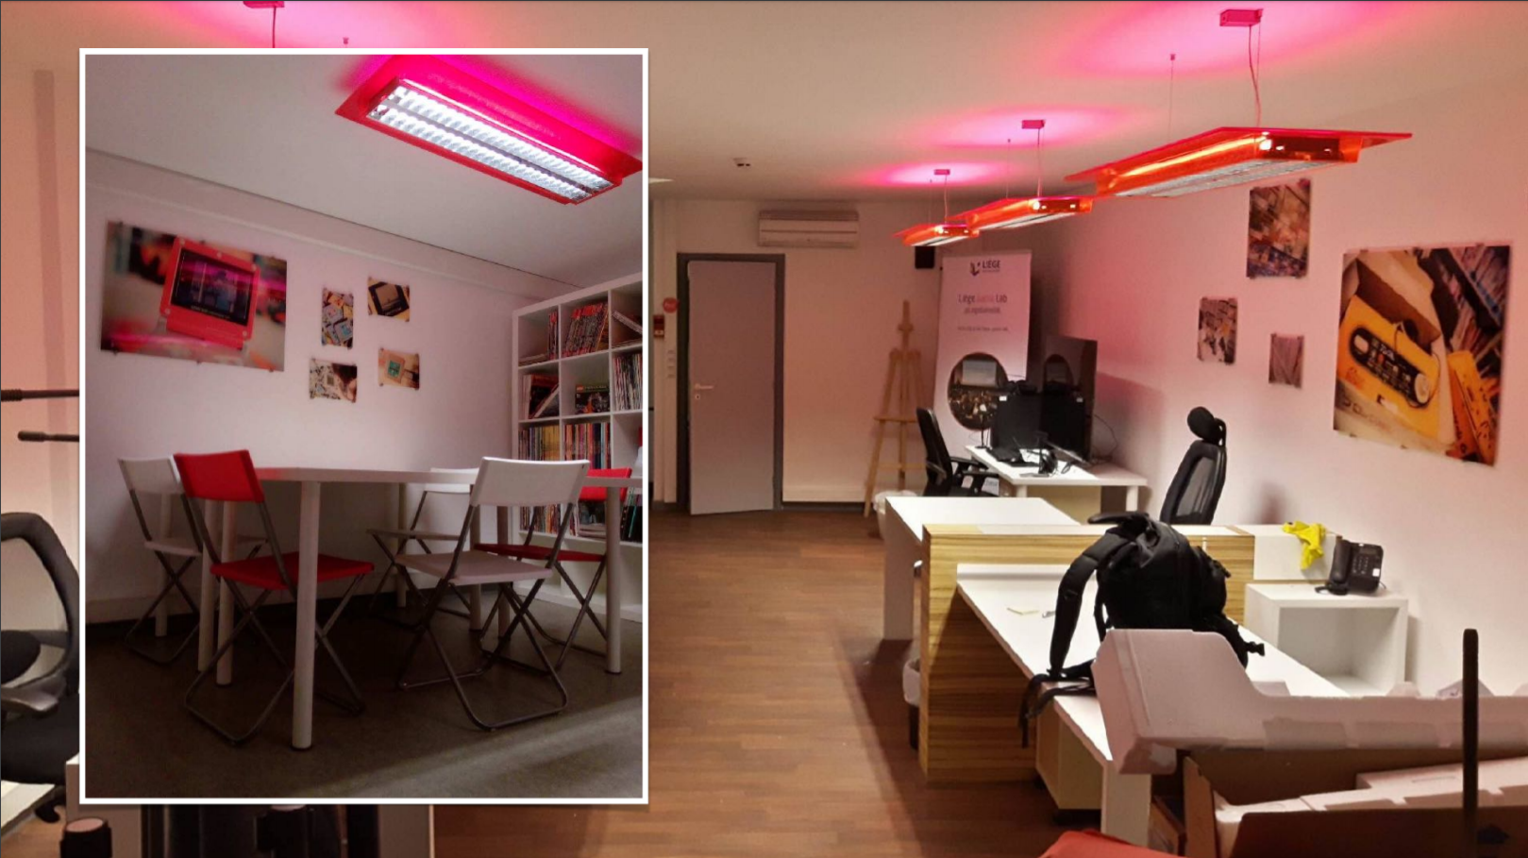
Notes:
The Digital Lab, which is a place of research work, a place of conservation of material (virtual reality, press archives) and a place of cultural mediation

Slide 6
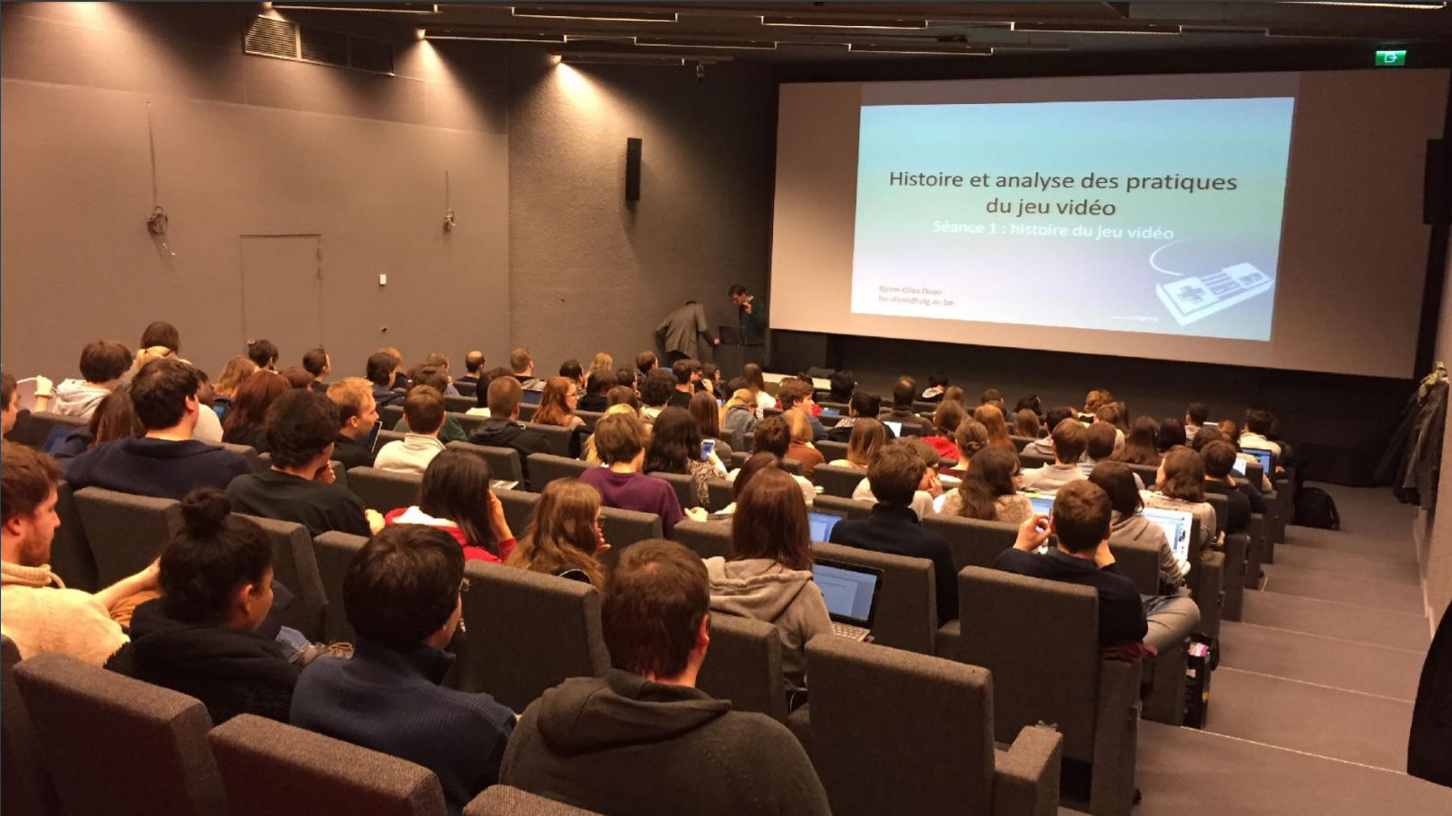
Notes:
The course, which is open to anyone who is interested in video games. It is a cycle of conferences, with speakers coming from different universities and presentation of our research

Slide 7
Laboratory’s members
Fanny Barnabé
PhD in literature / game studies
Narration in video games (Ma. dissertation)
“Détournement” of video games (fanfiction, machinima, modding, let’s play, speedrun, etc.) (PhD dissertation)
Paratext of videogames (Ritsumeikan university)

Slide 8
Laboratory’s members
Julie Delbouille
PhD candidate in communication / game studies
Avatar and player
Characters
Immersion
Secondary player

Slide 9
Laboratory’s members
Bruno Dupont
PhD candidate in German literature / game studies
Gamer novel
Intermediality
Gamification of the contemporary literature

Slide 10
Laboratory’s members
Björn-Olav Dozo
PhD in belgian french-speaking literature
Video games’ press
Virtual reality and augmented reality

Slide 11
Laboratory’s members
Pierre-Yves Hurel
PhD candidate in communication / game studies
« amateur » video games
Creation (Construct 2)
Cultural mediation

Slide 12
Laboratory’s members
Pierre-Yves Houlmont
PhD candidate in translation studies / game studies
Virtual reality
Video games’ texts
Localisation

Slide 13
Laboratory’s members
Boris Krywicki
PhD candidate in communication / game studies
Video games’ press
Investigation journalism

Slide 14
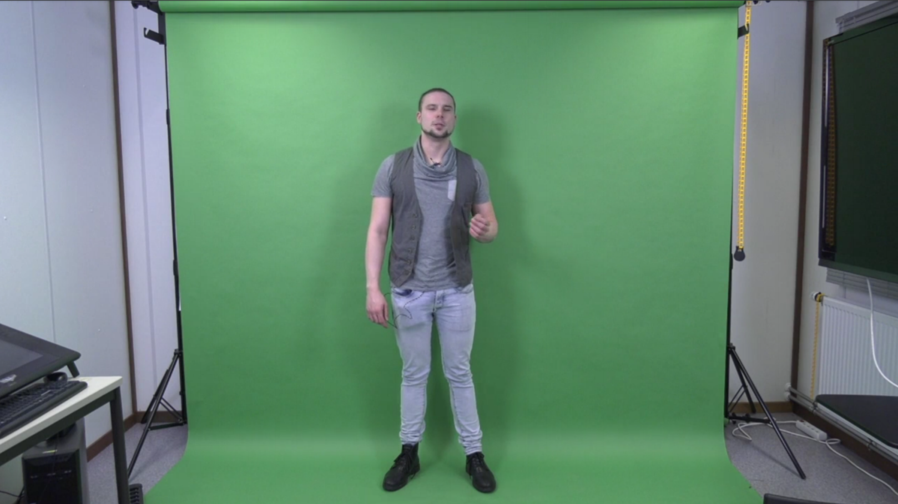
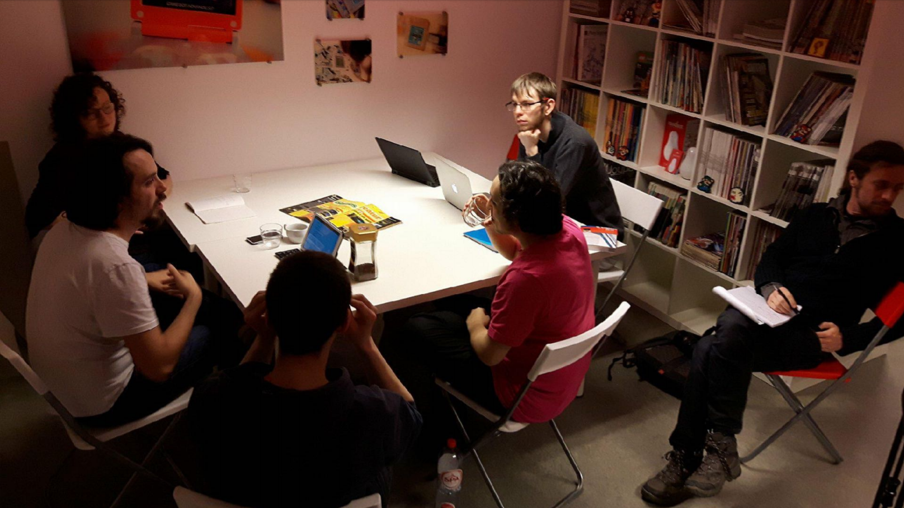
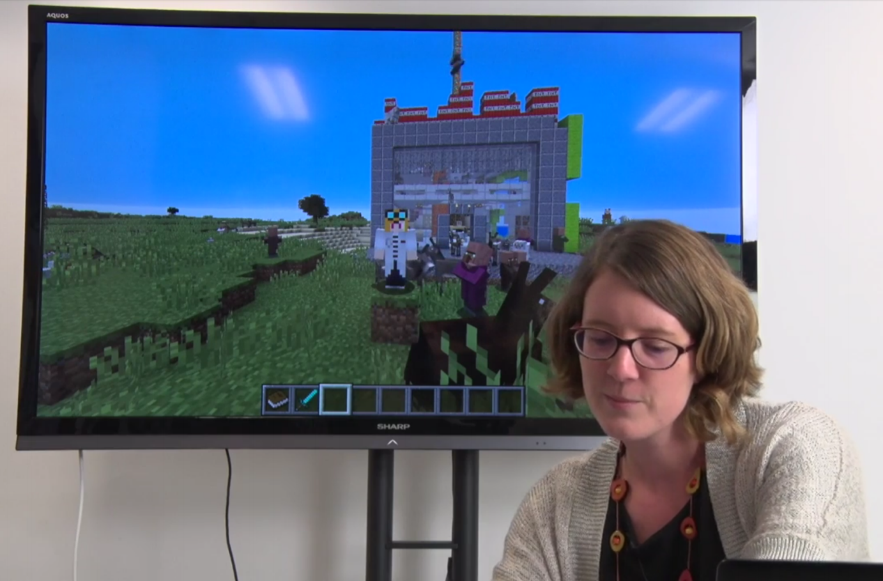
MOOC (Massive Online Open Cursus) :
september 2018
Notes:
Creation of a MOOC
Machinimooc, to present the research of Fanny about machinima in the MOOC
Interviews of game journalists who participate to the MOOC

Slide 15
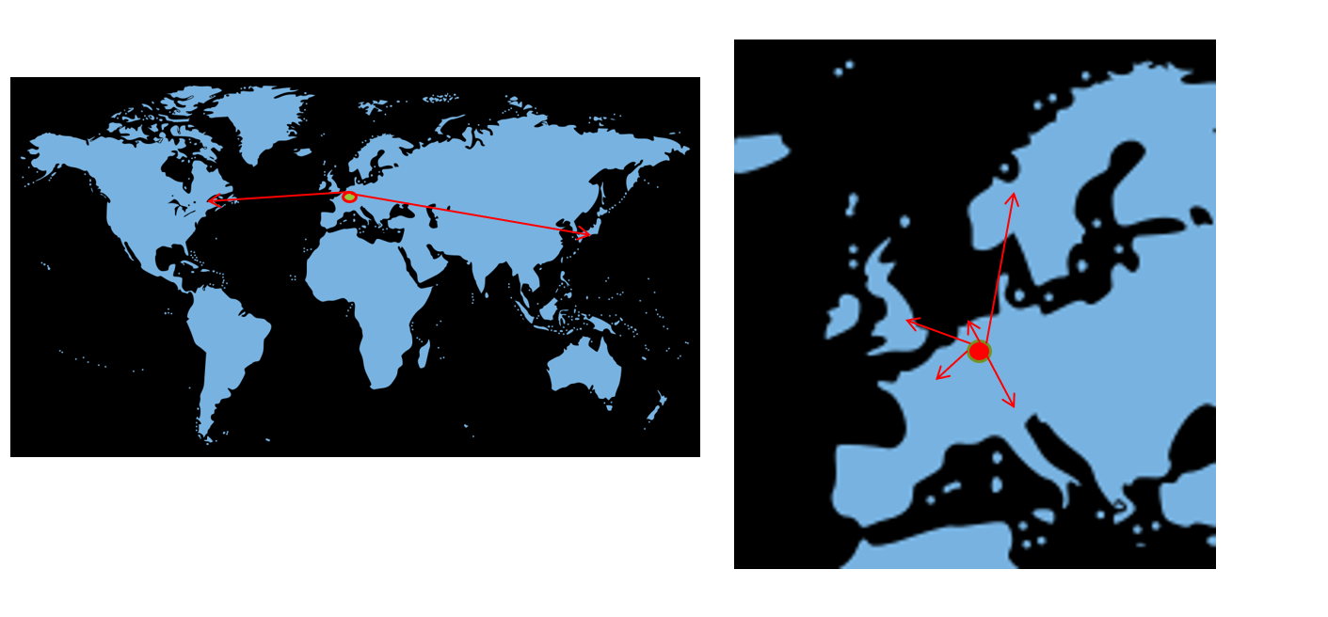
International network
Notes:
Utrecht in The Nederlands, Bergen in Norway, New Castle in England, Lausanne in Switzerland, Paris in France, Montreal in Canada, Kyoto in Japan

Slide 16
To know our work
Open Access Repository
http://orbi.uliege.be
Keywords : game studies / video games
Collection of books
« Culture contemporaine »
http://books.openedition.org/pulg/1611

