Slide 1

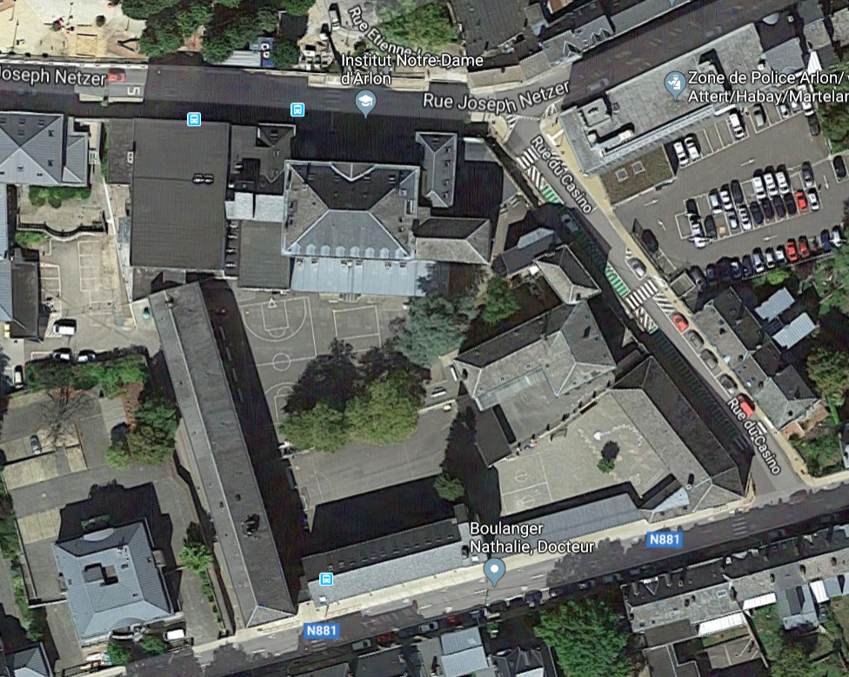
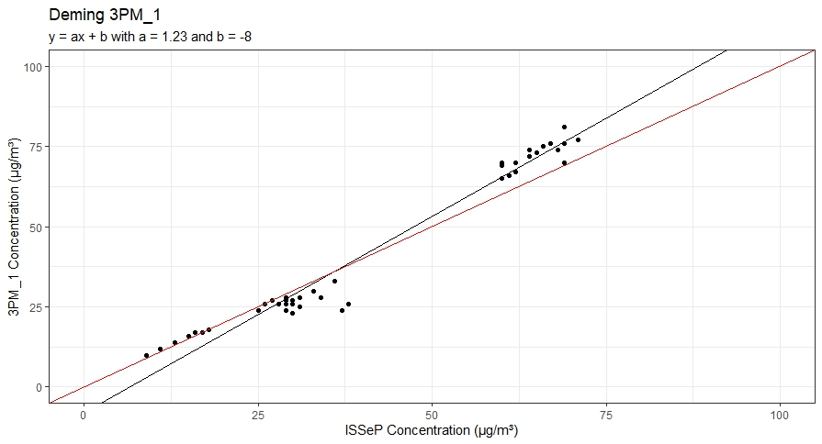
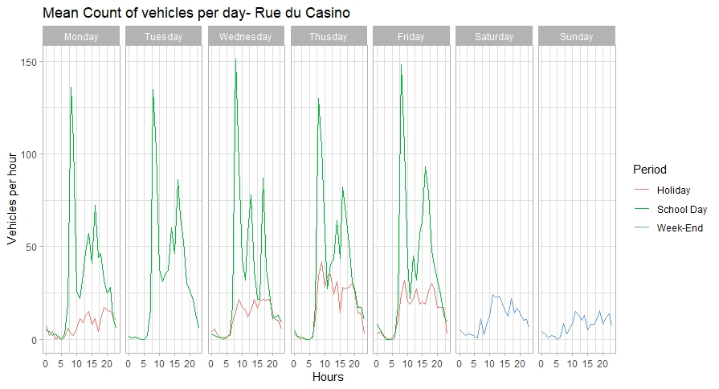
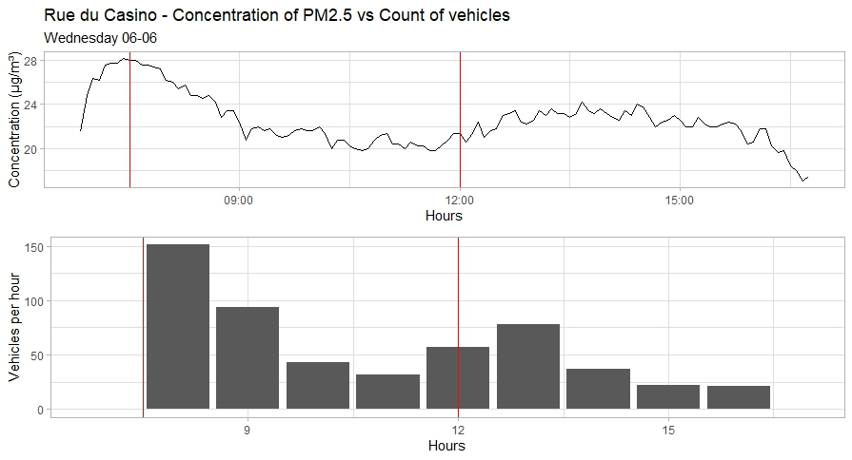
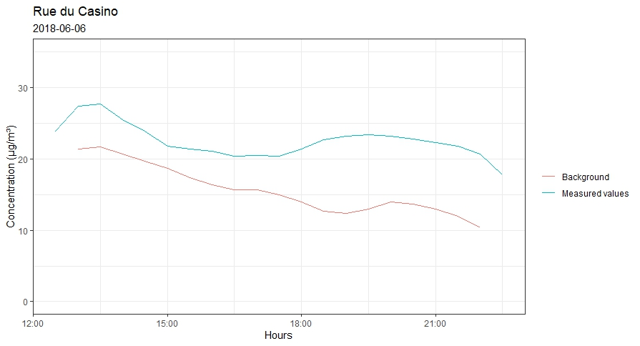
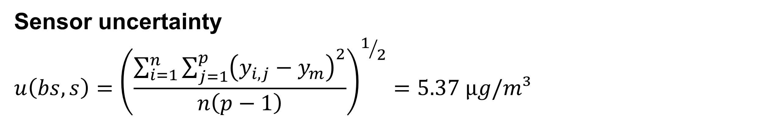
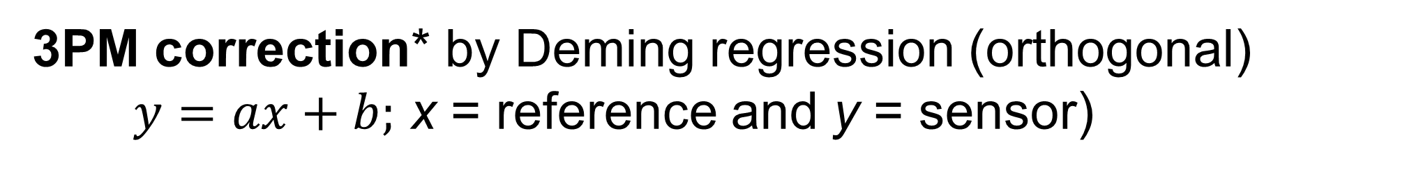
Evaluation of traffic’s influence near school front doors with low-cost PM_{2.5} monitoring
C.Falzone (1), F.Simon (1), F.Lenartz (2), A-C.Romain (1)
Sensing of Atmospheres and Monitoring, University of Liege, Arlon, Belgium (2) ISSeP, Liege, Belgium
cfalzone@uliege.be
Objectives
Field tests comparison: low-cost sensors collocated with Air Quality monitoring station
Monitoring traffic emissions of PM_{2.5} during the children drop-off at school
Highlighting children’s exposure to PM_{2.5} during school period
Material and methods
Field Test Comparison
3 lab-made devices, battery powered, (called 3PM, each one consisting of 3 low-cost sensors PM_{2.5} Honeywell HPM Series–HPMA115S0–XXX ;
0 - 1000 µg/m³ ; autonomy ±9h)
GRIMM EDM180 as reference for calibration
3 days comparison at ISSeP, Liege (Belgium)
        Sensor vs Sensor
        Sensor vs GRIMM
PM_{2.5} monitoring around of the school
3PM fixed above each entrance of the school during 14 days including school days, week-ends and holidays. Traffic is measured in 3 streets surrounding school with a TMSSA radar
Rural school located in the south of Belgium
Results and discussion
Field Test Comparison
3PM correction* by Deming regression (orthogonal)
$y=ax+b;$ x = reference and y = sensor)
n=44 | a | u(a) | b | u(b) | R² | RMSE
3PM_1 | 1.225 | 0.036 | -7.966 | 1.622 | 0.964 | 4.36
3PM_2 | 1.335 | 0.045 | -11.874 | 2.07 | 0.951 | 4.25
3PM_3 | 1.348 | 0.045 | -11.247 | 2.042 | 0.953 | 5.49
  Sensor uncertainty
  $$u\left(bs,s\right)={\left(\frac{\sum_{i=1}^{n}{\sum_{j=1}^{p}{{\left(y_{i,j}−y_{m}\right)}^{2}}}}{n\left(p−1\right)}\right)}^{1/2}=5.37 µg/m³$$
  n = measurment number ;
  p = replicas number ;
  y_{i,j} = sensor measure on i period
  y_{m} = mean of y on i period ;
Sensing of Atmospheres and Monitoring
PM_{2.5} monitoring around the school
  Traffic profiles highlight peaks during the beginning, middle and end of school-hours
  Concentration profile follows the traffic profile
  PM_{2.5} concentration exceeds the limit value when the background concentration is approximatively 20 µg/m³
25 µg/m³
5 minutes average
  Concentrations around the school are always higher than background concentrations
30 minutes average
07:30
1 hour average
07:30
Conclusions
Reproducibility between sensors is very good
Expanded relative uncertainty for limit value (25 µg/m³ ; Reference Measure uncertainty = 0.67 µg/m³)**:
    No corrected sensor: 60% and Corrected sensor: 54%
Upcoming Technical Specification from the CEN/TC/264/WG42 “Air quality – Performance evaluation of air quality sensors” will be useful
First results highlight that the children drop-off to school has an impact on PM_{2.5} values
Additional study is required, involving various long term measurement campaigns and different schools
References:
*Equivalence test: BV/AQ/AD202209/DH/2396; **Directive 2008/50/CE and https://ec.europa.eu/environment/air/quality/legislation/pdf/RIVM_PM_equivalence_v2.9.xls
WeBIOPATR, 2019; Belgrade

