Slide 1
RISK BASED INSPECTION AND MAINTENANCE PLANNING OF MITER GATES
Authors : Thuong Van DANG, Pablo G. MORATO, Quang Anh MAI, Philippe RIGO
Department of ArGEnCo, Faculty of Applied Sciences, University of Liège, Belgium

Slide 2
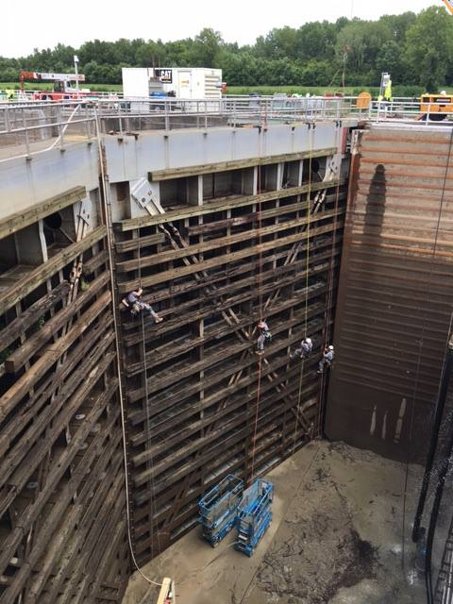
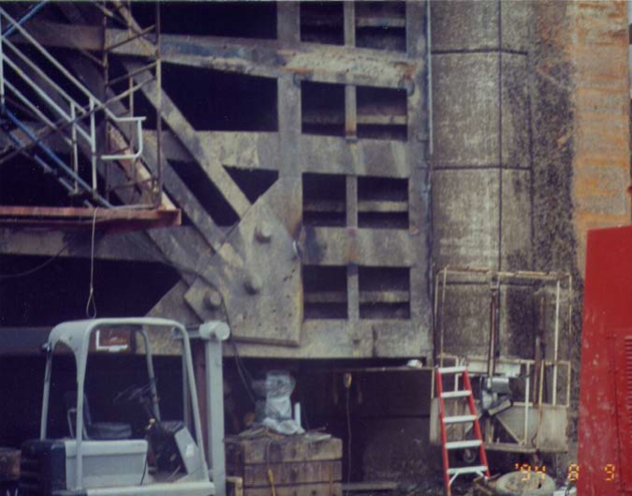
TARGET STRUCTURES

Slide 3
METHODOLOGY
Cyclic loading
Fatigue
Inspection cost
Total cost
Optimum
Failure
Inspection
and Repair
Expected cost
Failure cost
Optimal strategy
Repair cost
Maintenance efforts
Lock gates : miter gates, vertical lift gates,
Movable weirs, tainter gate

Slide 4
Message Objective
Dynamic Bayesian network
Cost model
Risk-based inspection
Inspections performed at regular time intervals
Inspections performed when failure probability threshold is reached
2 solutions:

Slide 5
Outline
Equivalent stress range
Fatigue crack growth model
Dynamic Bayesian Network (DBN)
Risk based decision analysis
Conclusion

Slide 6
Equivalent stress range
$∆σ= \sqrt[m]{\frac{D_{tot}C}{nT}}$
$D_{tot}$: total fatigue damage
m, C: material parameters
n : number of lockages (cycles)
T : time of observations (years)

Slide 7
Fatigue crack growth model
a) Paris’s law:
$\frac{da }{dN}$ $= C(∆K)^{m}$
b) The failure event is defined by the limit state function:
$g= a_{c}− a_{t}$
Failure of the element occurs if g $≤0$
c) The crack size at time t (m≠2) is:
$a_{t}=[a_{t−1}^{1−\frac{m}{2}}+\left(1−\frac{m}{2}\right)C{B_{s}^{m}∆σ}^{m}Y^{m}nπ^{m/2}]^{2/(2−m)}$

Slide 8
Fatigue crack growth model
Variable | Description | Distribution | Mean | Std/Cov
$a_{0}$ [mm] | Initial crack size | Exponential | 0.16
$a_{c}$ [mm] | Critical crack size | Deterministic | 25
∆σ [Mpa] | Stress range | Deterministic | 57
Ln(C) | Material parameter | Normal | -26.80 | Std = 0.29
m | Material parameter | Deterministic | 3
$B_{s}$ | Load uncertainty | Lognormal | 1 | Cov = 0.25
Y | Geometry function | Deterministic | 1.12
n | No. of cycles/year | Deterministic | 7048

Slide 9
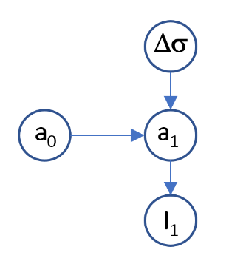
Bayesian Network
Directed Acyclic Graph (DAG)
qualitative
Local probability distributions
quantitative
Bayesian network
Δσ stress range (Mpa)
The damage crack size a₀ and a₁(mm)
Variable I₁ stands for a possible inspection outcome of the condition a₁
Inspection decisions
I₁ = 0 No inspection
I₁ = 1 Inspection

Slide 10
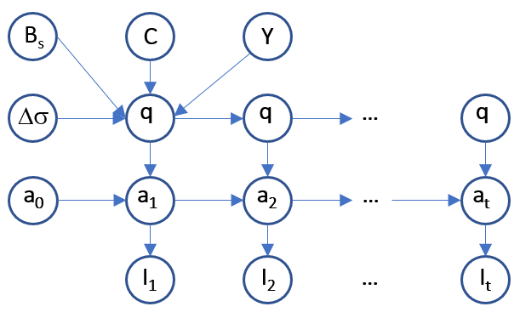
Dynamic Bayesian Network
$${ a}_{t} =[a_{t−1}^{1−\frac{m}{2}}+q ]^{2/(2−m)}$$
$q$ = $\left(1−\frac{m}{2}\right)C{B_{s}^{m}∆σ}^{m}Y^{m}nπ^{m/2}$

Slide 11
Dynamic Bayesian Network
Probability of detection (POD) describes the probability of detecting the crack and is given by:
$Pr($I_{t}$= D|a) = POD(a) = \frac{αa^{γ}}{(1+αa^{γ})}$
D is the event of detection, a (mm) is the detectable crack and α, γ are regression parameters.
Instantiating the inspection variable I_{t}
Updating failure probability

Slide 12
Risk based decision analysis
The total expected cost during the lifetime $E_{tot}$ :
$E_{tot}=\sum_{i=1}^{N_{t}}{\frac{P_{f}(t_{i})C_{f}}{{(1+α_{r})}^{i}}+ \sum_{i=1}^{N_{insp}}{\left(1−P_{fc}\left(t_{insp}\right)\right)}}\frac{C_{insp}+P_{r}(t_{insp})C_{r}}{{(1+α_{r})}^{t_{insp}}}$
$P_{f}$ is annual failure probability, $P_{r}$ is the probability that a repair is performed and $P_{fc}$ is the cumulative failure.
Costs | Value (money unit)
Failure cost, $C_{f}$ | 10⁶
Inspection cost, $C_{insp}$ | 0.002$C_{f}$
Repair cost, $C_{r}$ | 0.04$C_{f}$
Discounting rate, $α_{r}$ | 0.03

Slide 13
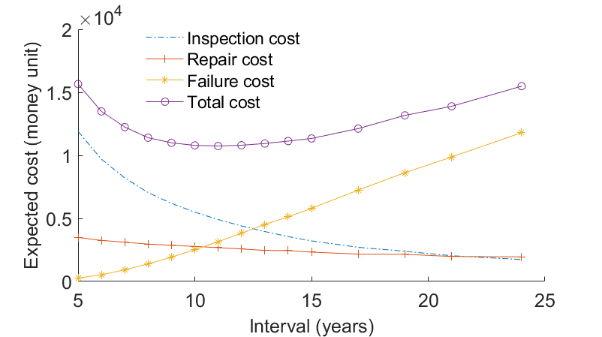
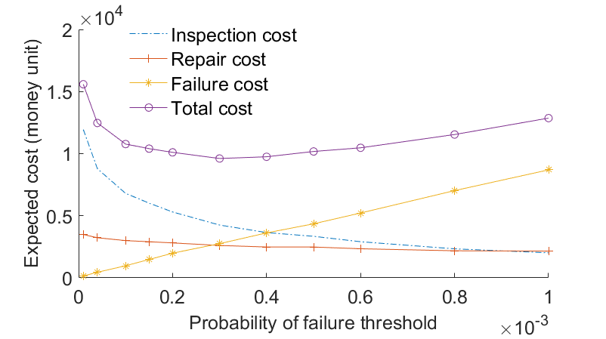
Risk based decision analysis
Optimum
Optimum
Optimal inspection inverval
every 11 years
$E_{tot}$ = 1.0742 x10⁴
Optimal inspection performed at $P_{f}$ = 3x10⁻⁴
$E_{tot}$ = 0.96095 x10⁴

Slide 14
Conclusions
The different stress-ranges occurring during the year are represented by an equivalent stress-range value.
A framework where Dynamic Bayesian network is used for risk-based inspection planning of a miter gate welded joint considering inspection data.
Further work can be used to consider the multiple structural components of a gate.

