Slide 1
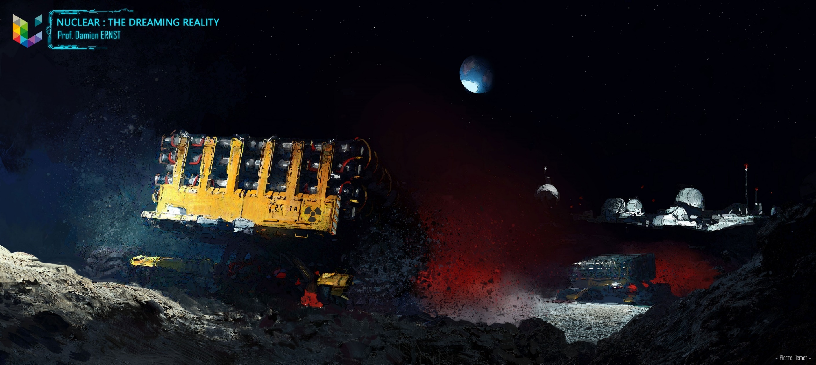

Slide 2
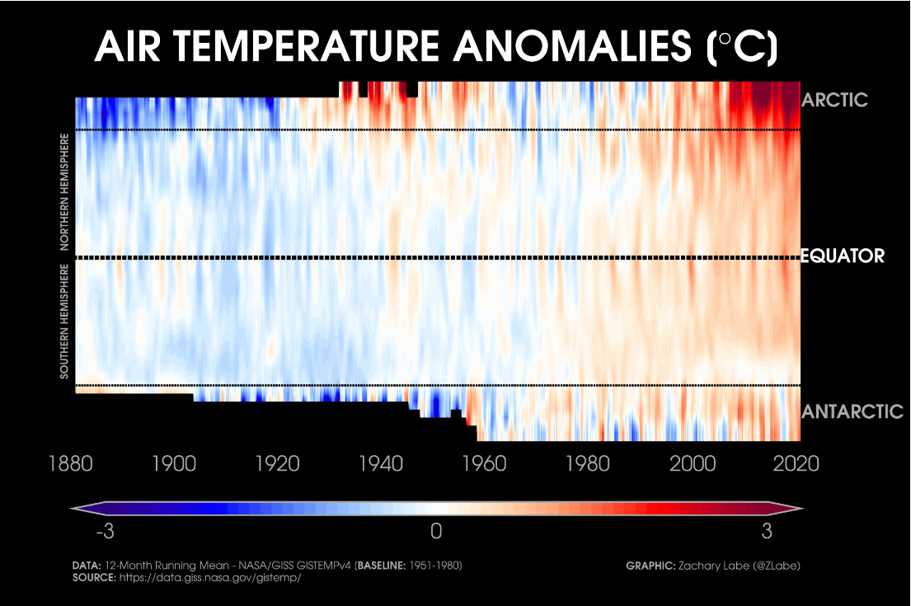
Climate change

Slide 3
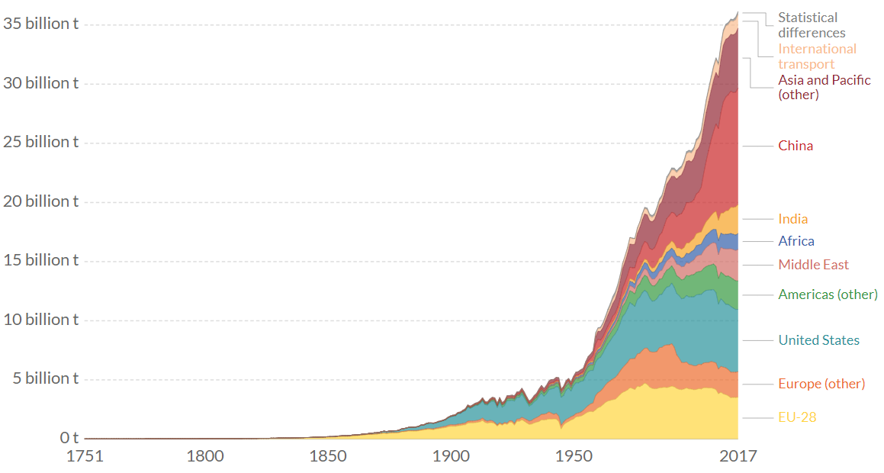
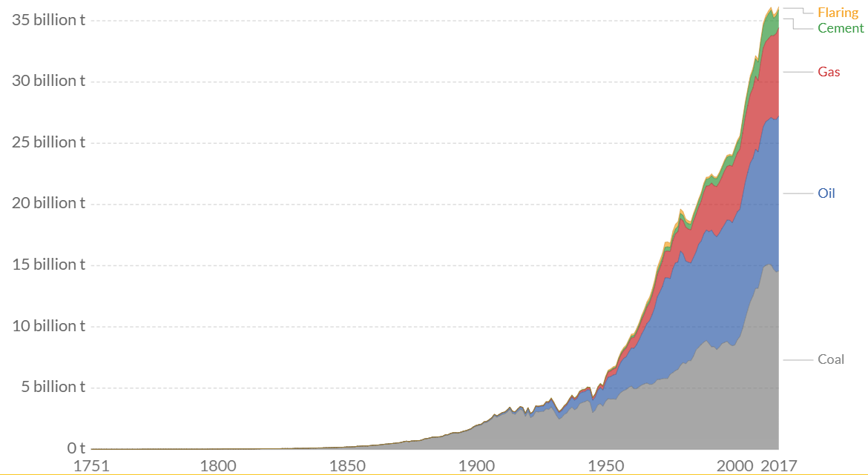
The culprit: Greenhouse gas (GHG) emissions
CO2 emissions from the combustion of fossil fuels and cement production: 36 Gt (65% of GHG emissions).
Total man-made GHG emissions: 55 Gt-CO2-equivalent (Other sources: F-gases 2%, Nitrous Oxide 6%, Methane 16%, CO₂ emitted from direct human-induced impacts on forestry and other land use 11%)
Sources: https://ourworldindata.org/co2-and-other-greenhouse-gas-emissions and https://www.epa.gov/ghgemissions/global-greenhouse-gas-emissions-data

Slide 4
Nuclear: One of the three credible ways to eliminate fossil fuels
Nuclear, solar and wind energy are the only types of energy that are sufficiently cheap and abundant enough to meet our energy needs in a CO2-free way.
that are cheap and abundant enough to cover our energy needs in a CO2-free way.
Here are some energy-related numbers:
Total global final energy consumption in 2016: 111,000 TWh.
2.3% growth in energy use in 2018.
Average final energy consumption per person, per day: 40 kWh
Average power produced by a top professionnel cyclist during a half-hour hill climb: 400 W. 100 hours of climbing needed to produce 40 kWh!
Average energy consumption per person, per day in the EU-28: 100 kWh

Slide 5
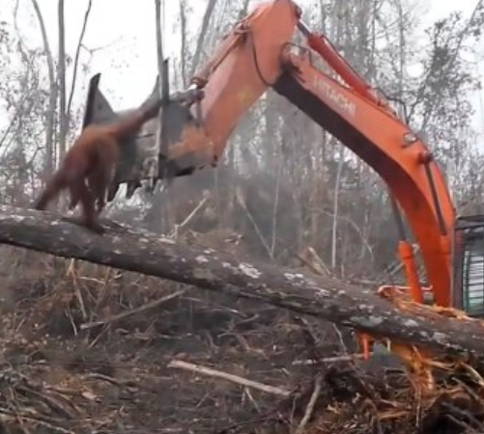
Why are we not including biomass?
A typical forest can absorb energy from the sun at an average rate of 0.2 W/m² (photovoltaic panels can harvest 50 W/m² in the best locations).
For producing 111000 TWh of energy,
63 million km² of forest is needed.
Earth’s surface: 510,1 million km²
Ocean surface: 360 million km²
Land surface: 134 million km²
Forest surface: 40 million km²
Source: https://metro.co.uk/2019/04/19/heartbreaking-moment-orangutan-takes-digger-david-attenboroughs-new-documentary-9258461/

Slide 6
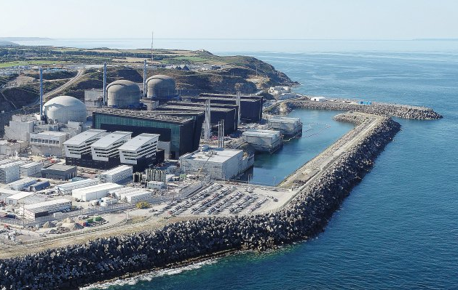
Producing 111,000 TWh of electricity using nuclear power
European pressurized reactor (EPR)
Power: 1650 MWe, 4500 MWth.
Load factor: 90%
Fuel: 25 tons of enriched uranium per year (5%). 150 tons of natural uranium per year (when using MOX fuel that allows to use 25% less uranium through recycling).
Two are in operation in Taishan (China). Connection to the grid of the Olkiluoto EPR (Finland) in July 2020. Flamanville in 2022.
To produce 111,000 TWh of electricity, we would need, annually, 8532 EPRs.

Slide 7
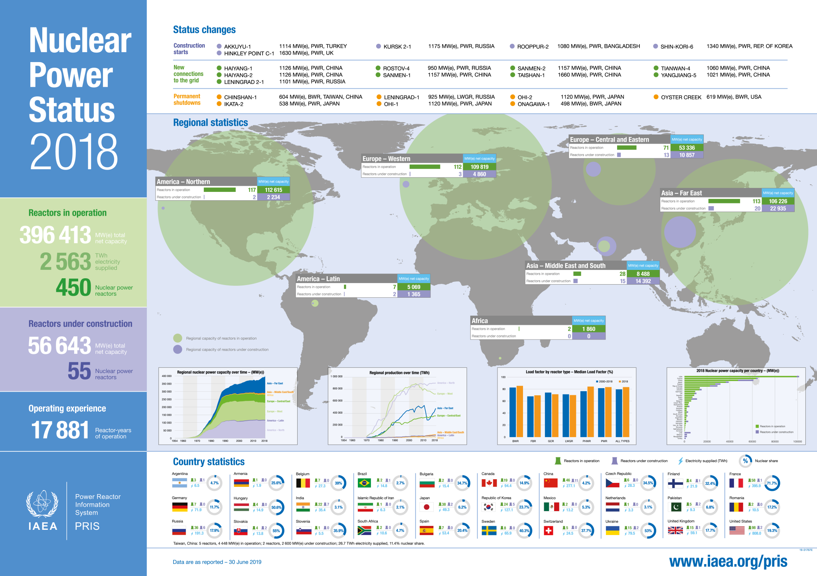

Slide 8
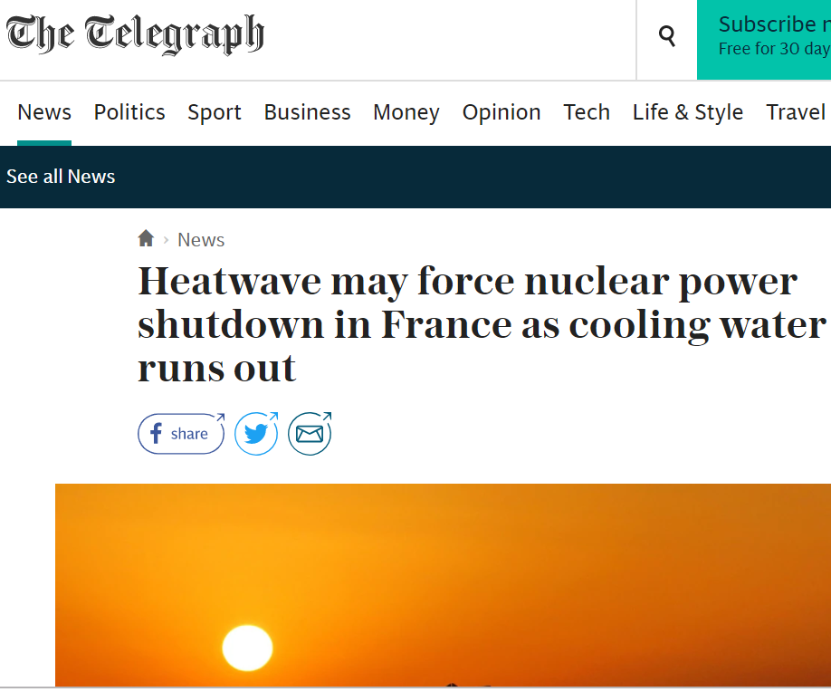
Not enough water for cooling down these reactors?
When an EPR is running, 2850 MW of heat power needs to be dissipated.
Correspond to the heat power needed for the vaporisation of 1.162 m³/s of water!
For the whole EPR fleet (with a 90% load factor), the amound of power needed would be 8922.7 m³/s
Vaporization of water at 20 °C requires 0.685 kWh/kg.

Slide 9
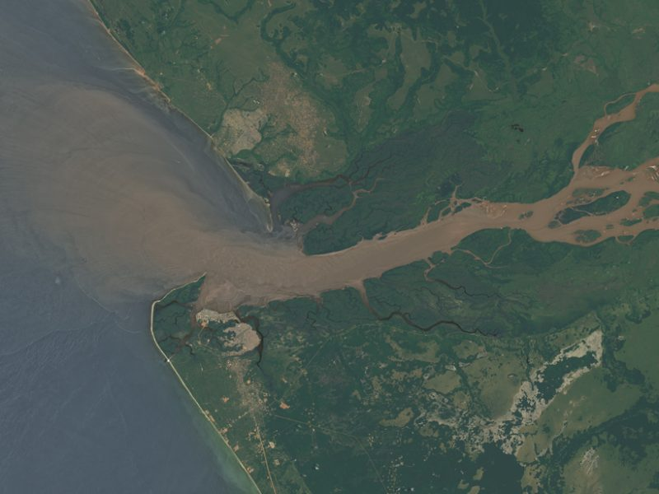
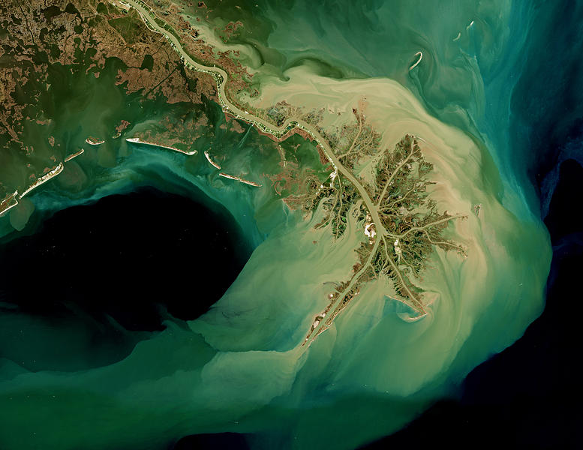
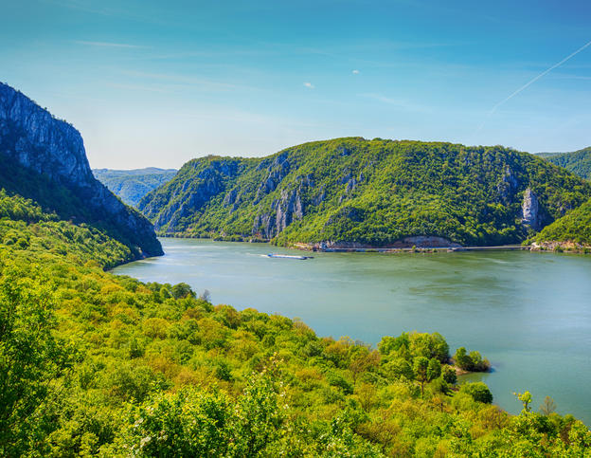
Congo river:
41000 m³/s
Mississipi:
16790 m³/s
Danube:
6500 m³/s

Slide 10
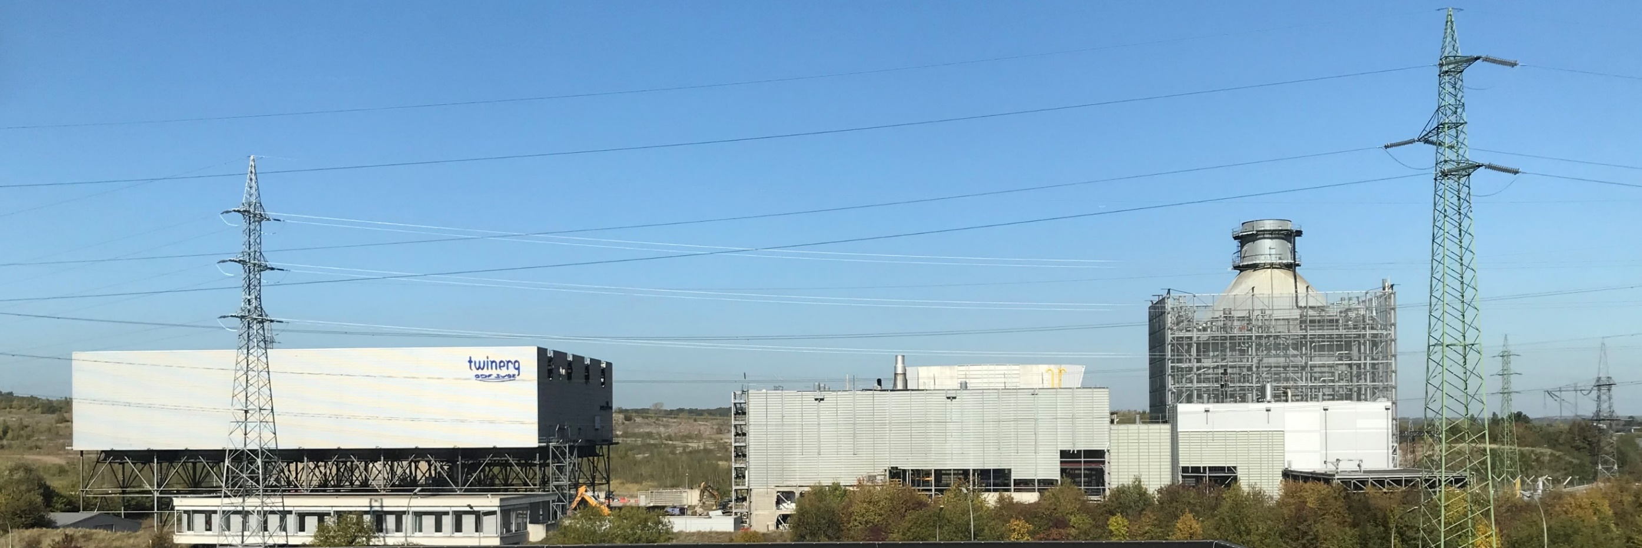
Power plant can cool down with a fully closed-circuit for water!
The 375 MW Twinerg power plant (2002-2016). The excess heat for district heating was dissipated in the atmosphere through a heat exchanger (on the left in the image).

Slide 11
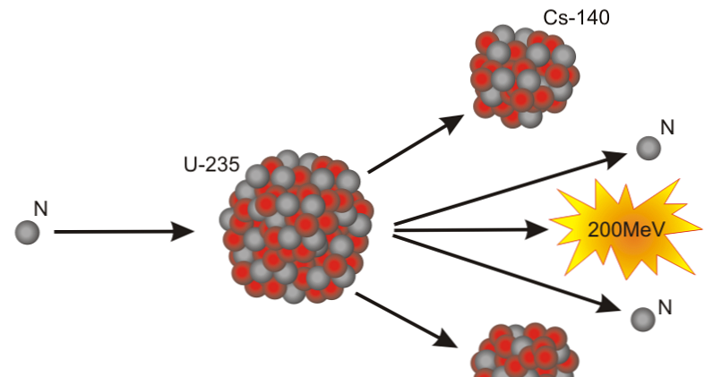
Snowball effect, but under control
But is there enough uranium?
Identified resources in Uranium : 8Mt (at a price < 260$/kgU).
Evaluated terresterial ultimate resources: 72Mt (<260$/kgU).
These resources provide to our fleet of 8532 EPR: $\frac{72∗{10}^{6}}{8532∗150}=$56 years of autonomy.
Not that much because there is only 0.7% of ²³⁵U in uranium ore and 99.3% of ²³⁸U which is not fissile.
Fission of an atom generates in average around 200 MeV of energy.
186 MeV directly.
14 MeV afterwards due to a degradation of fission products.
Many different types of fission products can be produced.
Source: AIEA : Uranium 2018, Resources, Production and Demand

Slide 12
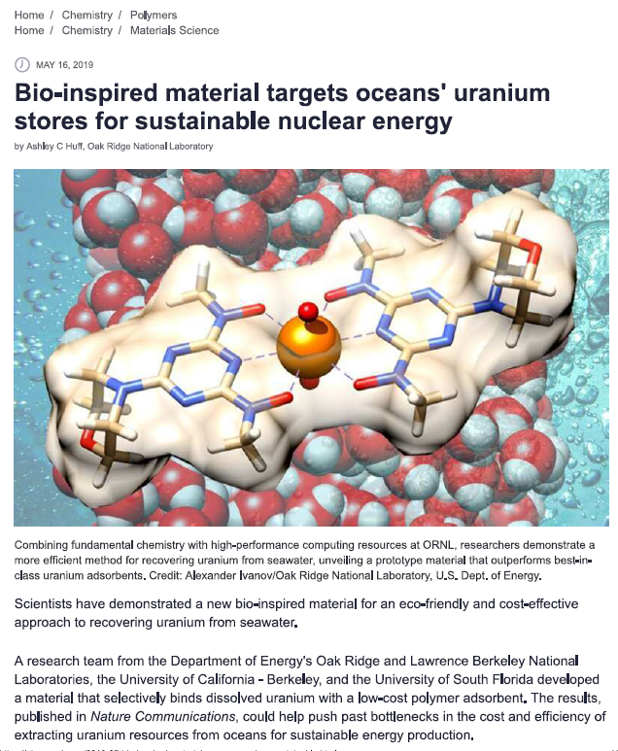
But wait - there is plenty of uranium in the ocean
Uranium in the ocean: 4,5 Gt (0.003 $\text{g} \text{per}$ ton of sea water).
Let us assume we can extract 10% of this resources - 450 million tons of uranium.
This equates to 350 years of fuel for our fleet of 8532 EPR.
Source: The Pacific Northwest National Laboratory, Global energy policy research

Slide 13
For this Japanese experiment (in the late 1990s),
1 kg of uranium was collected over 240 days or around 1.5 kg per annum.
Dimension of the device: 8 m x 8 m = 64 m².
8532 EPRs needs 150 x 8532 = 1,279,800 t of uranium per year.
Size of the collecting device: $\frac{1,279,800,000}{1,5 ∗1,000,000}$=853 km²

Slide 14
And there are fast-neutron (breeder) reactors
Fast-breeder reactors could, in principle, extract almost all of the energy contained in uranium, decreasing fuel requirements by at least a factor of 50 compared to widely used Pressured Water Reactors.
Land reserves: 56*50 = 2800 years
Land reserves + 10% sea water reserves:
(56 + 350)*50 = 20,300 years
Two commercially operating fast-neutron reactors: the BN-600 reactor (560 MWe) and the BN-800 reactor (880 MWe). Sodium-cooled reactors.

Slide 15
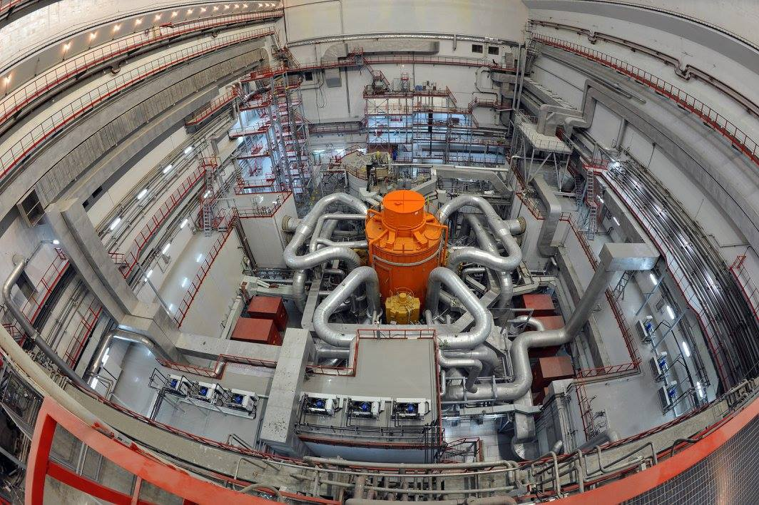
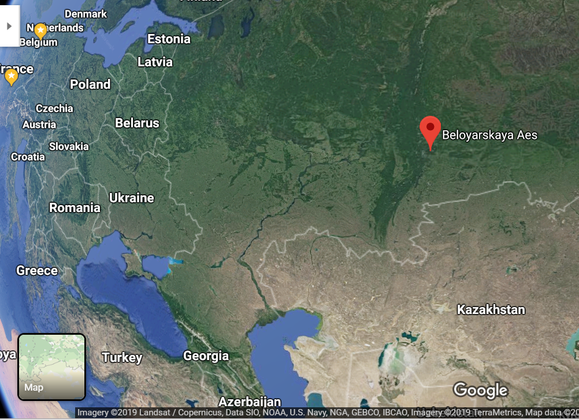
Unlimited power! (well, almost)
BN-800 Beloïarsk reactor

Slide 16
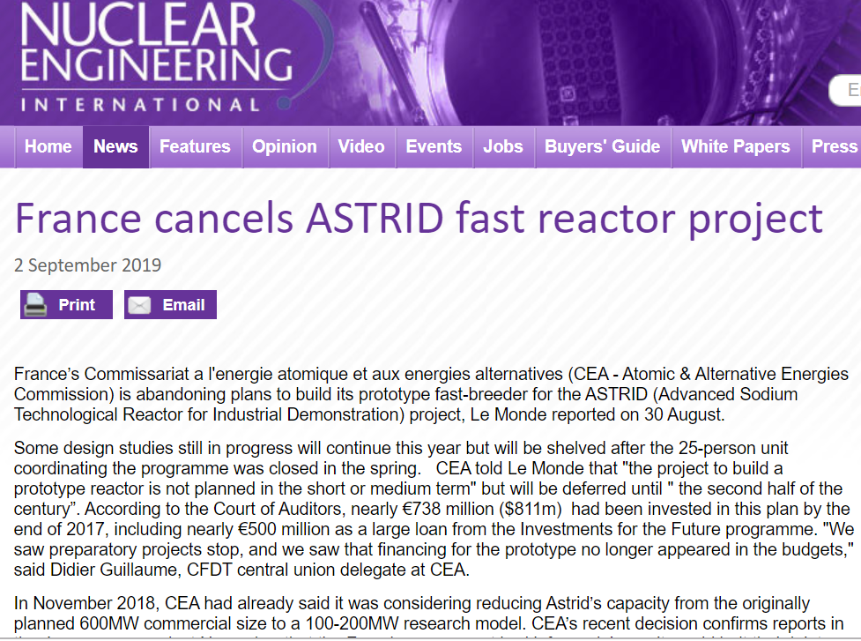
ASTRID into oblivion

Slide 17
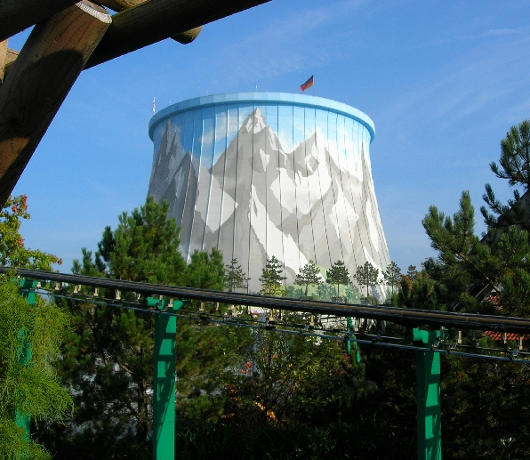
Wunderland Kalkar
The SNR-300 was a fast breeder sodium cooled nuclear reactor built near the town of Kalkar (Germany).
The reactor was completed in 1985 but never taken online. SNR-300 was to output 327 megawatts. The project cost about 3.5 billion €. 250 million € financed by Belgium.
The site is now the location of a theme park, Wunderland Kalkar.

Slide 18
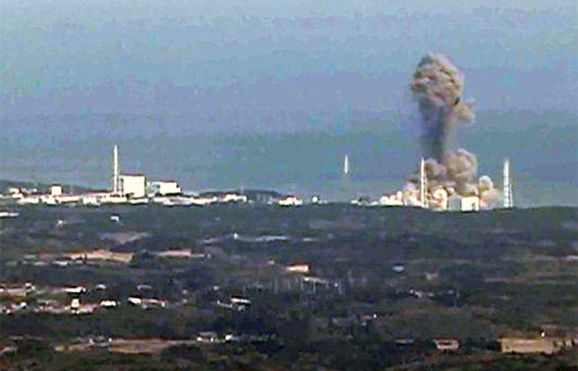
Safety issues of nuclear power
Chernobyl (April 1986)
Fukushima (March 2011)

Slide 19
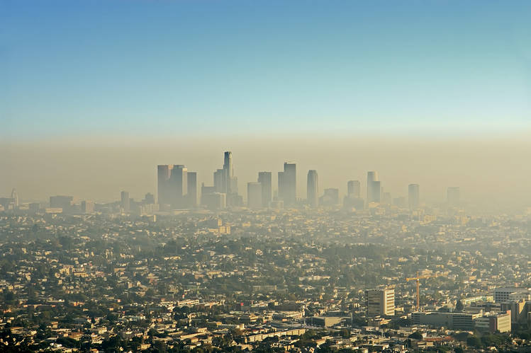
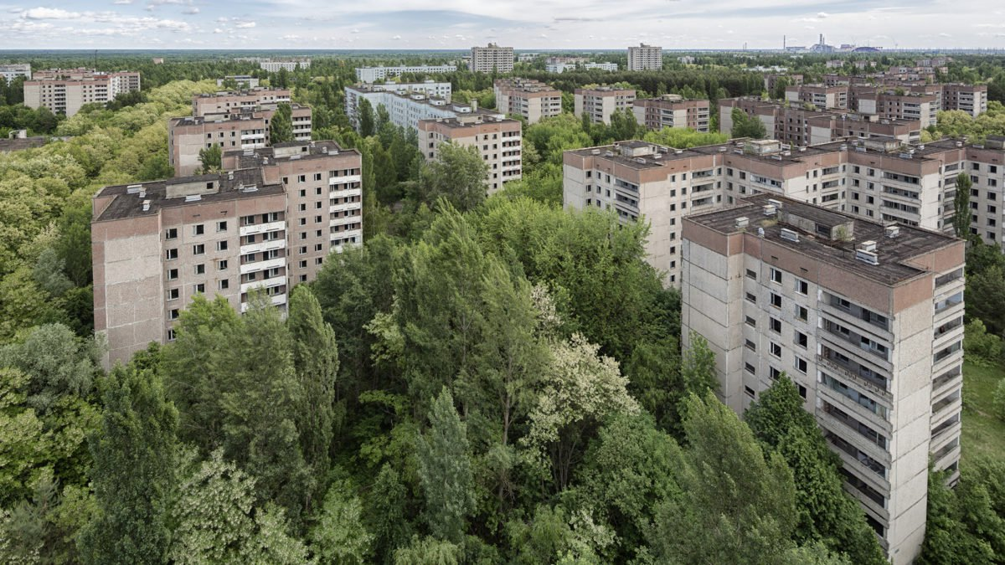
30 years after Chernobyl disaster, wildlife is flourishing in radioactive wasteland
Los Angeles, today
Chernobyl, today
Source: https://www.telegraph.co.uk/news/2016/04/23/wildlife-returns-to-radioactive-wasteland-of-chernobyl/

Slide 20
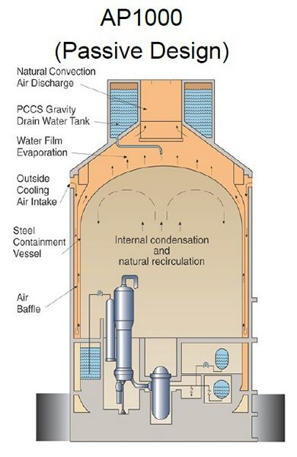
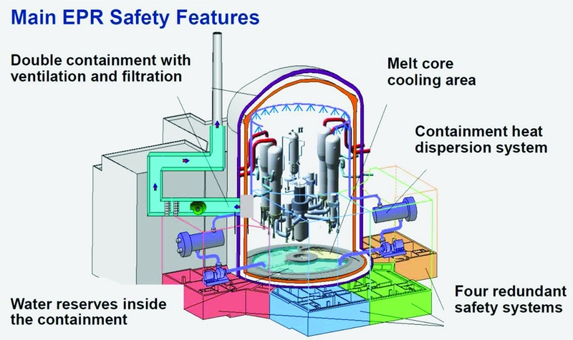
Gen III reactors safer

Slide 21
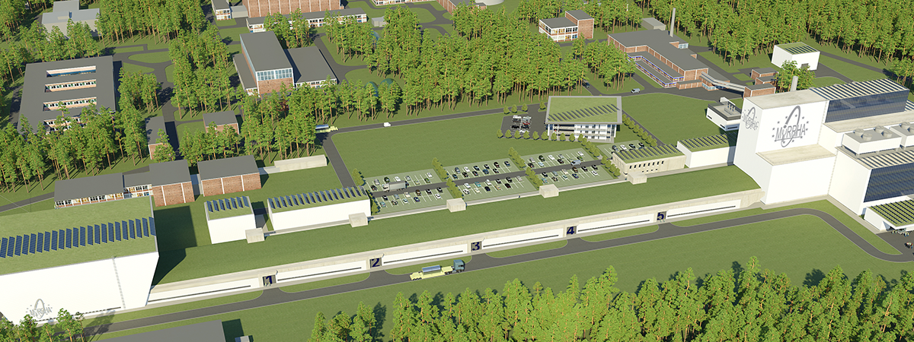
Gen IV reactors even safer
Two interesting features for Myrrha: (a) when the proton accelerator stops, the reaction stops immediately (b) this ADS-type of reactor makes it easier to burn safely large quantities of minor actinides whose fission produces little delayed neutrons (c) the lead-bismuth coolant is opaque to gamma radiation, but transparent to neutron flux; it melts easily at a low temperature, but does not boil until an extremely high temperature is reached (1740 °C); it does not greatly expand or contract when exposed to heat or cold; it has a high heat capacity; it will naturally circulate through the reactor core without pumps being required - whether during normal operation or as a means of residual decay heat removal; and it will solidify once decay heat from a used reactor has dropped to a low level.

Slide 22
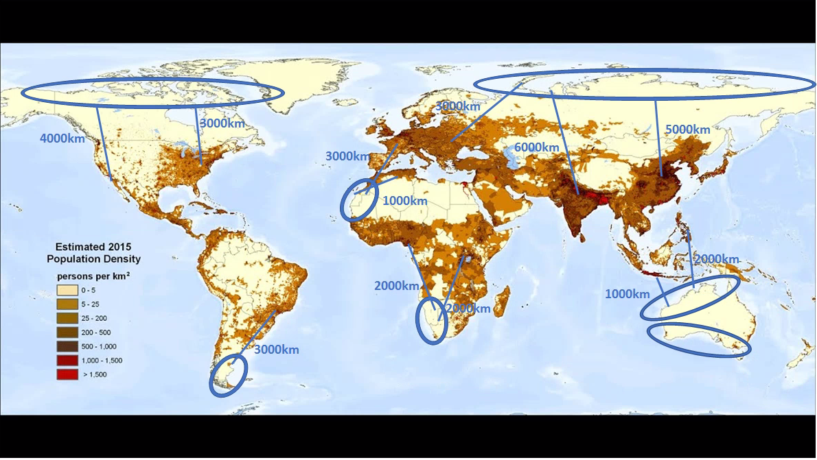
Put these reactors where noboby lives!
Good bye pipelines, hello power lines

Slide 23
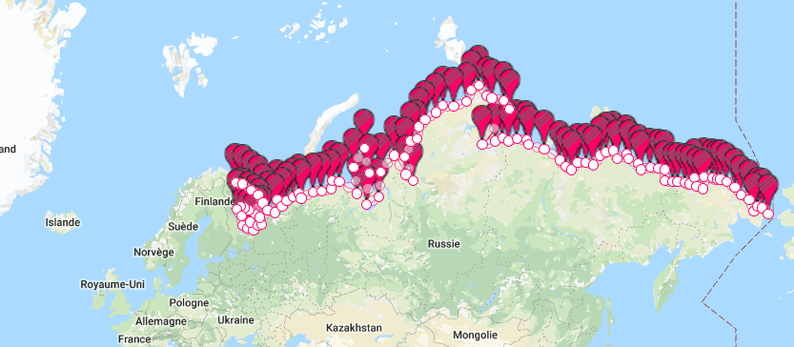
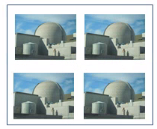
Northern Russia: about 12,000km of coastline.
Around 2400 EPRs (600*4) could be built in groups of 4 EPRs spaced 20 km apart.
In case of an INES 7 type incident, only four generators would be in an exclusion zone.
Chernobyl accident in 1986 with reactor 4. Reactor 2 closed in 1991, reactor 1 in 1996 and reactor 3 in 2000 => Even if the reactors were all grouped together, it is very unlikely that a major incident on one would endanger the integrity of the others.
20 km

Slide 24
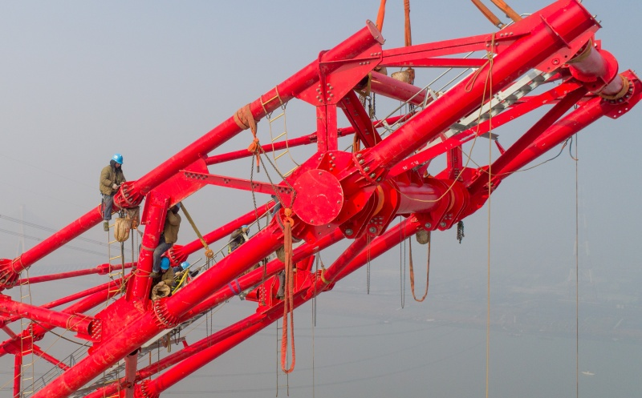
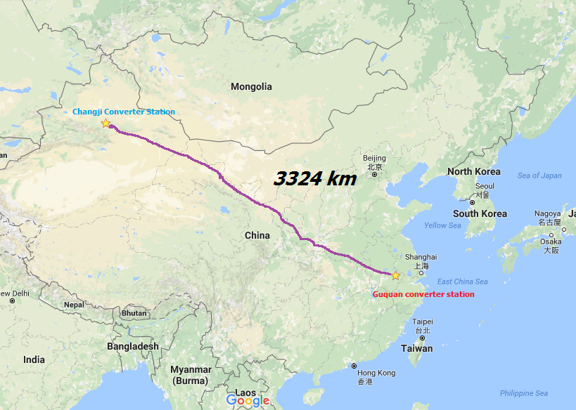
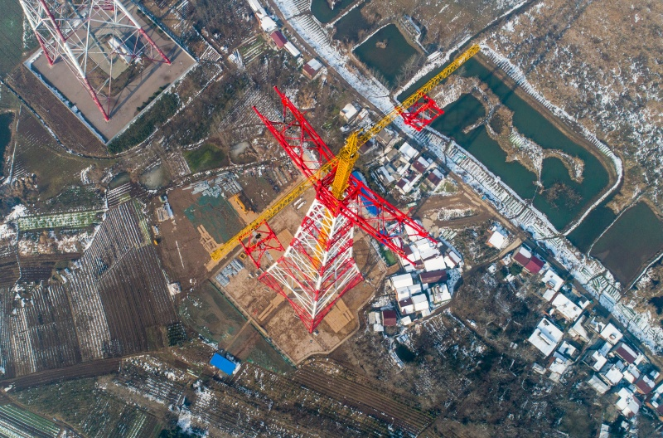
Huge towers for tiny electrons
Construction of an ultra-high voltage line (UHVDC, 1100kV, 12GW, 3000km) between Changji and Guquan, China

Slide 25
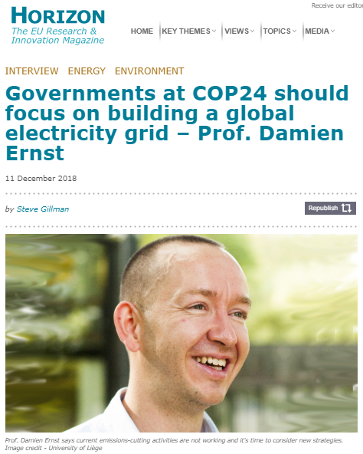
More info on the Global Grid: Global electricity network - Feasibility study

Slide 26
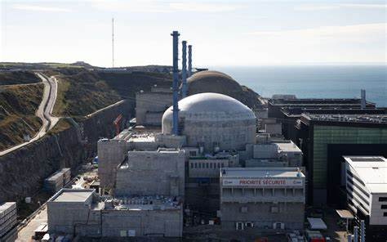
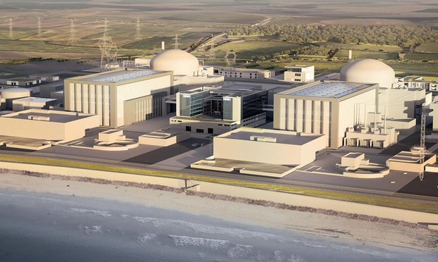
Hit parade of the less expensive new nuclear power plants
#9 Flamanville
Reactor(s): 1 EPR
Power: 1650 MWe
Price: 12,6G€
Construction: 2007-?
Price per MWe: 7,6 million €/MWe
#8 Hinkley Point
Reactor(s): 2 EPR
Power: 2x1650 MWe
Price: 22,5G€
Construction: 2018-?
Price per MWe: 6,8 million €/MWe

Slide 27
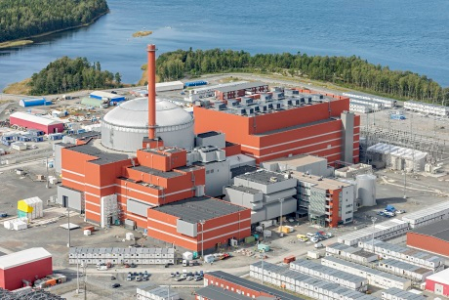
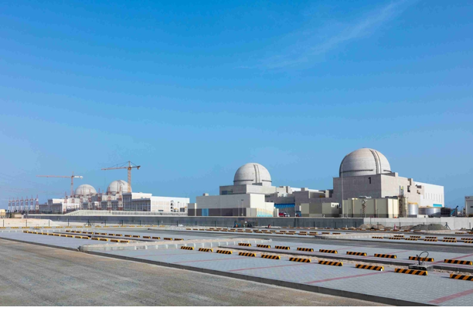
#7 Olkiluoto
Reactor(s): 1 EPR
Power: 1650MWe
Price: 8,5G€
Construction: 2005-?
Price per MWe: 5,2 million €/MWe
#6 Barakah
Reactor(s): 4 APR-1400 (KEPCO)
Power: 4x1400 MWe
Price: 24,4G€
Construction: 2010-?
Price per MWe: 4,3 million €/MWe

Slide 28
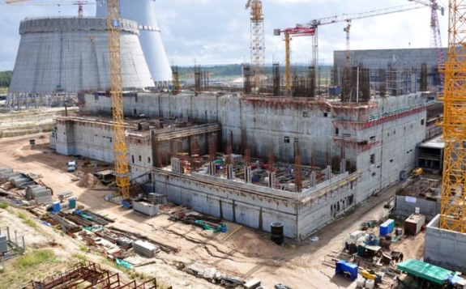
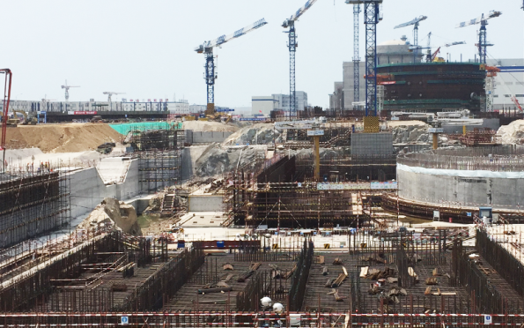
#5 Fuqing
Reactor(s): 2 Hualong 1 (CNNC and CGNPG)
Power: 2x1090 MWe
Price: 5,7G€
Construction: 2015-?
Price per MWe: 3,2 million €/MWe
#4 Leningrad
Reactor(s): 2 VVER-1200 (Rosatom)
Power: 2x1085 MWe
Price: 4,9G€
Construction: 2008-?
Price per MWe: 2,8 million €/MWe

Slide 29
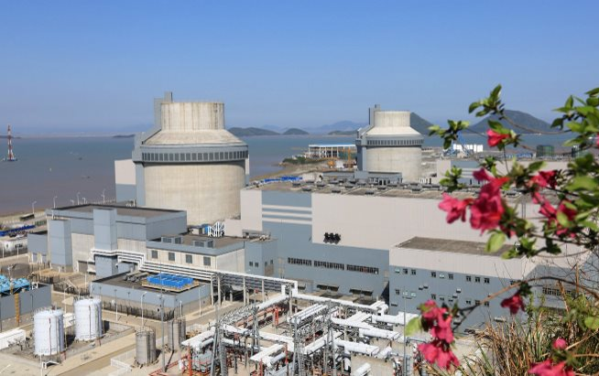
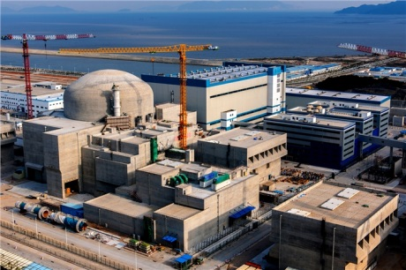
A low-cost EPR
#3 Sanmen
Reactor(s): 2 AP1000 (Westinghouse)
Power: 2x1000 MWe
Price: 5,5G€
Construction: 2009-2019
Price per MWe: 2,75 million €/MWe
#2 Taishan
Reactor(s): 2 EPR
Power: 2x1650 MWe
Price: 8G€
Construction: 2009-2018
Price per MWe: 2,4 million €/MWe

Slide 30
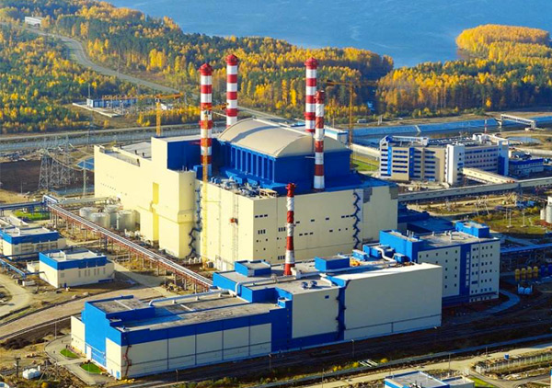
#1 Beloyarsk
Reactor(s): 1 BN-800
Power: 800 MWe
Price: 1,8G€
Construction: 2006-2016
Price per MWe: 2,2 million €/MWe

Slide 31
Nuclear energy in €/MWh
Cost of fuel (production, recyling and disposal): 9€/MWh
Variable O&M costs: 6.9€/MWh
Fixed O&M costs equal to 63000 € /(MWe*year) or to $\frac{63000€/MWe}{load factor∗8760h}=8.0€/MWh$
Price of CAPEX per MWh (with a WACC equal to 0) for Flamanville: $\frac{7.6M€/MWe}{60years∗load factor∗8760h}$= 16$€/MWh$
Price of CAPEX per MWh (with a WACC equal to 0) for Beloyarsk: $\frac{2.2M€/MWe}{60years∗load factor∗8760h}$= 4.6$€/MWh$
Cost for nuclear energy without a Global Grid
The cheapest 28.5$€/MWh$ | The most expensive 39.9$€/MWh$
Source: Projected costs of generating electricity, 2015 Edition, IEA-NEA

Slide 32
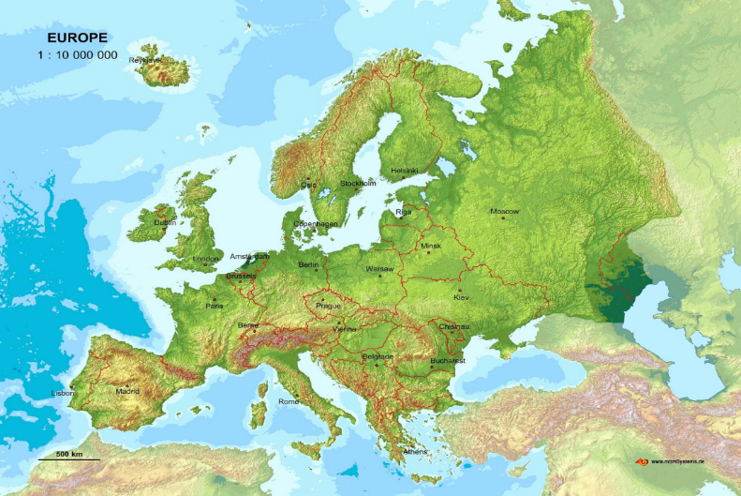
Estimation of the price with additional investment in a Global Grid setting
Good bye pipelines, hello power lines
Direct current overhead line (UHVDC 1000kV) | AC/DC converter
Cost: 0,22M€/km/GW Losses: 3%/1000 km Lifetime: 50 years | Cost: 90M€/GW Losses: 1% Lifetime: 25 years
4000km
Cost of transmission infrastructure = $\frac{\frac{0,22M€/km∗4000km}{50 years}+\frac{2∗90 M€}{25 years}}{1000 MW∗8760h}=2.\text{83}€/MWh$
Cost for nuclear with GG = $\frac{Cost of nuclear without GG }{1−losses}+Cost$ of transmission infrastructure
Cost for nuclear energy with a Global Grid
The cheapest 35.9$€/MWh$ | The most expensive 49.2$€/MWh$
Source: Global electricity network - Feasibility study

Slide 33
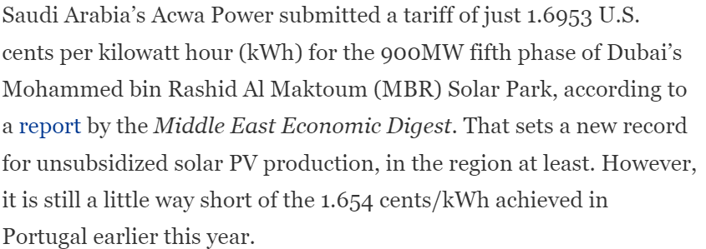
I want Sun!
46 €/MWh for
offshore wind power
15 €/MWh for
solar PV

Slide 34
Cost of nuclear vs cost renewables: a few thoughts
In €/MWh, solar PV is much cheaper than nuclear power.
Li-Ion batteries: cost of 100 k€/MWh, efficiency 92%, last for ten years at once cycle per day. Storing 1MWh of solar energy for 24 hours in Saudi Arabia would increase its cost from 15 €/MWh to 15/0.92+100,000/(365*10)= 43.7 €/MWh
In an optimized Global Grid setting, renewable energy is likely to be much cheaper than nuclear power.
In a non Global Grid setting, and in many countries, nuclear can put out of business electrical mixes with gas, storage and renewables.
A non-zero Weighted Average Cost of Capital (WACC) for nuclear will significantly increase its costs.
Power-to-gas technologies may further endanger the competitiveness of nuclear power in the future, even without a Global Grid.

Slide 35
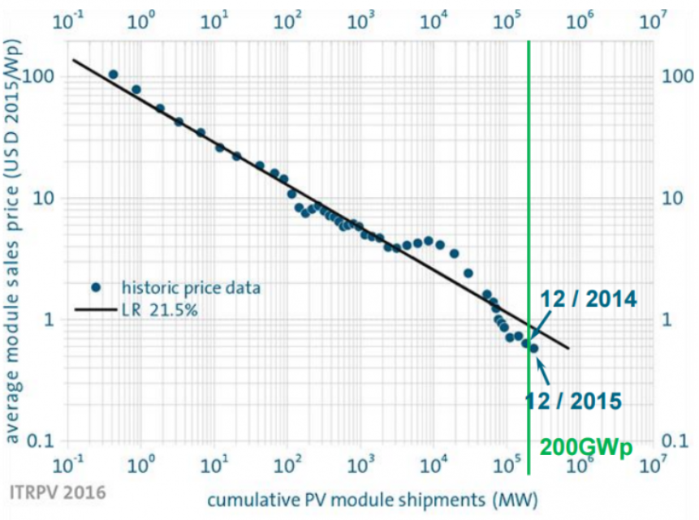
Three strategies for reducing the cost of nuclear energy
#1 Build more nuclear power plants to move down the learning curve
Learning rate for PV around 25% (for each
doubling of capacity, price of PV modules
has decreased by 25%).

Slide 36
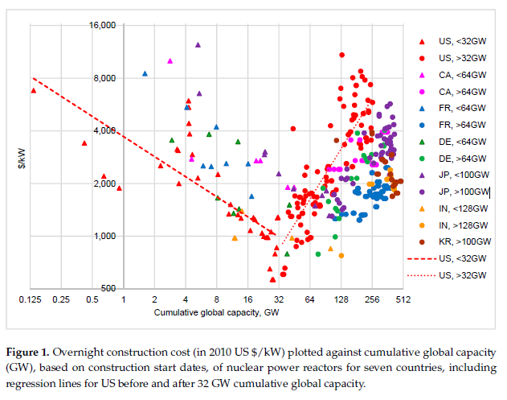
May not be that simple to achieve the same success for nuclear power as with PV since.
Due to add-on environmental requirements and labour cost increases, learning rates have become negative after first being positive.
Example: In the US, pre-reversal learning rates were around 24%. After 32 GW of cumulative global capacity (1967), they went down to minus 102%.
Source: Nuclear Power Learning and Deployment Rates; Disruption and Global Benefits Forgone

Slide 37
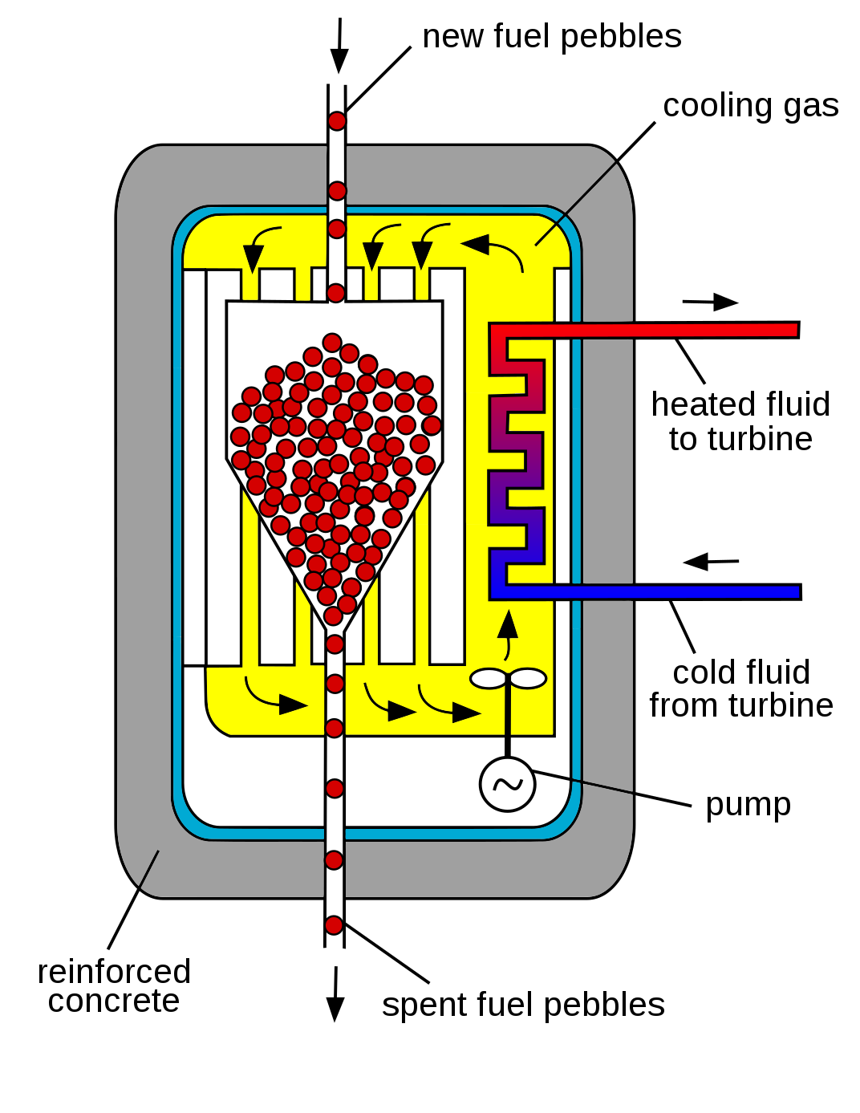
#2 Innovate³
The pebble bed generator: a good example of innovation.
Can work at higher temperature, as cooled by gas. Better efficiency.
Intrinsically safe (doppler broadening effect to decrease reactor power as fuel temperature increases; reactor cooled by an inert and fireproof gas; convection of the gas driven by the heat ensures passive cooling; pebbles are composed of TRISO particles that can withstand extreme temperatures which are well beyond the threshold of current nuclear fuels).
Fuel replacement is continuous.
Source: https://en.wikipedia.org/wiki/Pebble-bed_reactor

Slide 38
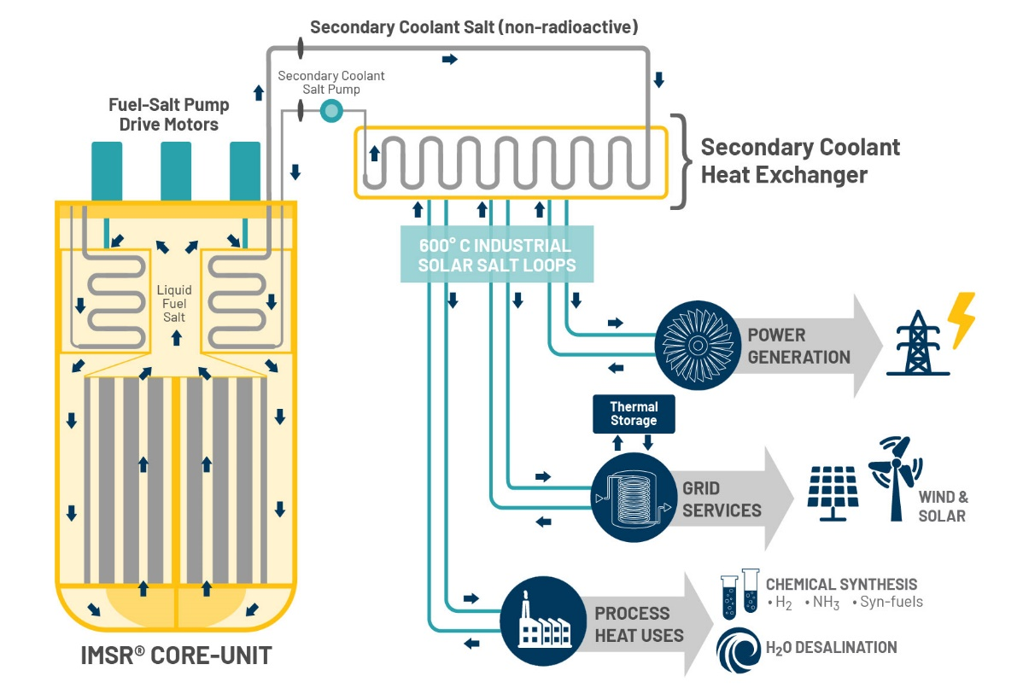
#2 Innovate⁴
Molten Salt reactors offer even greater perspectives:
Intrinsically safe (near atmospheric pressure, doppler broadening effect, high boiling point, fission products chemically bound to coolant, unlimited air cooling…).
Waste burner capabilities: Reduction of spent fuel inventory through fast-spectrum neutrons.
Source: https://www.terrestrialenergy.com/

Slide 39
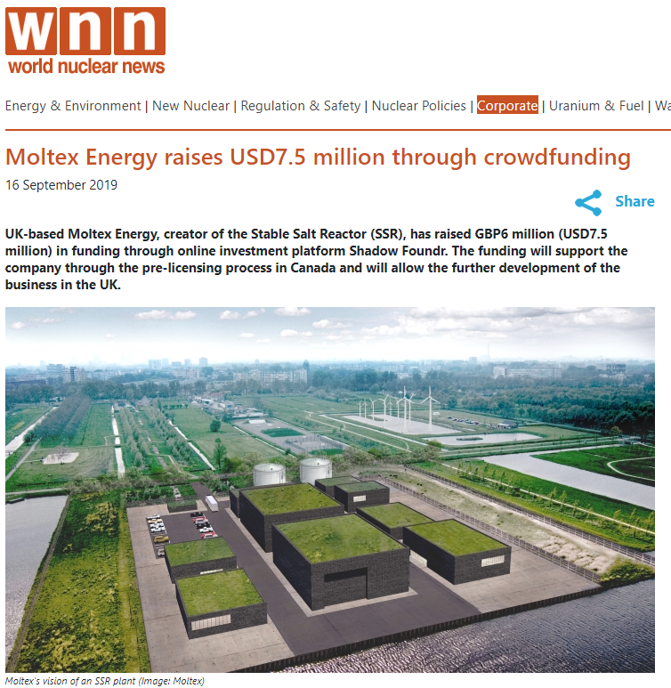
Apprenez à prononcer
And people believe in the potential of molten salt reactors: Moltex ... the first nuclear company to raise funds thanks to public crowdfunding !!!
And people believe in the potential of molten salt reactors: Moltex the first nuclear company to raise funds thanks to public crowdfunding!
Source: http://world-nuclear-news.org/Articles/Moltex-Energy-raises-USD7-5-million-through-crowdf

Slide 40
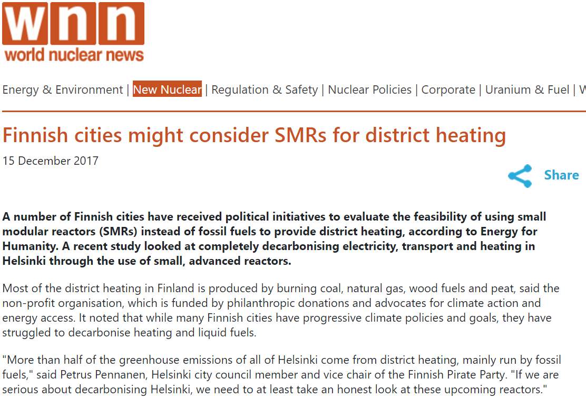
#3 Valorise lost heat
Easier to valorise heat from Small Modular Reactors (SMRs) than than large ones since it is difficult to transport heat over long distances.
SMRs may offer a great solution to decarbonize heating.
Small Modular Reactors can also help reduce the costs of nuclear power.

Slide 41
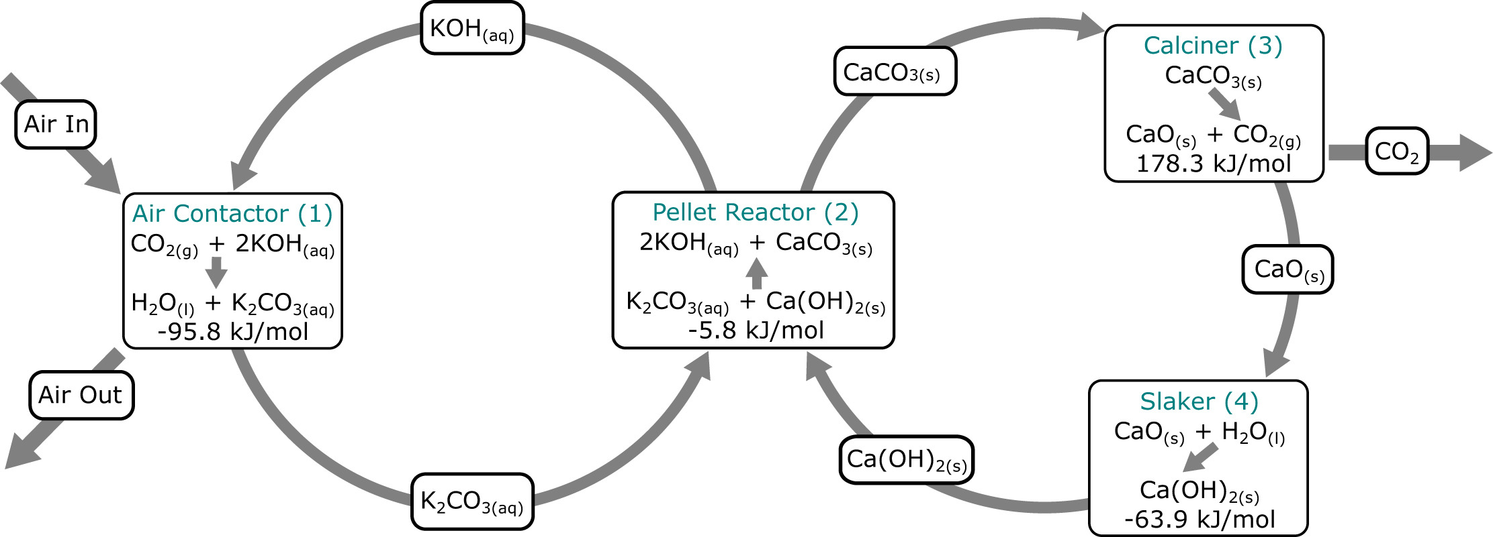
Using this heat for CO₂ capture
Process commercialized by Carbon Engineering for capturing CO₂. Air leaves with a CO₂ concentration of around 110 ppm. Energy required per ton of CO₂ captured and compressed at 150 bars: around 1.4 MWh of heat (at a temperature of more than 600 °C for the calciner – provided now by burning natural gas) and 0.4 MWh of electricity.
Source: https://carbonengineering.com/

Slide 42
What can be done with this CO₂?
Storing CO₂ underground.
Synthesize green fossil fuels using green hydrogen produced from water electrolysis with green energy. Example: the Sabatier reaction for producing CH₄
3. Transform CO₂ into graphite (pure coal) using, for example, the Bosch reaction, and building a mountain of coal.
High-temperature heat input can help optimise Solutions 2. and 3.

Slide 43
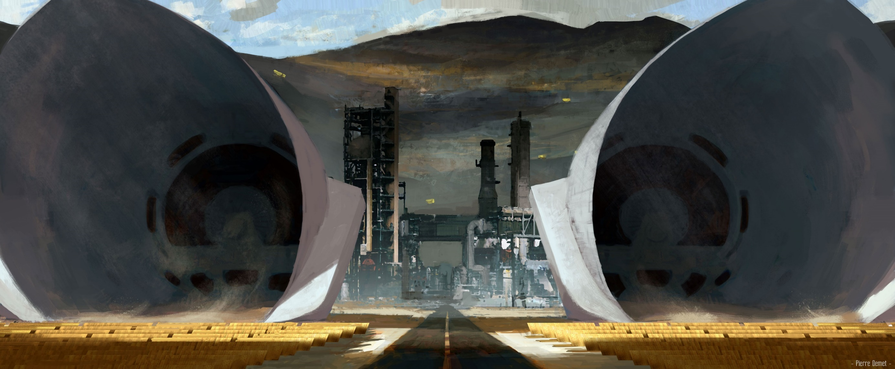

Slide 45
Energy needed to return to 280 ppm of CO₂
There are around 3.25 x 10¹² tons of CO₂ in the atmosphere. To return to preindustrial levels (280 ppm), $\frac{412−280}{412}$ * 3.25 x 10¹²=1.04 x 10¹² tons of CO₂ have to be removed from the atmosphere.
Removing 1 ton of CO₂ from the atmosphere requires (1.4+0.4)=1.8 MWh.
One ton of graphite generates 8.9 MWh when combusted. Due to the energy conservation principle, transforming one ton of CO₂ into graphite and O₂ would at least require $\frac{12}{(2∗16+12)}$ * 8.9 = 2.42 MWh of energy.
Transforming 1.05 x 10¹² of CO2 into graphite would require a minimum of 4,431,000 TWh of energy. This is 40 times our annual final energy consumption.

Slide 46
Burning this coal if one day the Earth is cooling down again
Source: 4.5 Billion Years of the Earth’s Temperature

Slide 47
Raw materials for generating CO₂-free energy
« Dig, baby, dig »
Consumption of materials in ton/MW | Nuclear | Photovoltaic panels | Wind turbines
Steel | 44 | 355 | 138
Concrete | 307 | 92 | 440
Copper | 1 | 5 | 4
Aluminium | 0,1 | 34,1 | 2,8
Source: Matières premières et énergie: les enjeux de demain, Olivier Vidal

Slide 48
How much raw material do we need every year to go 100% solar-, wind- or nuclear-powered? The answer:
World consumption in 2017 in millions of tons
Data: Load factor for PV = 0.2, Wind=0.3, Nuclear = 0.9. Lifetime (in years) PV= 30, Wind = 25, Nuclear = 60.

Slide 49
Moving mountains, literally
Chuquicamata copper mine (Chile).
Production in 2018: 321 kt.
: 32 Chuquicamata mines
: 21 Chuquicamata mines
: <1 Chuquicamata mine

Slide 50
Is extracting raw materials an environmental problem if the mining industry goes green?

Slide 51
Handling nuclear waste: The standard approach
LLW: Low-level radioactive waste
ILW: Intermediate-level radioactive waste
HLW: High-level radioactive waste
This is highly controversial.
The amount of HLW could be greatly reduced by reprocessing spent fuel and burning minor actinides in fast-neutron reactors (full nuclear cycle).
Reprocessing may, however, increase the volume of radioactive material due to contamination.

Slide 52
Low-level surface disposal in Dessel (Belgium)
Concrete monolith for storing low-level radioactive waste. Artist representation.

Slide 53
Deep geological disposal in Onkalo (Finland)

Slide 54
Sending long-lived radioactive waste to the Moon
The space industry is changing. We are entering the era of cheap space travel thanks to private entrepreneurs.
Reliability of rockets will improve and will drop dramatically.
Going to the Moon may soon become as common as crossing the Atlantic was a century ago.
Cost per kg sent into a geosynchronous transfer orbit.
Source: The New Rockets Racing to Make Space Affordable

Slide 55
See the video on Youtube: https://www.youtube.com/watch?v=Ff1kTF9Zv3Y

Slide 56
Energy spent sending nuclear waste to the moon versus energy generated by the uranium
We assume that the nuclear fuel cycle is limited to the production of MOX. From the 150 tons of uranium ore needed yearly for an EPR, only around 25 tons of enriched uranium enters the nuclear fuel cycle. We assume we want to send this amount to the moon. The EPR produces 13,008,600 MWh with this uranium.
Saturn V could send 40 tons to the Moon, consuming around 4000 MWh of fuel per launch.
Energy for sending 25 tons of waste to the Moon is 5203 less than the energy generated yearly by the EPR => From a standalone energy point of view, sending waste to the Moon is feasible.
Source: How do the Saturn V and other rockets compare with various nuclear bombs in terms of power, force, and energy?

Slide 58
Running out of renewable energy
Over the last 30 years, global energy consumption has grown at an average 2% per year.
The potential of renewable energy is limited. Limitations are induced also by land-use competition, and acceptance, together with resource quality and perhaps also remoteness.
For wind energy resources, the theoretical maximum is somewhere between 157,000 TWh and 594,000 TWh. Some authors predict that it could be as little as 9000 TWh in pratice.
Potential for solar energy is orders of magnitude higher, especially if solar PV can be harvested on oceans.
Source: Quantifying a realistic, worldwide wind and solar electricity supply ; Global Available Wind Energy with Physical and Energy Return on Investment Constraints

Slide 60
Covering the equivalent of Africa with PV panels
Let us suppose that the total feasible renewable energy potential is equal to the energy obtained by covering a quarter of Africa with 20%-efficient PV panels. With 60,000,000 TWh of solar energy reaching Africa every year, the total renewable energy potential would be of 12,000,000 TWh.
With a 2% energy consumption growth, $\frac{\ln\left(\frac{12,000,000}{111,000}\right)}{\ln\left(1.02\right)}=236$ years are needed to achieve this consumption level.
Fast-neutrons reactors would exhaust land reserves of uranium + 10% of sea water reserves in around 186 years if generating this amount of energy yearly.

Slide 61
Fusion to the rescue?
The deuterium-deuterium reaction:
Energy released by the fusion of 1 kg of deuterium is equal to 0.022 TWh. Sea reserve of deuterium: are 45 Tt (around 31 $\text{g} \text{per}$ ton of sea water against 0.003 g for uranium).
Energy generated through fusion of 10% of deuterium reserve in a 30% efficient generator: 3 x 10¹³ TWh, which would last for around 2,5 million years at a yearly global energy consumption level of 12,000,000 TWh.

Slide 62
Construction site of ITER (International Thermonuclear Experimental Reactor)
Final word: By the time human civilization reaches a level of energy consumption equivalent to the renewable energy potential of the Earth, it may have also reached a level of technological development that allows technical solutions other than fusion to generate additional energy.

Slide 63
Kardachev type I-II civilization

