Slide 1
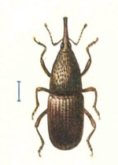
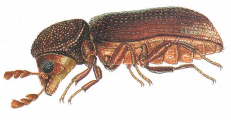
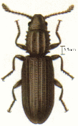
Laboratory of chemistry of natural molecules
1
Ir. Henri Martin
Pr. Marie-Laure Fauconnier
OILPROTECT – Development of new insecticides containing essential oils for grain storage

Slide 2
2
OILPROTECT project
WALInnov Project financed by DGO6 (Walloon Region - Belgium)
Collaboration between three Universities
ULiège – Gembloux Agro-Bio Tech
ULB – University of Brussels
UCL – University of Louvain
One industrial partner
Biosix Belgium

Slide 3
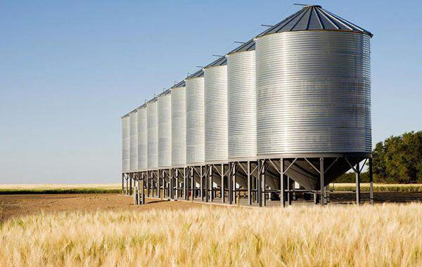
3
Table of content
1. Grain storage
2. Current solutions
3. Natural alternatives
4. Essential oils (EOs) as insecticides
5. Conclusions

Slide 4
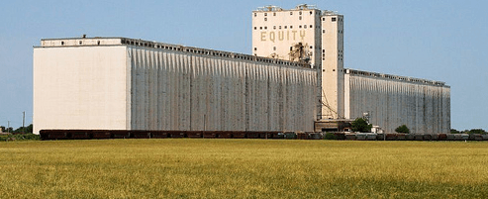
4
1. Grain storage
Grain global production (2019) :
2,7 billion tons (http://www.fao.org)
Importance of silos
Food : conservation → avoid food crisis
Agriculture → seeds conservation for future years
International trade
World’s Highest silo (Zurich, TZ).
Height : 118m, Capacity : 60 000 tons.
World’s largest silo (Hutchinson, Kansas). Capacity : 500 000 tons

Slide 5
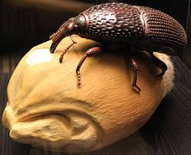
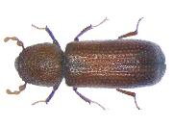
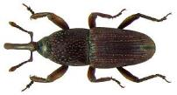
5
1. Grain storage
Grain storage issues :
Insects :
Eat grains
Lay eggs
Larvae development
Up to 30% of loss in silo
About 800 million tons a year
Oryzeaphilus surinamensis
Rhyzopertha dominica
Sitophilus granarius

Slide 6
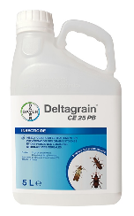
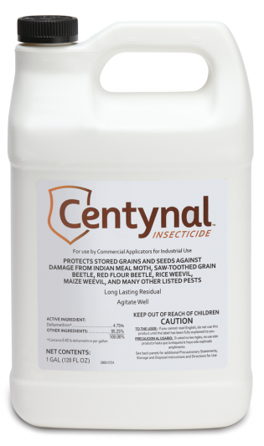
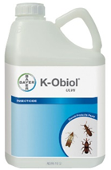
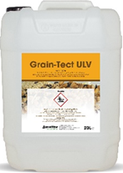
6
2. Current solutions
Synthetic pesticids
Ex: Chlorpyrifos-methyl, Deltaméthrine, Cyperméthrine, Pirimiphos-methyl, pyrethroids, …
Consequences
Effect on non-target organism & environment
Presence of residues
Development of insect resistances

Slide 7
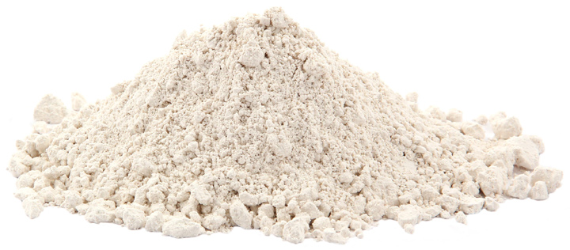
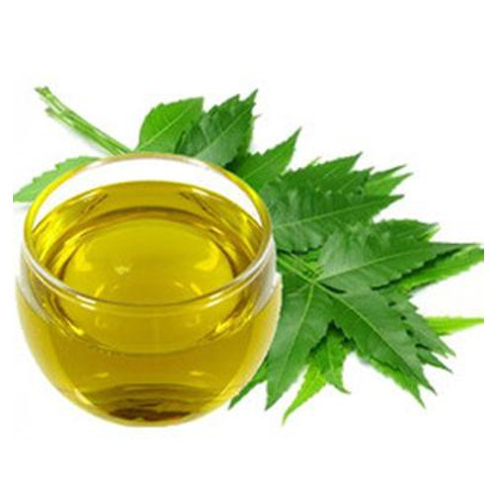
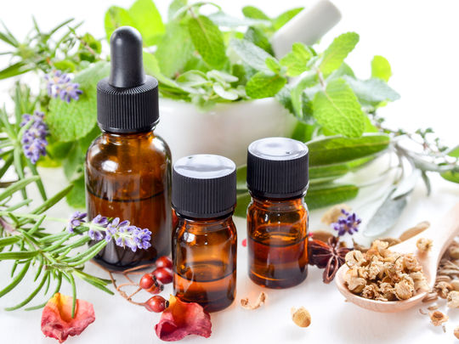
7
3. Natural alternatives
Diatomateous earth
Cuticle drying
Vegetable oils
Ex: Neem oil (Azadirachtin)
Essential oils (EOs)

Slide 8
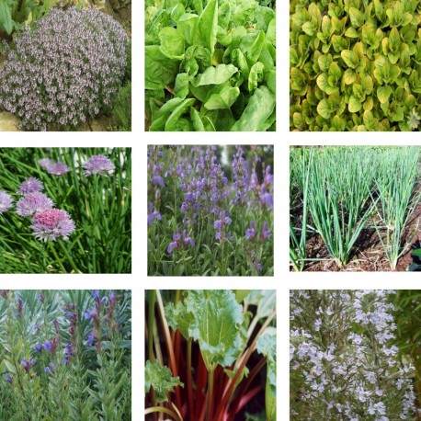
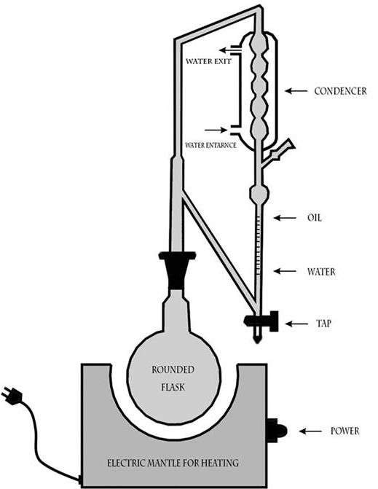
8
4. Essential oils as insecticide
Introduction
17 500 aromatic plant species
3000 essential oils
300 essential oils are used in industry
Essential oil extraction and distillation
Hydrodistillation
Mechanical process (citrus)
Dry distillation for woods
Solvent extract of plant = EO

Slide 9
9
4. Essential oils as insecticide
Composition
Volatile components : terpenes, benzene derivatives, hydrocarbons and other various compounds.
90% of monoterpenoids
Essential Oil = blend of compounds
Major compound(s) → main impact or not ?
Synergic effect or antagonist effect ?
Variation in composition
Season, location, part of the plant → chemotype

Slide 10
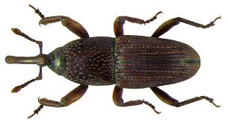
10
4. Essential oils as insecticide
Point of entry of toxins
ingestion
inhalation
Cuticle absorption

Slide 11
11
4. Essential oils as insecticide
Antifeedant effect
Insecticidal activity
Ex : Eugenol (Clove oil)
Repellent activity
Ex : Beta-Caryophyllene
(black pepper oil)
Fumigant activity
Ex : alpha-terpineol (pine oil)
Various modes of action
Neuronal activity inhibitor
Adenosine Triphosphatase (ATPase) activity inhibitor
Acetylcholinesterase (AChE) activity inhibitor
Octopaminergic receptors inhibitor

Slide 12
12
4. Essential oils as insecticide
Advantages
Less toxic for mammals
→ Octopaminergic receptor
Less residues
High volatility
biodegradability
Less insect resistances
→ mixture
Points of attention
Consequences on the product
Effect on organoleptic properties ?
Phytotoxic activity ?
Efficiency duration
High volatility
Oxidation
Light, temperature

Slide 13
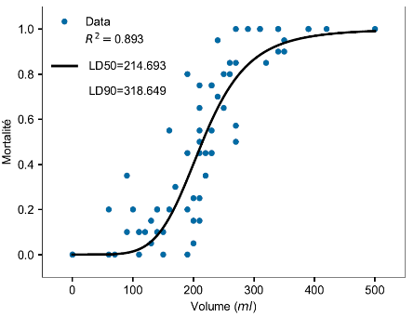
13
4. Essential oils as insecticide
How to find good candidates?
Screening of plants with insecticidal activity
Edible plants → less toxic
Medicinal plants
Other aspects
Availability of plant for a large scale production
Low price/kg of EO
Study of EO compostion
Study of different chemotypes
Quantify the insecticidal activity : LD50, LD90, …
→ µg of EO per insect and ml of EO per ton of grain
Mortality curve

Slide 14
14
4. Essential oils as insecticide
Formulation
Synergies
Improve the toxicity
Decrease the cost
Decrease the volume to spread
+
=

Slide 15
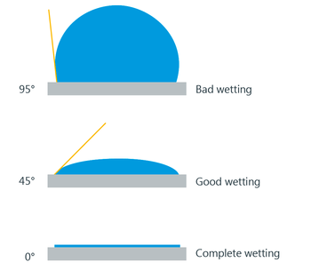
15
4. Essential oils as insecticide
Formulation
Contact angle
A small contact angle (insect) → increase wetting, improve penetration
On the contrary, a big contact angle (grain) → less residues

Slide 16
16
4. Essential oils as insecticide
Formulation
Penetration increasing

Slide 17
17
5. Conclusion
What about OILPROTECT?
Formulation of EOs + Natural adjuvents
→ Good mortality results in laboratory conditions
Need to try in the field (in big silos)
Need to undersand mode of action of our product
Study of proteomics (UCL)
Study of behaviour in silo (ULB)
Essential oils → promising alternative to synthetic insecticides
Need to be competitive : efficiency and cost
Solutions
Synergies between EOs
Formulation with adjuvents

Slide 18
18
Thank you for your attention!
Do you have any questions?
Contact: Henri Martin
henri.martin@uliege.be

