Slide 1


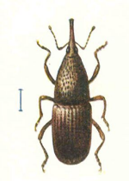
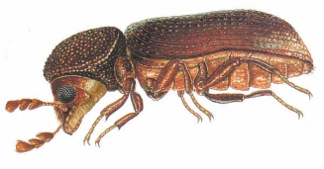
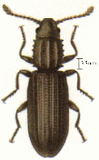



Laboratory of chemistry of natural molecules
1
Ir. Henri Martin
Pr. Marie-Laure Fauconnier
OILPROTECT - Essential oils valorization as insecticides for grain storage

Slide 2






2
OILPROTECT project
WALInnov Project financed by DGO6 (Walloon Region - Belgium)
Collaboration between three Universities
  ULiège – Gembloux Agro-Bio Tech
  ULB – University of Brussels
  UCL – University of Louvain
One industrial partner
  Biosix Belgium

Slide 3
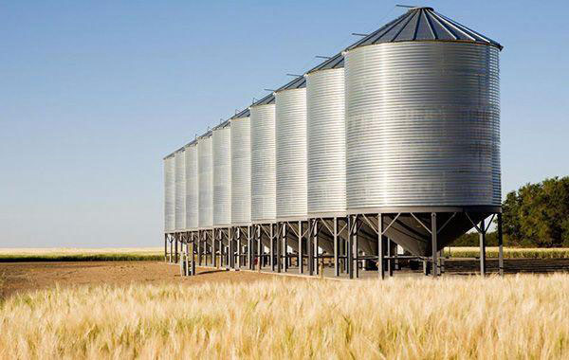
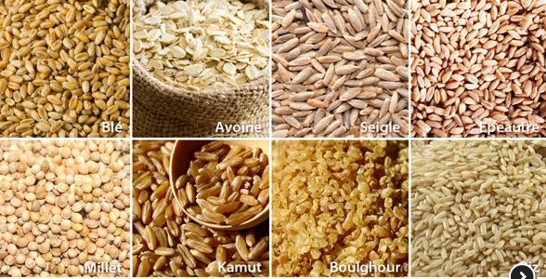
3
Table of content
1. Grain storage
2. Current solutions
3. Natural alternatives
4. Essential oils (EOs) as insecticides
5. Conclusions

Slide 4

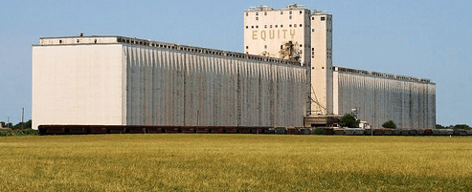
4
1. Grain storage
Grain global production (2019) :
  2,7 billion tons (http://www.fao.org)
Importance of silos
  Food : conservation → avoid food crisis
  Agriculture → seeds conservation for future years
  International trade
World’s Highest silo (Zurich, TZ).
Height : 118m, Capacity : 60 000 tons.
World’s largest silo (Hutchinson, Kansas). Capacity : 500 000 tons

Slide 5
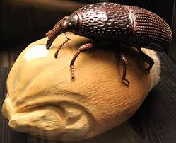

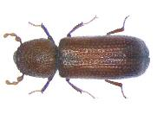
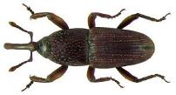
5
1. Grain storage
Grain storage issues :
  Insects :
    Eat grains
    Lay eggs
    Larvae development
  Up to 30% of loss in silo
    About 800 million tons a year
Oryzeaphilus surinamensis
Rhyzopertha dominica
Sitophilus granarius

Slide 6

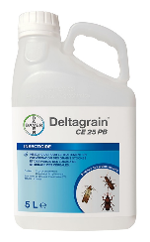
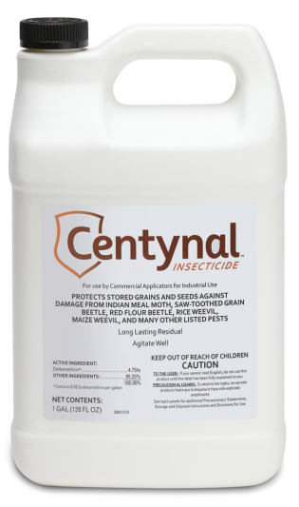
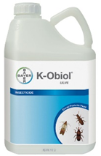
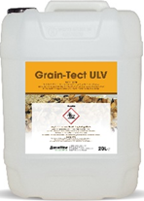
6
2. Current solutions
Synthetic pesticids
  Ex: Chlorpyrifos-methyl, Deltaméthrine, Cyperméthrine, Pirimiphos-methyl, pyrethroids, …
Consequences
  Effect on non-target organism & environment
  Presence of residues
  Development of insect resistances

Slide 7
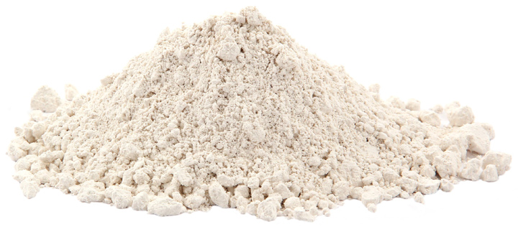
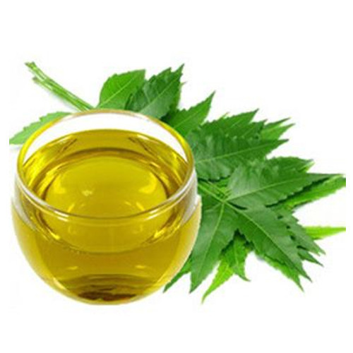
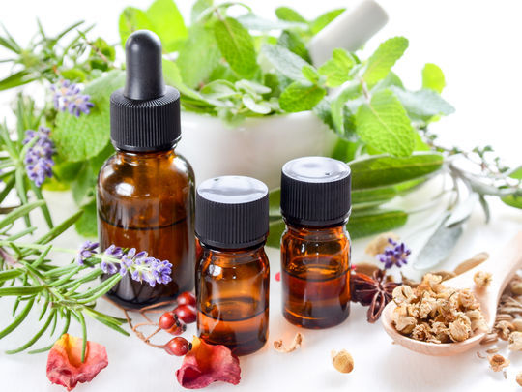
7
3. Natural alternatives
Diatomateous earth
  Cuticle drying
Vegetable oils
  Ex: Neem oil (Azadirachtin)
Essential oils (EOs)

Slide 8
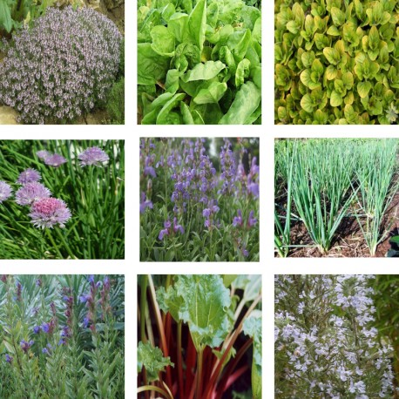
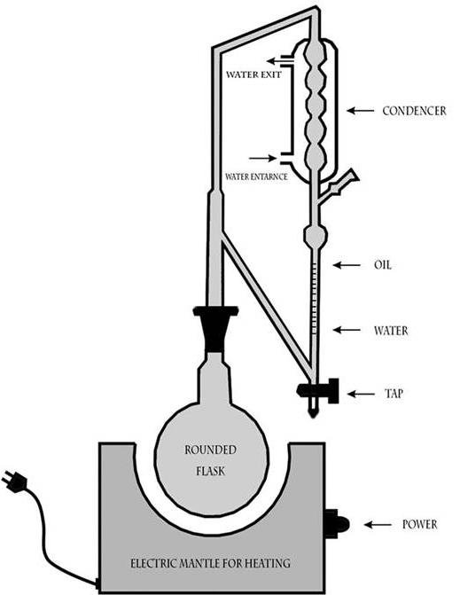
8
4. Essential oils as insecticide
Introduction
  17 500 aromatic plant species
  3000 essential oils
  300 essential oils are used in industry
Essential oil extraction and distillation
  Hydrodistillation
  Mechanical process (citrus)
  Dry distillation for woods
Solvent extract of plant = EO

Slide 9
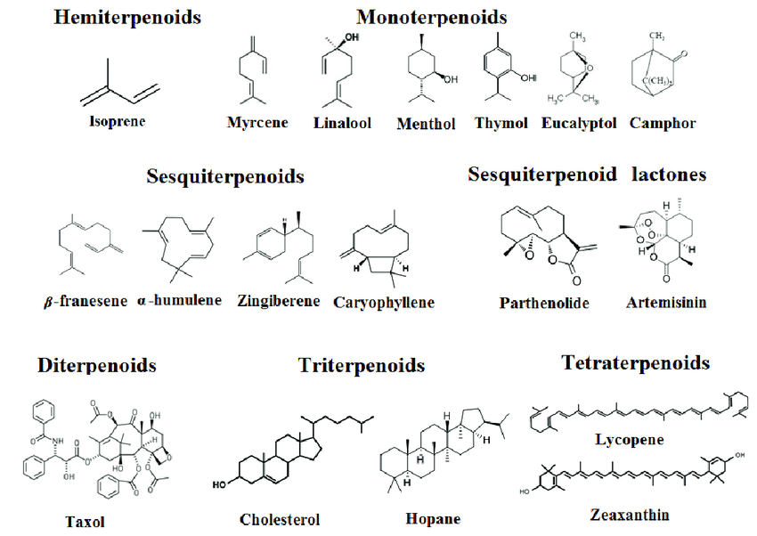
9
4. Essential oils as insecticide
Composition
  Volatile components : terpenes, benzene derivatives, hydrocarbons and other various compounds.
    90% of monoterpenoids
  Essential Oil = blend of compounds
    Major compound(s) → main impact or not ?
      Synergic effect or antagonist effect ?
  Variation in composition
    Season, location, part of the plant → chemotype

Slide 10
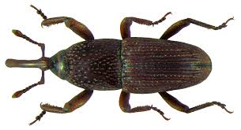
10
4. Essential oils as insecticide
Point of entry of toxins
ingestion
inhalation
Cuticle absorption

Slide 11
11
4. Essential oils as insecticide
Antifeedant effect
Insecticidal activity
  Ex : Eugenol (Clove oil)
Repellent activity
  Ex : Beta-Caryophyllene
  (black pepper oil)
Fumigant activity
  Ex : alpha-terpineol (pine oil)
Neuronal activity inhibitor
Adenosine Triphosphatase (ATPase) activity inhibitor
Acetylcholinesterase (AChE) activity inhibitor
Octopaminergic receptors inhibitor

Slide 12

12
4. Essential oils as insecticide
Advantages
  Less toxic for mammals
    → Octopaminergic receptor
  Less residues
    High volatility
    biodegradability
  Less insect resistances
    → mixture
Points of attention
  Consequences on the product
    Effect on organoleptic properties ?
    Phytotoxic activity ?
  Efficiency duration
    High volatility
  Oxidation
    Light, temperature

Slide 13
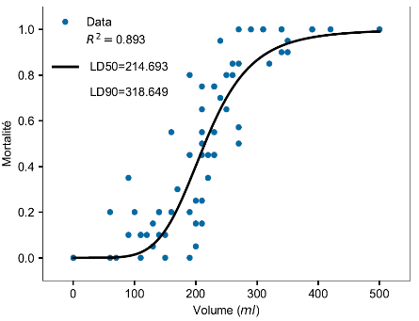
13
4. Essential oils as insecticide
How to find good candidates?
  Screening of plants with insecticidal activity
    Edible plants → less toxic
    Medicinal plants
  Other aspects
    Availability of plant for a large scale production
    Low price/kg of EO
    Study of EO compostion
    Study of different chemotypes
    Quantify the insecticidal activity : LD50, LD90, …
      → µg of EO per insect and ml of EO per ton of grain
Mortality curve

Slide 14

14
4. Essential oils as insecticide
Formulation
  Synergies
    Improve the toxicity
    Decrease the cost
    Decrease the volume to spread
+
=

Slide 15
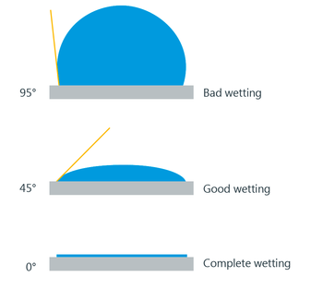
15
4. Essential oils as insecticide
Formulation
  Contact angle
    A small contact angle (insect) → increase wetting, improve penetration
    On the contrary, a big contact angle (grain) → less residues

Slide 16
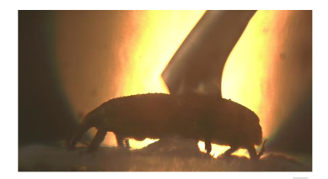
16
4. Essential oils as insecticide
Formulation
  Penetration increasing

Slide 17
17
5. Conclusion
What about OILPROTECT?
  Formulation of EOs + Natural adjuvents
    → Good mortality results in laboratory conditions
  Need to try in the field (in big silos)
  Need to undersand mode of action of our product
    Study of proteomics (UCL)
    Study of behaviour in silo (ULB)
Essential oils → promising alternative to synthetic insecticides
Need to be competitive : efficiency and cost
  Solutions
    Synergies between EOs
    Formulation with adjuvents

Slide 18


18
Thank you for your attention!
Do you have any questions?
Contact: Henri Martin
henri.martin@uliege.be

