Slide 1
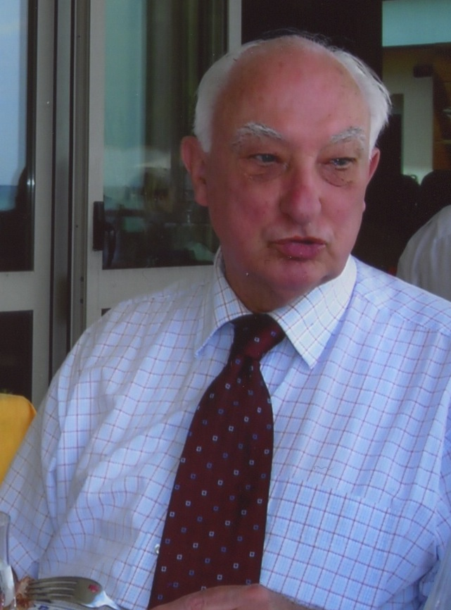
Hans Ankum and the sihda
Jean-François Gerkens (University of Liège)

Slide 2
Société d’Histoire des Droits de l’Antiquité – Fondation universitaire de Bruxelles
During the war, Fernand De Visscher and his colleagues meet every month.

Slide 3
December 1945: 1st international session

Slide 4
First sessions
1945 : I. Bruxelles
1947: II. Bruxelles
1948: III. Bruxelles
1949: IV. Bruxelles
1950: V. Bruxelles
1951: VI. Bruxelles
1952: VII. Florence/Sienne: U.E. Paoli
1953: VIII. Barcelone: J. Iglesias
1954: IX. Nancy: J. Imbert
1955: X. Bruxelles
1956: XI. Leiden

Slide 5
Leiden 1956

Slide 6
International sessions
1956 : XI. Leiden/Amsterdam (J.C. van Oven / R. Feenstra)
1957: XII. Oxford (D. Daube)
1958: XIII. Trieste (R. Ambrosino)
1959: XIV. Fribourg/B-Bâle (F.Pringsheim/H.J.Wolff/J.Fuchs)
1960: XV. Dijon (J. Paoli / J. Portemer)
1961: XVI. Split (Horvát)
1962: XVII. Turin (G. Grosso)
1963: XVIII. Bruxelles (F. De Visscher – last time)
1964: XIX. Glasgow/Aberdeen (Thomas / Stein)
1965: XX. Paris (Robert Villers – FDV is dead)

Slide 7
Perugia 1967

Slide 8
International sessions
1966: XXI. Salamanca (P. Fuenteseca: Société « F.De Visscher »)
1967: XXII. Pérouse (M. De Dominicis)
1968: XXIII. Fribourg Suisse (F. Wubbe)
1969: XXIV. Amsterdam (P.Verdam / H.Ankum)
1970: XXV. Vienne (W.Selb / H.Hausmaninger / B.Schmidlin)
1971: XXVI. Bordeaux (J.Ellul / P.Jaubert / E.Dravasa)
1972: XXVII. Dublin (J. Kelly)
1973: XXVIII. Athènes (P. Dimakis)
1974: XXIX. Cologne (H.Hübner / E.Klingmüller / A.Wacke)
1975: XXX. Oviedo (A. Torrent)
1976: XXXI. Trieste (G. Impallomeni)

Slide 9
Hans Ankum’s papers at the SIHDA
In German in Vienna 1970, Cologne, 1974, Salzburg 1988, Miskolc 1991, Vienna 1994 and Bochum 2005 (6).
In English in Oxford 1993 and New Orleans 1995 (2).
In Italian in Ferrara 1989 and in Messina 1997 (2).
In French : Bordeaux 1971, Athens 1973, Oviedo 1975, Trieste 1976, Perugia 1977, Ankara 1978, Palermo 1979, Brussels 1980, Madrid 1981, Perpignan 1982, Cairo 1983, Athens 1984, Namur 1985, Stockholm 1986, San Sebastian 1987, Sevilla 1990, Brussels 1996, Madrid 1998, Antalya 2000, Rotterdam 2001, Clermont-Ferrand 2003, Brasil 2004, Komotini 2006, Catania 2007, Fribourg 2008, Kavala 2009, Barcelona 2010 (27).

Slide 10
Hans Ankum’s position in the SIHDA
SIHDA Kavala 2009

Slide 11
International sessions
1986: XL. Stockholm
1987: XLI. San Sebastian
1988: XLII. Salzburg
1989: XLIII. Ferrara-Padova-Modena
1990: XLIV. Sevilla
1991: XLV. Miskolc
1992: XLVI: Amsterdam
1993: XLVII. Oxford
1994: XLVIII. Vienna
1995: IL. New Orleans
1996: L. Brussels

Slide 12
Hans Ankum’s interventions to improve the quality of the papers
SIHDA Kavala 2009

Slide 13
Hans Ankum and the extension of the SIHDA
SIHDA Kavala 2009

Slide 14
Hans Ankum and the future of the SIHDA
SIHDA Kavala 2009

Slide 15
Thank you for everything Hans!
SIHDA Kavala 2009

