Slide 1



Molecular Biophysics: A Novel Integrative Approach to Investigate Bioherbicide Mode of Action of Essential Oils
Marie-Laure Fauconnier and Laurence Lins
Laboratory of Chemistry of Natural Molecules
Laboratory of Molecular Biophysics at Interfaces
Notes:
As you can see we are in two
Research in essential oil field is becoming more and more multidisciplinary that’s why we are a duo of speakers today to present our recent work on molecular biophysics as a tool to investigate bioherbicide mode of action of essential oils

Slide 2
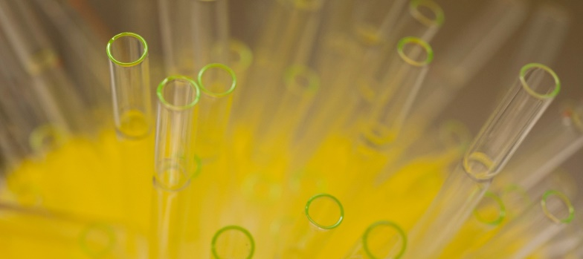
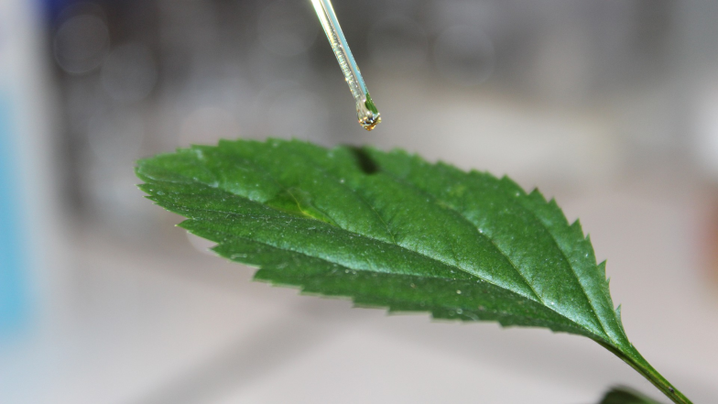
Fields of use of essential oils
« Historic applications »
  Flavoring / preservative agent in food
  Fragrance in cosmetics
  Aromatherapy / massage
  Human and animal health
  …
Recent trends in agronomy: bio-based pesticide or biopesticide
  Antimicrobial agent
  Antifungal agent
  Insecticide
  Herbicide
Notes:
During this symposium a lot of talks and posters were related to various uses of essential oils. The classical and well-known one are ….
More recently the trend is to use them for applications in agronomy as bio-pesticide
Like antimicrobial agent, antifungal agent or insecticides. During this symposium we have seen a lot of examples of use of essential oils as insecticide
But also as herbicide which is quite new. Of course we are not the first one to discover that essential oils can kill plants but the development of herbicide is more recent tan other applications

Slide 3
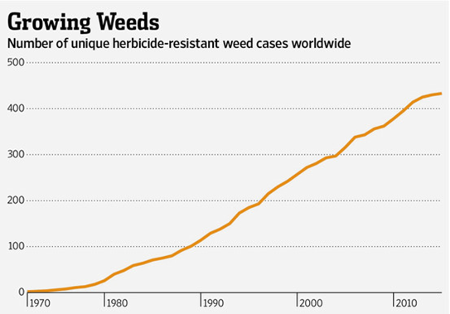
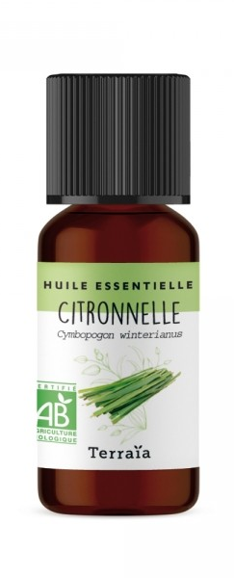

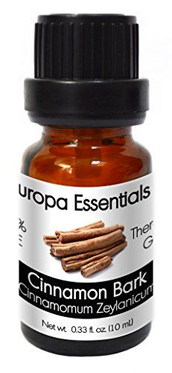
Essential oils as bio-herbicides
Conventional herbicides
- resistance
- impact on environment
- impact of human health
high demand for bio-based herbicides
Development of a bio-herbicide based on essential oils
Cinnamon
EO
Java Citronella
EO
Notes:
As you know, conventional herbicides presnet several problems like resistance, you can see here a graphic with the number of unique herbicide resistant weeds but there are also negative impact on environment and human health.
everyone here knows about the glyphosate problem
There is a strong demand for bio-based herbicides which puch us to develop a bio-herbicide based on essential oils. After a large screening we selected cinnamon and java citronella essential oil for our research.

Slide 4
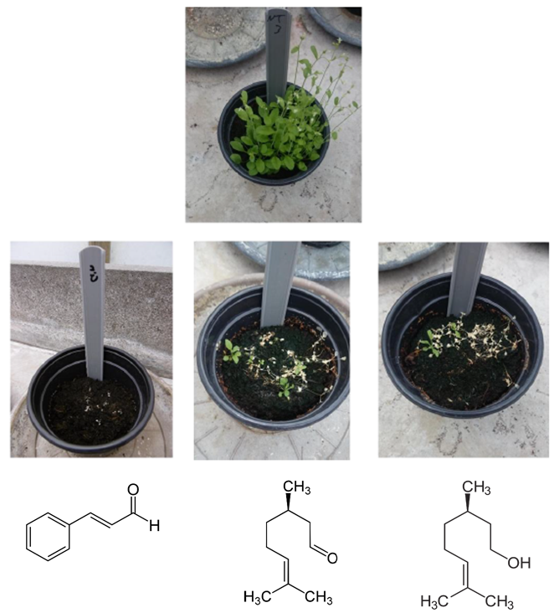
Bio-herbicide based on essential oils
Herbicidal activity after 7 days (A. thaliana)
Cinnamon
EO
3%
Citronel
la
EO
3%
Pelargonic
acid
Glyphosate
Blanck
Non
treated
Cinnamaldehyde
Citronellal
Citronellol
Int. J. Mol. Sci. 2019, 20, 4007; doi:10.3390/ijms20164007
Notes:
You can see here the herbicidal activity of the two essential oils tested on arabidopsis thaliana seven days after application. We used a 3 % emulsion of the essential oils and compared to two classical herbicide: pelargonic acid a bio-based herbicide largelly commercially available and the famous glyphosate. As you can see we obtained high herbicidal activities with our two essential oils preparation that are comparable to conventional herbicides.
We also tested some main compounds of essential oils : cinnamaldehyde from cinammon oil and citronellal and citronellol from java citronella oil. You can see again a strong herbicidal activity seven days after application

Slide 5
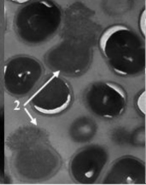
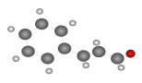
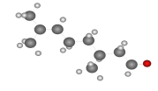
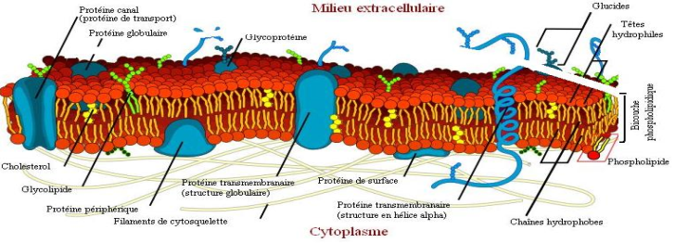
Bio-herbicide based on essential oils
Action modes of Eos as herbicide?
  waxy cuticular layer removal
  disruption of microtubule polymerization
  cellular respiration decrease
  mitosis inhibition
  ion leakage and membrane depolarization
  oxidative damages
  chlorophyll content decrease
Membrane damage to E. Coli and S. aureus by cinnamaldehyde (Shen et al, Food control,2015)
detailed molecular mechanisms ??????
  small amphiphilic molecules
  Could interact with the plant plasma membrane?
  Demonstrated in fungicide and bactericide activities
?
Notes:
So we have a very good herbicidal activity but we wanted to go deaper in the mode of action at molecular level
What is described in literature is

Slide 6
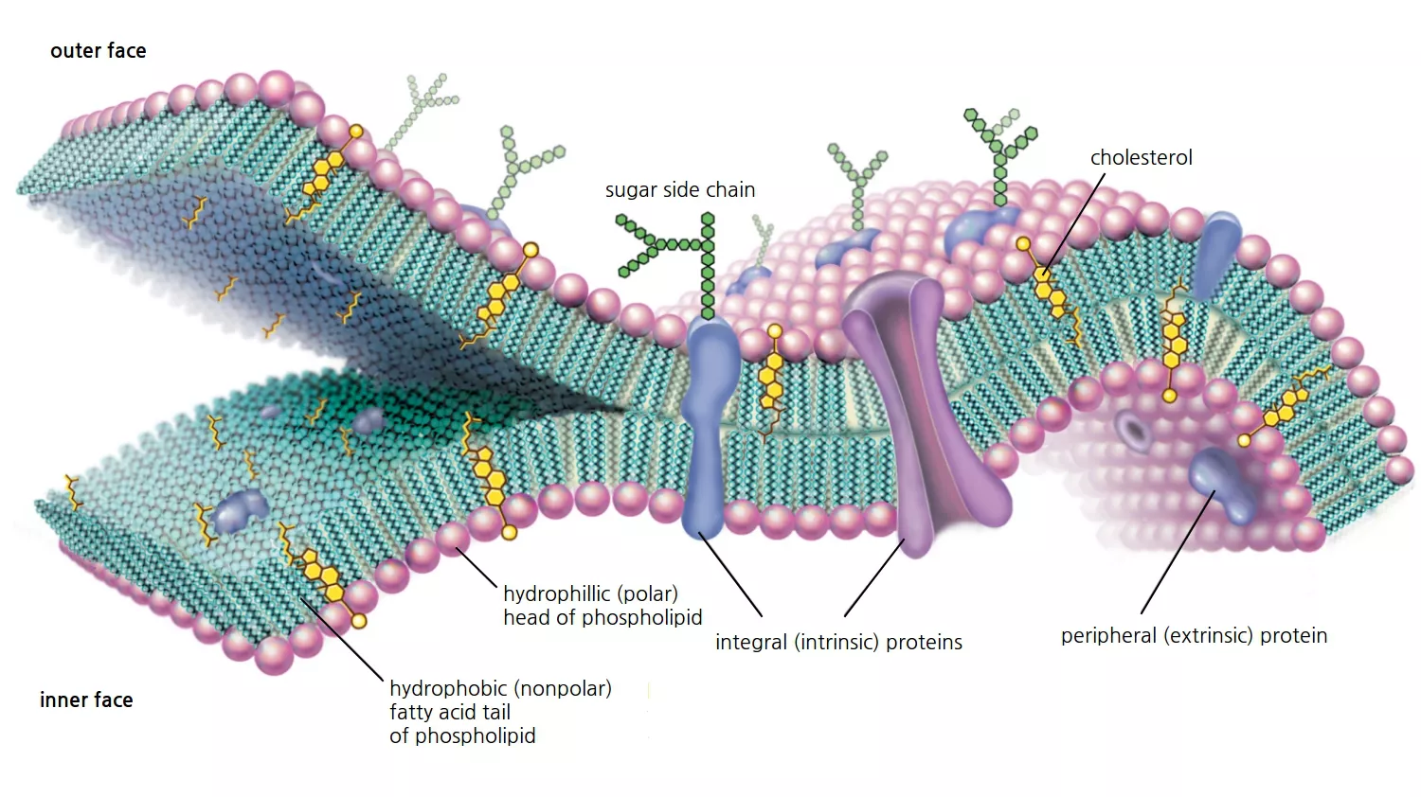
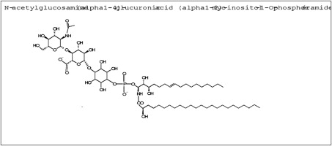
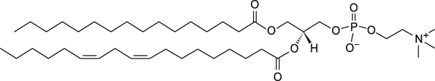
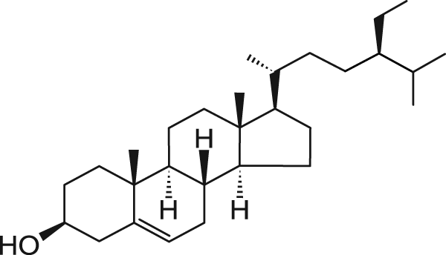
Plant plasma membrane
Adapted from Encyclopædia Britannica, Inc
Sterols
Glycerolipids
Sphingolipids
Palmitoyl linoleoyl Phosphatidylcholine (PLPC)
β-Sitosterol
Glycosyl inositol phosphoceramides (GIPC)
Model membranes PLPC/sito 80/20 with 10% CitO, CitA or CIN
Notes:
La membrane plasmique de plante est très complexe, elle est composée d’une grande diversité lipidique, de protéine ancrées dans la membrane, de sucre, ,,,

Slide 7



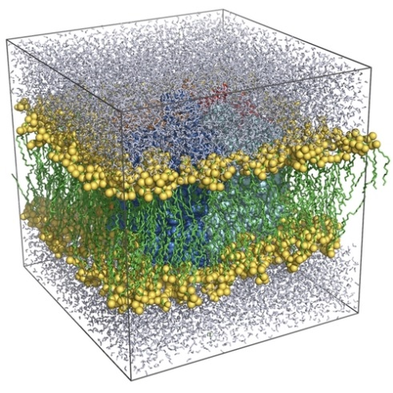
?
In silico approaches
In vitro biophysical tools
[liposomes]
[mol bioactive]
Molecular dynamics simulations
Isothermal titration calorimetry (ITC)
Lipid Permeability

Slide 8
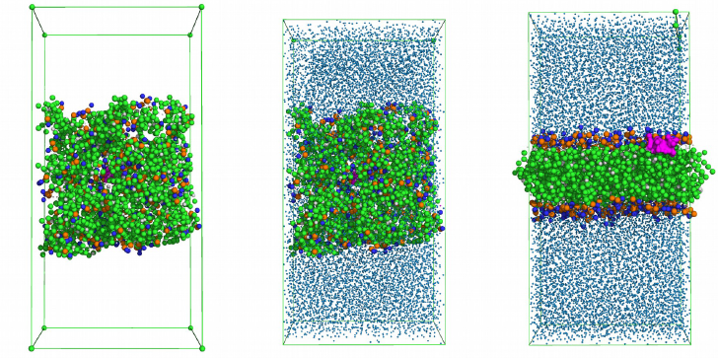
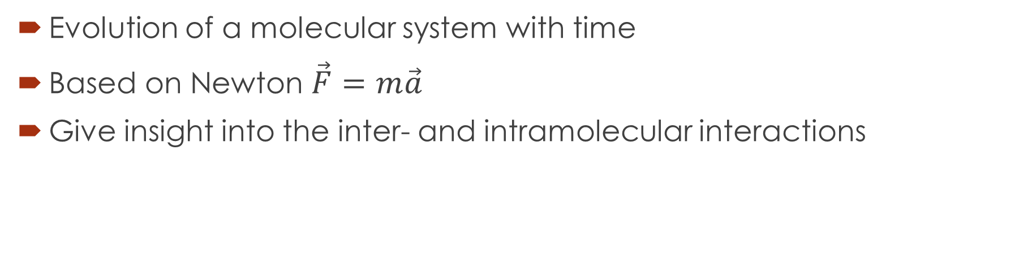
MD simulations
Evolution of a molecular system with time
Based on Newton $\vec{F}=m\vec{a}$
Give insight into the inter- and intramolecular interactions
Adapted from Crowet et al. (2012)

Slide 9
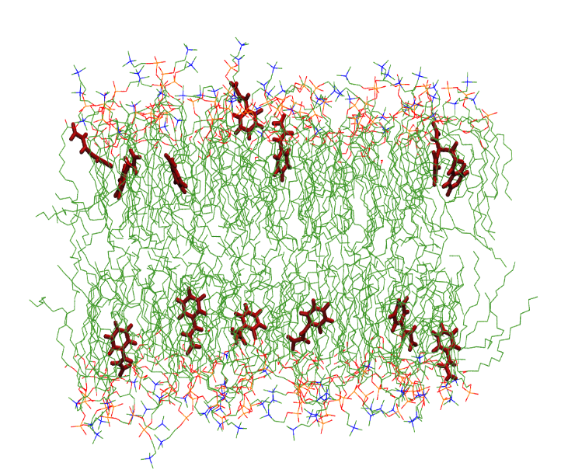
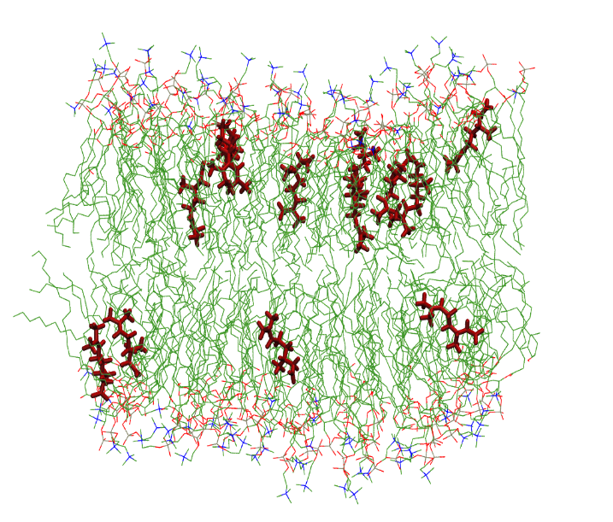
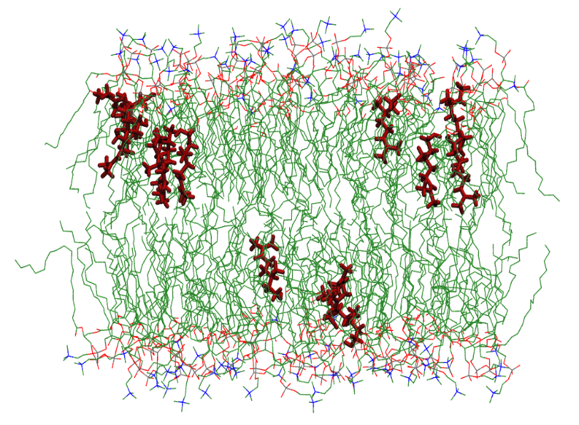

The EO molecules can insert into a model PPM
Polar heads
Hydrophobic tails
One lipid leaflet
CIN
CitA
CitO

Slide 10
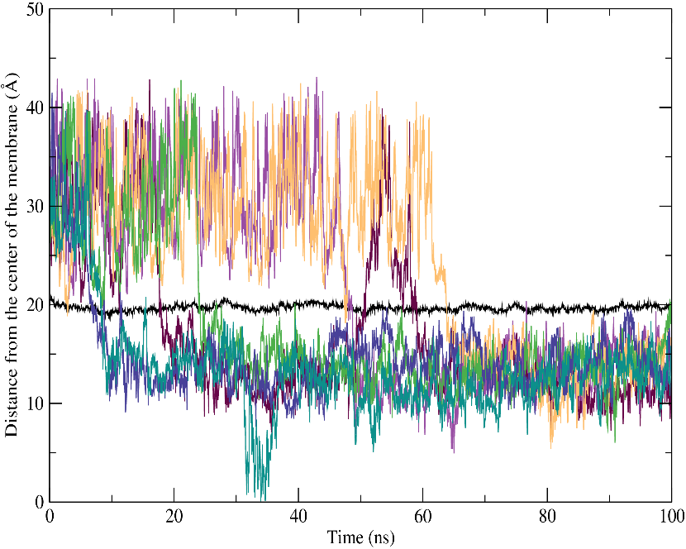
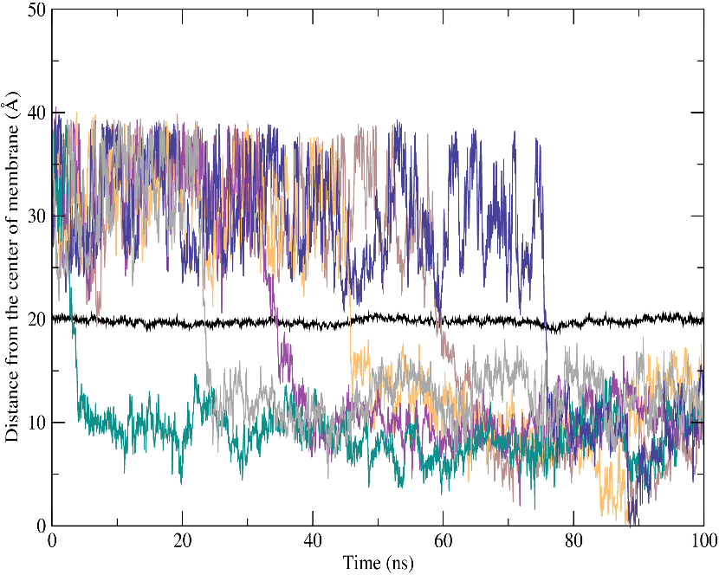
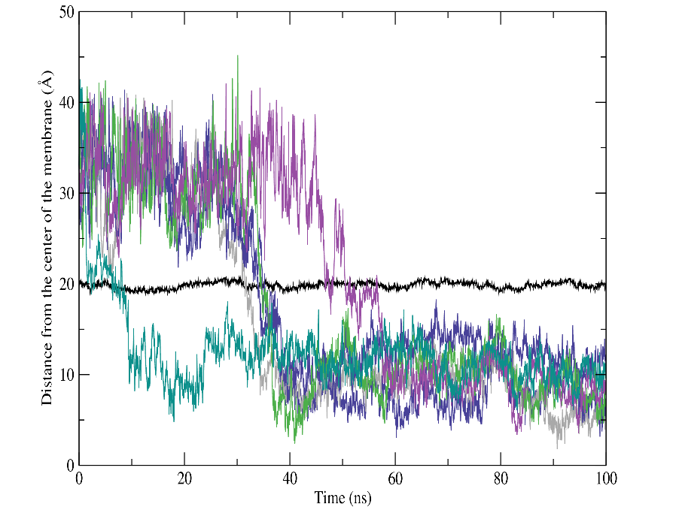
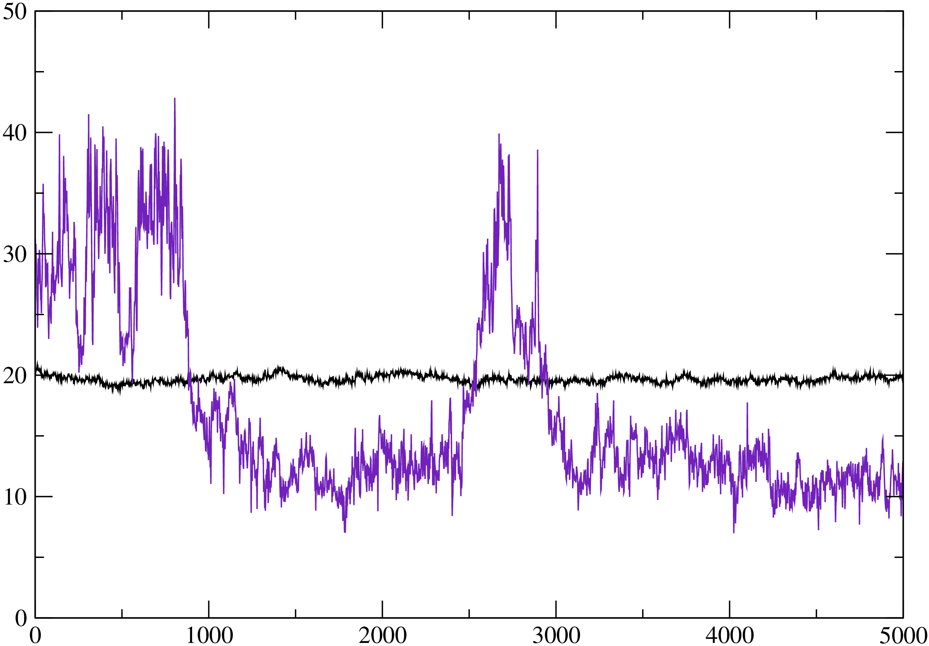
CIN, CitA et CitO have a different behavior
CIN
CitA
CitO
Insertion CIN less deeper than CitO/CitA
CIN can get out of the membrane

Slide 11
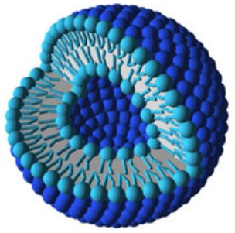
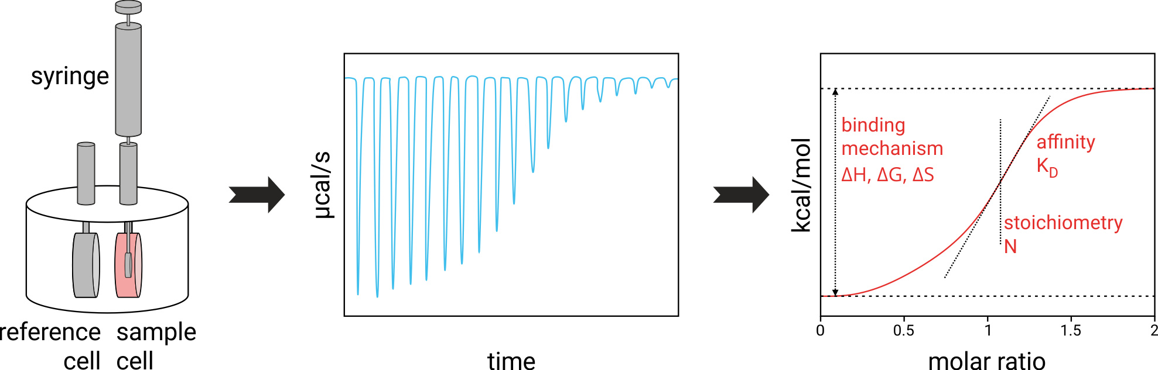
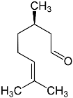
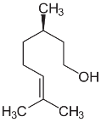

Isothermal Titration Calorimetry (ITC)
Full thermodynamical characterization of the interaction
(∆G, ∆H, ∆S, K_{D})
PLPC/sito liposomes
[liposomes]
[bioactive mol]

Slide 12
CitA et CitO interact with the membrane but not CIN

Slide 13
compound | K (mM⁻¹) | ∆H_{D}^{W→D} (kj.mol⁻¹) | T∆S_{D}^{W→D} (kj.mol⁻¹) | ∆G_{D}^{W →D} (kj.mol⁻¹)
Citronellal | 0.0307 ±0.004 | 5.13 ±0.64 | 21.62 ±0.34 | -16.53 ±0.93
Citronellol | 0.0147 ±0.006 | 5.05 ±0.52 | 23.28 ±0.50 | -18.47 ±0.46
K for PLPC/sito liposomes similar for CitA and CitO
Interaction is entropy driven (hydrophobic)

Slide 14
Fluorescence assays
No permeabilization of the membrane
Notes:
Un canal ionique de la membrane de mammifère appelé Ankyrin-1 (TRPA-1) qui est activé par le froid.

Slide 15
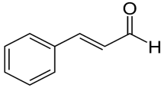
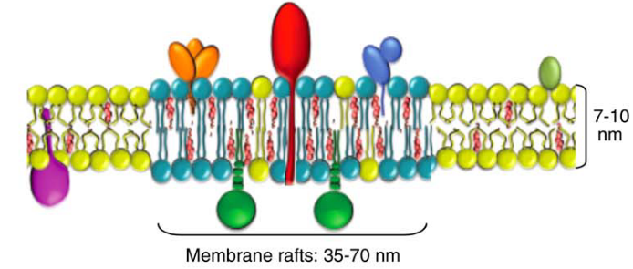
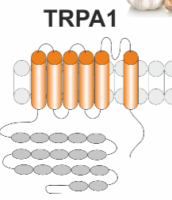
How is the membrane activity of EO components related to their herbicidal effects ?
CitO/CitA
no membrane permeabilization/effects of sterol:
Metabolism perturbation via interaction with lipid domains (signalling platform) ?
CIN
no direct interaction with the lipid membrane:
Interaction with membrane receptors ?
GCPR (phenylpropanoid receptors)
Signalling pathways modified
Int. J. Mol. Sci. 2019, 20, 4007; doi:10.3390/ijms20164007
Notes:
transient receptor potential ankyrin 1 (TRPA1) work as initiators and gatekeepers of nociception and inflammation. Cinnamaldehyde evoked significant spontaneous pain and induced heat and mechanical hyperalgesia, cold hypoalgesia and a neurogenic axon reflex erythema.

Slide 16
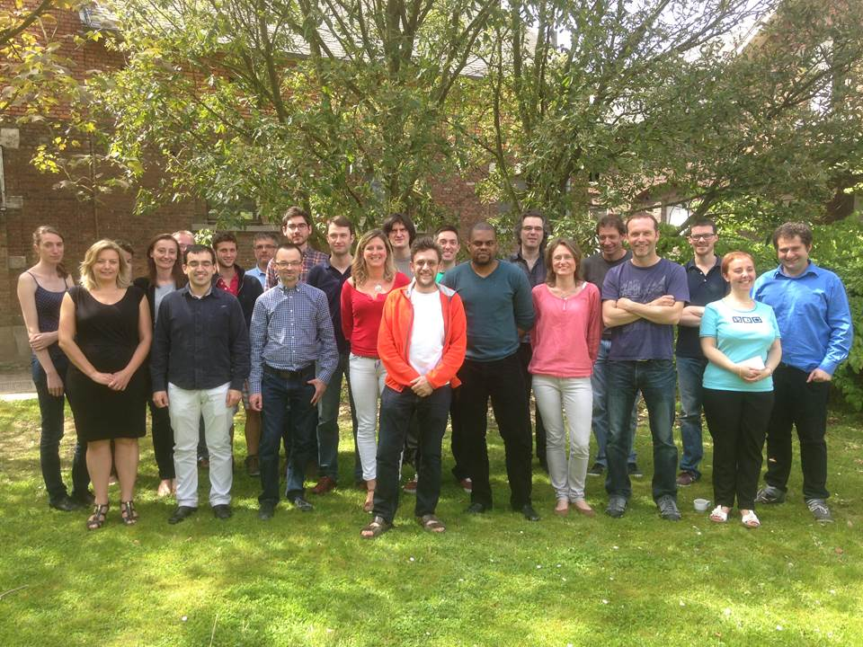
Conclusions
Promising herbicide activities
More than one action mode
Many work to be done …
  Formulation
  Environment effects
  More in depth action mode studies
Notes:
So we have promising herbicide activities it is not shown here but we have nice results in field conditions. The herbicide will be patented soon and a spin off of our university is working on commercialisation of the product. What is very positive is that we have more than one mode of action which is promising to avoid resistance mechanism.
But a lot of work is still to be done
We have to optimize formulation and test

Slide 17

Thank you for your attention

