Slide 1
Crop production and food consumption for farmers’ welfare in Rwanda
Aristide Maniriho (UR, ULiège)
Edouard Musabanganji (UR)
Philippe Lebailly (ULiège)
10th AgroSym - International Conference
Jahorina, October 4, 2019

Slide 2
Outline of the presentation
Introduction
Materials and Methods
Results and Discussions
Conclusion and Recommendation

Slide 3
1. Introduction
Agriculture is a source of livelihood for increasing population in the world
It provides mainly food and is expected to avail enough income to farmers and thus improve their livelihood through the increased yield.
However, the available resources (mainly land and labour) are not used for high productivity, and this constrains the agriculture to assume appropriately its role in economic development of mainly availing enough food to the population of a country and providing the surplus for exports (Johnston & Mellor, 1961) .

Slide 4
In Rwanda, the current statistics show that the agriculture sector increased at the growth rate of 6% in 2018, while the whole economy increased at 8.6% (NISR, 2018a).
Notwithstanding all these efforts and the agriculture development achievements, the malnutrition issues are still crucial among Rwandans especially the stunting cases (World Bank Group, 2018) at the countrywide rate of 35% (NISR, 2018b).
This study aims to assess the prospects of crop production and food consumption for farmers’ welfare in Rwanda.

Slide 5
2. Materials and Methods
(1) Source of Data
Data collected by the NISR-Rwanda
5th cohort of the Cross-sectional Survey on the Households’ Living Conditions /EICV-5 conducted in 2016/2017.
Data covers all socio-economic aspects of the households
It is a nationwide survey covering rural and urban areas
EICV-5 Sample: 14,580 households, including 12,054 rural households and 2,526 urban ones.
Study Sample: only 11,801 households due to missing value on interesting variables.

Slide 6
(2) Model formulation and Estimation
Following Gujarati (2009) and Wooldridge (2013), a model to be estimated for this study was specified as follows:
Where Y is a dependent variable (food consumption, or crop production), Xs are independent variables, is a disturbance term, s are parameters to be estimated.

Slide 7
(2) Model Estimation and Data Analysis
Two models were specified and estimated:
One is the linear model that included both farm inputs and socioeconomic characteristics of farmers (following the application by Mpawenimana, 2005 as an example),
while the other is a Cobb-Douglas production function that included exclusively the farm inputs (see Debertin, 2012 for details).
For linear model, OLS method is not giving consistent estimators
Presence of missing variables, and/or some covariates that are correlated with the error term (Wooldridge, 2013).
The most common approach to use is the instrumental variables (IV) model (Angrist & Pischke, 2009; Fisher, 2010).
The 2-SLS method used as it is the most used estimator of IV regression model, and allows addressing the Endogeneity concern and Simultaneity bias.
Notes:
Endogeneity that may be caused by omitted variables and unobserved heterogeneity
Simultaneous bias resulting in the Correlation between Error terms and Explanatory variables

Slide 8
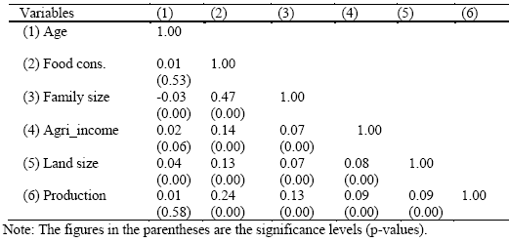
3. Results and Discussions
Pairwise correlations of the continuous variables

Slide 9
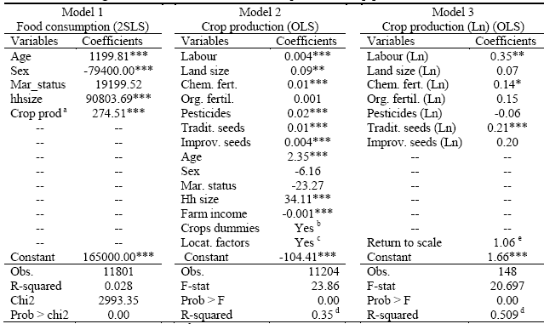
2. Linear regression estimates of food consumption and crop production
Notes:
In model 1: Crop production was instrumented with land size, farm income, chemical and organic fertilizers, traditional and improved seeds, as well as pesticides.

Slide 10
The 2SLS estimates from Model 1 indicated that food consumption was positively influenced by the age and the marital status of the household head, as well as the household size, while it was negatively affected by the sex of the household head. For the crop production, the log-log model (R2=0.39) was superior to the linear model (R2=0.36).
The results revealed that the crop output increased with the increase in inputs (labour, chemical fertilizers, organic fertilizers, pesticides, and traditional seeds) in line with the existing literature in economics (Dwivedi, 2006; Schotter, 2009; Besanko et al., 2011; Debertin, 2012).
The results also show that the crop system uses intensively the organic fertilizers (given their elasticity of 0.38) followed by labour (elasticity=0.21). This implied that the use of chemical fertilizers should be enhanced if the increasing crop productivity is to be achieved.

Slide 11
4. Conclusion and Recommendations
This study attempted to assess the way farmers’ welfare is affected by crop production and food consumption in Rwanda.
The results from linear regression analysis showed that the increase in agricultural inputs lead to a significant increase in crop output with increasing return to scale.
The most influential inputs were organic fertilizers, labour and pesticides and the agriculture scored increasing returns to scale. The results from econometric estimations and other statistical tests led to state that crop production was among the primary drivers of famers’ welfare besides the farm income, the land size and the family size.
From these findings, we recommend that the strategies to increase the crop yield and farm income and thus sustain food consumption and improve farmers’ welfare should be enhanced.

Slide 12
Thank you for your kind attention

