Slide 1

‘The notions of mobile workers’
Pontignano XXXVI Seminar | Group 1

Slide 2

Topics
Notions of mobile workers
1.
Context of the phenomenon
2.
Scope of the research
3.
Categories of mobility

Slide 3
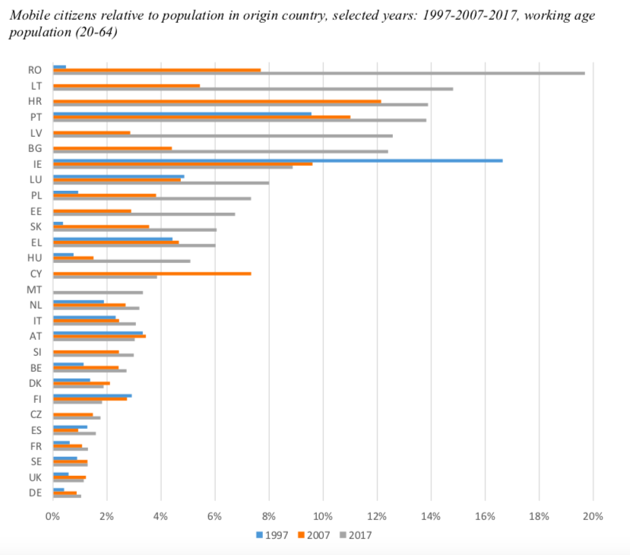

1.
Source:
Centre for European Policy Studies 2019
Context of the phenomenon

Slide 4

2.
Different concepts
European level
Free movement ; ECJ in Lawrie-Blum: work ; remuneration; link of subordination
Extension through case law to other fields
Some social protection Directives: back to national definitions
Safeguards by the Court (ex; Betriebsrat der Ruhrlandklinik case)
National level
Great variety;
Intermediary category between employed and self-employed workers
Work; Remuneration; Link of subordination (ex: Belgium)
In this research: subordinate workers (no self-employed workers)
What workers?
Scope of this research on ‘mobile workers’

Slide 5

2.
Types of mobility:
- Geographical
- Professional mobility
France
Italy
In this research: only geographical will be taken into account
Mobility
Scope of this research on ‘mobile workers’

Slide 6

3.
Worker mobility
1. ‘Within the labour market’
2. ‘Within the employment contract’
EU worker finds work in own Member State
EU worker finds work in another Member State
EU worker finds a job in non-EU country
Non-EU worker finds a job in a Member State
EU worker moves within own Member State
EU worker is send to another Member States
EU worker is send to a non-EU country
Non-EU worker is send to a EU country
Categories of mobility
3. Topical issue: highly mobile workers and expats
Notes:
Amber

Slide 7

1. ‘Within the labour market’
(a) EU worker finds work in own Member State
National (local) restrictions? Some examples:
Italy
  Bolzano case: language knowledge + residency
Spain
  Catalunya, Valencia, Balearic Islands, Basque country: language
Belgium
  Wallonia, Brussels and Flanders
Notes:
Peter

Slide 8

2. ‘Within the labour market’
(b) EU worker starts to work in another Member State
Freedom of workers
Social security coordination
Restrictions for incoming workers
  Public order exception (example: Austria)
  Practical: linguistic requirement for the contract (Belgium)
Restrictions for outgoing workers
  - Can a MS prevent national workers to work elsewhere?
  Incentives for loyalties (example: Austria)
Notes:
Peter

Slide 9

2. ‘Within the labour market’
(c) EU worker switches job to work outside of the EU
Possible: restrictions of the third country
Bilateral association agreements
Notes:
Amber

Slide 10
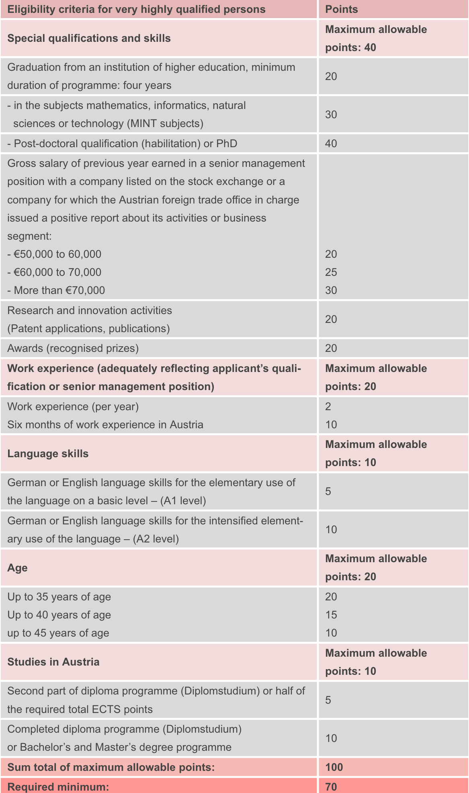

2. ‘Within the labour market’
(d) Third (non-EU) worker wants to work inside the EU
National immigration laws:
No harmonisation in the EU - some particularities
  Restricted systems
    Quota’s (Italy)
    Only if no priority enjoying workers ; national and EU (the Netherlands, Germany and Austria)
    Difficult coverage employment list (Spain, Austria and France)
    Only highly skilled workers or talented workers (example: the Netherlands, Austria and France)
  Illustration: Point System in Austria
Bilateral association agreements
Notes:
Together

Slide 11

2. ‘Within the employment contract’
(a) EU worker moves within the same country
‘Posting’ or secondment in national situations
National rules and policies
Some examples: Italy and NL
  Italy: strict provisions to limit the use of secondment (requirements mentioned in the national report)
  The Netherlands: no legal definition of posting (only ‘secondment’). Policy focus on ‘sham arrangements’ that are allegedly used to evade the applicability of binding employment laws and save on labour cost.
Notes:
In the Netherlands, we do not use the term ‘posting’ as a legal standard for national situations. We only have a legal definition of secondment. In the Netherlands, we see some constructions used by companies such as payroll or ‘contracting’. The Dutch policy makers are not to keen on constructions that are allegedly used to evade the applicability of binding employment laws and to save on labour and social cost

Slide 12

2. ‘Within the employment contract’
Administrative requirements in the host country:
    Duty to report for foreign service providers in advance to provide where and when and with which employees work will be performed
      Austria, Belgium, France, Italy and Germany: digital notification
      Netherlands: creation of the digital notification system in progress
    Also: obligation to provide information to the Inspectorate if requested, to have certain documents (such as payslips) and to have a contact person.
(2) EU worker is posted to another country
Posted Workers Directive
National implementation
  France: implementation of the Revised Directive in France
  Germany: hard core terms for all workers in Germany (even if they are not posted) – art. 9 Rome I
Diverging interests sending and receiving countries
Issue of social dumping?
    Austria: focus on inbound workers– Social Dumping Acts
    The Netherlands: focus on inbound workers– combat against social dumping
    Belgium: focus on inbound workers – Limosa declaration
    France: focus on inbound workers– bogus constructions
    Italy: less posting situations – relocation of the business
    Spain: Spanish workers don’t want to be posted (cultural factors, language)
Notes:
Together
Also other ways to move – like permanent relocation in the French Renaul to a different plant but you keep the same employment contract. It is not posting, but that’s not what we discuss here: we discuss situations that fall within the scope of the PWD.
National authorities of the host state may impose information duties on service providers and others, such as the service recipient. Most Member States have therefore imposed notification requirements on foreign service providers in order to enable the responsible govern- ment agencies to fulfil their monitoring and enforcement tasks. Often, Member States also impose other and/or additional requirements, such as the need to request prior authorization or to keep employment documents available for the authorities, or to appoint a representative, which may in certain cases be in breach of EU law.
The Netherlands
The WagwEU includes several measures to ensure that the core terms of employment can be enforced more adequately. For example, inspection services from the Member States can exchange information with each other and imposed fines can be collected across the border. In addition, there are a number of administrative statutory obligations for companies who are going to perform temporary work in the Netherlands. It involves four aspects:
The obligation to provide information, if requested, to the Inspectorate SZW which is required to enforce the WagwEU;
The obligation to have certain documents such as payslips and summaries of working hours available at the workplace (or have them digitally available at once);
The duty to report: foreign service providers must report in advance about where and when and with which employees work will be performed in the Netherlands. The service recipient in the Netherlands has to check whether the report has been made and whether it is correct.
The obligation to appoint a contact person who functions as a point of contact and who can be contacted by the Inspectorate SZW.
The failure to comply with the first two obligations will be regarded as a violation as from 18 June 2016 and may therefore be punished with an administrative fine. The duty to report will become effective at a later moment when a digital system is ready to submit the report. This means that at this moment no reports have to be submitted by the service provider and verified by the service recipient.

Slide 13

2. ‘Within the employment contract’
(c) EU worker is posted to non-EU country
Depends on law in non-EU country
Notes:
Amber
National authorities of the host state may impose information duties on service providers and others, such as the service recipient. Most Member States have therefore imposed notification requirements on foreign service providers in order to enable the responsible govern- ment agencies to fulfil their monitoring and enforcement tasks. Often, Member States also impose other and/or additional requirements, such as the need to request prior authorization or to keep employment documents available for the authorities, or to appoint a representative, which may in certain cases be in breach of EU law.

Slide 14

2. ‘Within the employment contract’
(d) Non-EU worker is posted to a Member State
By a third country company
By a company in a EU member state
    For example: Moldavian worker is recruited by a Polish company (with a valid Polish work permit) and is posted to the Netherlands - can the Netherlands set national immigration requirements?
    Possibilities to circumvent national immigration law requirements for non-EU workers in a certain country by entering in another (less strict) Member State?
Notes:
Together
National authorities of the host state may impose information duties on service providers and others, such as the service recipient. Most Member States have therefore imposed notification requirements on foreign service providers in order to enable the responsible govern- ment agencies to fulfil their monitoring and enforcement tasks. Often, Member States also impose other and/or additional requirements, such as the need to request prior authorization or to keep employment documents available for the authorities, or to appoint a representative, which may in certain cases be in breach of EU law.

Slide 15

3. Topical issues
Highly mobile workers
  Multiple countries in one day
  Dutch case pending case at the ECJ: does the current PWD apply? (Revised PWD excludes international truck drivers)
  In case of transit: German practice that German minimum wage should be applied if the work is performed in Germany – also for a few hours? Infringement procedures European Commission
Expats
  - Internal company policies
Notes:
Amber

Slide 16

Thank you!

