Slide 1
Isolation and characterization of a Nannochloropsis salina isolate from Vietnam with potential for biodiesel production
Luu Thao Nguyen

Slide 2
OUTLINE
Introduction
Methods
Results

Slide 3
Introduction
Rapid increase in world population have led to higher energy demand.
Fossil fuel, the widely used energy source, has been depleted overtime and the technologies of production have affected the environment.
The search for alternative energy sources is now considered as a top priority and microalgae are suitable candidates for producing biomass used in animal feedstuff and for lipid used in biofuels.
Microalgae have outstanding features of fast autotrophic growth and high lipid content.
Context in Vietnam: The waste water from shrimp cultivation released into the sea without treatment directly causes the pollution in the environment.

Slide 4
Method - isolation
Water samples were cultivated in liquid F/2 for 2 weeks.
100 µl of cultures in F/2 were spread on solid F/2 plates for 2 – 4 weeks.
Greenish colonies were picked out and streaked on other solid F/2 plates. Process was repeated until axenic cultures were obtained.

Slide 5
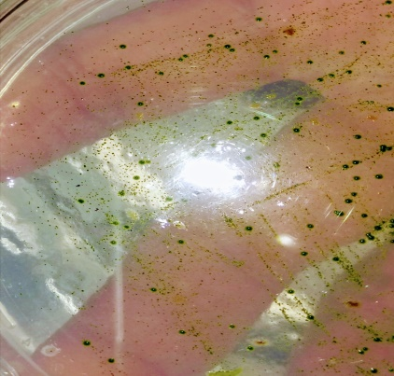
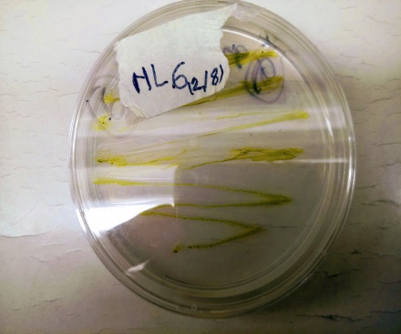
Microalgae colonies spread on plate
Enrichment in liquid F/2

Slide 6
Characterization
Species identification
Biomass composition

Slide 7
Species identification
Genomic DNA extraction
Genomic DNA was extracted
PCR
Amplification of 18S rDNA – ITS sequence using primers NS1 and ITS4
Search the DNA sequence
DNA sequence was searched against DNA sequences in NCBI database for a hit.

Slide 8
Set of primers

Slide 9
Result

Slide 10
Growth curve of isolate N. salina nl6 (F/2 medium, 24‰ NaCl, 25°C, 50 µmol m⁻²s⁻¹ light intensity)

Slide 11
Effect of growth phase on fatty acid profile

Slide 12
Effect of salinity on fatty acid profile

Slide 13
Effect of growth phase on pigment composition

Slide 14
Conclusion
A microalgal strain was isolated and genetically identified as N. salina nl6
The strain is potential candidate for biodiesel production with high biomass content of 0.603 ± 0.07 g L⁻¹ and fatty acid content of 18.17 ± 2.67% DW.
The presence of astaxanthin and canthaxanthin in stationary phase could facilitate the co-production of biodiesel and valuable pigments in N. salina nl6.

