Slide 1
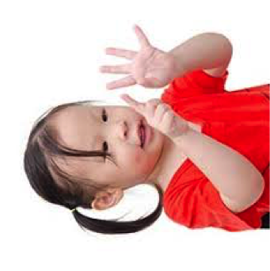
Finger games to improve precursors of arithmetic learning in preschool children
Line Vossius, Maelle Neveu, Christelle Maillart, Florence Binamé, Boris Jidovtseff & Laurence Rousselle
BAPS 2019

Slide 2
Introduction
Mission of schools : Reduce considerable variability in preschooler’s numerical ability (Ramani & Siegler, 2008; Starkley, Klein & Wakeley, 2004; Vilani, 2018)
Strong relationship between preschooler’s numerical ability and later arithmetical performance (Jordan, Kaplan, Ramineni & Locuniak, 2009; Geary, Hoard, Nugent & Bailey, 2013; Watts, Duncan, Siegler & Davis-Kean, 2014)
Notes:
In introduction, we know that one mission of schools is to reduce the important variability between children especially in their numerical abilities. It’s particularly important because we know that there is a strong relationship between early numerical abilities of children and their later arithmetical performance later, in primary schhol but also in secondary school and after.

Slide 3
Introduction
Early training to help children improve abilities and prevent learning disabilities (Suleman, McFarlane, Pllock, Scheinder Leroy & Skoczylas, 2014)
Different methods depending on the suggested activities and the location (Hall & Weaver, 2001; Hartas, 2004)
Classroom
Classroom
Classroom
Classroom
Multidisciplinary approach
Consultations
Interdisciplinary approach
Transdisciplinary
approach
Notes:
In multidisciplinary approach, the teacher teach in his classroom but some children have the opportunity to see another professionnal to have help when they have difficulties
In consultations, it’s the teacher who see the other professionnal to change his program teached in his classroom
In interdisciplinary approach, the teacher has the help of the other professional in the classroom. This person help just a little group when the teacher manage the whole group.
In the transdisciplinary approach, the teacher and the other professionnal share the same role in the classroom.

Slide 4
Introduction
Numerical learning
New teaching programs replacing traditonal activities in classroom
Additional activities with specific goals to enrich traditional numerical activities
Classroom
Classroom
Consultations
Interdisciplinary approach
Notes:
In the numerical training, we found in the literature the results in two types of training : consultations in which the teacher talk with an expert about new teaching programs replacing traditional activities and the interdisciplianry approach in which the expert comes in the classroom to suggest additionnal activities with specific goals to enrich traditional numerical activities that the teacher continues to give.

Slide 5
Introduction
The early use of these programs is important because arithmetic development is based on numerical foundations (e.g. the understanding of the cardinal meaning of numbers)
Acquiring the meaning of number words is a long-lasting process (Wynn, 1992) :
It’s a long and difficult process because the language does not keep track of the increase of quantities.
This process takes about one and a half years.
Fingers could help children in this learning.
/trois/
Notes:
The early use of these programs is particularly important because we know thaht aritmetic development is based on numerical foundations. For example, the understanding of the cardinal meaning of numbers is important to be efficient in arithmetics later. The learning of this understanding is a very long-lasting process beacause our langage is not trasparent and does not keep a visual track of the quantities. For some children, it takes one year, one year and the half. During this period, some searchers think that fingers could help children to understand the cardinality because with your finger you have this visual track of the precise quantities to learn.

Slide 6
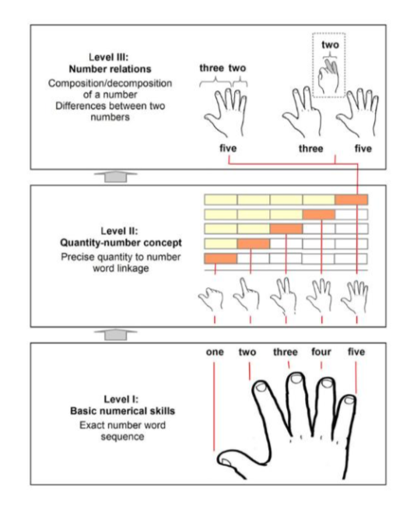
Introduction
A basis for calculation
Decomposition, recomposition andcomparison
Iconic cardinal representation
Support the association between quantities (digit configuration and verbal number (cardinal principle)
Association 1 finger-1 verbal numeral
Sustain the acquisition of the verbal number sequence and of the counting procedure (individuation of verbal nb, stable order, tagging, 1-1 correspondence)
Notes:
In general, a lot of studies showed a role played by finger in different stages of numerical development. The use of fingers can help children to recitate the verbal number sequence, the counting procedure with the help of pointing the object the child count. In the second level, as I said just before, the representation of numbers on their fingers can support the association between quantities and number words. And finally, the use of fingers can help children to be more efficient in the basic arithmetics.

Slide 7
How an interdisciplinary training program using number gestures to support the understanding of number words, helps children in the development of basic numerical skills ?

Slide 8
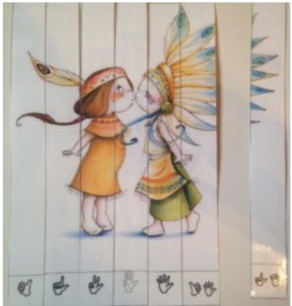
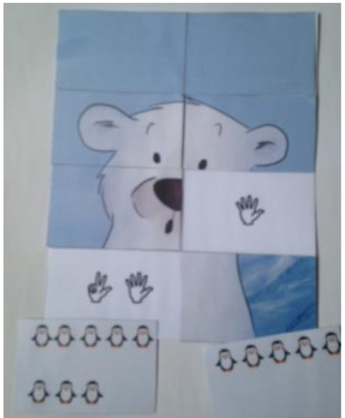
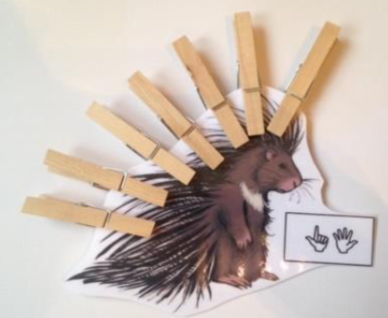
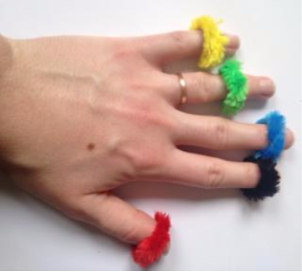
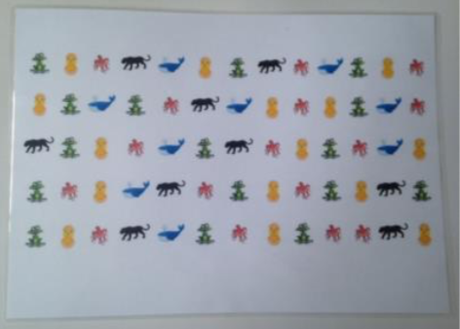
Methodology
Pretest
Training
Post-test
Post-test 1 year later
Post-test in 1st grade
Finger games training
(N=27)
Training program (10 weeks)
Numerical activities with number words and number gestures (1 to 10 progressively in comprehension and production games)
Dexterity activities ( finger dissociation & coordination skills)
Shared reading training
(N=26)
Global motor training
(N=29)
Notes:
For that we have 3 groups, our group in which we train numerical abilities with fingers. We have also two control groups :an academic controle group in which children participated in shared reading activities and non-academic control group in which children participated in global motor activities outside the classroom. In our group, we suggested to children two types of activities : some numerical activities always in both modalities : number words and number gesture such as puzzle to build based of finger representations. The other activities were dexterity activities in wich we trained the finger dissociation and coordination with some little rings for example. There was one ring with a different colour on each finger and the child has to put the good finger on the picture with the same colour

Slide 9
Methodology
Pretest
Training
Post-test
Pretest & Post-test before and directly after the training
Number verbal sequence : stable & conventional part
Counting skills : « How many ice-creams in total ? »
Cardinality understanding :
Production : « Give me three tokens » / « Give me tokens »
Arithmetic fluency with a picture support

Slide 10
Results
Pretest
Training
Post-test
Verbal number sequence
N= 43 (<10 in pretest) – Group effect : F(2,39) = 3.60,
p = .04, ɳ_{p}²=.17
Counting skills
N = 86 - Interaction Groups*Times : F(2,81) = 2.40,
p = .10, ɳ_{p}²=.06
Notes:
In our first results, we observed some specific and some non-specific effects. In the development of the verbal number sequence, we observe a general improvement in children in academic group, so in our group but also in the shared reading group but not in the global motor group. For the counting skills, we observed just a marginally significant difference between group after the training with a slight better progression in our group.

Slide 11
Results
Pretest
Training
Post-test
Give-a-number ? (with number words)
N = 44 - Interaction groups*times :F(2,40) = .75,
p = ns.
Understanding of Cardinal meaning of number
Give-a-number ? (with number gestures)
N= 44 - Interaction groups*times : F(2,40) = 7.56,
p = .002, ɳ_{p}²=.27
*
Finger games Shared reading Motricity
Finger games Shared reading Motricity
Notes:
In the understanding of cardinal meaning of numbers, we observe different results in each modality, children don’t seem to progress more in our group than the others but with number gestures, yes. There is a specific improvement in our group larger than in the others.

Slide 12
Results
Pretest
Training
Post-test
Artihmetic fluency with picture support
N = 86 - Interaction groups * times => F(2,81) = 5.48,
p = .01, ɳ_{p}²=.12
*
Finger games Shared reading Motricity
Notes:
In arithmetic, we observe a specific improvement of our group and not in the other group. These results are interesting because never in our training, we trained children to calculate so we can imagine that children transfer their knowledge in this field.

Slide 13
Conclusions & future perspectives
In 2020
Post-test 1 year later
Post-test in 1st grade
Efficiency & specificity : Children in finger game training progress more than children in other groups, especially in tasks requiring the processing of number gestures.
Transfer : This training seems to increase children’s arithmetical skills.
Future analyses :
Assessment of children’s numerical and basic arithmetical skills one year after
Assessment of children’s arithmetical skills in 1st grade of primary school
Future research :
Assessment of the influence of this training in populations at risk of developing learning disabilities in mathematics
Notes:
It’s just the begining of our analyses because, we just finished in april to assess children one year later and we would like to assess children when they will be in first grade of primary school to know if children will use their fingers in our group in different task and if this use will be more efficient to help children in the numerical and arithmetical skills.

Slide 14
Thanks!

Slide 15
Methodology
In 2020
Pretest
Training
Post-test
Post-test 1 year later
Post-test in 1st grade
Post-test 1 year later, in the 3rd grade in preschool
Cardinality understanding
Production : « Give me N tokens »
Direction & succession functions
Number word and Arabic number comparison
Pre-arithmetic tasks
Numerical inclusion
Additive decomposition
Arithmetical fluency with picture support and without support
Spontaneous use of fingers task : « Tell me 5 first names. No less no more. »
?

