Slide 1
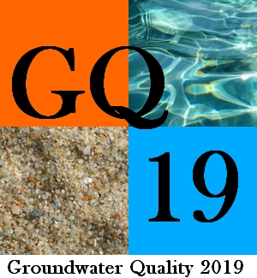
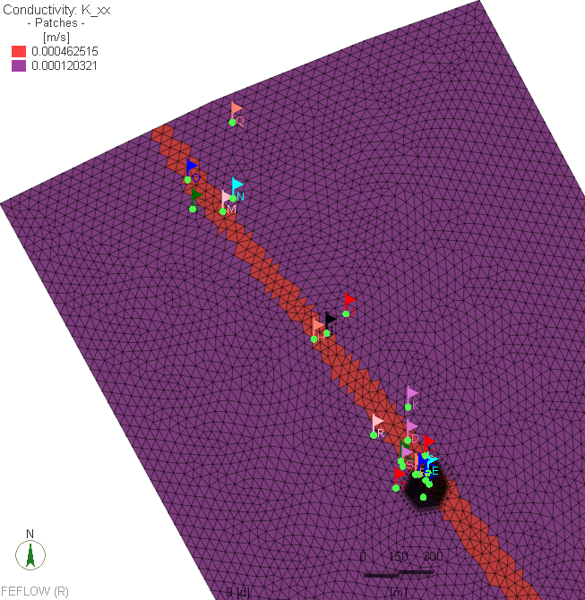
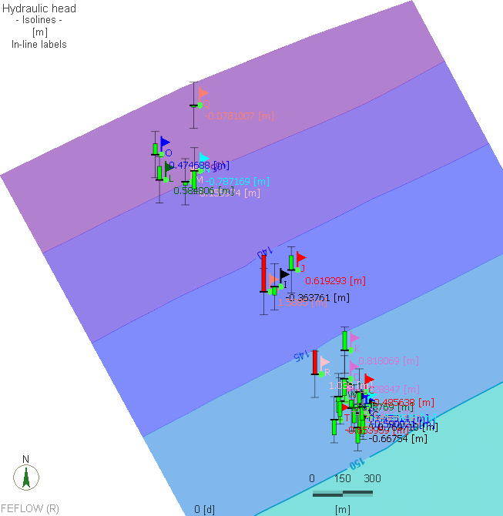
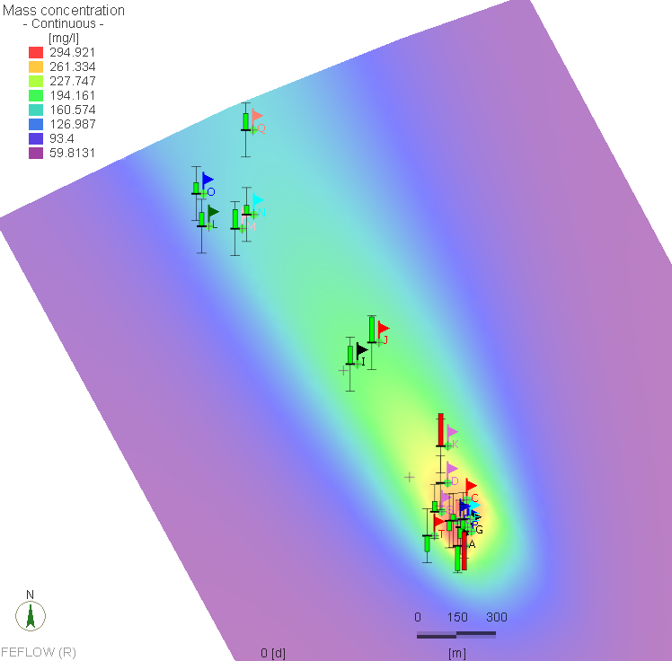
Groundwater flow and reactive transport modelling for a quantitative assessment of natural abiotic degradation of 1.1.1-trichloroethane in a Belgian chalky aquifer
Youcef Boudjanaª. Serge Brouyèreª. Philippe Orbanª. Davide Gasparella^{b}. Alain Dassarguesª
ª Hydrogeology and Environmental Geology. Urban and Environmental Engineering. University of Liège. Sart Tilman B52. 4000 Liège. Belgium.
^{b} AECOM. Maria-Theresiastraat 34 A. 3000 Leuven. Belgium.
Context of the study
Background
Important chalk aquifer mainly used for drinking water
Local pollution with CAHs dominated by 1.1.1-TCA
Abiotic degradation of 1.1.1-TCA by Hydrolysis and dehydrohalogenation (Results of Compound-Specific Isotope Analysis)
Mineralization changes: from degradation reactions and leaching od inorganic compounds from the backfill layer
Parameters of the chalk formation :
- Hydraulic conductivity : between 3×10⁻⁶ and 3×10⁻⁴ m/s
- Effective (transport) porosity ne: between 1 and 2%
Figure 1. Stiff diagrams for groundwater samples: comparison between the contaminated area and the groundwater quality before contamination.
Figure 2. Conceptual scheme summarizing the main process controlling the groundwater mineralization under the industrial site. (article under review)
Objectives
Methodology
Carry out a quantitative assessment of the natural attenuation processes of 1.1.1-TCA in the chalk aquifer considering mass transport processes with degradation reactions.
Flow model
Numerical modeling of groundwater flow and reactive transport of solute using FEFLOW®
Use the collected data form characterization stage and from previous studies
Conservative transport model
Reactive transport model
Context of the study
Flow Model
Steady state saturated‐unsaturated flow model
Equivalent hydraulic conductivity for the fissured chalk
Calibration with two Kh values for the chalk
Average annual recharge: 220 mm/an
Van Genuchten parameters for unsaturated flow:
 | θs | θr | α(m⁻¹) | n
Loess | 0.45 | 0.055 | 2 | 0.82
Chalk | 0.41 | 0.055 | 0.16 | 2.42
Figure 3. Boundary conditions and spatial discretization
Figure 4. Hydraulic conductivity and calibration results
Context of the study
Conservative transport model
Form the site investigation results, sulphate is considered as a conservative tracer in the transport model
Neumann mass transport boundary conditions:
- Source in the backfill layer
- Maintaining the sulphate concentration in the
aquifer
Calibration parameters: Effective porosity, longitudinal, transverse dispersivity and molecular diffusion coefficient
The calibrated model is able to reproduce the observed plume with a target ± 0,6 mmol/L
Calibration parameters for the chalk:
- Effective porosity: 2%
- Longitudinal dispersivity: 280 m
- Diffusion coefficient 3×10⁻⁸ m²/s
Figure 5. Simulated SO4 plume and calibration results
Context of the study
Acknowledgement
Next steps
Next steps
Calibrate the multi-species reactive transport model considering the occurring reactions (mainly hydrolysis and dehydrohalogenation of 1,1,1-TCA with calcite dissolution in the chalk matrix) using observed concentrations.
Improve the calibration with δ¹³C and δ³⁷C of 1,1,1-TCA.
The model will provide a more accurate assessment of natural attenuation process of 1,1,1-TCA in the chalk aquifer.
Special thanks to MIKE Powered by DHI for the FEFLOW academic license provided for this research.
Notes:
9.96 inches + 2 inches space

