Slide 1
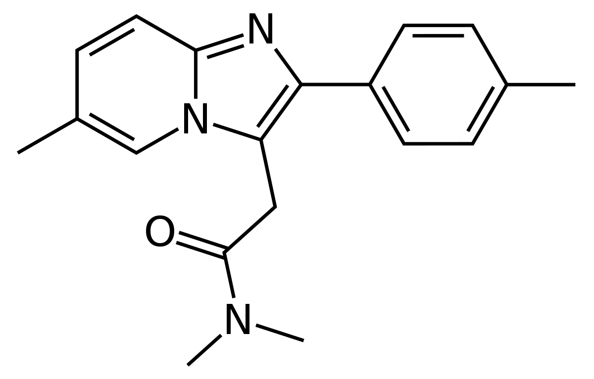
Preserved baseline fMRI connectivity in zolpidem responders with disorders of consciousness
C Ippoliti*, SK Larroque*, LRD Sanz, MA Bahri, M Carrière, C Aubinet, C Martial, L Heine, V Charland-Verville, A Vanhaudenhuyse, C Di Perri, S Laureys, O Gosseries
Coma Science Group GIGA Consciousness
University of Liège, Belgium
ePresentation
European Academy of Neurology
Oslo, June 30th 2019

Slide 2
BACKGROUND
DISORDERS OF CONSCIOUSNESS (DOC)
move arm
yes!
no !
UNRESPONSIVE WAKEFULNESS SYNDROME UWS
MINIMALLY CONSCIOUS STATE
MCS- MCS+
EMERGENCE
EMCS
[1]
[2,3]
transient
reflexive behaviours
repeatable conscious behaviours
functional communication / object use
[1] Laureys et al, BMC Med, 2010
[2] Giacino et al, Neurology, 2002
[3] Bruno et al, J Neurol, 2011
Figure adapted from Wislowska et al, Sci Rep, 2017

Slide 3
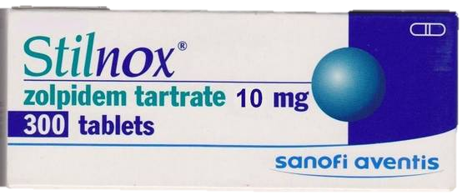
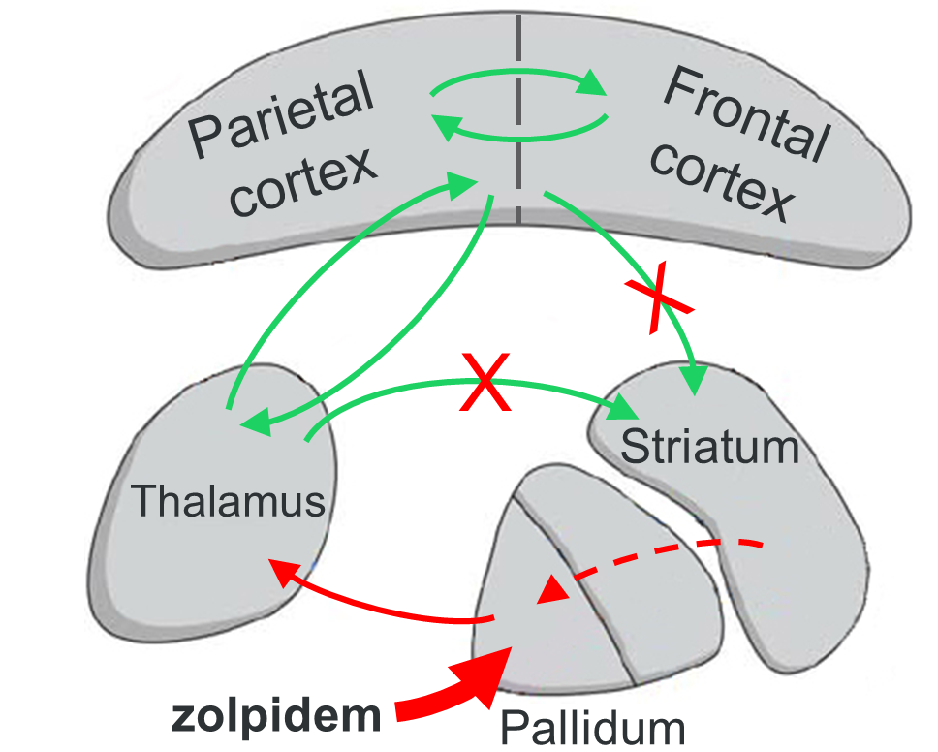
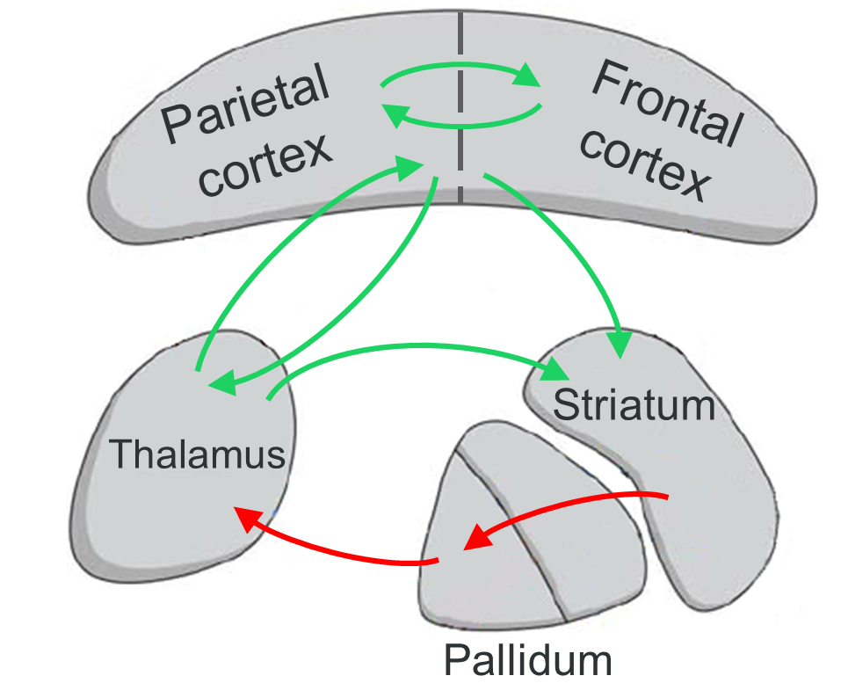
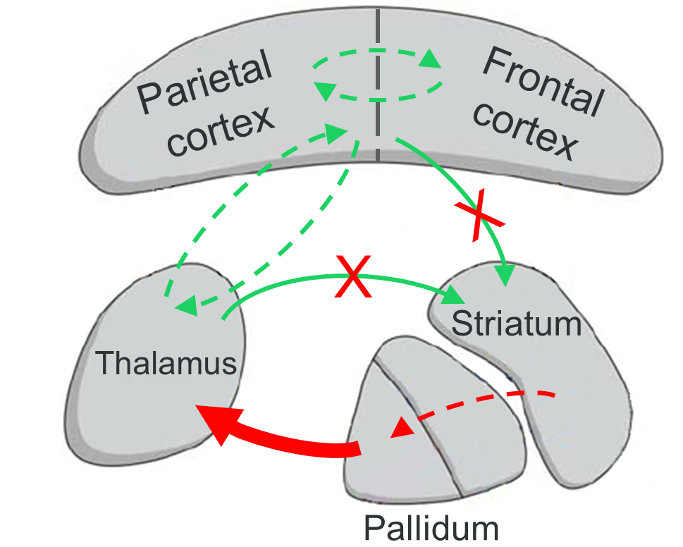
BACKGROUND
ZOLPIDEM
Theoretical framework
Mesocircuit hypothesis [3]
Commonly used as sleep inducer
One of the few treatment candidates for DOC [1]
5-7 % DOC patients show transient improvements [2]
Neural mechanism remains unclear
➔ Baseline preservation of functional connectivity In responders vs. non-responders
ZOLPIDEM
BRAIN INJURY
NORMAL
[1] Gosseries et al, Curr Pharm Des, 2014
[2] Whyte et al, Am J Phys Med Rehabil, 2014
[3] Schiff, Med Hypotheses, 2010
Notes:
UWS: 58% dead, 21% uws, 10 mcs, 11 emcs
MCS: 29% dead, 1% uws, 34,5% MCS, 36% emcs
As you might know, disorders of consciousness is a family of rare and severe diseases that patients can develop after acquired brain injury. They include notably the vegetative state or unresponsive wakefulness syndrome, where patients display eye opening but onl reflexive behaviors, and the minimally conscious state, where they show reproducible signs of consciousness but still no functional communication. Although these conditions represent a heavy burden on the healthcare system, with costs estimated to 120,000$ per year per patient for medical management only, no treatment is approved for chronic DOC. Only amantadine, a dopamine agonist which has proven to speed recovery in an early setting, is recommanded in 4 to 16 weeks after injury. Apomorphine is another dopamine agonist with a higher affinity for D2 subtype receptors, approved for Parkinson’s Disease and which can be delivered subcutaneously. It offers a well documented safety of use, and prelminary data suggest its effect to improve clinical recovery in these patients.

Slide 4
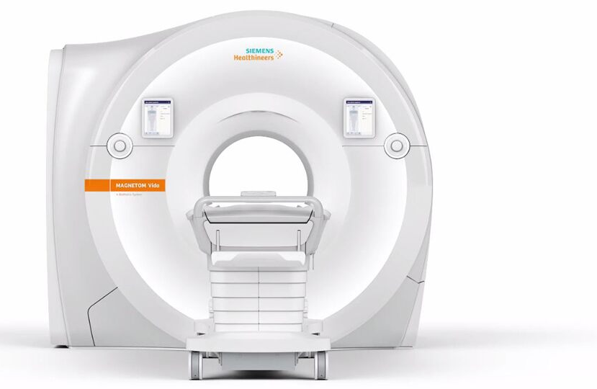
METHODS
15 MCS
5 EMCS
10 mg
single dose
9 responders:
new behavior with the Coma Recovery Scale - Revised, never observed before
11 non-responders
ANALYSES
Hypothesis-free
Seed-based (ROI: thalamus)
resting-state functional MRI
Notes:
age and gender regressed out

Slide 5
RESULTS
non-parametric permutation test cluster-mass p-FWE < 0.05 (primary threshold p-unc. < 0.001), 1000 iterations
Sedated group (5 resp. / 6 non-resp.)
HYPOTHESIS-FREE
SEED-BASED (THALAMUS)
z-score
Non-sedated group (2 resp. / 3 non-resp.): no significant differences
Notes:
Increased intrinsic connectivity in occipital, occipito-temporal and parieto-occipital areas in responders compared to non-responders
Better preserved functional connectivity of responders compared to non-responders between thalamus, left frontal areas (orbitofrontal, frontal pole, inferior frontal gyrus pars triangularis, frontal operculum) and insular cortex
*occipital fusiform gyrus left (OFusG), lingual gyrus (LG) left
* LG (l+r), OFusG r, Intercalcarine cortex (ICC, r)
*Superior parietal lobule l, posterior supramarginal gyrus l, Angular gyrus l (AG)
* Inferior & superior lateral occipital cortex
Responders have higher connectivity than controls and non-resp : EFFECT SIZE INFLATION, looking at effect size of regions we know are significant for responders, magnitude of effect size is inflated. Sign is interesting
Here 1 bar plot : mean effect size for all clusters per group, similar effect for each cluster individually

Slide 6
DISCUSSION
Hypothesis-free analyses
Parieto-occipital areas = hot zone of consciousness [1]
➔ Minimal preservation of connectivity to exhibit a response to zolpidem ?
Thalamus seed-based analyses
Preserved thalamic projections to the fronto-insular areas [2]
➔ Involved in the restoration of the mesocircuit functional loops ?
[1] Koch et al, Nat Rev Neurosci, 2016
[2] Laureys et al, Lancet, 2000
Notes:
The results of the first patient included in this open-label pilot study are promising and shoe behavioral and imaging improvement after 30 days of treatment.
Clinical status proved to be stable after withdrawal. The only availkable data is in traumatic brain injury and hemorrage seems to also be good candidates.
The subsequent larger placebo-controlled RCT will allow to confirm its efficacy and control for spontaneous recovery. You can find the protocol in Frontiers in Neurology.

Slide 7
Thank you !
leandro.sanz@uliege.be
www.coma.ulg.ac.be
Notes:
Thanks and go to clinicaltrials fr more info or email !

Slide 8
POPULATION
20 patients
1 unavailability of fMRI data
1 too large brain lesions
1 unsufficient image quality
1 age <18 yo
4 excluded
Analyses on 16 patients | Responder: 7 | Non-responder: 9
Sedated: 11 | 5 | 6
Non-sedated: 5 | 2 | 3
Notes:
The results of the first patient included in this open-label pilot study are promising and shoe behavioral and imaging improvement after 30 days of treatment.
Clinical status proved to be stable after withdrawal. The only availkable data is in traumatic brain injury and hemorrage seems to also be good candidates.
The subsequent larger placebo-controlled RCT will allow to confirm its efficacy and control for spontaneous recovery. You can find the protocol in Frontiers in Neurology.

Slide 9
RESULTS
Sedated group (5 resp. / 6 non-resp.)
occipital fusiform gyrus left (OFusG), lingual gyrus (LG) left
LG (l+r), OFusG r, Intercalcarine cortex (ICC, r)
Superior parietal lobule l, posterior supramarginal gyrus l, Angular gyrus l (AG)
Inferior & superior lateral occipital cortex
Non-sedated group (2 resp. / 3 non-resp.): no significant differences
Notes:
*occipital fusiform gyrus left (OFusG), lingual gyrus (LG) left
* LG (l+r), OFusG r, Intercalcarine cortex (ICC, r)
*Superior parietal lobule l, posterior supramarginal gyrus l, Angular gyrus l (AG)
* Inferior & superior lateral occipital cortex

