Slide 1
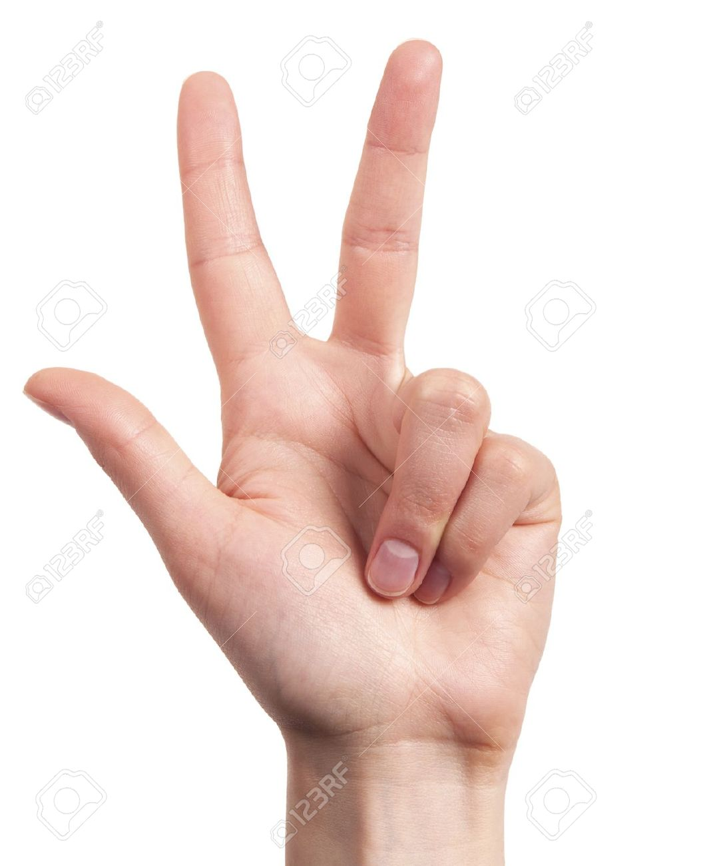
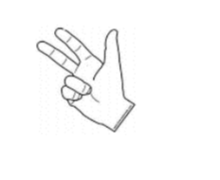
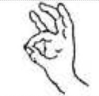
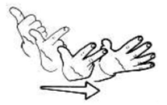
Does the development of number gestures and finger skills influence the understanding of the cardinal meaning of number words in preschoolers ?
Line Vossius¹, Marie-Pascale Noël² & Laurence Rousselle¹
¹University of Liège, Research unit on childhood
²Catholic University of Louvain
Methodology
Review of literature
Gestures support verbal number knowledge (Di Luca & Pesenti, 2011; Roesch & Moeller, 2015). Finger pointing and finger counting allow children to keep a visual track while reciting the verbal number sequence (Fuson, Richards & Briars, 1982; Saxe & Kaplan, 1981; Alibali & Di Russo, 1999). Fingers are usually used by young children to resolve arithmetical tasks (Fuson et al., 1982). Finally, finger gnosia are a good predictor of performance in arithmetics and problem-solving in primary school children (Fayol, Barrouillet & Marinthe, 1998; Noël, 2005).
However, the role of gestures in the understanding of the cardinal concept has been less studied in children and is still a matter of debate. Nicoladis, Pika & Marentette (2010) found that preschoolers (2-, 3-, 4- and 5-year olds) had no advantage of number gestures compared to number words in How many & Give-a-number tasks. In contrast, Gunderson, Speapen, Gibson, Goldin-Meadow & Levine (2015) showed that children who did not master the cardinal meaning of number words (assessed with the Give-a-number task) were more accurate at estimating numbers with gestures than with words.
Not only are these results contradictory, but the contribution of gestures to cardinal concept development has never been examined using a longitudinal design that permits a precise assessment of the developmental curve of children. Moreover, no study has ever determined which components of digital skills really influence the numerical development: gnosia or fine motor skills ?
TIME
T1
N = 47
3 years 0 months
T2
N = 60
3 years 4 months
T3
N = 60
3 years 8 months
T4
N = 60
4 years 0 months
T5
N = 47
4 years 4 months
Give-a-number with number words
Give-a-number with number gestures
Give-a-number with number words
Give-a-number with number gestures
Give-a-number with number words
Give-a-number with number gestures
Give-a-number with number words
Give-a-number with number gestures
Give-a-number with number words
Give-a-number with number gestures
Finger gnosia, finger dissociation, finger coordination tasks
Finger gnosia, finger dissociation, finger coordination tasks
Finger gnosia, finger dissociation, finger coordination tasks
Finger gnosia, finger dissociation, finger coordination tasks
Finger gnosia, finger dissociation, finger coordination tasks
Give-a-number task with number words
« Can you give me /THREE/ tokens? » The child received 10 tokens Cardinal development level = the largest numerosity accurately identified by the child two out of three times 0-knowers, 1-knowers, 2-knowers, 3-knowers, 4-knowers, Cardinal-Principle-knowers
Give-a-number task with number gestures
« Can you give me tokens? » The child received 10 tokens Cardinal development level = the largest numerosity accurately identified by the child two out of three times 0-knowers, 1-knowers, 2-knowers, 3-knowers, 4-knowers, Cardinal-Principle-knowers
/three/
Assessment of finger gnosia, finger dissociation and finger coordination skills
Finger gnosia assessment « Can you tell me which finger I’m touching ? » 8 touches for each hand behind a screen | Dissociation assessment « Can you do the same as my fingers ? » 10 digital configurations to imitate for each hand Presentation mirrored by the assessor | Coordination assessment « Can you do the same as my fingers ? » 3 praxia to reproduce for each hand Presentation mirrored by the assessor
?
Questions & Answers
How the cardinal meaning development of number gestures influence cardinal meaning of number words ?
Developing the understanding of the cardinal meaning of number gestures positively influences the development of the cardinal meaning of number words .
Moreover, this influence increases with age : the older the children, the more important is the influence of gesture on verbal number cardinal development in an identical task.
Does the development of digital non-numerical skills contribute to the progress in the understanding of the cardinal meaning of number words ?
Dissociation skills, but not finger gnosia and finger coordination, significantly influence the development of number words cardinal meaning understanding. This influence increases as children become older.
Results
Références:
Alibali, M. W., & DiRusso, A. A. (1999). The function of gesture in learning to count: More than keeping track. Cognitive Development, 14(1), 37–56.
Di Luca, S., & Pesenti, M. (2008). Masked priming effect with canonical finger numeral configurations. Experimental Brain Research, 185(1), 27–39.
Fayol, M., Barrouillet, P., & Marinthe, C. (1998). Predicting arithmetical achievement from neuro-psychological performance: A longitudinal study. Cognition, 68(2), B63–B70.
Fuson, K. C., Richards, J., & Briars, D. J. (1982). The Acquisition and Elaboration of the Number Word Sequence. In C. J. Brainerd (Ed.), Children’s Logical and Mathematical Cognition (pp. 33–92). Springer New York.
Gunderson, E. A., Spaepen, E., Gibson, D., Goldin-Meadow, S., & Levine, S. C. (sous presse). Gesture as a window onto children’s number knowledge. Cognition, 144, 14–28.
Nicoladis, E., Pika, S., & Marentette, P. (2010). Are number gestures easier than number words for preschoolers? Cognitive Development, 25(3), 247–261.
Noël, M.-P. (2005). Finger gnosia: a predictor of numerical abilities in children? Child Neuropsychology, 11(5), 413–430.
Roesch, S., & Moeller, K. (2015). Considering digits in a current model of numerical development. Frontiers in Human Neuroscience, 8.
Saxe, G. B., & Kaplan, R. (1981). Gesture in early counting: A developmental analysis. Perceptual and Motor Skills, 53(3), 851–854.
Any question ? Line.Vossius@uliege.be

