Slide 1
Local variation in the Coffin Texts: A case study of sentence structure in spell 75
Jorke Grotenhuis
Notes:
Good afternoon,
Today I would like to present the first results of my PhD study, which is, as the title states, about local variation in the coffin texts, to see if there are markers within the texts themselves that could support the other provenance methods available to us, and hopefully show a more complete picture of local identity in these status symbols of the elite of the elite. Although a large part of my research is based around the verbal system used in the coffin texts, I would like to discuss today the results I have obtained by comparing the sentence structure of these texts, focusing on spell 75 of the coffin texts specifically. As one can see by the size of the publications by de Buck, one can understand that a case study will suit a 20 minute talk better than a full discussion of the entire corpus, as that will likely take most of a year.

Slide 2
Local variation in spell 75
Coffin texts and terminology
Local variation
Method
Results
Future
Notes:
Thus, what I want to talk about today, is the following: First, I would like to give everyone here a quick reminder of what the coffin texts are, and any related issues that might be useful to hear. Second, I would like to look quickly at local variation. Third, I would like to introduce you to my underlying ideas of research, and the methods I use, for my comparisons and analysis. Fourth, I would like to show you my current results for spell 75. Finally, I would like to quickly discuss the future of my research.

Slide 3
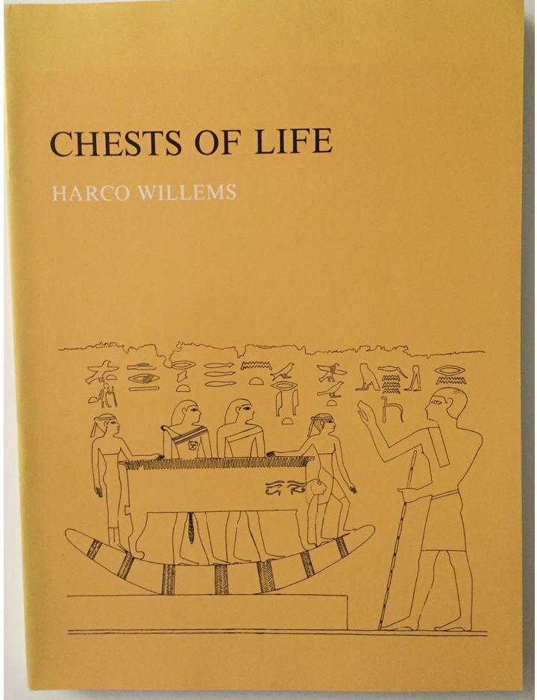
Coffin text and terminology
Willems, Harco. 1988. Chests of life: a study of the typology and conceptual development of Middle Kingdom standard class coffins. Mededelingen en Verhandelingen van het Vooraziatisch-Egyptisch Genootschap "Ex Oriente Lux" 25, Leiden.
Notes:
As a quick refresher what coffin texts are, simply put, they are the mortuary liturgies use in some (but far from all) coffins of the middle kingdom (although the texts occur often on other objects as well, as well as outside the middle kingdom). Note that the division in Egyptology of pyramid texts, coffin texts and book of the dead (etc) is actually a modern division in the mortuary liturgy, and it should not be understood as a division the Ancient Egyptians made themselves. For a extensive history of the Middle Kingdom coffins, I would like to refer to the following book by Harco Willems, which is THE book to read if you are interested in the subject of middle kingdom coffins. Note that the dating and provenance that I use for my studies here, are all based on his work!

Slide 4
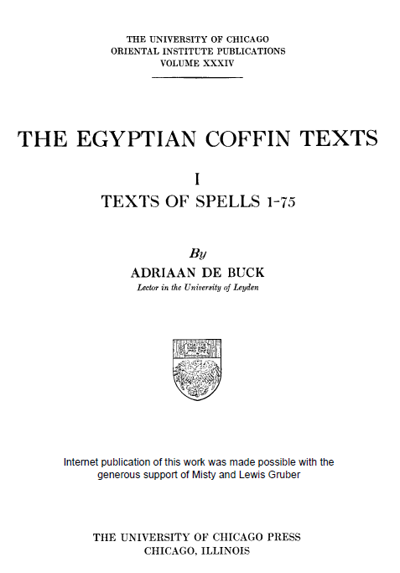
Coffin text and terminology
Buck, Adriaan de. 1935. The Egyptian Coffin Texts I: texts of spells 1-75. Oriental Institute Publications 34. Chicago: University of Chicago Press.
Notes:
Now, I would like to discuss the coffin texts themselves, the terminology, and some of less widely known the details of the texts that might be less clear to people due to the monumental work performed by de Buck. First, as I have name-dropped him multiple times already, I cannot discuss the coffin text without discussing THE publication of the coffin texts themselves, namely the work by de Buck, the scale and precision which still surprises me. Note that I have checked this publication with the de Buck Archive images here in Leiden, for spell 75, and except for 3 minor sign shape variants, the transcription is spot on.

Slide 5
Coffin text and terminology
Text in de Buck (CT1, 378a, B2L)
Notes:
Although it is spot on, one of the issues that does show up in the publication, is that the texts were transcribed as hieroglyphs, where in actuality, the writing method was actually more on a sliding scale of cursive hieroglyphs instead, with some of the graphemes used in the witnesses almost resembling hieratic instead. For example, I have here a phrase as used in de Buck:

Slide 6
Coffin text and terminology
Text in de Buck (CT1, 378a, B2L)
Outer coffin of gwA (BM EA 38039)
CC BY-NC-SA 4.0
https://www.britishmuseum.org/research/collection_online/collection_object_details/collection_image_gallery.aspx?partid=1&assetid=1613030935&objectid=129018
Notes:
Although it is spot on, one of the issues that do show up in the publication, is that the texts were transcribed as hieroglyphs, where in actuality, the writing method was actually more on a sliding scale of cursive hieroglyphs instead, with some of the graphemes used in the witnesses almost resembling hieratic instead. For example, I have here a phrase as used in de Buck,
And how it actually occurs in the coffin texts: A set of graphemes that are cursive, moving towards hieratic. Note that this is a specific example on one side, as there are coffins (mostly from Asyut and Meir), that are usually cursive closer to hieroglyphs.
Holding on to image, it allows me to quickly go over the terminology used here, which I will be using as well for the rest of the talk here, as it is a quicker way to talk about the coffins etc. As you can see with the text in de Buck, I have added a line which specifies where this is from, namely CT1 (De Buck coffin texts 1), 378a, (page 378, section a), B2L (variant B2L, which is the outer coffin of gwA). For the names of the coffins and their codes, I will have to refer you to Willems and de Buck, as the spell we are discussing today has 24 witnesses, which would be a long list to specify. Shortly stated: B is Deir el-Bersheh, S is Asyut, M is Meir, BH is Beni Hassan, T is Thebes, Sq is Saqqara, G is Gebelein, A is Aswan.

Slide 7
Local variation
Personal preference or local variation?
Notes:
So, why do I study the coffin text for local variation, and why and how do I actually study the material?
First and foremost, why even study local variation? This originates from my interest in dialect, which as most of you knows, is a difficult subject in Egyptology, as we only have written material, which is by nature standardized, and should never be considered an active representation of the language spoken at the time. Moreover, the vowels, the bread and butter of dialectal studies do not apply in Egypt. Thus, what is left to us is local traditions, which I assume exists, and which would influence even the language in its written form. Then you have to wonder, where is the limit between free personal variation, and local tradition?

Slide 8
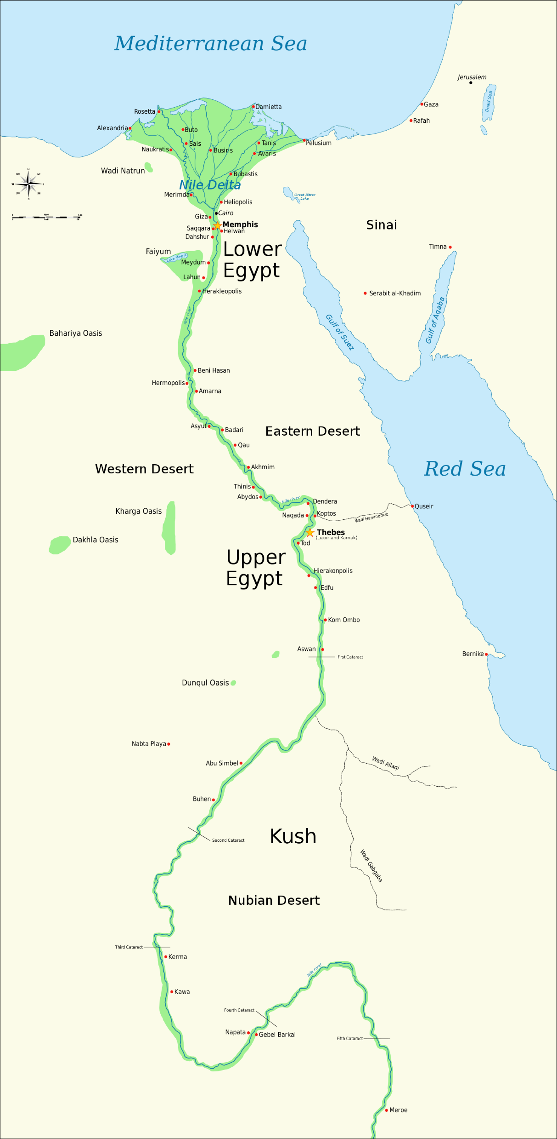
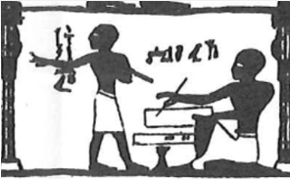
Local variation
Personal preference or local variation?
Beni Hassan, tomb of Amenemhat, hall, north wall, register 1 (Newberry, plate 315)
Notes:
So, why do I study the coffin text for local variation, and why and how do I actually study the material?
First and foremost, why even study local variation? This originates from my interest in dialect, which as most of you knows, is a difficult subject in Egyptology, as we only have written material, which is by nature standardized, and should never be considered an active representation of the language spoken at the time. Moreover, the vowels, the bread and butter of dialectal studies do not apply in Egypt. Thus, what is left to us is local traditions, which I assume exists, and which would influence even the language in its written form. Then you have to wonder, where is the limit between free personal variation, and local tradition?
Therefore, I would propose the following thought experiment: You have in the north and south of a country two teachers, both teaching their students the sign for seven. In the north, the teacher writes it with a horizontal stroke through the sign, where the one in the south teaches the bare sign. In this case, I hope that you would agree that for any reader of this sign, even though they are graphical variants of each other, they would be readable for any person in that country. But, as the children are introduced to one type of grapheme first, it is not unlikely that they will pick it up as their preferred grapheme. If one of those students becomes a teacher, I would not consider it unlikely that the new teacher would use the grapheme he is more comfortable with. Thus, repeat this over more generations, and I have to ask the following: At which point does a personal preference become a local tradition, and could this tradition, although technically speaking it has nothing to do with the language itself, be used to create a provenance for any object found with an unclear provenance? I would argue that a personal preference is not unlikely to become a local tradition. Although it is not dialect, it should be considered a local variation.

Slide 9
Why Coffin Texts?
Large corpus
Multiple witnesses from the same and different locations
Well published by de Buck
Notes:
Therefore, I wanted to try and see if it is possible to map local traditions within text, on a level of sentence structure (which words were used etc.). For this work, the coffin texts are ideal, as we have the same spell, from different locations, and they are well published in de Buck, although only in transcription. The feature in de Buck which was really beneficiary to my work is his separation of the spells in parallel phrases, which allowed me to work sentence by sentence.

Slide 10
Method
Encoding a database
Notes:
So, what was my method?
First, I encoded a database. I am lucky work in Liège, as it gave me access to the Ramses Online project and their excellent database, which has as an important feature that allows you to encode word by word, which I find ideal for this type of work, as it allows you to clearly mark variation (as well as other types of variation). Based on the Ramses system, my supervisor, Prof. Jean Winand, made a database for me, which I have expanded on over time.

Slide 11
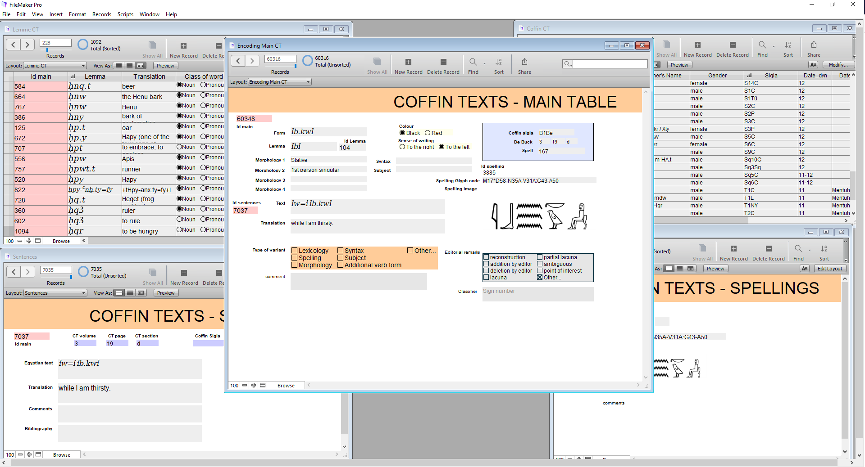
Method
Encoding a database
Notes:
So, what was my method?
First, I encoded a database. I am lucky work in Liège, as it gave me access to the Ramses Online project and their excellent database, which has as an important feature that allows you to encode word by word, which I find ideal for this type of work, as it allows you to clearly mark variation (as well as other types of variation). Based on the Ramses system, my supervisor, Prof. Jean Winand, made a database for me, which I have expanded on over time.

Slide 12
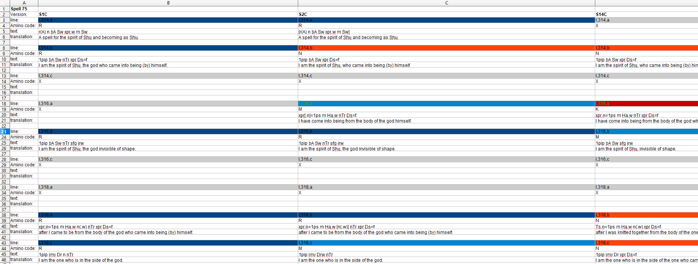
Method
Encoding a database
Create analysis files
Notes:
Second, using the data stored in my database, I decided to create a simple excel sheet, where I put the transliteration and translation of the different witnesses next to each other, spell by spell. As I retained the phrases from de Buck, it was easy to place them next to each other, and give them a colour code, where the same colour means that the phrase is identical in sentence structure. (so the exact spelling of the words might be different, but on the sentence level there was no change). Note that I tried to apply a harsh policy here, so if one witness uses a suffix pronoun for the owner, and the other witness used the name of the owner, it is a variant. Same if one has the name of the owner, and the other has the name of the owner and a demonstrative, different variant. The only exception I made here is that I did not take the gender of the owner in regard, so if one has the suffix =f for the owner, and the other has suffix =s, I would consider them the same, although of course, if one has a first person suffix, where the other has a 3rd person suffix, I would of course consider them separate.

Slide 13
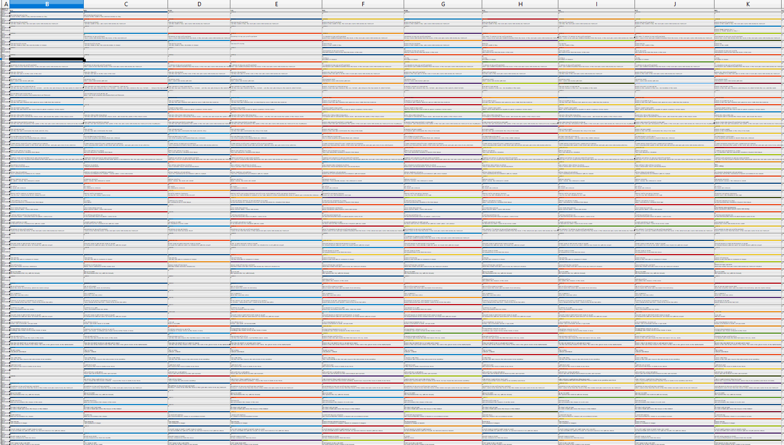
Method
Encoding a database
Create analysis files
Notes:
When one zooms out from this file, you get the following, which was responsible for my current progress, as I showed my work to some of my friends, and they said it reminded them of DNA, which caused me to wonder if I could tread it as such, and if I could automate part of my research because of it.

Slide 14
Method
Encoding a database
Create analysis files
Spells as proteins
Notes:
So, I decided to treat every witness of a spell as a protein strand, which is based on the phrases from de Buck. As there are usually more variations than 4 in every phrase, a protein fit the bill more concerning the comparison. One could consider the ‘original ideal spell’ (which of course does not exist, but can be considered an ideal version) as the DNA in the cell core, where it is turned through RNA into a protein strand, i.e the spell we currently have. To create the protein strands, I simply gave an Amino acid code to every colour in my database, and pulled the data so that I only had a file containing the Amino-acid code left:

Slide 15
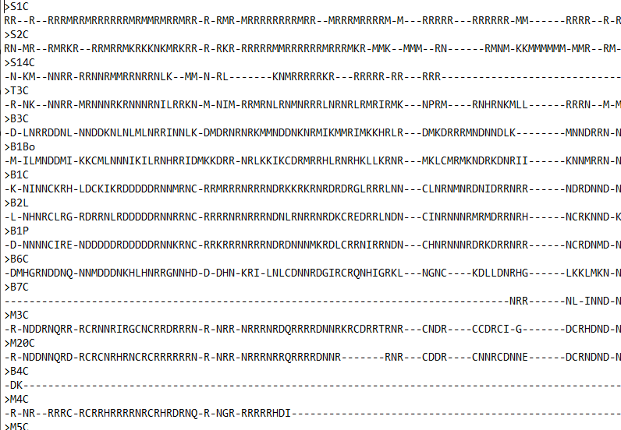
Method
Encoding a database
Create analysis files
Spells as proteins
Notes:
So, I decided to treat every witness of a spell as a protein strand, which is based on the phrases from de Buck. As there are usually more variations than 4 in every phrase, a protein fit the bill more concerning the comparison. One could consider the ‘original ideal spell’ (which of course does not exist, but can be considered an ideal version) as the DNA in the cell core, where it is turned through RNA into a protein strand, i.e the spell we currently have. To create the protein strands, I simply gave a Amino acid code to every colour in my database, and pulled the data so that I only had a file containing the Amino-acid code left:
Here, the letters stand for a variant phrase, and the strokes for not having a phrase here (which usually does not mean the phrase is lost, as I will have reconstructed it, but that there is no phrase at all).

Slide 16
Method
Encoding a database
Create analysis files
Spells as proteins
Notes:
Using these files, I have been able to use a biological program named iqtree as a sorting algorithm, which I used to construct trees, where the different versions are rated on proximity to other versions.

Slide 17
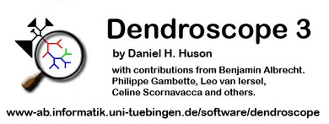
Method
Encoding a database
Create analysis files
Spells as proteins
Visualization
Notes:
The so-called tree-files this program creates, allows me to visualize the data as a dendrogram, using the program dendroscope. It allows me to visualize the data in an image like this, a tree like structure. This visualization is a lot easier on the eyes than my bulky excel file, and makes it a lot easier to actually read the data, and interpret it.
So, now I would like to show you, how it actually looks, taking spell 75 as a case study.

Slide 18
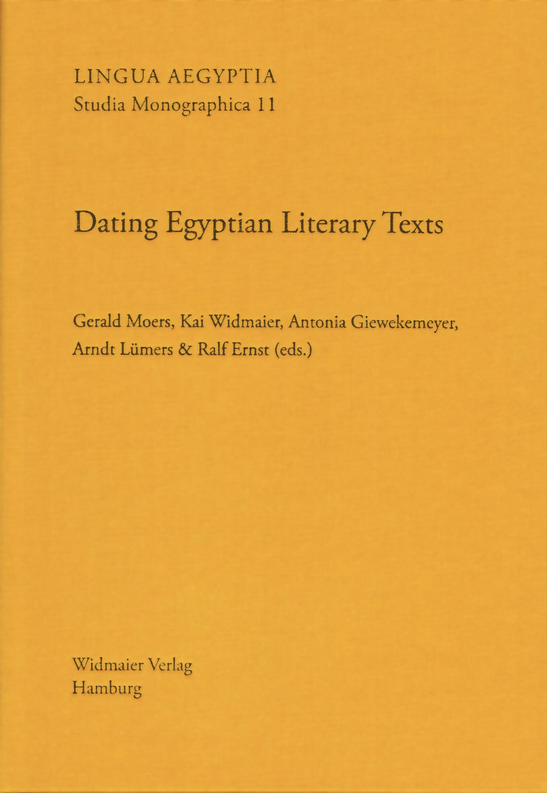
Method
Encoding a database
Create analysis files
Spells as proteins
Visualization
Schweitzer, Simon D. 2013. Dating Egyptian literary texts: lexical approaches. In Moers, Gerald, Kai Widmaier, Antonia Giewekemeyer, Arndt Lümers, and Ralf Ernst (eds), Dating Egyptian literary texts, 177-190. Hamburg.
Notes:
I would like to point out here that my method here is far from the first time this type of automated tree files are used in Egyptology, for example, it was used as well, on a vocabulary base, in the following article of Simon Schweitzer.

Slide 19
Spell 75
24+1 witnesses
8 witnesses from Deir el-Bersheh
8 witnesses from Meir (+1 unpublished, courtesy of Tobias Konrad, Mainz)
3 witnesses from Asyut
1 witness from Beni Hassan
1 witness from Gebelein
1 witness from Aswan
1 witness from the Theban area
1 witness from Saqqara
191 phrases
Notes:
First, I would like to give you a little bit more data concerning spell 75 specifically. In de Buck, there are in total 24 witnesses of this spell. of which some versions only have a small section. The spread of the different localities is as follows: ….
Note that for this work, due to the material provided to me by Tobias Konrad of the Johannes Gutenberg Uninversität Mainz, (Not yet published), I was able to add another coffin from Meir (Berlin, Ägyptisches Museum 32320) called M1Be, bringing the total up to 25 witnesses.
The spell consists of 191 phrases, although the number of phrases in de Buck is a little bit higher, as I combined some phrases together that de Buck separated. (the total should be around 210 at maximum). Do note that none of the 24 witnesses have all the phrases, but have a section of them. Note that there is a difference between not having a phrase and the section being damaged, as in the cases of damage, I reconstructed the phrases based on what de Buck (and later when I got access to the images) could still see, and otherwise I reconstructed the phrases based on the other versions, by looking at what I could see while encoding, and basing the origin of the reconstruction on that, as some witnesses have a clear similar structure, which makes the reconstruction more likely. I do have to state here that my reconstructions are based on the same location before anything else, unless the traces make it clear that that reading is impossible.

Slide 20
Spell 75
Notes:
To visualize the amount of reconstructions, I made the following graphs, where I made a distinction between partial reconstruction (there is something left, blue) or reconstruction (there is nothing left, red). As you can see here, Sq5C, M23C, M6C, B7C and S14C are heavily damaged, and rely for more than 40% on reconstructions. Therefore, I do want to include these versions in my data, but it has to be noted that these versions are not suitable for any sweeping claims, as they could only resemble another text closely due to my work, instead of being actually originally the same.

Slide 21
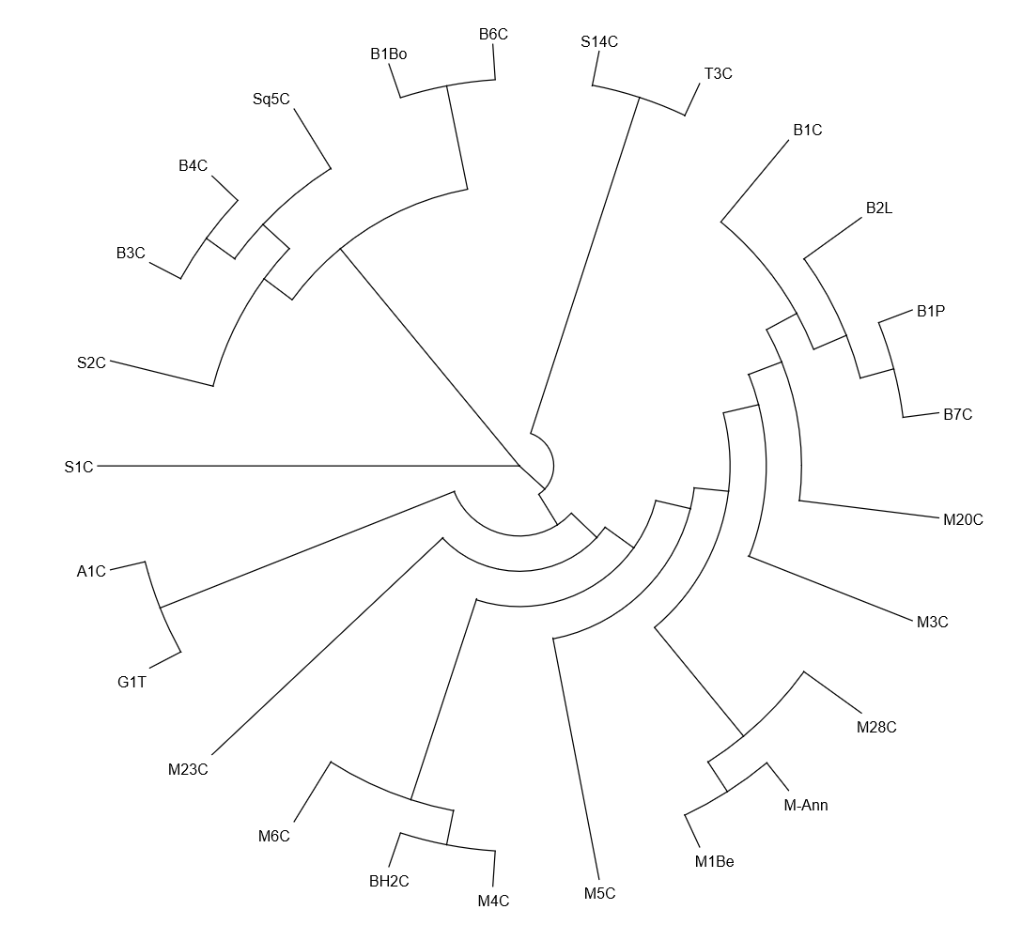
Results
Notes:
So, after puling my data through iqtree, and when I visualized it using dendroscope, I end up with the following Dendrogram. First, I would like to make one thing clear, the lines on this image do not denote ancestry or hierarchy. The results of the program are a visualization of proximity, so for example, B3C and B4C are in close proximity to each other, and therefore share a close connecting point. The center point here is the theoretical ideal spell, which of course does not exist. As you can see here, there are 3 main branches for this spell. Note that as expected, there are many areas that are not exactly clear, but for spell 75 at least, I can make the following statements:

Slide 22
Results
Notes:
The first group here, consisting of B1C, B2L, B1P and B7C, seem to have some clear proximity, as B1P and B7C have the closest proximity to each other, while B1C and B2L can be considered part of the same sub-branch.

Slide 23
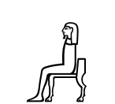
Results
Notes:
Now, I have to tell you that I was happy when this was the result here, as B1C, B2L, B1P and B7C share a specific feature in its text, which does not occur in the other versions, namely the use of A50 instead of A1 for first person (suffixes, statives, etc.).

Slide 24
Results
Sesostris II – Sesostris III
Notes:
Moreover, Willems groups these coffins under Group D and E respectably, which are dated by Willems during the reign of Sesostris II to Sesostris III. I do have to note here, that although B1C, B2L and B1P are relatively intact, B7C was badly damaged, and is mostly a reconstruction, except for one phrase where the A50 is used, which meant that I reconstructed this version based on the others from this group, and I am, except for the exact spelling, quite certain of my reading here.

Slide 25
Results
Notes:
The second group I would like to discuss is here: This is a group which is a lot less clear cut, although some comments can be made. These are all part of what I would call the second branch of the tree, although S1C is a lot farther away from the rest of this branch.

Slide 26
Results
Notes:
First, this sub-branch. These are two coffins from Bersheh that once again share a specific feature in their decoration. These have a specific way of adding the text to the coffin, namely by first incising the hieroglyph, and then adding paint. Second, both coffins are dated to the late 11th dynasty to the early 12th dynasty. So, based only on this and the other group from Bersheh, you can see, even before taking script specific details in regard, that you can differentiate between two periods of coffin creation in Bersheh.

Slide 27
Results
Late 11th dynasty – early 12th dynasty.
Incised cursive
Notes:
First, this sub-branch. These are two coffins from Bersheh that once again share a specific feature in their decoration. These have a specific way of adding the text to the coffin, namely by first incising the hieroglyph, and then adding paint. Second, both coffins are dated to the late 11th dynasty to the early 12th dynasty. So, based only on this and the other group from Bersheh, you can see, even before taking script specific details in regard, that you can differentiate between two periods of coffin creation in Bersheh.

Slide 28
Results
Notes:
Second, this sub-branch: Although I must warn that B4C only had 2 of the 191 phrases. But, to my advantage B3C and B4C belong to the same owner, namely sA.t-HD-HTp. These two coffins do not have the same decorative feature as B1Bo and B6C, and is dated to the reign of Amenemhat I to Amenemhat II.

Slide 29
Results
Amenemhat I – Amenemhat II
Notes:
Second, this sub-branch: Although I must warn that B4C only had 2 of the 191 phrases. But, to my advantage B3C and B4C belong to the same owner, namely sA.t-HD-HTp. These two coffins do not have the same decorative feature as B1Bo and B6C, and is dated to the reign of Amenemhat I to Amenemhat II. So, based only on this, the B1Bo-B6C group and and the other group from Bersheh, you can see, even before taking script specific details in regard, that you can differentiate between at least two periods of coffin creation in Bersheh, as based on sentence structure, the 3 subgroups are on two distinct branches of the tree.

Slide 30
Results
Notes:
When extending this Bersheh sub-branch, to include the next closest as well, we have Sq5C. Note that it was heavily reconstructed by me, but I can tell you all that although it is not clear here, Saqqara coffins often behave on the sentence structure level as Bersheh coffins, and in the other spells I have already been working on, Saqqara always ends up in proximity to Bersheh.

Slide 31
Results
Notes:
Finally, for this branch, the one that I cannot really explain. S1C and S2C belong to the same owner, the two versions where changed either by ancient design, or they are just random variants of each other, as, although they are technically on the same branch, they are far removed from one another.

Slide 32
Results
Notes:
And now for group 3, which is part of the same branch as the first group. Except for BH2C, all these coffins are from Meir. Note that most of these coffins are damaged to at least some extend, so the placement might have been influenced by my reconstructions.

Slide 33
Results
Notes:
And now for group 3, which is part of the same branch as the first group. Except for BH2C, all these coffins are from Meir. In this group, there are two sub-branches, namely M1Be with M-Ann and M28C. It has to be noted that de Buck did not see M-Ann and M28C himself, but used the manuscript of Lacau for these version. Willems considers these part of his group B, which is dated to Sesostris I – Amenemhat II

Slide 34
Results
Sesostris I – Amenemhat II
Notes:
And now for group 3, which is part of the same branch as the first group. Except for BH2C, all these coffins are from Meir. In this group, there are two sub-branches, namely M1Be with M-Ann and M28C. It has to be noted that de Buck did not see M-Ann and M28C himself, but used the manuscript of Lacau for these version. Willems considers these part of his group B, which is dated to Sesostris I – Amenemhat II. Do note here though that the dating here does not mean to much, as M4C, M6C, M3C should be dated to the same period.

Slide 35
Results
Notes:
Second, this sub-branch, which consists of M4C, M6C and BH2C. Note that the version of Beni Hassan sneaks in here. Although I do not want to make any suggestions, I do want to point out that BH2C is a bit earlier than M4C and M6C, dating from Amenemhat I, where M4C and M5C are dated to Sesostris I – Amenemhat II, as the first sub branch of this group.
Finally, concerning the entire group of Meir here, except for the two sub-branches, they share similarity with each other, as they are on the same major branch, but as they fan a bit, it is clear that they are also different.
I do have to note here, though, that M3C and M20C seemed close when I encoded them, and the fact that they were placed in each other’s general vicinity is meaningful, although a lot less than the other two sub-branches.

Slide 36
Results
Notes:
Finally I would like to discuss the two remaining branches, namely A1C and G1T, (which are on the same branch of group 1 and group 3) which are two coffins that are remarkably similar in decoration, and dating, as they both are dated to the reign of Mentuhotep II. This makes me wonder if they not both originate from the same workshop, although I would not want to guess where that workshop originally was.

Slide 37
Results
Notes:
And S14C and T3C, one from Assiut and one from the Theban area. I cannot say why they ended up together, but as they have done so, I will not deny it.

Slide 38
Results
There are many fuzzy borders
There seem to have been 3 major variations of this spell
There seem to have been at least two workshop traditions in Bersheh
Meir is vague, but there is some common ground
The coffins from Aswan and Gebelein seem to share a common origin
Notes:
As one could see in the earlier image, there are a lot of fuzzy borders, and some mixing between different locations, although one can say the following: There seem to have been 3 major variations of this spell (seen in the 3 branches), with the great branch which contained group 1, group 3 and the G1T and A1C subbranch, the branch containing Bersheh, Asyut and Saqqara, and third the Theban-Asyut branch. Note that these branches do not imply dating, although group 2 is generally earlier, the dates vary within the same branches. There seem to have been at least two workshop traditions in Bersheh, as they show up on two distinct branches of the spell, and are separated in date (11th dynasty and early 12th dynasty versus later 12th), although I would not imply that the traditions occurred side by side, and that there was more than one coffin workshop in use at one time or another (as the dates of the sub-branches do not overlap). Meir is vague, but there seem to have been some common ground, as they occur all on the same major branch, with having two sub-branches (although one includes BH5C), fragmentary the material might be. (which might influence the results). Aswan a Gebelein seem to share a common origin, although I have too limited data from either location (due to a lack of other coffins with text from either region available to me) at the moment to make any clear statement.

Slide 39
Future
Analyzing more spells using the same method, and comparing the results
Analyzing the verbal system used in the spells
Analysis of spelling of verbal forms
Notes:
I hope that I have shown you all that my method concerning sentence structure has some merit, and that it seems to be an interesting addition tool for dating and provenance, after some more fine tuning. (Dating mostly based on Bersheh, where the coffins of different dates ended up on different sub-branches). This I intend, and I have been doing by using the same methods on other spells, to see if the other spells show the same general features that were shown here. Ideally, I would try some blind tests to see if the coffin ends up where I expect it to. Second, I will create comparisons based on the verbal system, which should limit the issue of random variation in the spells. This is done in mostly the same fashion as the sentence structure, by grouping the different verbal patterns together per phrase, and marking them in the same fashion, to create a verbal system companion dendrogram to the sentence structure. Finally I intend to do a study of the spelling of the verbal forms used in the different witnesses, to see if there is any local preference for certain types of spellings.
I would like to thank you for your attention, and if there are any questions, I would love to hear them (if there is any time left).

