Slide 1
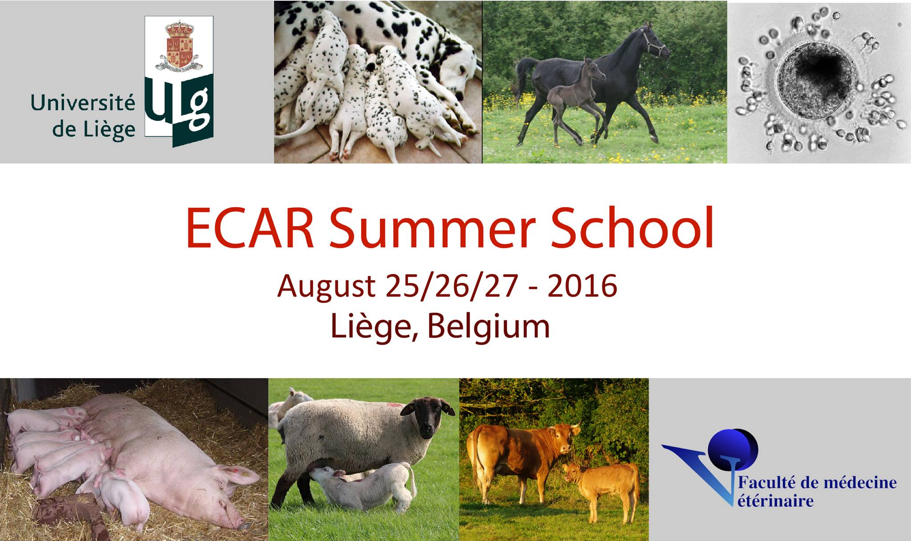
MALE ENDOCRINOLOGY
Christiane OTZDORFF, LMU
DVM, M. Sc., Ph. D., Diplomate ECAR
Jérôme PONTHIER, ULg
DVM, M. Sc., Ph. D., Diplomate ECAR

Slide 2
Plan
Physiology
Assays
Simple assays
Dynamic assays
Immuno-modulation

Slide 3
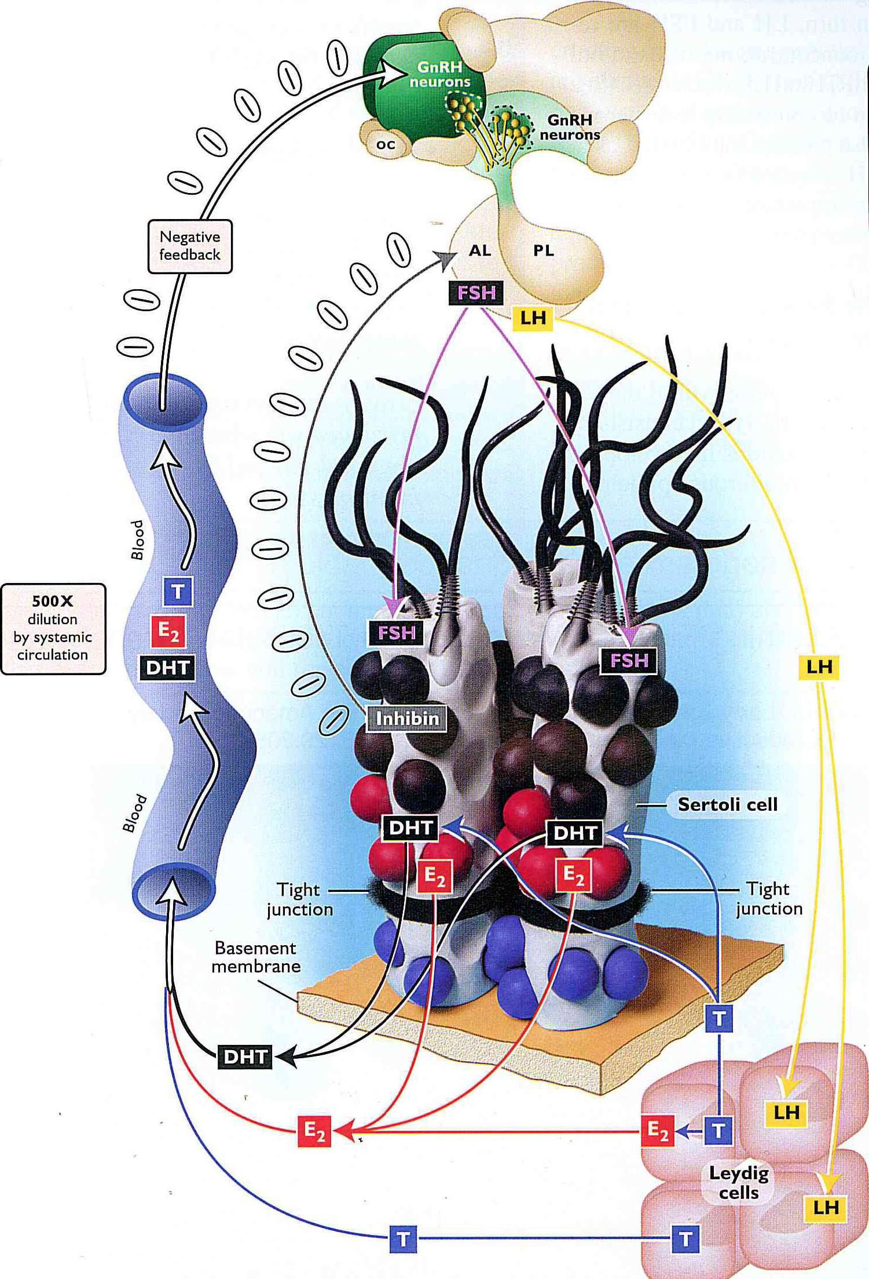
1. Physiology
Never forget !
« The Senger »

Slide 4
1. Physiology
Pineal Gland
Melatonin
Hypothalamus
FB-
FB-
GnRH
Hypophysis
FB-
FSH
LH
Testis
Sertoli cells
Leydig cells
Spermatogenesis
Estrogens
Androgens
Inhibin
AMH

Slide 5
1. Physiology
oestrogens
Sertoli
testosterone
Spermatogonia
Leydig
Spermatocyte
Spermatids

Slide 6
1. Physiology: step by step
Pineal Gland
Seasonnal effect:
Horse: winter:
 of DSP, or of MOT
 of libido
Melatonin
Hypothalamus
Cat: winter:
Sheep: summer
Melatonin responsive for seasonnal change of testosterone FB - on hypothalamus
 testis size, DSP & libido
Goats:
Effect less clear

Slide 7
1. Physiology: step by step
Hypothalamus
GnRH
Not by general circulation
No surge center
Bursts of GnrH:
4 > 10 days per day
Duration = minutes
GnRH
Hypophysis
FSH
LH

Slide 8
1. Physiology: step by step
Hypothalamus
GnRH
Hypophysis
FSH
LH
LH
Directly after an GnRH 
LH pulse:
Frequency: 4 > 8 pulse per 24h
Duration: 10 > 20 minutes
FSH: Pulse: ⬇concentration, ⬆duration
LH
FSH

Slide 9
1. Physiology: step by step
Hypothalamus
FB-
Estrogens
GnRH
Androgens: T & DHT
Hypophysis
FB-
Inhibin
FSH
LH
Inhibin implication: unclear in male

Slide 10
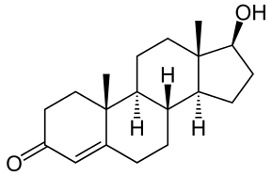
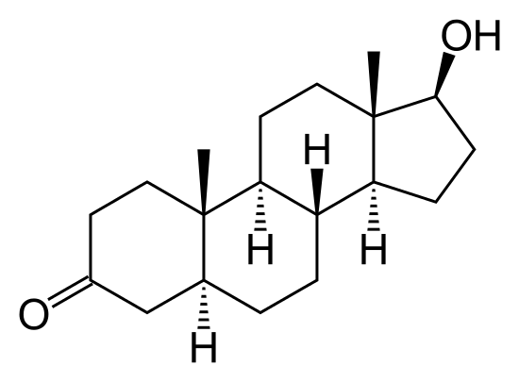
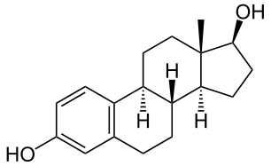
1. Physiology: step by step
FSH
LH
Testis
Sertoli cells
Leydig cells
Estrogens
Androgens
Testosterone secretion
Leydig cells > Sertoli cells
Di-hydro testosterone secretion
Sertoli cells > Leydig cells
Estrogens secretion:
Sertoli cells > Leydig cells
Inhibin & AMH secretion: Sertolic cells

Slide 11
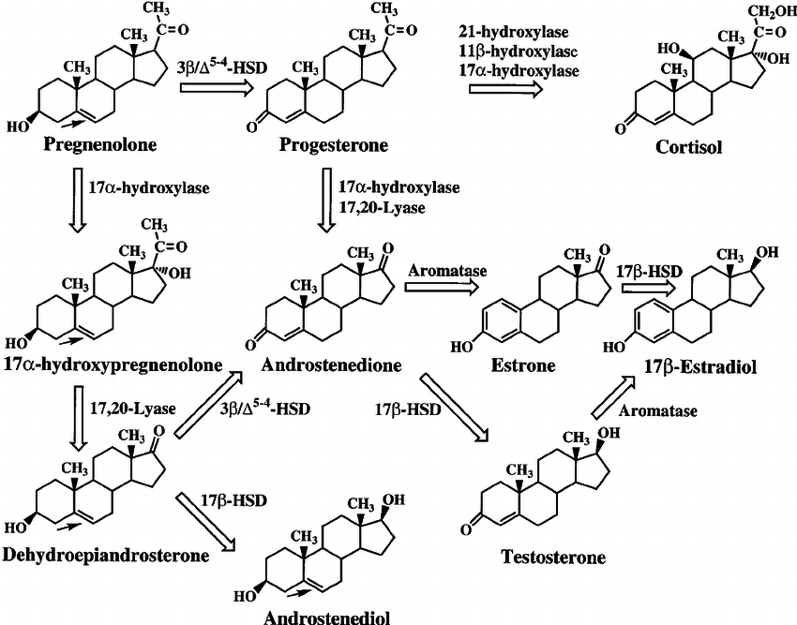
1. Physiology: step by step
FSH
LH
Testis
Sertoli cells
Leydig cells
Estrogens
Androgens

Slide 12
1. Physiology: step by step
FSH
LH
Testis
Sertoli cells
Leydig cells
FB-
High & sustained LH
Estrogens
Androgens
Particular case of testosterone production
Peaks:
2 to 4x basal testostérone concentration
During production peak: concentration inside parenchyma x10
Duration: 2 > 4 hours
High & sustained LH: Leydig testosterone production inhibited

Slide 13
1. Physiology: step by step
FSH
LH
Testis
Sertoli cells
Leydig cells
Estrogens
Androgens
Particular case of estrogens secretion:
Produced in testis
High levels in boar, stallion, human (free & conjugated)
Effects:
Spermatogenesis?
FB- on hypothalamus

Slide 14
1. Physiology: step by step
Sertoli cells
Leydig cells
Spermatogenesis
Estrogens
Androgens
Inhibin
AMH
Inhibin:
In both Sertoli and Leydig cells?
Glycoprotein
α & β₁ or β₂ subunits (activin = β₁ & β₂)
Inhibition of FSH secretion by hypophisis
Still unclear
Seasonnal change in horse

Slide 15
1. Physiology: step by step
Sertoli cells
Leydig cells
Spermatogenesis
Estrogens
Androgens
Inhibin
AMH
AMH: Anti-Mullerian Hormone:
Mullerian ducts = female embryological tract (paramesonephric)
Male: Wolffian ducts (mesonephric)
AMH secreted in male embryo
Role in adult male unclear
See B. Ball papers

Slide 16
2. Assays 1. Simple assays
Inhibin:
Decrease associated with subfertility in
Equine, Human
Assay in horse?

Slide 17
2. Assays 1. Simple assays
Anti-Müllerian Hormone & cryptorchidism
Human assay available: Horse, dog, cat
In horse (Ball et al., 2013, Therio):
a
Crypto
Crypto, no scrotal testis
?
ab
Stallion
Crypto, 1 scrotal testis
b
Stallion
Geld

Slide 18
2. Assays 1. Simple assays
Oestrogens & cryptorchidism
Stallions & boars (& humans…)
Other species: low levels
Remember oestrogens & prostatic pathologies in dogs
Oestrone sulfate & cryptorchidims in horse
Illera et al., 2003
Single sample (no hCG stimulation)
Information about presence of testicular tissue
Not in donkeys
Not <3years stallions (they all produce high level of oestrone sulfate)
Availibility of assay (e.g. difficult in Belgium)

Slide 19
2. Assays 1. Simple assays
Testosterone and cryptorchidism
Why not a simple assay?

Slide 20
Remember…
Hypothalamus
GnRH
Hypophysis
FSH
LH
LH
Directly after an GnRH 
LH pulse:
Frequency: 4 > 8 pulse per 24h
Duration: 10 > 20 minutes
FSH: Pulse: ⬇concentration, ⬆duration
LH
FSH

Slide 21
2. Assays 1. Simple assays
Testosterone and cryptorchidism
Testosterone is produced by Leydig cells under control of LH
Which means:
Testosterone concentration
Stallion
Time
???
Gelding

Slide 22
2. Assays 1. Simple assays
Testosterone and cryptorchidism
Why not a simple assay?
Variability of testosterone concentrations in the day
Lowest testosterone concentrations in stallions close to gelding concentrations (overlap)
Androstenedione as an alternative?
(Illera et al., 2003)

Slide 23
2. Assays 2. Dynamic assays
Testosterone and cryptorchidism
Dynamic assay
Mimic – bypass LH peak
Horse: hCG 6000UI
LH
hCG (LH effect)
Testis
Leydig cells
Androgens

Slide 24
2. Assays 2. Dynamic assays
Testosterone and cryptorchidism
Testosterone concentration
Stallion
>10ng/dL
Grey zone:
If t30 or t60 value = 2x t0 value
=> Stallion
Gelding <4ng/dL
hCG
hCG+30min
hCG+60min

Slide 25
2. Assays 2. Dynamic assays
Testosterone and cryptorchidism
Dynamic assay
Historically & physiologically very interesting
Oestrone-sulfate & AMH assays…
Becoming old and useless?

Slide 26
2. Assays
Conclusions:
Currently, hormonal assays only give information about the presence of hormonally active testicular tissue!
If there is a scrotal testicle, it’s clear that there is testicular tissue in this animal!
Future: specific marker of cryptorchidism
AMH is maybe the way…

Slide 27
MaleEndocrino: MQC1
A FSH pulse in a male animal:
Increases AMH concentrations
Is shorter than a LH peak
Stimulates spermatogenesis
Is increasing testosterone concentrations

Slide 28
MaleEndocrino: MQC1
A FSH pulse in a male animal:
Increases AMH concentrations
Is shorter than a LH peak
Stimulates spermatogenesis
Is increasing testosterone concentrations

Slide 29
MaleEndocrino: MQC2
Anti-Müllerian Hormone:
Increases Sertoli cells oestrogens production
Is increased in cryptorchids stallions when compare to normal stallions
Inhibits formation of the male embryonic genital tract
Has a very specific dependant structure

Slide 30
MaleEndocrino: MQC2
Anti-Müllerian Hormone:
Increases Sertoli cells oestrogens production
Is increased in cryptorchids stallions when compare to normal stallions
Inhibits formation of the male embryonic genital tract
Has a structure non conserved between species

