Slide 1
Data driven computational analysis of open foam RVEs
Nanda G. Kilingar[1][2]
K. Ehab Moustafa Kamel[2]
B. Sonon[2]
C. Leblanc[1]
L. Noëls[1]
T.J. Massart[2]
A. Jung[3]
Kilingar, N. G., et al, Computational generation of open-foam representational volume elements with morphological control using distance fields, Under review
[1] University of Liege, Aerospace and mechanics, Liege 4000, Belgium
[2] Université Libre de Bruxelles, Building, Architecture and Town planning Department, Brussels 1050, Belgium
[3] Saarland University, Applied Mechanics, Campus A4.2, Saarbrücken 66123, Germany

Slide 2
Open foam materials and numerical models
Metallic open foams
  Low density
  Novel physical, mechanical and acoustic properties.
  Offer potential for lightweight structures, with high stiffness and energy absorption capability.
  With advancing manufacturing capabilities, they are becoming more affordable.
Ability to model 3D foams based on actual foam samples
  Helps in characterization
  Stochastic approaches and multi-scale mechanics used to simulate the behavior
Microstructure → Plateau’s law (19th century)
  Soap bubble → Plateau’s law, Surface energy minimization
Tessellations of sphere packing distribution – Laguerre tessellations
  Sphere packing generation
  Tessellation generated by methods like convex hull (QHull, Barer et al 1996)
  Morphological parameters like face-by-cell count, edge-by-face count, interior angles match very well
DN-RSA: Distance neighbor based random sequential packing algorithm for arbitrary shaped inclusions (Sonon et al 2012)
Multiscale approaches → High cost, leads us to data driven solvers
Jung & Diebels 2014

Slide 3
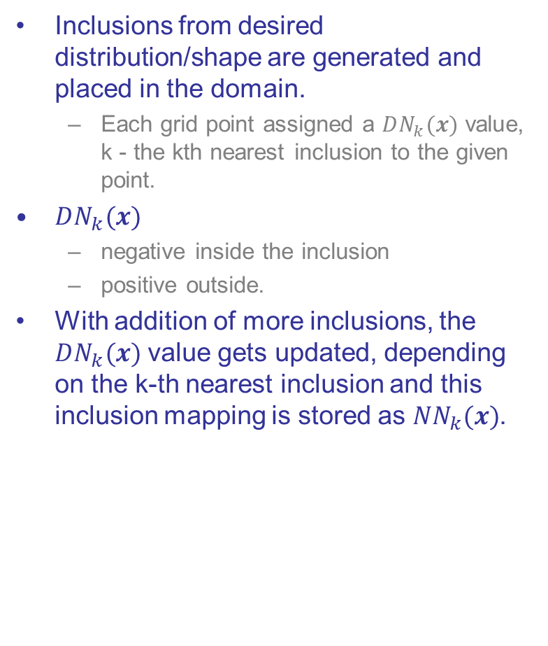

DN-RSA Notation
Inclusions from desired distribution/shape are generated and placed in the domain.
  Each grid point assigned a $DN_{k}(x)$ value, k - the kth nearest inclusion to the given point.
$DN_{k}(x)$
  negative inside the inclusion
  positive outside.
With addition of more inclusions, the $DN_{k}(x)$ value gets updated, depending on the k-th nearest inclusion and this inclusion mapping is stored as $NN_{k}(x)$.
$DN_{1}\left(x\right)$ plot with only 1 inclusion

Slide 4
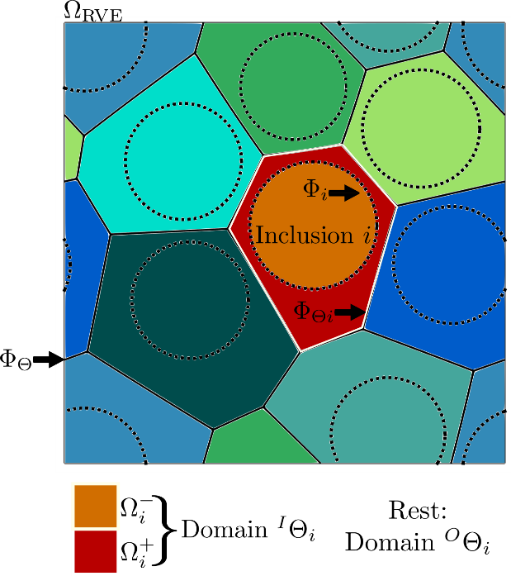
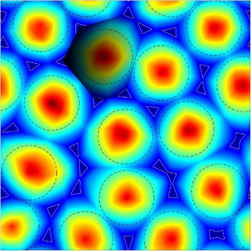
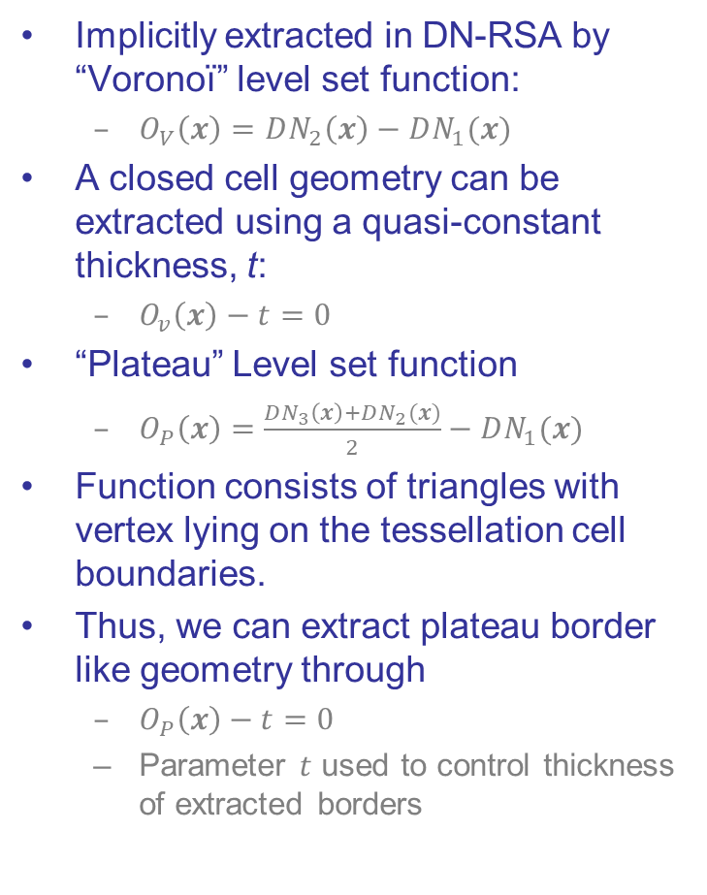

Open foam morphology
Implicitly extracted in DN-RSA by “Voronoï” level set function:
  $O_{V}\left(x\right)=DN_{2}\left(x\right)−DN_{1}(x)$
A closed cell geometry can be extracted using a quasi-constant thickness, t:
  $O_{v}\left(x\right)−t=0$
“Plateau” Level set function
  $O_{P}\left(x\right)=\frac{DN_{3}\left(x\right)+DN_{2}(x)}{2}−DN_{1}(x)$
Function consists of triangles with vertex lying on the tessellation cell boundaries.
Thus, we can extract plateau border like geometry through
  $O_{P}\left(x\right)−t=0$
  Parameter $t$ used to control thickness of extracted borders
i
$$Φ_{Θi}$$

Slide 5
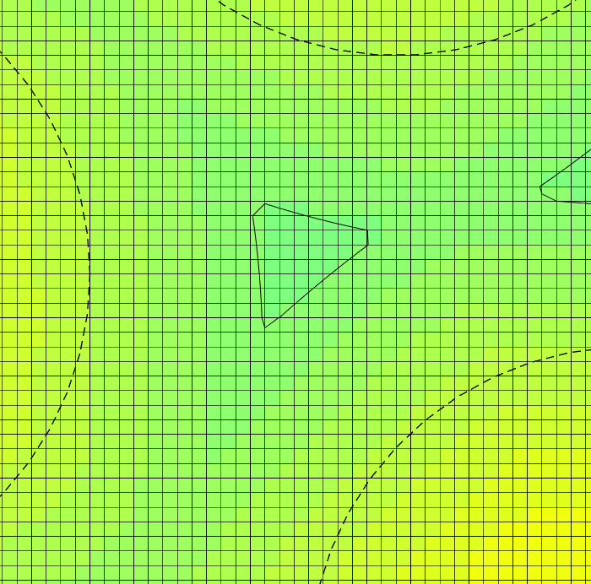
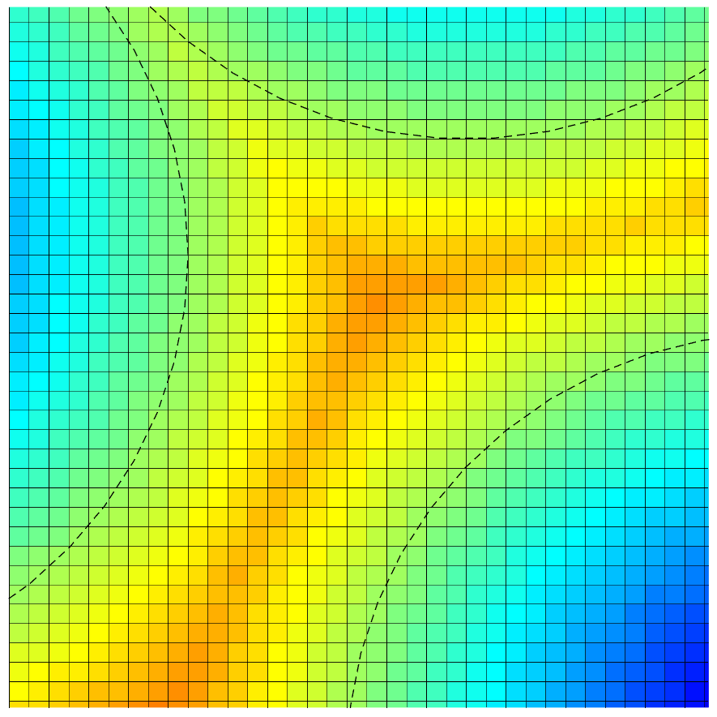
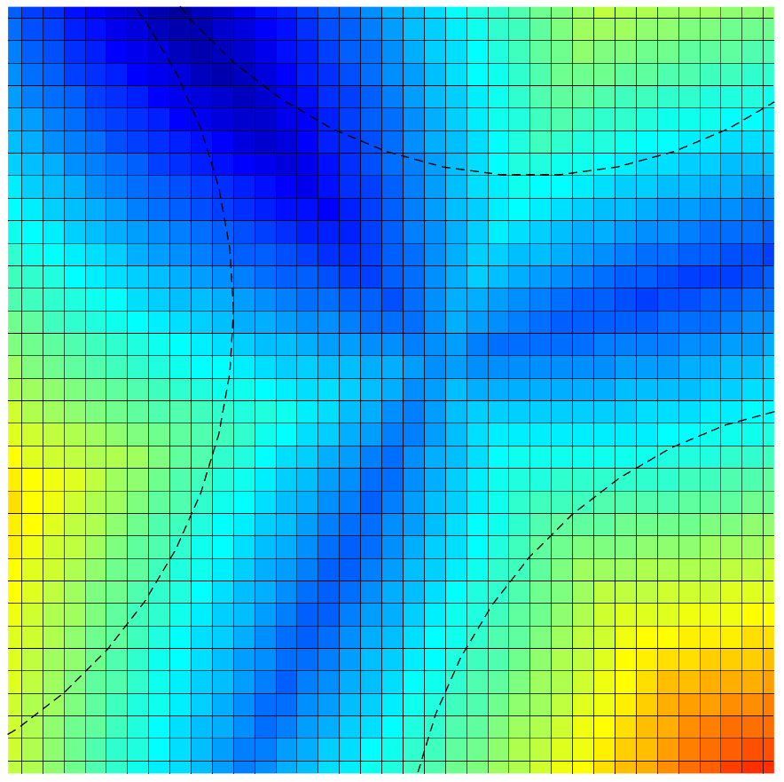
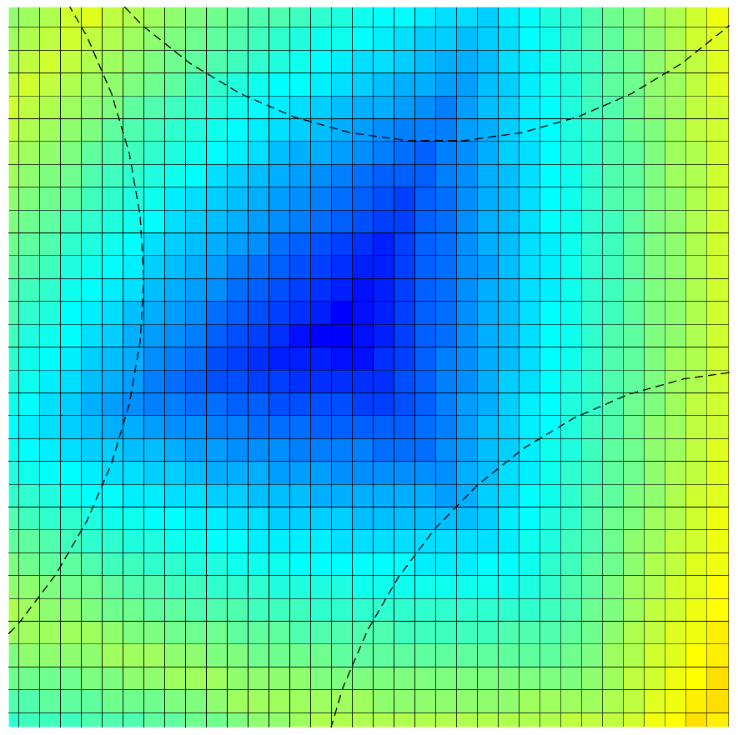






Sharp edge extraction
Plateau borders present sharp edges due to their triangular prism shape
  Origin is due to steep discontinuity of $DN_{k}(x)$ derivatives on $Φ_{Θ}$
Single level set function can not represent this with discrete level set functions, and we need multiple level set function strategy
Solved by extracting individual modified level sets for each inclusions
$$Φ_{Θi}$$
$t$ Level Set
$$DN_{1}(x)$$
$$DN_{2}(x)$$
$$DN_{3}(x)$$
Clipping of the triangular section at grid positions and the presence of discontinuities in $DN_{1}\left(x\right)$ and $DN_{2}(x)$ across $Φ_{Θ}$. $DN_{3}(x)$ is continuous.

Slide 6
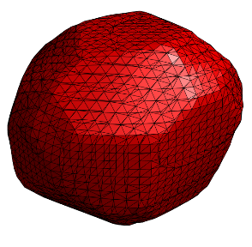
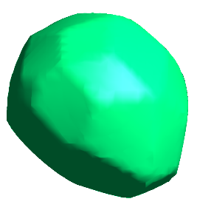
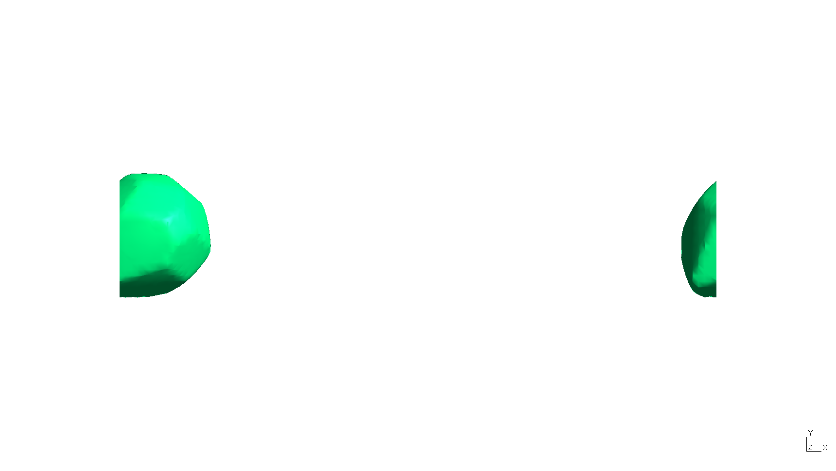
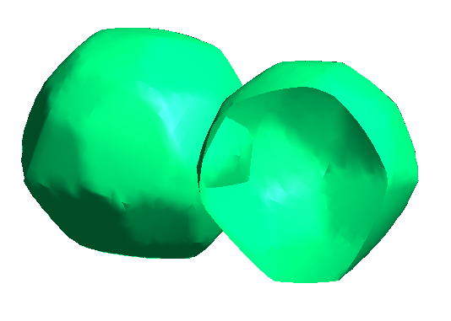
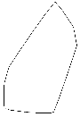
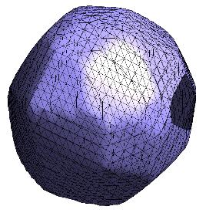
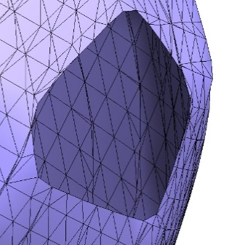
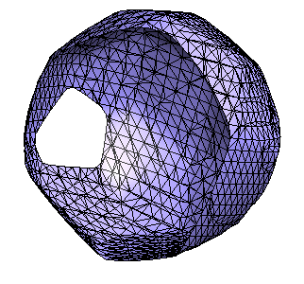
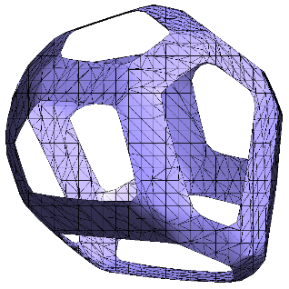
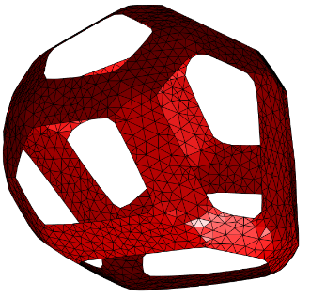

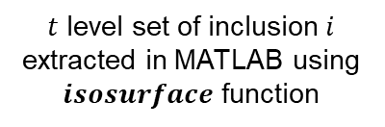



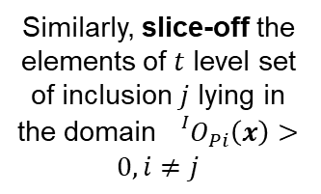
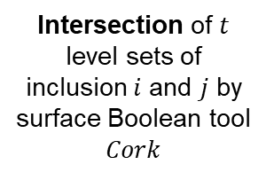

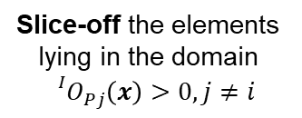

Sharp Edge extraction
$t$ level set of inclusion $i$ extracted in MATLAB using $isosurface$ function
Intersection of $t$ level sets of inclusion $i$ and $j$ by surface Boolean tool $Cork$
Extract, re-mesh and fix the line of intersection
$$i$$
$$j$$
$$i$$
$$j$$
$$i$$
Similarly, slice-off the elements of $t$ level set of inclusion $j$ lying in the domain ${ {}_{}^{I}O}_{Pi}\left(x\right)>0, i≠j$
Slice-off the elements lying in the domain ${ {}_{}^{I}O}_{Pj}\left(x\right)>0, j≠i$
$$j$$
Inclusions are then refined by level set based mesh conforming approach designed by [Karim et al (under preparation)] using analogy of equilibrium of 3D truss system (Persson and Strang, 2004) before assembling. 3D mesh is generated using Tetgen (Hang Si 2015)
Iteratively done, leaving only the plateau border part of the inclusion.
Traditional isosurface operations result in ill-formed elements.

Slide 7
Generation of open foam morphology

Slide 8

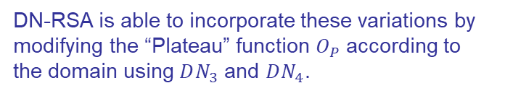
Strut cross section variation
$O_{S1}(x)=DN_{4}$($x$)$−DN_{3}(x)$
Value of the function increases from 0 at the intersection of struts to half the length of the strut at mid-span along the axis.
Strut cross section variation and mid-span cross-sectional area of a polyurethane foam; Gong et al 2004
$$Ω_{ijk}=\left(NN_{1}\left(x\right)=i\right)\&\left(NN_{2}\left(x\right)=j\right)\&\left(NN_{3}\left(x\right)=k\right)$$
Tetrahedral domain joining the center of the inclusion I, center of the common face between I and j, and the two ends of the strut formed by I, j, and k
DN-RSA is able to incorporate these variations by modifying the “Plateau” function $O_{P}$ according to the domain using $DN_{3}$ and $DN_{4}$.

Slide 9
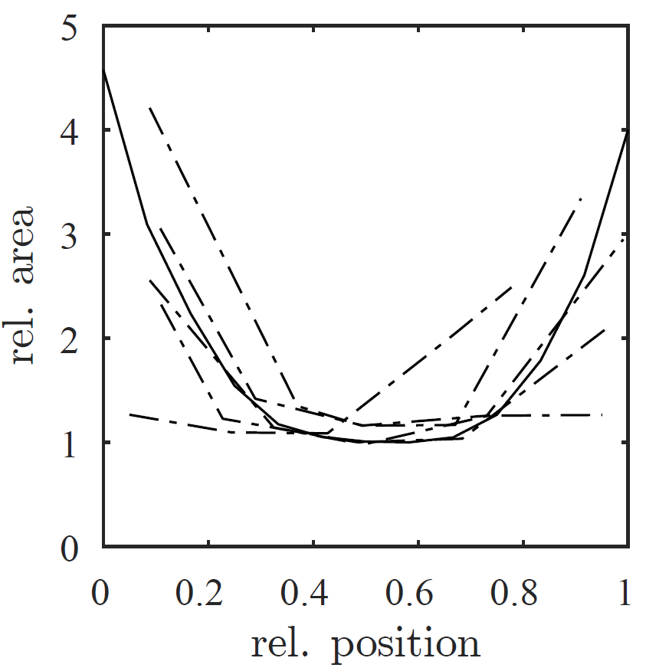
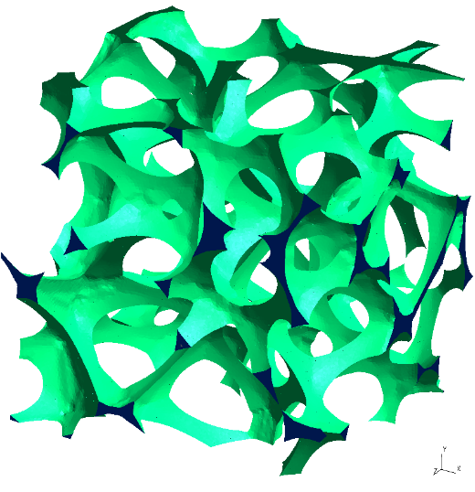
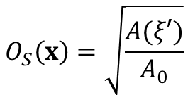
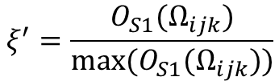

Strut cross section variation
$$ξ^{′}=\frac{O_{S1}(Ω_{ijk})}{max(O_{S1}(Ω_{ijk}))}$$
Dotted line – strut cross section area data from 20ppi foam sample from Jung and Diebels 2017
Bold line – data from a simulated 20ppi foam using DN-RSA
$$O_{S}\left(x\right)=\sqrt{\frac{A(ξ′)}{A_{0}}}$$
An RVE simulating a 20ppi foam with 25 inclusions
$$O_{P}\left(x\right)−tO_{s}\left(x\right)=0$$
The final operator and the equation that enables to generate variation in strut cross-section

Slide 10
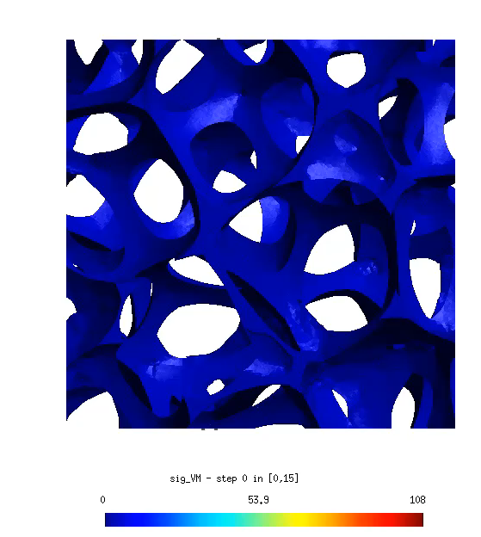
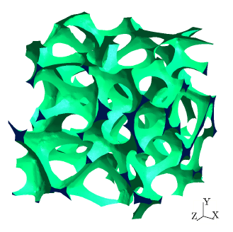
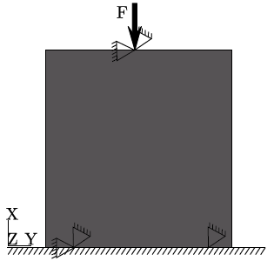
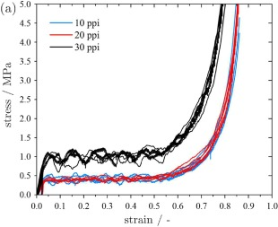
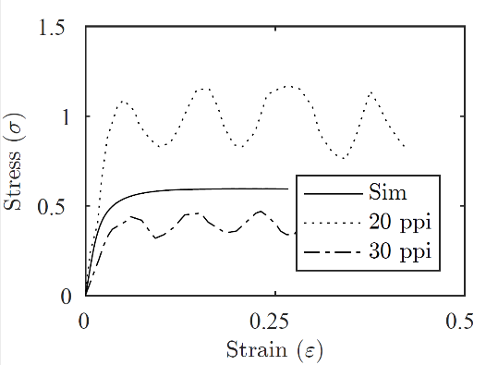
Numerical Simulation – RVE
Larger RVE with 25 inclusions completely inside the domain.
Uniaxial compression test comparison with experimental values; contact criteria not implemented.
Jung & Diebels 2017

Slide 11
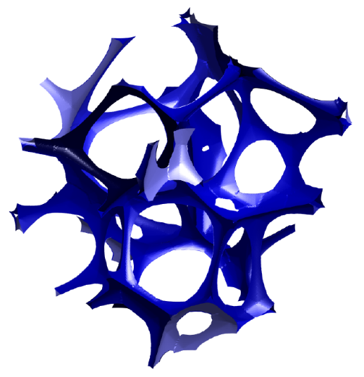
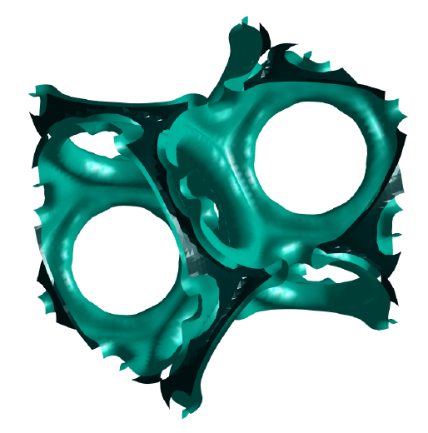
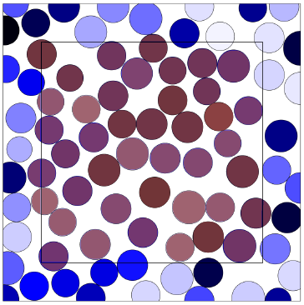
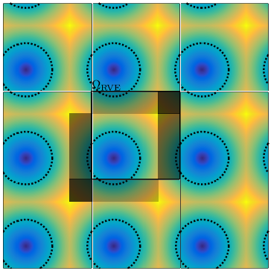
Further advantages of DN-RSA
Periodic RVEs and RVEs with free boundary
Strut cross-section concavity and convexity using concavity operators based on distance function
Generation of RVEs with layers of coatings with non-smooth coatings using distance functions
Concavity control
Layers of coatings
Free boundary RVE with minus sampling
Periodicity in RVE

Slide 12
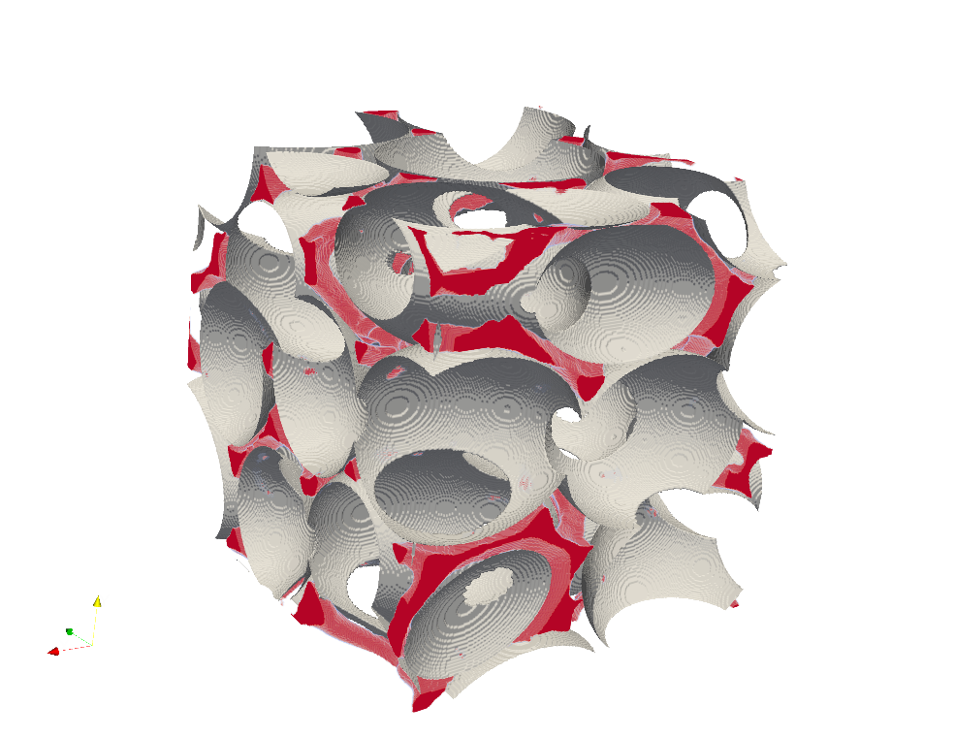
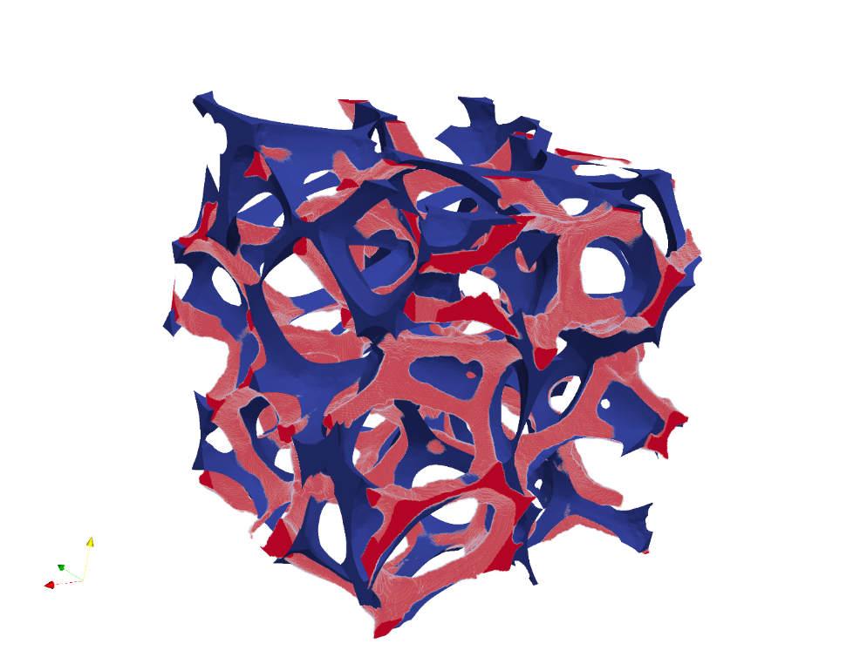
DN-RSA with ellipsoids
Generate ellipsoids based on pores extracted from CT scans of physical foam samples (Leblanc et al, under preparation)
Statistical validation for pore placement
DN-RSA to extract foam morphologies using package made of ellipsoids – statistical validation of pore placement
Sample made of 600 voxels in each dimension with each voxel = 24um
Relative Density
Voxel data 7%
DN-RSA 6.8%

Slide 13
Data driven models - Motivation
Complexity in analysing open-foam materials by including all the relevant information in the extracted models
Time consuming results – hierarchical coupling in classical multiscale methods
Meso scale models not efficient in accounting for the complex loading conditions
Non-uniformity of the microstructure
High computational cost to run micro-mechanical simulations for full scale problems
Difficulty to store, post-process and analyse large amount of data

Slide 14
Data driven models - Motivation
Complexity in analysing open-foam materials by including all the relevant information in the extracted models
Time consuming results – hierarchical coupling in classical multiscale methods
Meso scale models not efficient in accounting for the complex loading conditions
Non-uniformity of the microstructure
High computational cost to run micro-mechanical simulations for full scale problems
Difficulty to store, post-process and analyse large amount of data
Neural networks – capability to directly incorporate the micro-mechanical data and direct numerical simulations on the microstructure (Wang & Sun, 2018)
Generation of datasets – offline implementation – significant reduction in computational cost

Slide 15
Data driven models using neural networks
Artificial neural network – inspired from biological counterpart
Input layers -> Hidden layer(s) -> Output layer
Weights assigned to each artificial inner nodes
Combination of input signals and activation functions used, neurons can activate, de-activate or change

Slide 16
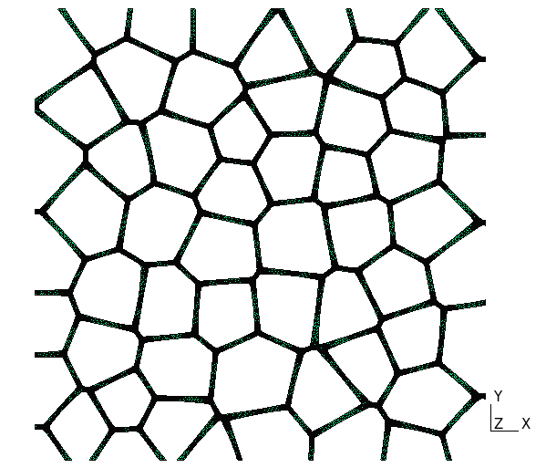
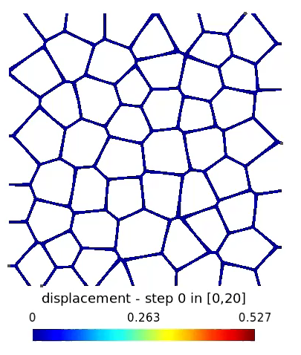
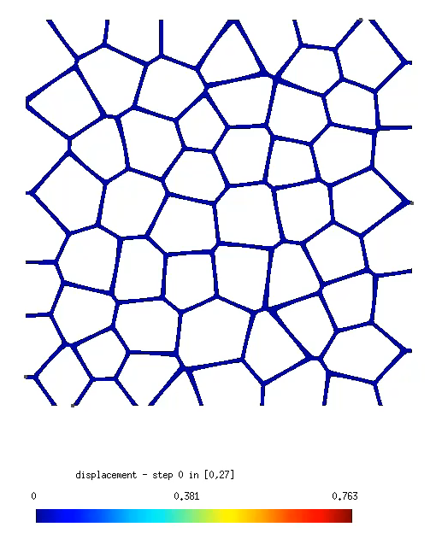
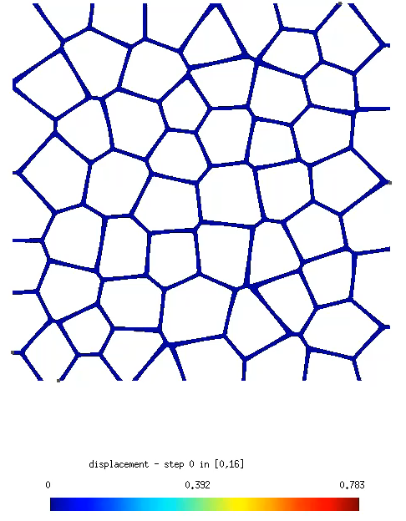

Data driven models using neural networks
2D solution data preparation with around 400 sample simulations for training the neural network
Modify deformation tensor while applying periodic boundary conditions
Apply final values for $u_{xx}, u_{yy}, u_{xy}, u_{yx}$

Slide 17
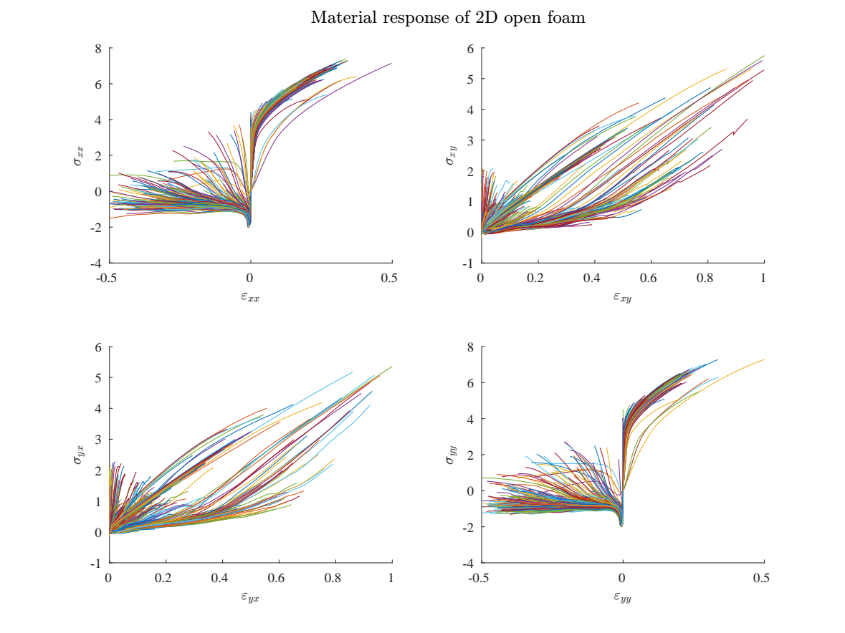
Data driven models using neural networks

Slide 18
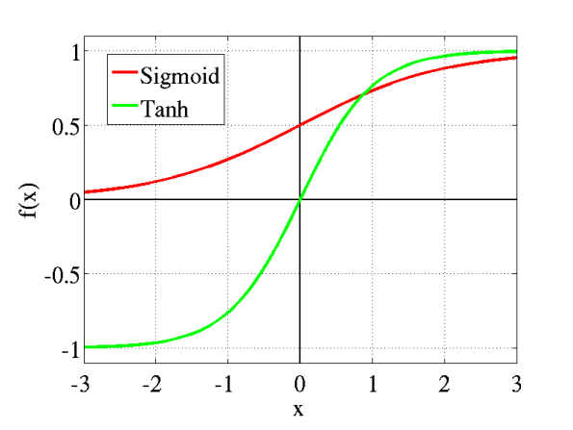
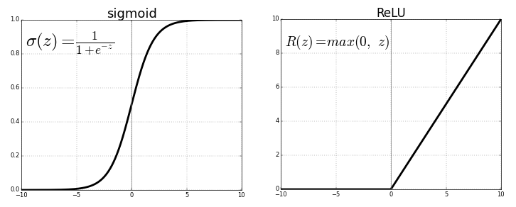

Activation functions for Neural Network
Transfer function used to get output of node
Used to determine the output of neural network and maps the resulting values
Some examples of non linear activation functions
  Sigmoid
  Tanh ($=2sigmoid\left(2x\right)−1$)
  Rectified Linear Unit (ReLU)
https://towardsdatascience.com/activation-functions-neural-networks-1cbd9f8d91d6

Slide 19
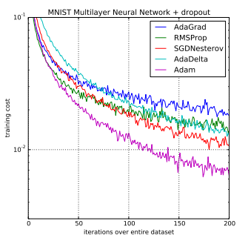
Layers for NN
Use of feedforward nets to accurately classify sequential inputs
Sequential layers are added piecewise
More layers → deeper the model
Epochs → Number of times the dataset is passed to the NN forward and backward
Batch size → Number of training samples in a single batch
Optimizers → Adaptive moment estimation (adam, combining adaptive gradient algorithm and root mean square propagation), stochastic gradient descent (SGD)
https://machinelearningmastery.com/adam-optimization-algorithm-for-deep-learning/

Slide 20
Data driven models using neural networks
Solution
  400 training samples
  100 validation samples
  500 epochs
  1 sequential input layer with 200 nodes
  1 sequential hidden layer with 100 nodes
  1 sequential hidden layer with 20 nodes
  1 output layer with 4 nodes
  All layers activated with ReLU and optimized with adam
  Prediction made on a new sample

Slide 21
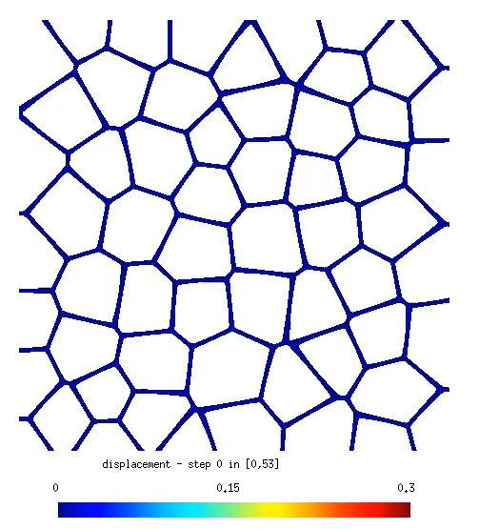




Towards the future with data science
Implementation of contact on all simulation series to be trained with neural networks
Back propagation through time models and long short memory units models implementation to predict history dependant behaviour
Develop models that take into account porosity and material behaviour parameters
Use the NN models developed to train 3D material model for numerical simulations
History dependant behaviour of 2D open foam

Slide 22
Thank you for your attention
Data driven computational analysis of open foam RVEs
Nanda G. Kilingar, K. Ehab Moustafa Kamel, B. Sonon, C. Leblanc, L. Noëls, T.J. Massart, A. Jung
Computational & Multiscale Mechanics of Materials – CM3
http://www.ltas-cm3.ulg.ac.be/
B52 - Quartier Polytech 1
Allée de la découverte 9, B4000 Liège
ngkilingar@uliege.be

Slide 23

Limitations and Advantages
Higher discretization of the grid required to capture higher sphere packing
Laguerre tessellations are known to have higher number of small struts and triangular faces that are skewed,
  captured by DN-RSA in the limit of vanishing discretization size.
Representation of foams with RVE having high dispersion rate of the inclusion size is difficult with this model due to the necessary discretization grid.
Easy access to the signed distance functions allows us to implement variations in the morphology
  strut cross-section variation at the mid-span and along the axis of the strut
  combination of open-closed faces of tessellated cells
  Coating of the RVE to represent realistic engineering applications
A balance of discretization size allows us to model the foam without the issues of small/skewed faces as they are implicitly enveloped by the extracted $t$ level set.
Extracted mesh can be easily utilized for a data-driven multi-scale study and understand the effects of upscaling the model to study the elastic-plastic properties of such foams

